Slide 1
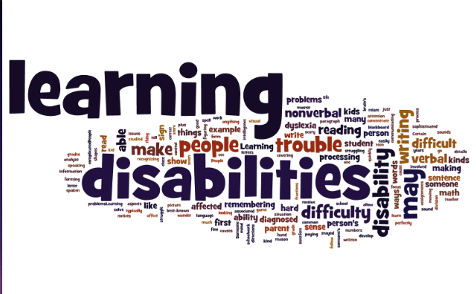
Part 3 of a 3 Part Webinar Series on Learning Disabilities
300
Notes:
Welcome to Learning Disabilities 300 webinar. This is part 3 of a 3-part series on Learning Disabilities. If you missed Parts 1 and/or 2 of this series, you can find copies of the PPTs in the file share box or on the JC Disability website.
It is not a requirement to have attended parts 1 or 2 of the LD series in order to gain knowledge and support from part 3; however, each presentation does build upon the skills and knowledge of the previous one(s) so we do encourage you to download parts 1 and 2 and review those as well.
Today, part 3’s focus is to help us assimilate all of the information previously learned in order to identify, develop and implement solutions that remove barriers to program participation for our students with learning disabilities.

Slide 2
Learning Objectives
Identify students’ strengths
Identify functional limitations (how learning is impacted)
Develop appropriate accommodation recommendations related to the previously identified strengths and functional limitations
2
Notes:
The purpose of this webinar is to build on the expanded knowledge from the LD200 webinar by challenging participants to take an active role in identifying strengths, functional limitations, and developing potential accommodations for students with different types of learning disabilities.
This webinar is going to use a case study approach. It will be interactive, and give you an opportunity to share any practical ideas you have to meet the needs of students with various types of learning disabilities. We will be focusing on three high-incident types of LD today: Dyslexia, Dyspraxia, and Auditory Processing Disorder.

Slide 3
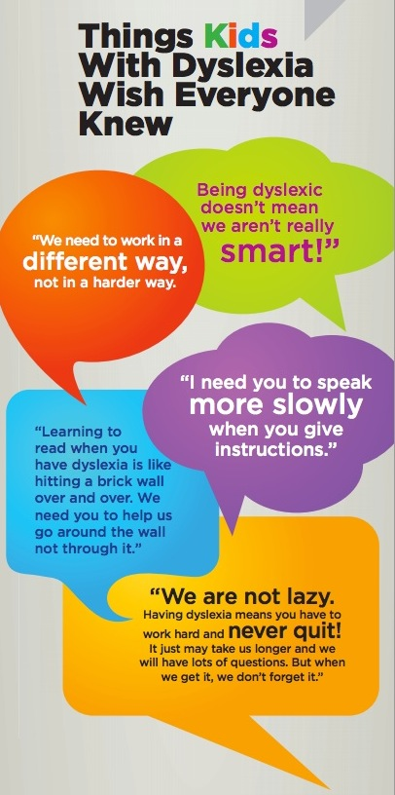
3
Notes:
Although this slide expresses what “kids with dyslexia wish everyone knew,” we can easily see how some of these comments would apply to any type of LD (e.g., “We need to work in a different way, not in a harder way.” “We are not lazy!”

Slide 4
Let’s Review!
Notes:
Let’s briefly review the types of learning disabilities and functional limitations from LD100 and LD 200.
Then let’s look at some case studies to determine how best to accommodate them on centers.
We will take a look at video clips to gain a sense of how it feels to have a LD, and what did not work/what is working for these individuals.

Slide 5
Poll
True or False?
Students with learning disabilities cannot also be “gifted” intellectually?
5
Notes:
Go to next slide to discuss.

Slide 6
What is a Learning Disability?
A LD is a neurobiological condition that affects the way individuals of average to above average intelligence
Receive information
Process information
Express information
www.ncld.org
LD can impact the ability to acquire basic skills of listening, speaking, thinking, reading, spelling, writing, and/or mathematics
6
Notes:
Even very smart individuals can have a learning disability. ... That's because it's not only possible—but even common—for intelligent individuals have a learning disability. A learning disability can impact the way individuals of average to above average intelligence receive, process, or express information.
LD does not reflect a person’s IQ or dictate their potential to succeed However, it can affect many areas of a student’s life even beyond what the definition implies.
An individualized approach is important in the development of each and every accommodation plan. We try to avoid getting caught up in the development of “cookie cutter” plans, particularly those that only serve to support students on the TABE test.

Slide 7
Types of Learning Disabilities
Dyslexia
Dysgraphia
Dyscalculia
Auditory Processing Disorders
Visual Processing Disorders
Notes:
We are going to focus on 2 of the types of specific learning disabilities today, dyslexia and dyscalculia, as they are the more high incidence specific learning disabilities and they often exist co-morbidly. Our goal today is to take a much more in-depth look into the impact of these disorders and discuss the types of accommodations, supports and strategies that can be used to enable students to access the Job Corps program as well as acquire the skills and abilities needed to enter into the workplace.

Slide 8
Let’s Talk About Dyslexia!

Slide 9
Let’s Set the Record Straight!
Individuals can grow out of having a learning disability.
People with learning and attention issues can’t have successful careers.
Accommodating students with LD sets them up for failure in the workplace!
9

Slide 10
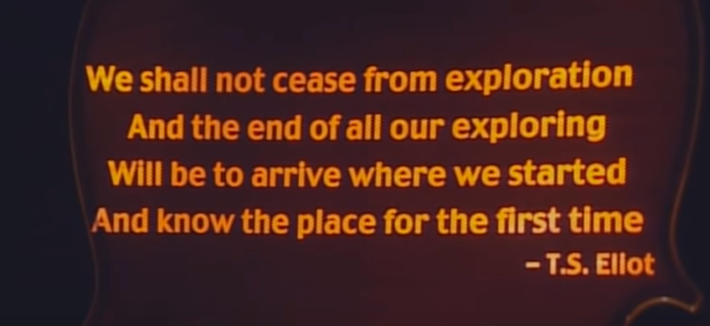
Let’s watch – what dyslexia feels like…
https://www.youtube.com/watch?v=15nOajd_7mo
Notes:
Video clip:
00:00 – 00:37

Slide 11
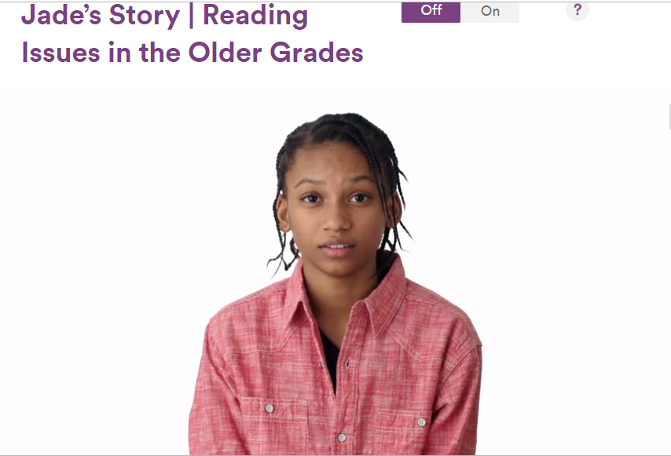
The impact of dyslexia… Jade’s Story
https://www.understood.org/en/tools/through-your-childs-eyes/player?simq=c07181bd-05a5-466c-aaa0-f54146a9d844&gradeId=d345222a-9e6f-483a-97eb-6ab55bd7288e&standalone=true
Notes:
Understood.org
Jade’s Story – Reading Issues in the Older Grades
Video Clip:
Approximately 2:20

Slide 12
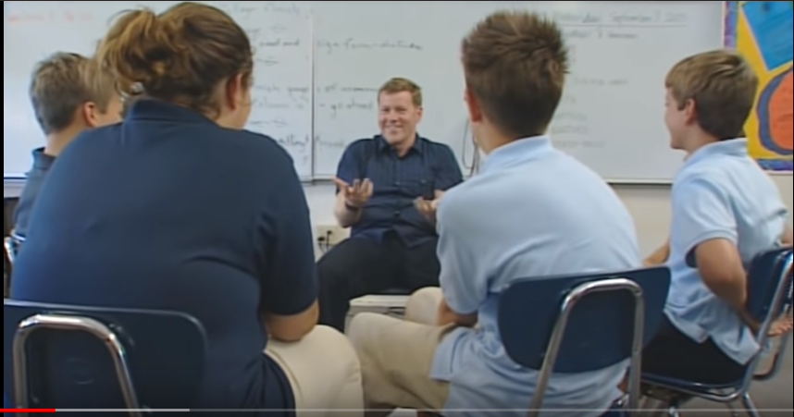
More on the impact of dyslexia…
https://www.youtube.com/watch?v=15nOajd_7mo
Notes:
Video clip #1:
05:39 – 06:15
06:54 – 07:41
08:03 – 08:56

Slide 13
1 in 5 individuals or 20 percent have dyslexia!
http://dyslexia.yale.edu/dyslexia/dyslexia-faq/
13
Notes:
http://dyslexia.yale.edu/dyslexia/dyslexia-faq/

Slide 14
Manifestations
We know that dyslexia manifests for different individuals in differing ways. Let’s review some of those:
Words move side to side on page
Words and letters move in wavy patterns on a page
Individual letters seemingly move to a different location
Words do not move but unable to decode words effectively
Spell phonetically
Images are sometimes interpreted differently than they really are
14

Slide 15
Your turn!
So, how would you enable students who have dyslexia to have access to print/written information when the words move on the page or they cannot decode effectively?
Some ideas!
Speech to text software
Books on tape
Extra time
Audio-taped content
Orally provided information*
15

Slide 16
What might be some instructional considerations?
Use multisensory approaches
What do we mean by that?
Maintain consistency in teaching specific concepts
academics and career technical should be teaching like concepts either together or similarly
Individualize support and instruction
Provide LOTS of positive reinforcement
Provide LOTS of opportunity for repetition
16

Slide 17
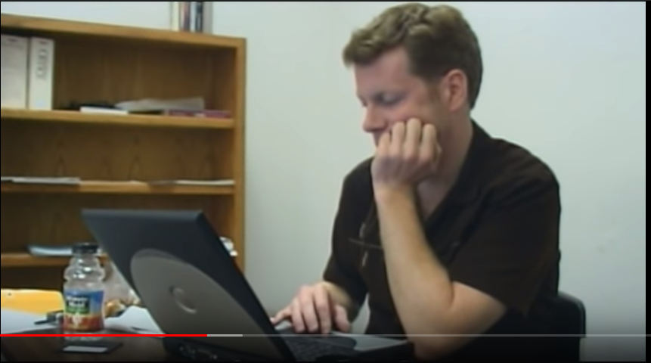
Learning the benefits of accommodations!
Notes:
10:02 – 10:25

Slide 18
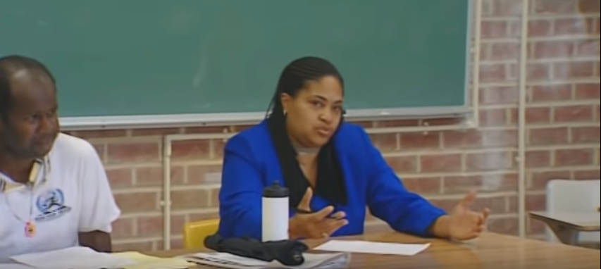
Renita’s Story
Notes:
Video Clip
15:16 – 15:56
17:31 – 18:51

Slide 19
Accommodations! Fostering independence! Growing employability skills!
Let’s think about and talk through this together…
What are the concerns if a student cannot read printed content but can understand information provided orally, even if it requires hearing it repetitively?
Are any of the concerns mentioned significant or valid enough to not afford a student these types of accommodations?
How does providing information only orally via a staff or a peer buddy prepare a student with a reading disability for advanced training, the workplace, and/or for life?
Embracing the use of technology and embracing accommodations that promote and foster independence are critical to preparing students with disabilities perform the skills and tasks that are required in the workplace.
19
Notes:
Embracing the use of technology requires that we develop a fundamental knowledge base about technology options and that we work toward growing our own comfort levels in using and guiding its use.

Slide 20
What is one of the key messages these video clips is trying to emphasize?
Finding a community of others who share similar challenges!!
Do any of your centers sponsor groups for students with disabilities where they can connect, share struggles, achievements, etc.?
Any thoughts about hosting one of these types of groups on center?
20

Slide 21
Support and a sense of community…
Notes:
Video Clip
22:00 – 23:29
24:30 - 25:13

Slide 22
Let’s Talk About Dyscalculia!

Slide 23
The impact of dyscalculia…
https://www.understood.org/en/tools/through-your-childs-eyes/player?simq=d7e339d7-7c55-4fd0-bef6-94b1a640d9dc&gradeId=9f2dc7e9-f5f4-466c-9474-dd12215662fc&personalized=true
Notes:
Play section about Sam – approximately 1:10
Simulation -
Then play expert video talking about the experience and dyscalculia in general and wrapping up with Sam (about 2:15)

Slide 24
Sylvia
Dyscalculia
Notes:
Our case study is Sylvia. She has Dyscalculia.

Slide 25
Sylvia – Gathering Information
Background:
Sylvia is working towards a GED and is completing career technical training in a medically-related trade.
Functional limitations:
Struggles with math facts and operations
Difficulty with number sequencing
Difficulty with overall organization
Strengths:
Excellent soft skills
Likes fashion and colors
25
Notes:
Remember, our first step is to gather information:
1. What are some initial observations? (Just notice)
2. What are some of Sylvia’s functional limitations? (Just notice)
3. What areas or activities on center might be difficult for Sylvia? (Brainstorm Chat box)
4. What are some ways we could accommodate her functional limitations? (Brainstorm Chat box) Think about the resources on your center, and what you know about Sylvia…

Slide 26
Sylvia – Reviewing & Determining Needs
What does the DC/RAC do first?
What are the functional limitations?
What type of documentation is included?
Did the student request any specific accommodations?
What things did the student indicate were difficult for her, her interests, her strengths?
What areas or activities on center might be difficult for Sylvia to navigate, be a participant, have access, etc.?
After gathering that information, what are some ways we could accommodate each identified functional limitation?
How can we leverage Sylvia’s strengths?
26
Notes:
Again, the questions on this slide can help with the process of gathering information, determining needs, and preparing accommodations.

Slide 27
Sylvia – Center-wide Considerations
Don’t forget! In Job Corps, the RAC must review the need for accommodations throughout the center.
How might the functional limitations related to Sylvia’s math disability impact her outside of the academic area. For example, what about in career technical? How about in residential?
27
Notes:
Let’s revisit the impact Sylvia’s functional limitations might have on these areas on center.
Remember she is in an office trade, so what might be some barriers we need to consider?
Some of her functional limitations include difficulty with math, number sequencing, and overall organization.
Let’s also consider any barriers in residential and overall behavior on center.
Use the chat box to brainstorm any impacts or barriers for Sylvia--just specific impact or barriers right now.
Maybe needs to use organizers to maintain phone #’s or phone apps; program frequently used phone #’s into phone speed dial options
Use digital clocks and watches; watches with a timer and reminders or phone apps

Slide 28
Sylvia – Developing Accommodation Plan
Functional Limitations
Accommodations
Difficulty with math facts and operations
Difficulty with number sequencing
Difficulty with organization
Challenge making change and handling money
Use diagrams, pictures, graphs, manipulatives, and real life examples to teach math facts, concepts and operations
Provide graph paper for organizing
Provide technology such as a talking calculator
Incorporate color into instruction and/or organizing or highlighting information
28
Notes:
Using the functional limitations on the slide, let’s consider some accommodations that may support Sylvia on center. Use the chat box to do that. Think about her strengths as you do this. Remember she has excellent soft skills and she likes fashion and colors.
(Wait for participants to brainstorm)
2nd bullet -- These are only a few ideas, you may have resources and ideas that would work better on your center to address Sylvia’s limitations or barriers.

Slide 29
Leveraging Strengths
Used color interests in providing accommodations related to areas of functional limitation
Incorporate garment construction-related math problems into math instruction and practice
Use her excellent soft skills and have her provide peer tutoring on some math skill that she has mastered or receive peer tutoring support
29
Notes:
When considering how might we use a student’s strength(s) when accommodating, sometimes it takes some creativity. We can start with whether the student has a favored modality (visual, auditory, hands-on…). Often times after we get to know our students better, we discover hidden strengths and talents such as Sylvia’s.
What about learning to manage a medical records filing system – could the color coding in the picture you saw earlier potentially be useful in teaching her the filing system?
So we might now know everything up front. That’s okay. When we revisit the efficacy of our APs, that may be the ideal time to leverage specific strengths that others may have discovered along the way.

Slide 30
Resources
Notes:
We have a few resources for you that may also support you with this topic.
I encourage you to conduct your own research. The resources we now have available to us due to the internet are game changers.
Here are a few…

Slide 31
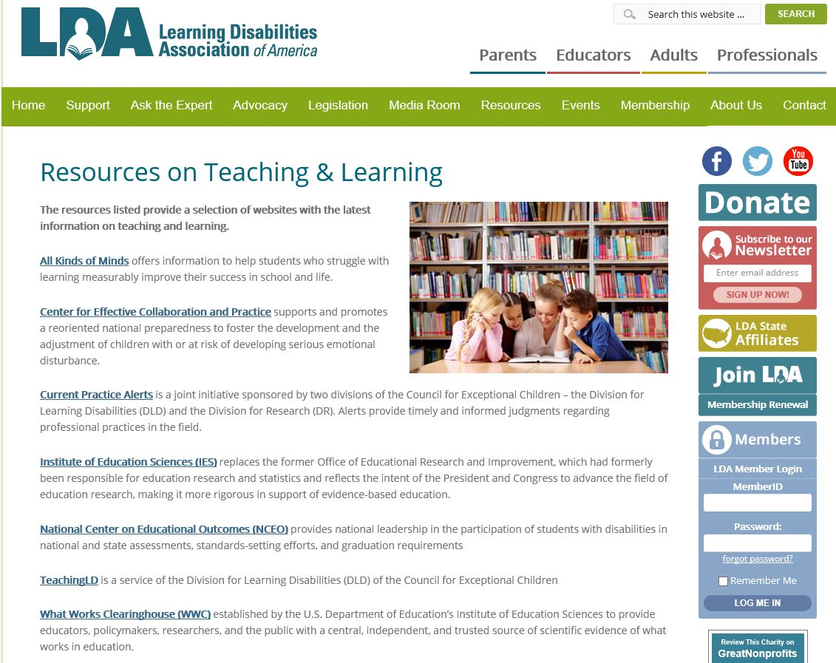
Learning Disabilities Association of America www.ldaamerica.org
Notes:
Learning Disabilities Association of America offers extensive resources on Teaching & Learning.
You can sign up for free newsletters that often feature issues we face daily at Job Corps such as how to support non to low reading adults.

Slide 32
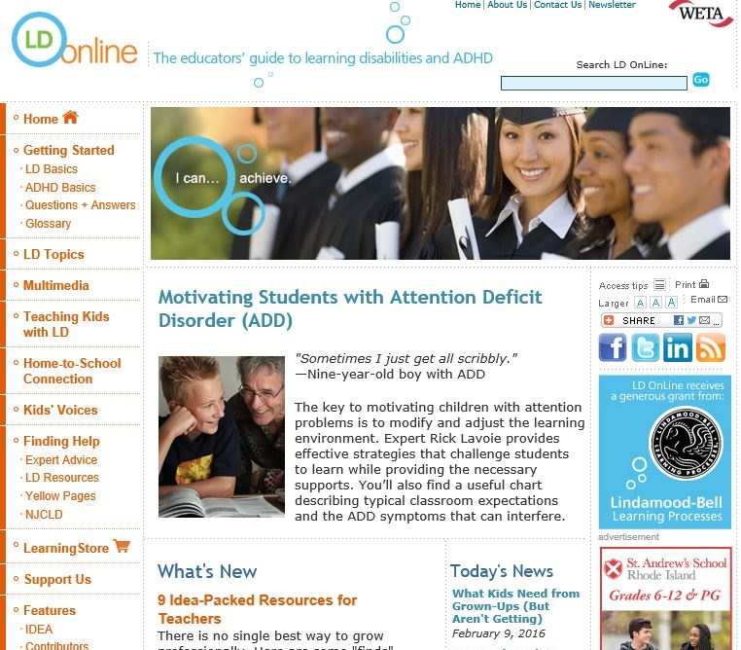
LD Online www.ldonline.org
Notes:
LD Online as an easy to navigate website. As you can see from the menu on the left hand side, the topics are relevant to Job Corps’ staff and students.

Slide 33
National Center for Learning Disabilities www.ncld.org
33
Notes:
National Center for Learning Disabilities website has up-to-date relevant information on the legal aspects of serving students with learning disabilities, as well as sponsoring programs designed specifically for young adults, professionals, educators, and parents.

Slide 34
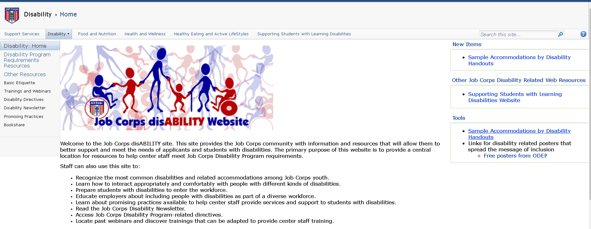
Job Corps Disability Website https://supportservices.jobcorps.gov/disability/Pages/default.aspx
34
Notes:
The primary purpose of this website is to provide a central location for resources to help center staff meet Job Corps Disability Program requirements. Staff can also use this site to:
Recognize the most common disabilities and related accommodations among Job Corps youth.
Learn how to interact appropriately and comfortably with people with different kinds of disabilities.
Prepare students with disabilities to enter the workforce.
Educate employers about including people with disabilities as part of a diverse workforce.
Learn about promising practices available to help center staff provide services and support to students with disabilities.
Read the Job Corps Disability Newsletter.
Access Job Corps Disability Program-related directives.
Locate past webinars and discover trainings that can be adapted to provide center staff training.​

Slide 35
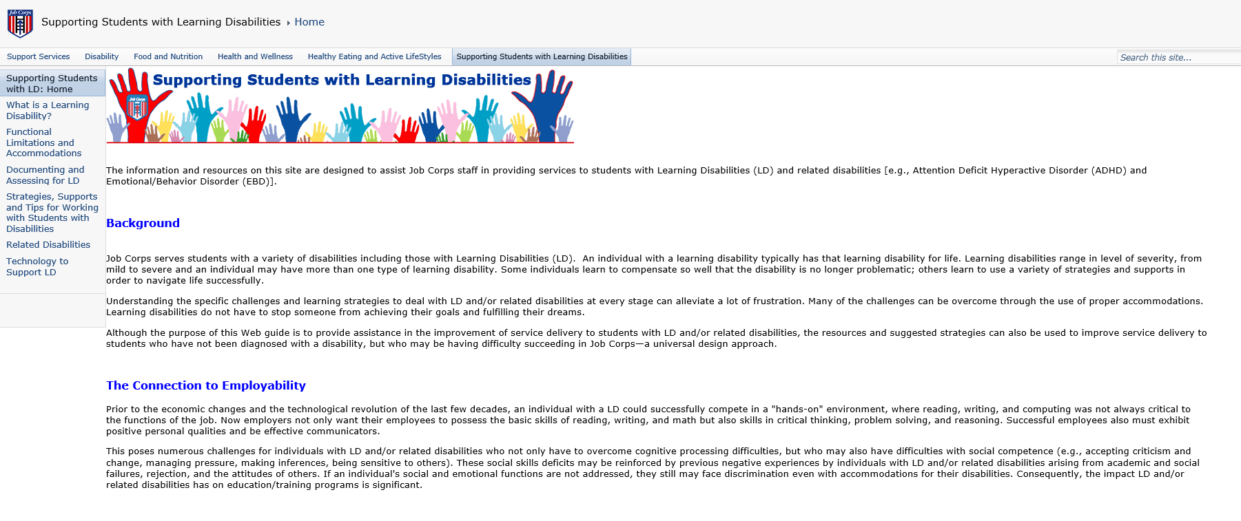
Job Corps Supporting Students with Learning Disabilities https://supportservices.jobcorps.gov/SupportingStudentsLD/Pages/default.aspx
Notes:
The LD website also within the JC community provides detailed information about all of those specific LDs we discussed and more. It also includes possible strategies and supports.

Slide 36
https://askjan.org/
Notes:
Job Accommodation Network is an extremely comprehensive FREE resource on workplace accommodations and disability employment issues.
When you use the website or call to talk to a member of JAN’s expert staff, you will immediately get the impression that they were created just for us at Job Corps. They are that relevant to the work that we do.
Many of the accommodations in this webinar came from JAN and were used on actual JC centers.

Slide 37
THANK YOU
Notes:
Again, thank you for taking the time to join me today to share ideas and learn from each other.
Enjoy the rest of your day. I will now turn the webinar over to our facilitator, Kristen.

