Slide 1
Utilizing Your State Assistive Technology(AT) Program
To Support Students with Disabilities
Notes:
Diane

Slide 2
Agenda
What is Assistive Technology (AT)?
What are State AT Programs?
Benefits: Job Corps Disability Program
Specific Job Corps Examples
How to Locate Your State AT Program
Resources
Notes:
Diane

Slide 3
Learning Objectives
Define how to access your individual state AT Program
Identify 3-5 types of assistance provided by State AT Programs
List 3-5 examples of AT that support independence & employability for a variety of functional limitations
Identify several resources that could be used to locate free/reduced AT to support students with disabilities
Notes:
Diane

Slide 4
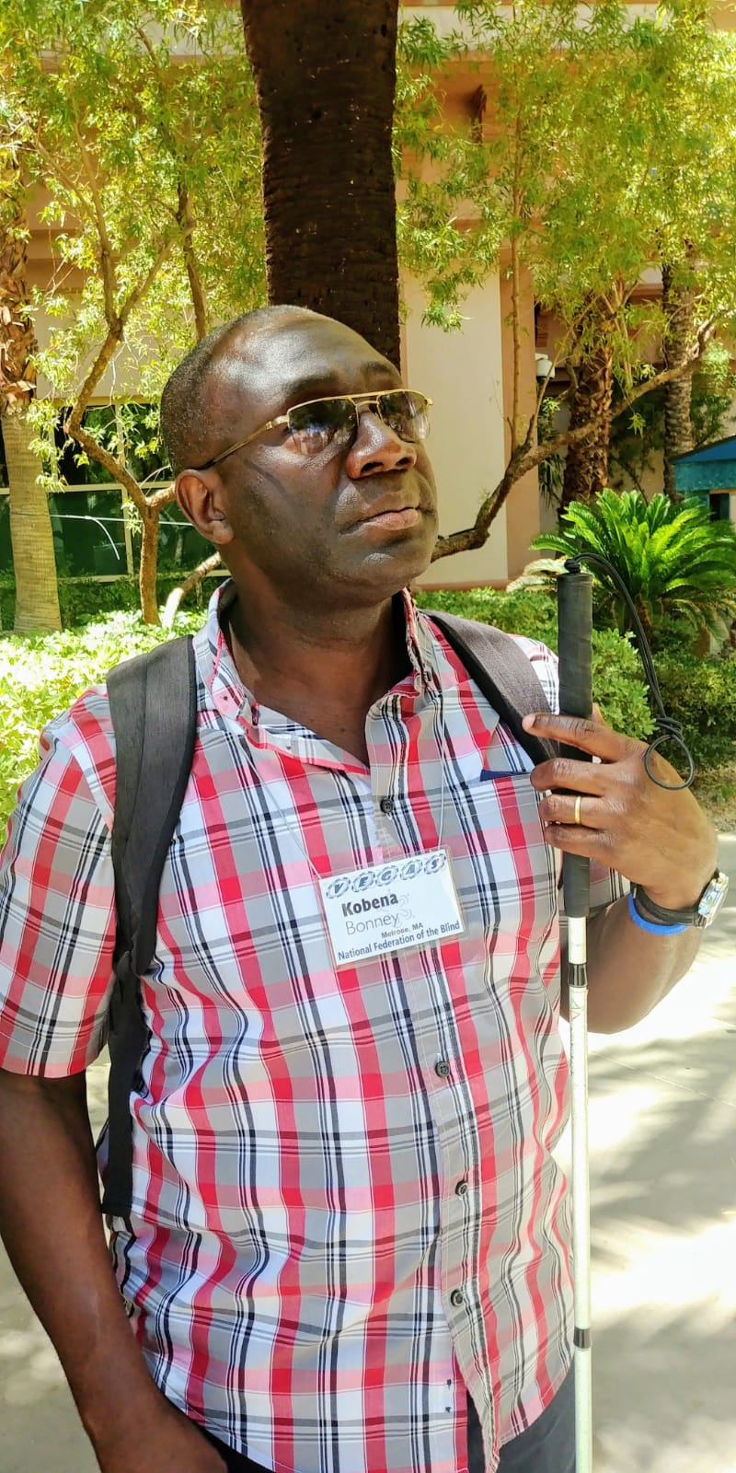
HELLO!
I am Kobena Bonney
I am the Coordinator of the Massachusetts Assistive Technology Program.
Notes:
Kobena

Slide 5
What is Assistive Technology (AT)?
1
5
Notes:
Kobena

Slide 6
The Assistive Technology Act of 1998 and as amended in 2004
“Any item, piece of equipment, or product system, whether acquired commercially off the shelf, modified, or customized, that is used to increase, maintain, or improve functional capabilities of individuals with disabilities."
6
Notes:
Kobena
One of the major changes brought about by the Assistive Technology Act of 2004 was a change in purpose. Previous Acts focused on helping states build "systems for improving access to AT devices for individuals with disabilities.” With the 2004 edition, the Act now required States to provide direct aid to individuals with disabilities to ensure they have access to the technology they need.

Slide 7
AT3 Center Definition:
AT is any item, device, or piece of equipment used to maintain or improve the functionality of people with disabilities, allowing them to be more independent in education, employment, recreation, and daily living activities.
AT includes the services necessary to get and use the devices, including assessment, customization, repair, and training.
7
Notes:
Kobena

Slide 8
Examples of AT
Motorized and manual wheelchairs
Adaptive computer hardware and software
Hearing aids and assistive listening systems
Text telephones
Van and home modifications
Screen access and print screening software, Braille displays
Low Tech items such as velcro straps, magnifiers, and talking calculators
8
Notes:
Kobena

Slide 9
What are State Assitive Technology (AT) Programs?
2
9
9
Notes:
Kobena

Slide 10
AT Act Of 2004
Increase access to needed AT devices for individuals with disabilities
Establish systems to directly help individuals with disabilities that need AT devices
Requires states to spend the bulk of state grants on direct services for individuals with disabilities
10
Notes:
Kobena

Slide 11
State Efforts
AT Reutilization Programs
Activities support the reuse of AT that is no longer needed or used by its original owner and is acquired by a new owner at substantial cost savings.
AT Demonstration Programs
Activities provide opportunities for people to become familiar with specific types of AT by comparing and contrasting the functions and features of devices through hands on exploration.
Device Loan Programs
Activities allow individuals to borrow AT for a limited time period to try out and determine if a device will meet their needs before a purchase is made.
Alternative Financing Programs
Activities support the purchase/acquisition of AT through financial loans or other initiatives using dollars from non-AT Act sources or save consumers money when purchasing AT.
Notes:
Kobena
The majority of state efforts are required to be conducted in the following areas: AT reutilization programs, AT demonstration programs, alternative financing programs and device loan programs.

Slide 12
Benefits: Job Corps Disability Programs
3
12
Notes:
Diane

Slide 13
Benefits: Job Corps Disability Programs
Possible partner/resource to support students with disabilities (Disablity Program requirement)
Cost benefits (alternative funding)
Ability to “sample” AT before making a purchase
Promotes independence and employability
Notes:
Diane – One of the 9 JC Disability Program requirements (as outlined in the PRH Chapter 5.1; R 34) is to develop resources and partnerships with outside agencies and programs that will assist the center in serving students with disabilities. Your state AT Program is an excellent example to meet this requirement. Along with obvious cost benefits, a center can actually “sample” AT before making a purchase. There are so many ways that AT can provide access to academic and career training while promoting independence and employability.

Slide 14
Specific Job Corps Examples
4
14
Notes:
Diane – We have a few specific examples of centers utilizing their State AT Programs to obtain AT support for students with disabilities.
I will turn over the next few slides to Kobena to describe one such example where he (as a State AT Program Representative) worked with one of our centers, then I will share a couple more past examples from other centers.

Slide 15
MassMATCH: State AT Program Partner
Mission: To promote the use of AT and AT services to enhance the independence of people with disabilities, enabling equal participation in all of life’s activities.
15
Notes:
Kobena

Slide 16
MassMATCH Assistive Technology Regional Centers
Massachusetts has three Assistive Technology Regional Centers (ATRCs).
The ATRCs provide a wide range of services including device demonstration, device loan, information and assistance, public awareness, and training.
A device (up to four total) can be borrowed free of charge or request a device demonstration by contacting one of our three ATRC locations.
16
16
Notes:
Kobena

Slide 17
MassMATCH and Shriver Job Corps Collaboration
Student with visual impairment came to center with a magnifying device.
The device stopped working which impacted the student’s ability to fully participate in the program.
The Regional Disability Coordinator located the same device on the State AT Loan Program Website.
The center Disability Coordinator contacted the State AT Loan Program at (MassMATCH) and was able to secure the device for the student. The student is now in Advanced Training for Computer Administration!
17
17
Notes:
Kobena

Slide 18
Other Successful State AT Partnership Examples
Hawaii:
ATRCs of Hawaii provides AT when needed. The center currently has a student with a degenerative visual impairment that received low vision goggles and specialized computer screen software.
Notes:
Diane – Another example from the past is where Hawaii JC Center partnered with “ATRCs of Hawaii) to support a student with a degenerative visual impairment. The student received low vision goggles and specialized computer screen software.

Slide 19
Other Successful State AT Partnership Examples
Frenchburg:
An applicant with a hearing impairment requested an FM communication device as an accommodation. The state AT program had multiple FM communication devices. The DC contacted the applicant to determine which device they would need and secured the device after the applicant enrolled.
Notes:
Diane

Slide 20
How to Locate Your State AT Program
https://www.at3center.net/stateprogram
Notes:
Kobena
National Assistive Technology Act Technical Assistance and Training (AT3) Center Website: https://www.at3center.net/stateprogram
AT Act Frequently Asked Questions: https://www.at3center.net/repository/atactinformation
For a complete copy of the current AT Act statute and additional information about the law, please visit the AT3 Center website https://www.at3center.net/

Slide 21
Association of Assistive Act Technology (ATAP)
Notes:
Kobena
Demo: Note: If time permits, demo how to locate https://www.at3center.net/

Slide 22
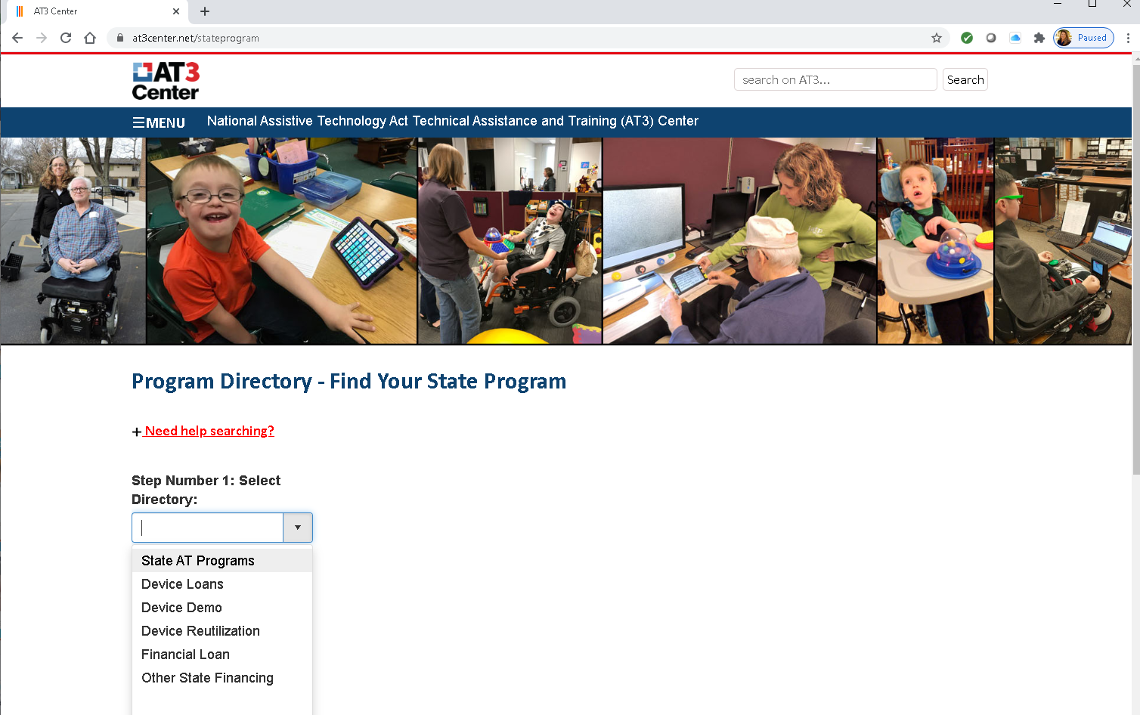
AT3 Program Directory – Find Your State Program
Notes:
Diane
Demo: Note: If time permits, demo how to locate https://www.at3center.net/
The AT3 website has other resources such as “how to make documents accessible”

Slide 23
RESOURCES
23
Notes:
Diane

Slide 24
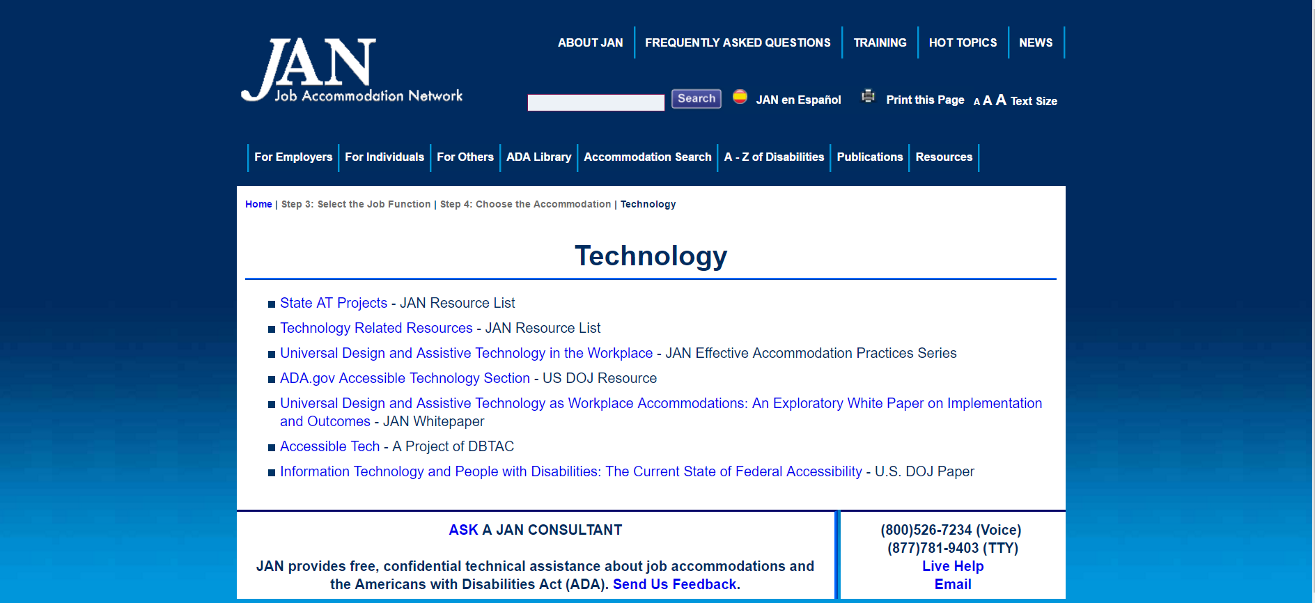
Job Accommodation Network http://askjan.org/topics/tech.htm
24
Notes:
Diane
Job Accommodation Network (JAN) is the leading source of free, expert, and confidential guidance on workplace accommodations and disability employment issues. Working toward practical solutions that benefit both employer and employee, JAN helps people with disabilities enhance their employability, and shows employers how to capitalize on the value and talent that people with disabilities add to the workplace.
JAN provides a search engine called “A to Z Disabilities and Accommodations,” also “SOAR = Searchable Accommodation Online Resource,” as well as links to other relevant resources. Using A-Z Search on the JAN website, let me show you an example of a search for supporting our case study, Jordan, with those functional limitations related to reading, math and organization.
https://askjan.org/ “A-Z” “By Disability” “Blindness” “By Limitation” “Blind Total”

Slide 25
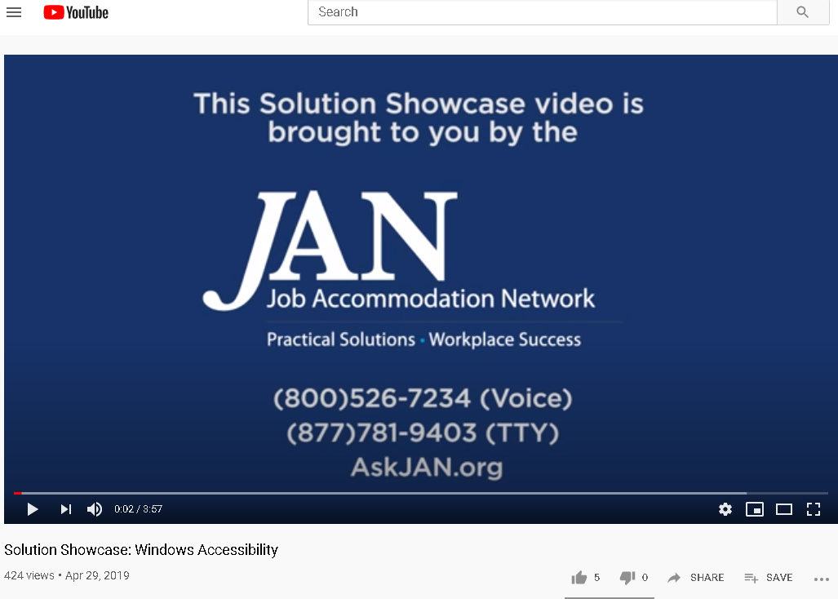
Job Accommodation Network (JAN) Multimedia Training Microsite
SOLUTION SHOWCASE VIDEOS
Learn more about how various solutions can be implemented as effective job accommodations:
Solution Showcase: Communication Access Realtime Translation (CART)
Solution Showcase: Windows Accessibility
Solution Showcase: iPad Accessibility
Solution Showcase: Alternative Mice
Solution Showcase: Smartpens
Solution Showcase: Speech Recognition
https://askjan.org/events/Multimedia-Training-Microsite.cfm
25
Notes:
Diane
Note: If time permits, demo “Windows Accessibility” https://www.youtube.com/watch?v=lyCq0sNsFN8

Slide 26
Tools for Life http://www.gatfl.org/
26
Notes:
Diane
If time permits, conduct a brief website tour using the “Tools for Life AppFinder”
“Tools for Life AppFinder” “Vision” “Android”

Slide 27
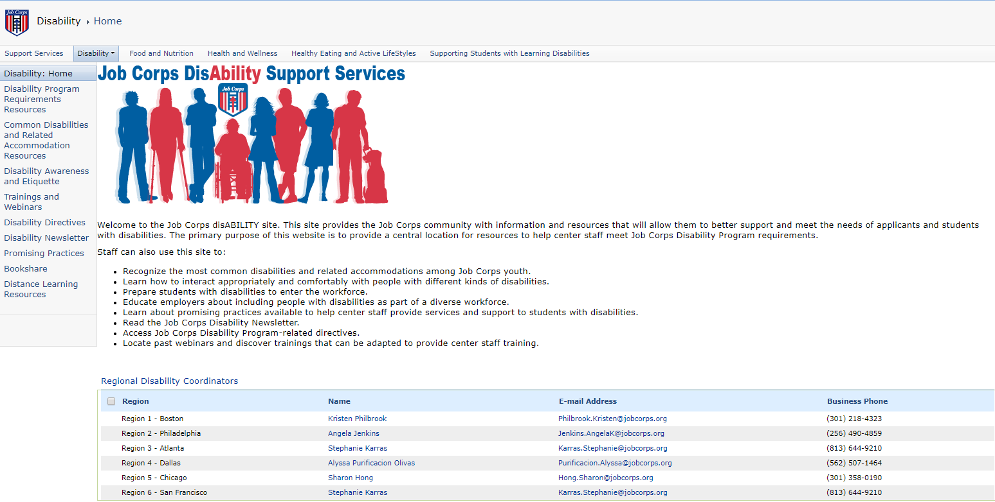
Job Corps Disability Website https://supportservices.jobcorps.gov/disability/Pages/default.aspx
27
Notes:
Diane

Slide 28
THANKS!
Any questions?
You can find Kobena Bonney at:
info@massmatch.org
www.massmatch.org
Notes:
Diane and Kobena

