Slide 1
Medical Separations, Medical Separation with Reinstatement Rights (MSWRs), and Direct Threat Assessments
Avoiding Disability-related Discrimination
2022
Notes:
Welcome to the training on Medical Separations, Medical Separations with Reinstatement Rights (MSWRs), and Direct Threat Assessments – Avoiding Disability-related Discrimination.

Slide 2
Index
01
Medical Separations
02
Direct Threat Assessments
03
Disability-Related Discrimination
Overview
2
Notes:
This training is for all Job Corps staff and will cover the following:
Medical Separations and the circumstances under which medical separations may be used.
Direct Threat Assessments and the circumstances under which direct threat assessment may be conducted.
Disability-Related Discrimination and the obligation of Job Corps to refrain from disability-based discrimination activities.

Slide 3
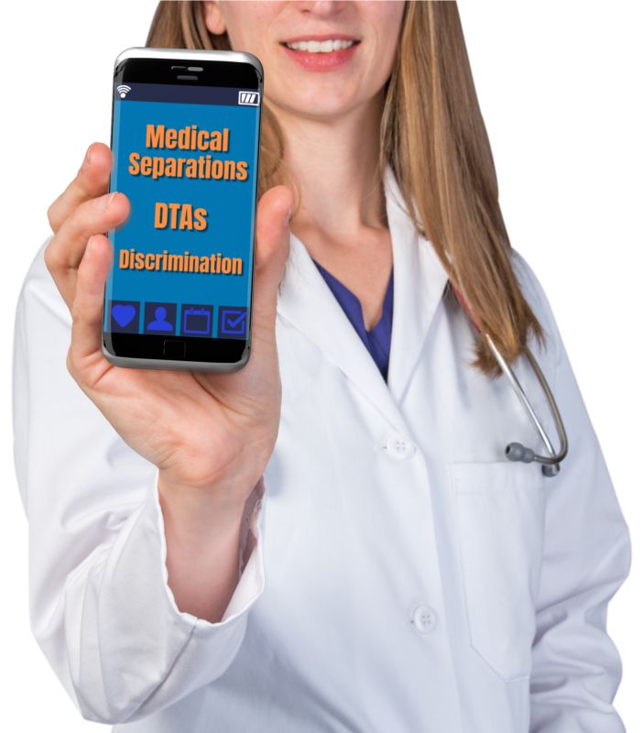
Purpose
This training provides a broad overview of all policy changes related to direct threat, medical separations/medical separation with reinstatement (MSWRs), related disability accommodation considerations and disability-based discrimination.
3
Notes:
Purpose
This training is a broad overview of policy changes related specifically to direct threat, medical separations/medical separation with reinstatement (MSWRs), related disability accommodation considerations and disability-based discrimination.
This is a basic training that is designed for ALL staff on center, that includes not only our health and disability staff, but counselors, instructors, teachers, residential advisors, security, our staff that work in the cafeteria , and everyone else. This training is intended to increase awareness for all staff – especially for those who are not typically involved in these areas and will be required annually for all staff and during the first 45 days of employment for new hires.
Again, this is a broad overview for all staff and will not go into all the process areas.

Slide 4
Medical Separations
Medical Separations
Types
Timelines
Documenting
4
Notes:
Let's begin with Medical Separations. This section will cover the types of medical separations, the timelines, and the required documentation.

Slide 5
Medical Separations
When Do Medical Separations Occur?
A medical separation occurs when a student is no longer able to participate in Job Corps due to medical conditions (including pregnancy-related) conditions, dental conditions, substance use conditions, or mental health conditions.
5
Notes:
When Do Medical Separations Occur?
A medical separation occurs when a student is no longer able to participate in Job Corps due to medical conditions, including pregnancy-related conditions, dental conditions, substance use conditions, or mental health conditions.
For example, a student that may require surgery and rehabilitation, a student that requires long-term inpatient care, or a partial hospitalization program for a mental health condition may be considered for medical separation.

Slide 6
Medical Separations (cont.)
What Type of Separation Occurs First?
At the time of medical separation, the student is always first separated as a Medical Separation with Reinstatement Rights (MSWR).
They may be reinstated into the Job Corps within 180 days.
A regular medical separation is given only if reinstatement following the MSWR does not occur.
6
Notes:
What Type of Separation Occurs First?
When a student is being considered for a medical separation, the student must always be first separated as a Medical Separation with Reinstatement Rights known as a MSWR.
This means the student may be reinstated into the Job Corps within 180 days and resume their previous enrollment. The student does not start over in the program; they pick up where they left off with their Job Corps training. A regular medical separation is no longer an option that can be given first to a student, it is given now only if reinstatement following the MSWR does not occur. So, if a student is given an MSWR and is not able to return to the center within 180 days, then a regular medical separation is given.

Slide 7
Medical Separations are a Last Resort!
Medical separations must be used only as a last resort, after the use of or consideration of
Administrative Leave with Pay
Personal Leave with Pay
Other types of leave
Other methods of addressing the relevant medical concerns have been tried or considered in each individual case and determined to be insufficient
and/or
7
Notes:
Medical separations must be used as a last resort, after the use or consideration of Administrative Leave with Pay, Personal Leave with Pay, and other types of leave.
This process was verbally shared with centers over the past couple of years, but it is now written in policy in the PRH. In addition, before medical separations are used, other methods of addressing the relevant medical concerns must be tried or considered in each individual case and determined to be insufficient. For example, an increase or change in medication or referral to an off-center outpatient community care must be considered.
Let’s discuss further the use of leave and MSWR. There may be situations where a center has considered leave, but it will not be sufficient, and the student needs to be placed directly on MSWR. That is allowed but should be determined on a case by case basis.
For example, a student is in a car accident and has injuries that require surgery and possibly rehab - we know this student is not going to be able to return quickly so the use or consideration of other leaves would be insufficient. The student would be placed directly on MSWR.
A student who is injured on center and claims worker’s compensation, commonly referred to as OWCP, must be placed directly on MSWR.
The intent of medical separations (MSWRs) being used as a last resort is not to immediately place students on MSWR when they might be able to use leave and come back to center in a few days.
Lastly, for students with disabilities, there must also be a consideration of disability accommodations which include reasonable accommodations, reasonable modification in policies, practices, or procedures, and auxiliary aids and services to see if any of those could assist in maintaining the student on center.

Slide 8
Medical Separation Considerations
Medical separations must not be used in lieu of providing reasonable accommodation, reasonable modification in policies, practices, or procedures, and auxiliary aids and services (RA/RM/AAS) to include equally effective communications for individuals with disabilities.
RA/RM/AAS must be tried or considered with the goal of allowing the student to participate in the Job Corps program to the maximum extent possible.
Medical separations must not be based on stereotypes regarding certain disabilities or speculation regarding their management or associated expense
8
Notes:
Medical Separation Considerations
Additionally, medical separations must not be used in lieu of providing disability accommodations (including equally effective communication) for individuals with disabilities.
Disability accommodations must be tried or considered with the goal of allowing the student to participate in the Job Corps program to the maximum extent possible.
Lastly and most importantly, medical separations must not be based on stereotypes regarding certain disabilities or speculation regarding their management or associated expense.

Slide 9
Medical Separation Qualified Providers
Medical separations must be documented in the student health record by a qualified licensed/certified health provider.
Qualified licensed/certified health providers include:
Center Physicians/Nurse Practitioners/Physician Assistants
Center Mental Health Consultants (CMHCs),
Center Dentists
Trainee Employee Assistance Program (TEAP) Specialists
Student’s treating provider
Outside specialist
Medical separations must be initiated by health services staff.
9
Notes:
Medical Separation Qualified Providers
Medical separations must be initiated by health services staff.
Medical separations are not initiated by counseling or other departments.
It is important to have a clear written justification for a medical separation. As such, medical separations must be documented in the student health record by a qualified licensed/certified health provider, including Center Physicians/Nurse Practitioners/Physician Assistants, Center Mental Health Consultants, Dentists, TEAP specialists, the student’s treating provider, or an outside specialist.

Slide 10
Medical Separation Requirements
Health and social service written referrals must be provided to medically separated students.
Health staff must approve all transportation plans and if an escort is needed.
Students must be followed up monthly by the Health and Wellness Director while separated.
Documentation of monthly follow up must be in the student health record.
10
Notes:
Medical Separation Requirements
When a medical separation is decided by a center. There are certain requirements in policy that must happen and be documented in the student health record.
Health and social service written referrals must be provided to all medically separated students. Job Corps wants to make sure students know where the resources are in their communities and how to access them.
Health staff must approve all transportation plans for safety reasons. There may be situations where a student may not be stable enough to fly home or get on the bus alone. Job Corps wants to make sure the student gets home safely.
Students must be followed up monthly by the Health and Wellness Director while separated to know how treatment is going and to encourage them to return.
Documentation of monthly follow up must be in the student health record.

Slide 11
Medical Separation Documentation
Documentation for a medical separation in the student health record must include at a minimum:
The clinical assessment for separation, including current symptoms/behaviors and functional impairments and a diagnostic code;
Individualized treatment instructions;
Student consent;
Referral source(s);
Transportation details, including whether an escort is needed;
Dates of separation and anticipated return to center;
Individualized student medical expectations to return; and
If the student is an individual with a disability, a copy of any accommodation plan and CIS Accommodation Plan Notes tab documentation.
11
Notes:
Medical Separation Documentation
To recap, listed are all the documentation requirements for the health staff that must be present in the student health record. As general staff we just want you to be aware of what the health staff must include for students.
At a minimum must include:
The clinical assessment for separation, including current symptoms/behaviors and functional impairments and a diagnostic code using SPAMIS which is the abbreviation for the Student Pay Allotment and Management Information System
Individualized treatment instructions that student and their guardian (if minor) understands;
Student consent;
Referrals and transportation we already discussed;
Dates of separation and anticipated return to center;
Individualized student medical expectations to return in language the student can understand and
If the student is an individual with a disability, a copy of any accommodation plan and CIS Accommodation Plan Notes should be included and There is a sample MSWR form with all the information just shared on the Job Corps Wellness website.
Lastly, just a reminder that student health records are protected health information (PHI) and must be maintained in a secure, restricted manner that complies with Health Insurance Portability and Accountability Act of 1996. Disability documentation and related information must also be treated as protected health information.

Slide 12
Direct Threat Assessments (DTAs)
DTA’s
Form 2-04
Defined
Accommodations
12
Notes:
Direct Threat Assessments or DTAs
This section will cover Form 2-04 which is the form used for Direct Threat Assessments, definitions, and disability accommodations.

Slide 13
Direct Threat Defined
Federal disability nondiscrimination laws define a “direct threat” as a significant risk of substantial harm to the health and safety of others that cannot be eliminated or reduced by reasonable accommodation, reasonable modification in policies, practices, or procedures, and auxiliary aids and services.
13
Notes:
Direct Threat Defined
In 2017, there was a change to the legal definition of direct threat that removed threat to self. Direct threat is now only for direct threat to others. This has required Job Corps to make revisions to PRH policies to ensure compliance with Section 188 of the Workforce Innovation and Opportunity Act, Section 504 of the Rehabilitation Act of 1973, and related implementing regulations to remove threat to self in the definition.
Now, federal disability nondiscrimination laws define a “direct threat” as a significant risk of substantial harm to the health and safety of others that cannot be eliminated or reduced by reasonable accommodation, reasonable modification in policies, practices, or procedures, and auxiliary aids and services.
So, if an applicant or student engages in self-harm behaviors, it will be addressed via Form 2-05 Health Care Needs Assessment.

Slide 14
Significant Risk Qualification
A “significant risk” means a high, not a slight,
probability of risk;
A speculative or remote risk is insufficient.
14
Notes:
A “significant risk” means a high, not a slight, probability of risk; A speculative or remote risk is insufficient for a direct threat determination.
Consider the following example:
A student is in the carpentry trade and has epilepsy that is well-controlled with medication. The student has not had a seizure in over 2 years and shows no sign of impairment. The carpentry instructor somehow finds out about the student's epilepsy history and wants the student removed based on a concern that the student may have a seizure while using heavy or sharp equipment with other students and harm a fellow student, creating a risk to the safety to others. The instructor’s request is based on a general concern about seizures, not on the actual medical facts of the student’s stable condition and controlled seizures. This is not a significant risk because it is speculative.
In a second scenario, consider a student with pulmonary tuberculosis and productive coughing who refuses to take their prescribed daily antibiotic medication or wear a mask. This is an example of a direct threat to others because this behavior puts others students and staff at significant risk of communicable disease.

Slide 15
Direct Threat Considerations
Direct threat may be considered if there is reasonable belief, based on objective evidence, that the individual has a medical condition or disability that may pose a significant risk of substantial harm to the health or safety of others.
Threat to self is no longer part of the definition of direct threat.
Direct Threat Assessments, Policy and Requirement Handbook Form 2-04 may be considered both for applicants as part of the Applicant File Review process and for students as part of the medical separation process.
15
Notes:
As mentioned in the medical separation section, a direct threat may be considered if there is a reasonable belief, based on objective evidence, that the individual has a medical condition or disability that may pose a significant risk of substantial harm to the health or safety of others. Threat to self is no longer part of the definition of direct threat.
Direct Threat Assessments, detailed on PRH Form 2-04, may be considered for applicants as part of the Applicant File Review process and for students as part of the medical separation process. We will look closer at these two areas as we go along.

Slide 16
Qualifying Standard
Job Corps requires, as a qualification standard, that an applicant or student not pose a direct threat to the health or safety of others, including students and staff.
Like any qualification standard, this requirement must apply to all applicants and students, not just to those with disabilities.
16
Notes:
Job Corps requires, as a qualification standard, that an applicant or student not pose a direct threat to the health or safety of others, including students and staff. Like any qualification standard, this requirement must apply to all applicants and students, not just to those with disabilities. All students are held to the same behavioral standard whether it is addressed by Form 2-04 Direct Threat Assessment for medical conditions or disabilities or by Job Corps' disciplinary system for behavior.

Slide 17
Clinical
Assessment
The clinical assessment of direct threat must only be determined by qualified health professionals who have current, documented expertise in the medical condition(s) or disability or disabilities involved in a particular case.
General medical expertise, without expertise in the specific medical condition(s) or disabilities at issue in a given case, is insufficient.
A center may need to consult with the individual’s treating provider or may need to retain an outside provider with the necessary current expertise in the particular medical condition or disability and its effects, to conduct a direct threat assessment in a given case.
17
Notes:
Clinical Assessment
The use of Form 2-04 direct threat assessment requires a clinical assessment. At Job Corps, the clinical assessment of direct threat must only be determined by qualified health professionals who have current, documented expertise in the medical condition(s) or disability or disabilities involved in a particular case. General medical expertise, without expertise in the specific medical condition(s) or disabilities at issue in a given case, is insufficient.
What does this mean? Our center health staff have experience with many medical conditions and disabilities, but, if an applicant or student has a health condition that a center health professional (qualified health professional) is not familiar with or have experience treating, then a center may need to consult with the applicant’s or student’s treating provider or may need to consult with an outside provider with the necessary current expertise in the particular medical condition or disability.

Slide 18
Determination of Direct Threat
The nature and severity of the harm
01
02
The duration of the potential risk
As part of the determination of direct threat, the qualified health professional must identify the specific medical condition or disability that is considered to potentially pose a significant risk of substantial harm to others, and consider four things, which are:
The likelihood that the potential harm will occur
03
04
The imminence of the potential harm
18
Notes:
As part of the determination of direct threat, the qualified health professional must identify the specific medical condition or disability that is considered to potentially pose a significant risk of substantial harm, and consider four things, which are:
The nature and severity of the potential harm; - “Nature” simply means what kind of harm to others? For example, death, incapacitation, serious injury, minor injury or emotional distress. Severity relates to the frequency and seriousness of harm? How serious is the harm and how often does it occur.
The duration of the potential risk; - How long will this risk last?
The likelihood that the potential harm will occur; How likely is this harm to happen? - and
The imminence of the potential harm. How soon will this harm occur?

Slide 19
Disability Accommodation Considerations
If, it is determined that an individual poses a direct threat as a result of a medical condition or disability, the qualified health professional conducting the assessment must determine whether disability accommodations would either eliminate the risk or reduce it to an acceptable level.
The identification of RA/RM/AAS must be done in collaboration with the Disability Coordinator.
19
Notes:
If, it is determined that an individual poses a direct threat as a result of a medical condition or disability, (defined as a physical or mental impairment that substantially limits one or more of the individual’s major life activities), the qualified health professional conducting the assessment must determine whether disability accommodations would either eliminate the risk or reduce it to an acceptable level.
The identification of RA/RM/AAS must be done in collaboration with the Disability Coordinator and every effort should be made to identify appropriate disability accommodations that may eliminate or reduce the risk in each case.

Slide 20
Disability-related Discrimination
Disability-related Discrimination
Definition
DA
Considerations
20
Notes:
Disability-related Discrimination
This section will cover the definition of a disability, disability accommodations and other considerations related to avoiding disability-related discrimination.

Slide 21
Obligation
Job Corps has an obligation to refrain from disability-based discrimination for applicants and students.
21
Notes:
Job Corps’ Obligation
Job Corps has an obligation to refrain from disability-based discrimination, even inadvertent instances of disability-based discrimination for applicants and students. This requires that all staff have a basic understanding of the definition of a disability and the considerations surrounding disability accommodations.
Be mindful of misperceptions and fears that may lead to discriminatory actions. Center staff may not base any determinations on an individual’s ability to participate in the Job Corps program solely on their medical condition or disability. For example, a student must not be excluded from participation in a career technical selection simply based upon the individual's condition. A person who is blind cannot be excluded from participation in culinary arts simply because they are blind. Instead, the center must engage the applicant in an interactive disability accommodation process to review access or participation needs.

Slide 22
Disability Definition
“Disability” means, with respect to an individual:
A physical or mental impairment that substantially limits one or more of the major life activities of such individual.
22
Notes:
“Disability” means, with respect to an individual: A physical or mental impairment that substantially limits one or more of the major life activities of such individual. Major life activities include such things as walking, talking, eating, breathing, learning, bodily functions, etc. If a person has certain conditions that impact major body or system functions, even when stable, that individual may be considered as a person with a disability. For example, if a person has diabetes, they are almost always considered to have a disability because of the impact of the condition to the endocrine system.
The definition of “disability” shall be construed broadly in favor of expansive coverage, to the maximum extent permitted by federal disability nondiscrimination law.

Slide 23
Stereotypes and Clinical Assessments
Clinical assessments for direct threat or medical separation must not be based on stereotypes regarding certain disabilities or speculation regarding their management or associated expense.
23
Notes:
Stereotypes and Clinical Assessments
Clinical assessments for direct threat or medical separation must not be based on stereotypes regarding certain disabilities or speculation regarding their management or associated expense.

Slide 24
Disability Accommodations
If an applicant or student has a disability, Job Corps must consider
reasonable accommodation,
reasonable modification in policies, practices, or procedures, and
auxiliary aids and services including equally effective communications
as part of either the direct threat or medical separation processes.
This process must not be based on stereotypes or discrimination.
24
Notes:
Disability Accommodations
Job Corps must consider disability accommodations (i.e., reasonable accommodation, reasonable modification in policies, practices, or procedures, and auxiliary aids and services) to include equally effective communication as part of either the direct threat or medical separation processes. The goal is to ensure that all reasonable disability accommodations that would allow the individual to remain the program are considered prior to separation.
Again, this process must not be based on stereotypes or discrimination.

Slide 25
For more information on Medical Separations, DTAs, and Disability Accommodation, please see the Job Corps Policy and Requirements Handbook Form 2-03, Form 2-04, and Chapter 6.
There is additional required training for clinical professionals on
Medical Separations and Direct Threat Assessments.
Please check the Job Corps training calendar for dates and times.
25
Notes:
For more information on Medical Separations, Direct Threat Assessments, and Disability Accommodation, please see the Job Corps Policy and Requirements Handbook, Form 2-03, Form 2-04, and Chapter 6.
There is additional required training for clinical professionals on all these topic areas. Please see also Medical Separations and Direct Threat Assessments: An in-depth review for Health staff including contractors (Exhibit 5-6). ​

Slide 26
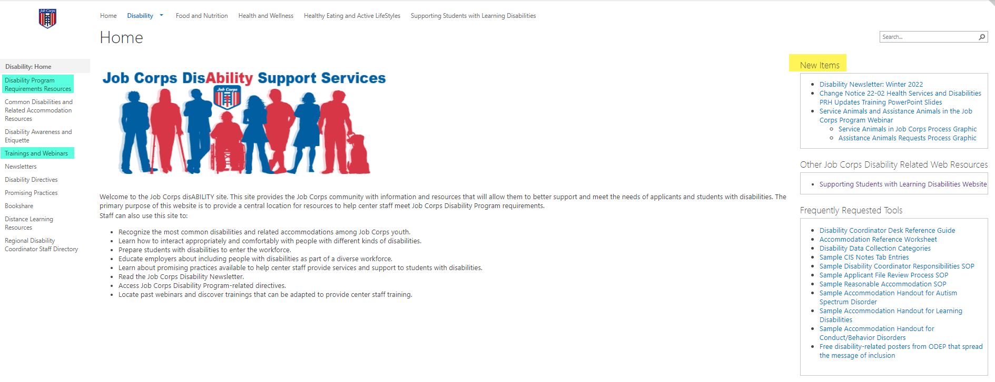
Job Corps Disability Website https://supportservices.jobcorps.gov/disability/Pages/default.aspx
26
Notes:
Job Corps Disability Website
The Job Corps Disability Support Services website contains numerous resources and tools on applicant file review and disability accommodation requirements, processes and procedures.
As new resources and tools are developed, they are listed under the New Items heading to the right side of the website page. See yellow highlighted area. Many of the resources needed are generally found in either the Disability Program Requirements Resources and/or the Trainings and Webinars resources, both of which are highlighted in teal to the left side of the web page.
The Job Corps Disability website link is located at the top of the slide.

Slide 27
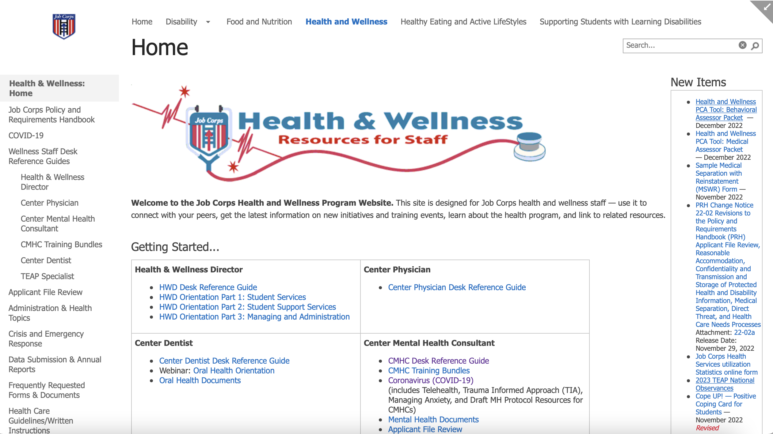
Job Corps Health and Wellness Website https://supportservices.jobcorps.gov/Health/Pages/default.aspx
27
Notes:
In addition to the Job Corps Disability website, the Job Corps Health and Wellness website provides numerous tools and resources to support center staff with health and wellness-related topics such as AFR, H&W-related policy/requirements health care guidelines and more!
Specific webpages are designed to support clinical staff.
Please visit the Job Corps Health and Wellness website often. As new tools are developed to assist with understanding and implementing PRH requirements, they are located under the New Items section on the right side of the Home Page. Your Regional Mental Health Specialists and Regional Disability Coordinators are here to help you navigate the PRH requirements – reach out as needed.

Slide 28
THANK YOU!
28
Notes:
Thank you for attending this training!

