Slide 1
Developing Partnerships and Resources to Better Serve Students with Disabilities

Slide 2
Overview
PRH Requirements
The Benefits of Partnerships
Picking your Partners and Resources
Potential Partners and Resources
Tips and Strategies
What to Consider when Seeking Partnerships and Resources
Successful Center Partnerships and Resources
Notes:
We are going to go over …

Slide 3
PRH Requirements
PRH 6.14, R6 (a-c) Partnerships and Resources
Notes:
Lets start with the PRH requirement

Slide 4
Requirements PRH 6.14, R6 Partnerships and Resources
Requirements: PRH 6:Section 6.14, R6 (a-c)
Each center must develop resources and partnerships with outside agencies and programs that will assist the center in serving students with disabilities. Special focus should be given to developing resources and partnerships that can assist the center in identifying or providing accommodation support that promotes student independence and employability.
Notes:
Take a minute to think about the partnerships your center has; are they specifically helping students with disabilities? Is the center specifically focusing on developing partnerships that assist in identifying or providing accommodation support for students with disabilities?

Slide 5
Requirements PRH 6.14, R6 Partnerships and Resources
Appropriate staff should be involved in the process.
Each center will document efforts to develop resources/partners by completing either the Disability Partnership Tool or the Customized Disability Partnership Tool.
Notes:
(Read part b and c from slide)…
Developing these partnerships, should be a team effort and should not fall only on the DCs.
Efforts to build partners to assist students with disabilities should be documented using the Disability Partnership Tool. You can find a standard Disability Partnership Tool on the JC Disability Website; however in September your RDIC sent out a customized tool. The customized tool was created to identify potential partnership within your state and local agencies.
If you notice, the word “efforts” has been highlighted. We understand the challenges in identifying partnerships in your area to support the Disability Program. We are simply asking that you make a strong attempt and document that attempt on the Disability Partnership Tool.

Slide 6
The Benefits of Partnerships and Resources
Notes:
Now that we know the requirements, let’s discuss some of the benefits of building strong partnerships and useful resources…

Slide 7
Benefits of Partnerships and Resources
Because of the increasing numbers of students with disabilities enrolling in Job Corps, there is an increase in the demand for additional support services that could be helped through community partners
Partnerships could help to provide
Access to resources in an effort to meet the varying needs of Job Corps students during and after their completion of Job Corps
An opportunity to increase community awareness about the Job Corps program
Notes:
As we visit different centers conducting our reviews, we always hear centers expressing the increase of students with disabilities. An increase in the number of students with disabilities, comes an increase in the demand for support services for these students. Partnerships have the potential to help with some of these demands.

Slide 8
Benefits of Partnerships and Resources
Potential partners may be able to provide:
Testing and assessment services
Staff and student training
Job development and retention services
Career development assistance
Career transition services
Access to assistive technologies
Additional funding for student needs and services
Notes:
Some areas in which partners may be able to provide assistance include…

Slide 9
Picking Your Partners and Resources: Where to Begin?
The Disability Partnership Tool

Slide 10
Disability Partnership Tool
Provides information about disability-related organizations that exist in most communities
Additional local partnership and resource opportunities can be added to the tool
Maintained by the Disability Coordinators (DCs) and presented during reviews to document efforts to establish partnerships and resources
DCs should maintain copies of Memorandum of Understandings (MOU) or formal agreements
Notes:
The disability partnership tool is meant to give you a starting point with ideas of organizations that serve individuals with disabilities that exist in most communities. It also leaves room for centers to add more partnerships to it. This tool, again is where you will document your efforts and it will be maintained by the DC and other staff. Any Memorandums of Understanding or formal agreements with partners should also be maintained.

Slide 11
Disability Partnership Tool
Notes:
This is the Standard Disability Partnership Tool. It is available on the JC Disability Website.

Slide 12
Customized Disability Partnership Tool
Notes:
Your customized partnership tool is a great place to start with building partnership especially in areas where partnerships would not otherwise be obvious. The tool helps to make it more obvious.

Slide 13
Potential Partnerships and Resources

Slide 14
Americans with Disabilities Act National Network
Ten regional centers
Provides information, guidance, and training on the Americans with Disabilities Act (ADA)
http://adata.org/
Notes:
What services are provided by the National Network?
Information and Guidance from an ADA Specialist
ADA specialists in each of the ten Regional ADA Centers provide information and guidance to anyone requesting ADA information through 1-800 calls, emails, and in-person consultations.
ADA specialists address complex questions on a wide range of topics such as reasonable accommodations at work, building codes for new construction projects, accessible housing, and transitioning from school to work.
ADA specialists also address questions about other disability laws, such as the:
Fair Housing Act
Individuals with Disabilities in Education Act
Rehabilitation Act

Slide 15
Bookshare
Provides individuals with print disabilities access to digitized audio books
Free for Job Corps centers/eligible students
Audio version materials can be used with eBooks, computers, tablets, Smartphones, MP3 players, and other assistive technology
Dedicated Job Corps Library – a collection of textbooks often used at centers
https://www.bookshare.org
Notes:
Bookshare is free to all Job Corps centers and eligible students
Largest online library of copyrighted content
Provides individuals with print disabilities access to digitized audio books for:
Academics
Career technical trades
Job seeking skills and transition
Pleasure reading
Periodicals and newspapers
Audio version materials can be used with eBooks, computers, tablets, Smartphones, MP3 players, and other assistive technology
Dedicated Job Corps Library – a collection of textbooks often used at centers
The book isn’t in the library? Bookshare offers free book digitizing services
We also have a webinar available on how to get a Bookshare membership. Essentially this is the simplest resource to take advantage of.

Slide 16
Centers for Independent Living (CILs)
Nonprofit agency that is designed and operated within local communities by individuals with disabilities
Assist people with disabilities in becoming independent within their community
Core services include:
Housing
Support Groups
Training
http://www.ilru.org/projects/cil-net/cil-center-and-association-directory
Notes:
The centers for independent living is an agency that promotes independence for individuals with disabilities. It is a great resource especially for our students who have adaptive living needs and will need assistance after JC.. We don’t want to wait however until right before the student leaves to connect them to the center for independent living. We want to build a relationship with the center for independent living early on and identify students that would benefit from this partnership. Some of their core services include: information and referral assistance, independent living skills training, and counseling.
Some centers have invited a nearby CIL to do presentations on center for staff and students and many regularly attend National Disability Employment Awareness Month events on center.

Slide 17
Disability Employment Initiative (DEI)
DEI is a collaboration between the Office of Disability Employment Policy (ODEP) and the Employment and Training Administration
The goal of this initiative is to improve effective and meaningful participation of people with disabilities in the workforce system
Grant awards to state workforce agencies to support American Job Centers
https://dei.workforcegps.org/
Notes:
The goal of the Disability Employment Initiative is to improve training and employment outcomes for individuals with disabilities who are receiving services through WIOA funded employment and training services in partnerships with VR, community colleges, human services agencies, business partners, and other education service agencies such as Job Corps.

Slide 18
Disability Employment Initiative (DEI) (cont.)
https://dei.workforcegps.org/
Notes:
This map represents the 55 projects in 30 states that have an agreement with the Department of Labor to implement employment services for youth and adults with disabilities in the workforce development system.
DEI has provided their grantees support for people with disabilities and their employers in apprenticeships, improved career pathways to college for individuals with disabilities, provided funding to workforce programs, and their staff often participate in career fairs.
If your state has an active program (highlighted in orange), reach out to your nearest workforce center to see how they can support your center’s needs.

Slide 19
Easter Seals Workforce Development Services
Easter Seals offers employment training by providing an individualized approach to identify goals, objectives, and planning needs
Provides assistance with assistive technology and job accommodations
http://www.easterseals.com/our-programs/employment-training/
Notes:
The Easter Seals Workforce Development Services provides a range of services for individuals with disabilities seeking employment that may include career exploration, guidance on conducting job searches, job placement, and job coaching. Again, this is a great resource to use for students with disabilities to utilize potentially during the transition readiness period.

Slide 20
Goodwill Industries International, Inc.
Goodwill Industries International, Inc. is a nonprofit organization that provides job training, employment placement services, and other community-based programs for individuals with disabilities.
Services Include
Technical training
Connect with local work incentives planning
Placement and support services
http://www.goodwill.org/
Notes:
Goodwill has been used by several centers to help with employment support. Goodwill also has several training programs that can serve as a placement for students who have completed the Job Corps program and are seeking additional certifications. Many locations also offer soft skills training.

Slide 21
Learning Disability Association of America (LDA)
The LDA provides:
Information about Learning Disabilities for all age groups
Information specifically for teachers about LD
Information on other disabilities such as mental health impairments and epilepsy
Resources
A list of state chapters with contacts
http://www.ldanatl.org/state_chapters/index.asp
Notes:
The Learning Disabilities Association of America is focused on providing information about LD and other disabilities like mental health impairments and epilepsy. Their website has a list of state chapters with contacts for you to connect with your local LDA. Great resource for students on centers who have Learning Disabilities. They could also be a good resource to provide staff training on various disabilities.
You can become a member and get up to date information and articles related to working with people with various learning impairments.

Slide 22
National Alliance on Mental Illness (NAMI)
Nation’s largest organization for mental illness
Advocates for access to services, treatment, supports and research
Provides free support groups, education, and advocacy for people with mental illness and their families
https://www.nami.org/Find-Your-Local-NAMI
Notes:
NAMI is focused on educating and raising awareness in local communities across the county. This organization provides free education, advocacy and support group programs for people living with mental illness and their loves ones. Centers have used this resource to provide training and information on mental illness.
NAMI can provide trainings for your staff and students and often participate in disability fairs or National Disability Employment Awareness Month activities on centers.

Slide 23
Office of Disability Employment Policy/State Liaison
ODEP provides national leadership by:
Developing and influencing disability-related employment policy
Practice affecting the employment of people with disabilities
Each state has an ODEP liaison office to inform the public about specific resources within the community
https://www.dol.gov/odep/contact/state.htm
Notes:
ODEP has many disability sensitive posters and flyers that you can order for FREE to hang in your classrooms, hallways, and offices. ODEP manages the “What can YOU do?” campaign for Disability employment and also promotes the National Disability Employment Awareness Month that is held annually every October. This year’s theme is “America’s Workforce: Empowering All”

Slide 24
State Assistive Technology Act Programs
Work to improve the provision of assistive technology to individuals with disabilities of all ages through comprehensive statewide programs of technology-related assistance
Provides training, technical assistance, loan programs, and other services
https://www.ataporg.org/about
https://www.at3center.net/stateprogram
Notes:
State-wide assistive technology program (ATAP), is focused on providing technology related assistance for individuals with disabilities. State Assistive technology projects exist in each state and provide training, technical assistance, AT loan programs, and many other services. Refer to the website or your Disability Partnership tool for more information on state AT in your area.
The 1st web address link on this slide will take you to a description of ATAP, its mission, purpose, and all general links. This link can also be found in the Partnership Tool.
The 2nd web address link on this slide will take you to a program directory where you can locate your individual state program. This link can also be found in the Customized Partnership Tool.

Slide 25
Vocational Rehabilitation (VR)
Services include
Counseling
Education
Training
Job Placement
Services on center can include
Testing
Technology Assessments
Equipment
And other services to assist them in completing their program
Specialized services are available for persons with sight and hearing disabilities
https://askjan.org/resources/index.cfm
Notes:
VR is a WIA partner mandated to work with other WIA partners., such as Job Corps. Many centers have a partnership with VR, but are not aware of all that the agency can provide. Services include: assessments, counseling, education training, tutoring, job seeking skills training, job placement, and assistive technology. Most centers seek out VR services for learning disability assessments and job placement assistance.
Check with your local VR to determine how you can use them as a resource or begin to build a partnership. You can find that by conducting an internet search using your state name and “Vocational Rehabilitation.” Additionally, you can visit the new updated JAN website, and conduct a “resource” search of VR for your state (Refer to the hyperlink on this slide).

Slide 26
Tips and Strategies
Notes:
In this section, we will be discussing a few tips and strategies that have worked for other centers when building successful outside partnerships and resources for their disability programs.

Slide 27
Tips and Strategies
Partnerships and Resources take time!
You shouldn’t try to do it alone–involve other staff.
Decide what you want to accomplish in this partnership or resource
What do you have to offer?
Do your research and homework.
Notes:
The Federal government gives each state funding to provide services to dislocated workers, the unemployed, youth, and individuals with disabilities. Many states have a contractor that provides mental health services to an area. These contractors often provide employment services for their members with mental health disabilities. This is why it is important to begin to reach out to partnerships. Remember these tips and strategies when you do reach out to partnerships: partnerships take time, involve other staff, decide what you want the partnership or resource to accomplish, what do you have to offer, research the partnership or resource.

Slide 28
Make it a Team Effort
Collaborate with other staff
Determine if you already have partners or resources that may benefit the needs of the Disability Program
Discuss the areas the Disability Program needs additional support (i.e., assessments) to target the appropriate partners and resources
Ask your Center Mental Health Consultant and other clinicians if they are aware of community partners or resources that would benefit students with disabilities
Notes:
Staff members at your center have valuable experiences which is why it is important to include them in developing partnerships. Not only will your disability program really be a center-wide focus, but these individuals may find additional help from partners in their every day jobs.
For example, Work-Based Learning (WBL) and Career Transition staff may have knowledge of partners and resources that can help with job placement or hire individuals with disabilities
The CMHC is a great resource because he or she may already work with outside partners they may be beneficial to the disability program on center.

Slide 29
What to Consider When Seeking Partnerships and Resources

Slide 30
Points to Consider
Before pursuing a partnership or resource, make sure there is a definite need
Be committed to the process of establishing the partnership or resource
Decide which staff members will be liaisons or contacts, and ensure they:
Can commit to the time required
Understand the importance of follow-through after the partnership or resource has been established
Notes:
It is important to make sure that your center has a need for developing partnerships because of the level of commitment it takes to maintain partnerships. Follow-through is important because you want don’t want to burn bridges with potential future connections. Recognize that it is a process and will not happen over night. It takes time to develop meaningful partnerships.

Slide 31
What Do You Want to Accomplish?
Employers seeking to hire individuals with disabilities?
Technology devices and accommodation assistance?
Independent living assistance for students completing the program?
Developing a larger network of community partners and resources to assist with developing supportive WBL sites?
New or updated testing and evaluations of students’ functional abilities and limitations?
Notes:
Again decide beforehand what you want to accomplish, here is a list of some of the potential questions you may want to consider when deciding what you want to accomplish with a partnership/resource.

Slide 32
What Does Job Corps Have to Offer?
Provide partners with hiring needs, a large pool of trained employees who are ready and willing to go to work if given a chance.
Several government agencies are a part of the Workforce Innovation and Opportunity Act (WIOA) which mandates they partner with other WIOA programs such as Job Corps.
Job Corps training goes far beyond teaching technical skills. Employability skills are emphasized every single day and in every area of Job Corps.
Notes:
Partnerships are a two way street. so it is essential for the center to understand and be able to communicate to potential WIOA partners what JC can offer in return for their services and resources. The biggest thing that JC has to offer is hiring pool of highly trained employees that are ready and willing to work.

Slide 33
What Does Job Corps Have to Offer?
Partners dedicated to serving individuals with disabilities will have a large pool of consumers all under one roof (Job Corps students) that will likely qualify to receive their services and typically have all needed documentation.

Slide 34
Doing Your Homework
Does the agency provide services to the typical Job Corps demographic?
Where does funding come from and are there any specific limitations?
What is the criteria to qualify for services?
Notes:
These are great questions to ask when doing your homework on a potential partner, because it will help you identify if you truly have a need for their services.

Slide 35
Doing Your Homework (cont.)
Is there a waiting list for services and if so, what is the typical timeline for receiving those services?
Does the corporation or business have employment opportunities suitable for your trade offerings and in sufficient numbers to make it worthwhile?
Is transportation a factor for students while in the program and after?
Notes:
Here are a few more questions you might ask of a potential partner…

Slide 36
The Bottom Line
Is the benefit of the partnership to both parties worth the time and effort that needs to be put into any good partnership?
Does staff taking the lead on the partnership have the time, commitment, and dedication to follow through?
Notes:
Here is the bottom line to consider if it is worth pursuing a the partnership.

Slide 37
Choose Carefully
Start with one potential partner who would be most beneficial to your students and staff.
Invest your time wisely!

Slide 38
Making Contact
Clearly state your “Who, What, Why, Who, When, & Where” (yes, who is twice).
Explain who you are, and your role at Job Corps
Explain what type of program Job Corps is, and describe the Disability Program
Discuss why they should collaborate with Job Corps and your partnership could be one of reciprocity
Who benefits from the partnership (the students)
When services will commence, and when they will terminate
Discuss where meetings/services will take place
Notes:
Cheat sheet for making initial contact. You want to give information about who you are and why you need the services and you also want to give information about why this partnership would also be beneficial to the partnership.

Slide 39
Be Prepared
Make sure all information presented is accurate
Rely on your admissions contractor-they may have great promotional ideas you can utilize
Schedule a formal meeting; if not on center, offer a time for the potential partner to visit the center
When providing tours, be sure students are tour guides and ambassadors of your center

Slide 40
When Establishing Partnerships
If it is not written down, it did not happen
Be sure to keep documentation of conversations, date and time when calls were made, etc
Use the Disability Partnership Tool
Formal Agreement
Not required, but strongly suggested to ensure all parties understand what is expected of them
Objectives
What is the desired outcome?
How will successful outcomes be measured and information exchanged?

Slide 41
Successful Center Partnerships and Resources
Notes:
Several JC centers have develop partnerships that provide significant benefit to their disability program. We have highlighted one or two partnerships from centers around the country to provide a broad view of the potential partnerships in our communities.
We also have 2 separate center guest speakers with us today who will be talking a little bit about their disability program partners.

Slide 42
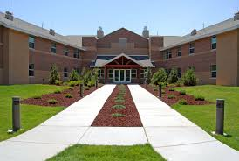
Clearfield Job Corps
Vocational Rehabilitation
Logistics Specialties
Weber State University Sp. Ed.
Workability Utah
UTAH Parent Center
Roads to Independence
Utah Center for Assistive Technology
Bookshare
Notes:
The DC and VR Counselor communicate weekly and the VR Counselor attends the Disability Advocate meetings monthly. The center uses VR to conduct disability evaluations referred through the Disability Advocate meetings and to coordinate off center therapy.
LSI has an office on center and comes to the center weekly. LSI provides an employability class to all students in the Career Development Period phase. During this class they identify prospective clients of VR and provide one-on-one support to students who are applying for VR services or have disabilities but may not be eligible for VR services.
The center has a partnership with Weber State University Special Education Department who provides student teachers to assist students with disabilities.
Workability Utah who keeps the DC informed of job fairs geared towards people with disabilities and provides transition services.
UTAH Parent Center actively refers students to the center and provides support for students who have received special education services in the past. They also have advocacy groups for parents with children who have disabilities.
Roads to Independence Disability Service Center provides additional assistance with housing and daily living skills.
Utah Center for Assistive Technology (AT) has provided AT for students. Through this partnership the center has been able to obtain a wheelchair for a student.
The center has established a membership with Bookshare.

Slide 43
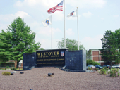
Westover Job Corps
Springfield and Holyoke Community College Disability Services
Massachusetts Vocational Rehabilitation
Connecticut Department of Rehabilitation
Stavros Center for Independent Living
Institute of Abilities
Notes:
The center has partnerships with Springfield and Holyoke Community College Disability Services, Massachusetts and Conneticut Vocational Rehabilitation, Stavros Center for Independent Living, and the Institute of Abilities to obtain individual training support, job coaching, and housing assistance for their students with disabilities.
The center also partners with all Springfield Public Schools and Chicopee Academy to provide dual enrollment to students and the schools provide special education support if needed.
The center has a BookShare membership.

Slide 44
Flatwoods Job Corps
The Department for Aging and Rehabilitative Services
The Virginia Association of Community Rehabilitation
People, Inc.
Commonwealth Catholic Charities
Notes:
The Department for Aging and Rehabilitative Services supports graduates with disabilities in obtaining vocational rehabilitation services to assist in maintaining employment.
The Virginia Association of Community Rehabilitation Programs has a staff person come to the center to assist students with disabilities in enrolling in support services to assist with housing and employment, as well as advising students on the types of benefits they are eligible for based on their disability status.
People, Inc. provides services for students with disabilities including housing support, job search assistance and training.
Commonwealth Catholic Charities provides counseling services, housing, and job search support for students with disabilities.

Slide 45
Dayton Job Corps
The School of Professional Psychology, Wright State University
Goodwill Industries
Miami Valley Works
Department of Job and Family Services – Disability Division
Urban League
Dayton Metro Public Library
Notes:
The School of Professional Psychology, Wright State University provides two psychology interns who work with students with mental health disabilities and conduct educational assessments.
Goodwill Industries assists with employment placement for students with disabilities.
Miami Valley Works provides a representative who comes to the center and works directly with students with disabilities on job placement.
Department of Job and Family Services-Disability Division provides employment, housing and career training for students with disabilities.
Urban League provides employment supports for students with disabilities as well as learning assessments for students suspected of having a disability.
Dayton Metro Public Library provides tutoring for all students, including those with disabilities.

Slide 46
Los Angeles Job Corps
Guest Speakers:
Tenia Penn – Academic Manager
Georgette Fields – Disability Coordinator, Health & Wellness
Notes:
We want to welcome two guest speakers from Los Angeles Job Corps. Georgette Fields is the current (DC). Tenia Penn is the previous DC and current AM. They will be sharing a few highlights from some of the ongoing partnerships with LAJC, and some of the benefits/supports from those partnerships…

Slide 47
Los Angeles Job Corps (cont.)
Los Angeles Unified School District
California Mentor
South Central Los Angeles Regional Center
Greater Los Angeles Agency of Deafness
Public Charter School
Mental Health Advocacy Services
Braille Institute
Notes:
Los Angeles Unified School District provides work-based learning placements (welding and culinary) for students with disabilities at LAJC.
California Mentor provides mentoring services for students with disabilities, and participates in the center’s annual disability fair.
South Central Los Angeles Regional Center participated in the center’s annual disability fairs. They also provide assessments for autism, intellectual disabilities, cerebral palsy, and epilepsy.
Department of Rehabilitation, Bay Cities Branch, assists students with APs with job preparation and placement.
Mental Health Advocacy Services participates in the center’s annual disability fairs, and also provides free legal services to individuals with disabilities.
Community Activities Living Independent and Free participated in the center’s annual disability fairs. They also assist students with disabilities with independent living skills (free of charge) to include budgeting and shopping.
Braille Institute provides students with volunteer opportunities to teach Braille to students with disabilities on center. They have also participated in the center’s annual disability fairs.
Greater Los Angeles Agency on Deafness (GLAD) has participated in several of the center’s disability fairs. The center partners with GLAD when resources are need for applicants/students that are deaf or hard of hearing.
SIATech Charter High School provides special education assessments and reports on students that are co-enrolled in the public high school and Job Corps. The school also has a special education teacher that works with the DC to develop RA ideas for students with specific disabilities.

Slide 48
Ottumwa Job Corps
Guest Speakers:
Monica VanGalder – Disability Coordinator
Scott McDonald – Academic Manager
Case Study
Applicant with the use of one arm
Notes:
We have another guest speaker, Monica Vangalder is the DC at Ottumwa Job Corps. She will be describing how some of the center’s RAC and disability program partners explored possible accommodations for an applicant with a disability along with the outcome of this actual case study.

Slide 49
Ottumwa Job Corps (cont.)
RAC Participants:
Applicant
Parent
DCs
HWM
Material Handling Instructor
Academic Manager
CTT Manager
Partners Utilized
Easter Seals – Iowa
Vocational Rehabilitation
Job Accommodation Network (JAN)
Indian Hills Community College

Slide 50
Resources

Slide 51
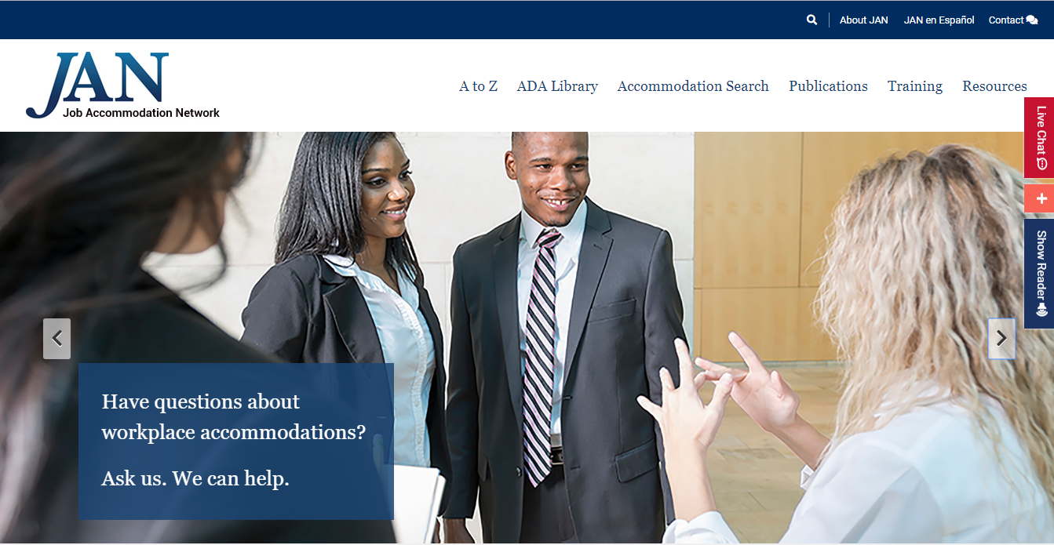
Job Accommodation Network
https://askjan.org/index.cfm
Notes:
The Job Accommodation Network (JAN) is the leading source of free, expert, and confidential guidance on workplace accommodations and disability employment issues. Working toward practical solutions that benefit both employer and employee, JAN helps people with disabilities enhance their employability, and shows employers how to capitalize on the value and talent that people with disabilities add to the workplace.
Their newly updated website allows for easy navigation through their many search engines. You can search for accommodations by disability or functional limitation, learn about accommodations by role (employer vs. individual seeking accommodation), and look up information about different disabilities using their A-Z guide. You can even contact someone on their team for help and advice through phone, email, or through live chat on their website.
A brochure on how Job Corps and JAN can work as a partnership is available on the Job Corps Disability Website.

Slide 52
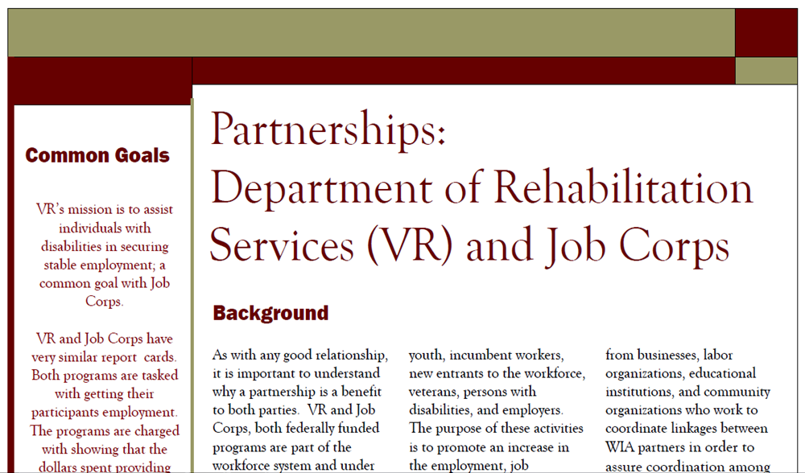
Vocational Rehabilitation Brochure
https://supportservices.jobcorps.gov/disability/Pages/R6.-Partnerships.aspx
Notes:
This brochure is a great resource to present to VR when trying to build a partnership. It explains how both parties benefit from the relationship. This and other partnership resources can be found on the Job Corps Disability website.

Slide 53
Webinars
Bookshare
Job Accommodation Network
Georgia’s Assistive Technology Act Program “Tools for Life”
Gaining Access Through Assistive Technology
https://supportservices.jobcorps.gov/disability/Pages/default.aspx
Notes:
Here is a short list of webinars that may be helpful when considering partnerships. Last year we had a staff member from Georgia’s AT program present a webinar on disability awareness and the benefits of state AT programs. This year we invited Therese Wilkomm “Macgyver” to share easy to create assistive technology to support every day tasks in the workplace. These topics and many others are available on the Job Corps Disability website or through your RDIC.

Slide 54
Regional Disability Coordinators
Kristen Philbrook – Boston Region Philbrook.Kristen@jobcorps.org
Annie Tulkin – Philadelphia Region
Tulkin.Annie@jobcorps.org
Stephanie Karras – Atlanta & San Francisco Regions
Karras.Stephanie@jobcorps.org
Alyssa Purificacion Olivas – Dallas Region
Purificacion.Alyssa@jobcorps.org
Sharon Hong – Chicago Region
Shong.Sharon@jobcorps.org
Notes:
As always, if you need help please feel free to reach out to your RDIC!

Slide 55
Questions?

