Slide 1
Reasonable Accommodation in Career Technical Training (CTT)
Easy and Practical Ways to Accommodate and Adapt
Notes:
Welcome to Easy and Practical Ways to Accommodate and Adapt: This webinar will highlight assistive technology accommodations and other practical adaptations that support both independence and employability for students with disabilities enrolled in several career technical training areas. The importance of developing supports that are portable and transferrable into the workplace also will be discussed.

Slide 2
Webinar Objectives
List at least 2-3 assistive technologies that are available in local stores and used in daily life that also can be used to accommodate students with disabilities in CTT.
List at least 3 specific assistive technology resources that provide support and services for students with disabilities who are enrolled in CTT.
Describe at least 2 ways to modify instruction that would remove barriers and provide access for students with various disabilities in CTT.
Notes:
During this webinar, we will be exploring a wide range of assistive technologies on a continuum of low to high tech, as well as free to a bit more costly. We will also explore how these accommodations can be used to provide more independence for students with disabilities, as well as provide support in more than one area of life.
You will be provided with several resources today that can be used to search for just the right accommodation for specific functional limitations, and resources that can be used to explore funding for AT.

Slide 3
Poll Question
Within your CTT program, how have you implemented the accommodations in your students’ accommodation plans (APs)?
I know the APs, generally, of my students and ensure routine implementation
I have reviewed my students’ APs but do not always consistently implement
I rarely review my students’ APs because my program naturally accommodates
I have never reviewed or implemented a student’s AP
Notes:
This poll gives us an opportunity to measure where the group weighs in regarding our implementation of our students’ APs.
If you are not in CTT, you still have some responsibility regarding APs. Answer as best you can.
Some of you may be new to JC or your position, so you would obviously mark the last choice.

Slide 4
Current CTT Accommodation Practices
In the chat box,
List a few ways that you are already supporting students with disabilities in your classrooms through:
Accommodations
Adjustments
Modifications
“Yes” or “No” – Are most of those accommodations, adjustments, or modifications taken from Job Corps Accommodation Plans?
Notes:
Now let’s take a moment to be a little more specific about our current practice.
In the chat box, list a few examples of accommodations, adjustments, or modifications you are providing or using to support students with disabilities in your classrooms or areas on center (e.g., posters of key information, extended time on quizzes…)
The 2nd part of this activity requires you to answer “yes” or “no” if most of the accommodations, adjustments, or modifications are taken from JC AP…do that now in the chat box.

Slide 5
Career Technical Training (CTT)
Inherent Benefits
Notes:
We want to acknowledge that CTT education and applications already come with many inherent teaching and learning benefits.

Slide 6
Although CTT has many built-in instructional strategies that naturally meet the needs of ALL learners, we cannot be complacent about how each student is performing or should have to perform.
Students with disabilities often get left behind. They have learned to “blend” or “cope,” but that does necessarily mean they are making progress. Their accommodations give them equal “access” to the program, but we must be mindful of potential barriers that may prevent their accessing them.
Notes:
Read the slide…
Also, many of our CTT settings contain “universal” designs or accommodations that benefit more than students with disabilities.
By understanding the functional limitations of our students with disabilities, we can better access whether or not our setting, instruction, and teaching materials actually meet the learning needs of those students.

Slide 7
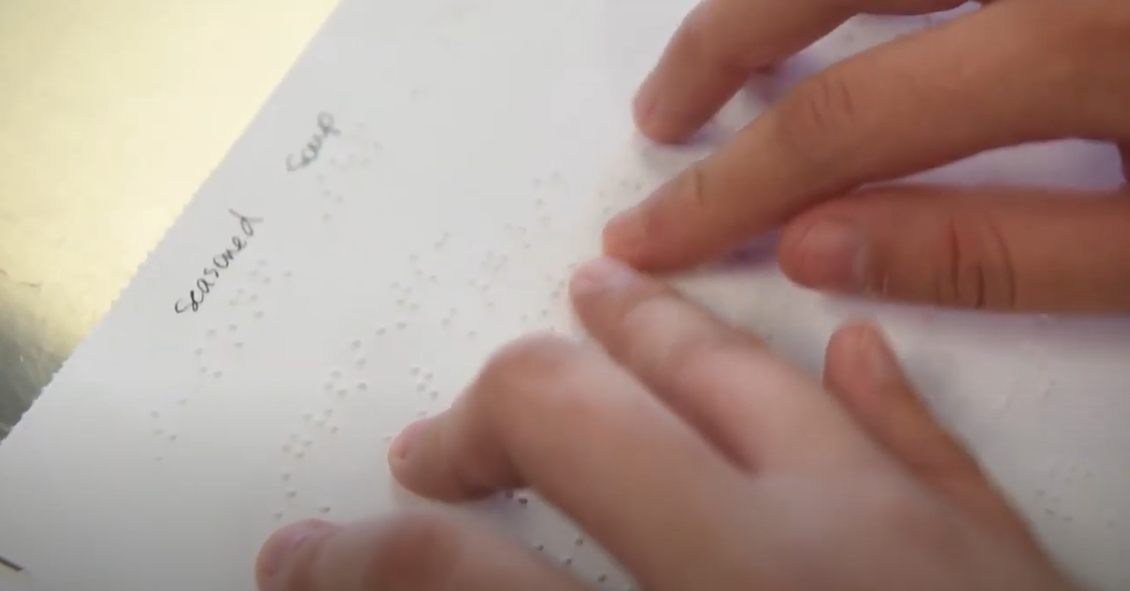
Accessing CTT
Accommodations and Strategies
Notes:
First, let’s take a look at those “inherent” accommodations and strategies that are often found in the CTT settings.

Slide 8
CTT Instructional Strategies
Set up your CTT environment with Universal Design for Learning (UDL) in mind!
Accessible equipment
Accessible furniture
Accessible programming
Hands-on learning
Modeling
Project-based learning
Peer mentors
Cooperative learning
Multi-modal instruction
Real life applications
Checking for understanding
Notes:
CTT is one of those areas in which there is a fair amount of inherently beneficial practices and strategies for students with disabilities that are naturally built into how we train and educate. Certainly, we know that hands-on and project-based learning often is a more successful model and a more interesting mode of learning for many of our students, with and without disabilities.
We know we can promote even greater access by thinking in terms of universal design and setting up the CTT environments with that concept in mind.
One way to further provide access, to further individualize instruction, and to grown and develop universal design is through the use of technology. We recognize that technology is not meant to replace the role of the instructor. It is used to enhance or support teaching and learning. It is used to provide access, promote independence, and improve employability.

Slide 9
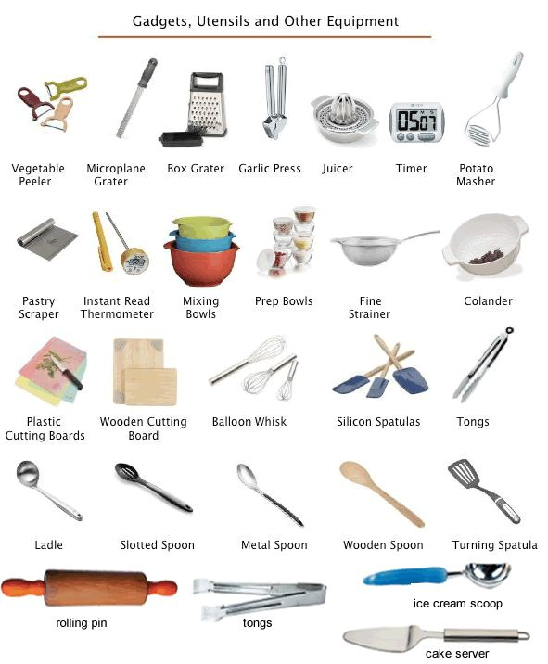
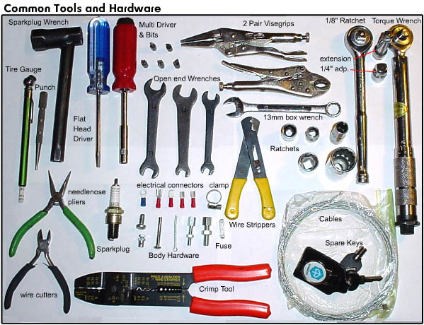
Instructional Strategies in CTT – “Word Walls”
Provides a meaningful approach to teaching vocabulary
Improves reading and writing skills
Provides visual cues for students
Reinforces understanding of subject-specific terminology
Helps students improve spelling and awareness of spelling patterns
Encourages increased student independence when reading and writing
Notes:
One example of a UDL CTT strategy is the use of word walls…in this case Culinary and Auto “word or vocabulary walls.”
This provides an easy way for all student in a particular setting to get more exposure/repetition to the key concepts using graphic representations paired with the name of the tool or key concept. More exposure often results in a greater way to reinforce new learning and memory recall.
Word or vocabulary walls also are a way to teach spelling, reading, interactive learning etc. NOTE: In DL settings, word walls can be posted to bulletin boards and shared (e.g., Google Classroom)

Slide 10
What is Assistive Technology?
Assistive Technology (AT) is any item or piece of equipment that is used to increase, maintain or improve the functional capabilities of individuals with disabilities in all aspects of life, including at school, at work, at home and in the community. AT ranges from low tech to high tech devices or equipment.
http://www.gatfl.org/assistive.php
Notes:
Let’s start with AT by providing a definition (slide)
(AT) can also be thought of as an umbrella term that includes assistive, adaptive, and rehabilitative devices for people with disabilities and also includes the process used in selecting, locating, and using them.
Assistive technology promotes greater independence by enabling people to perform tasks that they were formerly unable to accomplish, or had great difficulty accomplishing.
AT may provide ways for our students with disabilities to no longer be dependent on a person for special support.

Slide 11
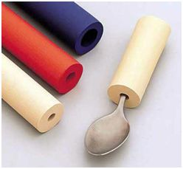
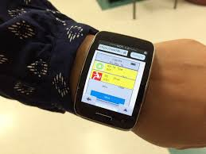
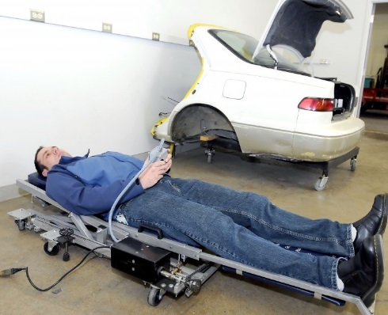
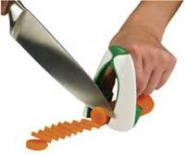
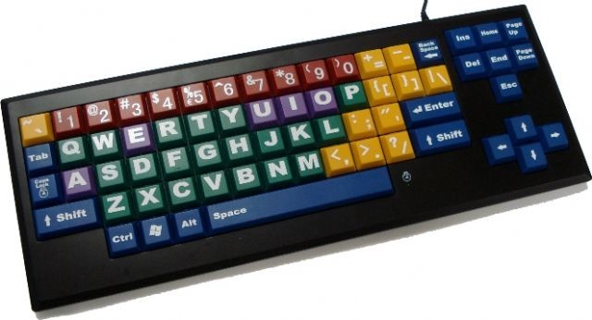
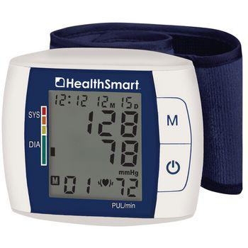
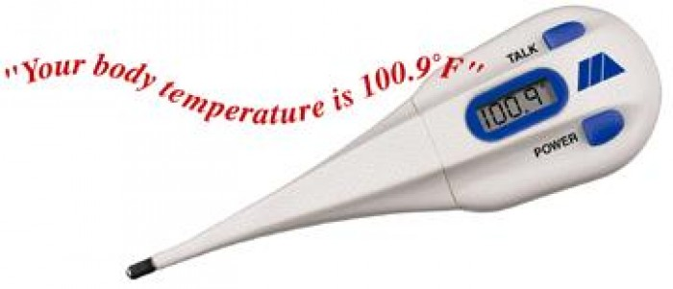
AT Examples
Large print text
Visually supported lists
Canes and walkers
Reachers and grabbers
Noise cancellation headsets
Specialized pen or pencil grips
Talking blood pressure monitors, Talking scales, talking calculators
Instructional videos (YouTubes…)
Amplifiers
Modified tools (handle grips, extenders…
Power wheelchairs, scooters
Digital hands-free headsets
Bluetooth integration for wireless connectivity
Automated creepers
Voice-recognition software
Notes:
AT can range from simple (low tech) to more complex; from free to high cost… “ Generally low tech requires little to no training to use where “high tech” may require more training or may have complex mechanical features.
Don’t get “high tech” confused with high cost. Often AT such as voice recognition software, Bluetooth, and videos are free to low cost.
What are some examples of any AT that is already being used by students with disabilities on your center?

Slide 12
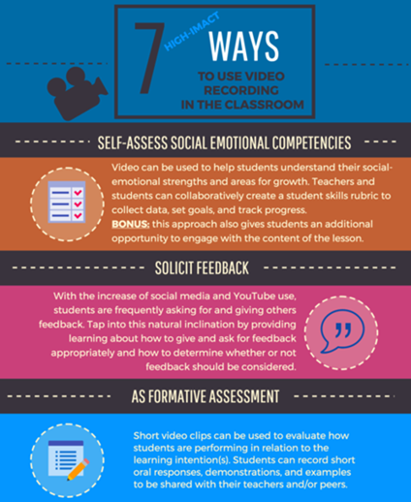
Using Videotaping of Instruction to Develop Accommodation and Instructional Resources
Improve accessibility on center by videotaping instructional segments of specific CTT programs and create a career technical information library. How does this improve accessibility?
Provides content in an alternative format
Affords a student the opportunity to work independently because they can review instruction and work ahead and/or review the instructional content as frequently as they need for mastery
Notes:
(Talk about the slide content)
There are some compelling studies out now showing how video learning is capable of improving academic, as well as social/emotional, and behavioral skills.
Instructors: All of us have “blind” spots. By videotaping our own instruction, we gain insight into how we communicate, reinforce, and model new learning.
Distance Learning Benefit:

Slide 13
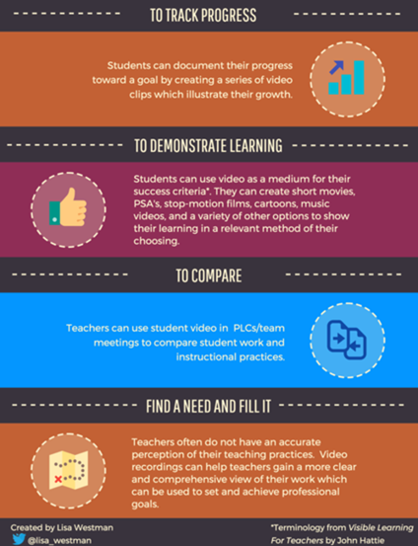
Videotaping Benefits on Instruction
Provides a multi-sensory resource
Allows the student to review at own pace
Allows the student to repeat content to enhance memory retention and automaticity of recall of skills
Affords student an opportunity to have a model to compare completed work against
Assists ELL/ESL learners with language/vocabulary development
Notes:
In addition to the student benefits listed here, instructors benefit by freeing up some of their instructional time to work with smaller groups, one-on-one—possible way to have devoted time to “check for understanding.”

Slide 14
Starting the Reasonable Accommodation Process for CTT Access
Did the applicant request accommodations or did someone else request accommodations on the individual’s behalf (e.g., CCMP)?
What are the skills, activities, and job functions required to complete the trade or career path?
What are the student’s functional limitations? (e.g., difficulty reading printed materials, difficulty lifting heavy objects, hard-of hearing, controlling emotions…)
What job tasks are difficult to perform as a result of the impairment(s)? (e.g., lifting materials, tolerating stress, reading manuals, communicating in writing…)
Notes:
Let’s talk about how we can get started with assistive technology in our CTT settings.
As I review the process for accommodating students with disabilities, be thinking about a student that you have or may have had in your Career Tech area that came with some type of disability or challenge.
In your mind, or on papers, answer these questions about that student.
The next slide has 2 more questions…

Slide 15
Starting the Reasonable Accommodation Process for CTT Access
How can we remove the barriers or provide supports/services that will provide access, and allow each student with a disability to demonstrate the required skills, aptitudes, and abilities?
What are our resources?
The individual with a disability
JAN, Tools for Life, Job Corps Disability Website, other disability-related partners…
What…skills, activities and job functions
What…functional limitations
How…remove barriers or provide supports/ services
What…resources
Notes:
(after reviewing slide)… What are some of the “disability-related” partners that your center uses for support for students with disabilities?

Slide 16
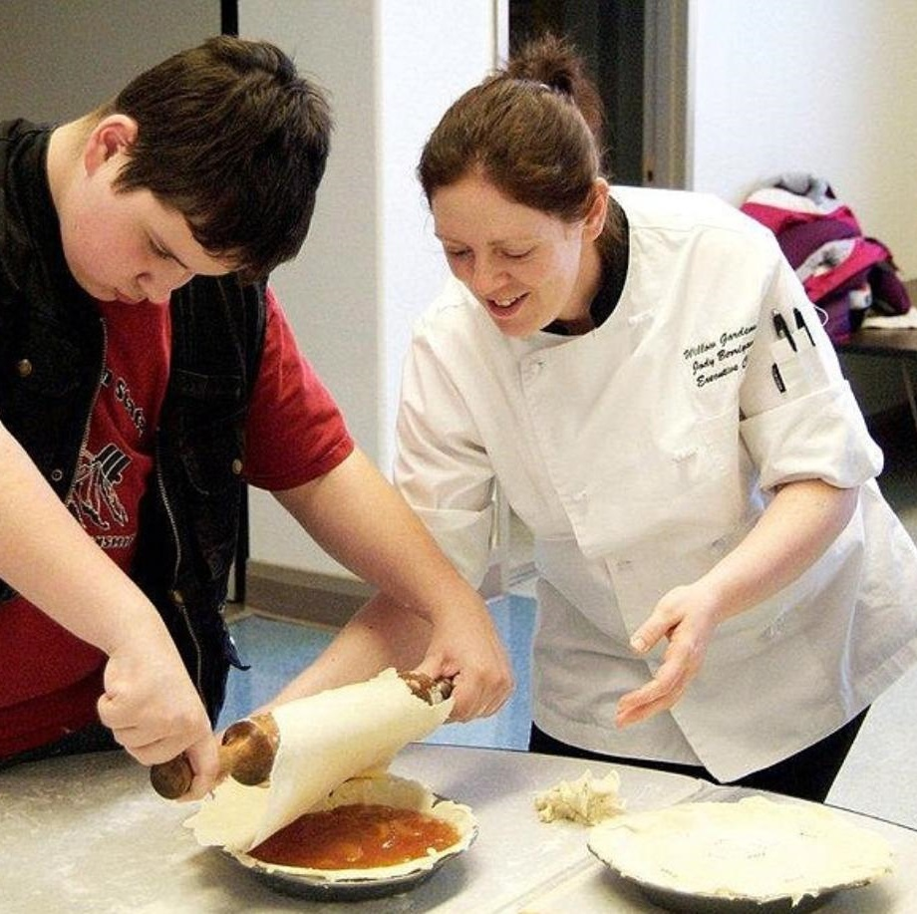
Practice: Let’s Review Jordan’s Information
Jordan wants to take Culinary Arts
He is legally blind (e.g., can see some shades, extremely large print on high contrast backgrounds)
He did not request any specific accommodations
What do we do first?
Notes:
Let’s practice with one case study using the questioning approach that we just reviewed.
What are some possible AT accommodations that we could consider to support Jordan with “remembering, reading, completing tasks, practicing safety in the kitchen, measuring, and conversations?”
Use the chat box for any ideas you have…
How might these accommodations be used in other areas on center or to build independence?

Slide 17
Jordan – Reasonable Accommodation Needs
Did Jordan request accommodations or did someone else request accommodations on the individual’s behalf (e.g., CCMP)?
No
What are the skills, activities, and job functions required to complete the trade or career path?
Reading (recipes, menus, directions, etc.)
Measuring, cutting, organizing, time management, safety
Notes:
Let’s practice with one case study using the questioning approach that we just reviewed.

Slide 18
Jordan – Reasonable Accommodation Needs
What are Jordan’s functional limitations?
Limited vision
A secondary question is how does his limited vision (e.g., functional limitation) impact Jordan?
How can we remove the barriers or provide supports/services that will provide access, and allow each student with a disability to demonstrate the required skills, aptitudes, and abilities?
Provide adapted equipment (cutting boards, talking scales, raised print measuring tools, etc.)
Provide read aloud resources or Braille instructional materials*
Provide a vibrating watch or other audio-based timer to help with time management
Notes:
Continuing with the question approach to accommodating Jordan…

Slide 19
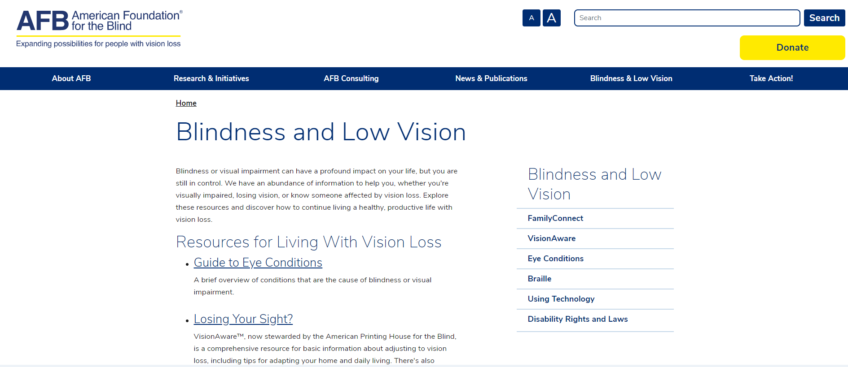
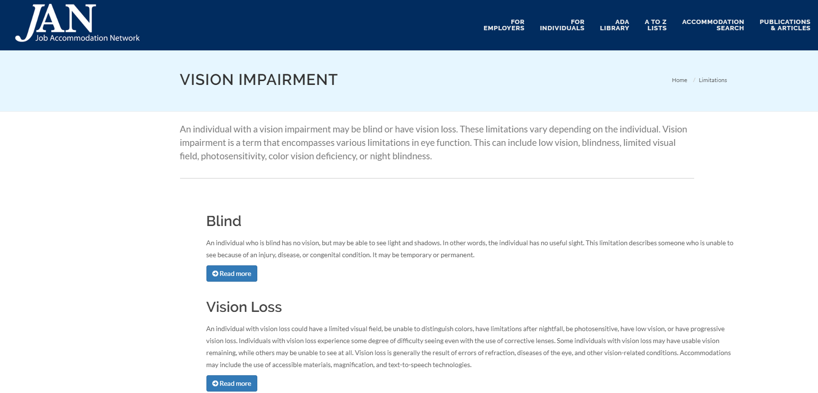
Jordan – Reasonable Accommodation Needs
What are our resources?
Notes:
Some great examples…

Slide 20
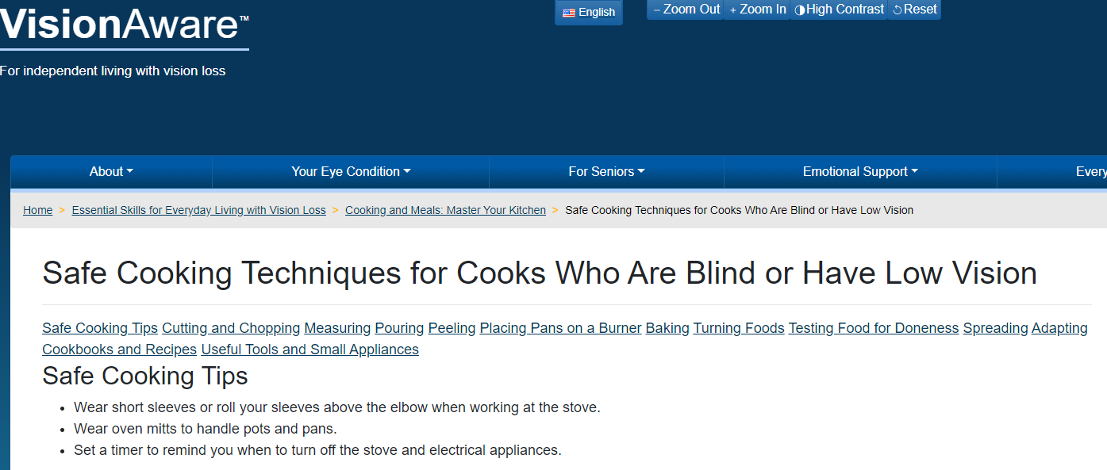
Jordan – Reasonable Accommodation Needs
What are our resources?
Notes:
Some great examples…

Slide 21
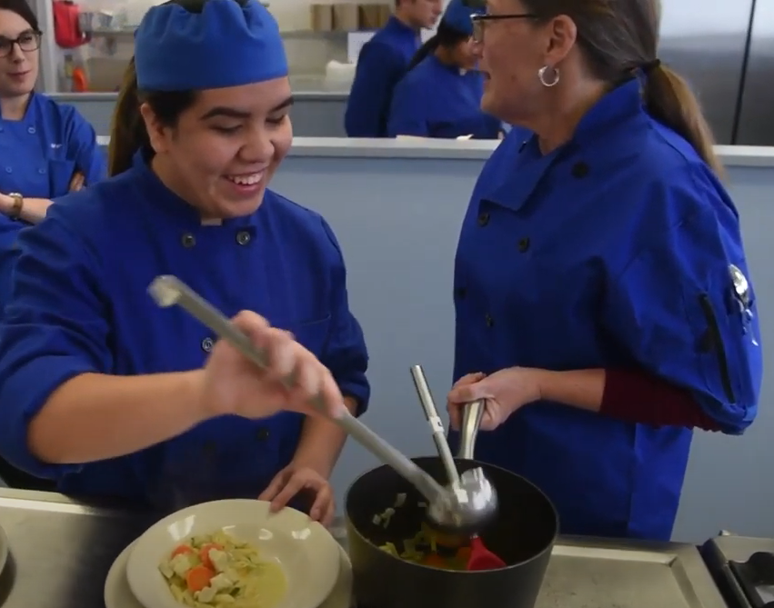
Culinary Arts
Practical Questions Answered
https://www.youtube.com/watch?v=O0--TAODZr8

Slide 22
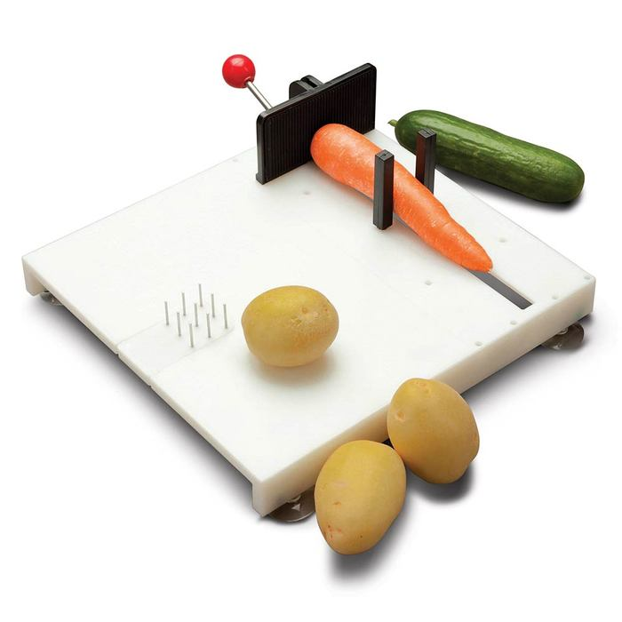
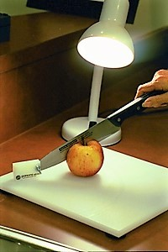
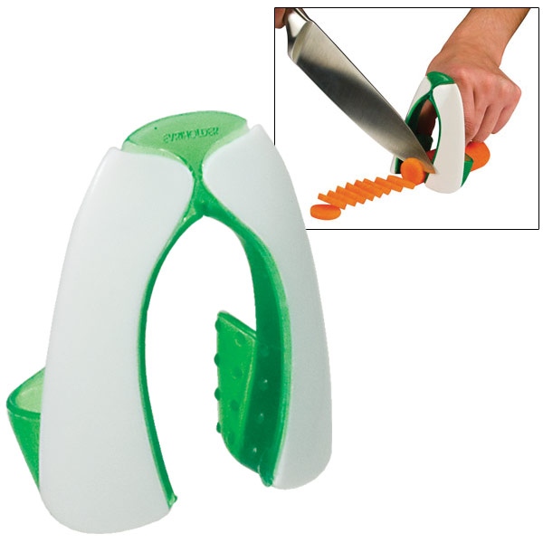
How Can a Student Who is Blind Use a Knife?
Knife guides
Cutting guards
Stabilizers
Attached knives to cutting board

Slide 23
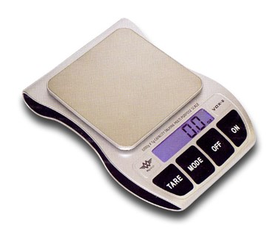
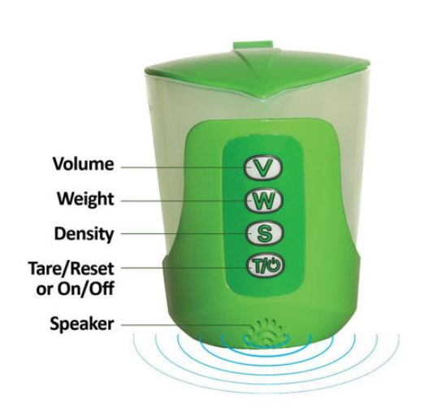
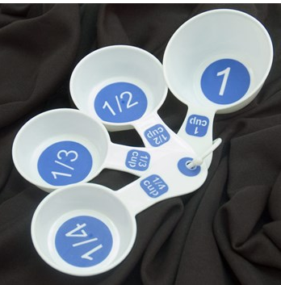
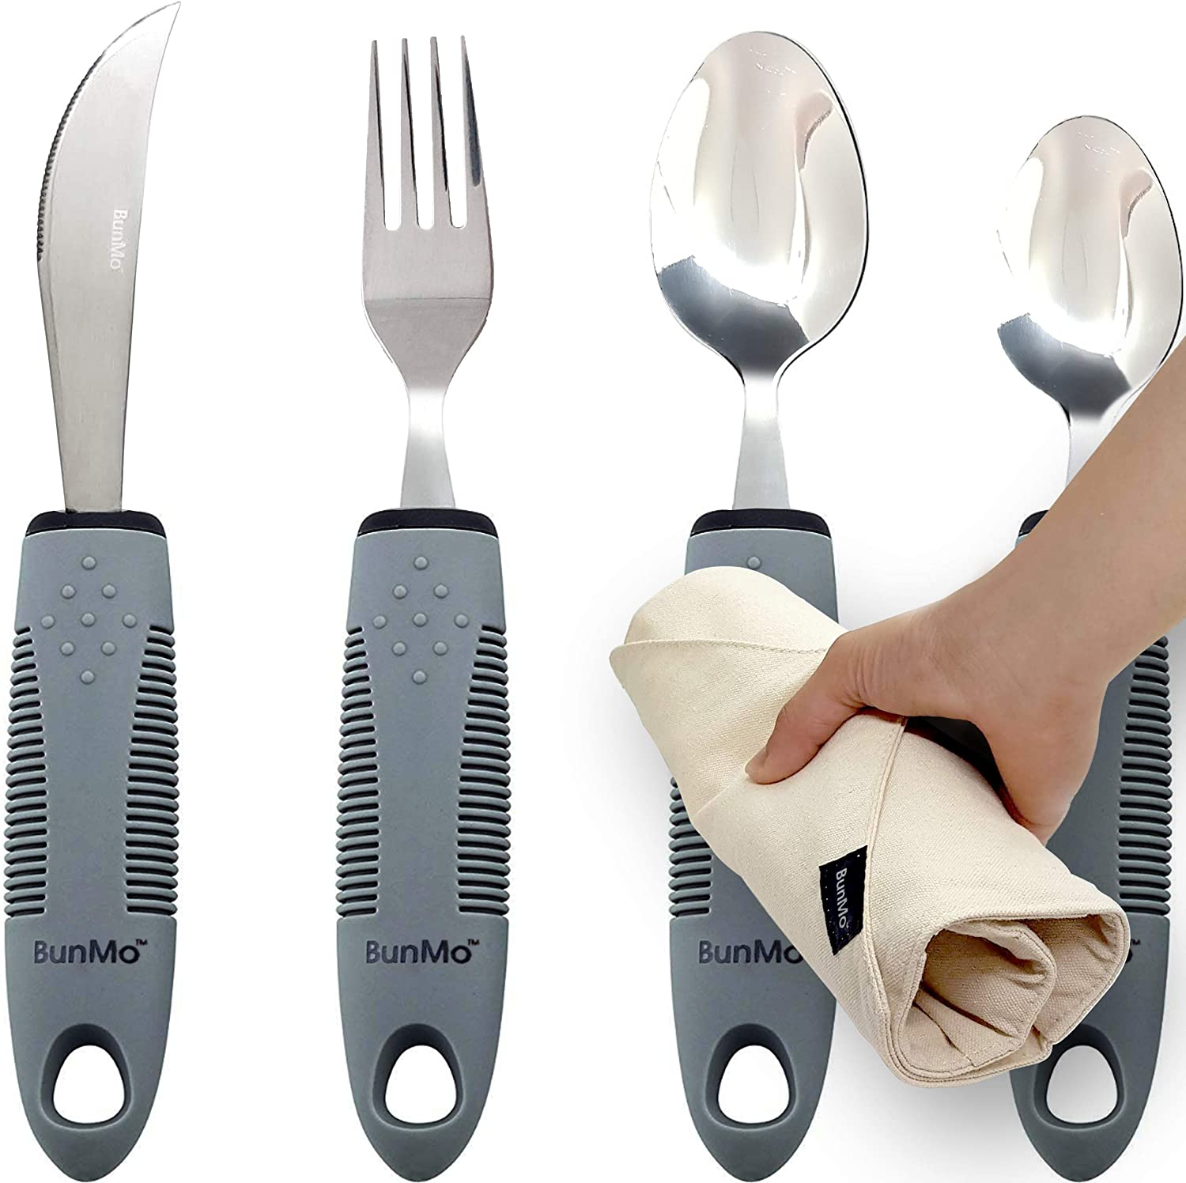
What are Some Other Adaptive Equipment Options?
Talking Food Scales
Talking Measuring Cups
Large Print Measuring Spoons
Adaptive Utensils
Various Shaped Measuring cups

Slide 24
What are Some Other Adaptive Equipment Options?
Touch the watch’s crystal face to
hear the time
Braille and talking watch

Slide 25
MasterChef, Christine Ha: How the Blind Cook
https://www.youtube.com/watch?v=65gqX2QhVRA
Notes:
https://www.youtube.com/watch?v=65gqX2QhVRA
Show 4-5 clip from “How the Blind Cook”

Slide 26
Distance Learning
Accommodations and Strategies

Slide 27
American Federation for the Blind: Using Google Docs and Drive
https://www.afb.org/blindness-and-low-vision/using-technology/assistive-technology-videos/using-google-docs-and-drive
Notes:
One “distance learning” tool = The AFB Technology Training and Awareness Program consists of an online self-paced training course on the use of Google Docs and Google Drive with the free NVDA screen reader for Windows. The training is divided into 10 modules, each containing brief videos, written reference information and an evaluation after each completed module. Sample modules include “Using Google Docs and Drive,” “Basic Document Formatting,” “Collaborating with Others,” etc.

Slide 28
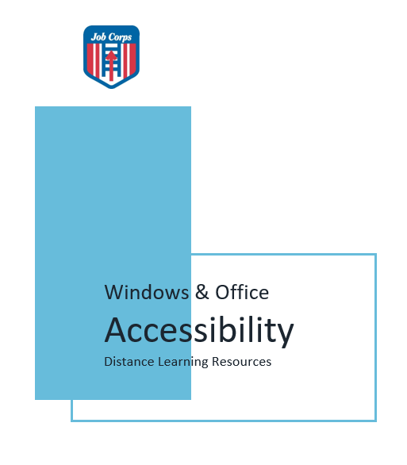
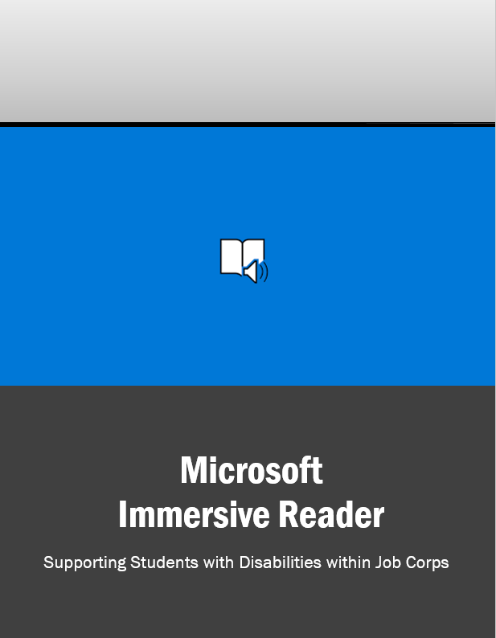
Reading and Other Assistive Technology Guides/Supports
Visit the Disability Job Corps website to download these guides and more!

Slide 29
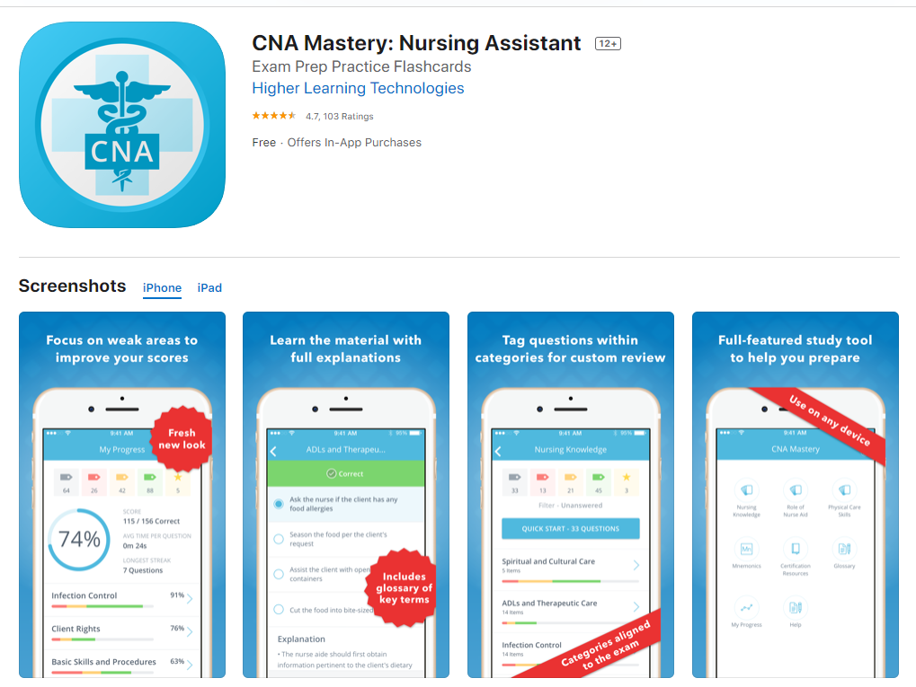
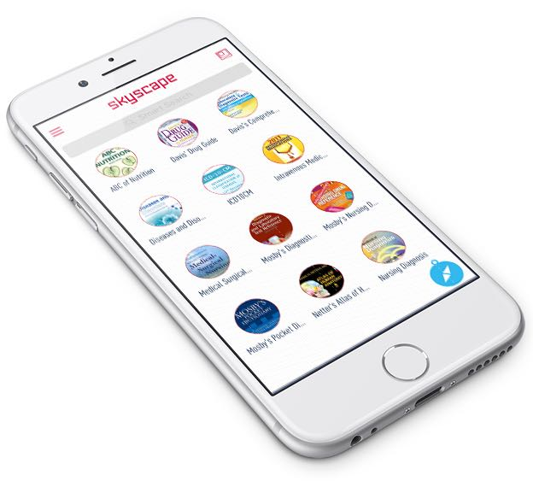
Mobile Support Examples: Medical CTT

Slide 30
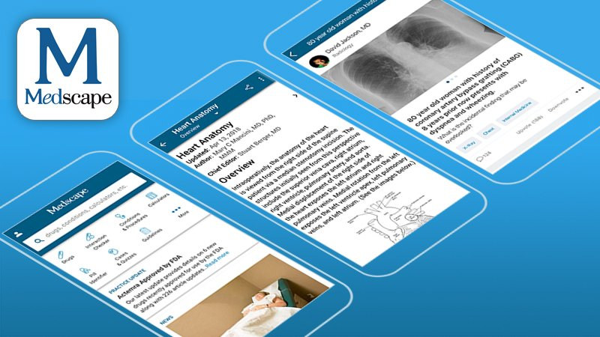
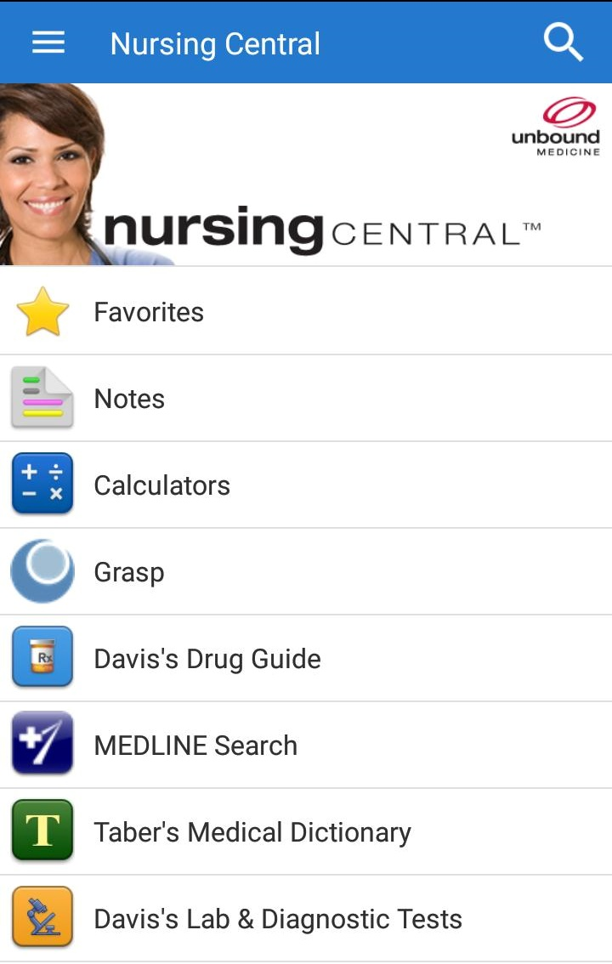
Mobile Support Examples: Medical CTT

Slide 31
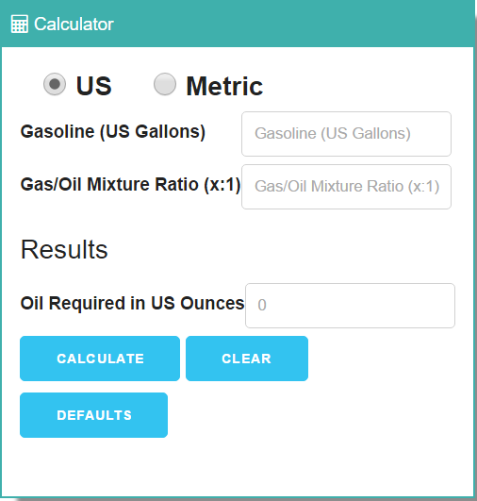
Online Support Examples: Automotive

Slide 32
Distance Learning
Center & Other Examples!
Notes:
Let’s take a look at some examples of AT being used on our centers that either benefit one student with a disability, or several student with or without disabilities.

Slide 33
Gadsden Job Corps Center
Center staff are creating YouTubes uploaded to a designated site where trade students can access pre-recorded introductions to distance learning, self-paced lessons/lectures that follow the assigned reading materials, and more.
Students that need repetition and instruction at their own pace can access the YouTubes from a variety of devices in their own time.
Notes:
Here is an example of using video technology (YouTubes) to provide information about DL instruction, and specific CTT lessons
Some ways it supports students with specific disabilities included:
Built in extended time
Reading support (materials read to them)
Opportunity to review and repeat lessons for memory/retention
Addresses some attentional issues by allowing students go at their own pace and see/hear lessons

Slide 34
Example: Gadsden JCC staff member created a CNA videos for students during COVID-19
https://www.youtube.com/watch?v=tNLvCDwh_XU

Slide 35
Example: Atterbury JCC staff member created Electrical Wiring videos for students during COVID-19
https://www.youtube.com/watch?v=7r7GLW9_8y4

Slide 36
https://www.youtube.com/watch?v=GciAsmfwlEc
https://www.youtube.com/channel/UC1aNZweYaP_AOslqmiasWGQ/videos
Notes:
There are many other examples of virtual instruction out there in YouTube format. This example is real time instruction in a distance learning setting using Google Classroom.

Slide 37
Resources
Assistive Technology

Slide 38
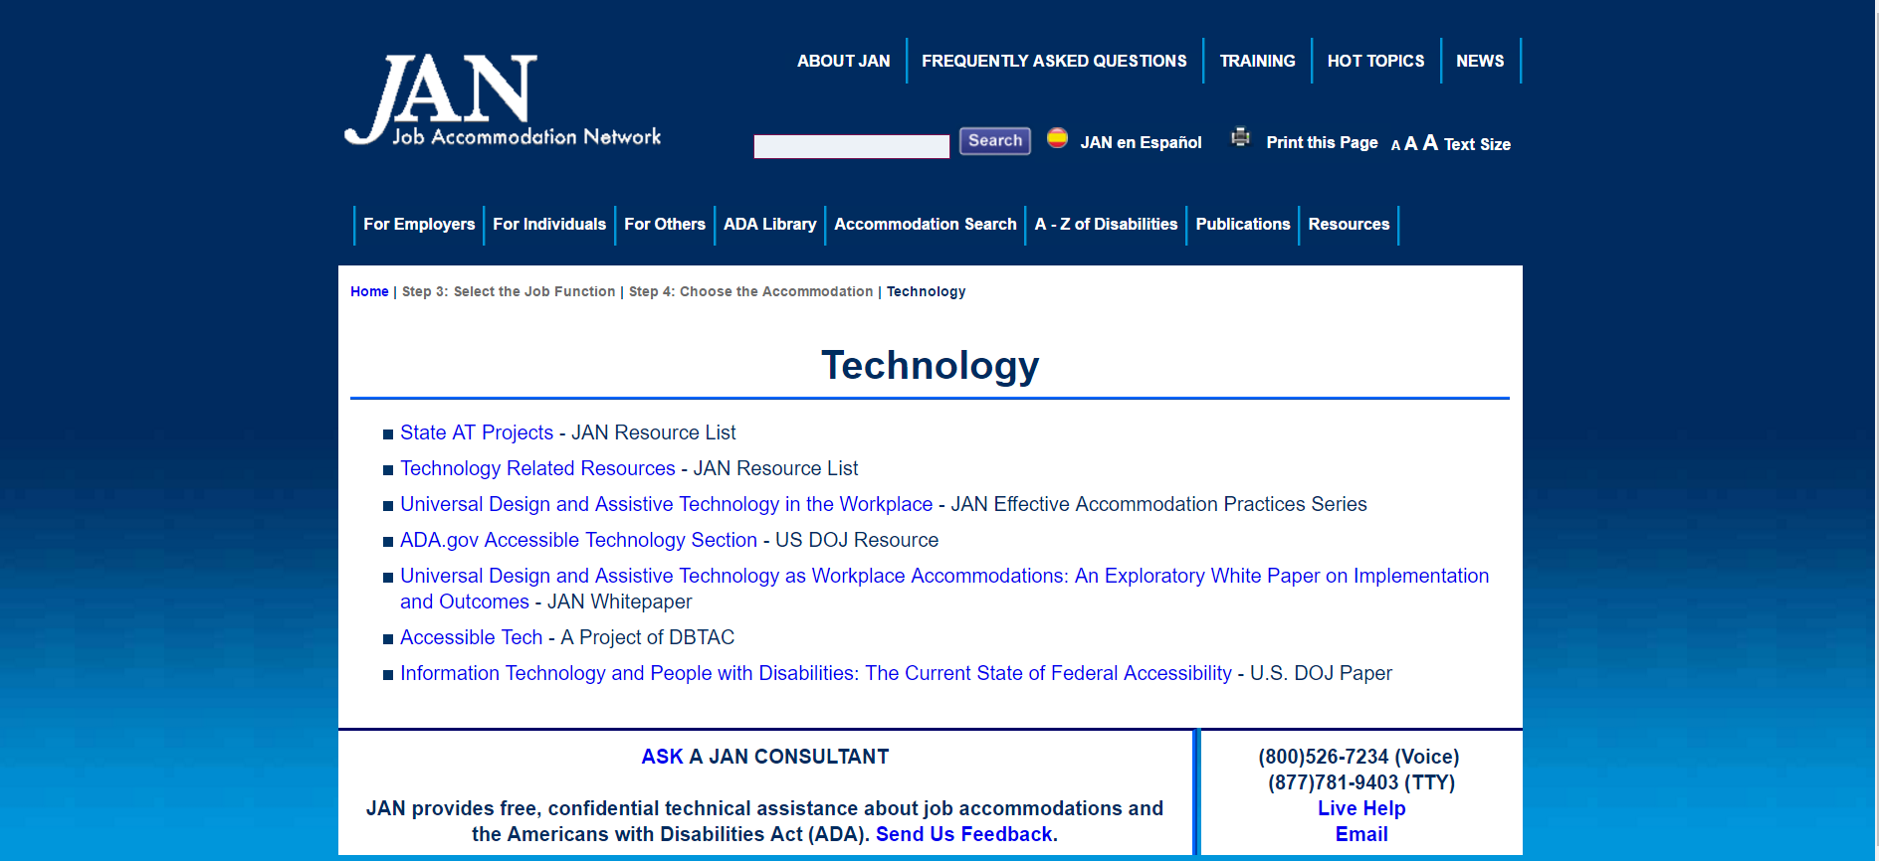
Job Accommodation Network http://askjan.org/topics/tech.htm
Notes:
Website tour: Use SOAR to demo LD (Case Study-Jordan)…choose reading, math, and organization to show how AT can accommodate

Slide 39
Tools for Life http://www.gatfl.org/
Notes:
If time permits, conduct a brief website tour using the “Tools for Life AppFinder”

Slide 40
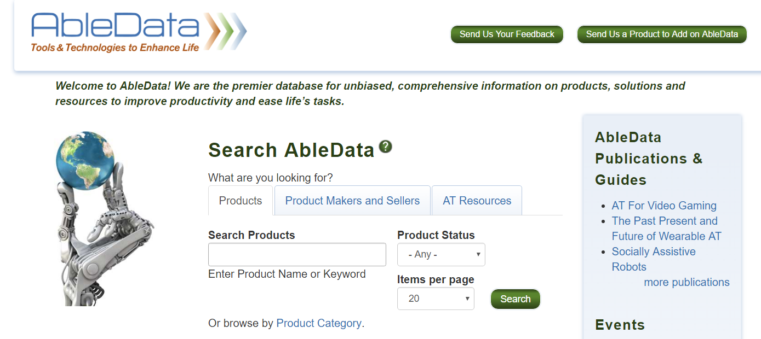
AbleData www.abledata.com
Notes:
Able Data is a searchable resource website that contains information on tools and technologies to “enhance life.” The user of this site can search by “product,” by “product makers/seller or categories” and by “AT Resources.”
The next slide shows a clip of searching by “Product Category.”
Welcome to AbleData! We are the premier database for unbiased, comprehensive information on products, solutions and resources to improve productivity and ease life’s tasks.

Slide 41
AbleData Search: Products by Category
Notes:
This is one way your can search on AbleData for possible AT or accommodations.

Slide 42
RESNA http://www.resna.org/
Notes:
RESNA is a national society engaged in the work of connecting those in need of AT to potential funding sources. Almost every state has a federally funded AT Program that offer device loans, funding sources, and further resources for AT.

Slide 43
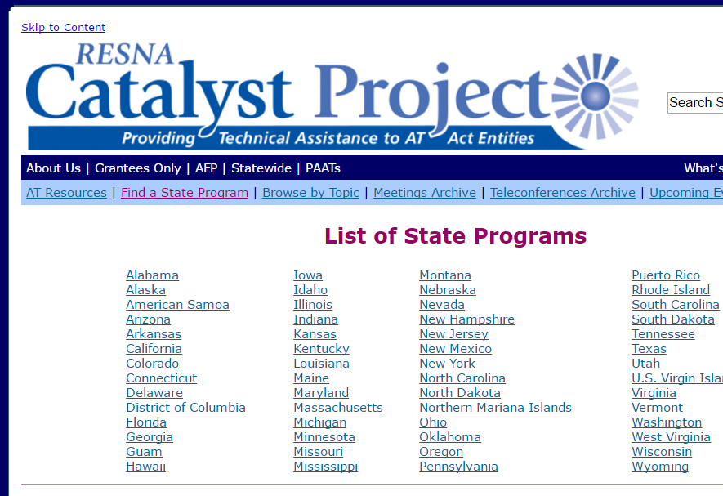
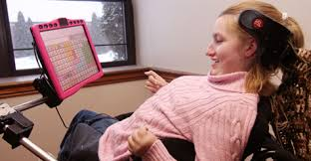
State AT Programs http://www.resnaprojects.org/allcontacts/statewidecontacts.html
Notes:
This slide is a snapshot of the actual list of state AT programs on the RESNA website. The right hand side of the slide has another snap shot of when you click on an individual state. In this case, it shows the contact info for the AT Program in DC.

Slide 44
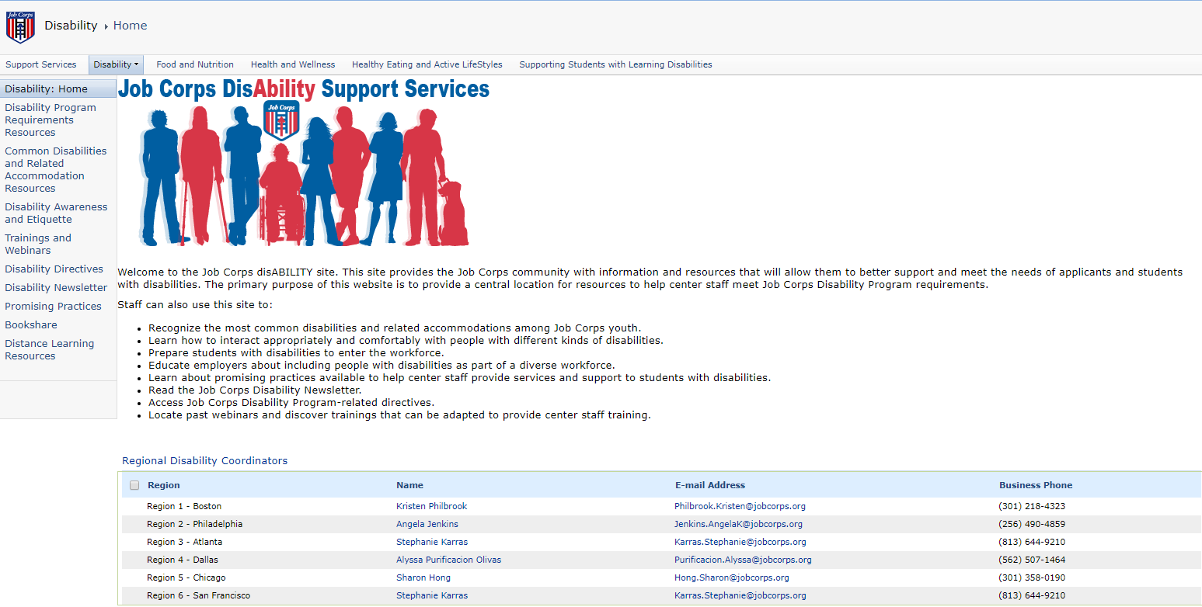
Job Corps Disability Website https://supportservices.jobcorps.gov/disability/Pages/default.aspx
44

