Slide 1
Reading 300 Part 3 of 3
A Case Study Approach
Notes:
The purpose of this webinar is to build on the previous knowledge gained from both Reading 100 and 200 webinars. .
You will take an active role in identifying strengths, functional limitations, and developing potential accommodations for students with mild, moderate, or severe reading difficulties.
You will have an opportunity to see how some centers are using resources and strategies to support students with reading difficulties in several center settings.

Slide 2
Learning Objectives
From review of case studies, you will be able to:
Identify specific strengths and functional limitations of students with disabilities who have various levels of reading challenges.
Identify accommodations for students with disabilities who have mild, moderate or severe reading abilities that apply to each of several areas on center and that promote and build compensatory skills, independence, and employability.
Describe at least two reading resources that support Job Corps staff with reading solutions for students with disabilities.

Slide 3
Poll Assistive Technology for Reading Support
Notes:
Our center is currently using some form of Assistive Technology (Bookshare, Screen Readers, reading apps, etc) to support students with reading difficulties.
Yes or No.

Slide 4
Goals when Considering Reading Accommodations
Building independence – What accommodations can promote independence and make the student less dependent upon others?
Accessibility – How can we best provide access to all areas of the program?
Employability – What accommodations translate well into the workplace if still needed?

Slide 5
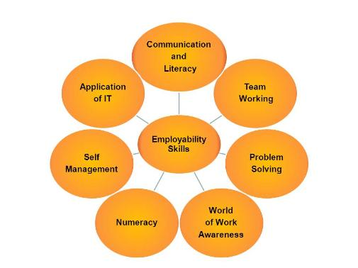
Building Compensatory Skills
Developing Independence
and Improving Employability
Notes:
Compensatory skills refer to the use of strategies, techniques, and adapted materials that students can access across settings…By teaching the use of compensatory skills, we are able to leverage our students strengths and interests.
For students with reading difficulties to keep trying or try harder to complete tasks and keep up with their peers, they have acquired a variety of compensatory strategies shown to them by a teacher, parent, or self-taught Let’s look at some of the most popular ones.

Slide 6
How Can We Support the Development of Compensatory Skills?
Use accommodations to remove barriers to the program
Teach strategies to improve independence/support learning
Remediate skills deficits
Notes:
Although we may initially use strategies or accommodations that are more teacher or mentor- centered to start out…that is mainly to remove barriers and build confidence.
An example in reading may be that we model good reading strategies, and walk a student through those fundamentals that help them dissect or comprehend the text. Then we slowly transfer the responsibility of using the strategies to the student--with some guided practice, so we can check for understanding.

Slide 7
Compensatory Skills/Strategies (Examples of Student Generated Compensatory Skills)
Reading & Word Recognition
Find a quiet, distraction-free place to read
Read aloud or use programs that read text aloud
Take frequent breaks when reading
Expect to need extra time for reading
Google words that don’t make sense, or use word parts (roots, prefixes…)
Skim the text or use context clues to gather the main idea
Ask to write in books to take notes, highlight, color-code
Notes:
These compensatory strategies were taken from a study on “self-generated, compensatory strategies for reading from students with dyslexia.”
This is what the students reported helped them the most with their reading difficulties.

Slide 8
Center-wide use of Compensatory Skills
How could the use of compensatory skills/strategies be applied to specific areas on center (WBL, Residential, Recreation…)
What types of compensatory skills/strategies promote employability and independence?
Why teach student-centered interventions, as opposed to teacher-centered interventions?
Notes:
Let’s use the chat box to have a brief discussion about center-wide use of compensatory skills.
Thinking about those compensatory strategies that student prefer to use from the previous screen (show), how might they apply to certain areas on center?
For example, having a handout of the dorm rules, so the student can take their own notes or highlight the critical details.
What else?

Slide 9
Leveraging Strengths
Supporting Reading Functional Limitations
Notes:
Again, our chances of transferring the responsibility of building compensatory skills/strategies to our students is much higher when we leverage their strengths and/or interests.
Let’s take a look at some of the research regarding “leveraging strengths.”

Slide 10
Leveraging Strengths
Research shows that many students with reading disabilities (particularly dyslexia) are highly creative, and have several cognitive and emotional strengths, despite a weakness in decoding words.
http://dyslexia.yale.edu/Strengths.html
Research also shows that by integrating a student’s strengths and interests into activities involving reading, it can significantly increase potential for improving reading skills.
http://dyslexiahelp.umich.edu/professionals/students-strengths-and-interests/what-the-literature-says
Notes:
Interest is a powerful motivator. Studies into the role of interest in learning have demonstrated evidence of gains in attention, persistence, deeper processing of content, and enhanced metacognition for all students including students with reading disabilities.
Examples of questions on a Reading Interest Survey:
What is the best book that was ever read to you?
What is the best book that you ever read yourself?
What are your favorite hobbies, sports, or activities?
What are some of your favorite movies or tv programs?
What are your favorite videos, DVDs, computer games, and Internet websites?
If you could take a trip, where would you go?
What careers interest you?

Slide 11
Case Studies
Identifying and Developing Relevant Accommodation Plans
Notes:
Let’s see how we can work through a couple of case studies on Job Corps students by identifying the functional limitations and leveraging their strengths and interests to address their need for barrier removal and accommodations in Reading.

Slide 12
Case Study # 1
Myra

Slide 13
Myra - Gathering Information
Background:
Myra came to Job Corps with an IEP stating she has a learning disability in Reading.
She did not complete her HS Diploma.
She is requesting to be in Carpentry.
Strengths:
Strong spoken language skills
Good social skills and self-knowledge
Learns well with color
Notes:
Do we have any other questions for Myra?

Slide 14
Myra - Reviewing & Determining Needs
Identify the functional limitations? How?
Review documentation.
What type of documentation is included?
Meet with Myra.
What did Myra say is difficult and easy for her?
Functional limitations:
Difficulty comprehending most texts
Difficulty copying from the board or other mediums
Difficulty remembering what she reads
Notes:
So we have her IEP, and we have had an interactive meeting with Myra…now we have a better read on her functional limitations )in the purple box).
Let’s take a look on center for areas where Myra might experience some challenges related to her functional limitations in Reading…

Slide 15
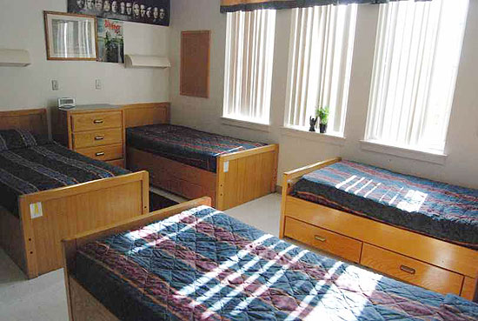
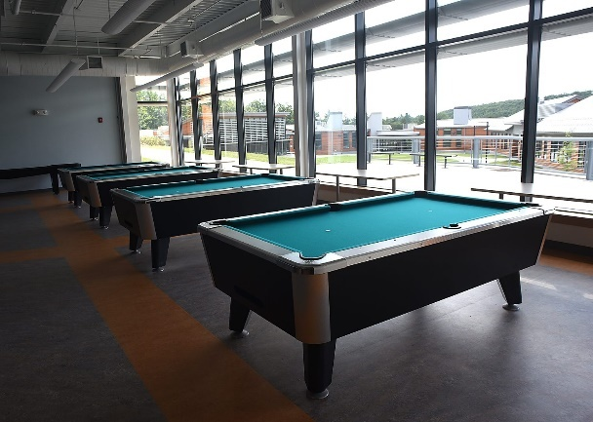
Myra - Center-wide Considerations
Which areas might Myra experience some challenges related to her functional limitations in reading?
All areas of the center
Notes:
Most likely all areas of the center require some type of reading skills.
So let’s drill down and think about the impact the following functional limitations might have in specific areas on center.
Next slide…

Slide 16
Impact of Functional Limitations
Where on center might these specific functional limitations impact Myra and how?
Reading/understanding written instructions or directions?
Interpreting signs, symbols, rules, expectations?
Time factor with activities involving reading?
Memorization of facts and details?
Academics
Career Technical
Residential
Workability
Behavioral Management System
Notes:
(Read the functional limitations on the slide)
Keeping in mind those 4 specific reading limitations, let’s explore the possible impact on activities. tasks, assignments, and expectations in the following areas:
Academics--use the chat box to share your ideas on how the stated functional imitations might impact Academics
Career Technical--Remember, she is interested in Carpentry
Residential--
Workability-
Behavioral Management System--

Slide 17
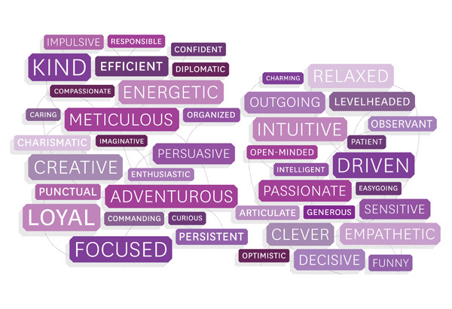
Myra - Leveraging Strengths
How can we build her strength in spoken language into her AP?
How can we utilize her strong social skills?
How might we use color to enhance her learning?
Notes:
Any ideas?
Some of our ideas might not be built directly into the AP, but might be teaching and learning strategies we can use. Myra might even know how to use some of her strengths as compensatory skills/strategies.
Let’s look at a basic Accommodation Plan for Myra, then talk a little more about strategies.

Slide 18
Myra - Developing an Accommodation Plan (AP)
Functional Limitations
Difficulty making sense of written materials
Difficulty copying from the board or other mediums
Difficulty remembering what she has read
Accommodations
Frequently check for understanding; reading pens or other reading software
Provide notes or handouts ahead of time; note-taker; audio file of relevant information
Allow use of graphic organizers; checklists; electronic to do lists or reminder supports
Notes:
So here is a basic AP stating Myra’s functional limitations along with accommodations to address them.
(Can Myra take a picture of the notes on the board or posted with her smart phone?)
I’m sure you can come up with similar and more accommodations that would remove barriers, and give Myra access to her assignments, tasks, and expectations.
Now let’s look at some specific teaching and learning strategies that Myra could possibly adopt as compensatory skills.

Slide 19
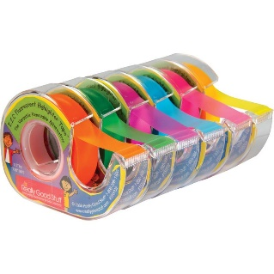
Reading Strategies
Myra
Have her read small sections of content and summarize either orally, into an audiotape recorder, or typing/writing very brief notes
Allow her to take pictures of notes on the board or overhead
Highlight unknown vocabulary words and use reading pen to scan and hear definition as a pre-reading strategy
Use her interest and like of colors to highlight, take notes, etc.
Notes:
She might even keep her own dialectical journal (to tap into her social side)
A dialectical journal is another name for a double-entry journal or a reader-response journal.
A dialectical journal is a journal that records a dialogue, or conversation between the ideas in the text (the words that you are reading) and the ideas of the reader (the person who is doing the reading).
Myra could then share her journal with her instructor to check for understanding and use her verbal strength.

Slide 20
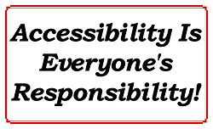
What do you think?
Why would we not want to have Myra rely solely on peer-read or staff-read content support?
Whose job is it to ensure that Myra has access to information throughout the center?
Notes:
(Note: Hold off on clicking the 2nd click until some people respond in the chat box)
We are always striving to build independence. We do not want Myra to become dependent on her teachers or peers to read everything to her. We often see a “learned helplessness” in our students when they come to us having had experiences where good-intending people have actually added to the disability.
We have to strike a balance where we transfer the responsibility of learning to our students.

Slide 21
Case Study # 2
Ben
Notes:
Our 2nd case study is Ben.

Slide 22
Ben - Gathering Information
Background:
Ben was in Special Education since elementary school and an old IEP indicates that he has weaknesses in
vocabulary development
decoding
distractibility
He used a screen reader or aide for most reading assignments.
He gets anxious when he has to complete either complex reading assignments or read out loud.
He wants to take Culinary.
Strengths:
Enjoys cooking and likes watching cooking competition shows
Good at math computation
Good with apps on his smart phone
Notes:
Like Myra, we want to gather all information about Ben’s functional limitations, any prior accommodations and strategies that helped, and his strengths and interests.
(Read the slide)
We can already connect his desire to take Culinary with his strengths.

Slide 23
Impact of Functional Limitations
Where on center might these specific functional limitations impact Ben and how?
Difficulty reading and comprehending written text?
Difficulty with writing assignments?
Difficulty with anxiety and self-control when reading is involved?
Academics
Career Technical
Residential
Workability
Behavioral Management System
Notes:
So we drill down again looking at specific tasks, assignments, skills, expectations that will be required in each area on center, and how Ben’s functional limitations might impact his success in those areas.
Can you think of any specifics in Academics?
Culinary?
Residential?
Workability?
Behavior Management System?

Slide 24
Ben - Leveraging Strengths
How might we build in Ben’s enjoyment for cooking into his accommodations and/or learning strategies?
How might we use Ben’s strong math computation skills to build his reading and writing skills?
How might we build in Ben’s strength with using apps on his smart phone to support his reading functional limitations?
Notes:
Read the slide (answer in chat box)

Slide 25
Ben - Developing an Accommodation Plan (AP)
Functional Limitations
Difficulty reading and comprehending written text
Difficulty with writing assignments
Difficulty with anxiety and self-control when reading is involved
Accommodations
Provide reading pen/reading software; Bookshare; Proctor read TABE; video-taped information
Allow oral responses; provide a scribe; allow the use of dictation software or voice-to-text apps
Provide a quiet space for assignments involving reading (study carrel) allow breaks when anxious; break-down assignments into sections
Notes:
When we build a specific AP for Ben, we want to keep in mind those functional limitations (left hand side).
Remember, the AP is an interactive process that includes the student or applicant, so in this case, the team (including Ben) agreed upon the accommodations on the right.
Are these accommodations locked in stone for the entire time Ben is at JC? (Chat box).
No they are flexible, and reviewed at each scheduled ESP or progress report.

Slide 26
Reading Strategies
Ben
Use Ben’s interest in cooking shows and videotape him performing certain tasks/recipes, etc. so he can use the multi-sensory support to review and critique his work, support memory deficits, etc.
Allow Ben to create his own visually supported recipe guides with step-by-step instructions.
Can complete on paper, using a phone application or use a PowerPoint presentation
Teach how to use metacognitive strategies (e.g., thinking about thinking). For example, model reading a couple of pages of text using the following comprehension monitoring strategies:
Identify where the difficulty occurs ("I don't understand the third paragraph on page 4.”)
Identify what the difficulty is ("I don't get what the author means when she says, 'Arriving in America was a milestone in my grandmother's life.'“)
Restate the difficult sentence or passage in their own words ("Oh, so the author means that coming to America was a very important event in her grandmother's life.“)
www.readingrockets.org
Notes:
Here are some specific teaching and learning strategies that Ben could possibly adopt as compensatory skills.

Slide 27
Center-wide Accommodations (Review)
Assistive Technology
Video-supported Instruction
Videos of specific instructional topics
YouTube or like options
Created on center
Purchased video series, particularly in career technical
Videos of specific tasks being performed in sequence
Notes:
This is a review from Reading 200 where we looked at how to use videos in reading instruction.
How could these accommodations be used throughout the center?
Do any of you have example of using video-supported instruction?

Slide 28
Reading Strategies in Action
Job Corps Centers
Notes:
Let’s see what some of our centers are doing to support Reading difficulties.

Slide 29
Bookshare
Alaska - Creating audio books in CNA, Accounting, and Culinary
Whitney M Young - CNA using audio books
Weber Basin - Trade instructors created audio books to place on disks that can be used on computers
Long Beach - TABE instructors created digitized text support materials.
Notes:
Bookshare is free for JC centers and provides access to digitized audio books for academics, career technical trades, job seeking skills and transition, pleasure reading, periodicals and newspapers.
We are in the process of collecting data on how centers have created partnerships with Bookshare, and what types of resources they are using to serve students with print disabilities.

Slide 30
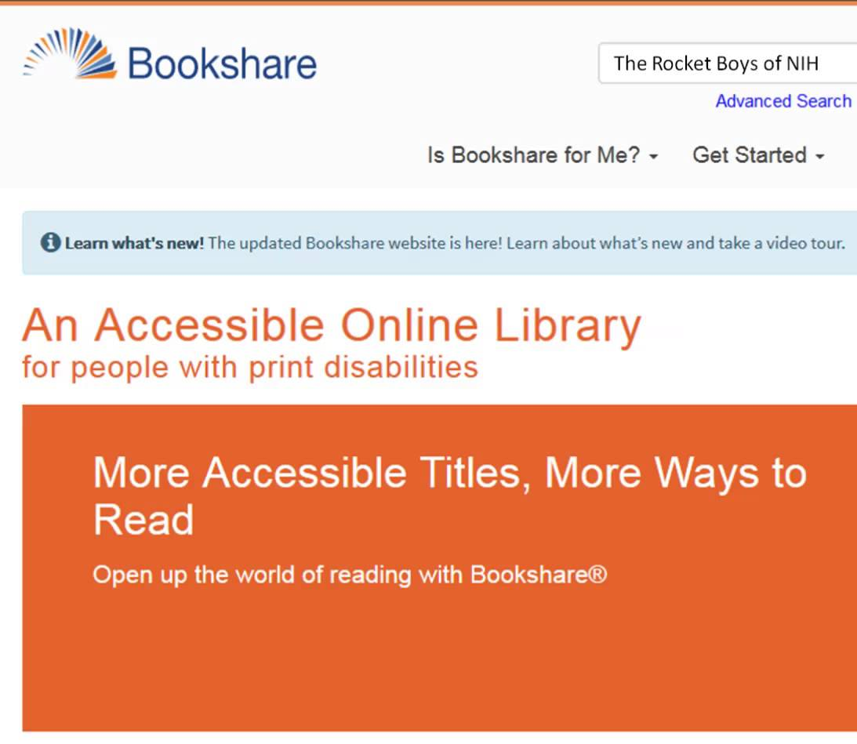
Bookshare
How might we use this free resource to provide center-wide reading support?
What are some benefits of audio books?
Notes:
Can you think of any standardized books or print materials that could be converted to audio books?
What are some benefits of using audio books?

Slide 31
GIST Reading Strategy
A summarizing strategy for any content area
Pinellas JC using this strategy to build comprehension skills
Notes:
We picked up the GIST Reading Strategy during our Reading 100 Webinar. One of our participants from Pinellas JC described how she uses this strategy to build comprehension skills with her students.
If you are interested, you can simply google GIST Reading Strategy, and get a variety of ways to apply this strategy.
This is another example of a compensatory skill or strategy that students can learn to use in all kinds of settings.

Slide 32
Disability-related and Reading Resources
Notes:
Do any of you have similar or even different strategies that can be transferred to our students, so they can use them independently?
Okay, that is our webinar for today. I want to share some Reading Resources with you. Remember that all 4 reading webinar are uploaded to the JC Disabilities website. Feel free to use them with your staff.

Slide 33
Bookshare https://www.bookshare.org/cms
Bookshare offers a free organizational membership to all Job Corps centers and individual memberships for our students
The service provides individuals with print disabilities access to digitized audio books for:
Academics
Career technical trades
Job seeking skills and transition
Pleasure reading
Periodicals and newspapers
Notes:
Bookshare is free for JC centers and provides access to digitized audio books for academics, career technical trades, job seeking skills and transition, pleasure reading, periodicals and newspapers. Contact your RDIC for more information on Bookshare. We also have a webinar available on how to get a bookshare membership. Essentially this is the simplest resource to take advantage of.
Go Read is an accessible e-book reader app that is directly linked to the Bookshare library. It can be used with or without talk back.

Slide 34
Text-to-Speech Tools (TTS) and Other AT
eLearning Industry
http://elearningindustry.com/14-free-text-to-speech-tools-educators-tts-teachers
Understood
https://www.understood.org/en/tools/tech-finder
Job Accommodation Network
Text-to-Speech Tools List (download in file share box)

Slide 35
Job Corps Learning Disabilities Website https://supportservices.jobcorps.gov/disability/Pages/default.aspx
Notes:
The LD website is located within the JC Community website portal and includes detailed information about LDs including reading and writing disabilities, accommodation recommendations, and possible teaching and learner strategies and supports.

Slide 36
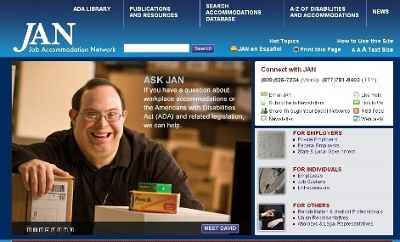
Job Accommodation Network http://askjan.org

Slide 37
Thank you for attending!

