Slide 1
Improving
Employability Outcomes by Enhancing
SELF-REGULATION
for
Students with Disabilities

Slide 2
Define self-regulation and its cognitive, emotional and behavioral components.
Identify 2-3 ways to implement specific strategies for improving students’ self-regulation skills.
Identify 5 essential self-regulation skills and
how they relate to employability.
Identify several accommodations that support self-regulation related functional limitations.
Outline specific strategies for improving students’
self-regulation and employability skills.
List 1-2 assistive technologies that could be used as accommodations to support self-regulation
skill challenges.
OBJECTIVES
2
Notes:
Hello, everyone, and thank you for joining us for this webinar on Improving Employability Outcomes Through Self-Regulation for Students with Disabilities. We have quite a number of learning objectives for you for this webinar, so let’s jump right in.

Slide 3
Understanding
SELF-REGULATION
3
Notes:
Let’s start by setting a good foundation – understanding just exactly what self-regulation is.

Slide 4
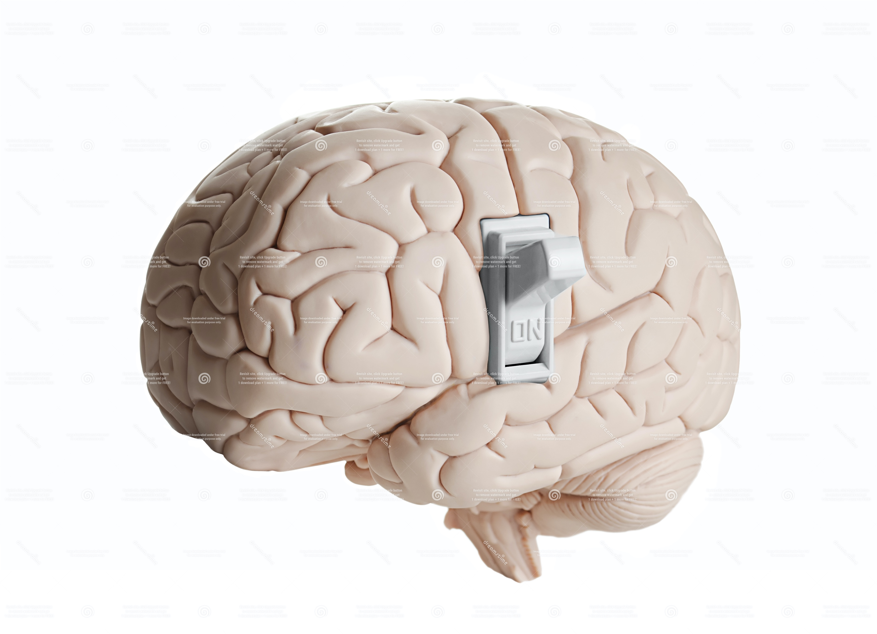
What is SELF-Regulation?
Type answer in chat box.
The ability to
control impulses
in favor of
longer-term goals
Notes:
What is self-regulation? Please type your answer in the chat box.
Self-regulation refers to a very broad set of skills that enable people to consciously and intentionally control thoughts, emotions, and behavior in order to attain a goal. But a very simple definition that captures perhaps the most fundamental skill underlying most self-regulatory capacities is the ability to control impulses in favor of longer-term goals. I want to emphasize that self-regulation is about attaining goals – any kind of goal -- by controlling one’s thoughts, feelings, and behaviors in the here and now. For our students, attaining and maintaining employment are the longer-term goals. The training provided at Job Corps is designed to equip them not just with specific job-related skills but with the broader set of skills needed to be successful in the workplace. This broader set of employability skills includes self-regulation.

Slide 5
3 Domains of Self-Regulation
Thoughts
Feelings
Behaviors
Notes:
Self-regulatory skills can be divided into 3 domains – cognitive skills (related to managing our thoughts), emotional skills (related to managing our feelings) and and behavioral skills (related to managing our actions). In real life, it’s actually not this simple as there is a lot of overlap and interaction between these 3 domains. In fact, the escalator provides a good illustration of how a series of skills are linked in the pursuit of a goal. Both models provide a useful way to think about self-regulation and dysregulation.
Self-regulatory skills are involved in setting, pursuing, and achieving goals of all kinds – and this includes obtaining and maintaining employment. We have probably all talked to students who tell us that they had a job but got fired due to interpersonal conflict with a coworker or with their boss, or because they showed up late too many times, or failed to call in when they couldn’t make it to work. In many cases, these behaviors be linked back to thoughts, feelings, or other behaviors that interrupted or interfered with progress towards the employment-related goal.
It is important to know that environmental factors, particularly early childhood trauma (things like neglect, witnessing domestic or community violence, having a parent with a mental health or substance use problem) can hinder the development and use of self-regulation skills. Our students frequently do not come from backgrounds where:
structure and routines were emphasized
where conflict resolution skills were taught or
where calendars and checklists were used for manage time and measure progress toward a goal.
The good news is that self-regulatory skills can be taught and improved using specific interventions and strategies, which you will hear more about later. Because self-regulation skills continue to develop and mature well into adulthood, adolescence and young adulthood represent a prime time to implement interventions to strengthen these critical skills.

Slide 6
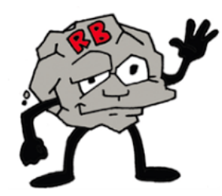
Cognitive Skills
Difficulties with Cognitive Flexibility
Handling transitions, shifting from one mindset or task to another
Handling unpredictability, ambiguity, uncertainty, novelty
Shifting from original idea, plan, or solution
Considering a range of solutions to a problem
Seeing the “grays”/concrete, literal, black-and-white thinking
Inflexible, inaccurate biases or interpretations (“I always get blamed for everything!” “That’s not fair!”)
ROCK BRAIN
The Zones of Regulation:
A Concept to Foster Self-Regulation and Emotional Control
http://www.zonesofregulation.com/index.html
Notes:
There are a number of different cognitive skills related to self-regulation. The one I want to focus on is cognitive flexibility and how difficulties in this area affect self-regulation. In a program for teaching self-regulation called the Zones of Regulation, there is a concept called “rock brain” and here are some examples. Difficulties with:
Handling transitions, shifting from one mindset or task to another
Handling unpredictability, ambiguity, uncertainty, novelty
Shifting from original idea, plan, or solution
Considering a range of solutions to a problem
Seeing the “grays”/concrete, literal, black-and-white thinking
Inflexible, inaccurate biases or interpretations (“I always get blamed for everything!” “That’s not fair!”)
You may be able to think of a student or two who has difficulties with cognitive flexibility. But it is also important to know that all of us can develop “rock brain” when under conditions of high stress or emotional arousal. So a student can be fine one day, then when presented with what he considers an overwhelming task, sudden becomes rigid and stuck in a particular way of thinking.

Slide 7
Emotional Skills
Difficulties with Emotion Regulation
Difficulty tolerating distress or frustration so that one can continue to think rationally
Sudden shifts in mood, especially irritability that results in reactive aggression and outbursts
Chronic irritability and/or anxiety that lowers the capacity for problem-solving or heighten frustration
Difficulty with calming oneself down in the moment (self-soothing)
Difficulty empathizing with others, appreciating another person’s perspective or point of view
www.psychologytools.com/resource/motivational-systems-emotional-regulation-systems/
Notes:
Emotional regulation involves a complex set of skills and systems in the brain. Emotional dysregulation can be a consequence of childhood trauma, and it tends to cause the most difficulties for students and disruptions in the class and the dorms. This is also area of difficulty that is least likely to be recognized as a skill deficit in need of instruction and remediation.
The most common manifestation of difficulties with emotion regulation is an inability to tolerate distress or frustration, which in turn impairs the ability to problem-solve and think rationally in a situation. This “poor frustration tolerance,” as it is sometimes called, can cause a student to shut-down and stop participating or cause a sudden angry or sad outburst that seems disproportionate to the problem.
Other difficulties related to emotional self-regulation skills are sudden shifts in mood, especially irritability. But I’m sure you have also known students who seem to be chronically irritability or anxious.
Most students with emotion regulation have a hard time calming themselves down – in the diagram we would see this as the threat system being in overdrive in the presence of an underdeveloped soothing system.
Finally, and often unrelated to other difficulties on this slide, is a social skill deficit that manifests as difficulty empathizing with others or apprearing another person’s perspective or point of view.

Slide 8
Behavioral Skills
Difficulties with:
Seeking attention in appropriate ways
Considering the likely outcome or consequences of actions (impulsive)
Expressing concerns or needs in words
Persisting on challenging or tedious tasks
Maintaining or shifting focus
Managing time
Appreciating effect of behavior on others
Attending to social cues, starting conversations, entering groups (social skills)
Notes:
The third domain of emotional regulation has to do with behavioral skills. Again, this is a very broad area and I’ve listed some of the most common difficulties:
Seeking attention in appropriate ways
Considering the likely outcome or consequences of actions (impulsive)
Expressing concerns or needs in words
Persisting on challenging or tedious tasks
Maintaining or shifting focus
Managing time
Appreciating effect of behavior on others
Attending to social cues, starting conversations, entering groups (social skills)

Slide 9
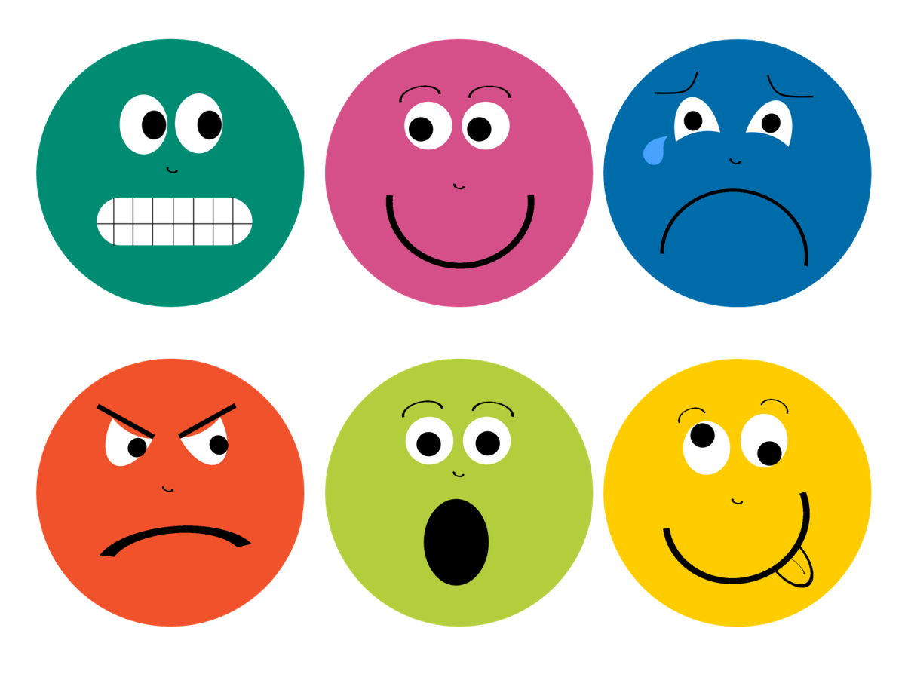
Self-Regulation
VIGNETTES
9
Notes:
Now let’s take a look at two student vignettes and see if we can identify the self-regulation difficulties.

Slide 10
DYLAN
Dylan’s trade instructor reports that he does well on individual tasks.
This morning Dylan was working on a group project. Suddenly, he jumped up out of his chair and shouted, “Nobody ever listens to my ideas. You think you’re the boss of everybody. It’s not fair!” before storming out of the room.
Which self-regulation skill deficits may have contributed to Dylan’s outburst?
Type your answer in the chat box.
10
Notes:
Dylan is a bit of loner. Whenever you see Dylan after the training day, he is always wearing earbuds. He has few friends. His trade instructor reports that he does well on individual tasks.
This morning, Dylan was working on a group project. Suddenly, he jumped up out of his chair and shouted, “Nobody ever listens to my ideas. You think you’re the boss of everybody. It’s not fair!” before storming out of the room.
Please type in the chat box: What self-regulation skills may have caused Dylan to have such an angry, emotional outburst?
Perspective-taking
Black and white thinking
Low frustration tolerance
Social skills

Slide 11
DESTINY
Destiny’s instructors report that she often needs reminders and encouragement to stay on task.
Tonight, the detail rotation in the dorm did not get updated because an RA called in sick. Destiny can be heard from another hall shouting and sobbing, “I’ve been mopping the bathrooms and halls every day this week! I’m sick of this [bleep]!”
Which self-regulation skill deficits may have contributed to Destiny’s outburst?
Type your answer in the chat box.
11
Notes:
Destiny likes to wear the latest fashions and is well-liked by most of her peers. Her instructors report that she often needs reminders and encouragement to stay on task.
Tonight, the detail rotation in the dorm did not get updated because an RA called in sick. Destiny can be heard from another hall shouting, “I’ve been mopping the bathrooms and halls every day this week! I‘m sick of this [bleep]!
Please type in the chat box: What self-regulation skills may have caused Destiny to have such an angry, emotional outburst?
Cognitive inflexibility
Low frustration tolerance
I want to point out that in both of these vignettes, the student felt unvalued or undervalued. This is something that we often see and can set a student up so that any perceived slight or injury (someone not using their idea, being stuck with the same detail) makes them even more vulnerable to becoming dysregulated.

Slide 12
Self-Regulation
GOAL ATTAINMENT
and EMPLOYABILITY
12
Notes:
Now let’s talk about how self-regulation skills relate specifically to goal attainment and employability.

Slide 13
Self-Regulation and Employability
Top 5 Skills:
Knowing when to start (initiation) and when to stop (inhibition)
Ability to delay gratification
Ability to persist even when things get difficult
Ability to tolerate ambiguity and uncertainty (prevent intolerable anxiety)
Ability to understand/identify one’s own emotions and to self-soothe
13
Notes:
These are the top 5 skills that can make a significant contribution to how well trainees do in employment settings.
Getting started and knowing when to stop
Delaying gratification involves s having the deep understanding that what you are doing day-to-day will not have immediate rewards, that the rewards could be months or even years down the road.
Persisting in the face of the difficulty is very difficult for most of us. It is particularly for young people with learning disabilities and other disabilities, who may have developed a condition called “learned helplessness” – when no matter how hard or how many times they try, they are met with failure rather than success. I love the acronym for FAIL that you see here – first attempt in learning. Assuring students that failure, even repeated failure, is part of the learning process is important for these students.
Ability to tolerate ambiguity and, uncertainty. ’We are all experiencing challenges in this area as the result of the pandemic. Almost all of us perform better when there are clear expectations; however, there are some students for whom ambiguity and uncertainty result in intolerable anxiety that impairs their ability to function
Ability to understand and identify one’s own emotion and to self-soothe. This may be one the most important skills. We will all encounter difficult situations at work that arouse emotions. Being able to keep those emotions in check is a requirement for workplace success. Fortunately, this is a skill that can taught and improved.

Slide 14
Self-Regulation and Employability
The OTHER Top 5 Skills:
Flexible problem-solving skills
Ability to engage in problem-solving rather than stonewalling, avoiding, or running away
Ability to ask for and accept help, when needed
Ability to benefit from constructive criticism
Ability to understand and identify others’ emotions and take another person’s perspective
14
Notes:
Other skills that are critical to improving employability are:
Flexible problem-solving skills (that’s pretty self-explanatory)
The ability during conflict to engage in problem-solving rather than stonewalling, avoiding or running away. Th3e reason that students shut-down or walk out of the room is because the conflict is causing them to feel emotionally overwhelmed (intolerable anxiety, anger, frustration, sadness). They only way they know to manage the feelings is to escape the situation.
Th3e ability to ask for and accept help, when needed. This can be difficult for many people because asking for help means that you make yourself vulnerable – vulnerable to rejection, hurt, criticism, shame. Some people would rather suffer in silence and even fail – rather than ask for help.
Ability to benefit from constructive criticism. For some students, all criticism is negative, is an assault on who they are. Providing feedback that focuses on behavior or performance rather than the person can sometimes help when students are emotionally fragile.
The ability to understand and identify others’ emotions and take another person’s perspective. This is a more difficult skill to teach and remediate, but it can be done. This could have contribute to Dylan’s difficulties working with a group of other students.

Slide 15
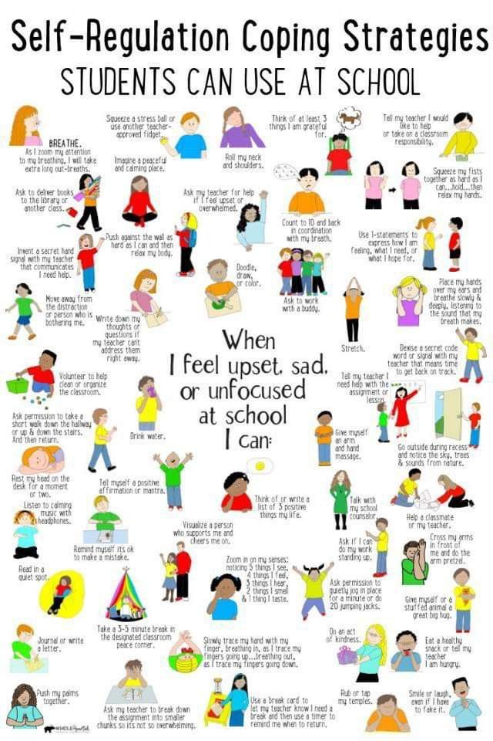
Interventions
INDIVIDUAL, GROUP AND CENTER-WIDE IDEAS THAT SUPPORT TRAINEE (AND STAFF) SELF-REGULATION
15
Notes:
Now I am pleased to turn the presentation over to my highly esteemed colleague, Dr. Janet Negley, a psychologist who has been the CMHC at the San Jose JCC for more than 20 years. She has a wealth of information and strategies to share about how to help our students with self-regulation difficulties.

Slide 16
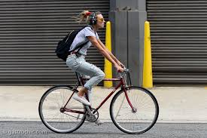
Assumptions that we all know…
Self-regulation problems come in all shapes and sizes and every imaginable expression.
We can also see that some of our trainees have more challenges with how they think about things and others are challenged by strong and difficult to manage emotions; others have histories of trauma; some have brain differences that challenge their reactions to the environment
To complicate the picture, some people become outwardly more angry or disruptive as they grow and heal, so behavior isn’t always an indicator of lack of progress.
None of us got on a bike for the first time and drove straight; we weaved. So will our young people when they try out new forms of expressing themselves.
16
Notes:
Janet: The skill deficits that Dr. Warner outlined are cross-diagnostic and look different in each person. Stress is also uniquely shown, some trainees internalize (have a low mood, withdraw and isolate) others, externalize (are loud, explosive, demanding, emotional); and these challenging behaviors or states of mind might be driven by thoughts about themselves or the world or by untethered and little understood emotions that erupt with little warning; they come from trauma, brain differences or community mores. Developmentally, some of our young people become more angry and internally riled up during their healing process as stuffed feelings are allowed to come out, so….we need to start with assessment: what is going on with this trainee at this point in time; is it a one off day or a pattern of response

Slide 17
Assessment (but assessment or triage starts the ball rolling…)
Assessing for skill deficits, assessing for mood problems, assessing for lack of motivation, assessing for limited self-visions or lifestyle pulls in unhelpful directions
17
Notes:
Janet: four areas of functioning; 1. skill deficits listed on Dr. Warner’s slides; 2. mood issues; 3. motivational problems; 4. limiting self-narratives, stories one carries about themselves that are negative and problem filled

Slide 18
Assessment of Problem Skill Areas
Good method for assessing behaviors.
The ALSUP (Assessment of Lagging Skills and Unsolved Problems) found at www.livesinthebalance.org, originated by Dr. Greene, who has developed a way to intervene with troubled youth that do not respond to the usual limits and consequences.
This method, the Collaborative and Proactive Solutions method, helps look at problems rather than diagnoses.
Key ideas of Dr. Greene:
Kids do well when they can.
Your explanation guides your intervention.
Many problems occur when the demands of the environment exceed the young person’s capacity to respond in an adaptive way.
Good interventions require that we creatively respond to the hand we’ve been dealt; i.e., match response to kid in front of you.
18
Notes:
Janet: When looking at skill deficits, this is a model that works well. Basic ideas from Dr. Greene, most kids prefer to do well even if it doesn’t look like that in the moment. Why is that simple idea important: because how we think about young people impacts how we will intervene when there are concerns. Problems happen when the demands exceed the trainees’ capacity to respond in an adaptive (mature, reasoned, reasonable, self-directed way). The assessment of lacking skills is a terrific listing of issues/problems/deficit skills areas to help us focus on what skill deficit might be at play when behavior is disruptive.

Slide 19
Dysregulation Skill Deficits: Inflexibility
Where does inflexibility come from?
Asperger’s and Autism; temperamental traits; language processing difficulties; mood issues; ADHD
Individual interventions:
Think antecedents, not consequences; titrate demands to reduce stress; predetermine safe spaces and people; teach awareness of emotional arousal (increase emotion word vocab); create social opportunities for peer connections; teach mindfulness for reducing resting levels of stress and how to bring breathing under control
19
Notes:
Janet –
Here’s one example of a skill deficit we might see with dysregulation: Inflexibility.
Let’s use this one skill to see that the deficit is associated with numerous diagnoses and situations. This is a skill that is best treated by looking at antecedents, what is happening right before we notice the inflexibility in a trainee; not focusing on consequences only, our go to model of how to intervene with disruptive behavior; set up environment where trainee can gain some success; teach signals that trainee can tell that they are emotionally upset before the meltdown; find ways to increase socializing in non-threatening ways (mentors, groups, one on one coaching/counseling, soft introductions to activities on center, ambassador programs).

Slide 20
Assessment of Emotional States:
Over Arousal or Emotions that Seem Out of Control
How often and in what form does the student feel/express/experience emotional dysregulation?
Occasionally or often?
Only when they are overwhelmed?
Mostly when there has been an interpersonal disappointment or is it after school failure?
Diagnostically, where do you situate their behavior? In….
Depression?
ADHD?
Lack of motivation?
Trauma affects?
Histories of abuse/neglect?
Exposure to violence?
Losses?
20
Notes:
Janet:
Assessment of Emotional States: when the problems seem to be over arousal; emotions that seem to us out of control
In addition to looking at skill deficits, we might notice that the dysregulation seems to be mostly in the emotional realm. Here’s some questions to ask? the methods of intervention may be similar regardless of etiology, but if medication seems indicated, it is important to separate out whether outbursts are from low mood which may be episodic or life long ways of functioning, maybe a brain difference

Slide 21
Depression and Down Moods: basic data and intervening
Depression is sometimes a contributor to dysregulation but research data shows us that an irritable mood is rarely the only sign of depression in young people (5.7%) but a low mood with irritability is associated with much higher rates of disruptive behavior, especially with girls.
Depressed boys are significantly more likely to present with irritability than depressed girls. In adults, 30% of depressed individuals also show significant irritability.
Use any assessment you prefer; we use the BDI (Beck Depression Inventory)
80% of our depressed trainees show relief without pharmacology after six weeks of counseling, using deep listening, behavioral activation and social engagement (refer to group, connect with a staff mentor, increase dorm counselor contact)
Teach sleep hygiene and if necessary, get cooperation from dorm staff for CBT-I
We have very little success with mood charts unless done in session; about five trainees out of 100 seen in our clinic the last year
Pharmacology, if short term counseling doesn’t work or if trainee has long term positive response to known medications.
21
Notes:
J Am Acad Child Adolesc Psychiatry. 2013 Aug; 52(8): 831–840.
On clinical case review; out of 100 trainees seen in our clinic in one year, depression is the most common diagnosis.
Most trainees can improve sleep with simple sleep hygiene methods; some need permission to unpair their bed with other than sleep activities; use chair outside room; use positional changes to associate sleep with posture (ie., don’t lay down and turn to side until going to sleep)

Slide 22
Lack of Motivation
“Lack of motivation” goes hand in hand with the behavioral, cognitive and emotional aspects of self-regulation problems.
This is put into quotes because most lack of motivation or “laziness” stems from a low mood, inability to envision a better future, strained executive functioning or bad habits allowed by an unsupportive home environment.
22
Notes:
Janet

Slide 23
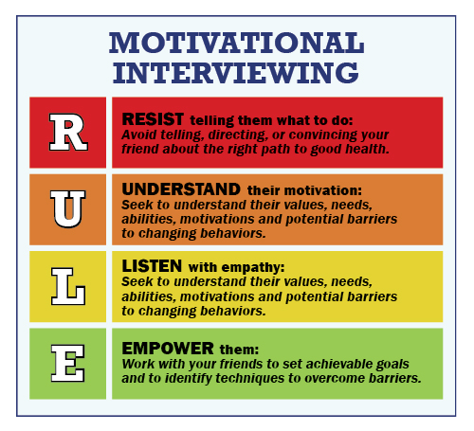
Lack of Motivation
Drawing from the motivational interviewing literature,
Change is hard.
Young people 16 to 24 like to be in control of their own choices.
If information was enough to get young people to change, our jobs would be over after CPP.
The trick is to get the young person to come up with their own ideas of when and how to change.
23
Notes:
Janet: most people have mixed feelings about changing a behavior or life style area: at JC, I describe this as having one foot in the door and one foot out: we have young people who have chosen to come to better themselves but haven’t left the old ideas, values and behaviors behind

Slide 24
In the moment methods: dealing with emotional dysregulation
Grounding/Distraction Techniques
Basics of de-escalation (see training PPT)
Naming the objects in the room, naming the colors that the student sees
Find 5 things you see, 4 things you hear, 3 things you feel, 2 things you smell, 1 thing you taste
Cute link from YouTube for training: https://www.youtube.com/watch?v=5LCP5wUl-0c
Thirty techniques to distract from distressing thoughts:
https://www.healthline.com/health/grounding-techniques
Teach staff basics of de-escalation
(PowerPoint in resources)
24
Notes:
Janet - We need to intervene in helping our trainees who show regulation problems in the here and now and as well as in longer term ways that will teach new skills, bring awareness to their triggers, help them reason out their inner emotional states, but if we don’t effectively intervene when there’s a major incident or behavior, we won’t have the chance to work in a longer term way.

Slide 25
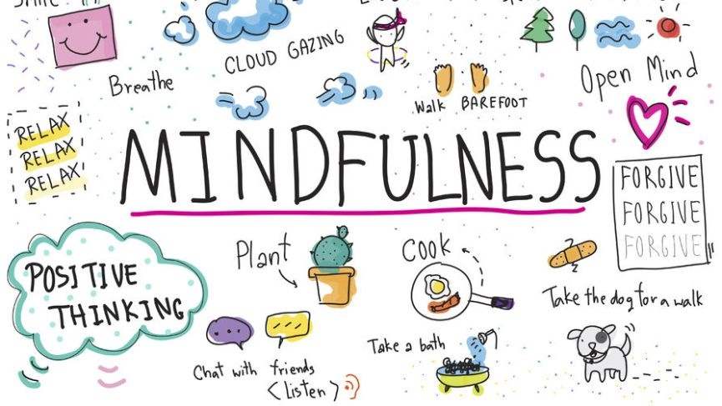
JUST Mindfulness
Research that supports mindfulness as a strategy for self-regulation as both an “in the moment” strategy and a down-regulation method for long term change:
Mindfulness helps a person become more aware of their feelings (not having less emotions) and this in turn, improves executive functioning and impulse control¹.
Participants in the Breathe program for adolescents showed significant statistical gains in emotion regulation skills including emotional awareness, access to regulation strategies, and emotional clarity. Mindfulness helps symptoms of ADHD².
[Hong Kong J Occup Ther. 2017 Dec; 30(1): 33–41]
¹http://cdp.sagepub.com/content/22/6/449
²https://www.tandfonline.com/doi/abs/10.1080/15427609.2013.818488
25
Notes:
Janet –Some context for those who aren’t sure mindfulness can work: what determines effectiveness; “it doesn’t feel like it works until you notice it just worked”

Slide 26
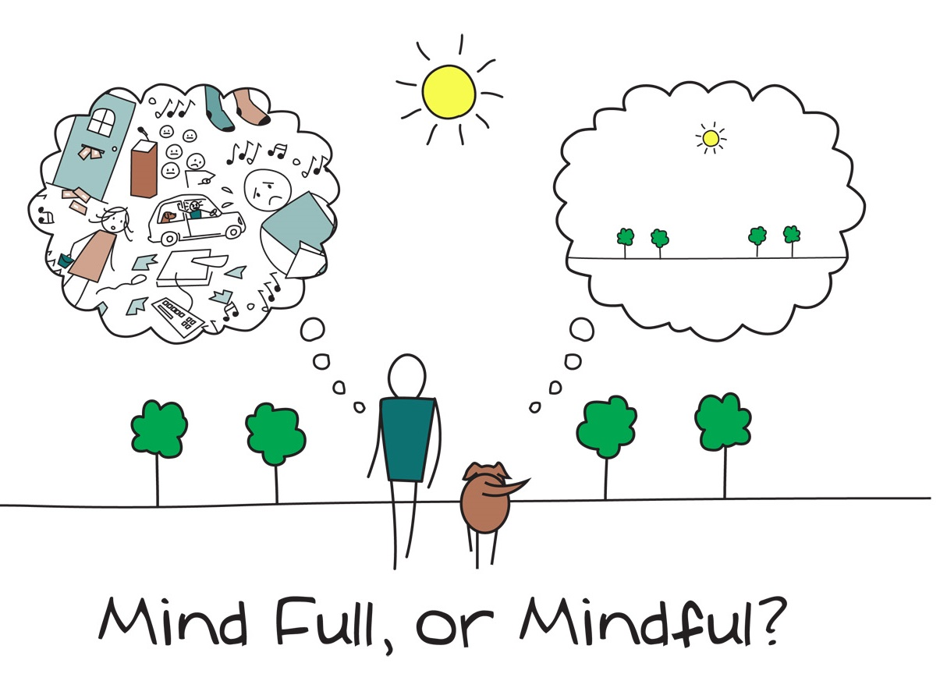
JUST Mindfulness
Mindfulness can be taught in classes, by CPP teachers, individually by counselors, in groups.
Forms of mindfulness:
Awareness of body exercises
Progressive Muscle Relaxation (can’t get the students to do this in groups)
Mindful eating/Mindful walking/Finding body safe spots
Awareness of breath scripts
Awareness of thoughts scripts
Awareness of perceptions in the here and now
To find the related RESOURCES,
please visit the Job Corps Disability website.
Self-Regulation Resources
26
Notes:
Janet -Four forms of mindfulness listed here; see Resources section to find a document with 20 mindfulness exercises appropriate for our JC population
RESOURCES PROVIDED (see two documents, flyer and 20 mindfulness exercises)
Mindfulness with skills=DBT: In the 80’s, developed by Marsha Linehan, good research basis, now has wider applications, many appropriate to our population; very skill based when conversation isn’t enough; has both top down and bottom up strategies, engaging the intellect and cognitive approaches as well as top up, emotionally based experiences; see manual referenced for skills, training is easily accessible

Slide 27
Narrative Approaches
Listen for the main narratives of the trainee’s life: Is it filled with negative descriptions of self or problems?
Ask them to describe their life story, individually or in group, in lyrics or art.
Acknowledge that story and after giving attention to the challenges of that story and finding out all the ways they have been hurt by, put down by, pushed aside by that narrative, find small ways in which an alternative narrative was also present in their history:
Did anyone ever take care of you? Did you have a proud moment where you stood up for friend or sibling? Did your family come together sometimes? When have you been able to cope? Etc.
Find out more about that alternative narrative: Elevate their agency in making the more positive view happen even if they just responded to chance.
Ask who would have known back then that you would be the one to sign up for Job Corps and make a go of it?
What did they see in you?
How can that trait/desire/personality/skill help you now to aim towards your preferred direction?
27
Notes:
Janet:
When the stories about oneself are narrow and limiting: narrative approaches
All students come to us with histories, some of trauma and neglect and abuse, some with self perceptions of chronic failure, some feeling alone and unloved in the world. We carry these stories around in our heads, and then the stories determine what we notice about the world or ourselves; our stories become self-limiting. So, if you failed out of HS, you might give importance to passing CPP; we got in a fight in every school we attended, we aren’t going to make a big deal out of getting through two months with no fights. We have never felt comfortable around other peers, we always say the wrong thing, we might not realize that there are two people in our CPP class that smile at us. So…

Slide 28
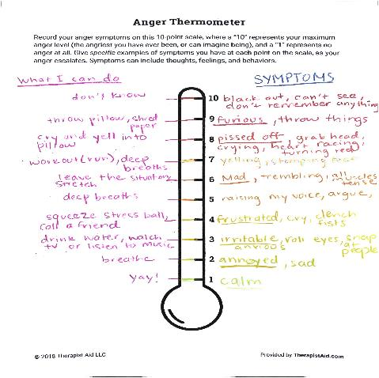
Our Favorite Anger Management Tool
The Anger Thermometer (finding one’s own anger profile):
Start with brainstorming every feeling word the trainees can think of; then, circle each emotion that has to do with anger
Fill out one’s own anger thermometer using their own level lines and words
Ask each person:
Where they sit most of the time
How fast they go up and down the thermometer
What makes them move from lower to higher
What they can do at every line of the graph
28
Notes:
Janet - Template in appendices; every AM protocol includes similar strategies: awareness of body cues, thoughts that lead to increase in emotional reactivity, learning triggers, increasing
Ability to communicate/express oneself without aggression; this is our favorite and most effective tool that helps our trainees develop their own anger profile

Slide 29
Chill and Chat
A group for students who show significant social anxiety, who are on the Spectrum or who seem to have difficulty making any friends.
On-going, slow moving, low demands for social interaction until the group naturally evolves.
Start and end every group with a check in which can be non-conversational.
Add a five minute mindfulness activity/exercise to every group.
Bring a plan for each group, be willing to abandon it if a good conversation gets going.
Use process comments lightly.
As a group member rises to take leadership, allow them to encourage the other group members.
Through a slow process, group members calm down in the presence of others, gradually learn to trust their peers, practice conversation skills in a non-demanding setting and make true friends.
29
Notes:
Janet - One of our best practices: a group for the socially shy, anxious, on the spectrum trainees. The basics: six to seven trainees, long term. Why does it work? Carefully selected group members, Gives a space to connect in non-confrontational, non hip ways, gives students a space to talk about concerns without pressure and with others who likely have same concerns, gives students who have language processing delays a slower paced conversational situation; “I never knew I could have friends” “I was too nervous to be in HS to GSA president after a year”; from lying on the floor moaning, “I just want to kill myself” to supporting friends in the dorm (and still being difficult)

Slide 30
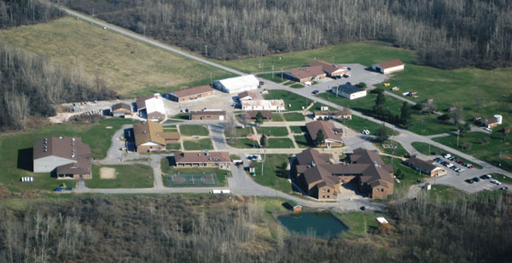
Center-wide Initiatives
Training staff on de-escalation techniques (including grounding, communication basics)
Training staff on Emotional Validation
Center-wide outreach for APPS: Put the apps on all of our phones and help the students to do so right at the point of contact, i.e., tabling.
Changing the campus culture to “accountability with respectful exchanges”:
Start at the top
Get HR buy in to increase all staff training
Target training to hot ticket items:
De-escalation
Emotional Validation
Ask department heads to find ways for departments to work together on projects
30
Notes:
Janet:: we do all staff training four times a year on every possible topic but these are the two that have had the largest impact on staff understanding and skills; pnnts in resources:
De-escalation techniques: so many disruptions come when staff up the ante with a trainee who is barely holding it together; Emotional validation is the practice of reflecting back the hardness of the experience the person is going through without judgment or agreement: we have staff practice validating each other pretending their partners are showing road rage: how to not agree but reflect the emotional experience of the other person.

Slide 31
Where to Start
“Human” Resources
31
Notes:
Janet: this is an incredibly demanding job with not enough time and something that pops up not on your schedule on most days…..

Slide 32
You can’t do this job alone: You need help.
Uploading effort to get help will greatly improve your time management later:
Interns
Cross training with dorm counselors
Mentorship program with selected staff
Outside providers
Peer advocates
Using student government
Finding non-MH professional co-leaders of groups
Resources for nurses to hand out
Pick one small project at a time and add one every quarter.
32
Notes:
We are very well resourced at our center: six interns who see ten trainees a week; six ongoing groups, much staff training. But, you can use what you have to implement the programs you find most useful for your center.

Slide 33
Accommodating Students
WITH SELF-REGULATION DIFFICULTIES
33

Slide 34
Center-wide Accommodation Consideration
Cluster into small non-demanding groups
Convene a Reasonable Accommodation Meeting (RAC) (e.g., residential, academic, career technical, etc.) and discuss accommodations.
5 minute break
pre-warnings of changes
seating choices in class and any dorm meetings
shorten assignments into chunks to deal with frustration
34
Notes:
Diane: When we are looking at supporting Functional Limitations, remember that consideration might need to be given to other areas (WHEN ON CENTER) such as recreation, the cafeteria, social activities or formal assemblies, etc. AND in a Distance Learning Model, consideration might be given to assignments, activities, programs—anything related to access.
Are the accommodations on the student’s plan enabling them to have equitable access to the program AND to the extent possible and practical, are they assisting the individual in becoming as independent as possible and building their employability skills?
Remind that there is a list of students with APs that is distributed at least bi-weekly; however, it may be necessary at times to convene a RAC and ensure that everyone is aware of the accommodations agreed upon for a student who has self-regulation challenges.

Slide 35
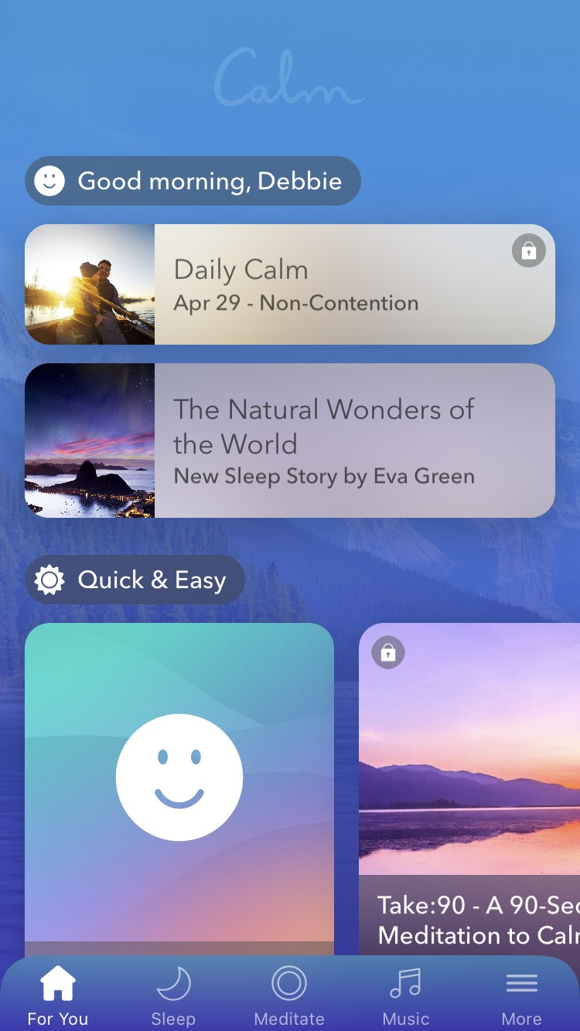
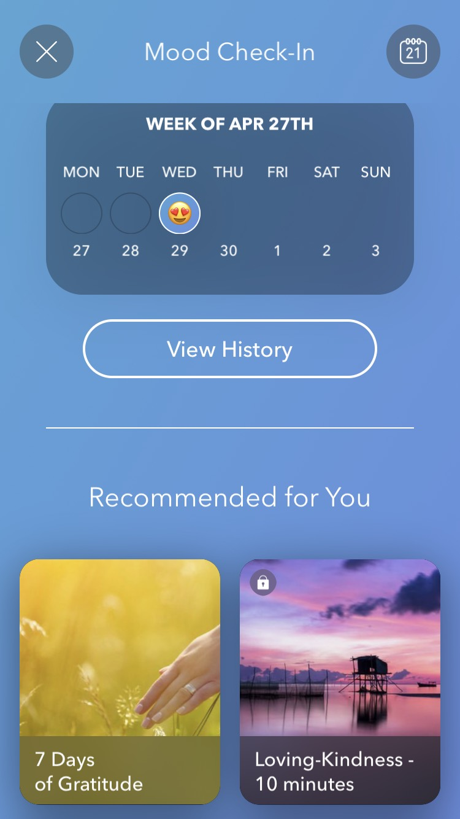
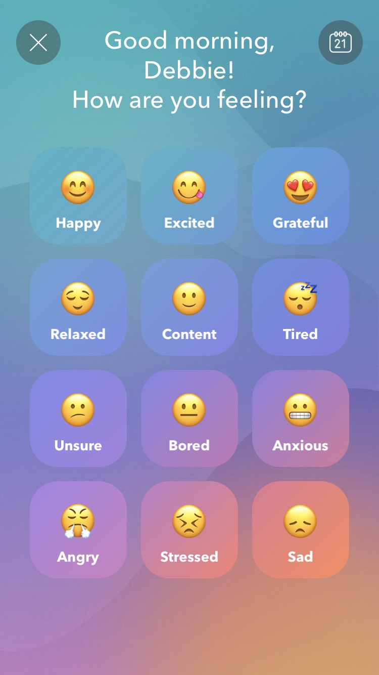
Assistive Technology “Calm”
35
Notes:
Although this is not a “free” app, there are MANY features that are free to use! Calm starts your day off with recommended meditations, offers serene pictures and sounds, checks in your mood and offers suggested content to listen to based upon your mood.

Slide 36
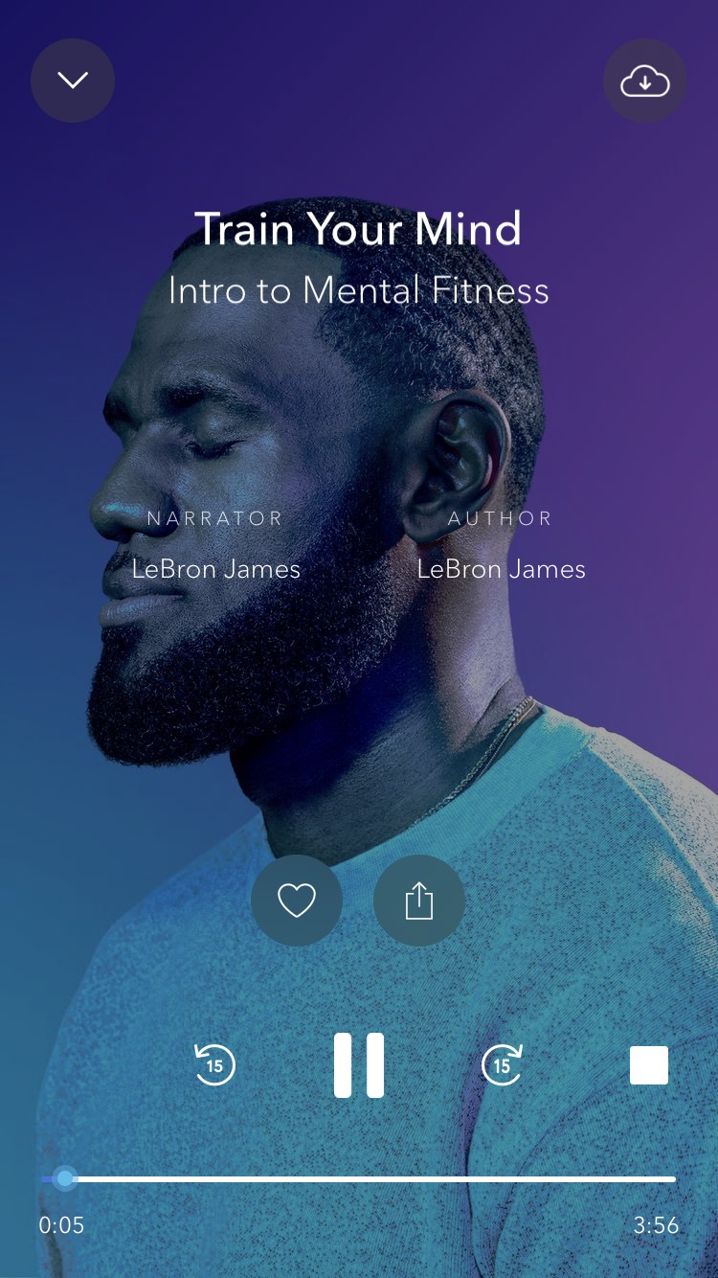
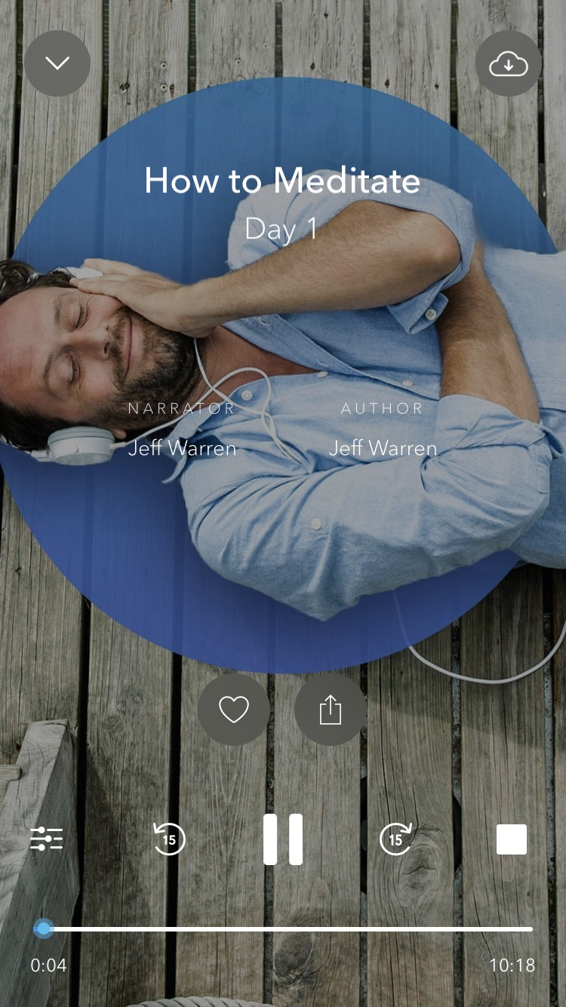
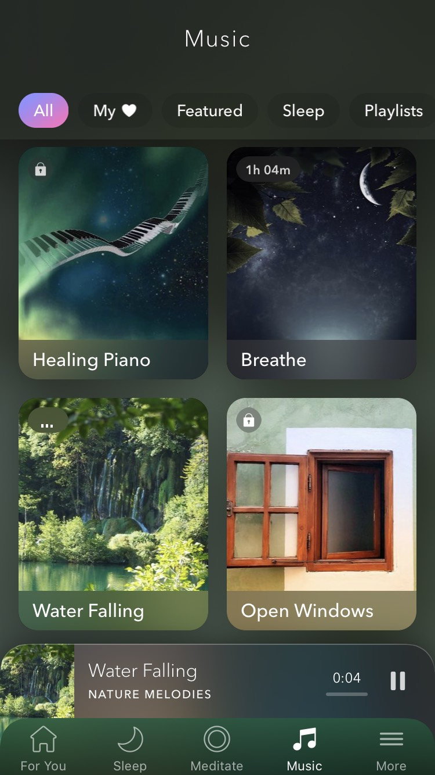
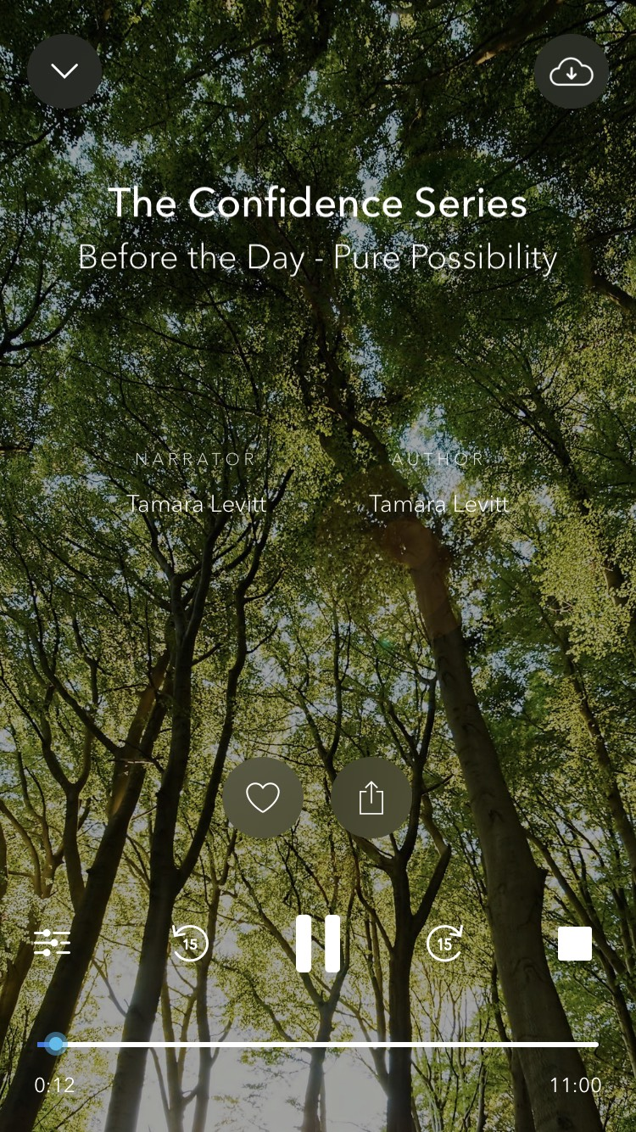
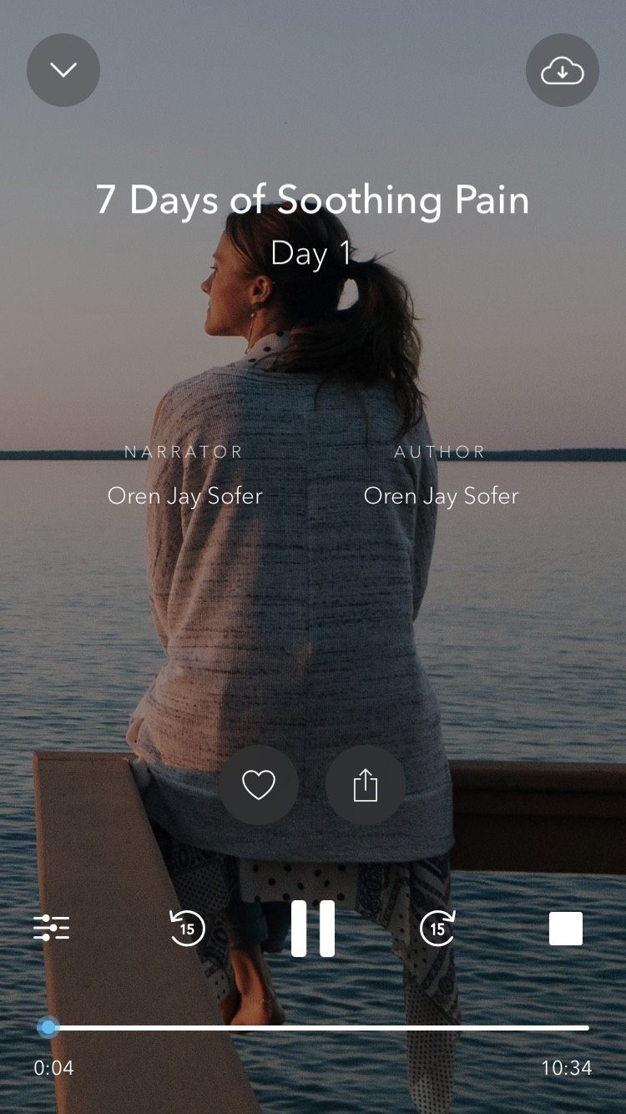
CALM “APP” (cont.)
Train Your Mind
How to Meditate
Music
Blue Gold
The Confidence Series
7 Days of Soothing Pain
…and more
36
Notes:
Calm continued: Learn how to meditate, listen to soothing sounds or music at night, train your mind! Calm offers many options for use with students who have self-regulation challenges.

Slide 37
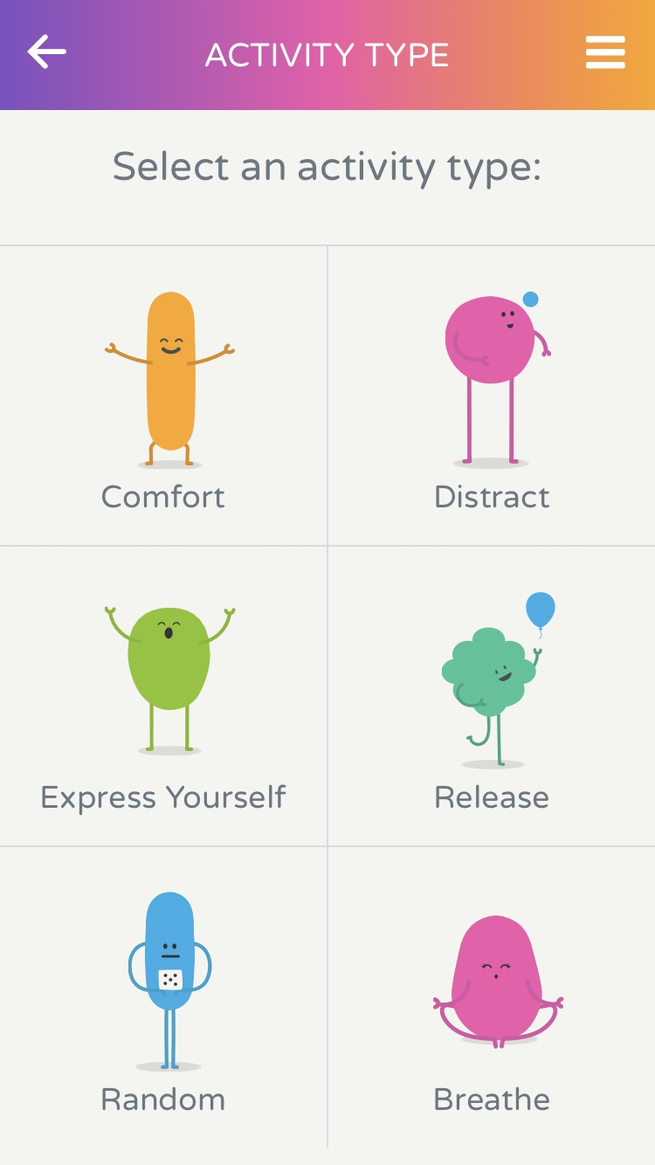
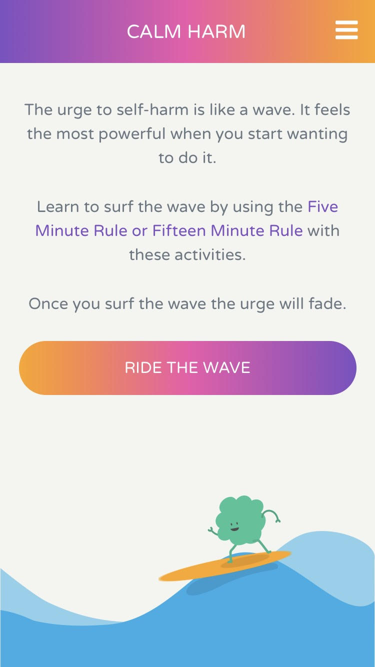
Assistive Technology “Calm Harm”
The urge to self-harm is like a wave.
It feels the most powerful when you start wanting to do it.
Learn to ride the wave with the free Calm Harm app using these activities:
Comfort, Distract, Express Yourself, Release, Random and Breathe.
When you ride the wave, the urge to self-harm will fade.
Calm Harm is an award-winning app developed for teenage mental health by Dr Nihara Krause, Consultant Clinical Psychologist, using the basic principles of an evidence-based therapy called Dialectical Behavioral Therapy (DBT).
https://calmharm.co.uk/#row1
37

Slide 38
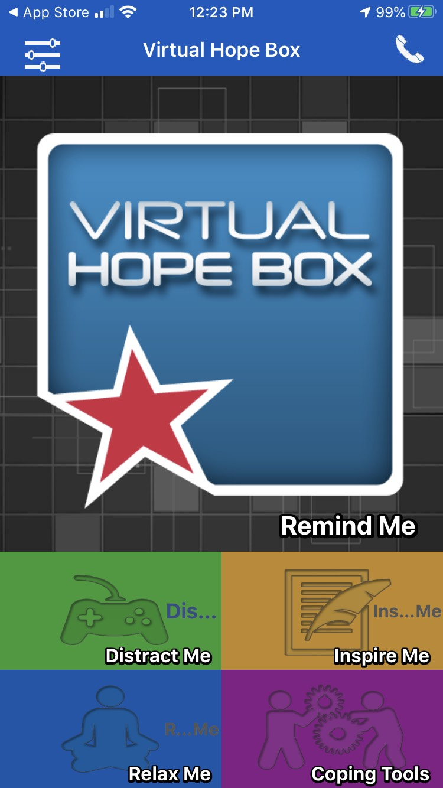
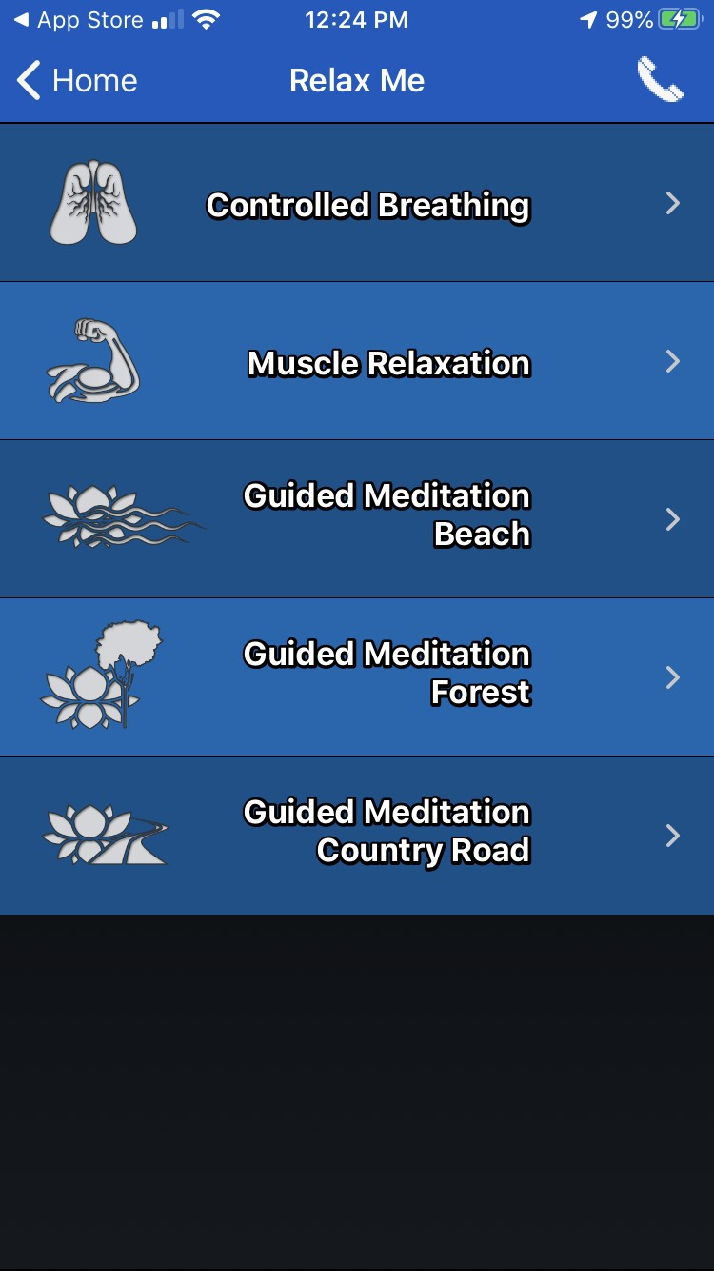
Virtual Hope Box
https://www.my-therappy.co.uk/app/virtual-hope-box
38
Notes:
The Virtual Hope Box (VHB) is a smartphone application designed for use by patients and their behavioral health providers as an accessory to treatment. The VHB contains simple tools to help patients with coping, relaxation, distraction, and positive thinking. Patients and providers can work together to personalize the VHB content on the patient's own smartphone according to the patient's specific needs. The patient can then use the VHB away from clinic, continuing to add or change content as needed. Patients can use the VHB to store a variety of rich multimedia content that they find personally supportive in times of need. For example, a patient can include family photos, videos and recorded messages from loved ones, inspirational quotes, music they find especially soothing, reminders of previous successes, positive life experiences and future aspirations, and affirmations of their worth in their VHB. A patient can also collaborate with their provider to create coping cards to use in response to personal problem areas they experience. Finally, the VHB provides the patient with positive activity planning, distraction tools, and interactive relaxation exercises including guided imagery, controlled breathing and muscle relaxation.

Slide 39
Accommodation Examples: Handling transitions and unpredictability
Functional Limitation | Accommodation(s)
Difficulty handling transitions Difficulty handing unpredictability, uncertainty, ambiguity | Provide student with notices/prompts of upcoming transitions Allow extra time to make transitions
 | Provide expectations in both written and oral formats Provide agendas, learning objectives, schedules as frequently as needed—especially when changes occur
 | Provide visual aids to help with routines/schedules Get student’s attention before telling/showing them of upcoming change/transition
Accommodation implementation in this area requires consistency and planning!
39

Slide 40
Accommodation Examples: Anxiety/Stress-Related difficulties
Functional Limitation | Accommodation(s)
Difficulty with response to frustration Irritability/Anxiety Difficulty with problem solving | Allow flexible seating/placement in classroom Allow the use of apps (e.g., stress relief, Mindfulness, mental health tips…) Provide up-front notice of changes/transitions
 | Allow movement breaks for stress management or go to Wellness Allow an assistance animal or a service dog, if appropriate and warranted (determined on a case-by case basis) Provide extended time on assignments, exams, tasks, etc.
 | Provide a mentor
40

Slide 41
Accommodation Examples: Behavioral Challenges
Functional Limitation | Accommodation(s)
Seeks attention in inappropriate ways | Provide frequent positive feedback for appropriate attention-seeking
Difficulty with task persistence | Break down assignments/tasks into smaller parts Provide prompts and frequent feedback on progress
Difficulty maintaining focus | Allow the use of noise cancelling headphones (non-instructional time) Provide a separate workspace with minimal distractions
Difficulty with time management | Provide organizational tool(s) (calendar, timer, check-list, apps, etc.)
Difficulty following rules/routines | Provide rules/routines in multiple formats (e.g., visual, auditory, etc.)
Difficulty with social skills | Provide peer mentor/model/buddy Teach appropriate social responses for activities/settings
41

Slide 42
Resources
WITH SELF-REGULATION DIFFICULTIES
42

Slide 43
Resources Pages Summary
DBT Worksheets (DEARMAN; WISEMIND; Pros and cons to manage urges)
Motivational Interviewing worksheet (Pros and Cons of Change) from SLIDE 23
Anger Thermometer from SLIDE 28
APPS outreach page from SLIDE 30
APPS and online resource page from SLIDES 35-38
Chill and Chat group outline from SLIDE 29
Sleep Hygiene Flyers (staff & students) from SLIDE 21
Mindfulness package (Twenty Mindfulness Exercises) from SLIDE 26
Staff Training PPTs; De-escalation and Emotional Validation from SLIDE 24 and 30
https://supportservices.jobcorps.gov/disability/Pages/Improving-Employability-Outcomes-By-Enhancing-Self-Regulation-for-Students-with-Disabilities-Webinar-Resources.aspx
43

Slide 44
Manuals for Free
Trauma Focused CBT Manual: https://tfcbt.org/wp-content/uploads/2019/02/Revised-Dealing-with-Trauma-TF-CBTWorkbook-for-Teens-.pdf
Adolescent DBT Manual: http://www.drcharlesbonner.com/publications-and-downloads.html (12th reference down the page)
Anger Management for Substance Use Disorder and Mental Health Clients: Participant Workbook https://store.samhsa.gov/product/Anger-Management-for-Substance-Use-Disorder-and-Mental-Health-Clients-Participant-Workbook/PEP19-02-01-002
44

Slide 45
Self-Regulation and Goal Attainment
Cavadel, E., Kauff, J., Anderson, M.A, McConnell, S., and Derr, M. (2017). Self-Regulation and Goal Attainment: A New Perspective for Employment Programs. Office of Planning, Research and Evaluation, Administration for Children and Families, U.S. Department of Health and Human Services. Washington, DC.
45

Slide 46
ALSUP
46
Notes:
“Assessment of Lagging Skills and Unsolved Problems”; a tool from Collaborative and Proactive Solutions methods; Identifies skill deficits that cross diagnoses; breaks down common areas that need addressing for young people who don’t respond well to” consequences as a strategy”: see Ross Greene’s approach and find many resources for learning this process at his website: Lives in the Balance: examples of skills that might be “difficulty handling transitions”, “difficulty considering the likely consequences of actions”, “difficulty expressing concerns, needs or thoughts in words”

Slide 47
Our Favorite Chart to Fill Out
PROS AND CONS | In the short run….. | In the long run……
Advantages of changing this behavior
Disadvantages of changing this behavior
47
Notes:
A motivational tool to help the students situate their decisions in terms of short term and long term gains and losses; helps spell out in visual terms reasons to not change now and gives those reasons acknowledgement and validation; helps those who are ambivalent open up to looking at long term gains; if the therapist sits on the side of “not change”, the “change” side has more pull

Slide 48
Lack of Motivation
Use of the values card sort works well: http://www.motivationalinterviewing.org/sites/default/files/valuescardsort_0.pdf
Directions for doing the card sort:
https://motivationalinterviewing.org/sites/default/files/valuesinstructions.pdf
We use this with individuals and groups, followed by conversations where students talk about and share their choices. Then, we brainstorm first steps in moving towards what is truly important to them.
When students are disruptive or appear out of control, it’s hard to see that they have strong personal values, but most do.
48
Notes:
Janet: values are part of numerous current validated therapies, including DBT and ACT; we find a good response to engaging students in discovering that they do have strong values: it is much easier to ask someone whether their behavior matches their personal values rather than telling them their behavior is inappropriate: mostly, they already know their behavior is “bad”; this way, students can aim to live in accordance with their own values rather than having an adult tell them what to do

Slide 49
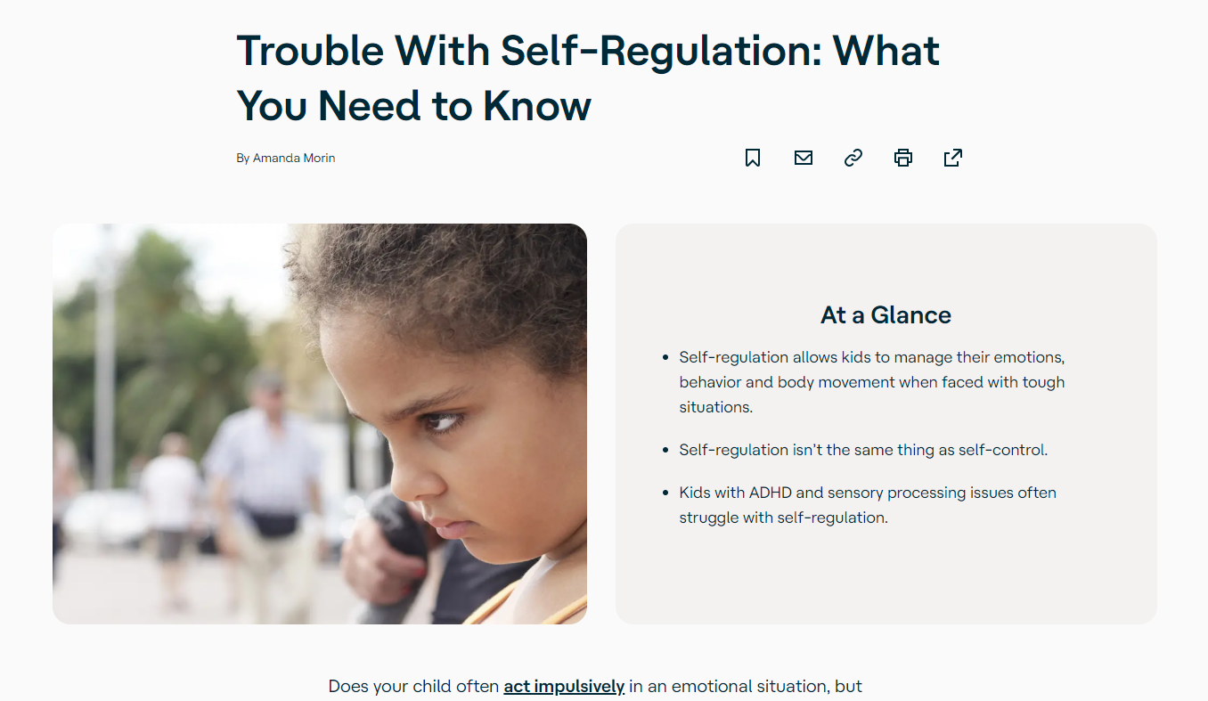
Understood.Org
Trouble with Regulation
49
Notes:
Diane

Slide 50
Job Accommodation Network https://supportservices.jobcorps.gov/disability/Pages/default.aspx
50

Slide 51
Job Corps Disability Website https://supportservices.jobcorps.gov/disability/Pages/default.aspx
51

Slide 52
Thank You!
52

