Slide 1
Say WHAT?
Students with
Medical Disabilities
May Need Accommodations?

Slide 2
AGENDA
Objectives
Disability Defined
Reasonable Accommodation
Functional Limitations
Let’s Practice
Resources

Slide 3
Describe how to draft a basic accommodation plan for a student with a medical disability.
Objectives
Identify 1-2 accommodations relevant to each of the more commonly seen functional limitations.
Articulate how to identify disability status for individuals with “medically-related” conditions.

Slide 4
DISABILITY
DEFINED
“Review”

Slide 5
Disability Defined
“A physical or mental impairment that substantially limits one or more of a person’s major life activities.”
Notes:
As defined by the Americans with Disabilities Act as Amended (ADAAA) , the definition of a disability is “a physical or mental impairment that substantially limits one or more of a person’s major life activities.” Whether a particular person has an impairment that satisfies this definition, and whether a specific accommodation is appropriate for a particular person must be determined on a case-by-case basis by someone with expertise in the field.

Slide 6
Major Life Activities
An activity that is “of central importance to daily life”
Examples of major life activities include, but are not limited to:
Learning
Reading
Concentrating
Thinking
Communicating
Interacting with others
Caring for oneself
Notes:
A Major Life activity is an activity that is “of central importance to daily life”
Examples of major life activities include, but are not limited to:
Learning
Reading
Concentrating
Thinking
Communicating
Interacting with others
Caring for oneself
Performing manual tasks
Seeing/Speaking/Hearing
These are just some of the more common ones
See Appendix 605 for more details on major life activities

Slide 7
Substantially Limited Determination
Requires an individual assessment
Should not require extensive analysis
Should be construed broadly in favor of expansive coverage
An impairment is a disability if it substantially limits the ability of an individual to perform a major life activity as compared to most people in the general population
Notes:
Just highlighting substantial limitation determination. For more details, see Appendix 605.
What is a substantial limitation?
When making a determination on whether an individual is substantially limited in performing a major life activity:
The determination requires an individualized assessment.
The determination should not require extensive analysis.
The term “substantially limits” should be construed broadly in favor of expansive
coverage; “substantially limits” is not meant to be a demanding standard.
An impairment is a disability if it substantially limits the ability of an individual to
perform a major life activity as compared to most people in the general population. An impairment need not prevent, or significantly or severely restrict the individual from performing a major life activity in order to be considered substantially limiting.
Although determination of whether an impairment substantially limits a major life activity as compared to most people will not usually require scientific, medical, or statistical evidence, such evidence may be used if appropriate.
Certain impairments will virtually always be found to result in substantial limitation in performing certain life activities. Those impairments listed in the ADAAA regulations are covered on the next 2 slides.

Slide 8
Examples of Impairments that are Always Substantially Limiting
Deafness substantially limits hearing
Blindness substantially limits seeing
An intellectual disability substantially limits brain function
Partially or completely missing limbs or mobility impairments requiring the use of a wheelchair substantially limit musculoskeletal function
Autism substantially limits brain function
Cancer substantially limits normal cell growth

Slide 9
Examples of Impairments that are Always Substantially Limiting
Cerebral palsy substantially limits brain function
Diabetes substantially limits endocrine function
Epilepsy substantially limits neurological function
Human Immunodeficiency Virus (HIV) infection substantially limits immune function
Multiple sclerosis substantially limits neurological function

Slide 10
Substantially Limited – Mitigating Measures
Lessen the impact of something
Examples include medications, medical equipment or supplies, hearing and mobility support devices…
When determining whether a person is substantially limited in a major life activity, ignore the beneficial effects of mitigating measures
Notes:
Mitigating measures lessen the impact of something
So for a person with a physical or mental impairment mitigating measures may be things such as:
medication
medical supplies, equipment, or appliances
prosthetics including limbs and devices, hearing aid(s) and cochlear implant(s) or other implantable hearing devices
mobility devices
oxygen therapy equipment and supplies
use of assistive technology
reasonable accommodations or auxiliary aids or services
learned behavioral or adaptive neurological modifications
psychotherapy, behavioral therapy, or physical therapy
When determining whether a person is substantially limited in a major life activity,
the beneficial effects of mitigating measures will be ignored.
There is an exception for ordinary eyeglasses or contact lens so you do consider their beneficial effects.
Mitigating measures in a nutshell-All it means is that we now have to determine what effects an impairment would have if the person did not use any mitigating measures.
See Appendix 605 for more details

Slide 11
Substantially Limited – Episodic or Remission
A condition is still a disability if it substantially limits a major life activity when active even if there are periods of remission or the condition is episodic
For example, a person with post-traumatic stress disorder who experiences intermittent flashbacks to traumatic events is substantially limited in brain function and thinking
Notes:
Examples of conditions that may be episodic or go into remission include epilepsy, multiple sclerosis, cancer, hypertension, diabetes, asthma, major depressive disorder, bipolar disorder, and schizophrenia.

Slide 12
Substantially Limited – Temporary Conditions
The effects of an impairment lasting less than six months can be substantially limiting if sufficiently severe
For example,
broken limbs, hand injuries, or short term impairments following surgery or medical treatments
Notes:
Typically, impairments that last only a short period of time are not covered.

Slide 13
AFR and Disclosure of Disability
A student with a medical disability may disclose their disability in multiple ways:
504 Plan
Documentation from a health care provider
Job Corps Health Questionnaire (ETA 653)
Individualized Education Plan (IEP)
Chronic Care Management Plan (CCMP)
Reasonable Accommodation Request Form

Slide 14
Points to Remember!
Do not spend a lot of time analyzing whether a student meets the definition of disability; the disability assessment should be done quickly and not demand extensive analysis.
When in doubt err on the side of entering the disability.

Slide 15
REASONABLE
ACCOMMODATION
Considerations

Slide 16
Developing an Accommodation Plan
Notes:
First, let’s review how to develop an individualized accommodation plan. There is a 4 step process. Our October 2016 call was dedicated at looking at developing plans in great depth. We will quickly review each of these steps, and then dive a bit deeper into accommodations that may need clarification in order for them to be successfully implemented.

Slide 17
Developing an Accommodation Plan
JAN or other community resources (Centers for Independent Living, Vocational Rehabilitation, Universities, etc.)
Determine what accommodations are necessary and appropriate for the applicant/student in the Job Corps setting

Slide 18
Accommodation Plan Content Restrictions
Accommodation plans will not contain any medical or diagnostic information.
This may include:
Disclosure of disability
Reference to types of documentation (IEP, Evaluations)
Prescription information
Psychological or medical evaluations/test results
Health-related case management notes
References to treating provider or facility (AA meetings, therapy appointments)

Slide 19
FUNCTIONAL
LIMITATIONS
and
ACCOMMODATIONS

Slide 20
Quick Check!
Which of these conditions “almost always” is considered a disability?
HIV
Asthma
Cancer
Diabetes
Seizure Disorder
Broken bone

Slide 22
Functional Limitations
Accommodations
Diabetes
Allow flexibility to sit or stand; reduce time standing in line
Limit the distance the individual needs to travel around center
Modify tasks requiring fine finger dexterity
Reduce the need to use sharp objects
Refrigerator on dorm
Breaks to have or obtain snack
Provide a rest area for reorientation after hypo/hyperglycemia episodes
Provide appropriate foods for center sponsored activities
Hypo/hyperglycemia
Neuropathy (Nerve damage)
Fatigue
Vision Impairments
Kidney Disease
Notes:
On the left side of the slide, you see some accommodations that the RAC could consider when addressing task completion issues…
On the right, are some supporting strategies for the same

Slide 23
Kylie – Diabetes Case Study
Kylie is a 20 year old CNA student at Candyland Job Corps with diabetes.
Kylie needs to come to wellness for medication during the training day.
She tends to get fatigued in the afternoons and has difficulties with her vision.
Kylie’s Chronic Care Management Plan indicates that she needs to stay hydrated and eat appropriate snacks throughout the day.
Who should likely participate in a Reasonable Accommodation Committee (RAC) meeting for Kylie?
What accommodations can we consider for Kylie?

Slide 24
Kylie’s Accommodations
Likely Reasonable Accommodation Committee (RAC) Composition:
If minimal accommodations needed: Kylie, Health and Wellness Manager (HWM)/DC, the Center Physician
If more complex accommodation needs: Kylie, Health and Wellness Manager (HWM)/DC, the Center Physician, Academic Manager (AM)/DC, Career Technical, Residential, and Food Services
Possible Accommodations:
Allow schedule adjustment to allow Kylie to come to wellness during the training day
Allow frequent breaks with a place to sit available
Allow water and snacks throughout the training day; access to appropriate meals and snacks
Allow frequent bathroom breaks
Reading materials will be provided in audio format
Notes:
Remember, the composition of the RAC is fluid and dependent upon the need to know. The student’s condition would not be a part of the discussion during the RAC meeting – only the associated functional limitations.
This list is not all inclusive and would be developed based upon all of Kylie’s functional limitations.

Slide 25
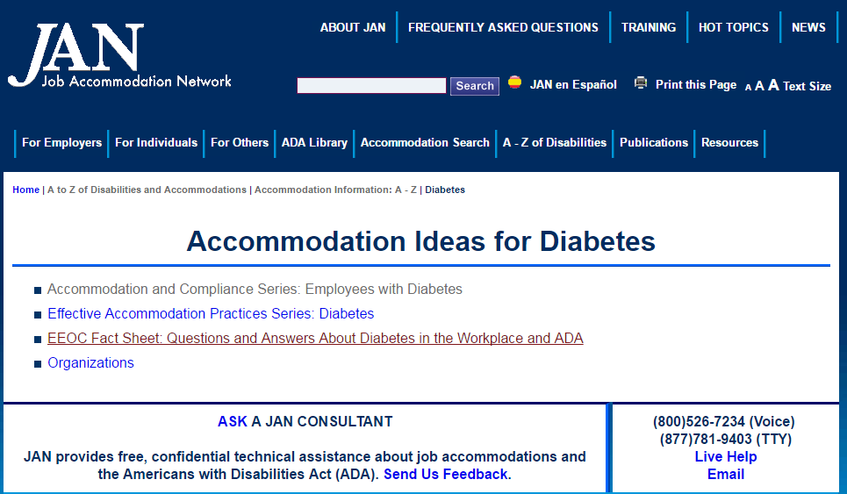

Slide 26
Sample Accommodation Plan Entries for Kylie
Accommodation | Specific Accommodation | Comments
Environmental | 04-Modified Schedule | Student may come to wellness as needed
Environmental | 04-Modified Schedule | Frequent breaks for use of bathroom as needed and for student to rest 15 minutes every 2 hours. Please ensure the student has a place to sit during breaks.
Personal Supports | 99-Other | Allow student to carry water throughout the training day. Student also needs snacks which can be eaten during her 15 minute breaks.

Slide 27
Sample Accommodation Plan Entries for Kylie
Accommodation | Specific Accommodation | Comments
Assistive Technology | 09- Books on Tape | Student has a Bookshare account, reading and academic materials are available in digitized format.
Assistive Technology | 01-Computer for word processing or other task completion | Student requires access to a computer to access Bookshare.

Slide 29
Functional Limitations
Accommodations
Seizure Disorder
Provide information in writing or through pictorial instructions
Provide checklists/outlines of task steps
Use charts/graphics/visual aids
Video tape instruction for the student to play back later
Utilize a monitor glare guard for the student computer
Allow frequent breaks from tasks involving computer work
Provide fluorescent light tube covers in the rooms the student will use most frequently on center
Balancing
Fatigue
Safety in the Workplace
Memory
Stress Management
Time Management
Photosensitivity
Sensory Impairments (seeing/hearing/speaking)

Slide 30
Functional Limitations
Accommodations
Seizure Disorder
Keep aisles, halls, classrooms, trades clear of clutter
Provide a flexible work schedule
Modify schedule to allow for appointments
Allow extended time to complete work
Balancing
Fatigue
Safety in the Workplace
Memory
Stress Management
Time Management
Photosensitivity
Sensory Impairments (seeing/hearing/speaking)

Slide 31
Trent – Seizure Disorder Case Study
Trent is a 23 year old Office Administration student at Candyland Job Corps. Trent has epilepsy and experiences difficulties with photosensitivity and fatigue.
Trent’s trade instructor reported on an accommodation effectiveness review that Trent appears forgetful and struggles with remembering everyday tasks and assignment due dates.
The accommodations currently in Trent’s plan include pass to wellness as needed, a schedule adjustment to allow for off center appointments, and bottom bunk in the dormitory.
Who should participate in a RAC for Trent?
Given the functional limitations Trent experiences and the information provided by the trade instructor, what additional accommodations should be discussed with Trent?

Slide 32
Trent’s Accommodations
Likely Reasonable Accommodation Committee (RAC) Composition:
If minimal accommodations needed: Trent, Health and Wellness Manager (HWM)/DC, the Center Physician
If more complex accommodation needs: Trent, Health and Wellness Manager (HWM)/DC, the Center Physician, Academic Manager (AM)/DC, Career Technical, and Residential
Possible Additional Accommodations:
Provide glare guard for student computer monitor
Allow frequent breaks
Provide assignment planner
Provide reminders of assignment due dates
Use checklists/outlines for tasks
Use fluorescent light tube covers in trade
Notes:
This list is not all inclusive and would be developed based upon all of Trent’s functional limitations.

Slide 33
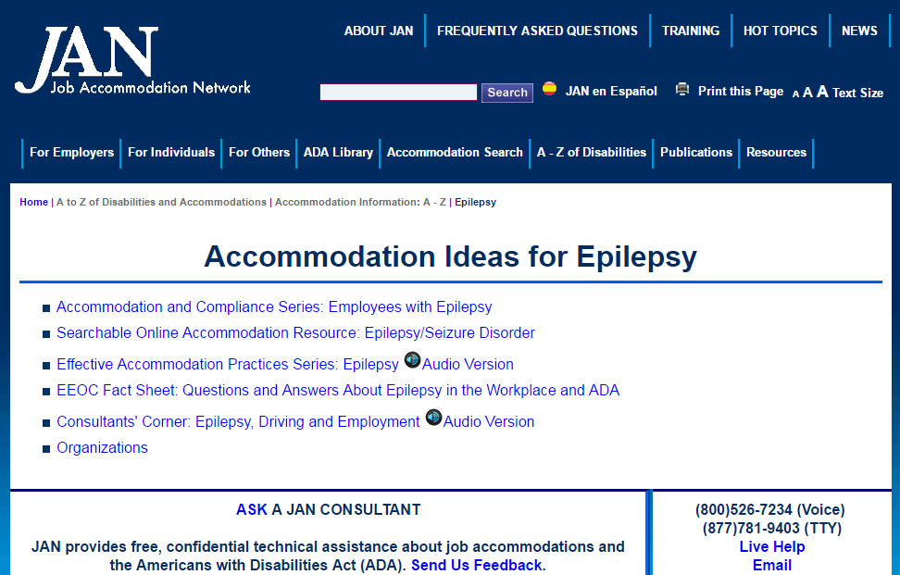

Slide 34
Sample Accommodation Plan Entries for Trent
Accommodation | Specific Accommodation | Comments
Environmental | 07-Dormitory-related | Bottom bunk
Environmental | 01-Pass | Pass to wellness as needed
Environmental | 04-Modified Schedule | Student will have a shortened training day ending at 1pm the last Friday of the month.
Instructional/Assignments | 01-Verification of understanding of instructions, rules, assignments | Provide all assignment instructions and due dates in writing

Slide 35
Sample Accommodation Plan Entries for Trent
Accommodation | Specific Accommodation | Comments
Environmental | 08-Special lighting | Fluorescent light tubes will be used in the students trade classroom and dorm room
Assistive Technology | 13-Adaptive Equipment | Glare guard for the students computer screen
Organizational | 03-Checklists (e.g. dorm tasks, daily tasks, assignment checklists)
Organizational | 01-Planners | Daily planner for appointments and assignment due dates
Environmental | 99-Other | Frequent breaks, 1 break every 2 hours for 15 minutes. No computer usage during breaks.

Slide 36
Related
ASSISTIVE
TECHNOLOGY

Slide 37
BG Cell Phone App
It’s FREE!
Calculate insulin and carbohydrates
Set reminders to check blood sugars
Create spreadsheets and graphs of your data and email reports to your doctor
Provides warnings for low blood glucose and insulin
Create a photo log of meals
Great if you are eating out, or say in the cafeteria, and need to record your food

Slide 38
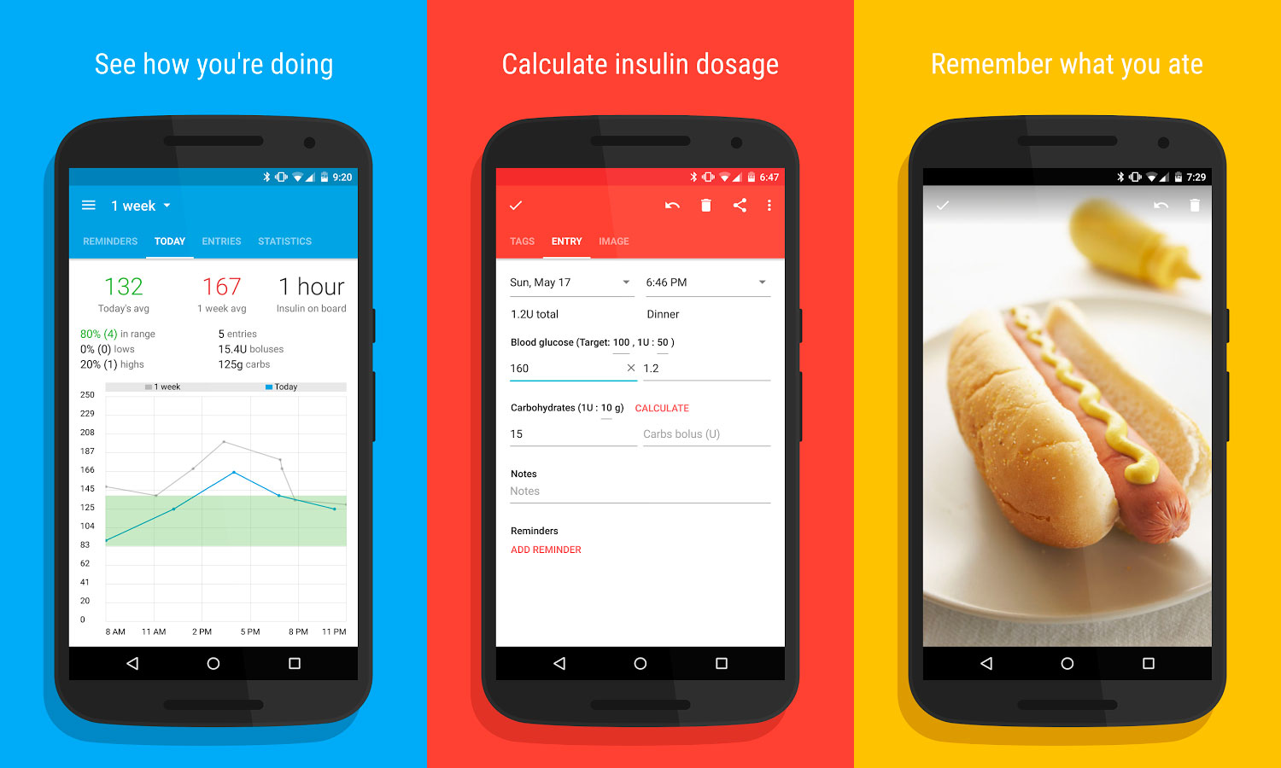

Slide 39
Epilepsy Toolkit
It’s Free!
My seizure diary
Export function to email seizure diary to healthcare providers
My medication function allows you to track medication taken
My reminders functions allow you to set alarm reminders to take medication
First aid function provides information on what to do when someone has a seizure
About me function allow you to record information about yourself, healthcare provider details, information about your diagnosis and test, reminder function for questions you may want to ask

Slide 40
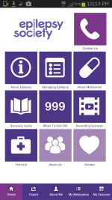

Slide 41
Care4 Today
Free on IPhone and Android devices
Input all your medications, with dosage and timing information
It will remind you when it’s time to take one
Will populate a chart showing your family, doctor, or care provider that you are taking everything as prescribed
Section to input side effects you experience

Slide 42
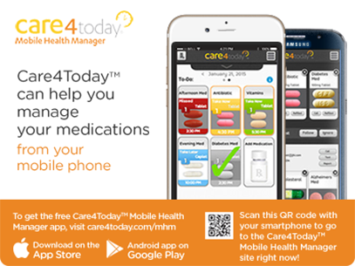

Slide 43
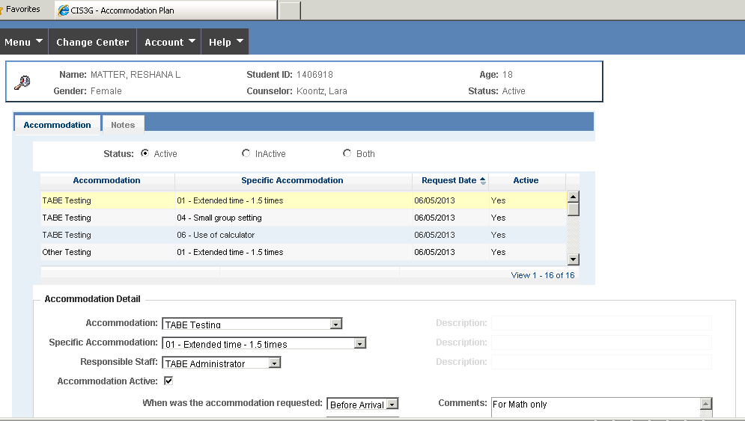
ACCOMMODATION
PLAN
Quality

Slide 44
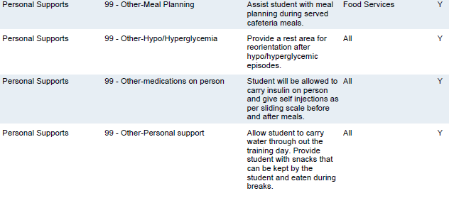
Appropriate Entries or Not?

Slide 45
Appropriate Entries or Not?

Slide 46
Appropriate Entries or Not?

Slide 47
Appropriate Entries or Not?

Slide 48
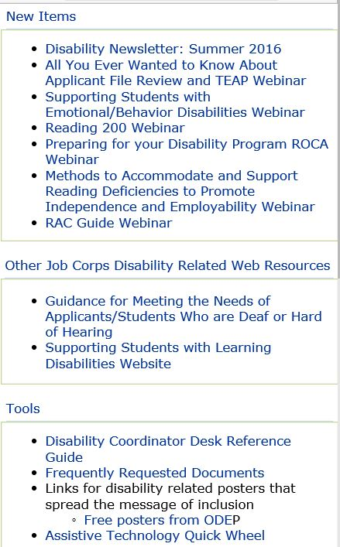
Job Corps Disability Website – https://supportservices.jobcorps.gov/disability/Pages/default.aspx

Slide 49
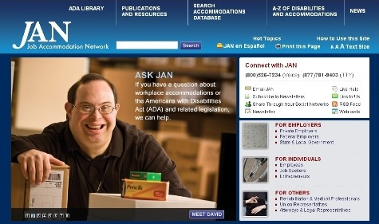
Job Accommodation Network http://askjan.org

Slide 50
Thank you for attending!
Questions?

