Slide 1
Sensory Processing Disorder

Slide 2
Objectives
Describe some of the signs, symptoms, and manifestations of SPD, and how they are often misread as other disorders
List 4-5 center-wide strategies that can be used to address/support SPD-related manifestations such as “feeling overwhelmed,” or “having difficulty concentrating.”
Identify at least 2-3 possible functional limitations and/or barriers resulting from SPD.
Describe the difference between “hypersensitivity” and “hyposensitivity” as it relates to sensory stimulation.
Develop 2-3 possible accommodations for SPD-related functional limitations.
2

Slide 3
Background
Definitions, Manifestations and
Functional Limitations

Slide 4
Poll
Are you familiar with Sensory Processing Disorder?

Slide 5
Sensory Processing Disorder (SPD) Defined
Sensory Processing Disorder (SPD), formerly known as Sensory Integration Dysfunction, refers to a condition in which the brain has trouble receiving, organizing, and responding to information that comes in through the senses.
In other words, It is an inability to use information received through the senses in order to function smoothly in daily life. Kranowitz, Carol: The Out of Sync Child, 2005, p.9
Notes:
In other words, the central nervous system is ineffective in processing sensory-related information.

Slide 6
8 Sensory Systems
Sensory Integration is the process your central nervous system goes through when it takes information in from your body’s 8 senses, processes that information, and then responds accordingly.
Auditory - sound/hearing
Visual - sight
Olfactory - smell
Gustatory - taste
Tactile - touch
Vestibular - movement
Proprioception - input from muscles and joints
Interoception - internal sensors indicating physiological conditions

Slide 7
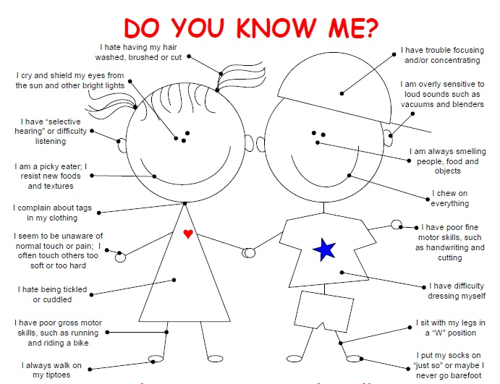

Slide 8
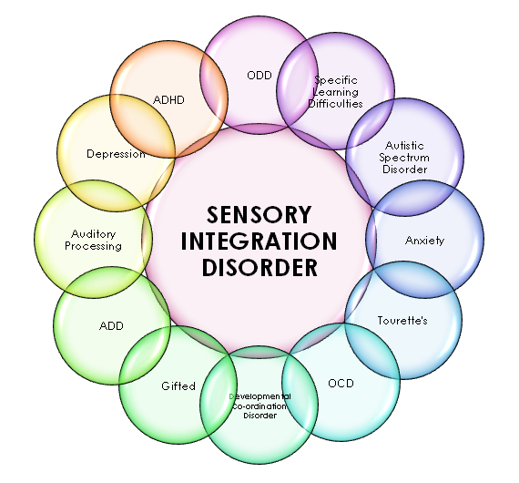
Sensory Processing Disorder (SPD)
Although not yet recognized officially (for example, in the DSM-5), Sensory Processing Disorder can be identified and categorized by an occupational therapist with advanced training in sensory processing and integration.
It is not one specific disorder but rather an umbrella term to cover a variety of neurological disabilities. There are 3 main subtypes:
Sensory Modulation Disorder
Sensory Discrimination Disorder
Sensory-Based Motor Disorder
Kranowitz, C., p.10
It is still debated as to whether SPD is actually an independent disorder or the observed symptoms of various other, more well-established, disorders.
Notes:
In other words, the central nervous system is ineffective in processing sensory-related information.

Slide 9
Sensory Modulation Disorder
Sensory Over-responsivity (Hypersensitive)
Sensory Seeking
Sensory Under-responsivity (Hyposensitive)
Sensory-Based Motor Disorder
Postural Disorder
Dyspraxia
Sensory Discrimination
Disorder
Difficulty Distinguishing One Sensation from Another

Slide 10
Sensory Modulation
Sensations | “Over-responsive” | “Under-responsive” | Sensory Seeking
Touch | Avoids touching or being touched | Unaware of contacts with objects and body | Rummages through items purposelessly; chews on inedible objects
Movement/Balance | Avoids moving or being moved | Does not notice being moved; Unaware of falling so protects self poorly; can swing for a long time without getting dizzy | Craves fast and spinning movement, being hugged/squeezed;
Position & Muscle Control | May be uncoordinated or rigid | Lacks inner drive to move for activities but may become more alert after actively pulling, pushing, lifting | Craves bear hugs and being squeezed; Seeks heavy work and more vigorous types of activities than others
Sights | Can get overexcited or overwhelmed with too much to look at; May over-react to bright light | Ignores novel visual stimuli such as an obstacle in the path; Can stare at and look “right through” faces and objects | Seeks visually stimulating scenes and screens for lengthy times
Touch | Avoids touching or being touched | Unaware of contacts with objects and body | Rummages through items purposelessly; chews on inedible objects
Position & Muscle Control | May be uncoordinated or rigid | Lacks inner drive to move for activities but may become more alert after actively pulling, pushing, lifting | Craves bear hugs and being squeezed; Seeks heavy work and more vigorous types of activities than others
Notes:
A student could by hypersensitive in some areas of sensory processing and hyposensitive in others. There can be variations in the type/level of sensitivity.

Slide 11
Sensory Modulation (cont.)
Sensations | “Over-responsive” | “Under-responsive” | Sensory Seeking
Sounds | Covers ears to block out sounds or voices; Even white noise objects may produce discomfort | Ignores ordinary sounds and voices but may respond to exaggerated or very loud sounds and music | Likes loud noises and volumes; likes crowds and action
Smells | Objects to certain smells such as a ripe banana that most others do not notice | May be unaware of unpleasant odors and unable to smell his meal | Seeks strong odors and may like to sniff objects/others
Tastes | Strongly objects to certain textures and temperatures of foods; may gag while eating | May be able to eat very spicy food w/o reaction | May lick or taste inedible objects like Play-doh; may prefer spicy or very hot foods
Sounds | Covers ears to block out sounds or voices; Even white noise objects may produce discomfort | Ignores ordinary sounds and voices but may respond to exaggerated or very loud sounds and music | Likes loud noises and volumes; likes crowds and action
Tastes | Strongly objects to certain textures and temperatures of foods; may gag while eating | May be able to eat very spicy food w/o reaction | May lick or taste inedible objects like Play-doh; may prefer spicy or very hot foods

Slide 12
Sensory-based Motor
Sensations | Manifestations
Components of Movement | May be tense or have “loose” or “floppy” muscle tone; may have a weak grasp on objects or difficulty fully extending or flexing limbs; Slouches and sprawls; may struggle to rotate body to throw a ball
Balance | Looses balance easily when walking or changing positions and can appear to trip on air.
Bilateral Coordination | May have difficulty using both sides of the body symmetrically like for clapping hands, catching balls; may have difficulty using one hand to assist the other such as holding paper with one hand while cutting it with the other or holding a cup while pouring
Unilateral Coordination | May not have a definite hand preference and may use either hand to eat, reach for objects, etc.
Crossing the Midline | May have difficulty using a hand, foot or eye on the opposite side of the body such as using one hand to paint or reading a line across the paper
Balance | Looses balance easily when walking or changing positions and can appear to trip on air.
Crossing the Midline | May have difficulty using a hand, foot or eye on the opposite side of the body such as using one hand to paint or reading a line across the paper

Slide 13
Sensory Discrimination
Sensations | Manifestations
Touch | Poor body awareness; may struggle to note where on his or her body they were touched; cannot distinguish objects by feel alone; may be awkward with fastening buttons, using hair clips; may struggle processing sensations of pain and temperature
Movement & Balance | Cannot feel him or herself falling; can become confused when turning or changing directions
Body Position/Muscle Control | Can appear and be “klutzy”; has difficulty positioning limbs for riding a bike; either uses too much or too little force in controlling a writing utensil.
Sights | May confuse likenesses and differences in pictures, written words, objects and faces; may miss facial expressions and/or gestures; may have difficulty with visual tasks such as lining up columns or again, judging where things are in space
Sounds | May have difficulty recognizing the differences between sounds, especially consonant sounds at the end of the word; may struggle to repeat or make up rhymes; may have difficulty picking out even a familiar voice in a group of talkers; may have attention and focus issues in crowded situations
Smells & Taste | May have difficulty distinguishing distinct smells such as lemons, vinegar or soap or be able to tell when food is too spicy, salty or sweet and may reject food simply based on its looks
Body Position/Muscle Control | Can appear and be “klutzy”; has difficulty positioning limbs for riding a bike; either uses too much or too little force in controlling a writing utensil.
Sights | May confuse likenesses and differences in pictures, written words, objects and faces; may miss facial expressions and/or gestures; may have difficulty with visual tasks such as lining up columns or again, judging where things are in space
Sounds | May have difficulty recognizing the differences between sounds, especially consonant sounds at the end of the word; may struggle to repeat or make up rhymes; may have difficulty picking out even a familiar voice in a group of talkers; may have attention and focus issues in crowded situations

Slide 14
The resulting manifestations from SPD should not be viewed as willful behavioral challenges but recognized as functional limitations that may require accommodations in order for the student to be able to access and participate in the Job Corps program.

Slide 15
How Individuals with SPD Describe their Experiences?
“During an auditory overload, just about every sound can feel like someone took a microphone to it and set it on full blast.” — Chelle Neufeld
“Sometimes it just feels like you need everything around you to pause… It’s like a bunch of things occurring while a bunch of other things are approaching at the same time — like a spinning room.” — TwoMlln Thghts AndCntg
https://themighty.com/2016/02/people-explain-what-sensory-overload-feels-like/

Slide 17
Accommodations
Supporting Students who have SPD

Slide 18
Let’s Recap – Functional Limitations Examples
Although there are numerous manifestations and resulting functional limitations that may be related to SPD, we certainly see some more commonly than others in the Job Corps setting:
loud noises that may result in the student experiencing physical pain. These responses might be triggered by fire alarms, bells that signal class changes, crowds of people talking simultaneously, etc.
touch that may result from skin exposure to various types of clothing fabric or to the tags in clothing, to others brushing physically by the individual perhaps in a crowded hallway during class changes, or from light or unexpected touch such as someone placing a hand on the person’s shoulder to gain their attention.
various types of lighting which may result in the individual experiencing dizziness, headaches, nausea and/or an inability to focus.
various types of food textures, smells, etc. which may result in the individual becoming nauseous or physically ill.
Notes:
In other words, the central nervous system is ineffective in processing sensory-related information.

Slide 19
How might you accommodate these functional limitations?
Clothing sensitivities
Soft cotton uniforms
Tagless clothing
Shoes?
What about linens? Could they be an issue?
Soft cotton linens
Hypoallergenic type washing detergent to eliminate smells

Slide 20
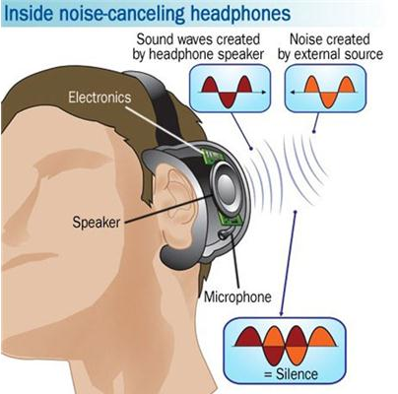
How might you accommodate these functional limitations?
Noise Sensitivies
Noise cancelling headphones or the use of appropriate music if the individual can better focus with that ONE sound
White noise may be irritating as well
Taking frequent breaks to a quiet place
Dorm room placement at end of hall or away from higher areas of traffic (not near the main exit or the shower/bathroom)
Alternate lunch break or allowed to take food to an alternate location

Slide 21
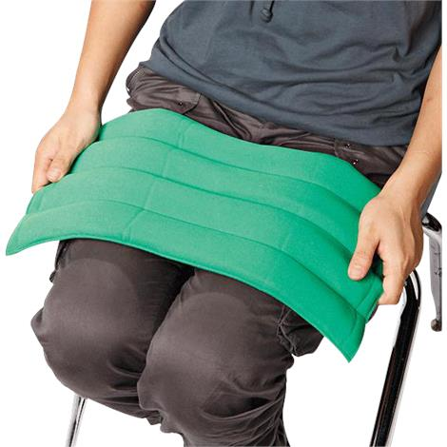
How might you accommodate these functional limitations?
Hypersensitive to Touch
Leave classroom 5 minutes before bell rings to go to next class
Use weighted objects to “calm” the nervous system (can take 20 minutes or so for the proprioceptive system to respond to having the weights)
Use cues (verbal or non-verbal) to get the student’s attention rather than using touch

Slide 22
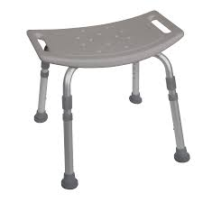
How might you accommodate these issues related to sensory processing challenges?
Hygiene Management
Adjust the shower spray to a lower pressure; add a handheld spray want
Provide perfume-free towels
Provide appropriate shower chair, safety bars if balance is an issue
Make a visual schedule of the morning and evening hygiene routines; Adults with organizing issues report that visual schedules still assist them

Slide 23
Claire – Case Study
Studying and focusing on assignments is difficult for Claire as she can hear each separate conversation in the room – simultaneously.
Crowded rooms or large groups feel overwhelming generally.
The smell of perfumes, body lotions, cologne make her nauseous.
The tapping of classmate’s pencils on their desks, if frequent, makes her feel like her skin is crawling.
Claire feels ashamed about her struggles to cope.

Slide 24
What are the areas that the RAC needs to address/discuss with Claire?
Always ask the student what their needs might be or about things that have helped them in the past.
Smell distractions
Crowded space(s)
Noise distractions
What can the RAC do about the expression of feeling ashamed?

Slide 25
What are some accommodations the RAC likely should discuss with Claire?
Smell distractions
Use of passes for breaks to get fresh air
Use air purifiers
Perfume free soaps, laundry detergents
Offer Claire a mask (like a disposable medical-type one) she can wear when the smell is bothering her
Crowded space(s)
Seating arrangement modified not to exclude but to minimize feeling crowded (i.e., maybe small group clusters)
Assign seat toward the back of the room out of the traffic flow
Could also be to position away from smell distractions
Use of pass for breaks to get some fresh air and reduce built up anxiety; to get some movement
Do you notice any patterns or similarities in the accommodations possibly needed in this scenario?
Note that a few of the same accommodations can potentially assist the individual with managing multiple functional limitations that are impeding her in the Job Corps environment.

Slide 26
What are some accommodations the RAC likely should discuss with Claire?
Noise distractions
Noise cancelling headsets
Seating arrangement – see Crowded spaces above
Phone apps for soothing sounds, noise reduction
What can the RAC do about the expression of feeling ashamed?
Refer to the CMHC
Assign a mentor
http://www.futureacoustic.com/soundcurtain/

Slide 27
Individuals with SPD Using It to Develop Appropriate Career Paths
“I’m really good at mowing because I use a pattern with very straight lines and it’s fun because the white noise of the mower helps me think more deeply and complexly.”
“I’m more sensitive to my environment, which helps me take perfect photographs.”
Kranowitz, C., p. 236

Slide 28
SPD Resources

Slide 29
The Out of Sync Child https://out-of-sync-child.com/

Slide 30
STAR Institute https://www.spdstar.org/research-library

Slide 31
Understood.org
https://www.understood.org/en/learning-attention-issues/child-learning-disabilities/sensory-processing-issues/understanding-sensory-processing-issues

Slide 32
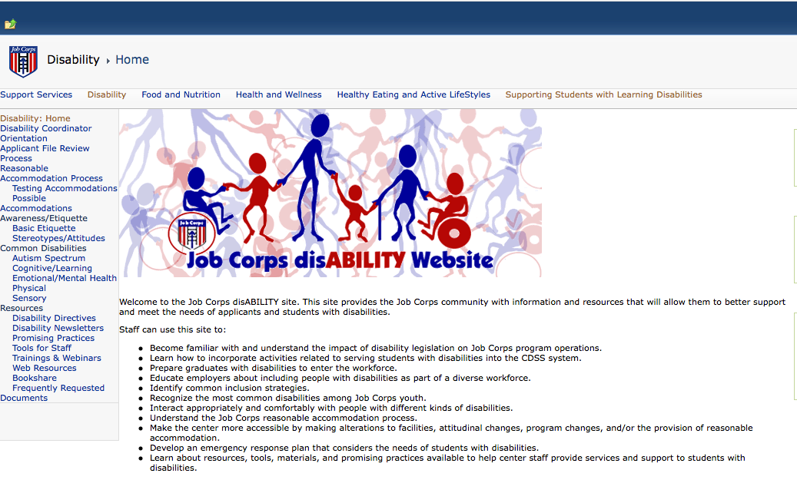
Job Corps Disability Website
https://supportservices.jobcorps.gov/disability/Pages/default.aspx

Slide 33
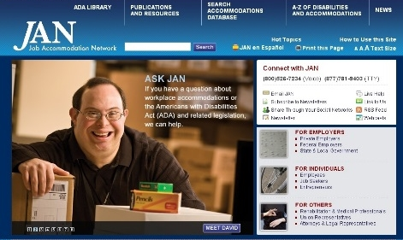
Job Accommodation Network http://askjan.org

