Slide 1
Disability Accommodations (DA)
Residential Living
Notes:
Welcome to Disability Accommodations in Residential Living!

Slide 2
01
Disability Accommodations
02
Functional Limitations
Agenda
03
Disability Accommodation (DA) Process
04
DA in Residential
05
Hot Topics for Residential Staff
06
Job Corps Disability Website/Resources
2
Notes:
Today we are going to talk about… (review the Table of Contents).
If you are a DC attending today's webinar, some of this information may be a review for you; however, you will gain greater insight to a variety of accommodations that may be important to consider for residential area when completing the disability accommodation process. If you are new to DC role or if you are a residential living support or management staff person, then today's information will assist you in understanding the necessary disability accommodation considerations that must be made to support students within the residential living area.

Slide 3
Have you ever identified or implemented residential related accommodations for a student with a disability in the Job Corps program?
Yes
No
Poll
Notes:
So we can better understand the level of experience and involvement in developing, identifying or implementing residential living disability accommodations, we have a poll question to pose to you.
Have you ever identified or implemented residential related accommodations for a student with a disability in the Job Corps program?
Please just respond with a “yes” or “no” response in the chat box.

Slide 4
No.1
Reasonable Accommodation, Reasonable Modification in Policies, Practices and Procedures, and Auxiliary Aids and Services (RA/RM/AAS)
Disability Accommodations
4
Notes:
Agenda item number 1 is the Introduction to What is a Disability, its definition, and impairments that are almost always considered a disability.
“Disability” means, with respect to an individual: A physical or mental impairment that substantially limits one or more of the major life activities of such individual. Major life activities include such things as walking, talking, eating, breathing, learning, bodily functions, etc. If a person has certain conditions that impact major body or system functions, even when stable, that individual may be considered as a person with a disability. For example, if a person has diabetes, they are almost always considered to have a disability because of the impact of the condition to the endocrine system.
The definition of “disability” shall be construed broadly in favor of expansive coverage, to the maximum extent permitted by federal disability nondiscrimination law.

Slide 5
Examples of RA/RM
Modified work or training schedules
Modification of equipment or devices
Adjustments or modifications to examinations, training materials or policies
Provision of interpreters
Use of assistive technology
Use of behavioral related supports
Allowance of assistance animals
If your center has a policy/practice of not allowing anyone to have a private room but the center could provide a private room to a student with a disability who needs one, is this acceptable despite the general practice/policy of not assigning private rooms to students?
5
Notes:
What are some examples of Reasonable Accommodation and Reasonable Modification?
Reasonable accommodation or reasonable modification might include such adjustments as modifying work or training schedules, modifying equipment or devices, modifying content or policies. Using assistive technology or providing behaviorally related supports or providing interpreter services or the allowance of assistance animals all are examples of reasonable accommodation and reasonable modifications.
Audience Participation:
If your center has a policy/practice of not allowing anyone to have a private room but the center could provide a private room to a student with a disability who needs one, is this acceptable despite the general practice/policy of not assigning private rooms to students?
Presenter Response:
Yes, the center may assign a private room to a student with a disability who has a demonstrated need for it and for whom alternate accommodations are not sufficient. This would be an adjustment to the center policy. We will talk more about private rooms and reasonableness in item #5 of the agenda.

Slide 6
Auxiliary Aids and Services Form 2-03 and Appendix 201
Auxiliary Aids and Services are devices or services that enable effective communication.
6
Notes:
Auxiliary Aids and Services are devices or services that enable effective communication. This might include the use of sign language interpreters, language interpreters, or a variety of assistive technology devices.

Slide 7
Why is Effective Communication so Important?
Without clear, accurate, effective communication, any encounter between a person with a disability and a program from which that person is seeking services, such as Job Corps, will be literally meaningless.
7
Notes:
Because communication is so important, the obligation to communicate effectively with people with disabilities is separate from the obligation to provide reasonable accommodation or reasonable modification in policies, practices, or procedures for qualified individuals with disabilities.
The Workforce Innovation and Opportunity Act (WIOA) nondiscrimination regulations distinguish between these two obligations for a very simple reason: Without clear, accurate, effective communication, any encounter between a person with a disability and a program from which that person is seeking services, such as Job Corps, will be literally meaningless.
In other words, it is NOT left up to our interpretation without ensuring that we have effectively communicated with an applicant/student.

Slide 8
Identifying or Determining What is Effective?
How Do You Know if Communication Accommodations are needed?
First – Determine HOW to communicate effectively with the individual with a disability.
Is a disability obvious?
Individual is deaf, visually impaired, etc.?
Individual requests auxiliary aids and services (e.g., communication accommodations or modifications).
The individual does not appear to understand what they are being asked or what is being communicated.
Primary consideration should be given to the requests of the person with a disability.
Why do you think the law does this?
8
Notes:
How Do You Know if Communication Accommodations are needed?
Is a disability obvious?
Individual is deaf, visually impaired, etc.?
Individual requests auxiliary aids and services (e.g., communication accommodations or modifications).
The individual does not appear to understand what they are being asked or what is being communicated.
Identifying or Determining what is Effective?
When a person who has a specific disability that affects his/her ability to communicate approaches Job Corps, the first thing we should do is find out how to communicate as effectively with that person as we would with people without disabilities. This essentially means we must engage the applicant/student in an interactive process to find out what communication methods/strategies the person can genuinely understand. Interactive does not mean we solely interact with paperwork/documentation, and not involve the applicant/student.
When considering how best to communicate with an applicant/student with a disability, primary consideration should be given to the requests of the person with a disability.
Audience Participation:
Why do you think the law requires this? (Use the text box to respond)
The individual with a disability is the best source of information about their own needs. Individuals who have the “same” diagnosis or disability may not be able to use and understand the same communication method. For example, individuals who have hearing impairments may use differing methods to communicate. Some individuals may use American Sign Language (ASL), others communicate using Signed English, while still others do not understand sign language at all and need a different method such as Computer Assisted Real-Time Transcription (CART).
Some communication methods/needs are more obvious than others. If a person is blind or visually impaired, written communication will be difficult and the individual may require an alternate form of communication. We need to be mindful of the different communication preferences and approaches, and not attempt to apply a “one type fits all” strategy. Again, individualizing the approach with an interactive meeting with the applicant/student is the best way to discover effective communication methods/strategies/accommodations.

Slide 9
No.2
Functional Limitations
It is not important to know the specific condition. It is more important to understand functional limitations and/or manifestations in determining the types of support needed.
Background
9
Notes:
Agenda Item number 2
Let’s review some of the basic Background information related to Common Disabilities and Functional Limitations
We will review briefly some common disabilities and common functional limitations in the areas of medical, mental health, neurodevelopmental and sensory.
It is not important to know the specific condition. It is more important to understand functional limitations and/or manifestations in determining the types of support needed. Why? Conditions impact individuals differently and one person’s functional limitations might be problematic for them but not for another person. There has been a longstanding expression amongst experts in the area of autism spectrum disorders. “If you have met one person with autism, you have only met one person with autism.” That is an excellent example of the awareness that manifestations can vary greatly amongst individuals with the same disorders or conditions.

Slide 10
Functional Limitations
Functional limitations can overlap from condition to condition
Functional Limitations are a result of a condition and reduce or eliminate your ability to do certain activities within a normal range of function. There are multitudes of possible functional limitations for each condition and we often forget to consider behavioral manifestations. Here are a few examples of commonly occurring ones:
Neurodevelopmental
Medical
Mental Health
Sensory
Should be considered on a case-by-case basis
Functional limitations may require support center-wide
May require program access considerations and behavioral ones
Functional limitations may be more obvious
Reading
Stamina
Concentration
Seeing
Anxiety
Strength
Self Care
Hearing
Attention/
Distractions
Condition Maintenance
Processing
Communication
Transitions
Mobility
Memory
Safety
Notes:
Functional Limitations
Functional Limitations are a result of a condition and reduce or eliminate your ability to do certain activities within a normal range of function. There are multitudes of possible functional limitations for each condition, and we often forget to consider behavioral manifestations. Here are a few examples of commonly occurring ones:
In the lists on the slide, you will note a wide array of areas that present barriers to students with disabilities in participating in the Job Corps program. You likely have noticed some of these struggles such as students experiencing frequent bouts of anxiety, has difficulty paying attention or stopping one activity to start another. Some students have limited stamina and need to have more breaks or struggle to concentrate so they need information provided in a variety of ways or repeated. Some students have various memory challenges and may need a visual schedule or a visual task support, assistive technology to remind them of tasks they have to complete, etc.
Important - Sensory related functional limitations may be more obvious to us. Those individuals might have difficulty seeing or hearing and as a result have difficulty with communication with others. They require additional planning to ensure their safety like a plan to include how they are to evacuate the dorms during fire drills, fire alarm scenarios, etc.
Are there specific symptoms and behaviors that you have seen in the residential environment that have been particularly challenging to support?
Contact the center’s Disability Coordinators to inform them of these challenges even if you do not know whether the person is an individual with a disability. The DCs will review the information and talk to the student. Some situations may require referral to a different staff resource but working with the center DCs is a good place to start.

Slide 11
No.3
Roles and Responsibilities, DA Requests, Access to Accommodation Plans
Disability Accommodation Process or DAP has 10 steps. Five of those steps apply to all areas of the center and will be reviewed today.
Disability Accommodations
Process Overview
11
Notes:
Agenda Item No. 3
Now let’s review the areas of the Disability Accommodation Process that apply to residential staff. We will discuss the roles and responsibilities of residential staff, what to do if a student requests accommodations in the residential area, and how you access accommodation plans.

Slide 12
Determining the Need for Disability Accommodation
A DA request can be communicated in any form (e.g., oral, written, sign language).
Contact your center Disability Coordinator if a student has a disability accommodation request.
Accommodation Requests
12
Notes:
Let’s start with Determining the Need for Disability Accommodation
A disability accommodation request can be communicated in any form. The individual can verbally request an accommodation, provide a request in writing or use sign language to request, etc. You get the idea.
If a student makes a request for a disability accommodation, residential related or otherwise, contact the center Disability Coordinator so they can begin processing the request.

Slide 13
Who is Responsible for Implementing Accommodations?
13
Any staff responsible for performing duties in an area in which the student
needs access to the program related to their disability, OR
needs supports that reduce or remove barriers to participation in the program.
13
Notes:
Who is Responsible for Implementing Accommodations?
Any staff responsible for performing duties in an area in which the student
needs access to the program related to their disability, OR
needs supports that reduce or remove barriers to participation in the program.
Again, many straightforward accommodation needs are handled solely by the DC and the individual but more complex scenarios might involve residential staff being invited to participate in the DAC for input such as requests for private rooms, requests for allowance of assistance animals, the impending arrival of a service animal, etc.

Slide 14
Notifying Staff
How Do you Know Who has an Accommodation Plan?
1
When APs are added or updated in CIS, but at least biweekly, a DC must e-mail staff members who interact with students a list of all students with accommodation plans available in the CIS.
2
The email list must include all students who have accommodation plans and specifically indicate any new or updated plans.
Examples: highlighting, placing an asterisk (*) next to, etc. the names of those with new or updated plans
14
Notes:
Notifying Staff of the Accommodation Plan
How Do you Know Who has an Accommodation Plan?
When APs are added or updated in CIS, but at least biweekly, a DC must e-mail staff members who interact with students a list of all students with accommodation plans available in the CIS.
If you are not receiving these emails, check with your residential manager to see if they are receiving them and if not, contact your center’s Disability Coordinator to inquire.

Slide 15
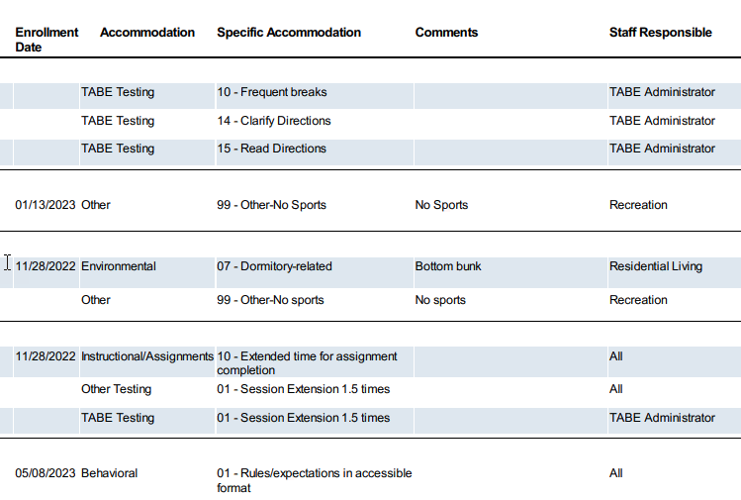
Large Photo Slide
15
Accommodation Plan –
Who is Responsible?
Which ones apply to Residential Living?
Notes:
Accommodation Plan and who is responsible for implementing the accommodation on the plan.
Look at the screenshot of an accommodation plan from CIS.
Which accommodations do residential staff need to ensure are implemented?
Both the ones tagged for Residential Living but also those that state “All” as the Staff Responsible. We will review a number of accommodation examples in the next section to help you understand “how” to implement various accommodations, especially those listed for “All.”

Slide 16
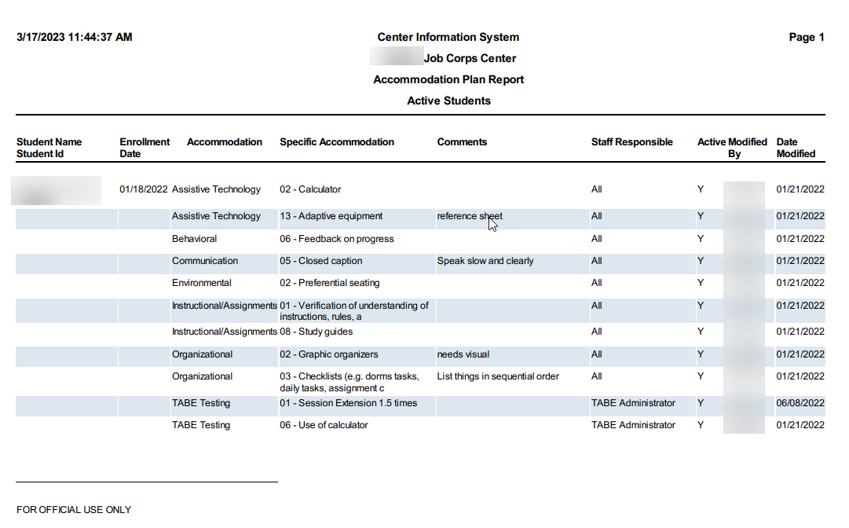
Accommodation Plan Report Access
All center staff responsible for providing accommodations will have access to the Accommodation Plan (without notes) Report in CIS.
16
Notes:
Accommodation Plan Report Access
All center staff should have access to the Accommodation Plan Report WITHOUT notes in CIS so that all staff responsible for implementing accommodations are aware of an individual’s accommodation needs.
Talk with center DC and/or the IT Point of Contact if you are not able to access student accommodation plans.

Slide 17
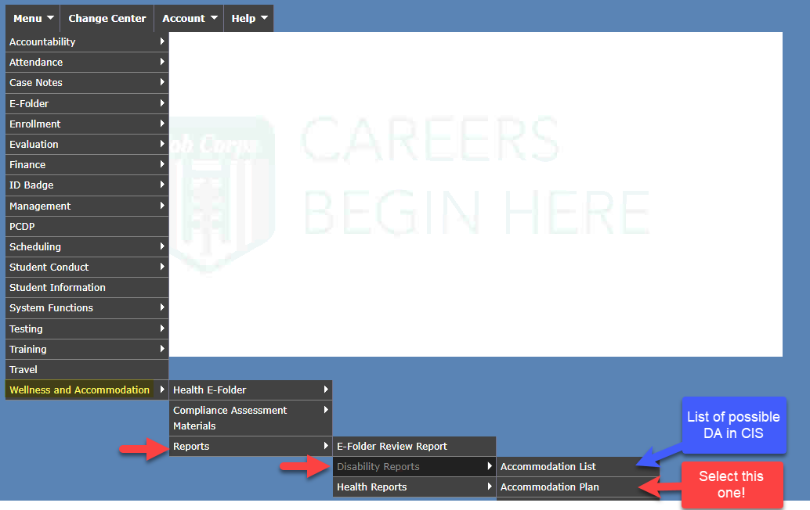
How to Access APs in CIS
First, ensure you have access to the “Accommodation Plan Report” in CIS.
Staff are responsible for providing accommodations as indicated in the accommodation plan.
Notes:
How to Access APs in CIS
First, log into CIS and ensure you have access to the “Accommodation Plan” report. Look at the screenshot at the right-hand side of the screen. Go to the Wellness and Accommodation Module in CIS, select Reports, then Disability Reports, and then Accommodation Plan. From here you view an accommodation plan report for one student, all students, etc. If you select the Accommodation List, that will simply give you a list of the type the accommodations that are available in the drop downs in CIS.

Slide 18
Effectiveness Monitoring
As the student participates in the program, new needs may be identified or accommodation adjustments may be required.
Frequency
Documenting
The DC evaluates/ monitors the effectiveness of a student’s accommodation plan at least every 60 days throughout the student’s enrollment in Job Corps.
If residential staff have concerns about the student’s supports (i.e., need for additional support), they should provide this feedback to the DC.
18
18
Notes:
Effectiveness Monitoring
As the student participates in the program, new needs may be identified or accommodation adjustments may be required.
How often must effectiveness of accommodations be reviewed?
The DC will review the effectiveness of a student’s accommodation plan at least every 60 days throughout the student’s enrollment in Job Corps.
If residential staff have concerns about the student’s supports (i.e., need for additional support), they should provide this feedback to the DC as soon as they have a concern or are aware of a new disability accommodation request made by a student, etc.

Slide 19
Initiating a Referral
Staff suspects a student may have a disability that is impacting their success in the program.
Student discloses a disability to a residential staff.
Student indicates to residential staff that they “may” need to speak with a Disability Coordinator.
19
Notes:
If you have a student on your dorm that does not have an accommodation plan in CIS and you suspect may have a disability that is impacting their success in the program or if a students discloses a disability to you, contact the DC. Also, if a student tells you that they are struggling and might need to speak with a center DC, help connect them so that they can discuss the support that may be needed.
The center may have a referral form you can complete to submit to the DC. The important part is ensuring that you communicate your concerns with a center DC.

Slide 20
No.4
Disability Accommodation Examples
This sections reviews some of the more commonly provided disability accommodations in the residential areas of the Job Corps program.
DA in
Residential
Common Supports
20
Notes:
Agenda Item No. 4
Now let’s review some common supports that are provided to students with disabilities within the Job Corps program.

Slide 21
Examples of Disability Accommodations in Residential
Room Dividers
Lower Bunks
White Noise Devices
Quiet Spaces
Special Alarms
May have anxiety/social or sleep hygiene challenges
May have medical condition or other safety risk
May have anxiety/social or sleep hygiene challenges
May need a space to regroup or get away from groups
May need vibrating alarms if the individual is deaf
Access to Snacks
Verification of Understanding
Praise/Positive Feedback
Visual Supports
Checklists
Need visual support for understanding
Need organizational and/or memory support
May need access to food for medical condition
Need staff to ensure understanding before starting task/activity
Need staff to provide praise, positive feedback, and encouragement.
21
Notes:
Examples of Disability Accommodations in Residential
This is a sampling of the types of accommodations that you might be responsible for implementing in the residential area. A student may need:
Room dividers because they may have anxiety/social or sleep hygiene challenges.
May require a lower bunk if they have a medical condition like a seizure disorder or have some other type of safety risk.
White noise devices because the individual may have anxiety being around others or other social engagement challenges or they struggle to sleep if they can hear noises.
Developing a “quiet” space that can be accessed by students with disabilities who are easily overwhelmed, have social engagement struggles, etc. to be able to regroup and have a little down time can be very helpful to the person who struggles being around a lot of people all the time.
Special alarms such as a vibrating alarm may be needed to help an individual who is hearing impaired or deaf wake up in the mornings.
Students who have intellectual, learning, or other related conditions may need visual supports (like pictures added to instructions) to aid understanding.
Checklists help those who have organizational and/or memory challenges and may not remember the sequence of steps in completing a task.
Individuals who are diabetic may need access to food when glucose levels shift.
Some students with disabilities are quick to say they understand something and want to rush through a task without fully understanding resulting in quick frustration. These students may need staff to verify that the student understands how to do a task or what is expected before they start a task or activity.
Some students are unsure and tentative in tackling a new task and need frequent feedback and encouragement. “Catch” them doing tasks or behaviors that are correct and praise them for it!

Slide 22
Actual Examples of Residential DA in CIS
DA in CIS
Are there other accommodations that have been implemented in residential at your center?
22
Notes:
Disability Accommodations in CIS
Here are some actual examples of residential related disability accommodations that are currently listed in CIS.
When working in groups, assign to a positive peer group. In other words, place the student with other students who are leaders, who are strong positive role models, perhaps outgoing, etc.
Lower bunks have been assigned when an individual has a seizure disorder, uses a c-pap machine, has anxiety related to heights, etc.
Student has a private room. This might be due to severe anxiety issues. It could be because the student must perform medical routines that require privacy like changing a catheter outside of the restroom area, etc.
Student has a rabbit as an assistance animal and in this case for mental health or emotional support.
The student has a positive behavior support of “praise work completion” which could be related to completion of dorm tasks, getting up or complying with other dorm rules and activities readily and quickly.
Are there other accommodations that have been implemented in residential at your center?

Slide 23
Residential Disability Accommodations Assigned to “All”
Checklists
First, talk to the student about the tasks that need to be completed.
Provide checklist of list of dorm tasks and a box to check off when complete.
Provide checklist organized by time of day (morning tasks versus evening ones).
Example
01
What must be implemented in the residential area for this student?
23
Notes:
Residential Disability Accommodations Assigned to “All” – Checklists
Example #1 – Provide daily and/or weekly checklists (to-do lists) to provide visual reminders and help student transition between tasks and/or assignment steps.
What must be implemented in the residential area for this student?
First, talk to the student about the tasks that need to be completed and ask them what is helpful to them. If they are uncertain, you might wish to try providing a checklist of dorm tasks and a box to check off when complete or you might provide a checklist organized by time of day (morning tasks versus evening ones) or you may determine that something else is needed. If the support is not working or you are having difficulty, always reach out to your center Disability Coordinators for assistance.

Slide 24
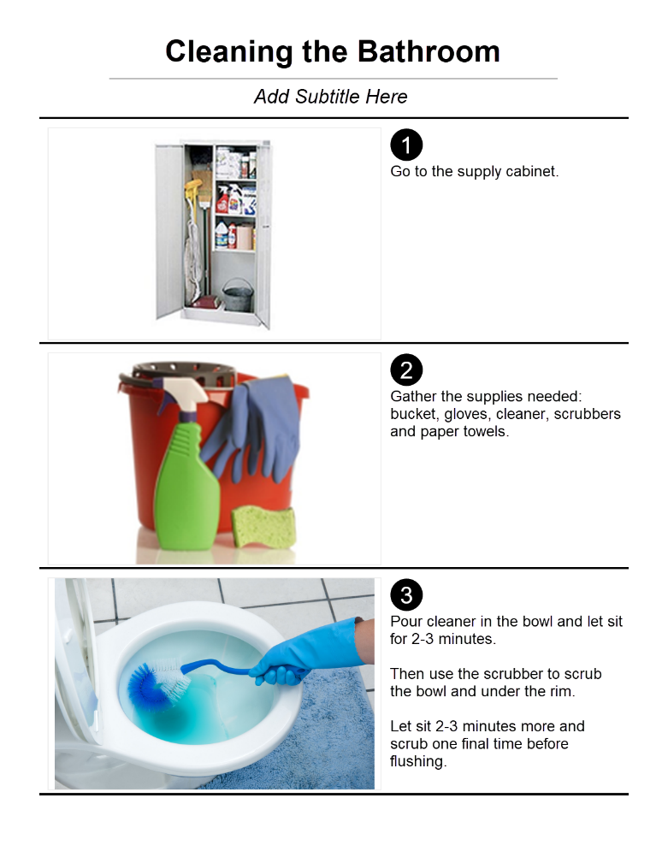
Visual Supports
Visual support examples:
Picture-supported task list
YouTube videos
Video modeling example – “Prompting”
Notes:
In the examples of disability accommodations, we mentioned visual supports. There are many differing types of visual supports but most often they included things like providing a picture-supported task like the example on the right hand of the slide. In this example, actual pictures of the dorm supply cabinet, materials, and the restroom are used to give the student a step-by-step guide to cleaning the bathroom. If the student has difficulty reading or seems to perform better hearing AND seeing the instructions, find a YouTube video that explains the steps or even better, create one yourself that can be used. The student can watch it repetitively as needed to assist them in completing the task. We will talk next about a specific type of video support call Video modeling and specifically using prompting to assist the student.
If you are using any type of visual support in your dorm, please share what you are doing in the chat box!

Slide 25
Video Modeling
Create your own visual supports as these work best!
Basic video modeling
Video modeling consists of recording another individual (e.g., staff, peer) performing the desired or targeted behavior.
Point-of-view video modeling
In Point-of-view video modeling, the video is created to show how the behavior would look from the student’s point of view.
Draws on strong visual skills
Can be used repetitively
Can include positive reinforcement
Video self-modeling
In video self-modeling, the student is recorded performing the target behavior while any inappropriate or other behaviors are edited out of the final video.
Video Prompting
Finally, video prompting is the process of showing sequences of behavior in different clips. The video is stopped after each segment for the student to practice the modeled behavior.
Notes:
There are multiple types of video models that can be used to assist students with tasks, behaviors, learning, etc.
Basic video modeling is like creating a YouTube video. You record another individual (e.g., staff, peer) performing the desired or targeted behavior.
Video self-modeling is when the student is recorded performing the target behavior while any inappropriate or other behaviors are edited out of the final video.
Point-of-view modeling is simply when the video is created from the vantage point of the person who is completing the task or action, similar to what you would see if wearing a head cam!
The last type is the one we want to talk more about today and that is video prompting. That is when sequences of behavior or completion of a task are shown one step at a time with a stop in between each step and a prompt to go to the next step when completed. This is especially useful for students who struggle with multi step tasks, have significant memory challenges, or need high repetition to master tasks.
Video modeling is often well received by students and draw on strong visual skills, again, can be used repetitively, and can include positive reinforcement as each item or task is completed.
We have a PowerPoint presentation on the JC Disability website on Video Modeling if you are interested in learning more.

Slide 26
Video Prompting Modeling
Single/smaller or sub-steps of the task are videotaped.
Staff or student pauses the video after each step to perform the task.
Used to teach a sequence of skills.
Continue the playing (prompting) of each step one at a time followed by completion of the step or task until the task is fully completed.
Notes:
Let’s talk a little more about Video Prompting Modeling
It can be very effective to help a student master a sequence of steps within a skill task or to remember a larger number of routine tasks that need to be completed each evening, for example.
A video prompting model includes single/smaller or sub-steps of the task in the video. Then the staff or student pauses the video after each step to perform the task and once complete, then can continue the playing (prompting) of each step one at a time followed by completion of the step or task until the task is fully completed.

Slide 27
Residential Disability Accommodations Assigned to “All”
Verification of Understanding/Reading
Ask the student to state their understanding of the information.
Have the student perform the first step or action in an activity to see if approaching task correctly.
Check the work being completed on a frequent basis.
Example
02
What must be implemented in the residential area for this student?
27
Notes:
Residential Disability Accommodations Assigned to “All” - Verification of Understanding/Reading
Example #2 – Verification of understating of instructions, rules, etc. with an added comment that states: “Check for understanding of reading materials.”
Ask the student to state or paraphrase their understanding of the information.
Have the student perform the first step or action in an activity to see if approaching task correctly or have them demonstrate the full sequence of tasks to be completed to ensure their accurate understanding of the task.
Check the work being completed on a frequent basis.

Slide 28
Assigned to “All” but States “Instructor and Student”
If an accommodation is assigned to the responsibility of “ALL” staff, check with the DC if questions.
Generally, apply the accommodation to a similar needed support related to your area – residential living.
Example
03
What must be implemented in the residential area for this student?
28
Notes:
Assigned to “All” but States “Instructor and Student”
Example #3 – Method of communicating need of time-out to be arranged between “instructor and student.” Even though it says, “method of communicating need of time-out to be arranged between instructor and student,” you can substitute residential advisor for instructor. Perhaps you are having a dorm meeting and the student is having difficulty being around so many people at once or is struggling with paying attention, the residential advisor can develop a pre-arranged signal that either could use to signal the need for a break, permission to exit the meeting, etc.
Generally, substitute staff roles and/or responsibilities to those in your area if an accommodation is assigned to all but appears to be academically-related.
For example, if a student has reading challenges and the accommodation comments reference an instructor or a specific academic class, remember that students do not only have those reading challenges in the academic or career technical area, they also will have them in residential living. Then you consider how you are going to ensure that the student has access to print information that is handed out, posted on bulletin boards, etc. Caution, try to implement accommodations in such a way as to foster independence so that they are portable and can be used in the work environment later (i.e., do not get in the habit of reading information to students; instead, provide them with assistive technology that can aid them in accessing print information).

Slide 29
Other Types of Behavioral Supports
Example
04
What must be implemented in the residential area for this student?
29
Notes:
Other Types of Behavioral Supports
Example #4 – Other – Provide fidgets
Fidgets may be used to help students who are anxious, who have difficulty focusing, who have some difficulties managing their own self-regulation, etc. As an aside, what is self-regulation? Andrea Bell from GoodTherapy.org has a straightforward definition of self-regulation: It’s “control [of oneself] by oneself” (2016). As Bell also notes: “Someone who has good emotional self-regulation has the ability to keep their emotions in check. They can resist impulsive behaviors that might worsen their situation, and they can cheer themselves up when they’re feeling down. They have a flexible range of emotional and behavioral responses that are well matched to the demands of their environment” (2016).
So, sometimes fidgets help the person to self-calm, to focus attention, or to reduce other perhaps repetitive and distracting behaviors, etc.

Slide 30
Accommodations
Unclear?
Is the DA clear in this example?
Is the DA clear in this example?
30
Notes:
Let’s review a couple of accommodations together and see how you would implement them in residential living.
Look at the first example for personal supports listed under Other – Dorm Coach and then has a comment that states, “Assistance needed with sleep routine and hygiene.” What does that mean to you?
The second example is a behavioral one that says, “Positive behavior supports.” What does that mean to you?
If you have questions about how an accommodation applies to residential living or you do not have enough information to know what must be implemented, please contact the DC to discuss and/or for clarification.

Slide 31
No.5
Private Room Requests, Assistance and Service Animals
Residential Staff may be involved in providing and/or assisting with complex accommodation or access needs for students with disabilities.
Hot Topics
For Residential
31
Notes:
Agenda item No. 5
Now, let’s spend some time talking about a few of the HOT Topics that impact residential living. Our HOT Topics review will include discussion on private room and assistance animal accommodation requests and the presence of a Service Animal in the residential living areas.
Students spend a large portion of their time in residential living so Residential Staff will be involved in providing and/or assisting with complex accommodation or access needs for students with disabilities.

Slide 32
Who Can Deny Accommodation Requests?
True or False:
A center may tell an applicant/a student that they may not have a private room on center.
Notes:
Who can deny accommodation requests?
True or False: A center may tell an applicant/a student that they may not have a private room on center? What do you think?
It is FALSE. Let’s discuss why centers may not deny accommodations at the center level.

Slide 33
Who Can Deny Accommodation Requests? (cont.)
Centers may not deny accommodation requests at the center level.
ONLY the National Office of Job Corps can determine the reasonableness of an accommodation request.
Reasonableness must be determined based upon the resources of the entire Job Corps program.
Notes:
Accommodations may only be denied if an accommodation/modification requested poses an undue burden to Job Corps. Centers may not deny accommodation requests at the center level because reasonableness must be determined based upon the resources of the entire Job Corps program. Because of this, ONLY the National Office of Job Corps can determine the reasonableness of an accommodation request.

Slide 34
Contact the center Disability Coordinator for Assistance!
Notes:
If you have any question about the reasonableness of a request, please contact the center Disability Coordinator for assistance!

Slide 35
How the DC Processes a Private Room Request
The DC/DAC conducts a reasonableness review. Is the center able to provide the requested accommodation?
Yes? DC documents the agreed upon request on the request form and enters the individual’s accommodation plan (AP) into CIS.
No? DC/DAC offers reasonable alternative accommodations that likely would be equally effective.
Alternative Accommodation Examples
Placed in room with no more than “x” number of roommates or not to exceed “x” number of roommates
Portable room divider/folding screen placed in room to increase privacy or positioning to improve privacy
White noise machines or noise cancelling headsets
Private space to go to for short periods of time
Notes:
How the DC Processes a Private Room Request
The DC/DAC conducts a reasonableness review, which likely will include discussion with center management to include residential living. Is the center able to provide the requested accommodation?
Yes? DC documents the agreed upon request on the request form and enters the individual’s accommodation plan (AP) into CIS.
No? DC/DAC offers reasonable alternative accommodations that likely would be equally effective.
What are Alternative Accommodations? Alternative accommodations are accommodations that the center has determined that would be reasonable and equally effective for the applicant or student’s functional limitations. For example, some alternative accommodation examples for a private room might include:
Placed in room with no more than “x” number of roommates or not to exceed “x” number of roommates
Portable room divider/folding screen placed in room to increase privacy or positioning to improve privacy
White noise machines or noise cancelling headsets
Private space to go to for short periods of time
If the individual accepts the alternative accommodations, those are entered into the accommodation plan in CIS. If they reject the alternative accommodations, then the DC will handle processing a reasonableness review that will ultimately be reviewed by the National Office. The National Office makes the final decision on the reasonableness of a complex or potentially unreasonable accommodation.

Slide 36
Assistance Animals may be an accommodation in Job Corps.
Generally, the animal will stay crated in the dorm during the day.
The student likely will need an accommodation to have breaks during the training day to either feed or take the animal out for a bathroom break, etc. dependent upon the type of animal.
The student is expected to provide for the needs of the animal and provide its care.
The animal must always be under the student’s control.
Assistance Animals
36
Notes:
Assistance Animals
Assistance Animals may be an accommodation in Job Corps. If the center approves or agrees to the requested accommodation, the assistance animal likely will be crated in the dorm room during the day. The student likely will need accommodations to have breaks during the training day to either feed or take the animal out for a bathroom break, etc. dependent upon the type of animal. The student is expected to provide for the needs of the animal and provide its care and the animal must always be under the student’s control and housebroken and typically must have a rabies vaccination.

Slide 37
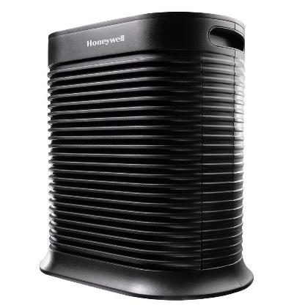
Allergies to Animal
Allergies and fear of animals are not valid reasons for denying access/accommodations to a student using either a service animal or an assistance animal.
Notes:
One question raised frequently is how can the program allow animals when there are individuals who have allergies to those animals and/or who have fears related to animals.
Allergies and fear of animals are not valid reasons for denying access/disability accommodations to a student using either a service animal or an assistance animal.

Slide 38
Allergies (cont.)
Suggestions for addressing issues related to allergies include:
Try to keep the animal and staff/students who are allergic in different areas of the center and establish different paths of travel for each student
Provide the student with a private room
Use a portable air purifier and add HEPA filters to existing ventilation system
Avoid use of common areas at the same time
Allow student to change to career technical uniform in the specific training area
Check with Wellness for OTC allergy medications
Notes:
There are lots of ways to address issues related to allergies.
Some ideas you may wish to try include:
Try to keep the animal and staff/students who are allergic in different areas of the center and establish different paths of travel for each student
Provide the student with a private room
Use a portable air purifier and add HEPA filters to existing ventilation system
Avoid use of common areas at the same time
Allow student to change to career technical uniform in the specific training area
Check with Wellness for OTC allergy medications
Although not required, the center staff could ask the student if they are willing to use dander care products on the animal and bathe it regularly, if that is possible. The center staff also could ask the student/employee who is allergic to the animal if they would like to, and would benefit from, wearing an allergen/nuisance mask.
It likely would be important to have areas where the animal is present - including carpets, walls, and window treatments - cleaned, dusted, and vacuumed regularly.

Slide 39
Service Animals are not an accommodation. They provide “access” for participation for an individual with a disability.
A student does not have to request an accommodation for a service animal. They inform the center of the service animal and the DCs proceed with next steps.
Service animals are “working” animals.
They generally accompany the individual throughout the program.
The student is required to provide for their needs and care.
The animal must have a rabies vaccination.
Service Animals
39
Notes:
A service animal is any dog that is individually trained to do work or perform tasks for the benefit of an individual with a disability, including a physical, sensory, psychiatric, intellectual, or other mental disability. Other species of animals, whether wild or domestic, trained or untrained, are not service animals.
Service Animals are not an accommodation. They provide “access” for participation for an individual with a disability.
This means an individual does not have to request an accommodation for a service animal. They inform the center of the service animal and the DCs proceed with next steps.
Service animals are “working” animals.
They generally accompany the individual throughout the program.
The student is required to provide for their needs and care.

Slide 40
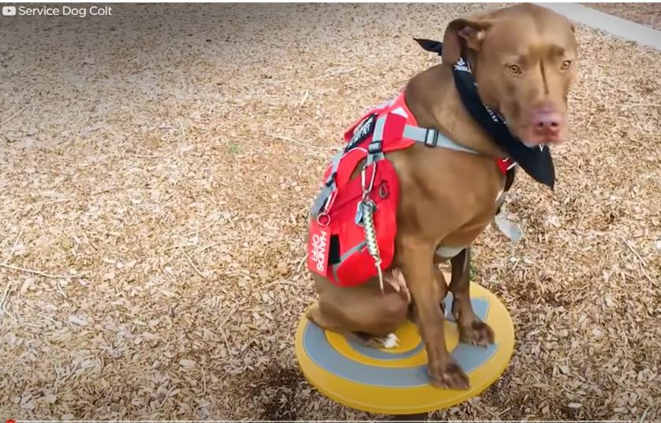
Service Animal Example
Notes:
Service animals provide a wide variety of supports for individuals with disabilities. This may include be a psychiatric service dog and clearing a room for a person who has PTSD or other fears, to diabetic and seizure alert dogs, to ones who assist individuals with vision and hearing related disabilities. Let’s watch a brief clip showing Colt at work.
https://www.youtube.com/watch?v=ivrZMGK6cMw
01:36

Slide 41
No.6
Common Disabilities, Accommodation Ideas, PowerPoint Presentations, and More!
Disability
Website
The Job Corps Disability website is loaded with resources and updates are made on a weekly basis!
Resource Review
41
Notes:
Agenda Item No. 6
Disability Website – Resource Review
The Job Corps Disability website is loaded with resources and updates are made on a weekly basis. Let’s take a quick look at some of the resources there to include common disabilities, accommodation ideas, and PowerPoint presentations to include the one on video modeling mentioned earlier in the presentation.

Slide 42
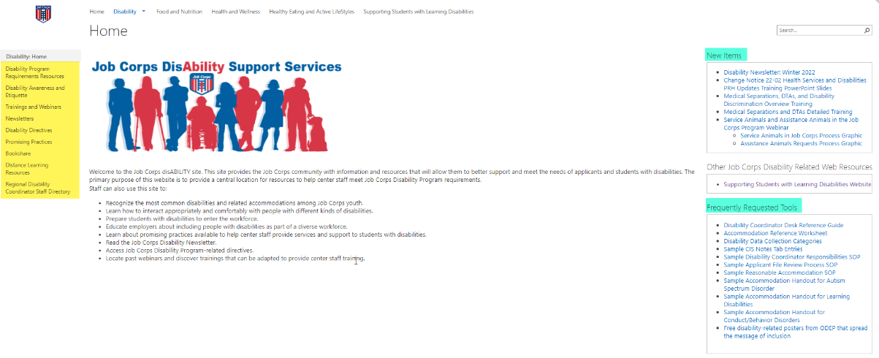
Job Corps Disability Website
https://supportservices.jobcorps.gov/disability/Pages/default.aspx
42
Notes:
Job Corps Disability Website
The Job Corps Disability Support Services website contains numerous resources and tools on all areas of the disability program.
As new resources and tools are developed, they are listed under the New Items heading to the right side of the website page. See teal highlighted area. Resources that are more commonly used and/or requested are listed under the Frequently Requested Tools section also highlighted in teal.
The categories of resources are listed on the left-hand side of the website and are highlighted in yellow.
The Job Corps Disability website link is located at the bottom of the slide.

Slide 43
Question and Answer Time!
43
Notes:
Question and answer time! Please put your questions in the chat box and then we will discuss them as they are posted.

