Slide 1
Universal Design
for Learning
To Promote Accessibility and Support Learning for Students with Disabilities
Notes:
Our topic today is Universal Design for Learning (UDL) and how it can promote accessibility and support learning for students with disabilities—actually for ALL students.

Slide 2
OBJECTIVES
OBJECTIVE #3
Identify one way you are either using UDL currently or can implement UDL in your present learning/training or living environment (in person or distance learning)
OBJECTIVE #1
Define UDL
OBJECTIVE #2
OBJECTIVE #4
List the 3 basic principles of UDL
Access 3-4 UDL-related resources to support teaching and learning in a variety of settings
2

Slide 3
Poll Questions
Question #1
How familiar are you with Universal Design for Learning (UDL) principles?
Very familiar
Somewhat familiar
Have heard of but that’s it
Not familiar at all
3
Notes:
Ask the poll question and for the audience to respond in the chat box.
Does anyone have an example of how you incorporated UDL principles into your center?

Slide 4
UDL Background
History and Examples
4
Notes:
Let’s talk a little about how Universal Design for Learning came about and even a legislative foundation for using UDL.

Slide 5
Accessibility
Section 188 of WIOA prohibits discrimination against individuals who apply to participate in, work for, or come into contact with programs/activities of the workforce development system (i.e., Job Corps).
WIOA also requires that Job Corps be accessible physically and programmatically, offering accommodations and incorporating Universal Design wherever possible.
(29 CFR Part 38)
5
Notes:
Section 188 of WIOA prohibits discrimination against individuals who apply to, participate in, work for, or come into contact with programs/activities of the workforce development system, including partners that are part of the American Job Center (AJC) delivery system. Section 188 prohibits discrimination on the basis of race, color, religion, sex, national origin, age, disability, or political affiliation or belief, among other bases. WIOA also requires that AJCs be accessible physically and programmatically, offering accommodations as needed and incorporating Universal Design wherever possible.
There is no one pathway to ensuring equal opportunity and nondiscrimination in Job Corps. However, there are a diversity of best practices that have been collected nationwide that significantly expanded access for individuals with disabilities. Section 188 can be used as a framework for improving access, equal opportunity and employment outcomes.

Slide 6
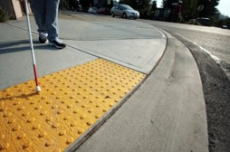
Brief History of and Defining UDL
Inspired by universal design movement in architecture and product design
Calls for “the design of products and environments to be usable by all people…”
UDL applies this general idea to learning:
Curriculum from the onset be designed to accommodate all kinds of learners…
CAST researchers formed a UDL framework for teaching and learning
(3-part UDL framework)
6
Notes:
Brief History of and Defining Universal Design for Learning
Have you ever used a curb cut in a sidewalk? For what purposes? [Examples – strollers, shopping carts, suitcases on wheels, bicycles, etc.]
Universal Design for Learning was inspired by and born from the overarching universal design movement (things like curb cuts as we just discussed). The goal was and remains to make products and environments usable by all people or accessible to the masses.
Universal Design for Learning applies this general idea to the learning environment – curriculum should be designed to inherently and naturally accommodate all kinds of learners!
CAST is the Center for Applied Special Technology and its researchers were responsible for designing and developing a 3-part UDL framework.

Slide 7
Video Clip:
The foundations
of UDL
John Spencer, professor and author
YouTube video provides an overview of the foundations of UDL using a sketchnote video. Understanding the foundation of UDL will support our growth and development in the framework and implementation of UDL principles.
7
Notes:
This brief video provides us the background we need to know the understand the foundations of UDL.
https://www.youtube.com/watch?v=NL2xPwDrGqQ
(0:00-2:46)

Slide 8
When you design for everyone, everyone benefits from the design!!

Slide 9
Who is the Focus?
Adjusting the view from designing curriculum/learning environments for the average student
9

Slide 10
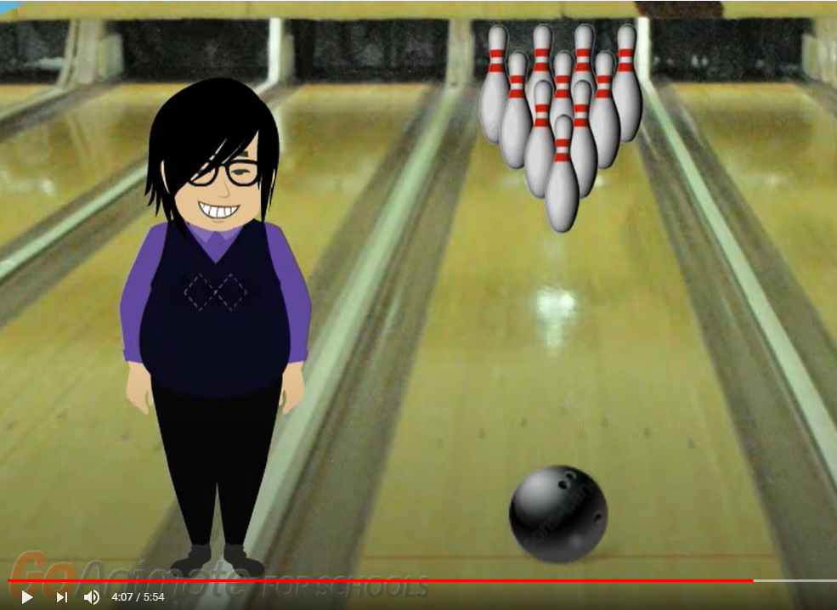
Video Clip:
“One size fits all…
or does it?”
https://www.youtube.com/watch?v=ylkD02EjG4A
10
Notes:
Video Clip
https://www.youtube.com/watch?v=ylkD02EjG4A
4:07-5:54
This brief video clip provides a bowling analogy to illustrate the UDL approach. “We have to change our aim.”

Slide 11
The Particulars of UDL
Engagement, Representation, and Action/Expression
11
Notes:
Framework of UDL – Representation, Expression, and Engagement
UDL does not imply a single optimal solution for everyone. Instead, it is meant to underscore the need for multiple approaches to meet the needs of diverse learners.

Slide 12
Framework of UDL
Multiple means of representation - to give learners various ways of acquiring information and knowledge
Multiple means of expression - to provide learners alternatives for demonstrating what they know
Multiple means of engagement - to tap into learners' interests, offer appropriate challenges, and increase motivation
http://www.cast.org/research/udl/index.html
Notes:
UDL is comprised of 3 main components
Multiple means of representation
Multiple means of expression
Multiple means of engagement
Let’s look a little closer at each.
Multiple means of representation means that we develop and implement a variety of ways for learners acquire information and knowledge. We will review some examples shortly.
Multiple means of expression means that we offer/provide learners alternative or multiple ways for demonstrating what they know or what they have learned.
Multiple means of engagement means that we “figure out” how to use learners’ interests and strengths, etc. to offer appropriate challenges, increase motivation, etc.
Often times we include “multiple means” in our accommodation plans.
What might be some examples of “multiple means” of representation, expression, and/or engagement that we provide through APs at JC?
Examples: Provide student with written instructions along with oral instructions. Allow student to demonstrate understanding of rules and expectations in an oral format rather than written responses. Provide video instruction.

Slide 13
Video Clip:
An Introduction
to UDL
Universal Design for Learning (UDL)
UDL is a framework to improve and optimize teaching and learning for all people based on scientific insights into how humans learn.
Center on Applied Special Technology (CAST)
YouTube video provides an overview of the UDL framework. UDL guides the design of instructional goals that can be customized and adjusted to meet individual needs.
13
Notes:
As we mentioned, UDL is the brainchild of the Center on Applied Special Technology or CAST. Let’s review the core framework of UDL a little more closely.
https://www.youtube.com/watch?v=U1B6yQXsr0c
(2:38-5:15)

Slide 14
UDL is PROactive
instead of REactive

Slide 15
Examples of UD and UDL
Common Ones and those that Apply in a
Variety of Learning Settings and Learning Models
15
Notes:
Now let’s take a look at some examples of Universal Design and Universal Design for Learning. We are going to review examples that are commonplace all around us, commonplace on Job Corps centers, and commonplace in the workplace as well as how UDL might “look” implemented in a variety of learning settings and within a variety of learning models.

Slide 16
Common Examples of UDL
in our World
Curb cuts, sidewalk ramps
Inclusive door handle designs
Closed captioning
Signs, signs, everywhere signs…
“Smart” designed homes
Voice, cell phone, manual management of environment
Counters and desks at varying heights
Apps and devices for just about everything including virtual assistants like “Alexa!”
Accessible signs
16
Notes:
Let’s start with reviewing some common examples of Universal Design and Universal Design for Learning that we all see on a routine basis.
Review some of the examples.
What other examples of UD/UDL can you think of? (Elevators, ramps, etc.)
Who benefits? We all do!

Slide 17
Common Examples of UDL
on Centers
Lever handles for opening doors
Flashing light fire alarms
Accessible ramps to building entries
Audio books
Speech recognition software
“Smart” Boards and “Smart” pens
Instruction that is being provided in multiple ways (visually, auditory, kinesthetic…)
Accessible books
17
Notes:
Here are some common examples of Universal Design and Universal Design for Learning that are found on centers!
Review the examples.
How many of you have Bookshare accounts? Bookshare is free and provides accessible books (read out loud) to students who have reading disabilities, intellectual disabilities, etc. More information on Bookshare can be found on the Job Corps disability website.

Slide 18
Common Examples of UDL
in the Workplace
Flexible seating which includes adjustable and stand up desks
Labels on equipment (often color-coded)
Control buttons on machines in large print
Environmental considerations such as low noise areas, climate control, physical accessibility
Rules, regulations, SOPs, etc. available in multiple formats
Accessible break areas
Lots of technology
Adjustable desk
18
Notes:
Here are some common examples of Universal Design and Universal Design for Learning that are found in the workplace!
Review some examples.
Look at the picture of the adjustable desk on the right-hand side of the slide. This is a desk that can be adjusted to standing height, for users in a wheelchair, etc. It’s adjustable and will accommodate a variety of needs!

Slide 19
Specific Examples in a Variety of Learning Settings/Models
Traditional Accommodation
Read text to student
Distance, On-Center, or Using Blended Model
Provide text-to-speech options
Microsoft Education Tools
Immersive Reader
Google Suite for Education
Office Lens
Immersive Reader (Chrome Extension)
Provide audio books (i.e., Bookshare)
Provide video-taped content
Notes:
Here is an example of how we might provide a “traditional” accommodation (reading text to our student) in Distance/on Center/or Using a Blended Model…where we might provide text-to-speech options or audio books like Bookshare, or video-taped content.
If using Microsoft Education Tools, we might connect the student with Immersive Reader or Office Lens to have the text-to-speech option. If using Google Suite for Education, we might again offer Immersive Reader as a Chrome Extension.
Our last newsletter (archived on the JC Disability Website) provides several of these type of examples that demonstrate accommodation portability.

Slide 20
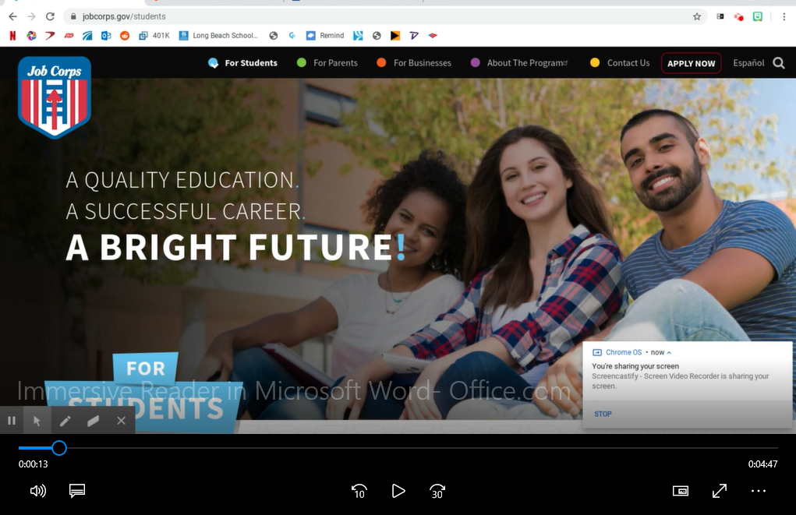
Long Beach – Immersive Reader

Slide 21
Implementation of UDL
Where to Start
21
Notes:
Of course, the goal is to implement and thread the concepts of Universal Design for Learning throughout the center so that access is improved for all students with disabilities. This applies to academics, career technical, residential, and certainly can have application to career preparation and career transition activities as well.

Slide 22
UDL: Reasonable Accommodation in Distance Learning Settings and Blended Learning Models
How Do We Implement a
UDL Framework?
Engagement: How can we use a variety of strategies to engage our students in distance learning?
Representation: How can we offer multiple ways to present information to students in distance learning?
Expression: How can we offer multiple ways for our students to complete tasks, assignments, etc. in distance learning?
Notes:
So how do we implement a Universal Design for Learning framework? First, we must think of the 3 core principles of UDL, engagement, representation and expression.
To provide accommodations for students with disabilities, innovative thinking and an understanding of the resources and tools available are required. Instructors and other Job Corps direct service staff can create and/or provide lessons that are accessible in multiple ways.
So how do we implement a Universal Design for Learning framework. First, we must think of the 3 core principles of UDL, engagement, representation and expression.
For example, how can a career technical instructor teaching carpentry implement the concept of engagement – why the student should learn the content being presented and how they can use this skill or information. Engagement requires thinking about diverse ways that students can be involved with the instructor, with fellow students, and with the course content. During our upcoming UDL webinar, the presenter will go into detail about how to engage students using UDL principles.;
Post the goal of an activity or for the day.
Appoint a student to be an assistant for a demonstration.
Create small teams to design, solve, or answer various problems or questions.
Afford multiple different opportunities to engage with the content – via video, on paper, hands-on, etc.
How could we implement the concept of representation – multiple ways to present information to students?
Demonstrate a skill from the Training Achievement Record or TAR. Accompany the demonstration with oral instructions.
Record the demonstration. Later allow students to re-watch the demonstration (as and if needed)
Hand out visuals/graphics of the task to be demonstrated. Accompany those with written guidance.
The student could demonstrate the skill live, by making videos, creating a PowerPoint, drawing a graphic or visual board, etc.
UDL is a way of thinking about how to make instruction accessible for all.

Slide 23
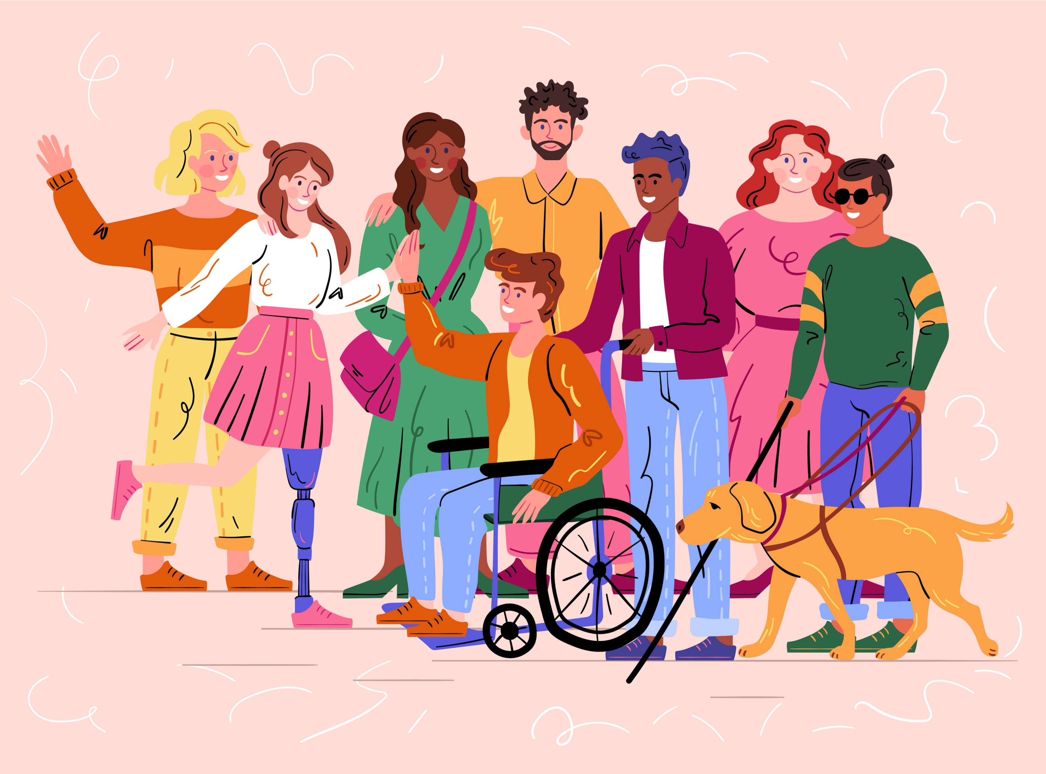
Preparing to Reach All Learners
Ensure familiarity with your students’ strengths and weaknesses.
Know the most common types of accommodations that appear on students with disabilities’ accommodation plans.
Notes:
Let’s review a few basic things that staff can begin to do to establish a foundation for using Universal Design for Learning principles.
Review the content on the slide.
3

Slide 24
Preparing to Reach All Learners
Consider at least one alternative way to engage students in a learning activity, one alternative way to present information, and one alternative way to allow students to complete tasks or demonstrate their knowledge.
Use assistive technology and digital materials as much as possible.
Notes:
Let’s review a few basic things that staff can begin to do to establish a foundation for using Universal Design for Learning principles.
Review the content on the slide.
3

Slide 25
Strategy!
Start (a lesson or task) EASY and move towards more difficult content.
End (a lesson or task) with going from the harder or more difficult content to EASY content.

Slide 26
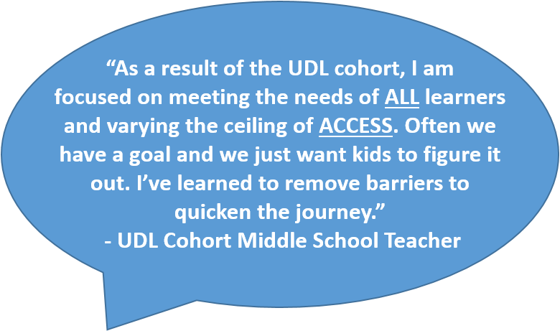
Why Use UDL
Benefits and Unintended Consequences
26
Notes:
We have discussed a few benefits of UDL such as leveraging students’ strengths and supporting ALL students—not just students with disabilities. Let’s look at a few more benefits.

Slide 27
How can this be useful to students with disabilities who need accommodations?
27
Notes:
IF we design learning environments, experiences, etc. to include those on the fringes from the beginning rather than wait until there are challenges and struggles, we are going to do a better job supporting all students including those with disabilities. Essential accommodations may become natural supports; may be provided in instances where they were inadvertently overlooked on an accommodation plan; or may provide benefit as a new support that has been previously unexplored.

Slide 28
28
Notes:
Here we have some general and individual benefits…
Naturally reduces barriers to the learning environment and to content.
Benefits all students.
Improves student engagement and motivates students to participate because learning is accessible.

Slide 29
Others Who Benefit!
People with disabilities
English Language Learners (ELL)
Unidentified strugglers
29
Notes:
As we have discussed multiple times already, implementation and use of UDL benefits all students but it can especially be helpful to students with disabilities. Additionally, individuals who are English Language Learners may benefit from the use of technology and other material adaptations (i.e., use of visual and auditory supports) and of course, it can benefit those students who have unidentified learning challenges by providing access to information in a variety of ways and by allowing them multiple ways of demonstrating skill mastery.

Slide 30
Other Benefits
Saves time
Saves money
Promotes inclusion
Assists in avoiding legal issues
Provides access and opportunities for learning to take place anytime/ anywhere (distance learning)
30
Notes:
Some other benefits include UDL saves time by embedding natural supports that help all students; promotes inclusion by ensuring that all students are engaged in learning and have access to the learning environment; assists in avoiding legal issues by again, embedding accommodation supports, and provides access and opportunities for learning to take place anytime/anywhere including distance learning.

Slide 31
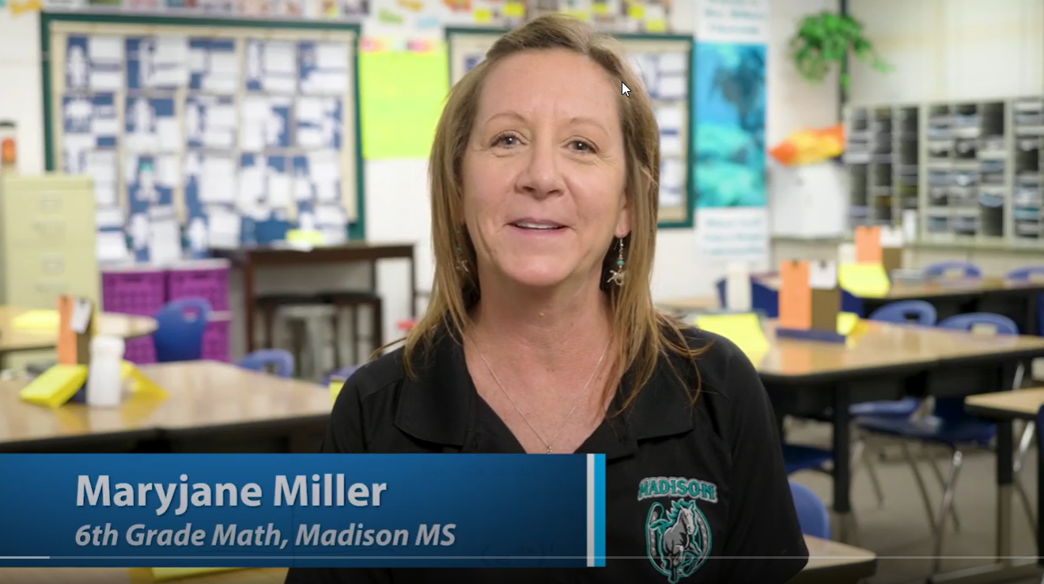
Video Clip:
UDL in Action
31
Notes:
https://www.youtube.com/watch?v=9h0u957rr6Q
00:15-5:00

Slide 32
Resources
Websites
32
Notes:
A few more UDL resources are available in this section.

Slide 33
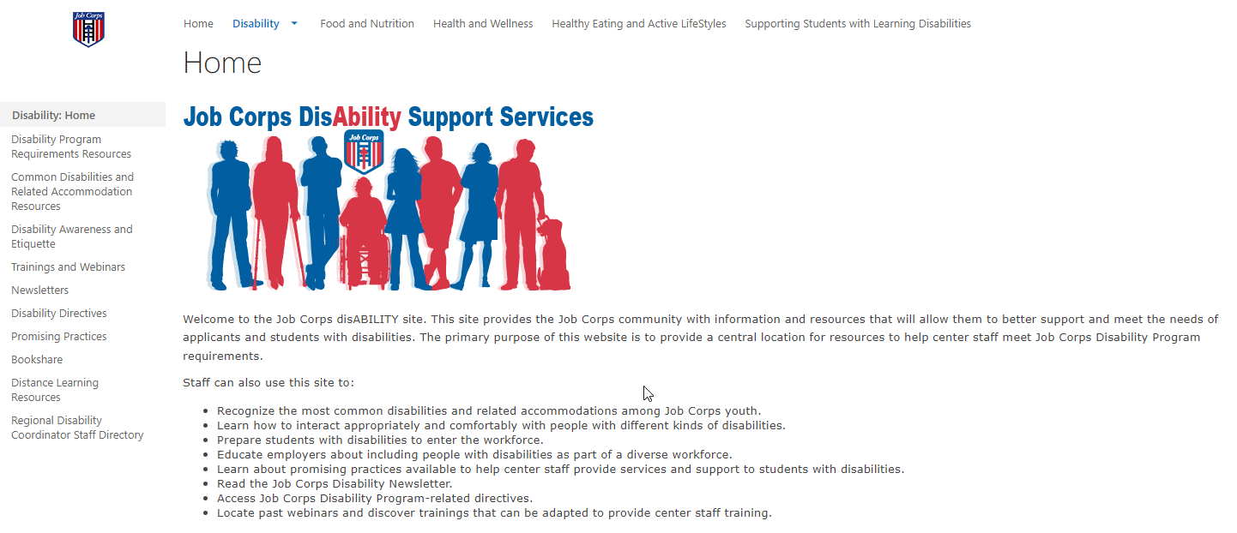
Job Corps Disability Website
https://supportservices.jobcorps.gov/disability/Pages/default.aspx
33

Slide 34
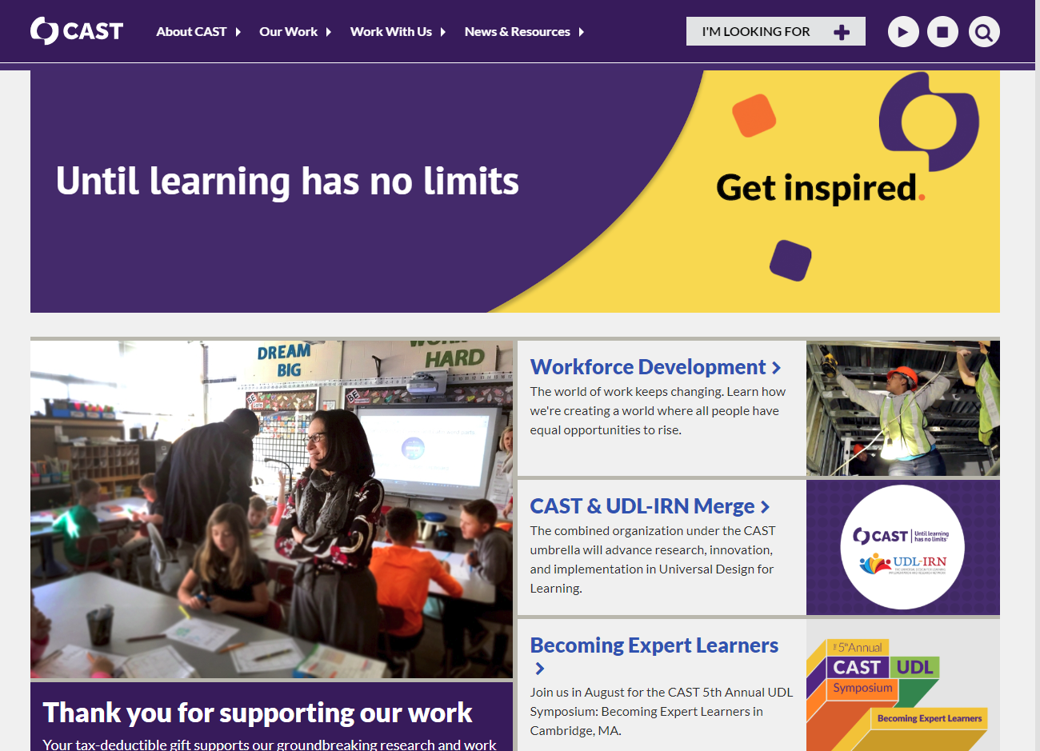
CAST http://www.cast.org/
34
Notes:
CAST – Center for Applied Special Technology
The team at CAST has been working with UDL framework for over thirty years.

Slide 35
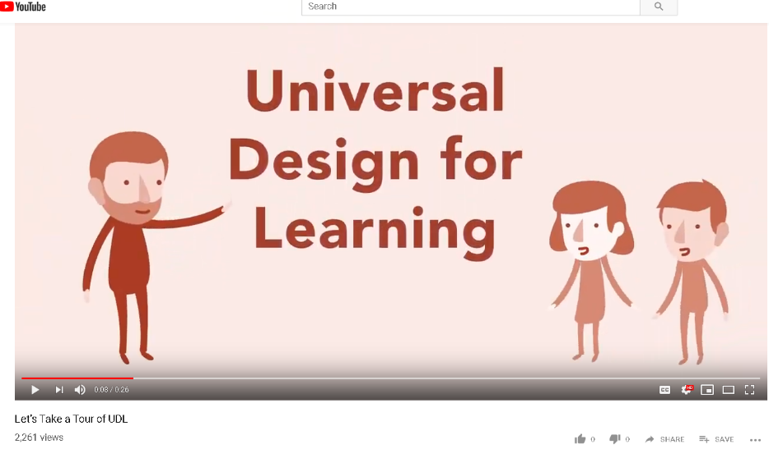
National Center on UDL https://www.youtube.com/watch?v=JR8EPXsTgbA
35

