Slide 2
Dental Health
Full body health
Impacts
Cardiovascular health
Chronic infections

Slide 3
Dental Health
Affects
Pregnancy
Unborn child
Chronic infection

Slide 4
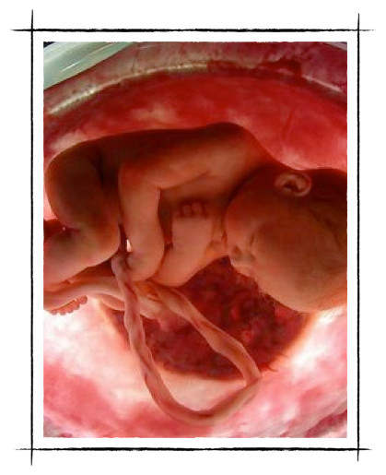
Chronic Infections
Dental bacteria
Placque
In cord blood
Increased premature births

Slide 5
Dental Health
Creates havoc with diabetes

Slide 6
Nutritional Diet
Taste versus nutrients

Slide 7
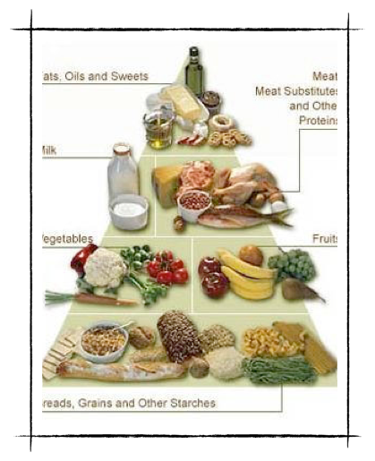
Healthy Diet
Food
Pyramid
Healthy living

Slide 8
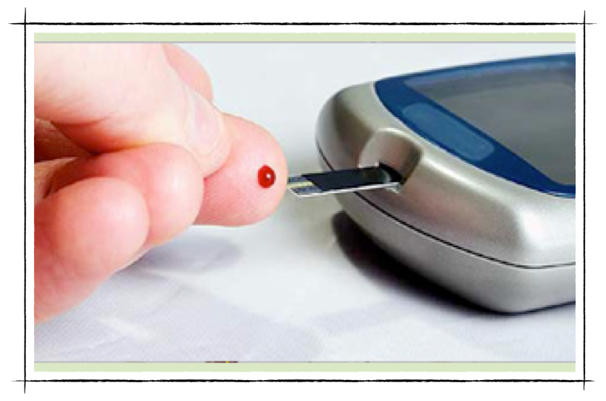
Chronic Infections
Uncontrolled blood sugar

Slide 9
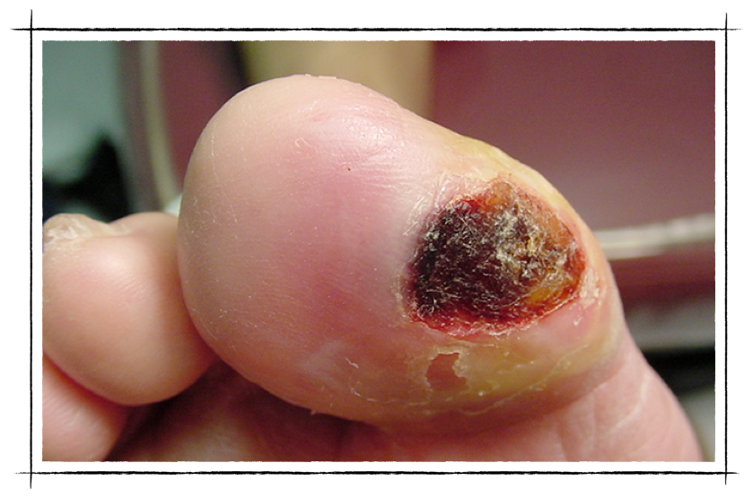
Diabetic Ulcers
Uncontrolled diabetes

Slide 10
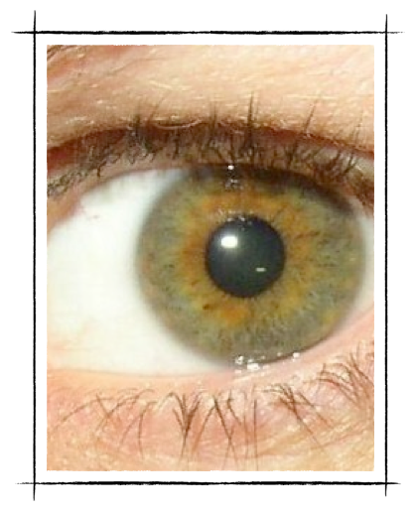
Dental Health
Diabetic Complications
Vision
Neuropathy
Low Birth Weight
Premature
Heart Attacks
Strokes

Slide 11
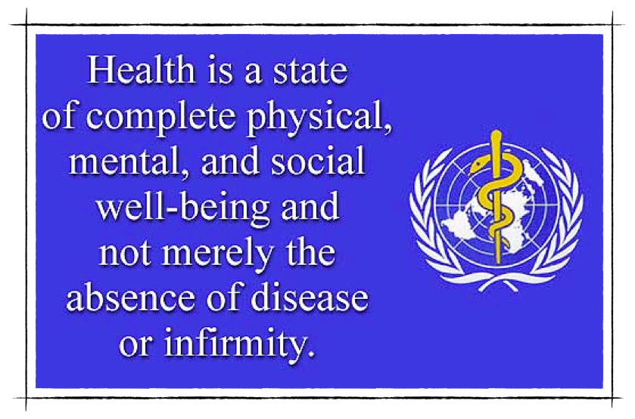
World Health Organization
The compartmentalization involved in viewing the mouth separately from the rest of the body must cease because oral health affects general health

Slide 12
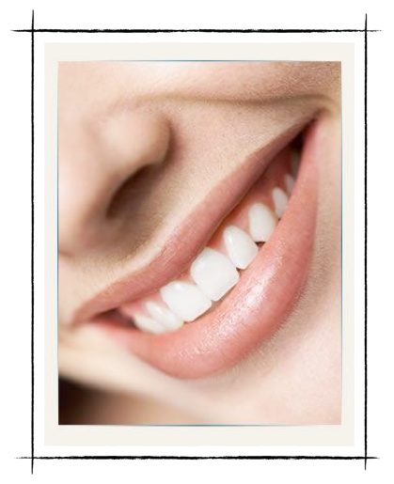
Dental Hygiene
Smile
Chew Food
Bite Food
Speaking & Singing

Slide 13
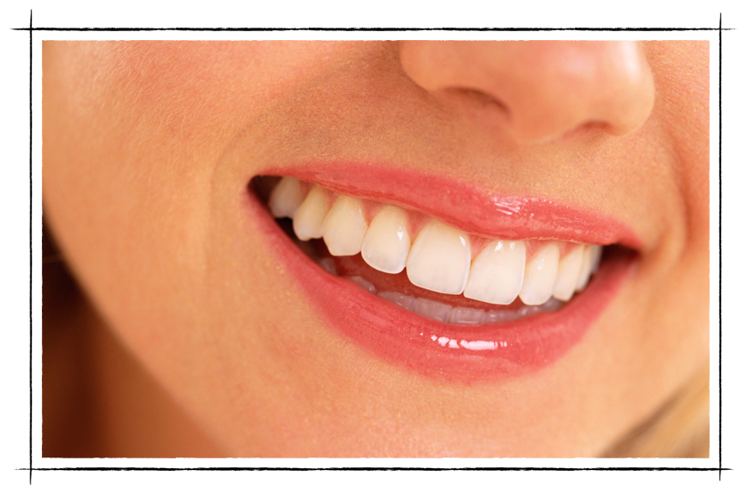
A Healthy Smile
Could make you more employable

Slide 14
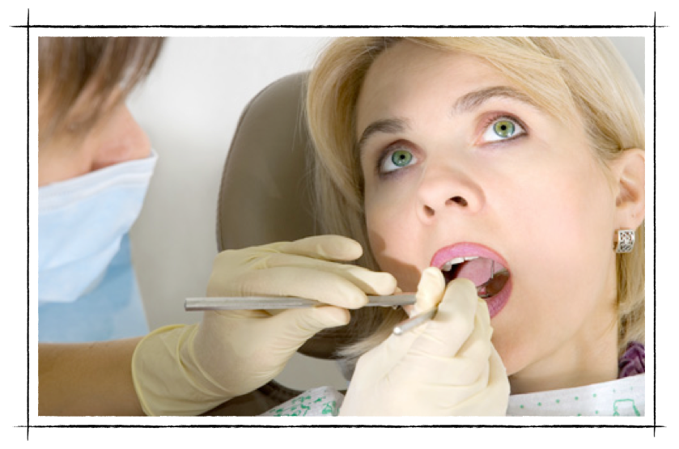
Dental Hygiene
Every six months

Slide 15
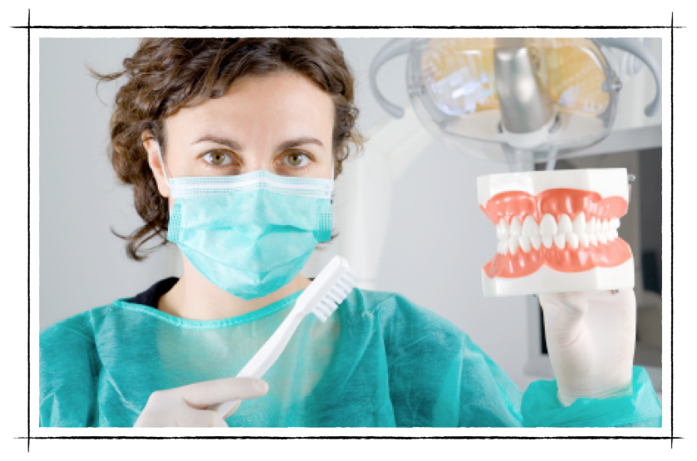
Toothbrushing

Slide 16
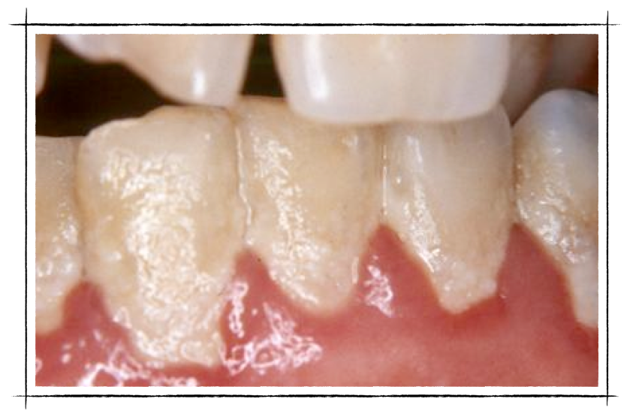
Dental Placque
Hard to see

Slide 17
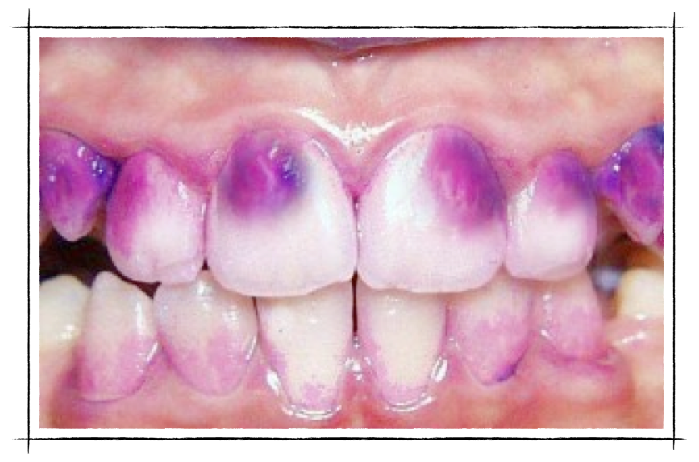
Disclosing Dye
To see the bacteria infecting your gums & teeth

Slide 18
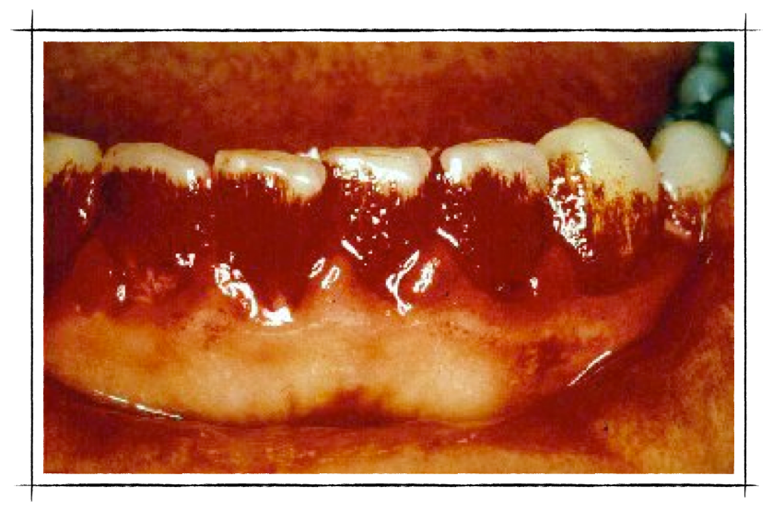
Disclosing Dye

Slide 19
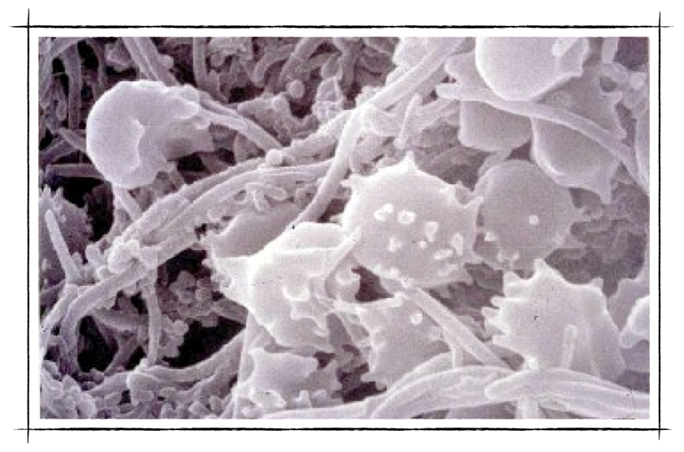
Bacteria In Plaque

Slide 20
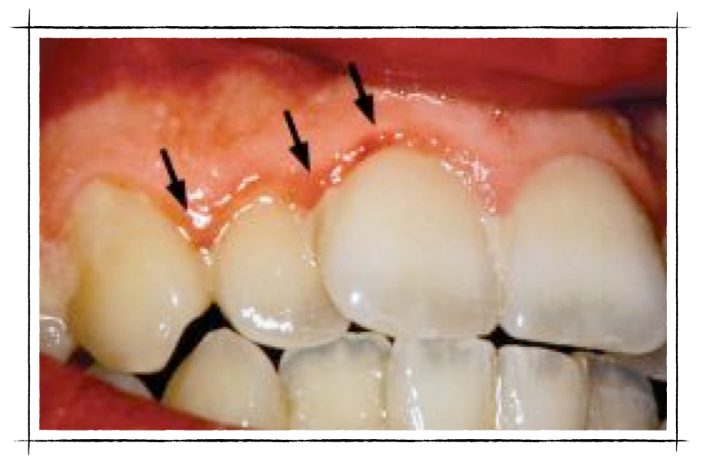
Gum Infection
Chronic inflammation

Slide 21
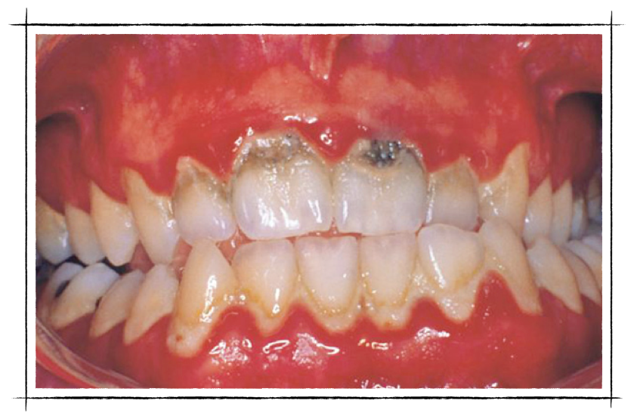
Dental “Cavities”
Acid destruction of teeth - from plaque

Slide 22
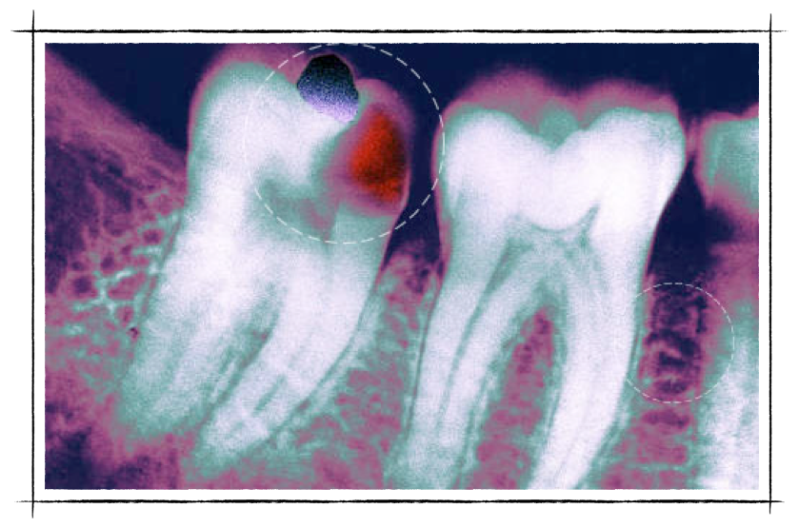
Dental Decay
From not flossing to remove plaque

Slide 23
Dental Pain
Due to deep cavities into the dental nerve

Slide 24
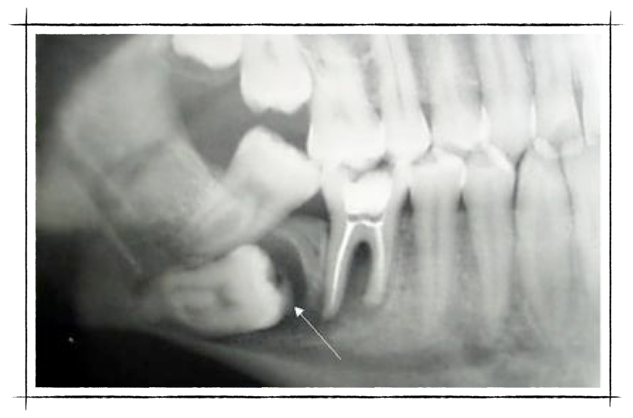
Dental Abscess
Infecting three teeth –possible jaw fracture

Slide 25
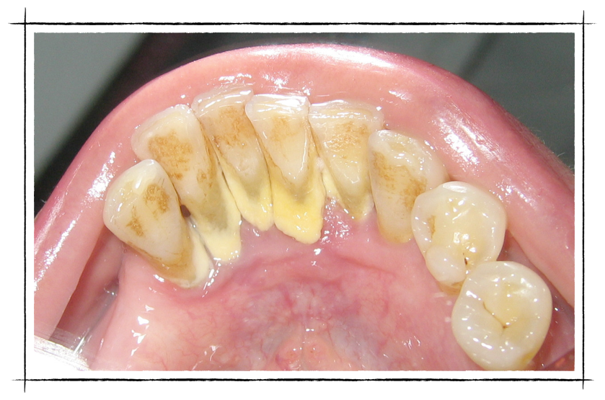
Long Term
Plaque hardens & causes gum disease

Slide 26
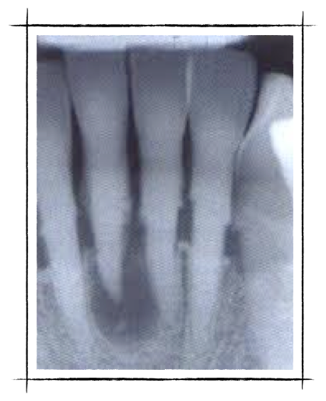
Gum Disease
Bone loss & infection

Slide 27
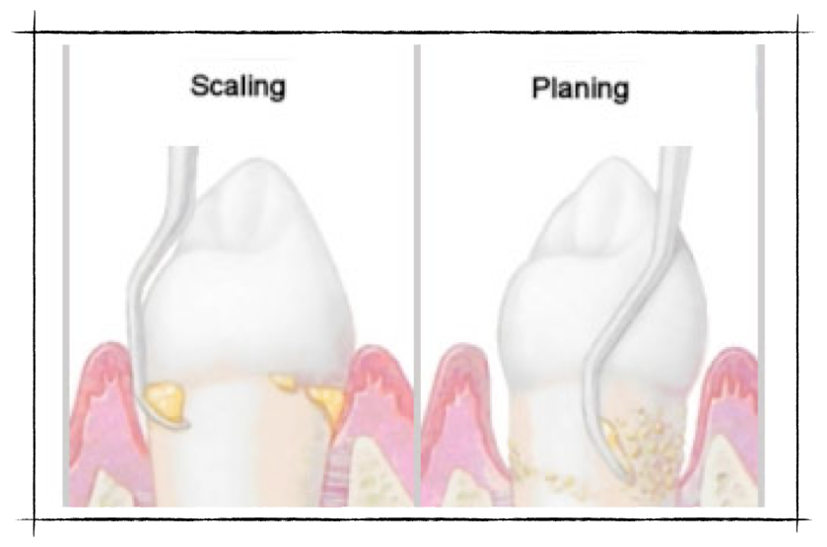
Dental Cleaning

Slide 28
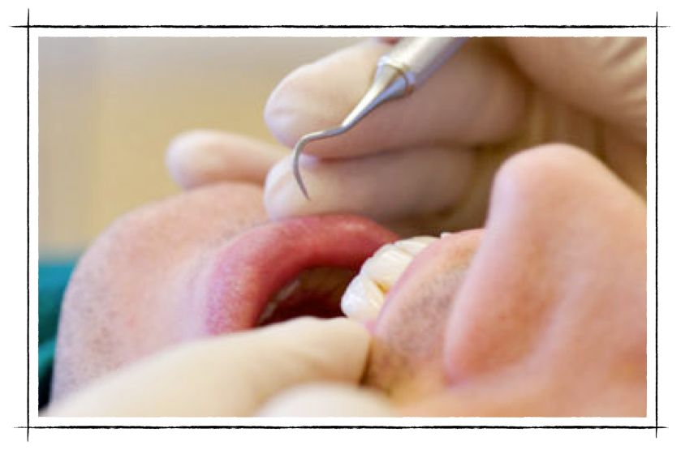
Gentle Cleaning
Does NOT hurt

Slide 29
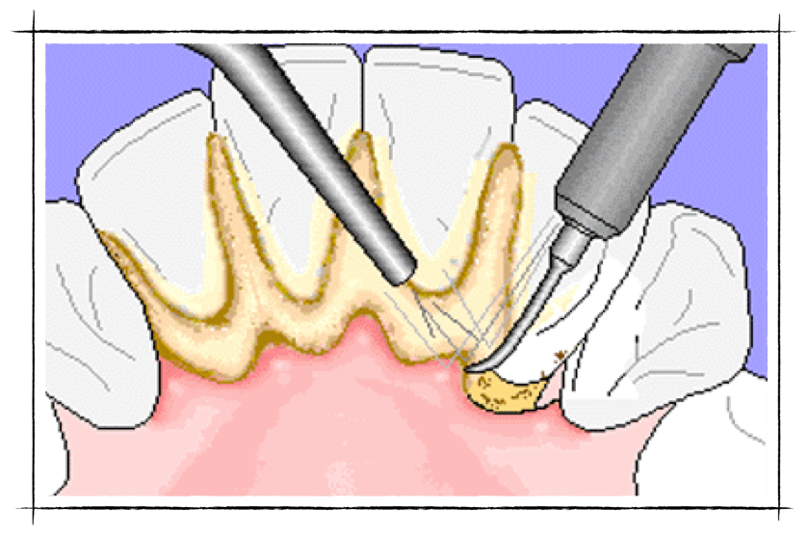
Dental “Scaling”
Removes the “calculus” & bacteria

Slide 30
Brush ALL sides
Inside, outside, on top

Slide 31
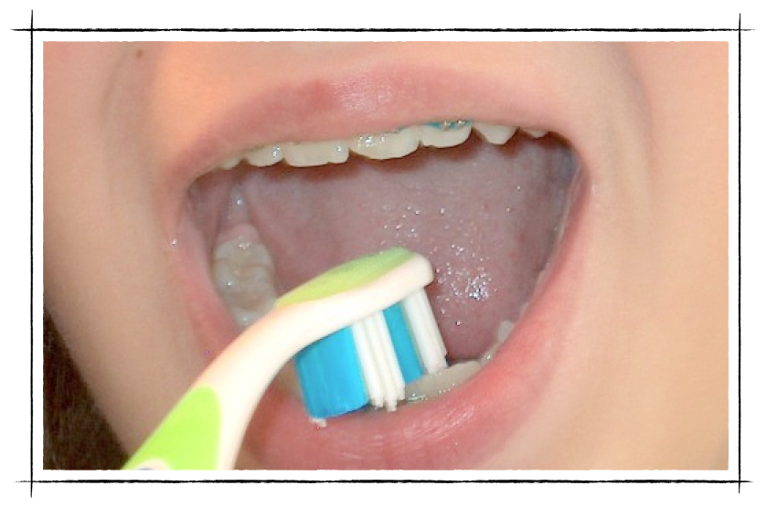
Inside

Slide 32
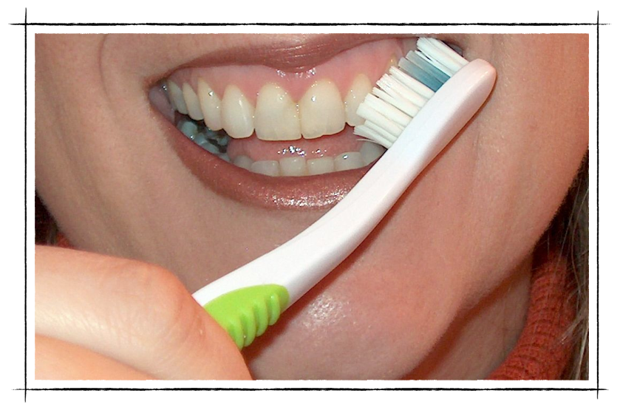
Outside

Slide 33
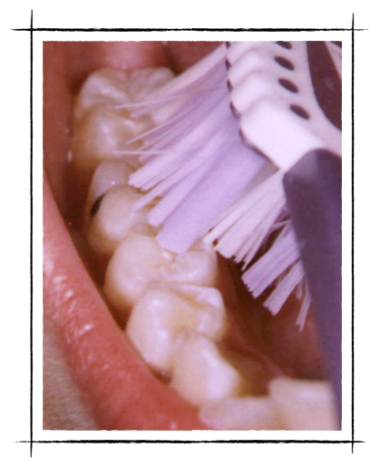
Tooth Brushing
On Top Of Teeth

Slide 34
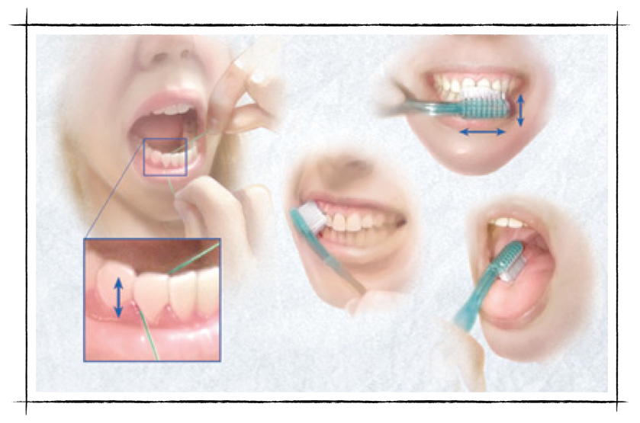
Between Teeth Floss “String”

Slide 35
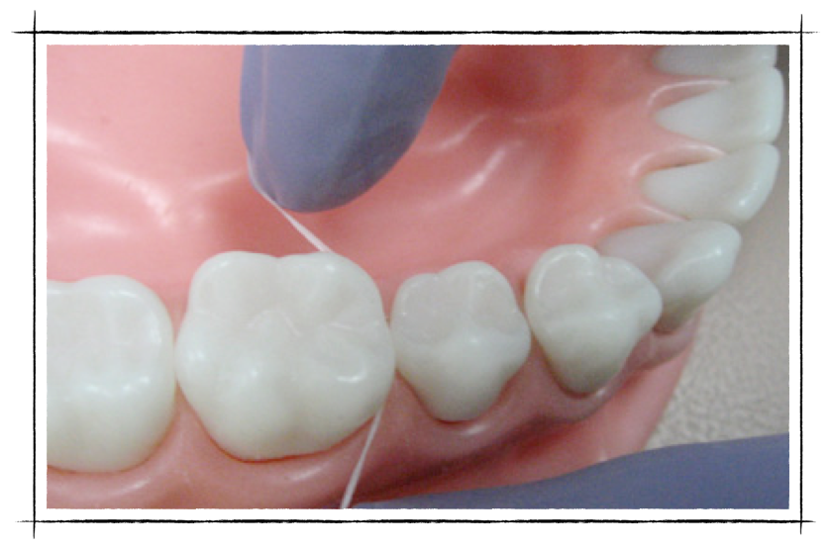
One Side
Then the other tooth

Slide 36
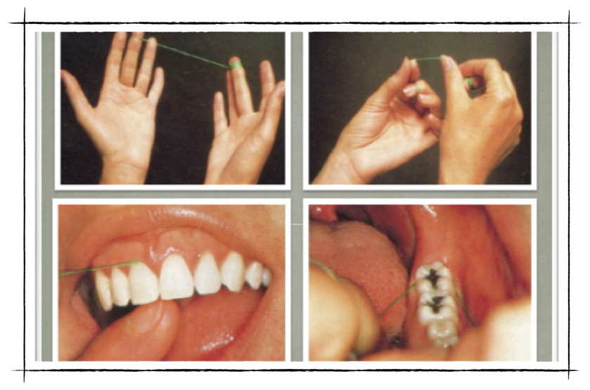
Floss Once A Day

Slide 37
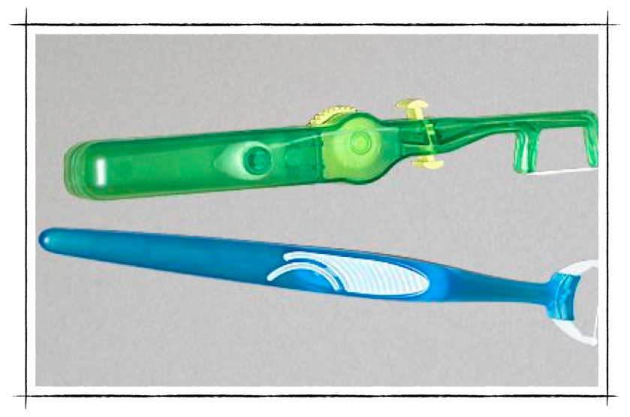

Slide 38
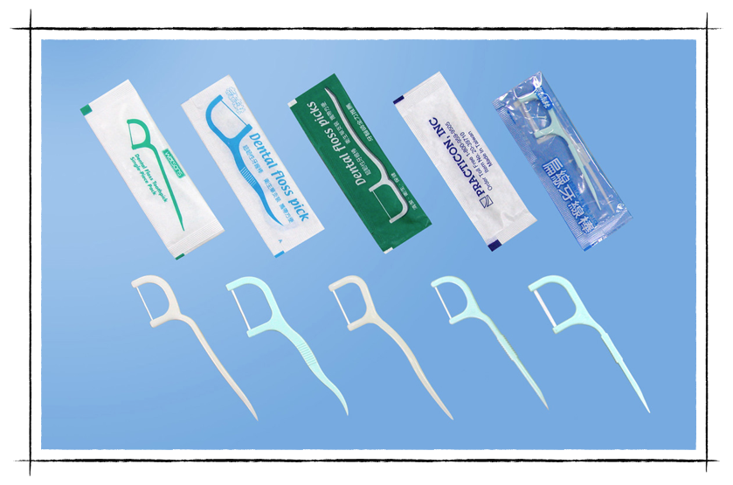

Slide 39
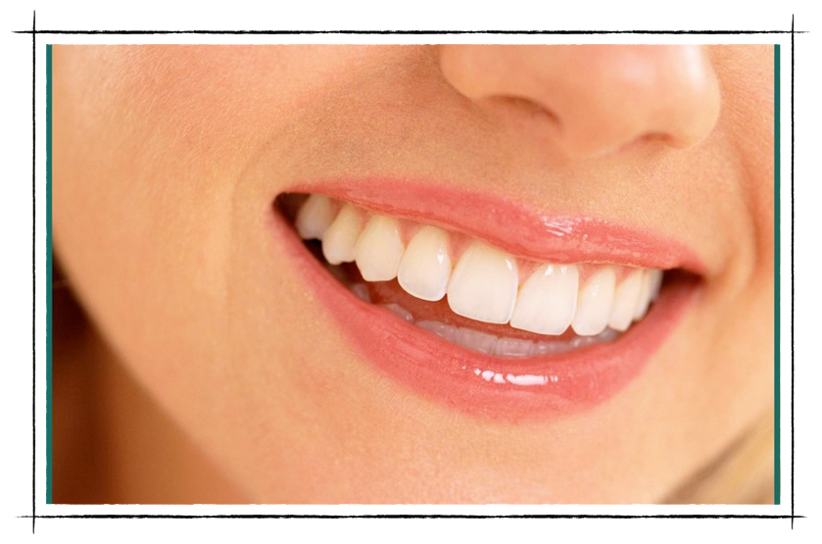
Healthy Smile
First impressions: employment & others

