Slide 1
Pamela Alston, DDS
Lead Oral Health Specialist, Humanitas, Inc.
August 10, 2020
Dental Aerosol Containment

Slide 2
Dental Facilities

Slide 3
Dentistry work tasks associated with exposure risk levels
Lower (caution) | Medium | High | Very High
Performing administrative duties in non-public areas of dentistry facilities, away from other staff members. Note: For activities in the lower (caution) risk category, OSHA's Interim Guidance for Workers and Employers of Workers at Lower Risk of Exposure may be most appropriate. | Providing urgent or emergency dental care, not involving aerosol-generating procedures, to well patients (i.e., to members of the general public who are not known or suspected COVID-19 patients). Working at busy staff work areas within a dentistry facility. | Entering a known or suspected COVID-19 patient's room or care area. Providing emergency dental care, not involving aerosol-generating procedures, to a known or suspected COVID-19 patient. Performing aerosol-generating procedures on well patients. | Performing aerosol-generating procedures on known or suspected COVID-19 patients. Collecting or handling specimens from known or suspected COVID-19 patients.
Reference: Dentistry Workers and Employees, Accessed at:
https://www.osha.gov/SLTC/covid-19/dentistry.html

Slide 4
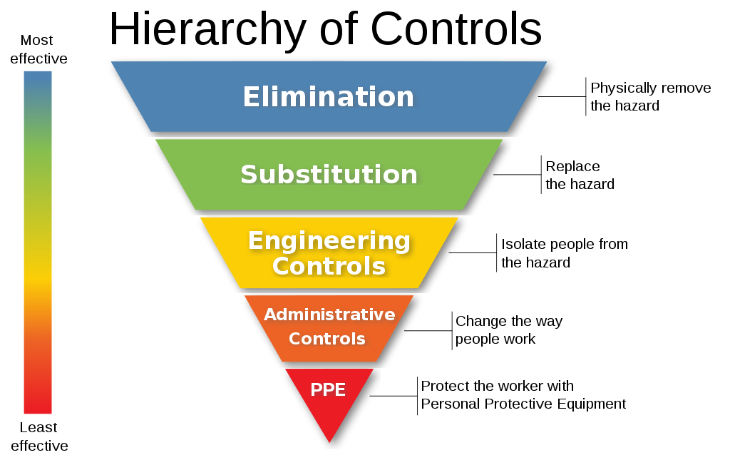
Accessed on 8/2/20 at:
https://www.cdc.gov/niosh/topics/hierarchy/default.html

Slide 5
Webinar Objectives
After this webinar, the participant will be able to:
Explain the risk factors and basic properties of aerosols generated during routine dental procedures.
Describe ways in which dental aerosols are generated
Describe Job Corps Aerosol Containment Engineering Controls

Slide 6
Aerosols generated from a patient’s mouth can contain up to 100,000 bacteria per cubic foot of air.

Slide 7
The Coronavirus is in saliva
A recently published study showed that the live novel coronavirus that triggered the COVID-19 was detected in the self-collected saliva of 91.7 per cent (11/12) of patients. The study showed that the live virus was detected in saliva by viral culture.
Cold and flu viruses are the most likely ones to spread through a little burst of saliva.
Experts said the rhinovirus (which causes the common cold), and norovirus (the stomach flu) can both be found in someone’s spit - and just transferring extremely small doses of the norovirus can result in infection.
Reference: Kelvin Kai-Wang To, Owen Tak-Yin Tsang, et al, Consistent Detection of 2019 Novel Coronavirus in Saliva, Clinical Infectious Diseases, Volume 71, Issue 15, 1 August 2020, Pages 841–843, https://doi.org/10.1093/cid/ciaa149

Slide 8
The aerosol particles of Coronavirus pose an even greater threat than those of other transmissible diseases.

Slide 9
These aerosols pose a threat to the oral health personnel in proximity.
Most aerosol containing infectious agents originating from the patient remain 36 inches from the patient’s face.
COVID-19 aerosols have been estimated to travel up to 20 feet.
The Coronavirus remains viable in aerosols for 3 hours or more around your dental chair.

Slide 10
So far, 155,000 Americans have died of the COVID-19

Slide 11
COVID-19: Infectious Disease Concept
Shedding Virus
Danger
Period
Latent Period
Infectious Period
Time
Incubation Period
Exposed
Onset of clinical signs
Resolution/death
Sub-clinical
Clinical
Source: http://eadonline.com.au/modules/overview/infectious_disease_concepts.html

Slide 12
Respiratory Droplets
The official word is that the COVID-19 is a respiratory disease.
The coronavirus spreads when an infected person coughs, sneezes or talks, producing respiratory droplets.
Respiratory droplets can land in the mouths or noses of people who are nearby
Respiratory droplet can be inhaled into the lungs.

Slide 13
Respiratory microdroplets
Expelled when someone exhales, speaks or coughs.
Can linger in the air a long time and travel through indoor spaces.
When someone catches a virus this way, the process is called “airborne transmission.”

Slide 14
Will the WHO concur on airborne transmission?
A group of scientists is urging WHO to update its COVID-19 guidance to include airborne transmission

Slide 15
Dental Aerosol Generation
dental instruments
rotary instruments dental handpieces
three-way syringes
Ultrasonic scalers
These aerosols are suspensions of fine solid particles or liquid droplets in air or another gas.
The particles contain water, bacteria, viruses, blood, and saliva.
These aerosols can contain up to 100,000 bacteria per cubic foot of air.

Slide 16
PRH-2.3, R17(b) Communicable Disease & Infection Control
The Center must:
Manage all cases of communicable disease and use protective measures as recommended by the Centers for Disease Control and Prevention (CDC).

Slide 17
CDC recommends
Capturing dental debris and microorganisms in the oral cavity through high volume suction during dental procedures
Removing aerosolized dental debris and microorganisms that escape high volume suction by using an extraoral vacuum unit during dental procedures
Removing residual dental aerosols that escape intraoral and extraoral suction devices with an air purification filtration/UV germicidal irradiation system

Slide 18
Job Corps Program Instruction Notice (PIN) 20-02
Aerosol Containment Engineering Controls
Purpose: To provide guidance on the aerosol containment engineering controls needed for Job Corps dental health facilities

Slide 19
Engineering Controls
Intraoral High Volume Evacuation
Extraoral Suction
HEPA Air Filtration

Slide 20
Engineering Controls
Rubber dams are not appropriate always.
4-handed dentistry is sometimes counterproductive.

Slide 21
Engineering Control: high-volume evacuation/isolation system
Research has found that high-volume evacuation significantly effective
Reduce aerosols by 90% or more at source
Practical and convenient
Provide continuous suction

Slide 22
HVE Mirror
HVE Mirror combines properly placed, continuous HVE suction for aerosol and spatter reduction
dental mirror offers clear clinical views and retraction

Slide 23
HVE adapter with mouthpiece
for high-volume isolation
placing continuous, high-volume suction in the mouth where they originate.
Minimizes exposure to aerosols when working by yourself.
More effective than high volume evacuation

Slide 24
Engineering Control: Extraoral Suction

Slide 25
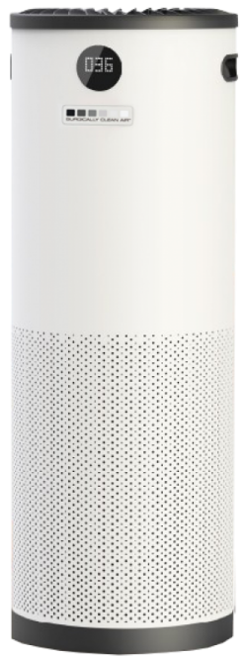
Engineering Control: HEPA Air Purifier
Certified to capture particles that are 0.1 micron in diameter
Clean air delivery rate of at least 240

Slide 26
Dental Equipment List and Specifications – 2020 tab for the Aerosol Containment Additions
https://supportservices.jobcorps.gov/health/Pages/OralHealth.aspx

Slide 27
Mouthpiece Adapter Comparison Chart

Slide 28
On the Horizon
A simpler COVID-19 test that could provide results in hours from saliva
Not approved for clinical diagnosis yet
Repeated testing is the key to detecting infected people quickly so they can be isolated

Slide 29
“This sort of testing, if it is successful and can be expanded, offers hope that schools and workplaces could receive rapid turnaround testing to assist in the complex decision of managing education during the outbreak with a test that is still sensitive enough to catch the people who are contagious, but exceptional in terms of accessibility, cost, and turnaround time.”
--David O’Connor, Professor at the University of Wisconsin School of Medicine
and Public Health
Chris Bancard, “Simpler COVID-19 test could provide results in hours from saliva,”
by Chris Bancard, University of Wisconsin Madison News, accessed on 8/10/20 at:
https://news.wisc.edu/simpler-covid-19-test-could-provide-results-in-hours-from-saliva/

Slide 30
"As if Americans need yet another reason to avoid the dentist, now they have concerns about the coronavirus to consider...Dental practices are adapting how they work in and around a patient's mouth to account for those concerns...The CDC suggests that respiratory droplets expelled when an infected person coughs, sneezes, talks or breathes are the primary way the virus spreads. But the CDC reports there's 'no data available to assess the risk of SARS-CoV-2 transmission during dental practice...Dentistry is not an elective procedure...it's important to remember that going to the dentist isn't the same as going to the barber...'are accustomed to be thinking about infectious-disease risk. They're already taking precautions,' says epidemiologist and MD Bill Miller."
--Washington Post

Slide 31
Adversity restores your humility. It hones your objectivity, and it makes you more resilient. By Simon Wright
When COVID-19 first appeared in December 2019, it was a brand-new type of coronavirus (hence the initial name "novel coronavirus") that experts knew very little about. Now, eight months later, we know more about the basics of the virus—but we still don't know everything. So, stay humble, open to learning and adapting.

