Slide 1
Oral Health & Wellness Program Update
Pamela Alston, DDS
Lead Oral Health Specialist, Humanitas, Inc.
July 13, 2020

Slide 2
“When will we be back treating students?”
Centers will continue virtual operations indefinitely
All centers will not open at the same time
Center-by-Center approval basis
JCC Resumption of Physical Center Operations Plans being developed

Slide 3
Humanitas, Inc. COVID-19 Protocols
Each HW unit will have a protocol
Protocols have been approved yet

Slide 4
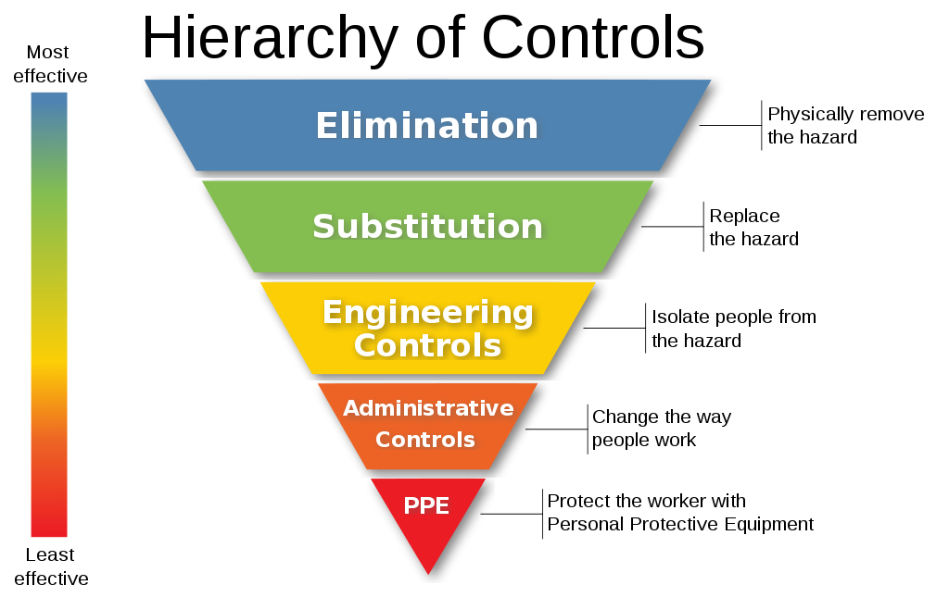

Slide 5
While you are waiting…
Stay update on state & county guidance
Plan how you will schedule patients
Design patient flow protocols
Investigate PPE

Slide 7
Personal Protective Equipment (PPE)
You will need an adequate amount of PPE
Refer to PIN 19-18: Projected PPE Needs for Job Corps Health Staff (released on April 29, 2020)
PPE shortages led to volatile prices

Slide 8
Increased PPE costs
Surge in demand
PPE Shortages
Huge volatility in prices
PIN 19-18: Projected Annual PPE Needs for Job Corps Health Staff (4/29/20)
Reference: Volatile Costs Complicate Office Re-openings, Decisions in Dentistry, June 2020, Page 46

Slide 9
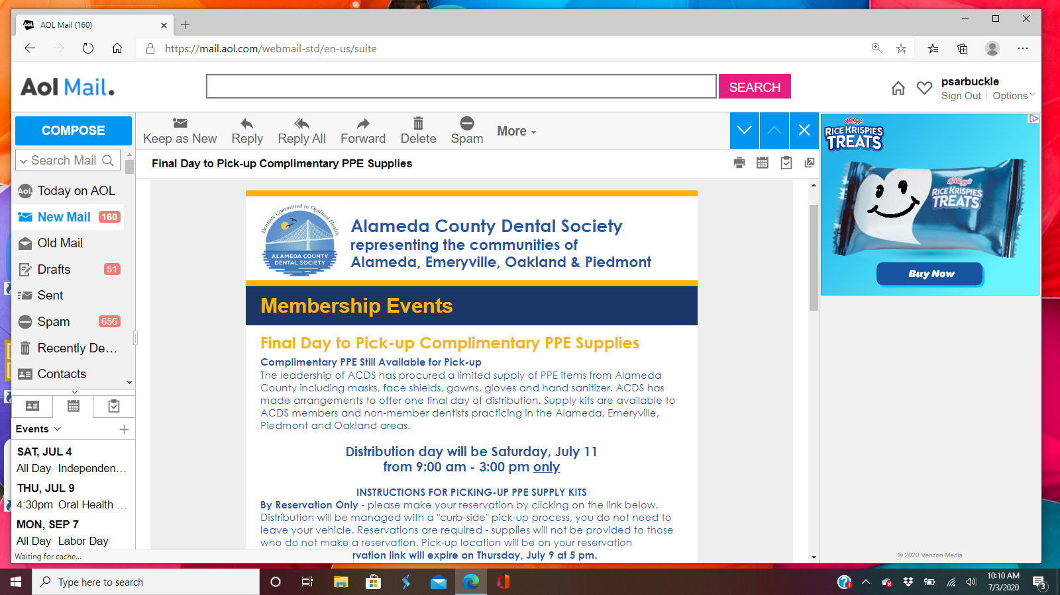

Slide 10
Reference: California Department of Public Health

Slide 11
Guidance for Dental Settings Interim Infection Prevention and Control Guidance for Dental Settings During the COVID-19 Response Updated June 17, 2020
The recommendation to wait 15 minutes after completion of clinical care and exit of each patient without suspected or confirmed COVID-19 to begin to clean and disinfect room surfaces has been removed…

Slide 12
Evidence emerging' of airborne spread of COVID-19
Some scientists urged a WHO update how the respiratory disease passes between people July 7th
Possible that airborne transmission and aerosol transmission are COVID-19 modes
More evidence needs to be gathered and interpreted

Slide 13
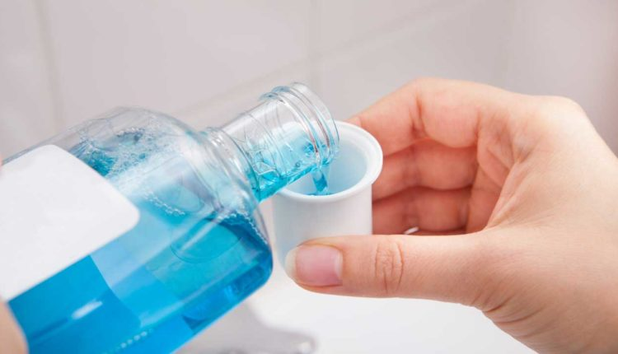
Preprocedural Rinsing
CDC has not made a recommendation for it
SARS-CoV-2 highly susceptible to oxidation
Povidone-iodine & hydrogen peroxide are oxidizing agents.
More research needed for effectiveness against the novel Corona virus

Slide 14
Amalgam Waste Best Management Practices
use of amalgam separators
use of chair-side traps
regular inspection and cleaning of traps
use of appropriate commercial waste service to recycle and/or dispose of collected amalgam

Slide 15
Hand Sanitizers - Beware
methanol which can be toxic
FDA issues an initial consumer alert/warning
Check ingredients labels

Slide 16
Teledentistry

Slide 17
Factors to reduce the risk of COVID-19 infection

Slide 18
“It is not the strongest of the species that survive, nor the most intelligent, but the one most responsive to change.” – Charles Darwin

