Slide 1
Oral Health Protocol Training—Part II Pamela Alston, DDS, Lead Oral Health Specialist

Slide 2
CDC’s Guiding Principle
CDC’s guiding principle is that dental settings should balance the need to provide necessary services with the need to minimize risk to patients and oral health personnel.

Slide 3
Webinar Objectives
1) To learn CDC recommendations for provision of oral health care to patients with COVID-19 and to patients without COVID-19
2) To learn CDC guidelines for providing care in a way that minimizes harm to patients
3) To learn CDC guidelines for protecting personnel from potential exposure to COVID-19

Slide 4
What is known about the Coronavirus in droplets
Inhalation of coronavirus represents a major transmission route (COVID-19).
Coronavirus size dictates its aerodynamic behavior, its ability to be inhaled
Viruses in droplets (larger than 100 μm) fall in seconds within 6 feet
The droplets can be sprayed like tiny cannonballs onto nearby individuals.
Physical distancing reduces exposure to these droplets.

Slide 5
What is known about the Coronavirus in Aerosols
Virus in aerosols (smaller than 100 μm) can remain suspended in air for hrs
They are highly concentrated near an infected person
But aerosols containing infectious virus can also travel more than 9 ft
They accumulate in poorly ventilated indoor air
Individuals with COVID-19, many of whom have no symptoms, release thousands of virus-laden aerosols and far fewer droplets when breathing and talking.
Attention is being shifted to protecting against airborne transmission.
Reference: Kimberly A. Prather, Linsey C. Marr, Robert T. Schooley, Melissa A. McDiarmid, Mary E. Wilson, Donald K. Milton, Airborne Transmission of SARS-CoV-2, Science 05 Oct 2020

Slide 6
What is known about the Coronavirus in Aerosols
Follow existing mandates of mask-wearing, social distancing, hand hygiene
Improve indoor air using ventilation and filtration
Improve protection for high-risk workers.
Reference: Kimberly A. Prather, Linsey C. Marr, Robert T. Schooley, Melissa A.
McDiarmid, Mary E. Wilson, Donald K. Milton,
Airborne Transmission of SARS-CoV-2, Science 05 Oct 2020

Slide 7
What is known about the Coronavirus in Aerosols
Follow existing mandates of mask-wearing, social distancing, hand hygiene
Improve indoor air using ventilation and filtration
Improve protection for high-risk workers.
Reference: Kimberly A. Prather, Linsey C. Marr, Robert T. Schooley,
Melissa A. McDiarmid, Mary E. Wilson, Donald K. Milton,
Airborne Transmission of SARS-CoV-2, Science 05 Oct 2020

Slide 8
What is known about the Coronavirus in Aerosals
Many individuals with COVID-19 don’t have any symptoms
COVID-19 individuals release thousands of virus-laden aerosols but far fewer droplets when breathing and talking.
One is far more likely to inhale aerosols than be sprayed by a droplet.
Attention is being shifted to protecting against airborne transmission.
Reference: Kimberly A. Prather, Linsey C. Marr, Robert T. Schooley,
Melissa A. McDiarmid, Mary E. Wilson, Donald K. Milton,
Airborne Transmission of SARS-CoV-2, Science 05 Oct 2020

Slide 9
COVID-19: Infectious Disease Concept
Shedding Virus
Danger
Period
Latent Period
Infectious Period
Time
Incubation Period
Exposed
Onset of clinical signs
Resolution/death
Sub-clinical
Clinical
Source: http://eadonline.com.au/modules/overview/infectious_disease_concepts.html

Slide 10
What is known about the Coronavirus in Aerosols
Virus in aerosols (smaller than 100 μm) can remain suspended in air for hrs
They are highly concentrated near an infected person
But aerosols containing infectious virus can also travel more than 6 ft
They accumulate in poorly ventilated indoor air
Individuals with COVID-19, many of whom have no symptoms, release thousands of virus-laden aerosols and far fewer droplets when breathing and talking.
Attention is being shifted to protecting against airborne transmission.
Reference: Kimberly A. Prather, Linsey C. Marr, Robert T. Schooley,
Melissa A. McDiarmid, Mary E. Wilson, Donald K. Milton,
Airborne Transmission of SARS-CoV-2, Science 05 Oct 2020

Slide 11
Applying Hierarchy of Controls for COVID-19
Elimination is out of our control
Substitution is out of our control
Engineering controls include ventilation and physical barriers

Slide 12
Work Practice and Patient Management
Screen and rule out COVID-19
Use barriers, dental dam, use aerosol
Containment equipment
Limiting the number of people in the dental
facility, hand hygiene, social distancing
Respirators, gowns, face shield, eye
Protection, gloves

Slide 13
Precautions When Performing Aerosol Generating Procedures (AGPs)
Perform AGP cautiously and avoid if possible.
If performed, the following should occur:
wear an N95 mask, eye protection, gloves, and a gown.
AGPs should ideally take place in an AIIR.
Use high volume intraoral suction
Use extraoral vacuum unit between patient’s mouth and provider’s face
An air purification filtration/UV germicidal irradiation system.

Slide 14
Controls
Engineering--Aerosol Containment Equipment
Administrative--Masks on patients except during intraoral procedures

Slide 15
VacuVUE HVE Mirror
HVE Mirror combines properly placed, continuous HVE suction for aerosol and spatter reduction
dental mirror offers clear clinical views and retraction

Slide 16
VacuLUX HVE adapter
for high-volume isolation
placing continuous, high-volume suction in the mouth where they originate.
Minimizes exposure to aerosols when working by yourself.

Slide 17
Engineering Control: Extraoral Suction

Slide 18
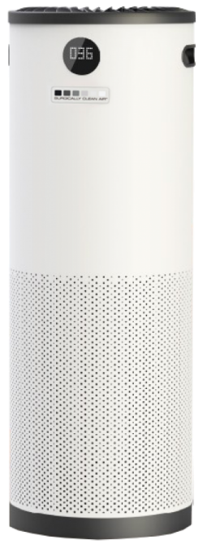
Engineering Control: HEPA Air Purifier
Certified to capture particles that are 0.1 micron in diameter
Clean air delivery rate of at least 240

Slide 19
Oral Health Personnel
OSHA categorizes oral health personnel as very high risk when performing aerosol generating procedures
Rotary dental instruments create a visible spray
The spray contains particle droplets
No confirmed cases of COVID-19 transmitted in a dental setting
OHP have the potential for direct or indirect exposure to patients or infectious materials including:
body substances
contaminated medical supplies, devices, and equipment
contaminated environmental surfaces
contaminated air

Slide 20
Dentistry work tasks associated with exposure medium & high risk levels
Medium Risk
High Risk
Urgent or emergency dental care, not involving aerosol-generating procedures to well patients (i.e., to members of the general public who are not known or suspected COVID-19 patients).
Providing emergency dental care not involving aerosol-generating procedures to a known or suspected COVID-19 patient.
Performing aerosol-generating procedures on well patients.

Slide 21
CDC’s Interim Infection Prevention and Control Guidance for Dental Settings
CDC’s Interim Guidance supplements the 2003 Guidance
“Interim” indicates that the guidelines were developed using less thorough processes.
CDC issued CDC's Interim Guidance in 2020 for Dental Settings in March, April, May and June.
The latest guidance was issued June 3rd.

Slide 22
Telehealth

Slide 23
CDC Interim Infection Prevention and Control Guidance for Dental Settings
Initially recommended that only dentists only perform emergency evaluations and urgent care
Used the American Dental Association’s definitions for emergency & urgent conditions
2 reasons for delaying elective visits and procedures--to protect oral health personnel and to preserve PPE
Removed recommendation that all elective procedures be postponed on May 18, 2020

Slide 24
Health Care System caveats for providing elective services
Must operate without crisis standards
Ensure adequate staffing
Must have PPE & other supplies available
Must have a plan in the case of a community surge in transmissions
Have patient scheduling and flow protocols

Slide 25
Getting Ready to Reopen
Take inventory to decide on supply of PPE and supplies
(2 weeks of PPE in clinic)
Learn about facility screening practice for COVID-19
Know what methods will be in place to reduce/eliminate aerosol production
Decide the logistics for
social distancing among patients and the dental team

Slide 26
Getting the dental facility ready
Dental unit waterlines (DUWL)
Autoclaves and instrument cleaning equipment
Air compressor, vacuum and suction lines, radiography equipment, high-tech equipment, amalgam separators, and other dental equipment: Follow protocol for recommended maintenance per manufacturer IFU.
Get the ventilation system checked.
Notes:
After a period of non-use, dental equipment may require maintenance and/or repair. Review the manufacturer’s instructions for use (IFU) for office closure, period of non-use, and reopening for all equipment and devices. Some considerations include:
Dental unit waterlines (DUWL):Test water quality to ensure it meets standards for safe drinking water as established by the Environmental Protection Agency (< 500 CFU/mL) prior to expanding dental care practices.Confer with the manufacturer regarding recommendations for need to shock DUWL of any devices and products that deliver water used for dental procedures.
Continue standard maintenance and monitoring of DUWL according to the IFUs of the dental operatory unit and the DUWL treatment products.
Autoclaves and instrument cleaning equipmentEnsure that all routine cleaning and maintenance has been performed according to the schedule recommended per manufacturer’s IFU.
Test sterilizers using a biological indicator with a matching control (i.e., biological indicator and control from same lot number) after a period of non-use prior to reopening per manufacturer’s IFU.
Air compressor, vacuum and suction lines, radiography equipment, high-tech equipment, amalgam separators, and other dental equipment: Follow protocol for storage and recommended maintenance per manufacturer IFU.

Slide 27
When Oral Health Personnel Return
As part of routine practice, monitor selves for fever and symptoms consistent with COVID-19.
Provide for oral health personnel to stay home when ill or under quarantine without jeopardizing job security.
If fever (T≥100.0˚F) or symptoms consistent with COVID-19 develop while at work, keep cloth face covering or facemask on, inform supervisor, and leave the workplace.

Slide 28
When Oral Health Personnel Return
Evaluate the necessity of the dental care based on urgency
Prioritize care that was previously postponed
Prioritize dental conditions likely to lead to dental emergencies if treatment is not provided in a timely manner.
Provide preventive services (fluoride, sealants, scaling) taking measures to minimize aerosol generation.
Consider minimally invasive restorative techniques
If aerosol generating procedures are necessary, employ aerosol management tools

Slide 29
Aggressive Source Control* Measures
Perform fever and symptom tracking.
Require everyone to wear a cloth face covering while in the dental facility, regardless of symptoms.
Instruct patients to perform hand hygiene before and after they touch or adjust their cloth face covering
Have appropriate triage, evaluation, and isolation of individuals who report symptoms should still occur.
*Source control presumes everyone is infected and symptomatic and asymptomatic and sets forth measures that might help reduce the risk of transmission of SARS CoV-2.

Slide 30
Have you experienced any of the following symptoms in the past 48 hours?
fever or chills
cough
shortness of breath or difficulty breathing
fatigue
muscle or body aches
headache
new loss of taste or smell
sore throat
congestion or runny nose
nausea or vomiting
diarrhea
This tool was developed by the Centers for Disease Control and Prevention (CDC) for use by CDC. The tool, however, is in the public domain and may be recreated, utilized, and adapted by the public at will. The CDC name and logo may not be utilized if the tool is recreated for use by an external entity. The tool is provided “as-is”; CDC accepts no liability for the use by an external entity. The external entity assumes all risks and liabilities associated with the recreation, utilization and adaption of the tool for external entity’s use. CDC will not provide any support for the tool if recreated by an external entity. CDC, with regard to this tool, makes no other representations, warranties, express or implied, and hereby disclaims all implied representation and warranties, including any warranty of merchantability and warranty of fitness for a particular purpose.

Slide 31
Personal Protective Equipment
Dental procedures not involving aerosol-generating procedures
Dental procedures that may or are known to generate aerosols
Work clothing, such as scrubs, lab coat, and/or smock, or a gown
Gloves
Eye protection (e.g., goggles, face shield)
NIOSH-certified, N95 filtering facepiece respirator or better (can be a “duckbill” type
Gloves
Gown
Eye protection (e.g., goggles, face shield)
NIOSH-certified, N95 filtering facepiece respirator or better (can be a “duckbill” type

Slide 32
Respirators
Recommended for oral health personnel during the COVID-19
N95 respirators or respirators that offer a higher level of protection should be used instead of a facemask when performing or present for an aerosol generating procedure
Must be in the context of a complete respiratory protection program in accordance with OSHA Respiratory Protection standard (29 CFR 1910.134)
OSHA has issued temporary enforcement guidance regarding discretion, e.g., enforcement discretion for required annual fit testing

Slide 33
Extended Use of Facemasks and Respirators
Should only be undertaken when the facility is at contingency or crisis capacity and has reasonably implemented all applicable administrative and engineering controls.
Such controls include selectively canceling elective and non-urgent procedures and appointments for which PPE is typically used by DHCP
Extended use of PPE is not intended to encourage dental facilities to practice at a normal patient volume during a PPE shortage, but only to be implemented in the short term when other controls have been exhausted.
Once the supply of PPE has increased, facilities should return to standard procedures.

Slide 34
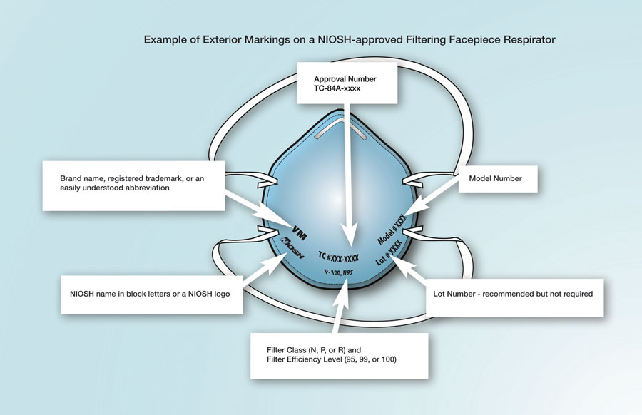

Slide 35
Eye Protection
Put on eye protection (i.e., goggles or a disposable face shield that covers the front and sides of the face) upon entry to the patient room or care area, if not already wearing as part of extended use or reuse strategies to optimize to optimize PPE supply.
Personal eyeglasses and contact lenses are NOT considered adequate eye protection.
Reusable eye protection (e.g., goggles or loupes) must be cleaned and disinfected according to manufacturer’s reprocessing instructions prior to re-use.

Slide 36
Gloves
Put on clean, non-sterile gloves upon entry into the patient room or care area.
Change gloves if they become torn or heavily contaminated during the patient visit.
Remove and discard gloves when leaving the patient room or care area and immediately perform hand hygiene.

Slide 37
Gowns
Put on a clean isolation gown upon entry into the patient room or area.
Change the gown if it becomes soiled and after aerosol generating procedures
If there are shortages of gowns, they should be prioritized for:
aerosol generating procedures
care activities where splashes and sprays are anticipated

Slide 38
Headcovers and shoe covers
Not considered PPE
Heads are close enough for droplets and aerosols to land on
Shoes touch floors where droplets land

Slide 39
Environmental Infection Control
Ensure that environmental cleaning and disinfection procedures are followed consistently and correctly.
Routine cleaning and disinfection procedures (e.g., using cleaners and water to pre-clean surfaces prior to applying an EPA-registered, disinfectant

Slide 40
Disinfection
Wait 15 minutes after completion of clinical care and exit of each patient to begin to clean and disinfect room surfaces.
Appropriate PPE should be worn for all activities involving potential exposure to patient body fluids, contaminated surfaces and equipment, and hazardous chemicals (e.g. disinfectants).
Puncture resistant/utility gloves, masks, eye protection and gowns should be worn while handling contaminated instruments.
Patients should be scheduled in a manner that allows for complete disinfection of operatories. It is recommended to increase patient appointment time
Do not double-book appointments.
Barriers should be used when possible, especially for hard-to-clean surfaces (e.g. light switches, computer, mouse, dental unit) and changed between patients.

Slide 41
“During the resumption process, centers must abide by federal, state, and local regulations regarding physical distancing, size of group gatherings, and wearing face masks by following whichever regulations are the most restrictive. In some cases, PRH requirements may not be able to be met because they are in conflict with regulations.”

Slide 42
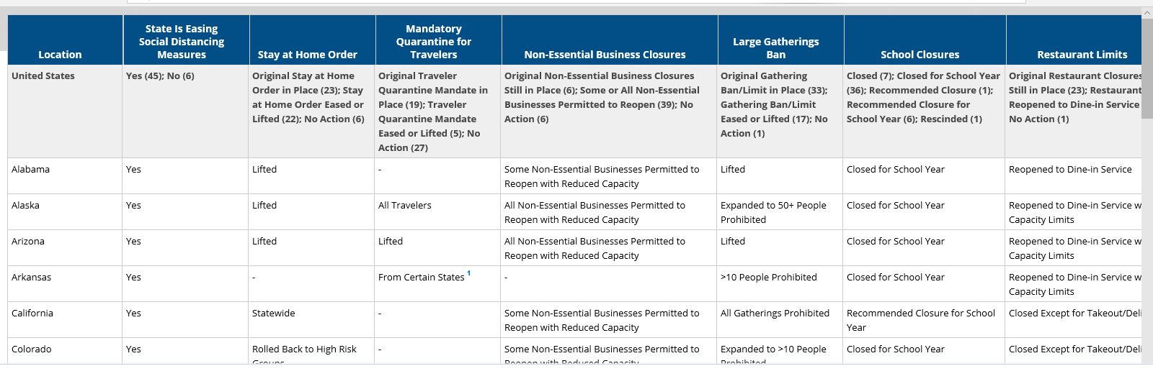
State Actions and Policy Actions to Address the Corona Virus
Reference: www.kff.org

Slide 43
“Until more is known about how COVID-19 spreads, OSHA recommends—”
using a combination of standard precautions, contact precautions, and contact precautions.
performing patient care that does not involve aerosol-generating procedures on individuals without suspected or confirmed COVID-19
Follow OSHA's Bloodborne Pathogens (29 CFR 1910.1030) standard
Follow Personal Protective Equipment (29 CFR 1910.132) standard
Follow OSHA’s Respiratory Protection (29 CFR 1910.134) standard

Slide 44
References
ADHA Interim Guidance on Returning to Work adha.org
CDC’s Interim Infection Prevention and Control Recommendations for Patients with Suspected or Confirmed Coronavirus Disease 2019 (COVID-19) in Healthcare Settings
Guidelines for Infection Control in Dental Health Care Settings – 2003
Interim Infection Prevention and Control Guidance for Dental Settings During the COVID-19 Response(May 19, 2020)
https://www.cdc.gov/coronavirus/2019-ncov/hcp/dental-settings.html

Slide 45
Resiliency
“I can be changed by what happens to me but I refuse to be reduced by it.”
--Maya Angelou

