Slide 1
Trauma informed approach
Activities for centers and cmhcs

Slide 2
Introduction
The following trauma-informed activities will help to:
Teach students/staff skills that will help strengthen positive relationships,
Create safer emotional environments, and
Promote resilience
Centers may use the activities as they feel appropriate.

Slide 3
Getting ready for groups
Brief the group on issues of confidentiality and respect.
Ensure that everyone understands that discussions do not leave the room and that this should be a safe place to explore questions and express differing views.
Read through the activities ahead of time to be well prepared.
Promote a nonjudgmental environment that invites safe reflection. Encourage sharing but do not require students/staff to reveal personal information.

Slide 4
Relationships and active listening
important parts of a trauma informed approach

Slide 5
“Too often we underestimate the power of a touch, a smile, a kind word, a listening ear, an honest compliment, or the smallest act of caring, all of which have the potential to turn a life around.” Leo Buscaglia
Positive Relationships Can Alter the Effects of Trauma. ALWAYS REMEMBER THAT…

Slide 6
TO ACHIEVE A POSITIVE RELATIONSHIP NEVER FORGET TO…
“LISTEN WITH CURIOSITY. SPEAK WITH HONESTY. ACT WITH INTEGRITY. THE GREATEST PROBLEM WITH COMMUNICATION IS WE DON’T LISTEN TO UNDERSTAND. WE LISTEN TO REPLY. WHEN WE LISTEN WITH CURIOSITY, WE DON’T LISTEN WITH THE INTENT TO REPLY. WE LISTEN FOR WHAT’S BEHIND THE WORDS.”
ROY T. BENNETT, The Light in the Heart

Slide 7
Give Attention
Withhold Judgement
Reflect
Listen for Feelings
Look to understand topic
Share
Avoid interruption /distraction
Repeat
Paraphrase
Clarify
Ask open questions
Summarize
ACTIVE LISTENING
Notes:
Guidelines for Reflecting
Be natural.
Listen for the basic message - consider the content, feeling and meaning expressed by the speaker.
Repeat what you have been told - using exactly or almost exactly the same words used by the speaker.
Paraphrase by rendering the message using similar words & similar phrase arrangement to the ones used by the speaker.
When repeating/paraphrasing, look for non-verbal as well as verbal cues that confirm or deny the accuracy of your repeating/paraphrasing. (Note that some speakers may pretend you have got it right because they feel unable to assert themselves and disagree with you.)
Do not add to the speaker's meaning.
Do not take the speaker's topic in a new direction.
Always be non-directive and nonjudgmental.
Do not question the speaker unnecessarily.
As you gain a clearer understanding of the other person’s perspcetive, you can beging to introduce your own ideas, feelings, and suggestions.

Slide 8
LISTENING ACTIVITY
Place participants into pairs.
Participants will take turns being narrators and listeners.
Narrators will identify their favorite movie and then share how they felt when they watched their favorite movie. Listeners will practice active listening.
Afterwards allow participants to share how they felt being in both roles.

Slide 9
perspective
An important part of a trauma informed approach
Source: Greater Good in Education 1-2-3 Clap: A School Team Building Activity
Notes:
Underlying trust is psychological safety, or the feeling that it’s safe to make mistakes, admit ignorance, or voice concerns and opinions, without the fear of being silenced or humiliated. Numerous studies show that when individuals feel psychologically safe, their ability to learn from mistakes improves, resulting in better performance.
You could use the following activities to help teach your students/staff that it’s okay to make mistakes while learning and that we should encourage each other rather than putting each other down. Teach that the classroom/workplace should be a safe place to take chances, learn and grow by gaining new perspective.
Source: https://ggie.berkeley.edu/practice/1-2-3-clap/#tab

Slide 10
Perspective Taking...What do you see?
Explain that the way we see or how we feel about something depends on how we are looking at the situation.
Show the following pictures and debrief by pointing out that participants might not have seen what someone else did until after they pointed it out.
In the same way, making the effort to gain new perspective will often lead us to new and different solutions.

Slide 11
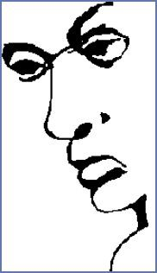
What Do You See?

Slide 12
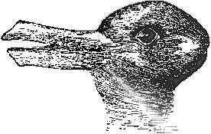
What Do You See?

Slide 13
What Do You See?

Slide 14
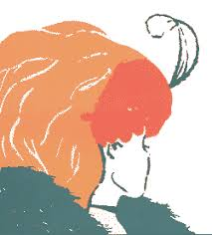
What Do You See?

Slide 15
Resilience
An important part of a trauma informed approach

Slide 16
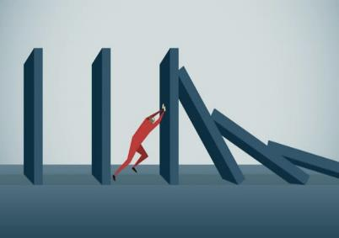
Why Overcome Obstacles?
Facing obstacles and navegating one’s way through them builds resilience capacity.
Confronting obstacles implies assessing the situation with new eyes and innovate creative solutions.
Knowing that one can overcome obstacles, learn from stuggles and benefit from mistakes lays a solid foundation for success in later life.
Notes:
Some celebrities have achieved success after overcoming serious obstacles in their lives. We can remember their stories whenever we are facing a difficult situation – to keep us focus in regaining strenght to reassess the situation based on lessons learned to create a new plan to move forward.
Next, autobiographical facts from 7 celebrities will be revealed to see if the group can identified whom they are. FEEL FREE TO CREATE NEW ONES!

Slide 17
Who am I?
As a child was diagnosed with tics, anxiety, and obssesive-compulsive disorder
At age 11 a neurologist confirmed they have Tourette’s syndrome
“If they film long enough, you’re going to see a lot of tics”. “They’re exhausting”.
“I wiggle my ear back and forth and raise my eyebrows and click my jaw and flex my arm here and this arm there”.
People think I’m trying to be funny. They think I’m (ticcing) as a funny move… so they go, ‘Ha,’ and I’m always left incredibly offended by that. Or they go ‘What?’ and then I go, ‘I have Tourette’s.”
California singer and songwriter
Have won multiple awards – 7 Grammy Awards, 2 American Music Awards, 3 MTV Video Music Awards, and an Academy Award
They first gained public attention in 2015 with debut single “Ocean Eyes”

Slide 18
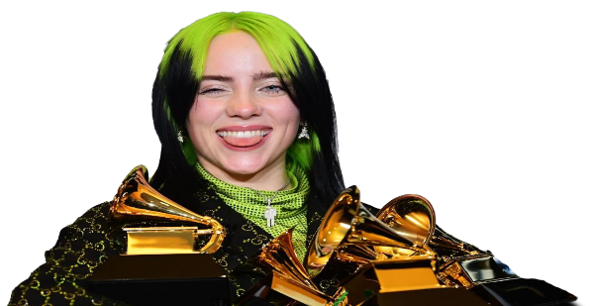
Billie eilish

Slide 19
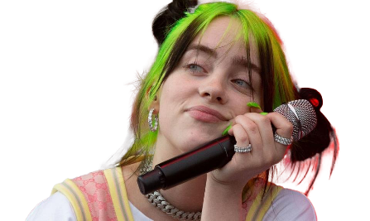
“i would love to get this straight so everyone can stop acting goofy..
I have diagnosed with tourettes.
…ive just never wanted people to think of
tourettes everytime they think of me.
&
my tics are only physical and not super noticeable to
others if youre not really paying attention.
(believe me, HAVING them is a whole
different type of misery)
my tourettes makes easy things a lot harder.
certain things increase and/or trigger
the intensity of my tics.
but its something I grew up with and am used to…
ive taught myself ways of suppressing my tics and certain
techniques to help reduce them when i don’t want to be
distracting in certain situations..but again suppressing
them only makes thing worse after the moment is over…
this compilations yall been making of my tics are lowkey
funny even when yall make fun of them…
i know youre all confused so as to what it is, so
just to let ya know..
Its tourrettes.”
Here is part of Billie’s Instagram response when tic compilation videos became public.

Slide 20
Who am I?
Born into poverty in rural Mississippi to a teenage single mother
Experienced considerable hardship during childhood
Disclosed I was raped at age 9
Faced numerous sexual assaults by family members
Became pregnant at 14; child died in infancy
Ranked the richest African-American of the 20th century
For a time was the world’s only African-American billionaire
Built a multi-award-wining talk show – highest-rated program of its kind for 25 years (1986 – 2011)
Actress, telelvision producer, author, and media proprietor (OWN)

Slide 21
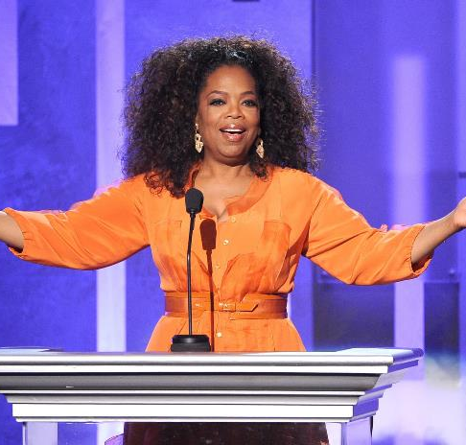
Oprah Winfrey

Slide 22
Who am I?
I was diagnosed with obsessive-compulsive disorder (OCD) as a child
Revealed that I suffer from OCD with Attention Deficit Disorder
It caused me to wash my hands obssessively and align every object perfectly
OCD caused me to have intrusive thoughts, which are unwanted and often disturbing thoughts that can become obssessions
“It’s complicated,” they stated when asked about living with these conditions
Is a musician and actor who has won many awards including 7 American Music Awards, 9 Billboard Music Awards, and 4 Emmy Awards.
Is from Memphis, Tennessee
Their most famous song is “My Love” featuring rapper T.I.

Slide 23
Justin
Timberlake

Slide 24
Who am I?
No basketball coach would give me a chance because I was short
Cut from the varsity basketball team in my sophomore year
Using a connection to get into a camp from which players for college teams were chosen, I got noticed by a coach – who still chose not to invite me to the team
Named NBA finals most valuable player 6 times
Won six championships with the Chicago Bulls
Considered by many the greatest basketball player of all time

Slide 25
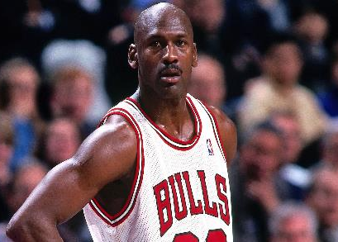
Michael Jordan

Slide 26
Who am I?
In 2011, I had a 3 month stay at a treatment center, where I was treated for anorexia and bulimia
“I never found out until I went into treatment that I was bipolar”
“Looking back it makes sense. There were times when I was so manic, I was writing seven songs in one night and I’d be up until 5:30 am”.
I told my story in 2 documentaries: MTVs “Stay Strong,” and YouTube’s “Simply Complicated”
“Simply Complicated” is an honest look at my recovery from bipolar and eating disorders as well as drug addiction.
Has won over 60 awards for their work in music, film, and television
Their latest studio album Dancing with the Devil includes “What Other People Say.”

Slide 27
DEMI LOVATO

Slide 28
Who am I?
Grew up in near poverty
Had an abusive father – “a merchant of chaos”
School was very difficult – found it hard to keep up with my peers or do work at the same speed as everyone else
At age 7 was diagnosed with dyslexia – a learning disability
Nominated for 3 Academy Awards
Won 3 Golden Globe Awards
As of 2012 is Hollywood’s highest-paid actor
14 of their films grossed over $100 million domestically
20 of their films have grossed in excess of $200 million worldwide
Plays the role of Capt. Pete “Maverick” Mitchell in the movie Top Gun: Maverick

Slide 29
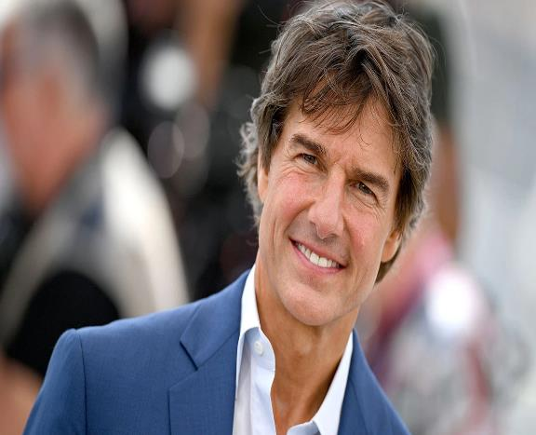
Tom Cruise

Slide 30
Who am I?
When I was born in Columbus, Ohio, both of my parents suffered from severe drug and alcohol issues.
My father abondoned the family, and my mother was unable to take care of me and my 4 siblings
“When I was 3 years old, my siblings and I were removed from her custody.”
“From there, we bounced around” in foster care
At age 6 was adopted by maternal grandfather and his wife along with a sister; moved to Texas
At the 2016 Olympics in Rio de Janeiro, became the first U.S. gymnast to win four gold medals at a single Games
The first gymnast to win three consecutive world all-around titles (2013–15)
Won 25 World Championship medals

Slide 31
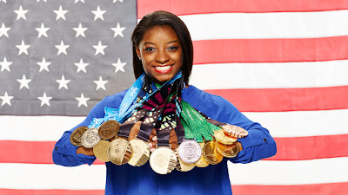
Simone Biles

Slide 32
Who am I?
Unemployed and as a single mother had to rely on welfare benefits to survive
Suffer depression so severe that at times contemplated suicide
Their first book was rejected by 12 different publishers before selling it for a measly $4000
The book was an international hit
Went on to write 6 more books for the series
Book series sold into hundreds of millions of dollars
Book series was adapted into a huge blockbuster film franchise
Is the 13th wealthiest person in Britain

Slide 33
J. K. rowling

Slide 34
Always end a group session with a positive or inspirational message!
The Light in the Heart Quotes
Notes:
The link in the slide – The Light in the Heart Quotes – will take you to 30 of the 175 quotes that are contained in the book titled The Light in the Heart: Inspirational Thoughts for Living Your Best Life, by Roy T. Bennett – one of Bennett’s quotes was presented in slide # 6.
On the next two slides are two other examples of inspirational thoughts.

Slide 35
EMBRACE …

Slide 36
“No matter how bleak or menacing a situation may appear, it does not entirely own us. It can’t take away our freedom to respond, our power to take action.”
― Ryder Carroll

