Slide 1










Asking About Suicide?
Myths and Objections
Notes:
Hello, I’m pleased to present this training session on ”Asking About Suicide.” I will cover a couple of the myths related to suicide as well as some of the common objections that people make when it comes to asking another person if they are thinking about hurting or killing themselves. I will also provide some practical information about what to do and what not to do when reaching out to someone who is experiencing thoughts of suicide. My hope is that by the end of the presentation you will feel more confident starting a conversation that could save someone’s life.

Slide 2

Death is always hard to talk about.
Hard to understand.
Even. Harder. After. Suicide.
The End.
Notes:
Let’s start with the most obvious fact: Death is always hard to talk about. It doesn’t matter whether the death was expected or unexpected. It doesn’t matter whether it sudden or gradual. And It shouldn’t matter whether the death is accidental or intentional – as in the case of suicide.
Suicide is hard to wrap you head around. It is hard to understand the harsh intensity of the emotional pain and despair that could lead someone to consider taking their own life. But it happens every day. According to the Centers for Disease Control and Prevention or CDC, more than 45,000 people died by suicide in 2020. For the age group of the students who attend Job Corps (ages 15-24), suicide was the third leading cause of death.
If death is hard to understand and hard to talk about. It is even harder after a suicide.
Source: https://wisqars.cdc.gov/data/lcd/home
Causes:
#1: Unintentional injury (15,117)
#2 Homicide (6,466)
#3 Suicide (6,062)

Slide 3
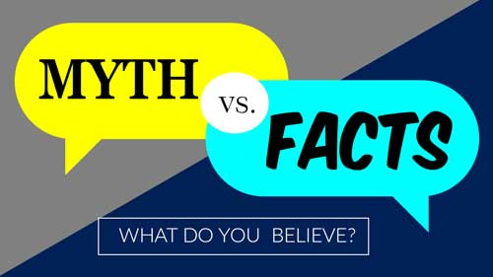
Notes:
To start our conversation about suicide and ways to ask about it, I would like to start with some myths vs. facts about suicide. When armed with a better understanding about suicide, my hope is that we will all feel more comfortable not just talking about suicide -- but about taking action to prevent suicide, when needed.

Slide 4

Myth #1: Suicide is About Death
When someone is struggling with thoughts about suicide, they are struggling with …
This fact should give us
LIFE
HOPE
Notes:
Myth #1 is that suicide is about death. And as mentioned earlier, most people are NOT comfortable talking about death. The truth is that suicide is about the fact that someone is struggling with LIFE.
For the person contemplating suicide, at that moment, life, and its problems, feels unbearable. The person feels that they have exhausted all of their resources – emotional, physical, financial, and support – to keep to going even one more day.
When people who have attempted suicide are interviewed after surviving an attempt, the overwhelming majority state that they did not want to die. They just didn’t know how to keep living with the excruciating emotional pain.
The fact that the suicidal person is struggling with life is something that should give us HOPE. -- Hope that by just reaching out with a question and showing support and compassion we can help them discover the reasons and the resources to keep living.
Now before we go to the next slide, I would like for you to type in the chat box, the one word that comes to mind when you think of someone who is suicidal and how they are feeling:
[Wait for responses in the chat box or in person. Expect: depressed, sad, …..]

Slide 5
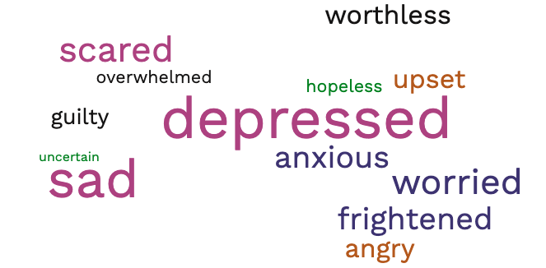
Notes:
This word cloud captures the responses that we typically get to the question about how someone who is suicidal is feeling:
The largest words are ”depressed” and “sad,” followed by “scared,” “frightened” and “worried.”
You can also see “anxious,” “angry”, “upset.” “guilty” and “worthless.”
But it is two of the smallest words that matter most: “overwhelmed” and “hopeless.”

Slide 6

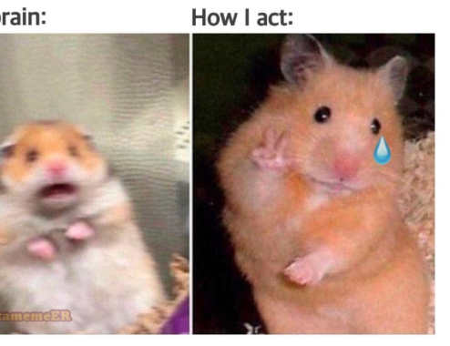
My brain:
How I act:
Notes:
“OVERWHELMED” is the word that people who have experiencing suicidal thoughts or engaged in suicidal behaviors use to describe their state of mind .
In their minds, there were no other options for dealing with the intense, crushing emotional pain that they were feeling inside.
They had no where else to turn. They had no other choice. They had exhausted all options. There was no one else they could turn to. No one understood how they were feeling.
The only way to end to the intolerable, unbearable emotional pain, they thought, was to end their life.

Slide 7
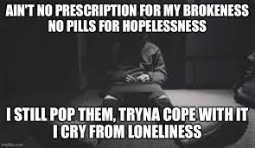
Hopelessness
One the strongest predictors of suicide risk is
LOSS OF HOPE.
If you hear or see signs of hopelessness,
ACT
IMMEDIATELY.
Notes:
In addition to “overwhelmed,” “HOPELESSNESS” is the other word that people who have experienced suicidal thoughts or suicide attempts use to describe their state of mind. When mental health professionals assess suicide risk, one of the strongest predictors is loss of hope. When you hear that someone doesn’t believe that things will ever get better, that there is no use trying anymore, that they would be better off dead, or that other people would be better off if they were dead….if you hear or see signs of hopelessness, it is important to act immediately.

Slide 8

Myth #2: Asking About Suicide Will Cause Suicide
There is no evidence that asking someone about suicide if they were NOT thinking about suicide leads to someone to suicide.
There is a lot of evidence that asking someone about suicide if they ARE thinking about suicide can PREVENT a suicide.
Notes:
Myth #2 – if you ask someone about whether they are thinking about suicide, it will cause them to suicide.
Based on decades of research studies, there is no evidence that asking someone about suicide, if they were NOT thinking about suicide, will lead to someone to attempt suicide or die by suicide. People who were not thinking about suicide before you asked them, do not suddenly think, “Suicide. What a great idea. Why didn’t I think of that?”
On the other hand, there is substantial evidence that asking someone about suicide if they ARE thinking about suicide can prevent a suicide attempt or death. Now let’s be clear: It CAN prevent a suicide if the person answers the question truthfully. Sometimes people say ”no” that they are not thinking about suicide when, in fact, they are. Still, it is important to ask because asking opens up the possibility that the person can admit to suicidal thoughts and give you an opportunity to intervene.

Slide 9
Trauma-Informed Language About Suicide
Old Language | Trauma-Informed Language
Committed suicide | Died of suicide
Successful attempt | Suicide death
Unsuccessful attempt | Suicide attempt
Completed suicide | Suicide
Suicidal person, suicide attempter | Person living with suicidal thoughts or behavior
Notes:
Before we go on to the third objection, I like to take a moment to talk about HOW we talk about suicide because language matters.
When discussing a death by suicide, we often hear that the person “committed suicide” – which suggests that what the person did was criminal – as in “to commit a crime.” The preferred language is to say that the person “died of suicide” – this is factual and neutral and not judgmental.
In a similar vein, we in the mental health community no longer use the words “successful” and “unsuccessful” to refer to a suicide or suicide attempt. Why? Because that language suggests that a suicide is something to be accomplished (as either successful or not). It adds a layer of “good” or “bad” to the person and the situation. Now we simply use the words “suicide death” or “suicide attempt.” The same is true of “completed suicide” – that language has now been replaced by just the word “suicide.”
Finally, when talking about the person who is living or struggling with suicidal behavior or thoughts, we want to use person-first language – put the person first because the person is not solely defined by their behavior or thoughts. So instead of saying “suicidal person” or “suicide attempter,” we simply say the “person living or struggling with suicidal thoughts or behavior. “
Words do matter. Using factual and direct language that is free of judgment helps us to focus on reaching out rather than distancing ourselves from the person who is or has struggled with life.

Slide 10

Myth #3: It’s Hard to Ask Someone About Suicide
Common Objections
“What do I say?”
“What if they get angry at me?”
“What do I do if they say, ‘yes’?”
Notes:
Myth #3: It’s Hard to Ask Someone About Suicide
Actually, it’s not as hard as you think is. It may be difficult the first time or first few times you do it, then you’ll find that it’s not hard at all. Just about every mental health professional can tell you about being in graduate school and going through training in doing suicide risk assessments. Almost all of us remember that first time that we had to ask someone eyeball-to-eyeball, with our heart thumping in our chest: “Are you thinking about hurting or killing yourself?” It was tough. But then you ask another client or another patient and another one until you can do it with ease and compassion, “Are you thinking about hurting or killing yourself?”
Here are 3 of the most common objections to asking someone if they are thinking about suicide.
“What do I say?”
“What if they get angry at me?”
“What do I do if they say, ‘yes’?”
Let’s deal with each one of these in more detail.

Slide 11
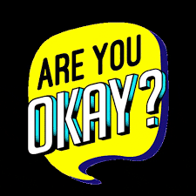



Type in the chat box:
What do you think you could say?
Asking about suicide
Objection #1:
“What do I say?”
Notes:
Type in the chat box, what do you think you should say? [Wait for responses in person or in the chat box.]
[Acknowledge or read appropriate responses. Avoid critiquing responses unless they are entirely inappropriate.]
The simple answer is that you could start by saying, “Are you OK?” “Estas bien?” Simple, right! “Are you OK?”
If it often helpful to let the person know that you are worried or concerned, by something like:
“You don’t seem like yourself. Are you OK?”
“I’m concerned about about you. Are you OK?”
Say it: “Are you OK?” That wasn’t that hard.

Slide 12
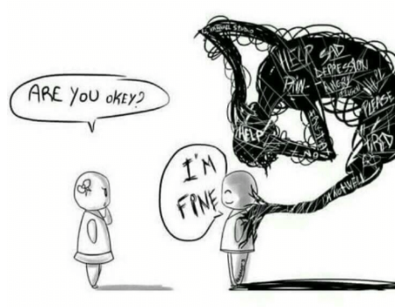

Trust your gut:
Don’t stop at “I’m fine.”
Would you like to talk to someone?
One more question could make the difference.
Notes:
You can’t just stop with “Are you OK?” because it is so easy for the person to give the socially acceptable response, “I’m fine” or “I’m OK,” when, in fact, like in the cartoon, there is a dark cloud of pain and doom hanging over their head. They want help, but they don’t know how to ask.
If your gut instinct is that the person is NOT OK, trust your gut and DO NOT STOP with “I’m fine.”
Share what you are seeing or thinking, then ask again. Say something like,
“You don’t seem fine to me.” or “It’s OK to not be OK.”
Then ask, “Are you REALLY OK?”
You could also ask, ”Would you like to talk to someone?”
This last example is important because sometimes people don’t want to tell YOU exactly what is going on, but they do want to talk to someone. This offers them a way out – a way to ask for help and still ”save face” or not be embarrassed to tell you their problems.

Slide 13
Are you thinking about hurting or killing yourself?
DO NOT LEAVE THE PERSON ALONE.
I want to get some help.
Notes:
Beyond “Are you OK,” the real question to ask is: “Are you thinking about hurting or killing yourself?” I know it sounds kind of blunt and to the point, but it is direct and powerful.
Say it out loud right now so you hear yourself say the actual words. Say it again. Say it a third time. You more you say it, the easier it gets.
“Are you thinking about hurting or killing yourself?”
Then wait for an response. Wait patiently. Do not hurry or rush through this moment.
You may find yourself getting antsy inside, but just breathe through it and wait for an answer.
The longer the person takes to answer, the more likely it is that “yes,” they have been thinking about hurting or killing themselves.
This moment of silence may feel like an eternity, it’s not. It is the moment of opening, of connecting for the person thinking about or planning for suicide. It is an incredible moment of turning away from death to life. Just wait and listen.
“Are you thinking about hurting or killing yourself?”
Regardless of the answer that you get, if you still have some concerns, do not leave the person alone. Call for help or have someone else go get help...
[Note to presenter: It is intentional that the question is repeated multiple times on this slide and on the following slides so that people can get use to hearing it and rehearsing it.]

Slide 14

Asking about suicide
Objection #2:
“What if they get angry at me?”
Notes:
The second objection people make about asking someone about suicide is: “What if they get angry at me?”
When you ask someone if they are thinking about hurting or killing themselves, you will get one of 2 responses:
Something like, “No, do you think I’m crazy? I would never do that!” OR
Something like, “Yeah, I don’t know…maybe…why are you asking me that?”
My response to this is: ”So what if they get angry at you?” Asking someone about suicide is a sign that you care.
You could say, “I’m sorry I didn’t mean to offend you. I’m just concerned about you.”
If the person is thinking about suicide, you asking the question may just save their life. I would prefer that my friend or colleague or loved one be alive and mad at me than dead.

Slide 15

Asking about suicide
Objection #3:
“What do I do if they say ‘yes’?”
Acknowledge response
  NOT “empty” comfort or advice
Invite the person to talk more.
  If not you, then with someone else
Notes:
A third objection to asking someone about suicide is:: “What do I do if they say, ‘yes’?” Believe it or not, getting a “yes” is a tremendous sign of hope. They fact that the person has shared this with you demonstrates that they are still clinging to life and want to stay alive.
So, the first thing you should do after getting a “yes” response is to acknowledge that response by saying something like, “Thank you for sharing that with me. That must have been hard.”
Acknowledge the response and do not provide empty comfort by saying things like, “It can’t be that bad.” “You don’t really want to kill yourself, do you?” “Things always get better.”
Don’t try to fix the problem or lecture or offer advice. The most important thing you can do is listen.
Invite the person to talk more by saying something like, “Tell me what has been going on that you are thinking about hurting or killing yourself.
If the person doesn’t want to talk to you, that’s OK, like I mentioned before. Just say: “That’s OK. Would you like to talk privately with someone else?”
That could be someone in Health and Wellness, another staff person, calling a counselor on the JC Safety Hotline, or a national or local crisis line like 988. Sometime people prefer talking or texting with a crisis hotline because they can remain anonymous. Don’t worry, if the person needs immediate intervention, the person on the crisis line will make sure that happens.

Slide 16
Some Things NOT to Say
“How could you think of suicide? Your life’s not that bad.”
“Things could be worse.”
“Other people have problems worse than you and they don’t want to die.”
“You have so much to live for.”
“Don’t you know I [or your family] would be devastated if you killed yourself?”
“Suicide is selfish.”
“Suicide is cowardly.”
“You need to stop dwelling on your problems.”
“You’ll feel differently next week.”
“You’re just looking for attention.”
“You don’t mean that. You don’t really want to die.”
“You won’t do it – nobody who talk about it ever does.”
“Suicide is a permanent solution to a temporary problem.”
“You will go to hell if you die by suicide.”
Notes:
Here are some things that people often say that are NOT helpful according to people who have lived with suicidal thoughts. Take a few moments to read them. [WAIT.]
The statements tend to come in a few different “flavors” if you will:
The 4 statements at the top in green try to use logic to address the situation: “Your life’s not that bad. Things could be worse.” The problem is that suicidality has a logic of its own and these statements, although well-intended, are not logical or helpful to the person living with suicidal thoughts.
The 3 statements in turquoise rely on “shock value:” Statements like “Think about how it would affect your loved ones” and “Suicide is selfish.” only make the person feel worse – more guilty, more anger, more hopeless.
The statements in blue and light purple offer simple solutions such as “Stop dwelling on your problems” or positive thinking strategies like “You’ll feel different next week.”
The 2 statements in light blue are like challenges or dares – “You don’t really want to die.” or “You won’t do it.” These are dangerous statements because the person contemplating suicide may just think, “I’ll show you!”
Finally, the last 2 statements are things that you may believe – and there is some truth to the notion that suicide is a permanent solution to a temporary problem. But when you’re trying to pull someone out of the depths of despair – that is NOT a time to lecture.
Rather than being helpful, ALL of these statements tend to alienate or push away the person with suicidal thoughts, making them feel even more alone and isolated. They do not instill hope – which is the what the person needs the most.
DO NOT READ: Adapted from:
https://www.speakingofsuicide.com/2015/03/03/what-not-to-say/
https://purplepersuasion.wordpress.com/2014/04/09/ten-things-not-to-say-to-a-suicidal-person/

Slide 17
Helpful Things To Say
“I’m here to listen.” (friends, family members)
“I’m sorry to hear you’ve been having such a hard time.” (cousin, teacher)
“That must be very difficult.” (friend, teacher)
“I’m not going anywhere.” (parent, partner)
“Here’s my number. Call me any time. And I mean any time.” (various friends)
“What can we do to help you regain your equilibrium?” (nurse, therapist)
“I know you’re taking your meds, but it doesn’t seem like they are working for you, are they?” (senior colleague)
“How can I help?” (anyone)
“The times when you’re unwell don’t matter. I’d rather have one of you than ten other people with a clean sickness record.” (manager)
“Just let me know when you’re ready to come back.” (choir director)
Notes:
This is a list of some helpful things to say to someone struggling with suicidal thoughts was taken from a list compiled by a woman living with bipolar disorder. She called it “Ten supportive things I’m glad somebody said to me.” Not all of these are things that YOU in your role as a staff member or fellow student can say, but I thought it was important for you to get an idea of the types of things that are helpful to say.
The first 3 statements in light yellow are words that convey empathy: “I’m here to listen. I’m sorry you’ve been having such a hard time. That must be difficult.” Listening is the most important way you can support the person struggling with thoughts of suicide – even though what they are saying may be hard to hear or hard to understand.
The next 2 statement in yellow offer steadfast support. They say that I am here for you no-matter-what: I’m not going anywhere.” “Call me any time.”
The next 2 statements in light green are statements about taking action to get things back in balance and stabilized. They are also offers of help: “What can we do to help you regain your equilibrium? How can I help?” If you are ever unsure of what to do say, you can always ask, “How can I help?”
The last 2 statements recognize that that the person struggles with mental health issues, and they are still valuable. It also recognized that sometimes that the person who deals with mental health issues may need to take a break from their job or activity.
DO NOT READ Adapted from:
https://purplepersuasion.wordpress.com/2011/08/03/ten-supportive-things-im-glad-somebody-said-to-me/

Slide 18


Get help.
  By phone
  By going somewhere
  By getting someone else to go get help
Notes:
Get help – do not leave the person alone. You can get help by calling the Health and Wellness Center, a staff member, the JC Safety Hotline, or 988, the National Suicide and Crisis Lifeline. You can walk with the person to Health and Wellness Center or have someone else go get help. If it’s after hours or on the weekends or a holiday, be sure to follow your center’s procedures for Mental Health Emergencies.

Slide 19
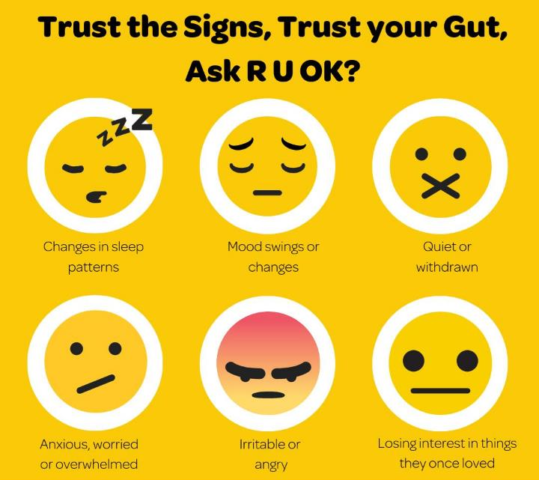
  Who should I ask?
  Anyone you are concerned about
  Changes in:
  Sleep
  Mood
  Behavior
    Sad / Hopeless
    Anxious / Overwhelmed
    Irritable / Angry
Notes:
A question you may have on your mind is: “Who should I be asking about suicide?” This is a great question. The simple answer is, “anyone that you are concerned about.” Trust your instincts first and foremost. You would always rather be more cautious than less cautious.
Here are some of the most important signs of suicide. All of the signs indicate that the person’s mood, behavior or patterns have changed significantly in some way.
One serious sign that is easy to miss is a change in sleep pattern: having trouble falling asleep or staying asleep, or sleeping a lot more or a lot less. Poor sleep drains a person of emotional resources, making them more vulnerable to stress and less able to figure out solutions to life’s challenges.
Changes in mood such a significant increase in sadness and depression; an increase in anxiety, worry, or feeling overwhelmed; or or an increase in irritability or anger can be also be signs of suicide. I’m not talking about the normal ups and downs that everyone experiences. You should only be concerned when someone’s overall mood, usual mood, or baseline mood changes significantly..
Remember: if you hear hopelessness, that is definitely cause for concern. Also, sometimes, after a period of being really down, a person may suddenly appear to cheer up and have more energy – that may be because they have settled on a solution to all of their problems and that solution is suicide.
Changes in behavior:
If someone who is outgoing, suddenly becomes more quiet or withdrawn – again, when there is a change in their usual behavior or patterns, this should raise your level of suspicion that maybe something is wrong.
If the person seems to have lost interest in things they once enjoyed – such as music or exercise or a hobby, and especially if they start giving away things related to their interests, definitely express some concern to someone.

Slide 20

The good news:
Job Corps is protective against suicide
LOWER than national statistics for young people ages 15-24.
Notes:
Here is the good news: What you do at Job Corps DOES make a difference. Job Corps is protective against suicide for the young people that our program serves. Looking at data going back to 2009, the suicide rate among Job Corps’ students is lower than the national statistics for young people ages 15 to 24 -- with the exception of one year (PY 2011). Not only was the Job Corps rate less than the national rate; in several years, it was was half the national rate. In two program years, there were no suicides at all. The Job Corps program and, most importantly, its staff provide a significant and strong buffer against the despair that causes so many young people to take their own lives.

Slide 21
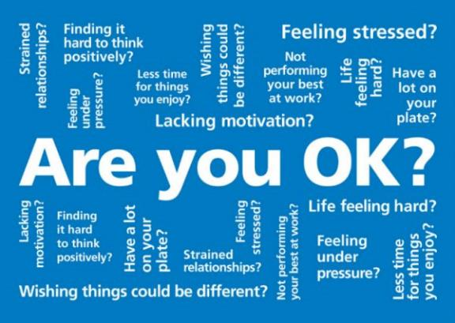
  RECAP
  Suicide is about struggling with life (feeling overwhelmed and hopeless), not wanting to die. This should give us hope and the courage to help.
  Asking about suicide prevents suicide. It does not cause suicide.
  Asking about suicide is not as hard as you think. If the person gets angry, it’s because they are still alive.
Notes:
Just to recap the information presented in today’s webinar:
Suicide is not about death. Suicide is about struggling with life (feeling overwhelmed and hopeless), not wanting to die. This fact should give us hope – and the courage to help.
Asking about suicide prevents suicide. It does not cause suicide.
Asking about suicide is not as hard as you think. It gets easier with practice: “Are you thinking about hurting or killing yourself?” Remember, if the person gets angry, it’s because they are still alive, thanks, in part, to you.

Slide 22
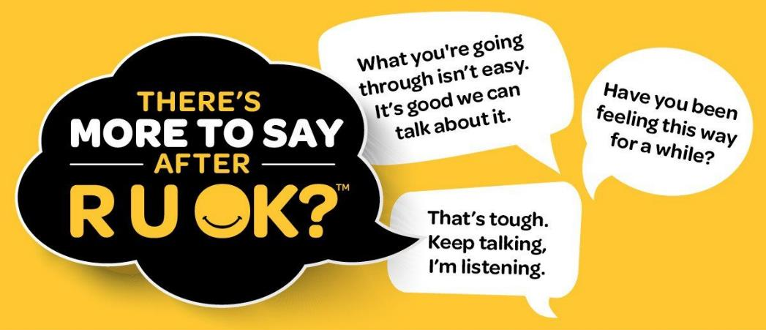
  Ask
  or
  Trust your instincts.
  Don’t leave the person alone.
  Get help.
more than once
more than one way.
Notes:
How do you ask? You start by asking, “Are you OK?” but there is more to say after “Are you OK?” It’s too easy for someone to say, “I’m fine.” In fact, I’m sure you’ve done it when you were having a horrible day, and someone said, “How are you?” You said, “I’m fine” because that’s what you’re supposed to say. The same is true for the person who is hurting so bad that they think they no longer want to live. Trust your instincts. Tell them that you are concerned. Ask again in a different way, “Do you want to talk? Do you want to talk to someone if it’s not me?”
If you are concerned enough to ask the person about suicide, then do not leave that person alone. Get help – whether by phone, by going somewhere that is safer (like around other people) or by taking them to someone who can help.

Slide 23
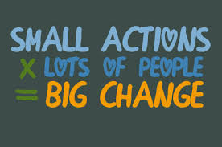
It’s easier to offer help than to ask for help.
No qualifications needed.
What we do at Job Corps DOES make a difference.
Notes:
There are no special qualifications needed to ask someone if they are thinking about suicide. It has been said that “It’s easier to offer help than to ask for help.” Be a lifeline for someone who is struggling with life. A single conversation can change a life.
In the same way that many people know CPR, we in the mental health community hope that everyone will be able to save a life by asking a simple question. “Are you thinking about hurting yourself or killing yourself.” If lots of people -- if we all do this -- as part of taking care of one another in the Job Corps community, then small actions like asking about suicide, can help to curb the tidal wave of suicide, which was the third leading cause of death among individuals between the ages of 15-24 in 2020. What we do at Job Corps does make a difference in the lives of the young people we serve.

Slide 24







  WHO WILL YOU ASK?
Notes:
Who will you ask: ”Are you OK?” “Are you thinking about hurting or killing yourself?” A conversation can change a life.

Slide 25



Notes:
Now let’s talk about what you just saw and heard. Type in the chat box: What is something new or helpful that you learned today?
[Note: if there is time for questions, then say, “Are there any questions or concerns that anyone would like to raise?” I will do my best to answer questions, but there may be other people with knowledge or experience who may want to chime in. If I am not able to answer you question, I will be hap]y to do some research and get back to you.”}

Slide 26
For Staff Only
Symptomatic Management Guideline (SMG) for Suicidal Self-Directed Violence (SSDV)
Notes:
These next 4 slides are to be included for staff training only and talks about the Symptomatic Management Guideline (SMG) for suicidal self-directed violence. Some of you may be asking what is a SMG?
The SMGs are for non-health staff like residential counselors, security, counselors, teachers, recreational staff, etc.
They provide guidance for non-health staff about how to how to handle common medical, mental health, substance use, and oral health symptoms during hours when no health staff are present on center. The SMGs provide guidance about about when to refer the student urgently to the on-call health staff or, if they are not reachable, to a local emergency response team or urgent care center.
At a minimum, copies of the SMGs should be found in the HWC, residential, security, and recreation areas on center.
New non-health staff members must receive training in the use of SMGs within their first 90 days of employment. In addition, all non-health staff should receive training every year. (PRH Exhibit 5-4).
Today we will focus on the SMG for suicidal self-directed violence.

Slide 27
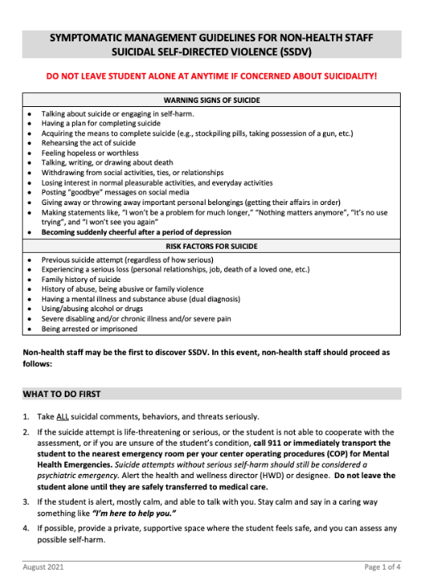
Warning Signs of Suicide
Risk Factors for Suicide
What to Do First
Assess Symptoms and Risk Factors
What To Do Next
Symptomatic Management Guideline (SMG)
for
Suicidal Self-Directed Violence (SSDV)
Notes:
The recommendations presented earlier for asking a student about suicide – asking ““Are you OK?” and asking more than once” -- are general suggestions. Job Corps’ SMG has more explicit instructions to guide staff through the steps of what to do when a student may be suicidal. It contains:
a list of the warning signs of suicide and some of the risk factors for suicide that I will show you in a minute
It is divided into 3 step-by-step sections –
what to do first
assessing symptoms and risk factors
what to do next

Slide 28
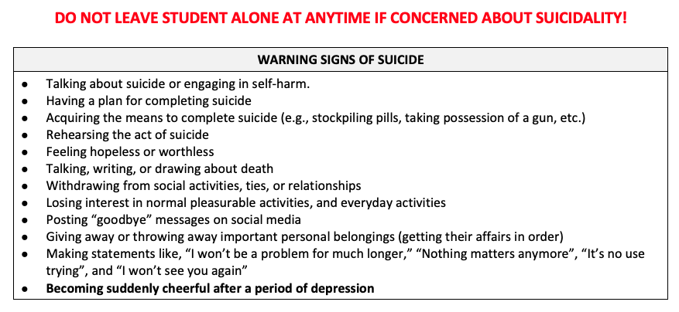
Notes:
This list of the warning signs of suicide has all of the signs listed in the previous sign but also has a few more specifics, including:
Acquiring the means to complete suicide, such as a stockpiling pills for an overdose attempt
Talking, writing, or drawing about death
Posting “goodbye” messages on social media and
Making statements like, “I won’t be a problem for much longer,” “Nothing matters anymore,” ”It’s not use trying,” and “I won’t see you again.”
The last bullet also highlights the fact that someone people when contemplating suicide become sudden cheerful about a period of depression. Again, this sudden change in behavior could reflect the fact that the person has made a decision and a plan for ending their life.

Slide 29
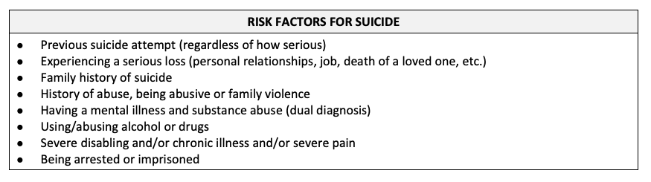
Notes:
This is a partial list of some of risk factors for suicide. When one or more of these factors are present, it increases the likelihood that the person may try to end their life or suicide.
[Read list.]
Also, in general, the more risk factors a person has, the greater the chances of harm or death.

Slide 30
I know it might be difficult, but I need to ask some questions about how you are thinking and feeling.
1
Sometimes people feel that life is not worth living.
How are you feeling about living right now?
Have you ever thought of harming yourself or trying to end your own life?
Are you feeling that way now?
Have you thought about how you would do it?
Do you have a way to carry out that plan?
2
3
DO NOT LEAVE THE STUDENT ALONE.
Notes:
This is how the questions for asking about suicide are written in the SMG.
It starts with 2 lead-in sentences:
I know it might be difficult, but I need to ask some questions about how you are thinking and feeling.
Sometimes people feel that life is not worth living.
Then there are 5 questions. You should ask the first 3 questions:
How are you feeling about living right now? This is an open-ended question which is designed to just get the student talking. Listen patiently, non-judgmentally and with genuine concern.
Have you ever thought of harming yourself or trying to end you own life? This question asks about the past. Why? 1) Because it can be easier to talk about the past than to talk about the present. 2) It gives you important information about suicide risk. People who have attempted in the past and more likely to attempt in the future.
Are you feeling that way? This question brings the question to the present. IF the student answers yes, then you ask the next 2 questions to get more information about risk.
The last 2 questions about whether the person has a plan and a way to die by suicide.
Have you thought about how you would do it?
Do you have a way to carry out that plan?
The PRH ( requires training on SMGS for all new hires within 90 days and annually for all center staff

