Slide 1
Mastering the Center AFR Process
Increasing Understanding and
Improving Efficiency of
Applicant File Clinical Review and
Reasonable Accommodation Processes

Slide 2
Objectives
One
Two
Three
Four
Five
OPTION 3
Describe the process steps in making applicant file recommendations with the consideration of reasonable accommodations.
Articulate ways to “think through” information presented in applicant files and applicant interviews to determine and subsequently support recommendations.
Appropriately and thoroughly complete Appendices 609 and 610 assessments.
Describe specific factors that trigger a reasonable accommodation review within the AFR assessment process.
Identify scenarios that allow the center File Review Team (FRT) to cease the applicant file review process and “return” the file to the Admission Counselor (AC).

Slide 3
Clinical Review
Applicant File Review
Center Process
Reasonable Accommodation

Slide 4
Review of the Initial AFR Process Steps
1
2
3
4
5
Step ONE
File is “received” on center (electronically or otherwise) by the records staff who record the file in the records log and track its movement.
Step TWO
Records forwards the sealed medical, health, or disability-related information unopened to the Health and Wellness Manager (HWM) if anything is received in hard copy.
Step THREE
The HWM reviews the “Job Corps Health questionnaire (ETA 653)” and the medically related documentation to determine:
The health care needs of the applicant and whether JC can meet those needs, and
If the applicant presents a direct threat to self or others.
Step Four
The HWM determines who else may need to review the protected information based upon the determination of “need to know.” This is your File Review Team (FRT)!
Step Five
The members of the FRT conduct a clinical review to determine if a health care needs or a direct threat assessment is necessary.

Slide 5
Let’s Review the File Review Team (FRT) Composition
Who should be the typical participants of the file review team?
Center Mental Health Consultant (CMHC) reviews mental health-related information
Center Physician/Nurse Practitioner/Physician’s Assistant reviews medical information
Center Dentist reviews dental/oral health information
TEAP Specialist reviews substance-related information
Disability Coordinator (often the Academic Manager) reviews IEPs, 504 plans, educational reports including special education assessments and provides feedback back to HWM (but cannot complete health care and direct threat assessments)

Slide 6
No Health Care Needs or Direct Threat Concerns?
If there are no health-care needs or a direct-threat concerns, schedule the applicant for enrollment.

Slide 7
Clinical Review
Applicant File Review
Center Process
Reasonable Accommodation

Slide 8
How do we decide when to enroll or recommend denial for an applicant?
What Do
I Do
Now?
Based on health care needs and direct threat with consideration of reasonable accommodations.
8

Slide 9
Individualized Clinical Considerations
Individualized consideration
Current stability
History of stability
Current behaviors
History of behaviors
Medical risks and health care needs
SAFETY
Failure to comply with an outside provider’s recommendation does not automatically mean a recommendation of denial.
Being in a residential facility, hospital, or juvenile detention facility does not automatically mean a recommendation of denial.

Slide 10
Applicant File Important Information to Review
ETA 6-52 (Outreach and Admissions Applicant Information Sheet)
ETA 6-53 (Health Questionnaire)
CCMP provider forms
Inpatient psychiatric or medical hospitalizations or emergency department visits (if relevant), treatment summaries
IEP, 504, and other educational information provided
Disability classification, social/emotional /behavioral functioning
Does disability/behavior impede the learning of others?
Behavior intervention plan
Psychological assessment
Background check
Individual statement from applicant

Slide 11
Applicant Interview AND Professional Contact are KEY!
Interactive in-person or telephone WITH APPLICANT.
Only ask specific questions regarding any behaviors or information of concern that has been disclosed or documented in the applicant file.
Document specific behavioral or clinical observations from interview.
If center H & W staff (including TEAP specialist) disagrees with the opinion provided by outside professional on CCMP, try to contact professional to resolve or explain difference of opinion. Document contact or lack of response from professional.

Slide 12
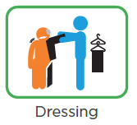
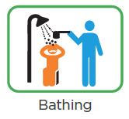
Applicant Interview also is KEY if:
Center has concerns regarding cognitive ability and adaptive functioning of applicant.
Ideal:
Provide in depth tour noting how well applicant functions during time on center.
Document specific behaviors that arise indicating applicant might be vulnerable or have difficulty in group setting or with training environment.
Focus on applicant’s adaptive living and social skills and ability to make safe decisions/judgments.
Not solely on IQ!

Slide 13
What Must Be Done First?
It depends!

Slide 14
Applicant Monica
18-year-old applicant who reports current treatment for diagnoses of ADHD since age 13 and reports Learning Disability on the ETA 6-53 Health Questionnaire.
Recent ADHD CCMP documentation by treating psychiatrist describes applicant as stable, medication compliant over past year, and good prognosis.
IEP (a year old) – No behavior intervention plan (BIP), academic accommodations, good effort in classroom.
14

Slide 15
Should CMHC review this file?
Yes
No
15

Slide 16
Should CMHC interview this applicant?
Yes
No
16

Slide 17
Outcome – Version # 1
Clear for enrollment
HWM contacts applicant regarding medications, if appropriate
CMHC provides DC with potential accommodations to discuss with applicant

Slide 18
Applicant Monica Version # 2
18-year-old applicant who reports current treatment for diagnoses of ADHD since age 13 and reports Learning Disability on the ETA 6-53 Health Questionnaire.
Recent ADHD CCMP documentation by treating psychiatrist describes applicant as stable, medication compliant over past year, and good prognosis.
IEP – Social Emotional Disturbance (SED) with or without BIP.
18

Slide 19
Outcome – Version # 2
Center clinician of highest level of licensure related to the applicant’s primary areas of concern (i.e., CMHC in this case) and the HWM contact applicant and conduct clinical interview
DC engages applicant in the interactive reasonable accommodation process (i.e., reviews accommodations to support identified functional limitations); the CMHC participates, if available

Slide 20
Applicant Monica Version # 3
18-year-old applicant who reports current treatment for diagnoses of ADHD since age 13 and reports Learning Disability on the ETA 6-53 Health Questionnaire.
Recent ADHD CCMP documentation by treating psychiatrist describes applicant as stable, medication compliant over past year, and good prognosis.
IEP – Social Emotional Disturbance (SED) with or without BIP.
Interview reveals hospitalization for serious suicide attempt 2 months ago with new diagnosis of Bipolar Disorder.
20

Slide 21
Outcome – Version # 3
May request additional health information
May contact treating psychiatrist
Considers Health Care Needs Assessment
Participates in RAC
Makes recommendation for enrollment or denial

Slide 22
Applicant Monica Version # 4
18-year-old applicant who reports current treatment for diagnoses of ADHD since age 13 and reports Learning Disability on the ETA 6-53 Health Questionnaire.
Recent ADHD CCMP documentation by treating psychiatrist describes applicant as stable, medication compliant over past year, and good prognosis.
IEP – Social Emotional Disturbance (SED) with or without BIP.
Interview reveals hospitalization for serious suicide attempt 2 months ago with new diagnosis of Bipolar Disorder. Reports no longer taking medications, daily suicidal ideations, increased anger with recent attack on Mom with police involvement 1 month ago. Became agitated during interview.
22

Slide 23
Outcome – Version # 4
May request additional health information
May contact treating psychiatrist
Considers Direct Threat Assessment
Participates in RAC
Makes recommendation for enrollment or denial

Slide 24
HCNA or DTA
The differences between a
Health Care Needs Assessment (HCNA) and a
Direct Threat Assessment (DTA)
evolution
24

Slide 25
Health Care Needs (HCN) and Direct Threat (DT) Assessments
HCNA – Appendix 610
DTA – Appendix 609
The HCNA should be completed if there is a concern that the center cannot meet the basic health care needs of the applicant.
MUST be completed by a clinician
MUST use the required form and ensure it is the most current one
A DTA should be completed whenever center believes that an applicant poses a direct threat to the health or safety of himself or others.
MUST be completed by a clinician
MUST use the required form and ensure it is the most current one

Slide 26
DTA versus HCNA
HCNA – Appendix 610
DTA – Appendix 609
Imminence: Immediate safety concern
Suicidal behavior
Homicidal behavior
Paranoid thinking
Threat of assault
Serious or life-threatening medical condition
Rarely used when dealing with Substance Abuse/Dependency issues with applicants unless connected to harm to self or other concerns
May have safety issues related to health needs, but threat is not imminent
Mood swings
Impulsive behavior
Impaired judgment
Uncontrolled seizures
Dialysis
Specialized treatment
Substance Abuse/Dependency

Slide 27
Appendix 610
evolution
Health Care Needs Assessment
(HCNA)
27

Slide 28
Appendix 610 Health Care Needs Assessment
The Health Care Needs Assessment should be completed if there is a concern that the center cannot meet the basic health care needs of the applicant.
The applicant’s health-care needs exceed those of basic care and cannot be met by the center or the community near the center.
The applicant’s health-care needs are manageable at Job Corps as defined by basic health-care services in Exhibit 6-4, but require community supports and services which are not available near center.
Assessment conducted and signed by appropriate licensed health provider (CMHC, CP) or TEAP specialist.
All information is on assessment, not on attachments or addendums.
28
Notes:
Addendums may be added to “supplement” your answers but not in lieu of responding to the question on the assessment.

Slide 29
Exhibit 6-4 Job Corps Basic Health Care Responsibilities
Mental Health Basic Health Care
Assessments (not psych testing)
Short-term counseling with mental health checks as needed, with a focus on retention and behaviors that represent employability barriers
Collaboration with center physician and health and wellness staff on psychotropic medication monitoring
Psycho-educational groups as needed in collaboration with counseling
Crisis intervention as needed
Off center referrals
29

Slide 30
Let’s Learn about Carter!
HWM provides you with a file of 19-year-old applicant Carter.
6-53 indicates applicant is receiving treatment, on prescribed medications, with diagnoses of Autism Spectrum, Intellectual Disability, and Depressive Disorder-Recurrent.
Discharge summary and evaluation from 4 day hospitalization 6 months ago due to depression and non suicidal self injury (cutting marks on leg). Evaluation references inappropriate sexual behavior with a younger sibling 2 years ago.
CCMPs – Autism Spectrum Disorder- Level 1.
CCMP - Depressive Disorder – applicant can attend JC with weekly counseling and monthly psychiatric follow-up.
Current IEP- Intellectual Disability- low reading/math scores./ some difficulty with peer relationships/ no behavioral issues, does not impede the learning of others.
Applicant has state funded insurance and is applying to center out of state.
Notes:
Let’s Practice!

Slide 31
31

Slide 35
Chronic Care Management Plan
CCMP Provider Form: Does the provider recommend applicant to enter Job Corps? Yes No
If conflicting recommendation with treating provider, indicate efforts to contact treating provider for discussion in addition to summary of information on the CCMP.
refers to these two questions:
In your opinion, will the applicant be able to self-manage his/her medications unsupervised and participate in a non-mental health residential vocational training program? If no, explain.
In your opinion, will the applicant be appropriate to reside in a non-mental health dormitory style residence with minimal supervision? If no, explain.

Slide 36
Applicant presented as cooperative with lower cognitive functioning as evidenced by concrete thinking and difficulty understanding questions. During the phone interview, additional communication strategies. For example, slow speech, short sentences, asked applicant to repeat back questions to ensure understanding, gave ample time for applicant to respond, repeated and reframed questions with concrete examples.
Applicant reported feeling sad daily, rated depression 8/10, easily angered when things do not go his way, and continues to have suicidal ideations, but not as often if taking meds. No longer receiving therapy after hospitalizations. Last self-injury behavior was a month ago on arms with a pen, went to urgent care and came home.
Applicant presented as moderately anxious with limited insight and judgement when posed with common scenarios with peers and Job Corps life. For example, when asked how he would handle feeling stressed or upset, he said he did not know. “Maybe cry and call a family member.” Applicant was not able to list any coping skills to independently manager anger or behaviors.
Applicant Interview Summary
Summary of the clinical interview content – 4 areas:
MENTAL STATUS EXAM – Statement about communication accommodations (if needed).
CURRENT FUNCTIONING – Current symptoms and behaviors; whether/how symptoms interfere with funcitoning.
PAST and CURRENT TREATMENTS
COPING STRATEGIES

Slide 37
Applicant Interview Summary (cont.)
Does not like to be around groups and sometimes feels scared around peers. When asked about reported past inappropriate sexual behavior, applicant stated that it happened when he was younger and did not want to talk about it. “I got treatment and judge said I am good.”
He identified autism symptoms as having difficulty with too much change at once or abrupt and quick change he doesn’t know is coming.
During interview applicant’s rate of speech was slowed; tone was soft. His thought processes were coherent, but answers were delayed. He denied auditory hallucinations but engages in rocking behavior sometimes when anxious. He reported obsessions and compulsions around trading phones but denied phobias.
He was not oriented to time. Intelligence was estimated to be below average per IEP. Judgement and impulse control were inadequate as evidenced by recent cutting behavior and suicidal ideations.
Summary of the clinical interview content – 4 areas:
MENTAL STATUS EXAM – Statement about communication accommodations (if needed.)
CURRENT FUNCTIONING – Current symptoms and behaviors; whether/how symptoms interfere with funcitoning.
PAST and CURRENT TREATMENTS
COPING STRATEGIES

Slide 38
Do we have enough information yet?
No - We need to consider current functional limitations (symptoms/behaviors) and health care barriers to enrollment.

Slide 39
Carter’s Functional Limitations
Diagnoses of Autism Spectrum, Intellectual Disability, and Depressive Disorder-Recurrent, recently hospitalized and started on mood stabilizer.
Clinical interview indicates communication challenges, current symptoms of depression, irritability, anger, poor peer relationships, poor impulse control, difficulty with change, etc.
When you ask about the impact of these symptoms, applicant reports: “I don’t like groups.”
CCMP provider states applicant has difficulty with noisy environments.

Slide 40
Tips Section 4
Make sure you write a brief narrative explaining the care needs! It’s critical to show why the needs exceed what Job Corps can provide.
Common Mistakes
Don’t use this section to write any evaluative statements about whether JC can meet the applicant’s health care needs. The determination about JC’s ability to meet needs must come after reasonable accommodations are considered in section 5.

Slide 41
Do we have enough information yet?
No – The DC needs to engage the applicant (if a person with a disability) in the interactive reasonable accommodation process to consider reasonable accommodations and/or modifications and document in section 5.
This is STEP 6 in the AFR Process.

Slide 42
Clinical Review
Applicant File Review
Center Process
Reasonable Accommodation

Slide 43
Reasonable Accommodation Committee (RAC)
Reviews and discusses potential accommodations with the applicant as part of the Health Care Needs or Direct Threat Assessments.
Recommends accommodations and modifications to the FRT.
Does NOT make decisions about enrollment.

Slide 44
Reasonable Accommodation (RA) in the Assessment Process
The DC and the applicant MUST be involved in the RA review as per the PRH.
The DC is the coordinator of the reasonable accommodation process; therefore, this individual must lead this portion of the assessment process.
The clinician completing the assessment should not be leading the RAC; however, s/he is encouraged to participate/make RA recommendations, if time permits.

Slide 45
Is Applicant Person with a Disability?
If yes, the DC selects the “yes” response box to the question: “Is this applicant a person with a disability?”
DC completes section 5 with applicant input.
If not, the DC selects the “no” response box and the center clinician resumes completion of the assessment at section 6 of the HCNA.

Slide 46
Review – When Do You Identify RA?
Do you consider accommodations if:
There is documentation of a disability?
for a mental health condition?
for a medical condition?
for a substance use condition?
It depends!
for an oral health condition?
Not typically but some serious conditions/situations may warrant consideration as a temporary disability. General orthodontia related-situations would not qualify.

Slide 47
RAC is unable to ID RA
It is RARE that you will select this option because generally there are accommodations that can be identified; however, if the applicant is significantly violent or seriously unstable to the point it is even impeding their ability to participate in the interview process, then there likely are no appropriate accommodations that can be considered in that case and/or at that time.

Slide 48
RAC has been unable to ID any RA
Appropriate to check the “UNABLE TO ID box in these scenarios? (Must always make the determination on a case by case basis)
Yes or No:
The DC or RAC is able to identify RA but does not think they will be sufficient?
Applicant is experiencing symptoms which impairs his/her judgment such that they could not reasonably participate in the decision-making process to determine RA even if given RA to assist with participation.
Applicant has significant history of self-harm or self-harm attempts coupled with recent events that have been increasing in either frequency and severity or both.
Applicant has single incident of self-harm with ER visit but no resulting hospitalization and no previous history.

Slide 49
There are 3 areas of consideration when considering accommodations within the assessment process. The RAC will identify/consider accommodations:
Section 3 of HCNA
28.45
Functional Limitations in Section 3 of HCNA
when listed as recommended accommodations by the outside treating provider on a CCMP such as the need for frequent breaks, limited exposure to crowds, access to appropriate snacks for blood sugar maintenance, etc.
Applicant Requests
Outside Provider Recommends in CCMP
for each of the functional limitations or behaviors selected in item #3 of the HCNA.
when the applicant requests accommodations that are relevant to the barriers impacting enrollment.
How to ID RA
49
Notes:
Applicant Requests:
For example, an applicant may ask for extended time during testing. That accommodation typically is not relevant to any of the health care needs that may be impacting enrollment.

Slide 50
What do you think?
NOTE
An accommodation request can be made in ANY form (i.e., verbally, in writing, etc.). The center must document the request on a Request for Accommodation Form (RARF) found in Appendix 605 of the PRH.
What if the applicant wants a private room due to sensory or anxiety-related issues? Does the RAC need to consider this request?

Slide 51
How to ID RA!
Section 3 of HCNA
Section 5 of HCNA
Notes:
Start by reviewing the functional limitations/behaviors in section 3 of the Health Care Needs Assessment. Then find that same functional limitation in Section 5 and discuss any accommodations in that section that may be helpful to removing the barriers to enrollment. For example, if the functional limitation of “Avoidance of group situations and settings” is checked or selected in section 3, then look for the “Avoidance of group situations and settings in section 5. See the arrow connecting the two areas in the graphics on the screen. If there are more REASONABLE accommodations needed than those listed in a particular section, then you certainly can discuss those with the applicant and document the outcome in the “OTHER” section of Section 5. We will discuss that further in an upcoming slide.

Slide 52
Things to Remember When Considering RA in the Assessment Process!
Make sure you consider accommodations/supports for EACH of the functional limitation areas checked in section 3. You can consider additional accommodations in other sections, but you must ensure that there are supports identified for every functional limitation selected and/or identified.
For example, if difficulty regulating emotions, difficulty with communication and avoidance of group situations are all selected in section 3, then there must be accommodations that support each of those areas discussed and documented on the HCNA.
For example, if the outside treating provider recommends that the applicant be allowed to prop his/her leg up so many minutes a day, etc., then accommodations related to that need also must be discussed and documented on the HCNA.

Slide 53
Completing the Check Boxes in Section 5 of the HCNA
Checking “yes” means that the applicant was offered the specific accommodation and accepted it.
Checking “no” means that the applicant was offered the specific accommodation and rejected or refused it.
Leaving the box blank means the accommodation was not offered and/or discussed because it was not appropriate or necessary.
The applicant accepted the accommodation to have breaks as needed to cool down and to use a peer mentor/staff.
The applicant rejected the flexible scheduling for counseling and for having staff taught how to support using emotion regulation strategies

Slide 54
“Other” Option in Section 5
List the accommodation(s) discussed.
Document whether the applicant accepted each accommodation.
If the applicant rejects an alternate accommodation offered or the center believes a request is unreasonable, contact your Regional Disability Coordinator (RDIC) to discuss next steps
TIP!
Don’t dismiss accommodation consideration due to a belief that they would not do any good or change the outcome.

Slide 55
RAC Summary
The RAC Summary area should only be used if there are comments or information that the Reasonable Accommodation Committee wishes to add related to the discussion of accommodations.
For example, the DC explained the interactive RA process to the applicant who then insisted that he did not need or wish to discuss accommodations.
This area is not for clinical summaries or statements related to health care needs.

Slide 56
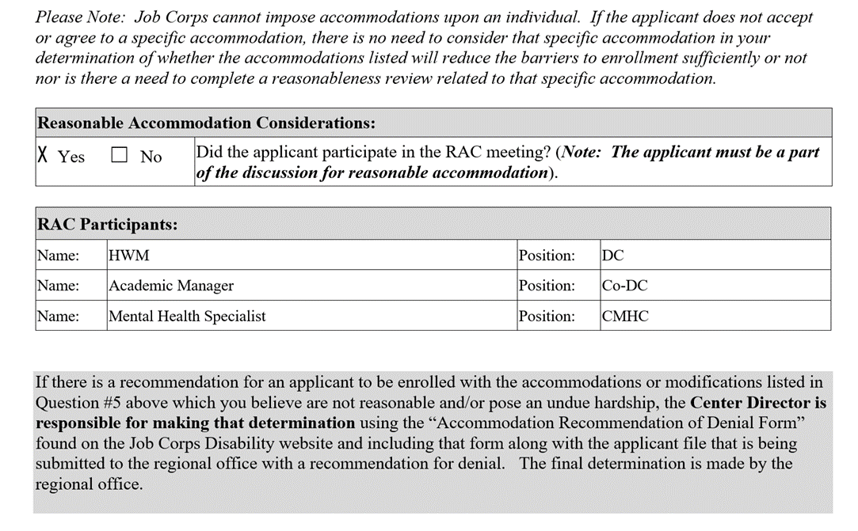
Tips Section 5
The applicant MUST be a participant if accommodations were required to be reviewed.
The DC must lead the RAC and the center clinician is encouraged to participate if time permits.
Common Mistakes
Including staff in the reasonable accommodation committee meeting that do not have a “need to know” protected health/disability information (e.g. administrative staff, CSO).

Slide 57
Poll Question
At this point, what would you do?
Enroll
Recommend denial based on cannot meet Basic Health Care Needs (HCN)
Not enough information to answer
Call your Regional Mental Health Specialist

Slide 58
Center Licensed Clinical Professional Completes the HCNA
STEP 7 - The center licensed clinical professional completing the assessment considers whether accommodations would sufficiently remove the barriers to enrollment.
STEP 8 - In Section 6 of the HCNA, the center licensed clinical professional makes a final decision based upon the findings of the assessment.

Slide 59
Tips Section 6
Ask yourself, do the accommodations in section 5 remove the barriers for enrollment.
Include a CMHC summary note.
Common Mistakes
Check 1st box for alternate center, but indicate applicant is not stable on other sections of the assessment.
FAQ
What if we want the applicant to go to an alternate center?
Check 1st box and complete Section 7.
Notes:
FAQ
Is this a common selection?
No, only 2 to 4 percent of all recommendations of denials.

Slide 60
Tips Section 7
Alternate Center
Recommendation
Must document what you did to show that health care needs cannot be met in the community where your center is located.
Common Mistakes
Leave blank.
Only write that applicant has out of state insurance but no documentation of efforts to accommodate near center.

Slide 61
Alternate Center Consideration
EXAMPLES
Called the local mental health center and verified they will not accept out-of-state insurance and they have a 4 month waiting list.
If you think the applicant could need emergency services and your center is in a rural/remote area, you could document that applicant would not have access to emergency services because the nearest hospital is more than an hour away.

Slide 62
Tips Signature
CMHC should sign and if dual with TEAP specialist or CP, both should sign
Must be original signature and not a typed signature.
Common Mistakes
HWM Signs.

Slide 63
Recommendations of Denial
Any applicant file recommended for denial must be forwarded to the Regional Office for review and final determination of the application status.
The applicant file must be printed out in its entirety when being submitted for Regional Review (i.e., admissions paperwork, health and disability documentation, case notes, consents, etc.). See Program Instruction 13-25.
Finish Line!

Slide 64
Process Concern
What is the issue here?

Slide 65
Tips
CCMP Review and Tips
Do not the check “no” to reflect YOUR opinion about whether the applicant should be recommended for Job Corps.
CCMP Provider Form: Does the provider recommend applicant to enter Job Corps? Yes No
 | Contact provider? | Check Box | Narrative
No CCMP provided | No | Leave blank | “No CCMP provided.”
Provider answers “no” to both questions | No | Check “No” | Provide summary of CCMP including provider’s “no” recommendation.
Provider answers “yes” to one or both questions | YES | Check “Yes” | Provide summary of CCMP and discussion with provider/dates you tried to contact provider.
FAQs
What if I cannot reach the provider after at least 2 attempts?
Document efforts to reach provider (dates).
What If there is more than one CCMP and one provider recommends JC but another provider does not?
You must speak with any provider who recommends applicant to Job Corps.

Slide 66
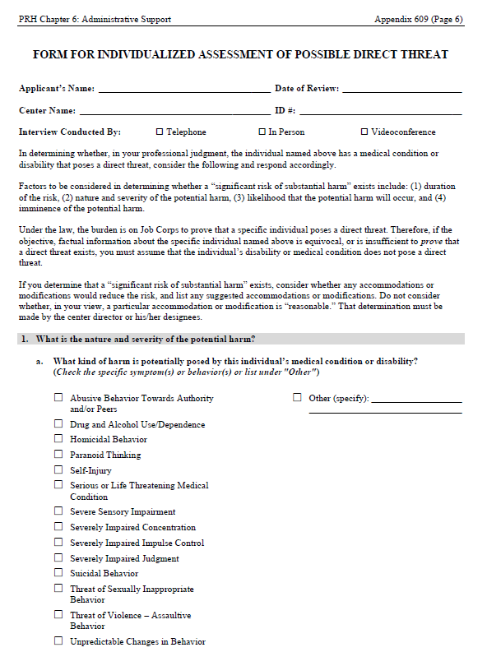
Appendix 609
evolution
What Factors Trigger a Review
of Individual’s File for
Direct Threat?
66

Slide 67
Direct Threat Assessments (DTAs)
Higher clinical standard than HCNA.
Imminent risk, not speculative.
Active harm behaviors to self or others.
Can be used for behaviors, such as sexual offense histories, assaultive histories, other significant behavioral safety concerns.
Cannot revisit behavioral (criminal) clearance done by ACs, this is clinically driven.
Discuss with Regional Mental Health Specialists.
SAMPLE AVAILABLE
67

Slide 68
Direct Threat Factors
Nature and Severity
Duration of the Risk
Likelihood Potential Harm Will Occur
Imminence of the Potential Harm
Threat is imminent: current specific behaviors, symptoms indicating instability.
Taking all four of these factors into
consideration, the assessor should determine whether the applicant’s condition poses a significant risk of substantial harm.
What is the nature and severity of potential harm?
What kind of harm is posed by the individual’s medical condition or disability?
What is the seriousness of the potential harm (e.g., death, serious injury, minor emotional distress?
What is the duration of the risk (e.g. how long will risk last)?
What is the likelihood that the potential harm will occur (e.g. high, moderate, low)?
What is the imminence of the potential harm (e.g. how soon likely to occur)?

Slide 69
Direct Threat Considerations
Do you still have to include file review summary, CCMP info, applicant interview summary in Appendix 609 – Direct Threat?
Where do you put this information on the Appendix 609 –Direct Threat Form?
RA in the Direct Threat Assessment – What must be Considered?
Review any behaviors/functional limitations checked with an affirmative answer in Section 1 of the DTA. Then go to item Section 5 and identify related appropriate accommodations that may assist the applicant based upon the behaviors/functional limitations checked in item #1!
Review any accommodations recommended by outside treating providers or requested by the applicant if the impact “may” affect the barriers to enrollment (i.e., not testing accommodations but need for private room, access to food 24/7, etc.

Slide 70
Additional Triggers from Interview, CCMPs, and Other Documents
History of suicide attempts and expresses current suicidal thoughts with imminent risk.
Active hallucinations and/or delusional thinking which places them or others at imminent risk.
Significant history of inappropriate sexual impulses, assaults, recency or increased violent episodes. Non-compliant with tx.
Homicidal thoughts
Expresses harm to self or others
Impaired judgment
Paranoid thinking
Threat of violence/assaultive behavior
Self-harm behavior due to drug and alcohol use
Medical condition with imminent high risk

Slide 71
DTA
Mental Health
and Medical Examples
evolution
DTA Considerations
and Review
71

Slide 72
Mental Health Examples Qualify for Possible Direct Threat Assessment?
History of superficial mutilation that requires no medical attention (cuts, burns, pinches, scratches) on body. Not in treatment.
History of chronic impulsive suicidal/homicidal behavior with injury to self or others or threats when off meds. Reports being currently stable (in the past 3 months). Stopped treatment and meds two weeks ago. Has never had more than 3 months of symptom free behaviors without meds.
Serious personality disorder predominately and currently characterized by chronic anger, hostility and impulsivity, negative attitude, unresponsiveness to treatment and lack of insight. These symptoms are associated with violent behaviors to others or self.
NO
YES
Maybe

Slide 73
Medical Examples Qualify for Possible Direct Threat Assessment?
Type 1 diabetic with hospitalization 1 month ago for Diabetic ketoacidosis (DKA) with dehydration, confusion, and vomiting and initial diagnosis; being seen by endocrinologist but difficult to control diabetes. During interview sounded confused, reported being thirsty a lot but not taking medications- “I don’t want others to know I have diabetes.
Applicant with unmanaged asthma. Hospitalization 2 months ago that required intubation. Recently has had 3 visits to emergency room in past 4 weeks; does not take medications regularly.
YES
YES

Slide 74
Poll Questions Review!
What is key in determining whether to do a Health Care Needs Assessment or Direct Threat Assessment?
If student makes decisions that place them at risk
If applicant is unstable and not safe
If applicant is an imminent risk to self and others
What are the steps required if you request that an applicant be considered to a Job Corps center in their home state due to health care needs?
Contact the AC and arrange for the applicant to go to another center
Document contact with treating provider to discuss options, document efforts to arrange for care near current center on HCNA form, and forward file to RO.
Document unsuccessful efforts to arrange for care near the current center and forward to RO
Notes:
1. What is key in determining whether to do a Health Care Needs Assessment or Direct Threat Assessment?
A. If student makes decisions that place them at risk
B. If applicant is unstable and not safe
C. If applicant is an imminent risk to self and others
2. What are the steps required if you request that an applicant be considered to a Job Corps center in their home state due to health care needs?
A. Contact the AC and arrange for the applicant to go to another center
B. Document contact with treating provider to discuss options, document efforts to arrange for care near current center on HCNA form, and forward file to RO.
C. Document unsuccessful efforts to arrange for care near the current center and forward to RO
3. If you receive an applicant file with medical conditions listed on the 6-53 with supporting documentation and the applicant gives new medical information during the interview, what do you do?
A. Contact the AC and ask them to get the information
B. Ask applicant to get information or provide release so center can get the information
C. Collaborate with the AC and see who is the best person to get the information quickly.
4. Can you recommend denial for health care needs due to non-compliance with medications or treatment?
A. Yes
B. No
C. It depends. Not solely on non-compliance must document what behaviors or symptoms are currently unmanageable and require care beyond basic health services.
5. If you are able to reach applicant and asks for additional information to be sent and you do not receive, what do you do?
A. Return file to the AC
B. Make decision on clinical interview and information available
C. Recommend denial for lack of information and send to the region

Slide 75
Poll Questions Review!
If you receive an applicant file with medical conditions listed on the 6-53 with supporting documentation and the applicant gives new medical information during the interview, what do you do?
Contact the AC and ask them to get the information.
Ask applicant to get information or provide release so center can get the information.
Collaborate with the AC and see who is the best person to get the information quickly.
Can you recommend denial for health care needs due to non-compliance with medications or treatment?
Yes
No
It depends. Not solely on non-compliance must document what behaviors or symptoms are currently unmanageable and require care beyond basic health services.
Notes:
3. If you receive an applicant file with medical conditions listed on the 6-53 with supporting documentation and the applicant gives new medical information during the interview, what do you do?
A. Contact the AC and ask them to get the information
B. Ask applicant to get information or provide release so center can get the information
C. Collaborate with the AC and see who is the best person to get the information quickly.
4. Can you recommend denial for health care needs due to non-compliance with medications or treatment?
A. Yes
B. No
C. It depends. Not solely on non-compliance must document what behaviors or symptoms are currently unmanageable and require care beyond basic health services.

Slide 76
Poll Questions Review!
If you are able to reach applicant and ask for additional information to be sent and you do not receive, what do you do?
Return file to the AC
Make decision on clinical interview and information available
Recommend denial for lack of information and send to the region
Notes:
5. If you are able to reach applicant and asks for additional information to be sent and you do not receive, what do you do?
A. Return file to the AC
B. Make decision on clinical interview and information available
C. Recommend denial for lack of information and send to the region

Slide 77
Resources
Clinical Review and
Reasonable Accommodation
77

Slide 78
Regional Disability Coordinators
Boston
Kristen Philbrook
Philbrook.Kristen@jobcorps.org
Philadelphia
Lydia Kidder
Kidder.Lydia@jobcorps.org
Atlanta and San Francisco
Stephanie Karras
Karras.Stephanie@jobcorps.org
Dallas
Alyssa Purificacion Olivas
Purificacion.Alyssa@jobcorps.org
Chicago
Sharon Hong
Hong.Sharon@jobcorps.org

Slide 79
Regional Mental Health Specialists
Boston
Eugia Meminger, PhD
Meminger.Eugia@jobcorps.org
Maria Acevedo, PhD
Acevedo.Maria@jobcorps.org
Philadelphia
Valerie Cherry, PhD
Cherry.Valerie@jobcorps.org
Atlanta
Eugia Meminger, PhD
Meminger.Eugia@jobcorps.org
Dallas and San Francisco
Tamara Warner, PhD
Warner.Tamara.D@jobcorps.org
Chicago
Helena MacKenzie, PhD
MacKenzie.Helena@jobcorps.org

Slide 80
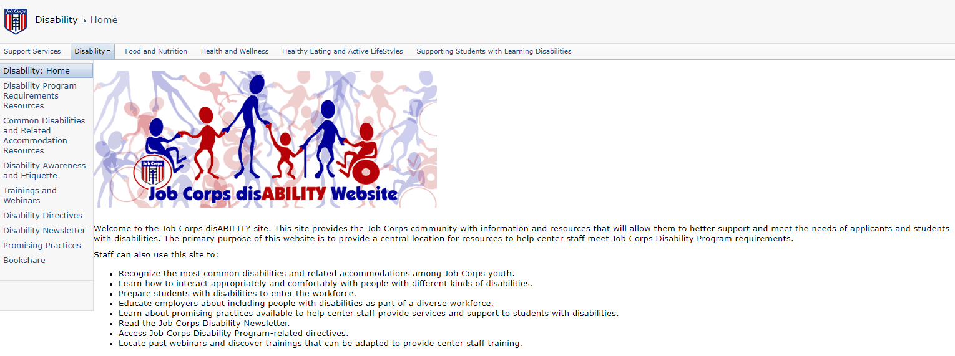
Job Corps Disability Website https://supportservices.jobcorps.gov/disability/Pages/default.aspx

Slide 81
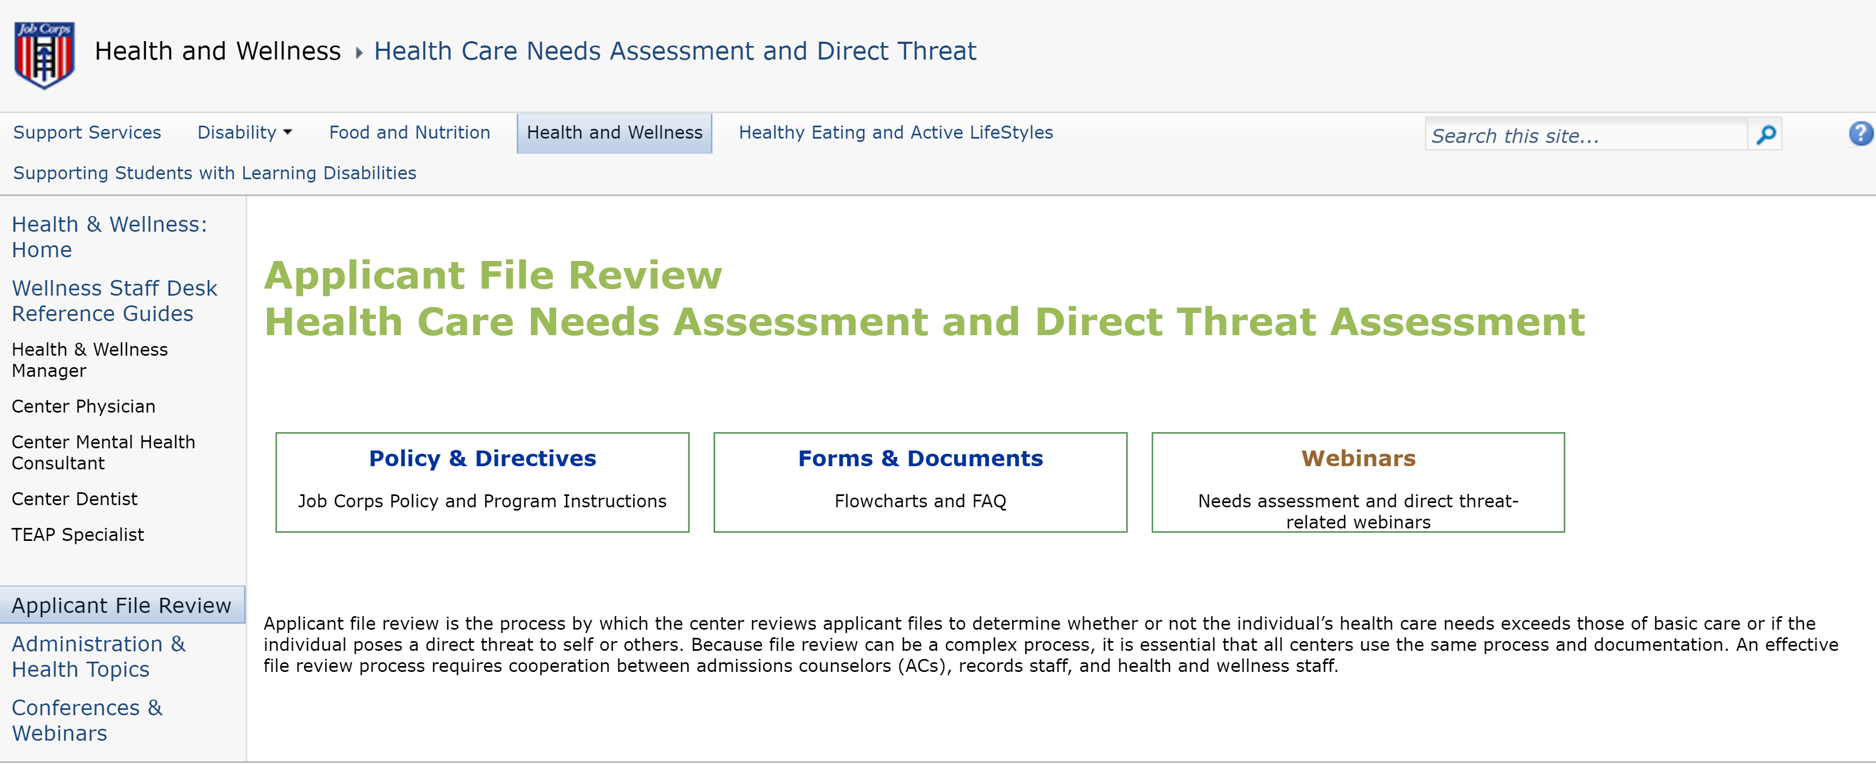
Job Corps Health and Wellness Website https://supportservices.jobcorps.gov/health/Pages/NeedsAssessmentDirectThreat.aspx

Slide 82
Job Corps Health and Wellness Website https://supportservices.jobcorps.gov/health/Pages/NeedsAssessmentDirectThreat.aspx

Slide 83
Thank you for attending!

