Slide 1
Healthy Eating and Active Lifestyles (HEALs): Nutrition, Exercise, and Motivation
Julie Klinger-Luht, MPH

Slide 2
Welcome!

Slide 3
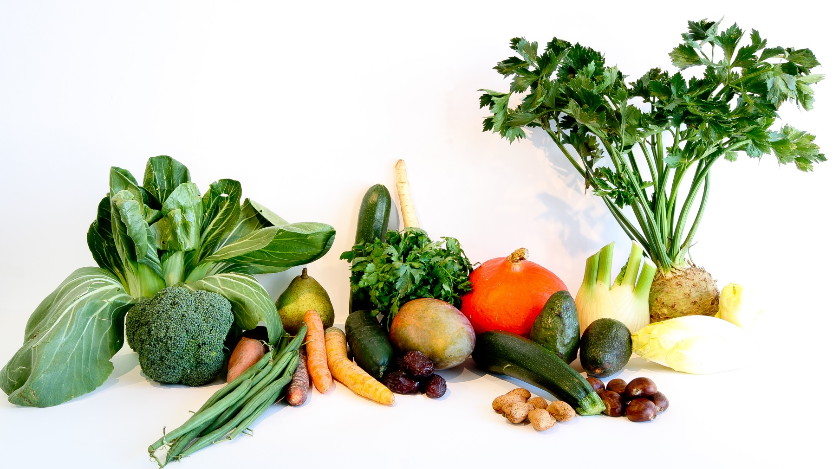
Nutrition Trends and Decision Making

Slide 5
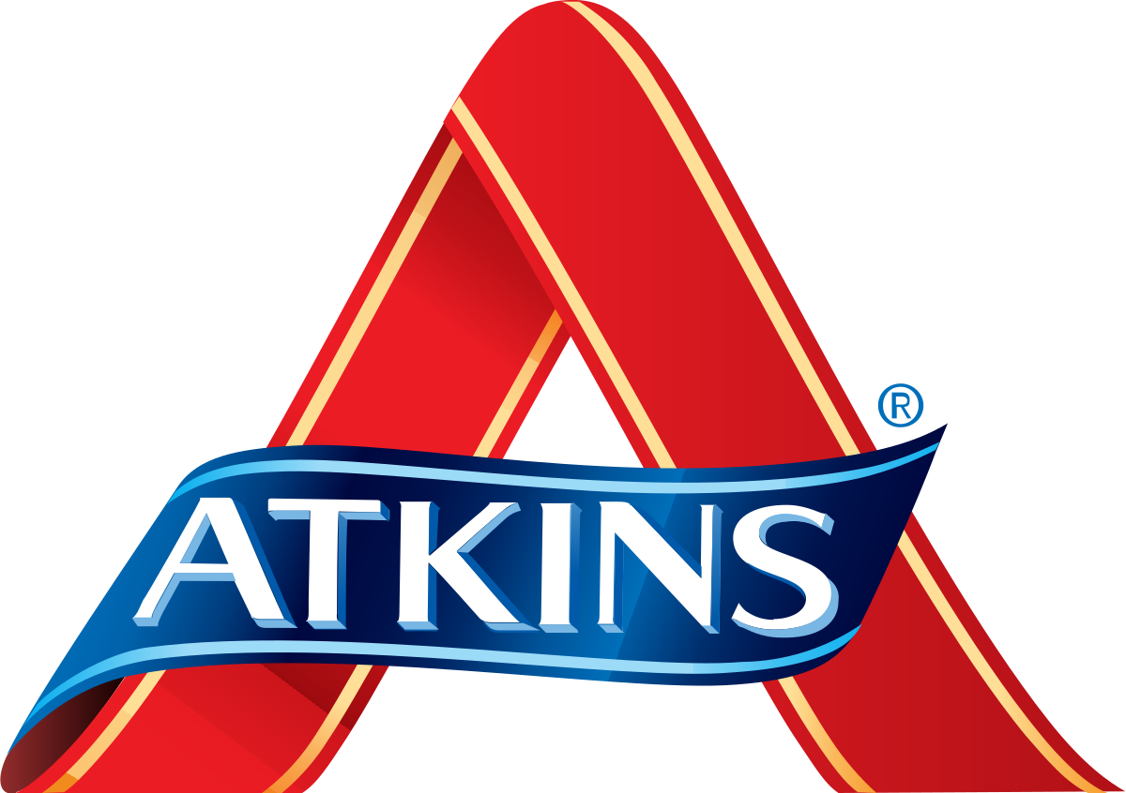

Slide 7
Intermittent Fasting (IF)
Minimal weight loss
Marginal improvements in metabolism
Might improve cognition, and delay aging
Anti-inflammatory effects
Improves gut health and insulin sensitivity
Source: Stockman, M., Thomas, D., Burke, J., & Apovian, C. M. (2018). Intermittent Fasting: Is the Wait Worth the Weight? Current Obesity Reports, 7(2), 172-185. doi:10.1007/s13679-018-0308-9

Slide 8
Paleo/Whole 30
Both programs focus on consuming whole, clean, natural foods. Both Whole30 and Paleo ban eating:
processed foods
grains
dairy
alcohol
legumes

Slide 9
Does Paleo/Whole 30 Work?
Moderate effects
Weight loss (5 lbs in 3 weeks)
Body mass index decrease
Waist circumference decrease
Systolic blood pressure decrease
Intake of energy decreased by 36%
Other effects were also observed, both favorable (fat composition, antioxidants, potassium-sodium rate) and unfavorable (calcium).
Source: Österdahl, M., Kocturk, T., Koochek, A., & Wändell, P. E. (2007). Effects of a short-term intervention with a paleolithic diet in healthy volunteers. European Journal of Clinical Nutrition, 62(5), 682-685. doi:10.1038/sj.ejcn.1602790

Slide 10
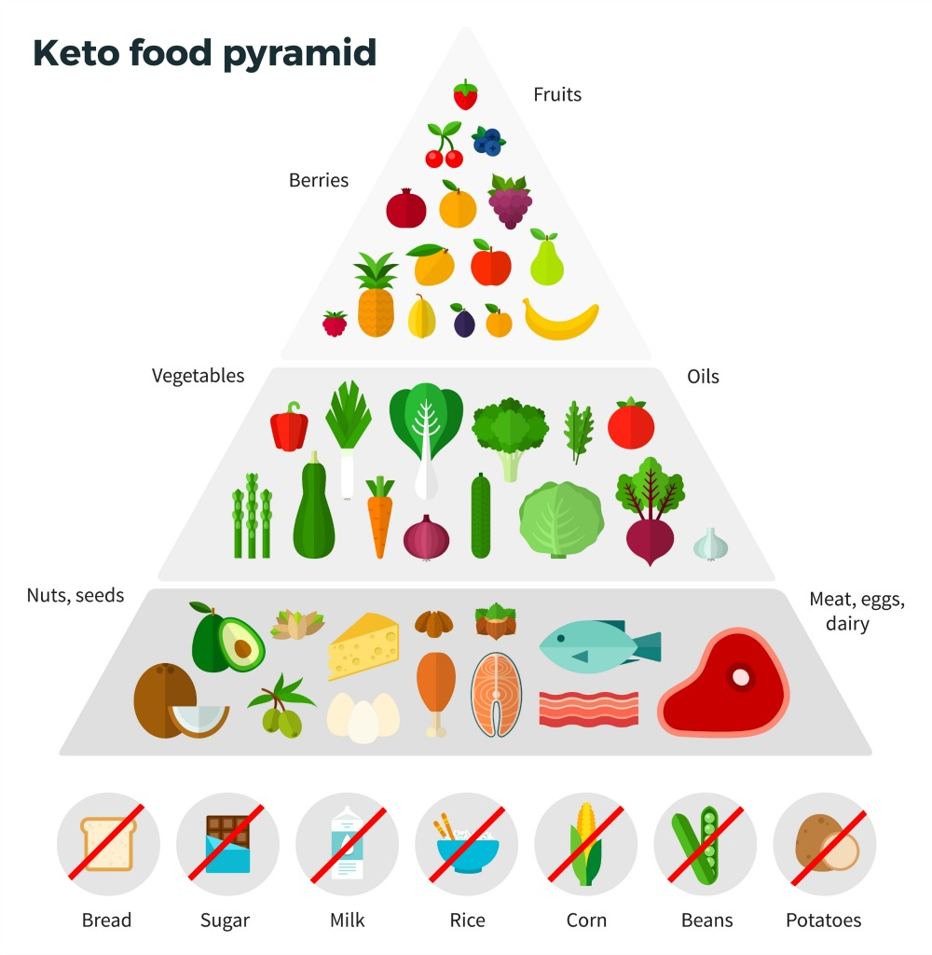

Slide 11
Does Keto Work?
Significant weight loss
Decrease in systemic inflammation
Reduced insulin resistance
Improved lipid profile
Increased physical activity
Huge carbon footprint
Source: Murphy, E. A., & Jenkins, T. J. (2019). A ketogenic diet for reducing obesity and maintaining capacity for physical activity. Current Opinion in Clinical Nutrition and Metabolic Care, 22(4), 314-319. doi:10.1097/mco.0000000000000572
Omalley, K., Willits-Smith, A., Aranda, R., Heller, M., & Rose, D. (2019). Vegan vs Paleo: Carbon Footprints and Diet Quality of 5 Popular Eating Patterns as Reported by US Consumers (P03-007-19). Current Developments in Nutrition, 3(Supplement_1). doi:10.1093/cdn/nzz047.p03-007-19

Slide 12
Vegetarians, Vegans, and Flexitarians

Slide 13
Diets and Mood
Weight loss group: Most food cravings, disordered eating symptoms, emotional eat, and negative affect
Paleo and vegan groups: lowest level of eating disorder symptoms, food cravings, emotional eating, and negative affect
Vegetarian and gluten-free diets same as unrestricted
Source: Norwood, R., Cruwys, T., Chachay, V. S., & Sheffield, J. (2019). The psychological characteristics of people consuming vegetarian, vegan, paleo, gluten free and weight loss dietary patterns. Obesity Science & Practice, 5(2), 148-158. doi:10.1002/osp4.325

Slide 14
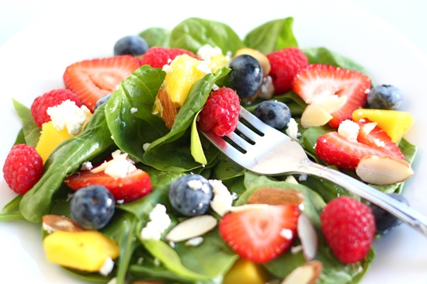
How do you choose what to eat?
Taste (81 percent say it has at least some impact in their buying decisions)
Familiarity (a new addition in this year’s survey, at 65 percent)
Price (64 percent)
Healthfulness (61 percent)
Convenience (54 percent)
Fresh (41 percent)
Sustainability (39 percent)
Notes:
The key drivers behind consumers’ food and beverage purchases are largely unchanged in 2018. “Taste” still reigns supreme (as it has every year the Food and Health Survey has been conducted), with 81 percent saying it has at least some impact in their buying decisions, followed by familiarity (a new addition in this year’s survey, at 65 percent), price (64 percent), healthfulness (61 percent), convenience (54 percent) and sustainability (39 percent).
But a little of the luster is off the “fresh food” halo from last year, at least compared to frozen foods. A significant change from 2017 was that 41 percent in 2018 perceived a fresh product to be healthier than a frozen one, which dropped from 47 percent last year, while 10 percent (in both 2017 and 2018) believed frozen products were healthier.

Slide 15
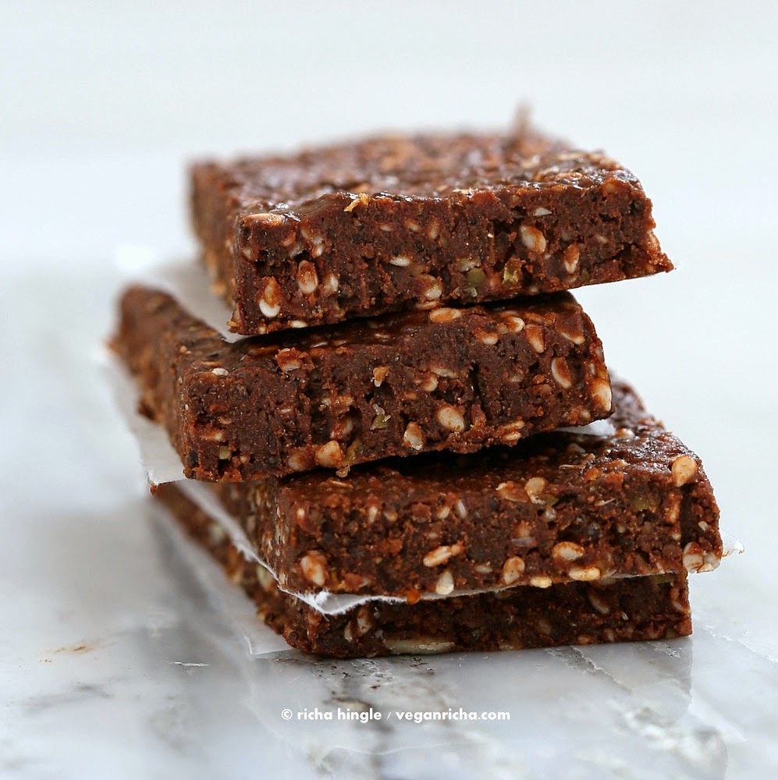
“A new health bar containing high levels of protein, vitamins and fiber, and no artificial sweeteners”
“A chocolate bar that is very tasty and yummy with a chocolate raspberry core”
Notes:
Labeling something as healthy has really mixed results. I want you to think about what might happen in this situation. Researchers put two tables out with an identical chocolate and raspberry protein bar. One group of researchers marketed the bar as “A new health bar containing high levels of protein, vitamins and fiber, and no artificial sweeteners”, the other “A chocolate bar that is very tasty and yummy with a chocolate raspberry core”. The researchers asked people to rate their hunger afterwards. What do you think happened?

Slide 16
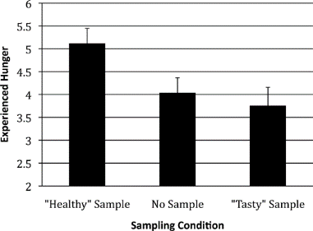
“Healthy” Choices Sometimes Backfire
Imposed healthy eating makes people feel hungrier than not eating at all
More pronounced among individuals who are less concerned with watching their diet
Source: Stacey R. Finkelstein, Ayelet Fishbach, When Healthy Food Makes You Hungry, Journal of Consumer Research, Volume 37, Issue 3, October 2010, Pages 357–367, https://doi.org/10.1086/652248
Notes:
The people who ate the bar marketed “healthy” walked away hungrier and were more likely to eat something unhealthy afterward.

Slide 17
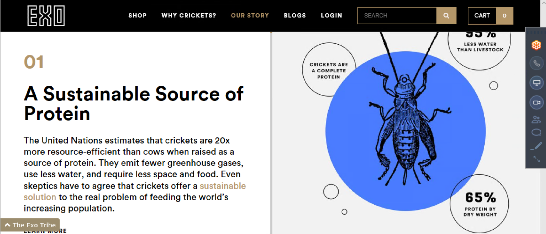

Slide 18
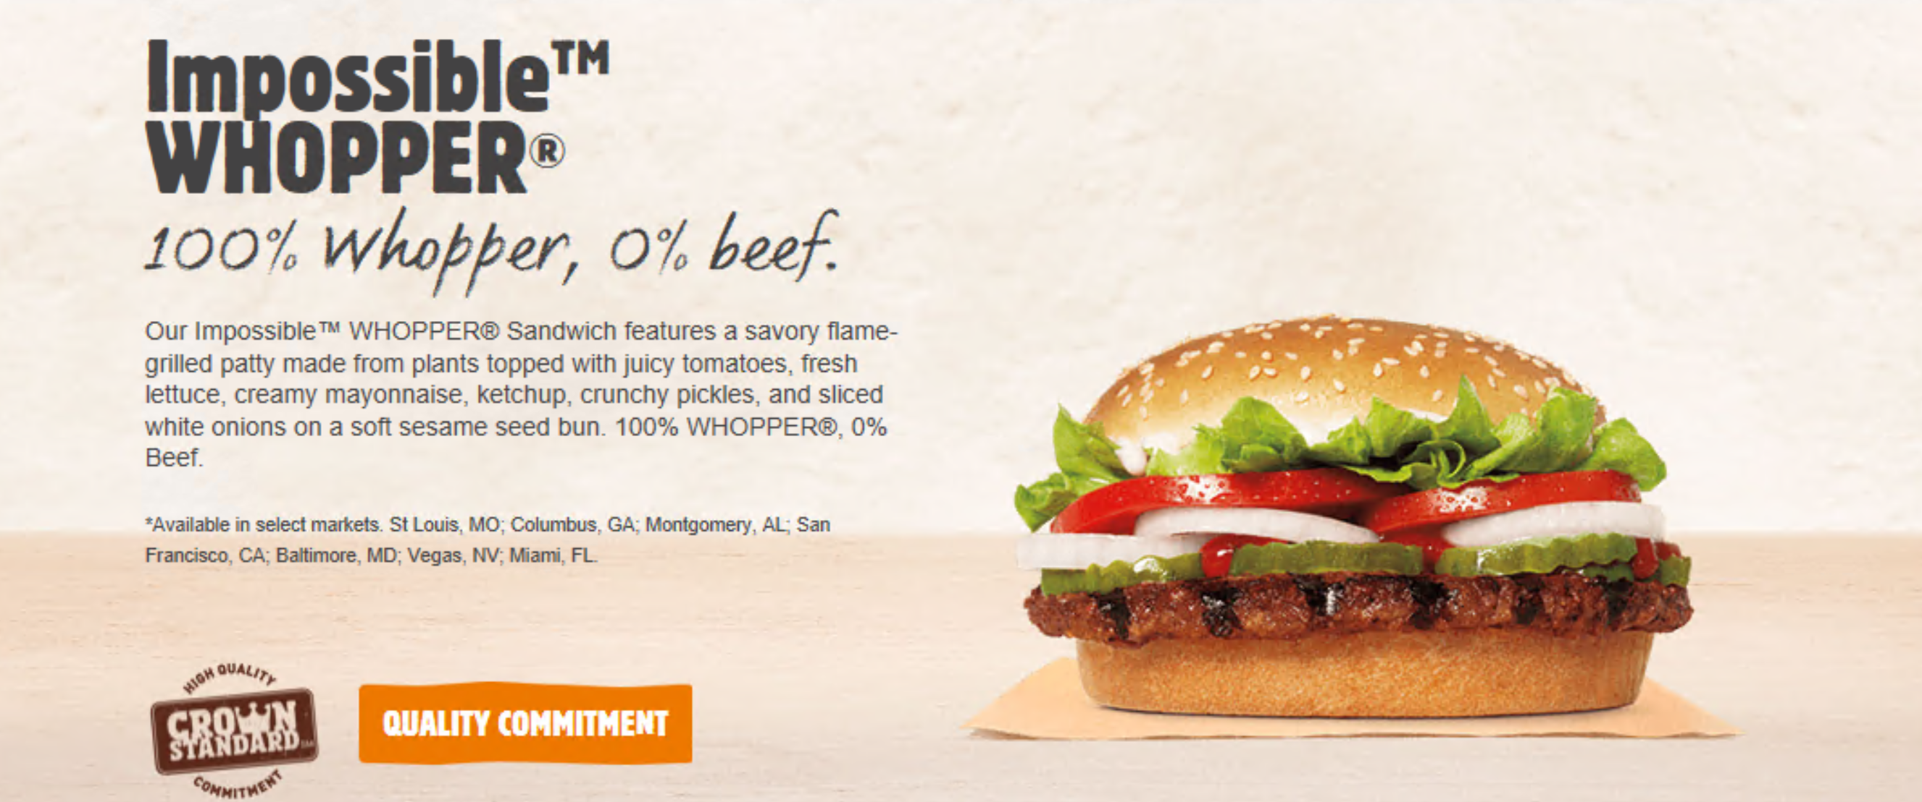

Slide 19
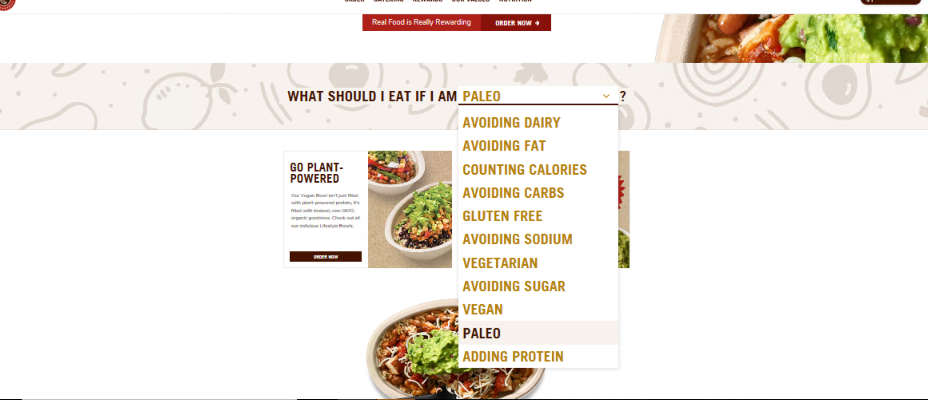

Slide 20
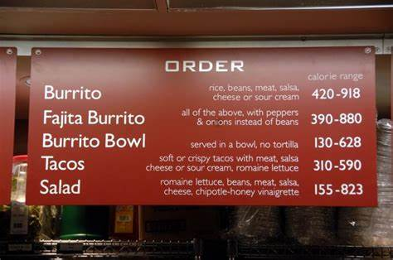

Slide 21
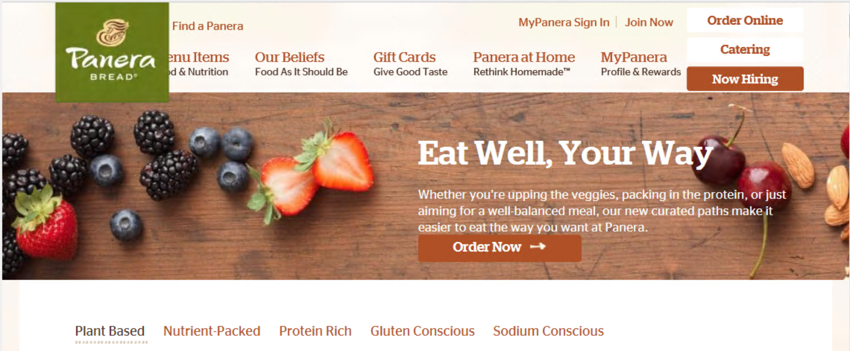

Slide 22
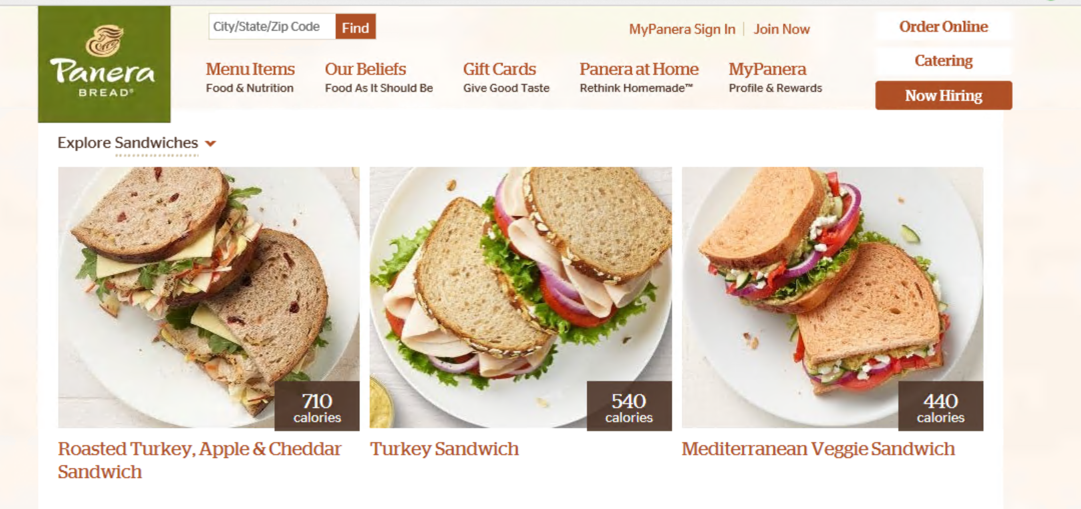

Slide 23
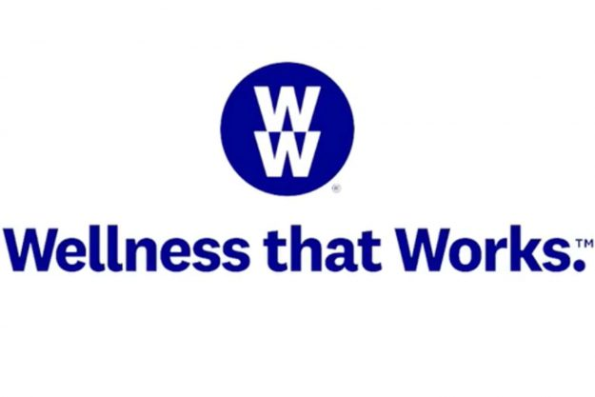
Notes:
Maybe the biggest change this year on how we think about nutrition and weight comes from the biggest name in the business, the company formerly known as weight watchers. They have switched from simply having a focus on weight, to a wellness lifestyle brand. Weight watchers points system has also changed, assigning many foods including fruits, vegetables, eggs, beans, tofu, fish, and low fat poultry and free foods.

Slide 24
Applying this to Job Corps
Focus on taste.
Don’t segregate a “HEALs” menu. Make the healthy appealing, but don’t call it healthy. Be mindful of the conflict between tasty/satisfying and healthy.
Use descriptors “Roasted” “Mediterranean” “Toasted” “Fresh”
Keep in mind that “healthy” eating means different things to different people.
Make things familiar.
Pay attention to “food tribes” on your center.
Create an attractive display.

Slide 25
Attractive Displays

Slide 26
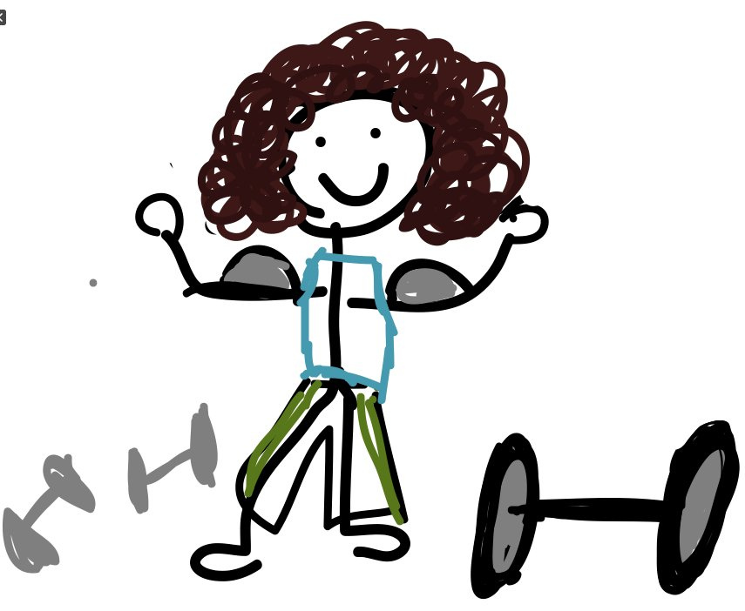
Fitness Trends and Lessons for Job Corps

Slide 27
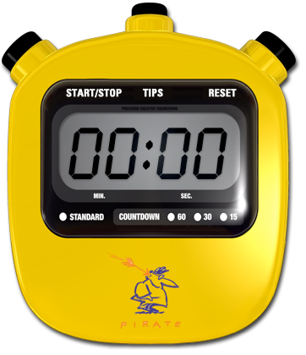
High-Intensity Interval Training (HIIT)
Short bouts of exercise, followed by recovery
Tabata (20 seconds on, 10 seconds off)
Very effective!
2 minutes of sprinting=30 minutes of moderate intensity activity
Increases VO2 max and stroke volume
Makes body a “furnace”
Improved cognitive function

Slide 28
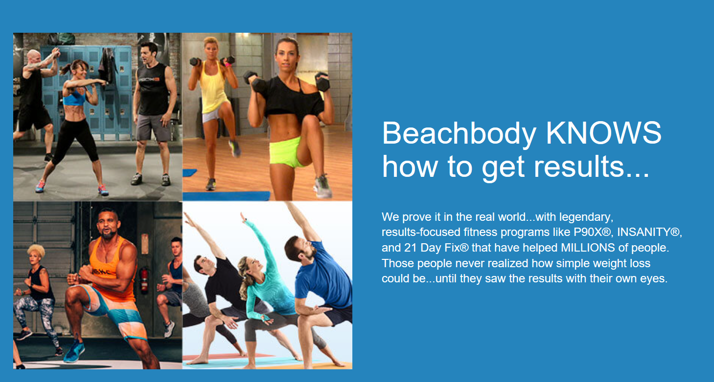
Streaming and Online Workouts and Apps

Slide 29
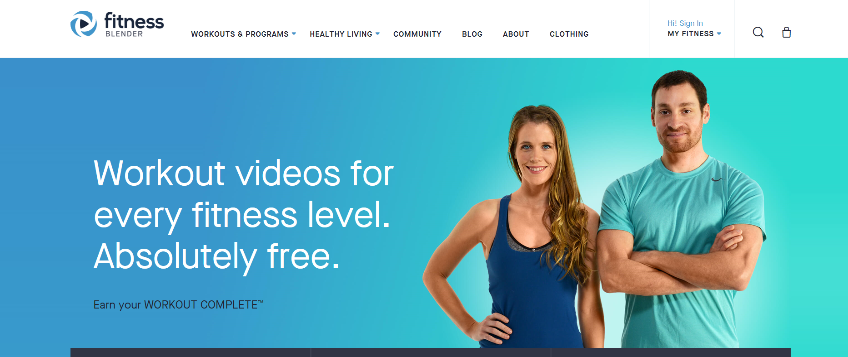
Streaming and Online Workouts and Apps

Slide 30
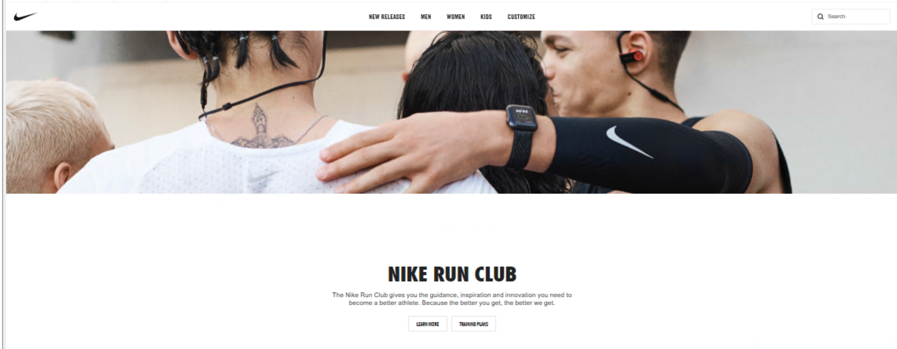
Streaming and Online Workouts and Apps

Slide 31
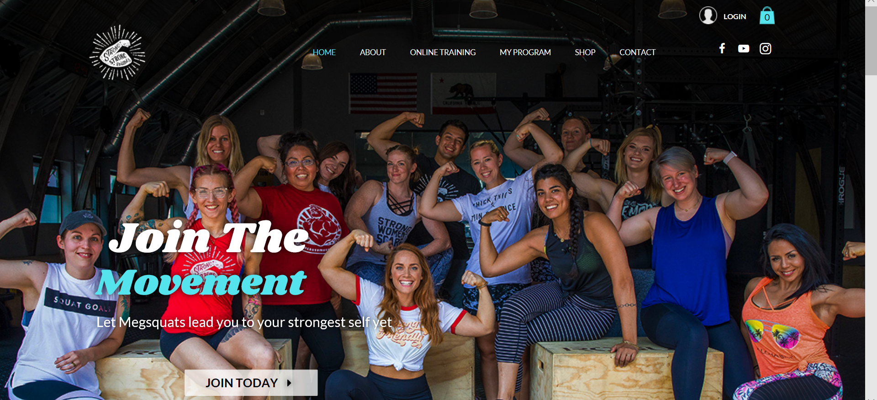
Streaming and Online Workouts and Apps

Slide 32
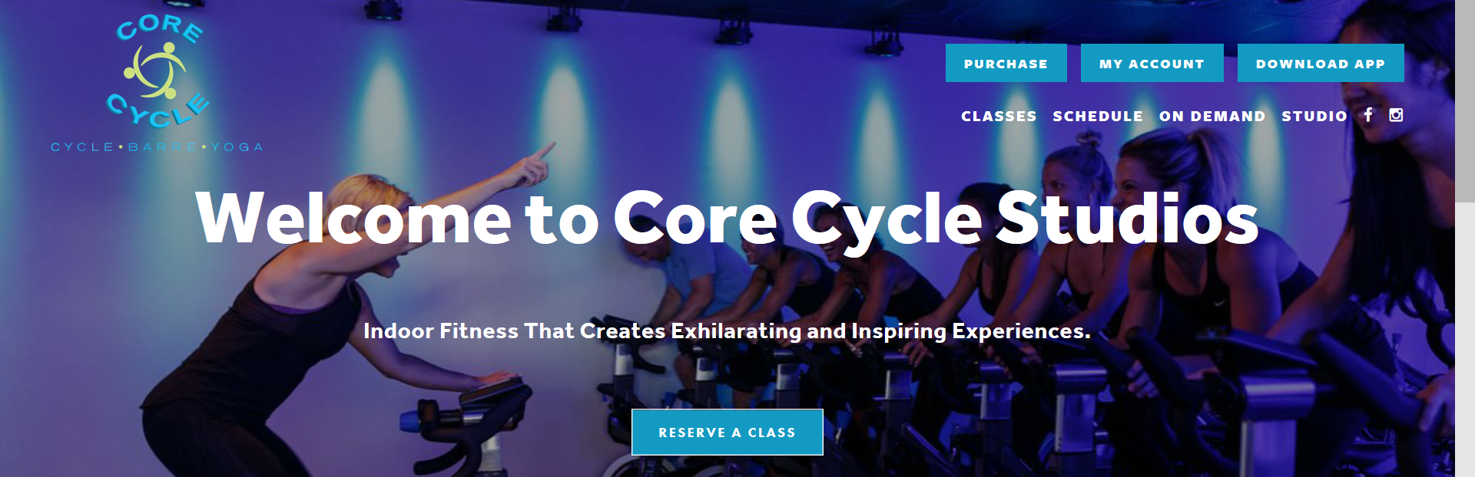
Boutique Fitness

Slide 33
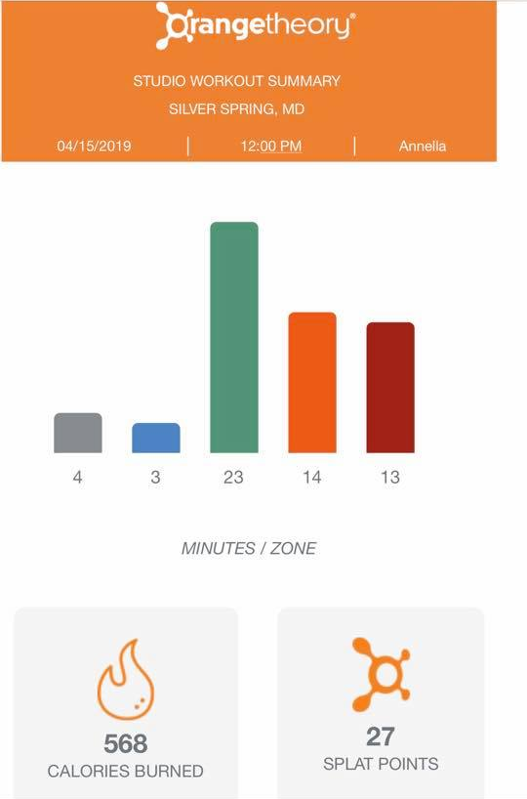

Slide 34
Why are these so popular?
Ease of use/takes away the planning from exercise
Fun
Results focused
Camaraderie
Cost and convenience?

Slide 35
5 Things to Make your Program Successful

Slide 36
#1: Focus on Fun

Slide 38
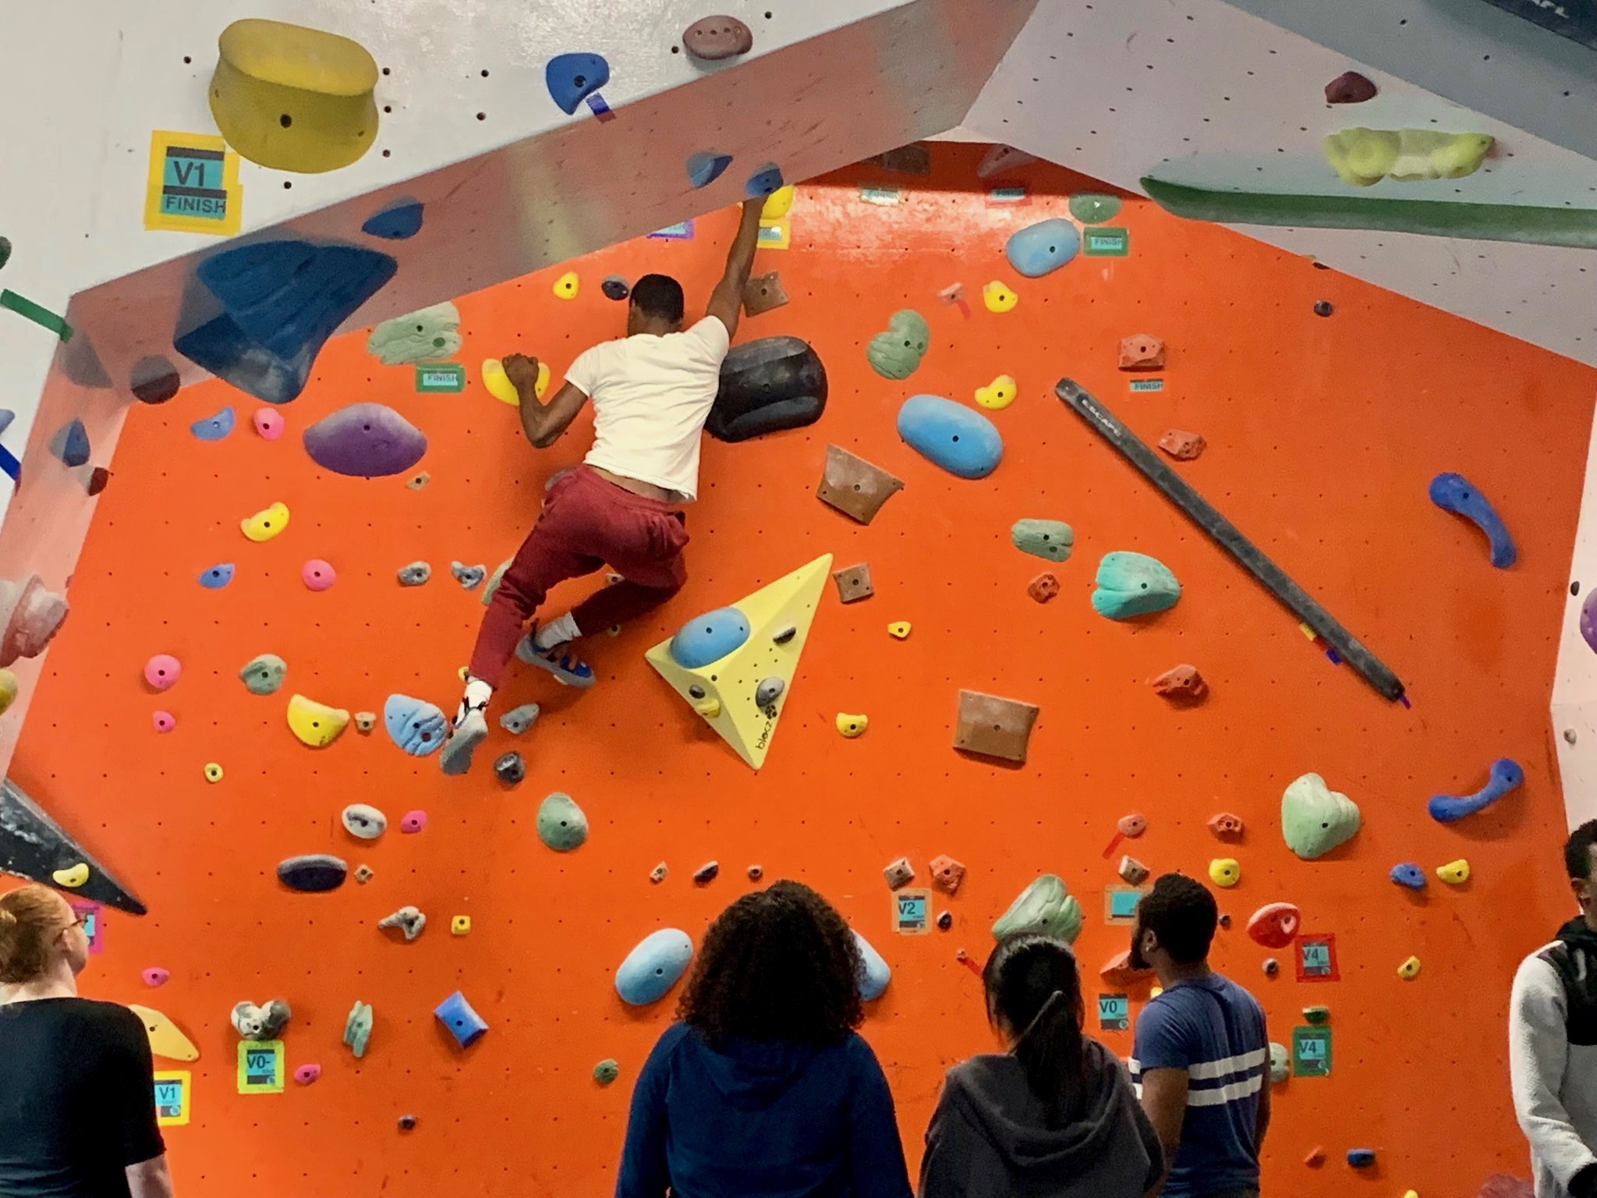

Slide 39
#2:
Positive Feedback
From Staff

Slide 40
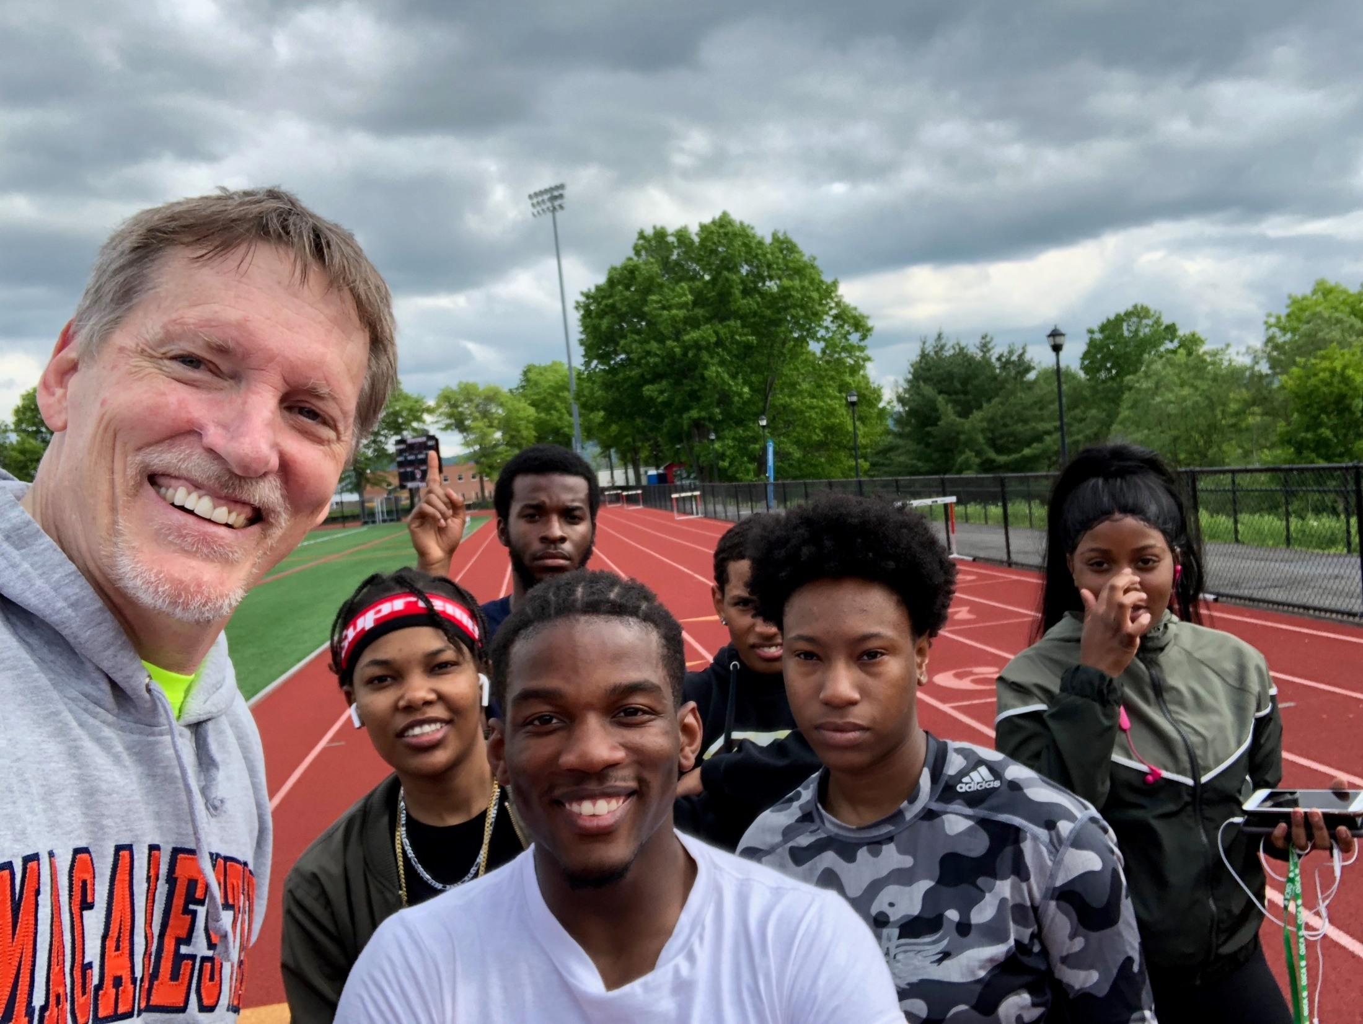

Slide 41
#3:
Comradery

Slide 42
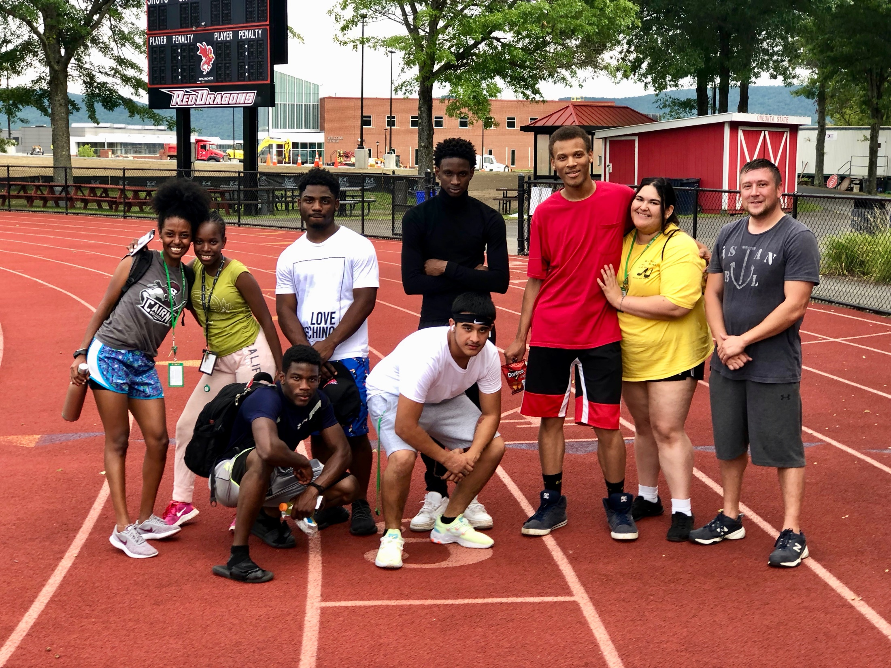

Slide 43
#4:
Take the Guesswork
Out of Fitness

Slide 44
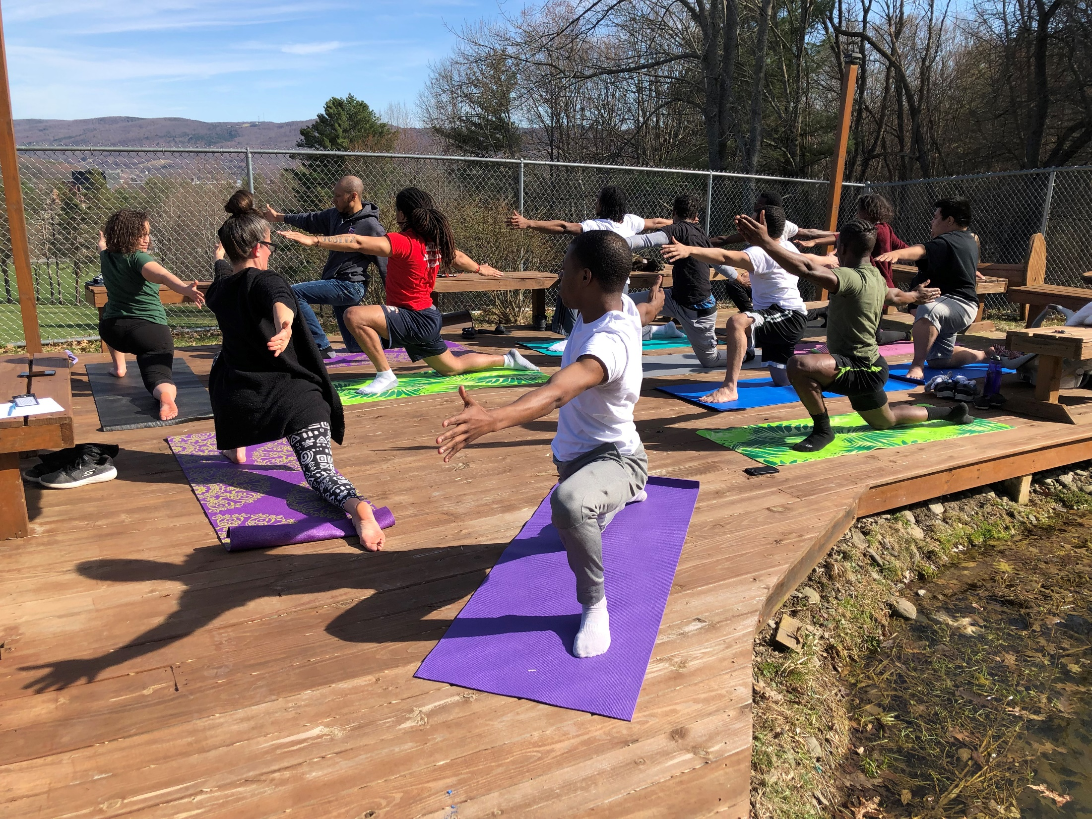

Slide 45
#5:
Set Goals, Build Competence and
Get Results

Slide 46
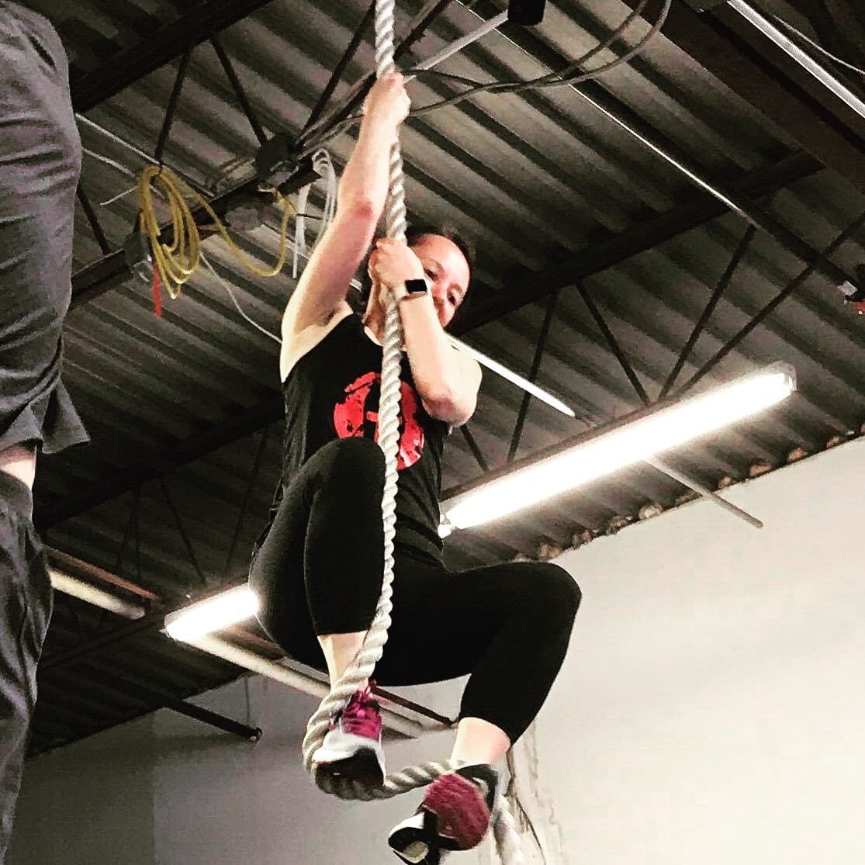

Slide 47
How do you get build confidence and get results?
Think beyond weight and set goals.
Able to walk a mile
Couch to 5K
Do a pull up or 10 push ups
Plan or program.
You can’t outrun a bad diet.

Slide 48
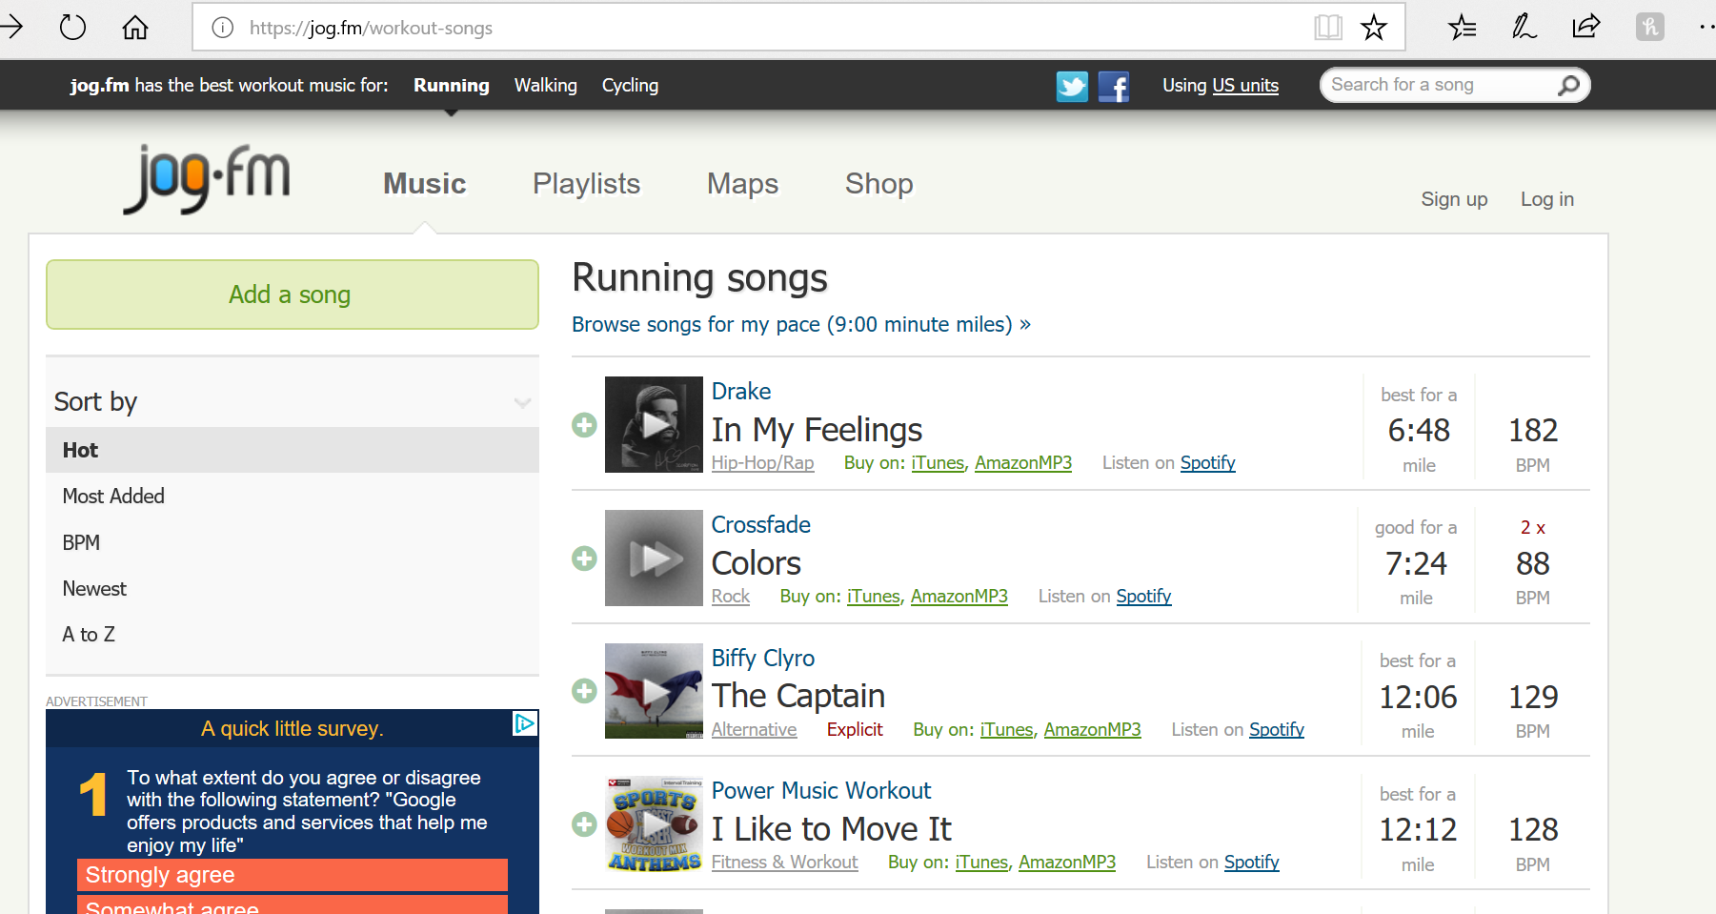
Other Motivation Tools
Prioritizing and scheduling exercise
Autonomy and choice
High-intensity music
Maddigan ME, Sullivan KM, Halperin I, Basset FA, Behm DG. 2019. High tempo music prolongs high intensity exercise. PeerJ 6:e6164 https://doi.org/10.7717/peerj.6164

