Slide 1
New Uses for Formalized Assessment Measures for TEAP Specialists
Diane Tennies, PhD, LADC
Christy Hicks, LCADC, CSW

Slide 2
Learning Objectives
After this webinar, participants will be able to:
1) Articulate the steps necessary to ensure that students with substance misuse issues are identified when entering Job Corps by developing an assessment protocol.
2) Develop a list of formalized assessment instruments appropriate for use with Job Corps students.
3) Score and interpret formalized assessment measures such as the MAST and the DAST.
4) Develop strategies to support students who are identified as high risk for not completing Job Corps.

Slide 3
Assessment Protocol Process
Goal: Identification of ALL students at high risk, meaning those at risk for not completing JC
PRH 2 R5 is silent about the specifics of the assessment process
Historically this occurred as part of the intake process with students coming down to HWC
Those elements included:
Review of the SHR (and the 653)
Review of the SIF (and the CRAFFT)
Formalized assessment measures administered to those with 2 or more on CRAFFT
Interview the Student (inform them of drug and alcohol testing policy, procedures, and consequences of positive Urine drug screen)
Initial UDS results
Offer voluntary TEAP services to those with 2 or more on CRAFFT and those with other identified risk factors
But now….

Slide 4
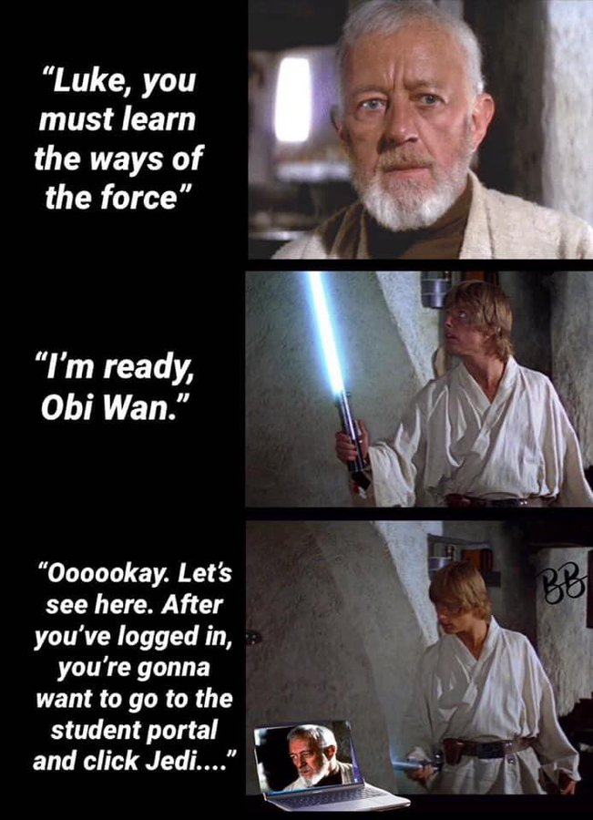
Moving to a Virtual Platform for Assessment Process

Slide 5
Who needs assessment?
New incoming students (virtually enrolled).
But what about current students who are in-person or virtual?
What do we know about COVID-19’s impact?
Assessment process should include both new and current students.

Slide 6
Basics of Using Video Conferencing
Google Classroom - do you know how to use it?
Who helps with technical support?
Does your platform offer confidentiality?
What does your “office” look like and is it as welcoming as your physical office?
Adequate lighting – in front of your face
Quiet environment without interruptions

Slide 7
Transferring in-person assessment process to a virtual assessment
Review of the SHR (and the 653) – how will this occur?
Review of the SIF (and the CRAFFT) – how do you get access?
How do you set up to interview the student?
Administer formalized assessment by either emailing protocol to student or administer it while talking with student
Review of UDS (there will be some type of initial test but no specifics yet).

Slide 8
Same steps but different mechanism
Bottom Line
Must develop an assessment process that can be completed virtually for new incoming students that allows you confidence that you are identifying students who need additional support to be successful at Job Corps.

Slide 9
Formalized Assessment Measures
PRH requires that for those scoring 2 or more on Questions 4-9 of the CRAFFT that formalized assessment measures/clinical judgement are administered.
Formalized Assessment Measures (FAMs) are defined as an empirically established standardized instrument that allows comparison between the student you are assessing and a normative group
Examples of FAMs that are in the public domain are:
Michigan Alcohol Screening Test (MAST) (for adolescents and adults)
Drug Abuse Screening Test (DAST - 10 or 20) (for adolescents and adults)
The Cannabis Use Disorders Identification Test – Revised (CUDIT-R)
Alcohol Use Disorders Identification Test (AUDIT) (for adolescents and adults)

Slide 10
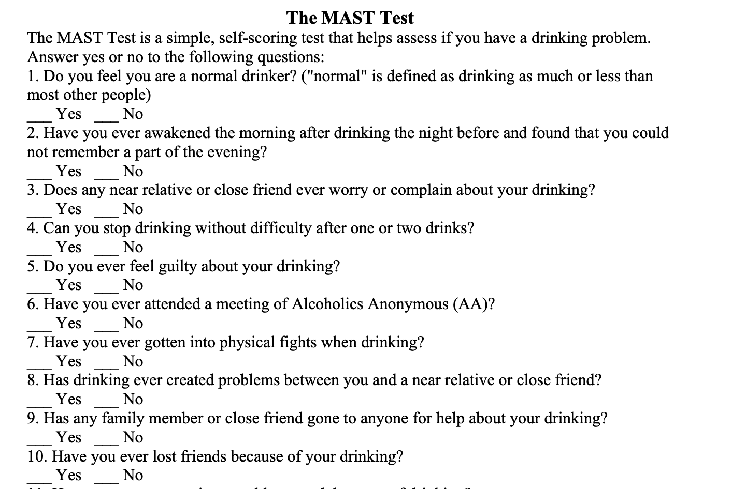
FAM Specifics
The Michigan Alcohol Screening Test (MAST) is a 22 item measure used to detect emerging alcohol problems. When scoring the MAST, a score of 4 or more indicates a student is at higher risk for problematic alcohol use.

Slide 11
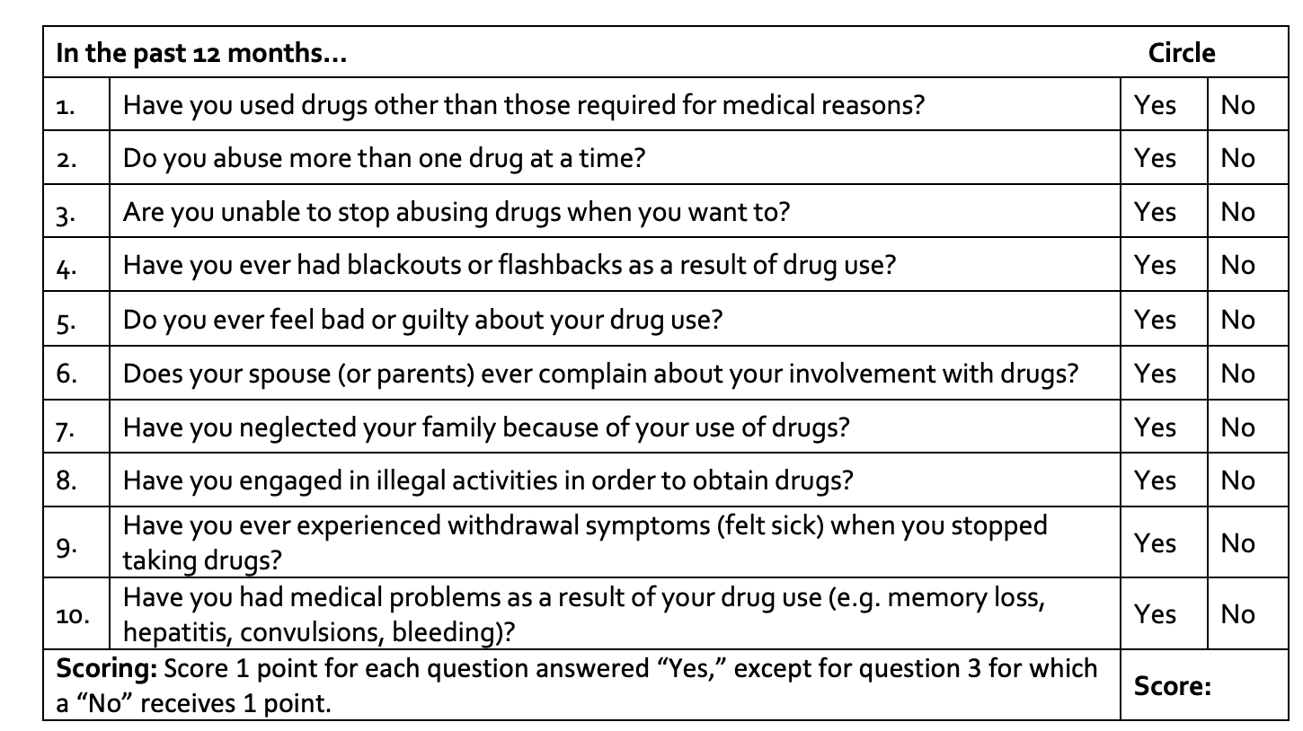
FAMs continued
The Drug Abuse Screen Test (DAST-10) is a 10 item measure used to detect emerging drugs use issues. When scoring the DAST-10, a score of 3 or more indicates a student is at higher risk for problematic drug use.

Slide 12
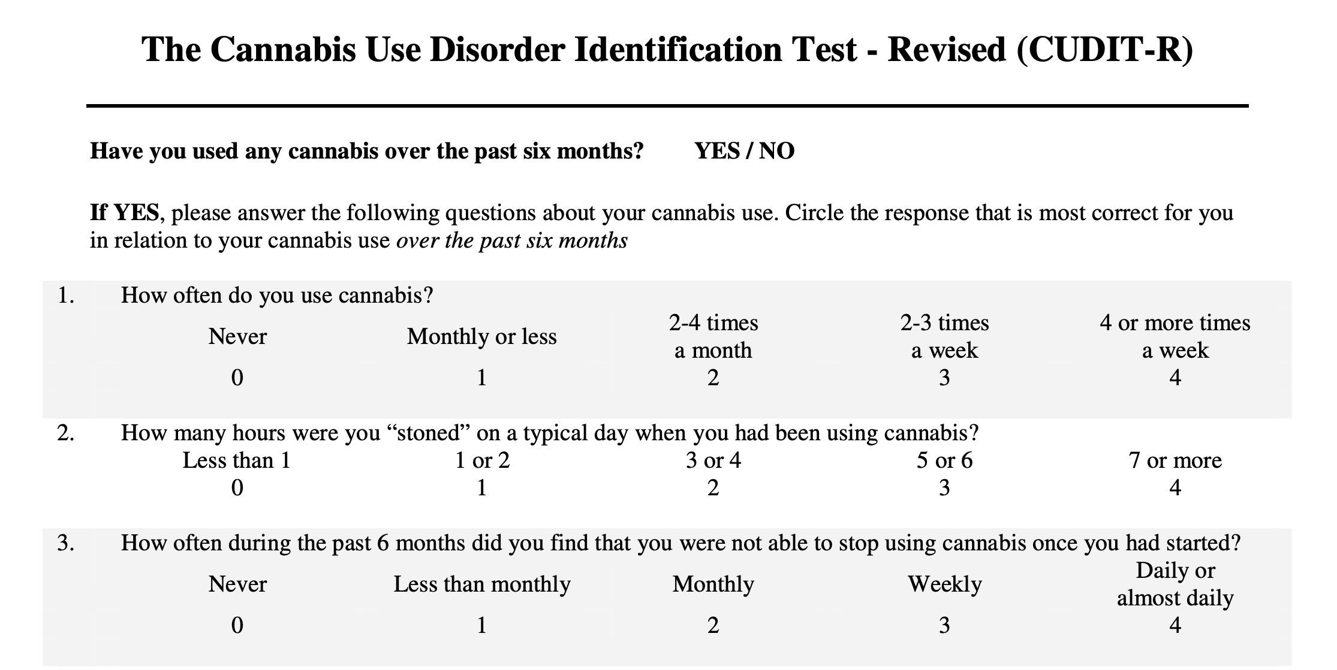
FAM Specifics continued
The Cannabis Use Disorders Identification Test – Revised (CUDIT-R) is an 8 item measure for identification of cannabis misuse. Available for download at several sites on line. Scores of 8 or more equal at-risk use of marijuana and may suggest more support is needed.

Slide 13
FAM Specifics continued
Alcohol Use Disorders Identification Test (AUDIT) (for adolescents and adults). Available for download at several sites on line. Score of 8 or more is considered harmful/hazardous alcohol use and warrants more support is needed.

Slide 14
FAMs Available for Purchase
SASSI-3 or 4, SASSI-A2, Spanish SASSI (available from SASSI corporation)
PEI- Personal Experience Inventory (available from WPS and for adolescents)
If using these measures – makes sure they are purchased well in advance as COVID-19 has created shipping delays

Slide 15
Preparation for Administering FAMs
Obtain copies of instruments you are going to use.
Have FAMs that address both drugs and alcohol.
If using a new-to-you FAM, then review ahead of time and practice.
Determine how to administer virtually.
Some FAMs have interview version or send them to students ahead of time. But if doing this – how are you going to get them back?

Slide 16
Time-Out for Documentation

Slide 17
Issues to Sort Out
How are your notes secured if you are working from home?
Do the notes remain with you or do you send them (via JC email) to center?
How are you including the FAM protocols, making sure you have documented, results, recommendations and student’s response.
Options for format include using fillable SF-600; hand writing on SF-600 or using computer to document in separate file for each student.

Slide 18
The Five Elements are Still Required
Content of interaction
Student’s response
Plan
Date
Signature with credentials

Slide 19
Disclosure Statement
Entry into TEAP section of SHR:
On date, 2020 at AM/PM student gave verbal consent for video conferencing as modality for services due to current COVID-19 pandemic and current operations being virtual.
Student was informed of the inherent limits of confidentiality when using technology. Student was contacted via phone number, (xxx-xxx-xxxx)
During the session, the following individuals present were also present with the student: ______________________.

Slide 20
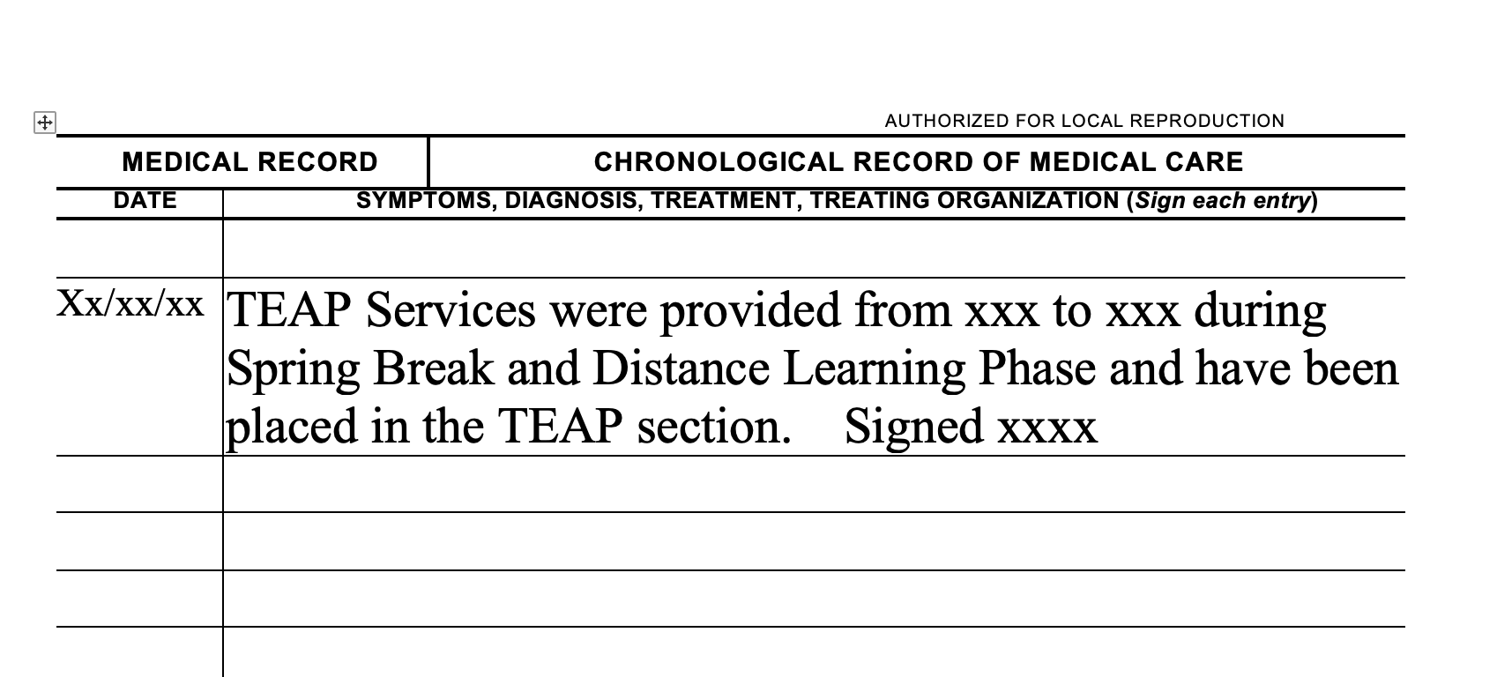
Example for
Chronological when no Access to SHR

Slide 21
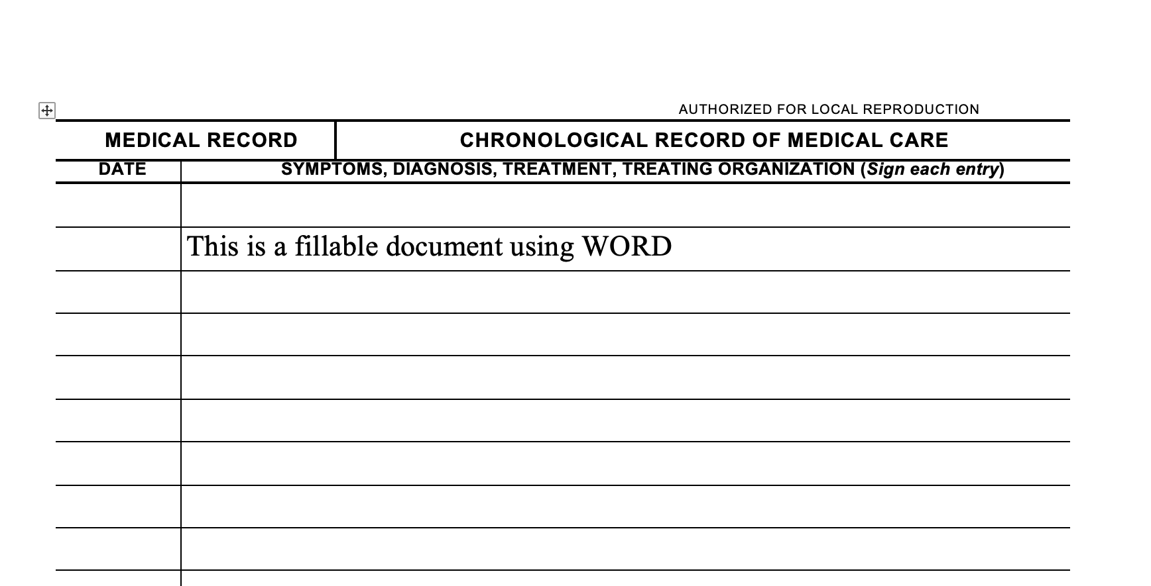

Slide 22
Next Steps: Providing Support
For those who tested positive on entrance (intervention services).
Also includes those who did not have an initial positive UDS but scored 2 or more on CRAFFT.
Any other students you identified through the assessment process that may be at increased risk due to their history, current use or other factors.

Slide 23
What to do?
Remember goal is connection and support during this time.
Individual or group meeting in google classroom.
Dropping in to other classrooms (with permission).
Telephone calls.
Enrich your google classroom with materials.
HEALs and collaboration with CMHC/HWC staff
Email with specific images, memes, homework and other information.
Old fashion means of communication – USPS.
Do your research – what online supports are there.

Slide 24
Online Supports
Alcoholics Anonymous Groups
https://www.aa-intergroup.org/index.php
AA Telephone Meetings
AA Audio/Video Meetings
12-Step Forums
AA Online Meeting
AA Family Group Online Meeting
Narcotics Anonymous
Narcotics Anonymous Online Meeting List
Never Alone Club
Never Alone Club Online Chat
Marijuana Anonymous
Marijuana Anonymous Online Meeting Schedule
See document for more resources at the Support Services Website

Slide 25
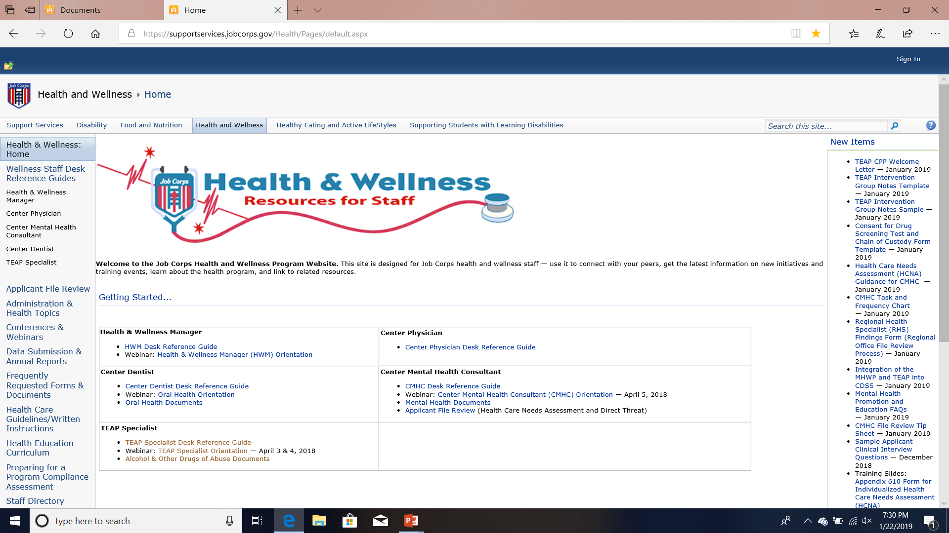
Where to Find Content?
SupportServices Website: https://supportservices.jobcorps.gov/health/Pages/default.aspx

Slide 26
Enhancing Responsiveness
This will continue to be challenging for everyone.
Remember goal: Students to remain connected to the program by engaging in virtual learning activities that support gains in learning and career skills training.
Remember to your flexibility.
R3emember your humor and more humor.
Consider reviewing TIP 35: Enhancing Motivation for Change in Substance Use Disorder Treatment (Download at SAMHSA).
Use Brief Intervention Strategies or Awareness Raising Interventions (see SBIRT at https://www.samhsa.gov/sbirt).

Slide 27
Snapshot of the Process
Develop/conduct assessment (with FAMs) on all students.
If no evidence of substance use concerns then no further action needed except to document.
If mild substance use concerns then develop an individualized support plan.
If substance use concerns that require more than TEAP support, consider a referral to a substance use treatment provider in community.
If significant substance use concerns that interfere with functioning at JC – then consider a MSWR.

Slide 29
A Few More Reminders
Drug or alcohol testing is not occurring right now except for suspicion screens.
Students in the intervention period before the Spring Break, should continue with virtual intervention services.
Use the CDP and CTP templates (on website) for other material.
SAMHSA has new materials on marijuana (https://www.samhsa.gov/marijuana), including brief videos and handouts.

Slide 30
Contact Us
Diane A. Tennies, PhD, LADC
Boston, Philadelphia, and San Francisco Regions
datphd@aol.com
Christy Hicks, LCADC, CSW
Atlanta, Dallas, and Chicago Regions
Christy.hicksmsw@gmail.com

