Slide 1
Medical, Mental Health, TEAP, and Oral Health COVID-19 Protocols: Overview and Scenarios
Humanitas, inc
This Photo by Unknown author is licensed under CC BY-SA.

Slide 2
Infection control Procedures
Masks
Handwashing/hand sanitizing
Cleaning
Physical distancing

Slide 3
Stay home if you’re sick!
Do not come to center
Notify your supervisor
Consult your healthcare provider
Call your supervisor if you have a sick family member
Symptom Tracker and Attestation daily
This Photo by Unknown Author is licensed under CC BY-ND

Slide 4
Outbreak and pandemic response committee
Ensure plans are in place
Attend regular meetings
Coordinate communications
Stay up to date
Plan education and training
Minimize the impact of influenza
Respond to positive COVID-19 cases
This Photo by Unknown Author is licensed under CC BY-SA

Slide 5
strategies to prevent widespread COVID-19 infection
COVID-19 Testing
Quarantine (Cohort and Individual)
Isolation
Contact Tracing

Slide 6
Scenario #1: Kendra
No symptoms or contact reported on COVID-19 Pre-Arrival Screening Questionnaire
Scheduled to come to center

Slide 7
Screening
Positive COVID-19 test on entry
Mild respiratory symptoms
This Photo by Unknown author is licensed under CC BY.

Slide 8
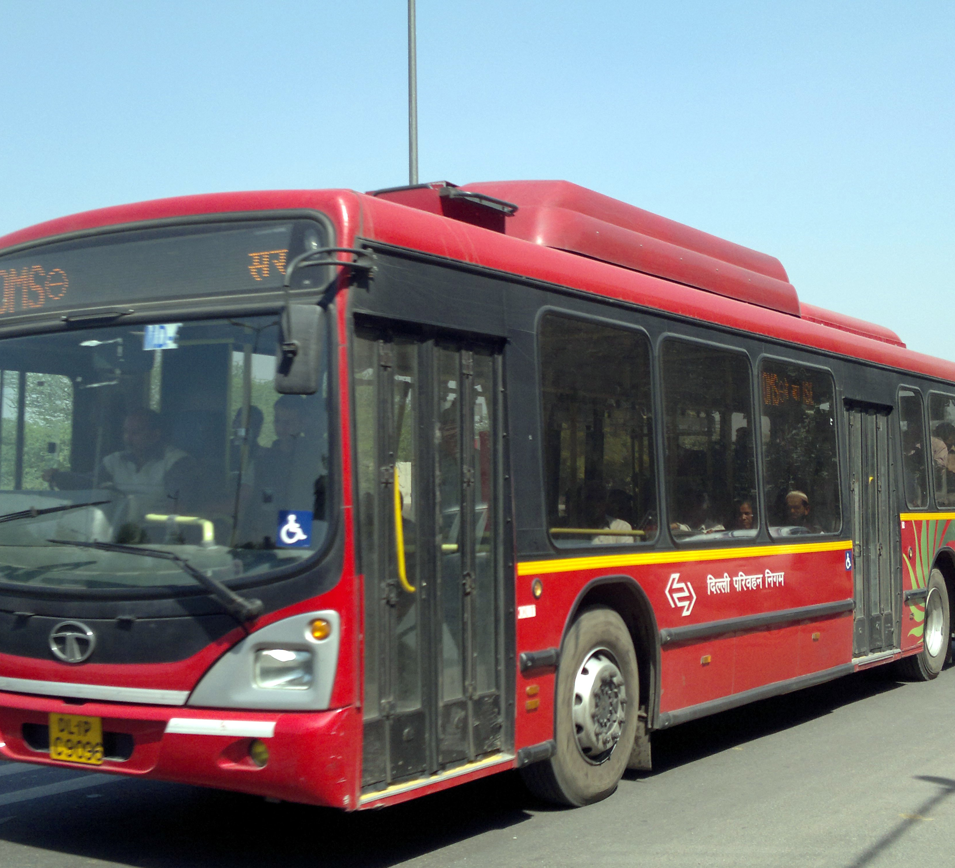
Should Kendra Stay on center or go home?
Most students will stay on center
Mode of transportation
Home environment
No public transportation
This Photo by Unknown author is licensed under CC BY-SA.

Slide 9
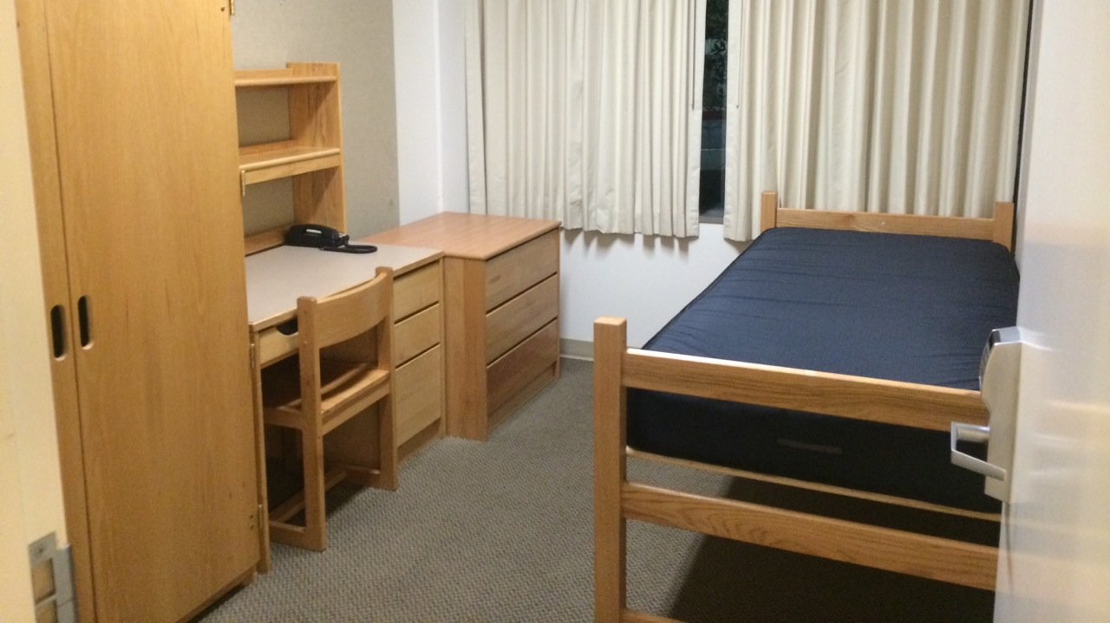
Isolation
Private room and bathroom (may share room with other COVID+ student)
Health and wellness staff check 2x/day
Symptom Tracker and Attestation 2x/day
Emotional Wellness Checks 1x/day
Food delivered
Follow SMGs and TGs
This Photo by Unknown author is licensed under CC BY-SA.

Slide 10
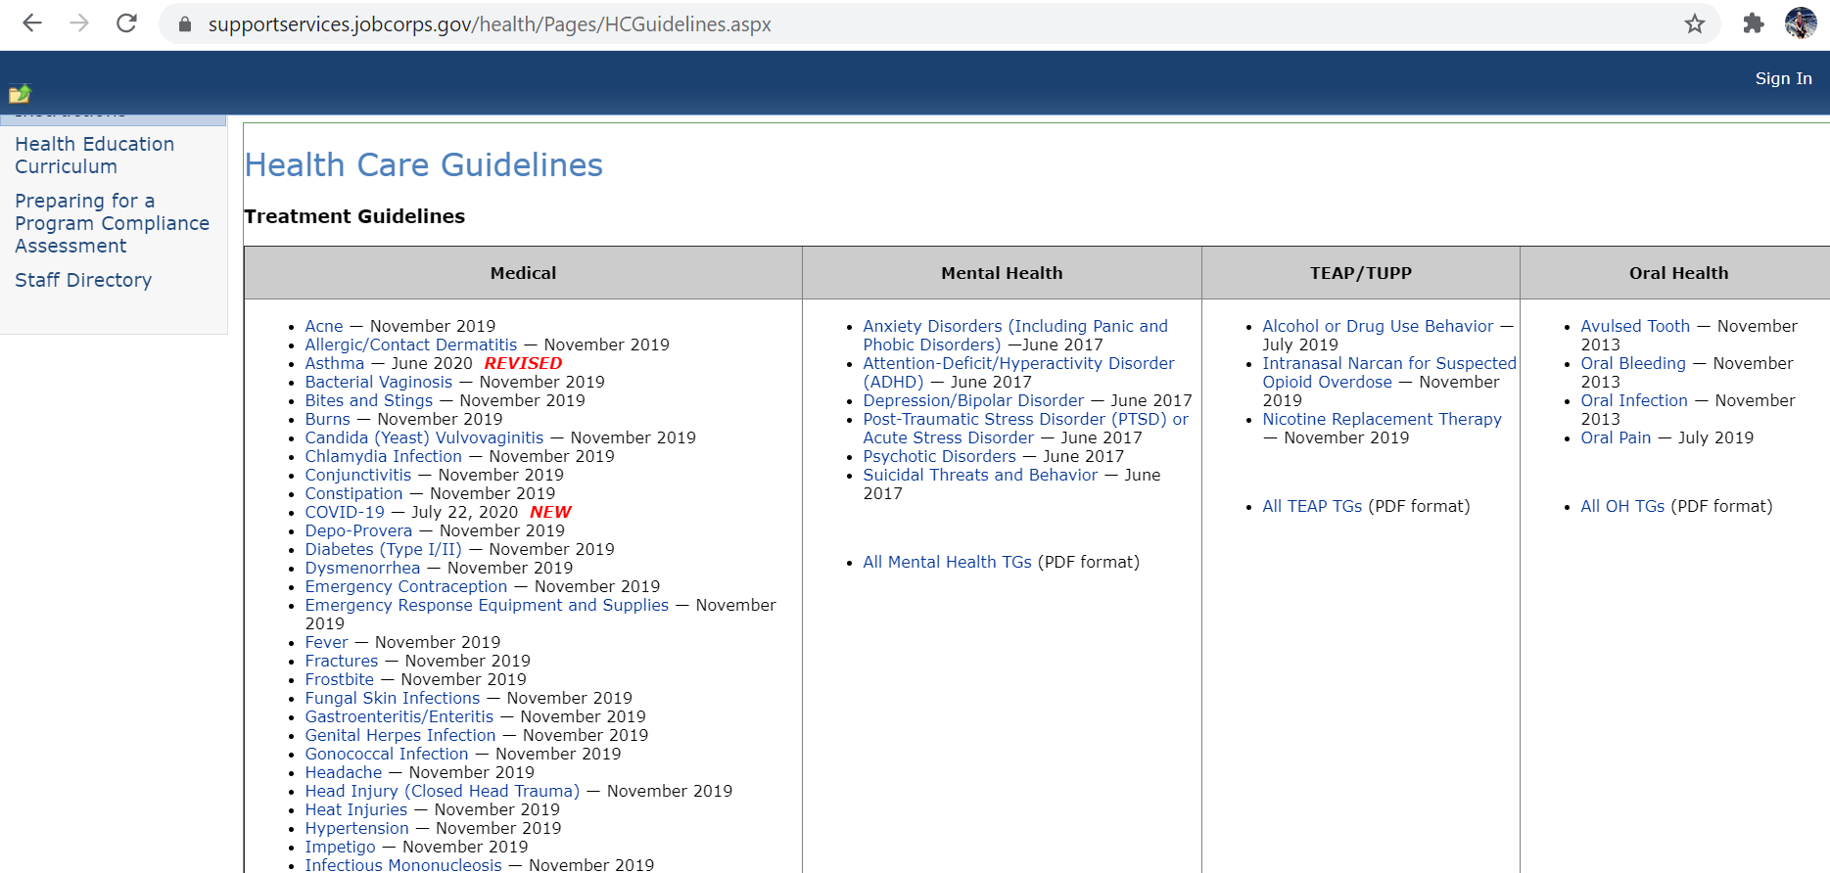

Slide 11
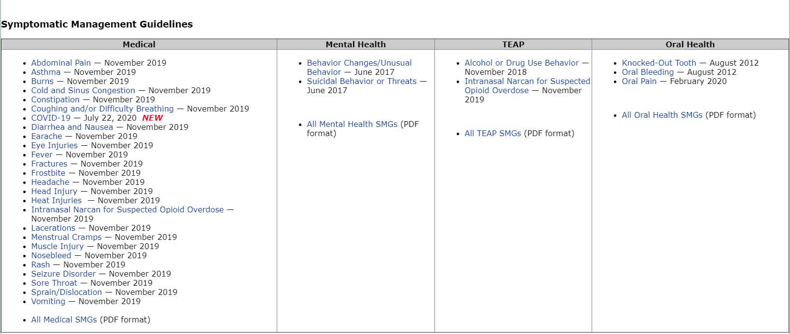

Slide 12
Mental health and wellness
1. Daily Emotional Wellness Checks
Counselor virtual check-ins
2. CMHC reviews the Social Intake Form (SIF) with Kendra
Virtual individual assessment
PHQ-9, GAD-7, CSSR-S and others
3. Possible Outcomes
Virtual CMHC and/or Counselor Support, Mental Health Google Classroom Groups, Other Referrals

Slide 13
TEAP
MAST and DAST-10 self-administer
SIF (if Kendra is a new student)
Virtual Check Ins with TEAP Specialist

Slide 14
No in-person Dental services during isolation May be evaluated
This Photo by Unknown Author is licensed under CC BY-SA

Slide 15
Clearance to exit isolation
At least 24 hours have passed since recovery (resolution of fever and improving of respiratory symptoms); and
At least 10 days have passed since the symptoms first appeared
This Photo by Unknown author is licensed under CC BY-SA.

Slide 16
Scenario #2: Anthony
Negative COVID-19 test on entry
No COVID-19 symptoms

Slide 17
Quarantine in clusters
Maximum 12 students
Single dormitory room
Clusters may share bathroom
May eat together, visit recreation, etc. No contact with other students.
Symptom Tracker and Attestation 2x/day
Emotional Wellness Checks 1x/day
Educated about COVID-19 prevention

Slide 18
At the end of Anthony’s first 14 days on center
Positive 14-day test
Asymptomatic for COVID-19
This Photo by Unknown Author is licensed under CC BY

Slide 19
What happens with Anthony and his cluster?
Anthony is moved to isolation.
Anyone else in the cluster who tests positive is moved to isolation.
Members of the cluster who test negative are placed in individual quarantine.

Slide 20
Mental Health and Wellness during cluster quarantine or isolation
Daily Emotional Wellness Checks
Social Intake Form (SIF)
Individual Assessments
Support Plan
Virtual CMHC and/or Counselor Support, Mental Health Virtual Groups, Other Referrals
https://supportservices.jobcorps.gov/health/Pages/COVID-19.aspx

Slide 21
teap Services during cluster quarantine
MAST and DAST-10 self-administer
SIF (for new students)
Virtual Check Ins with TEAP Specialist
This Photo by Unknown Author is licensed under CC BY-SA-NC

Slide 22
No Oral health services during individual or cluster quarantine. May be evaluated.
This Photo by Unknown Author is licensed under CC BY-SA-NC

Slide 23
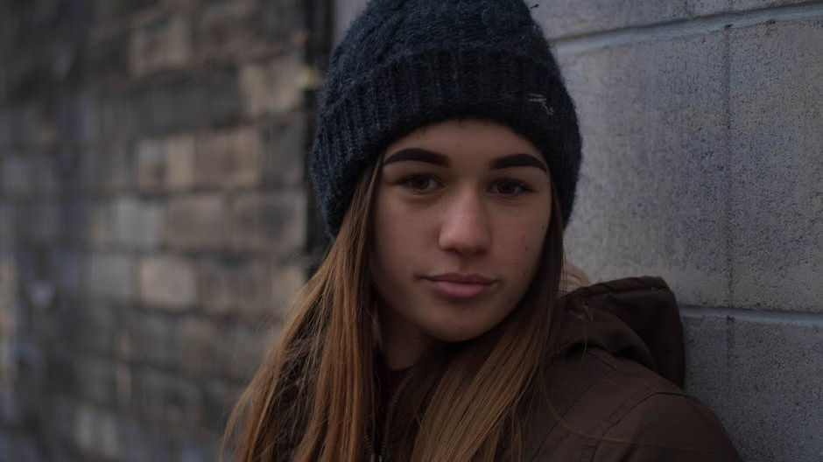
Scenario #3A: Josie
Negative Day 1 and Day 14 Tests
No symptoms during 14-day cluster quarantine

Slide 24
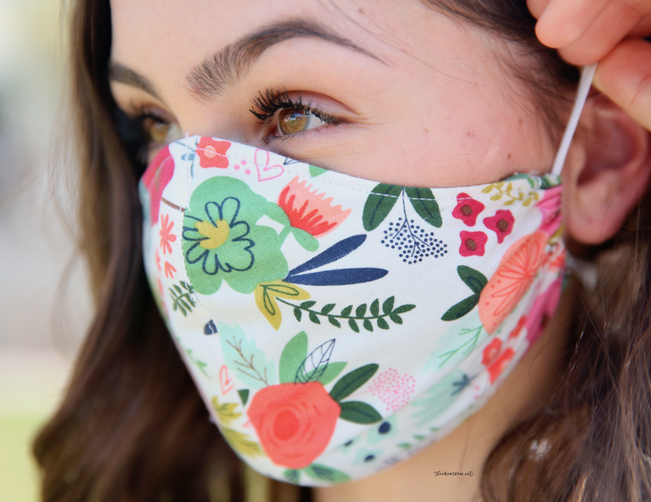
Josie moves into general procedures
Follow center-wide infection control protocols
Use Symptom Tracker and Attestation daily
Maximum of 4-students in dormitory room
No routine weekend passes/leave
This Photo by Unknown Author is licensed under CC BY-NC-ND

Slide 25
Mental health and teap general procedures
Meet PRH requirements
Provide virtual services
Small group interaction and monitoring
Referrals, intakes, assessment, and treatment plans
Crisis intervention

Slide 26
Increase TUPP services
TUPP Coordinator
Tobacco-free areas and/or times
Physical distancing in tobacco use areas
Nicotine replacement products
Online resources
Evidence-based nicotine cessation programs
This Photo by Unknown author is licensed under CC BY-ND.

Slide 27
Oral health general services
Screen
Screen students for fever and symptoms of COVID-19 before they enter the dental facility.
Ensure
Ensure students use hand-sanitizer and wear masks except during intraoral procedures.
Prioritize
Prioritize students with urgent conditions for basic oral care and dental hygiene.
Use
Use aerosol containment equipment for procedures generating dental aerosols.
Incorporate
Incorporate teledentistry (e.g., voice or video conferences).
Implement
Implement a patient schedule and a patient flow that allow for adequate visit time.
Follow
Follow standard precautions and CDC guidelines.

Slide 28
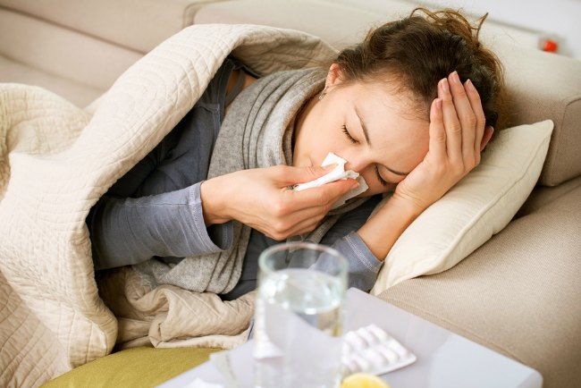
Scenario #3b: Josie develops COVID-19 symptoms after 6 weeks and tests positive
Isolate Josie.
Follow procedures outlined in Information Notice No. 19-09 Checklist Tool for Center Directors when a Staff Member or Student Tests Positive for Coronavirus (COVID-19).
Health and Wellness staff will follow Health and Wellness Treatment Guidelines for COVID-19.
Non-health staff will follow Symptomatic Management Guidelines for COVID-19.
This Photo by Unknown Author is licensed under CC BY-NC-ND

Slide 29
Work with your local public health department
Contact tracing
Reporting
This Photo by Unknown Author is licensed under CC BY-NC-ND

Slide 30
Questions?
This Photo by Unknown Author is licensed under CC BY

