Slide 1
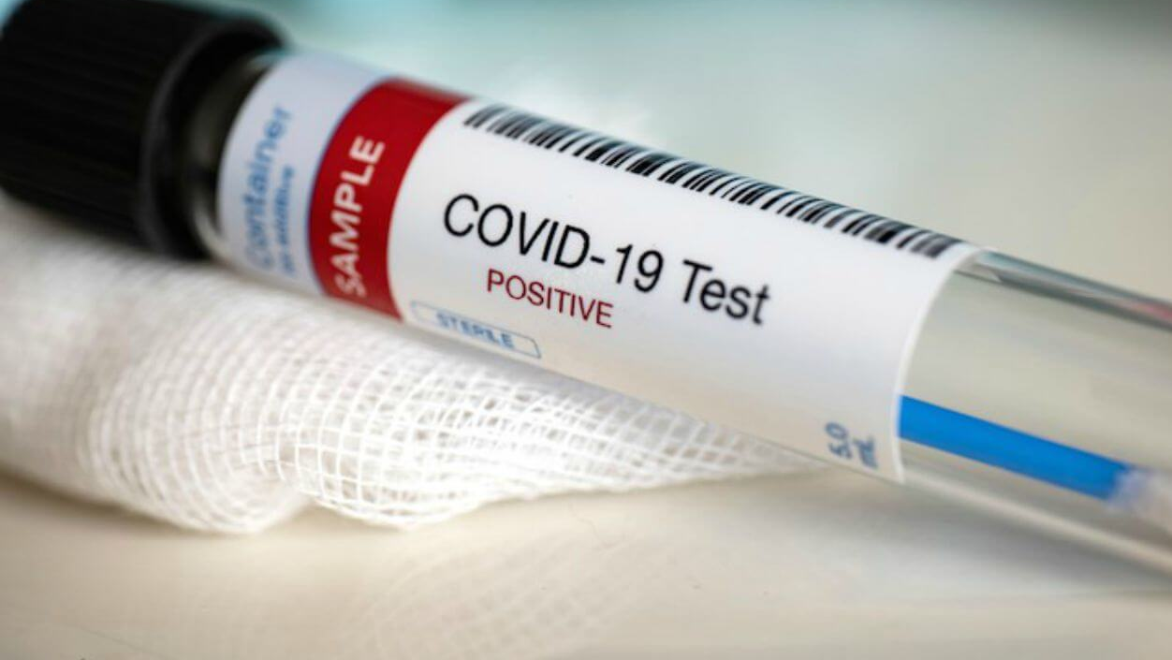
Responding to Positive COVID-19 Cases
Julie Klinger-Luht, MPH |Sara Makenzie, MD, MPH | Humanitas, Inc
This Photo by Unknown Author is licensed under CC BY

Slide 2
Reduce spread of COVID-19 on centers
This Photo by Unknown Author is licensed under CC BY-NC

Slide 3
Learning Objectives
Quarantine/Isolation
Contact tracing
Response (IN 20-02; replaces IN 19-09)
Preventing future cases
This Photo by Unknown Author is licensed under CC BY-NC
Notes:
Preventing future cases

Slide 4
On-Center Collaboration
Internal notification to Center Director, Health and Wellness Manager, and Infectious Disease Response Committee
This Photo by Unknown Author is licensed under CC BY

Slide 5
Initial notification to COR, Regional Director (RD), corporate office, and Humanitas Nurse Specialist (within 12 hours). Serves as draft of SIR for approval by RD.
Collaboration beyond center.
This Photo by Unknown Author is licensed under CC BY-NC

Slide 6
Notification and SIR
Name and title and/or position of staff or student with his or her student ID number and age (minor or adult);
When the staff member or student was last on the center;
Whether the staff member or student had “close contact” (defined by the CDC as being within 6 feet for 15 or more minutes over 24 hours) with others;
Health status and current location of the staff and/or student;
Date of symptom onset (if applicable);
Date and/or time tested;
Reason for the test;
Date and time the COVID-19 confirmed positive test result was received by or reported to the center; and
Source and date of the exposure (if known).

Slide 7
Date of Symptom Onset
Close contact exposure - 48 hours before symptom onset or 48 hours before positive test
This Photo by Unknown Author is licensed under CC BY-NC

Slide 8
Significant Incident Report (SIR)
Within 24 hours
New SIR for each case

Slide 9
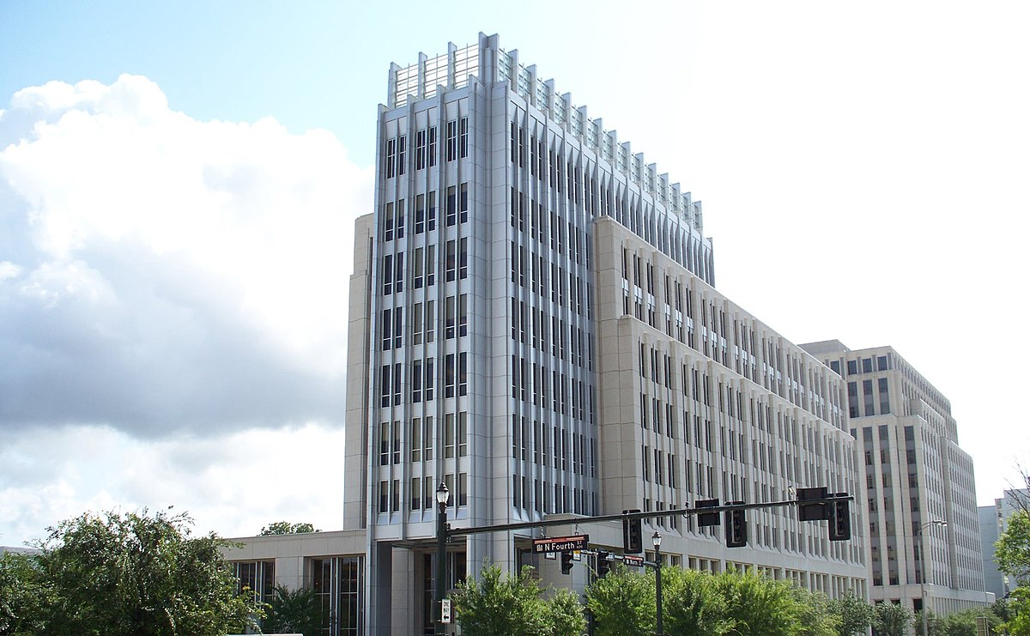
Contact Health Department
Within 1 business day
Report positive case and coordinate response
This Photo by Unknown Author is licensed under CC BY-SA

Slide 10
Initiate Contact Tracing
Complete a crosswalk of the schedule(s) with student and staff interactions, noting names when possible.
Provide this information to the RD and the health department.
Determine whether the health department, the center, or both will notify contacts and provide direction.
This Photo by Unknown Author is licensed under CC BY-NC-ND

Slide 11
Close Contact Definition per CDC
Within 6 feet for > 15 minutes within 24 hours

Slide 12
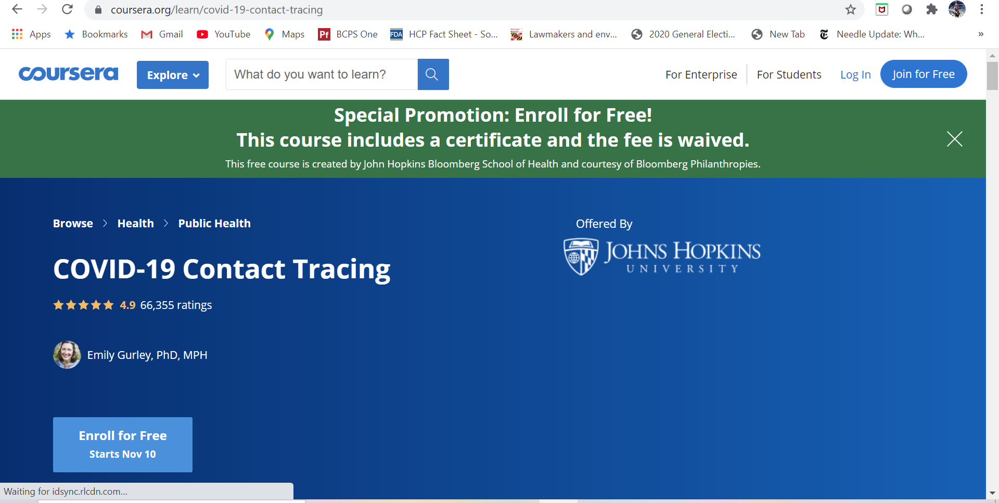
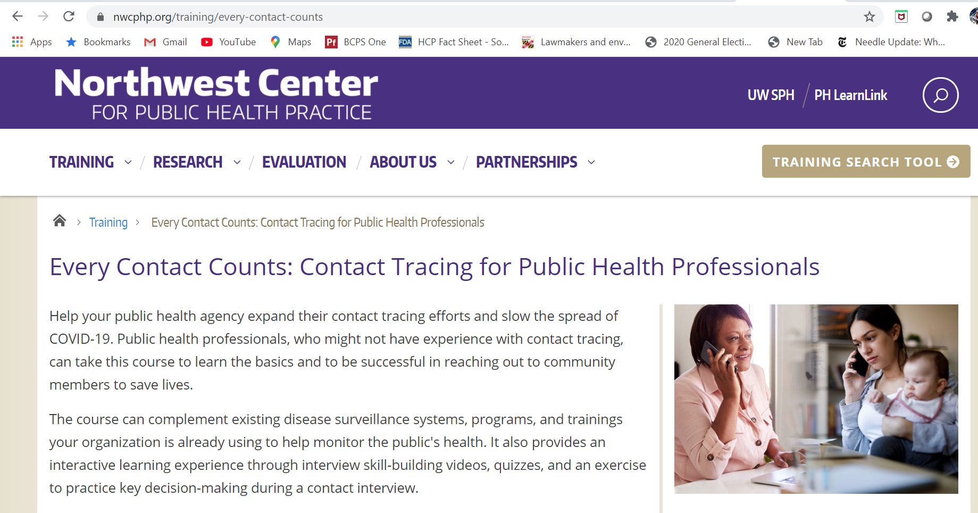

Slide 13
Notify
Close contacts and educate regarding quarantine and testing requirements.
Quarantine = 14 days
Testing recommended at 5-7
Still need to quarantine
Student’s parent/guardian, if student is a minor.
This Photo by Unknown Author is licensed under CC BY

Slide 14
Who needs to quarantine?

Slide 15
Probable Quarantine
Roommates
Significant others
Pod/bubble/friends who have not distanced
Staff who share an office space

Slide 16
What about health staff?
No quarantine with proper PPE
Quarantine for 5-7 days with 2 negative tests, then wear N95 at all times
This Photo by Unknown Author is licensed under CC BY-SA
Notes:
HCP not wearing a respirator or facemask⁴
HCP not wearing eye protection if the person with COVID-19 was not wearing a cloth face covering or facemask
HCP not wearing all recommended PPE (i.e., gown, gloves, eye protection, respirator) while performing an aerosol-generating procedure¹

Slide 17
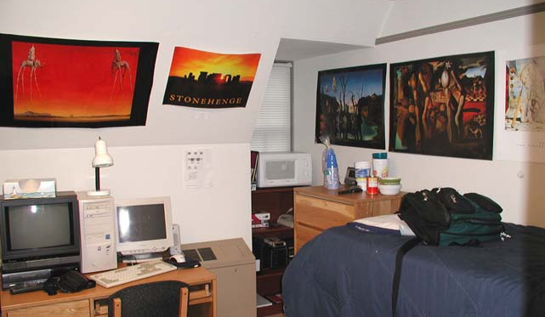
Isolate Positive Students
COVID-19 Medical Mental Health, TEAP, and Oral Health Protocol
Work with Health and Wellness
10 days or until fever-free for 24 and symptoms begin to resolve, whatever is longer
Meals delivered, wellness checks on 2x a day
This Photo by Unknown Author is licensed under CC BY-SA

Slide 18
Travel Home?
Should a student’s parent or legal guardian request that the student return home, the center must inform the parent or guardian of the isolation policy and measures taken to contain spread of the virus.
If the parent or legal guardian still requests that the student return home, contact the Job Corps Regional Office immediately.
No public transportation.
This Photo by Unknown Author is licensed under CC BY-SA

Slide 19
Notification Letter
Center Director prepares a COVID-19 Notification Letter to all staff and students informing them of the positive test while ensuring all PII is kept confidential.
Notes:
The center works with the Job Corps RD on a joint draft.
The center works with the appropriate corporate management staff for review of the joint draft. Job Corps’ RD coordinates reviews and approvals with Job Corps’ national office.
The center or others as appropriate sends the communication to the RD and COR once it is approved.

Slide 20
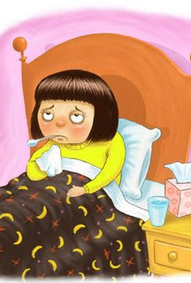
Positive Staff Members
Coordinate with Health and Wellness staff and positive staff member regarding return to work
In accordance with staff member’s health care provider
Must be at least 10 days since symptom onset/positive test result (if asymptomatic)
No repeat testing
This Photo by Unknown Author is licensed under CC BY-SA

Slide 21
Forward media and congressional requests to the RD for Job Corps National Office coordination.
This Photo by Unknown Author is licensed under CC BY

Slide 22
Lessons Learned
Were staff and students adequately distanced?
What could have prevented spread/quarantine?
What will you do differently in the future?

