Slide 1
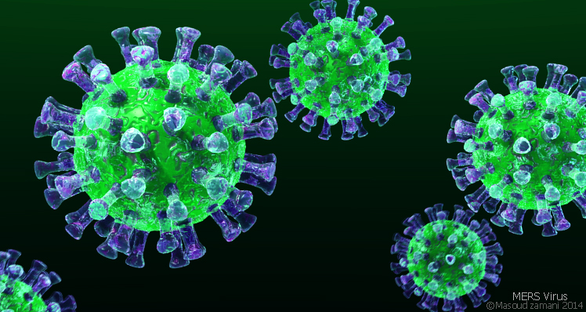
COVID-19 Medical Protocol for Residential Staff
This Photo by Unknown author is licensed under CC BY-SA.

Slide 2
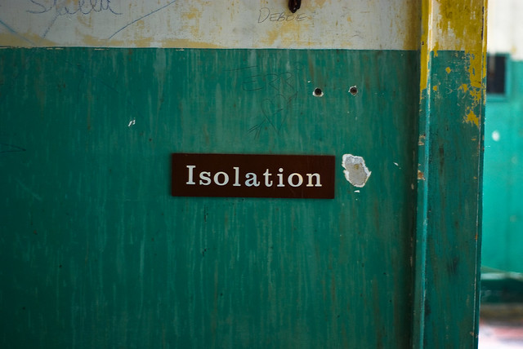
Isolation and Symptomatic Management Guidelines
This Photo by Unknown Author is licensed under CC BY-NC-ND

Slide 3
Isolation is reserved for students who test positive for COVID-19.
This Photo by Unknown Author is licensed under CC BY

Slide 4
How long does isolation last?
For most persons with COVID-19 illness, isolation and precautions can generally be discontinued 10 days after symptom onset¹ and resolution of fever for at least 24 hours, without the use of fever-reducing medications, and with improvement of other symptoms.
Health and Wellness Center staff will manage this.
This Photo by Unknown Author is licensed under CC BY

Slide 5
Notes:
SMG

Slide 6
Non-health staff should not enter the room of a student who is positive for COVID-19. All conversations should take place via telephone or text message. Medication should be left outside of the student’s door.
This Photo by Unknown Author is licensed under CC BY-NC-ND

Slide 7
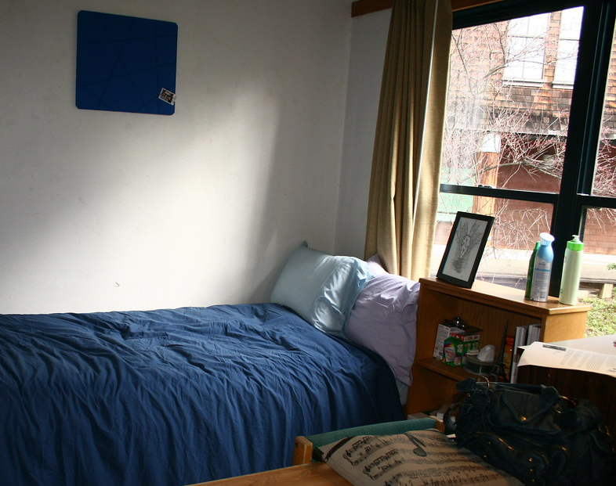
Students with COVID-19
Must remain in isolation until cleared
May isolate together
This Photo by Unknown Author is licensed under CC BY

Slide 8
Symptom Treatment
Symptom | Medication
Fever >100°F | Acetaminophen 650 to 1000 mg every 4 hours [maximum daily dose 4 g] or ibuprofen 400 to 600 mg every 6 hours [MDD 2400 mg]. Encourage oral hydration.
Headache/body aches | Acetaminophen 650 to 1000 mg every 4 hours [maximum daily dose 4 g] or ibuprofen 400 to 600 mg every 6 hours [MDD 2400 mg].
Sore throat | Throat lozenge or have him/her gargle with warm salt water every hour as needed while awake
Nausea, vomiting and/or diarrhea | Offered clear fluids to take frequently in small quantities
Abdominal pain | Should generally avoid solid food but may take small amounts of clear fluids
Mild abdominal cramps caused by diarrhea | Offer the student loperamide caplets (Imodium AD), 2 caplets initially, then 1 caplet with each subsequent loose stool, not to exceed 4 caplets in 24 hours. Take caplets with 8 ounces of water

Slide 9
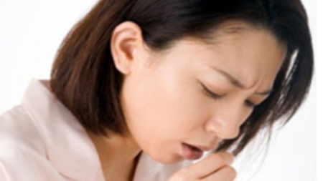
Coughing and Difficulty Breathing
If the student reports worsening cough and/or difficulty breathing, observe for:
Noisy breathing, gasping, blue color and other signs of acute distress suggest that immediate attention is needed. Call 911.
If coughing without pain or respiratory distress, offer the student cough syrup in a dose containing 30 mg of dextromethorphan, for use primarily at bedtime, but no more than every 12 hours. Encourage oral hydration.
This Photo by Unknown Author is licensed under CC BY-NC

Slide 10
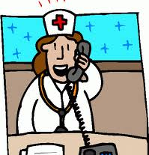
Contact On-Call Health and Wellness Staff
If fever is >103°F
If signs of acute respiratory distress
If difficulty swallowing or drooling
If headache is associated with changes in vision or vomiting, or does not respond to the recommendations given above
If abdominal pain
If nausea, vomiting and/or diarrhea does not respond to the recommendations given above
If the student vomits more than twice in an hour or is not able to keep any liquid down
If the student reports having blood in the stools or vomits blood
This Photo by Unknown Author is licensed under CC BY-NC

Slide 11
This Photo by Unknown Author is licensed under CC BY-SA

Slide 12
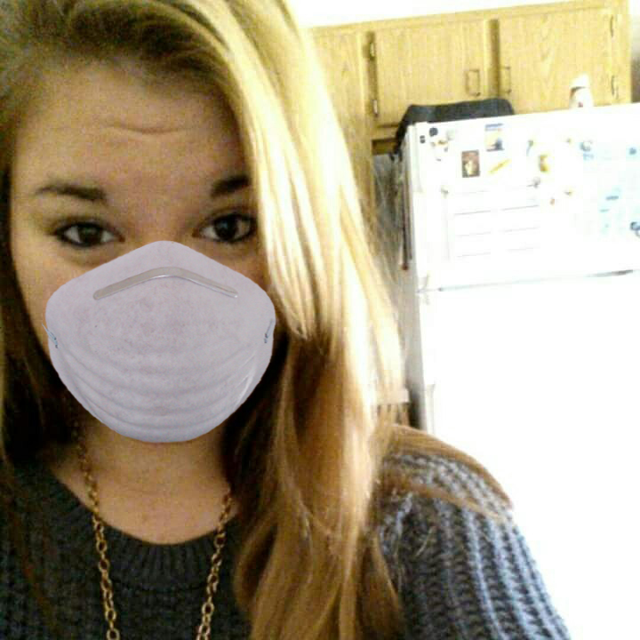
Types of Quarantine
Cluster Quarantine
Individual Quarantine
This Photo by Unknown Author is licensed under CC BY

Slide 13
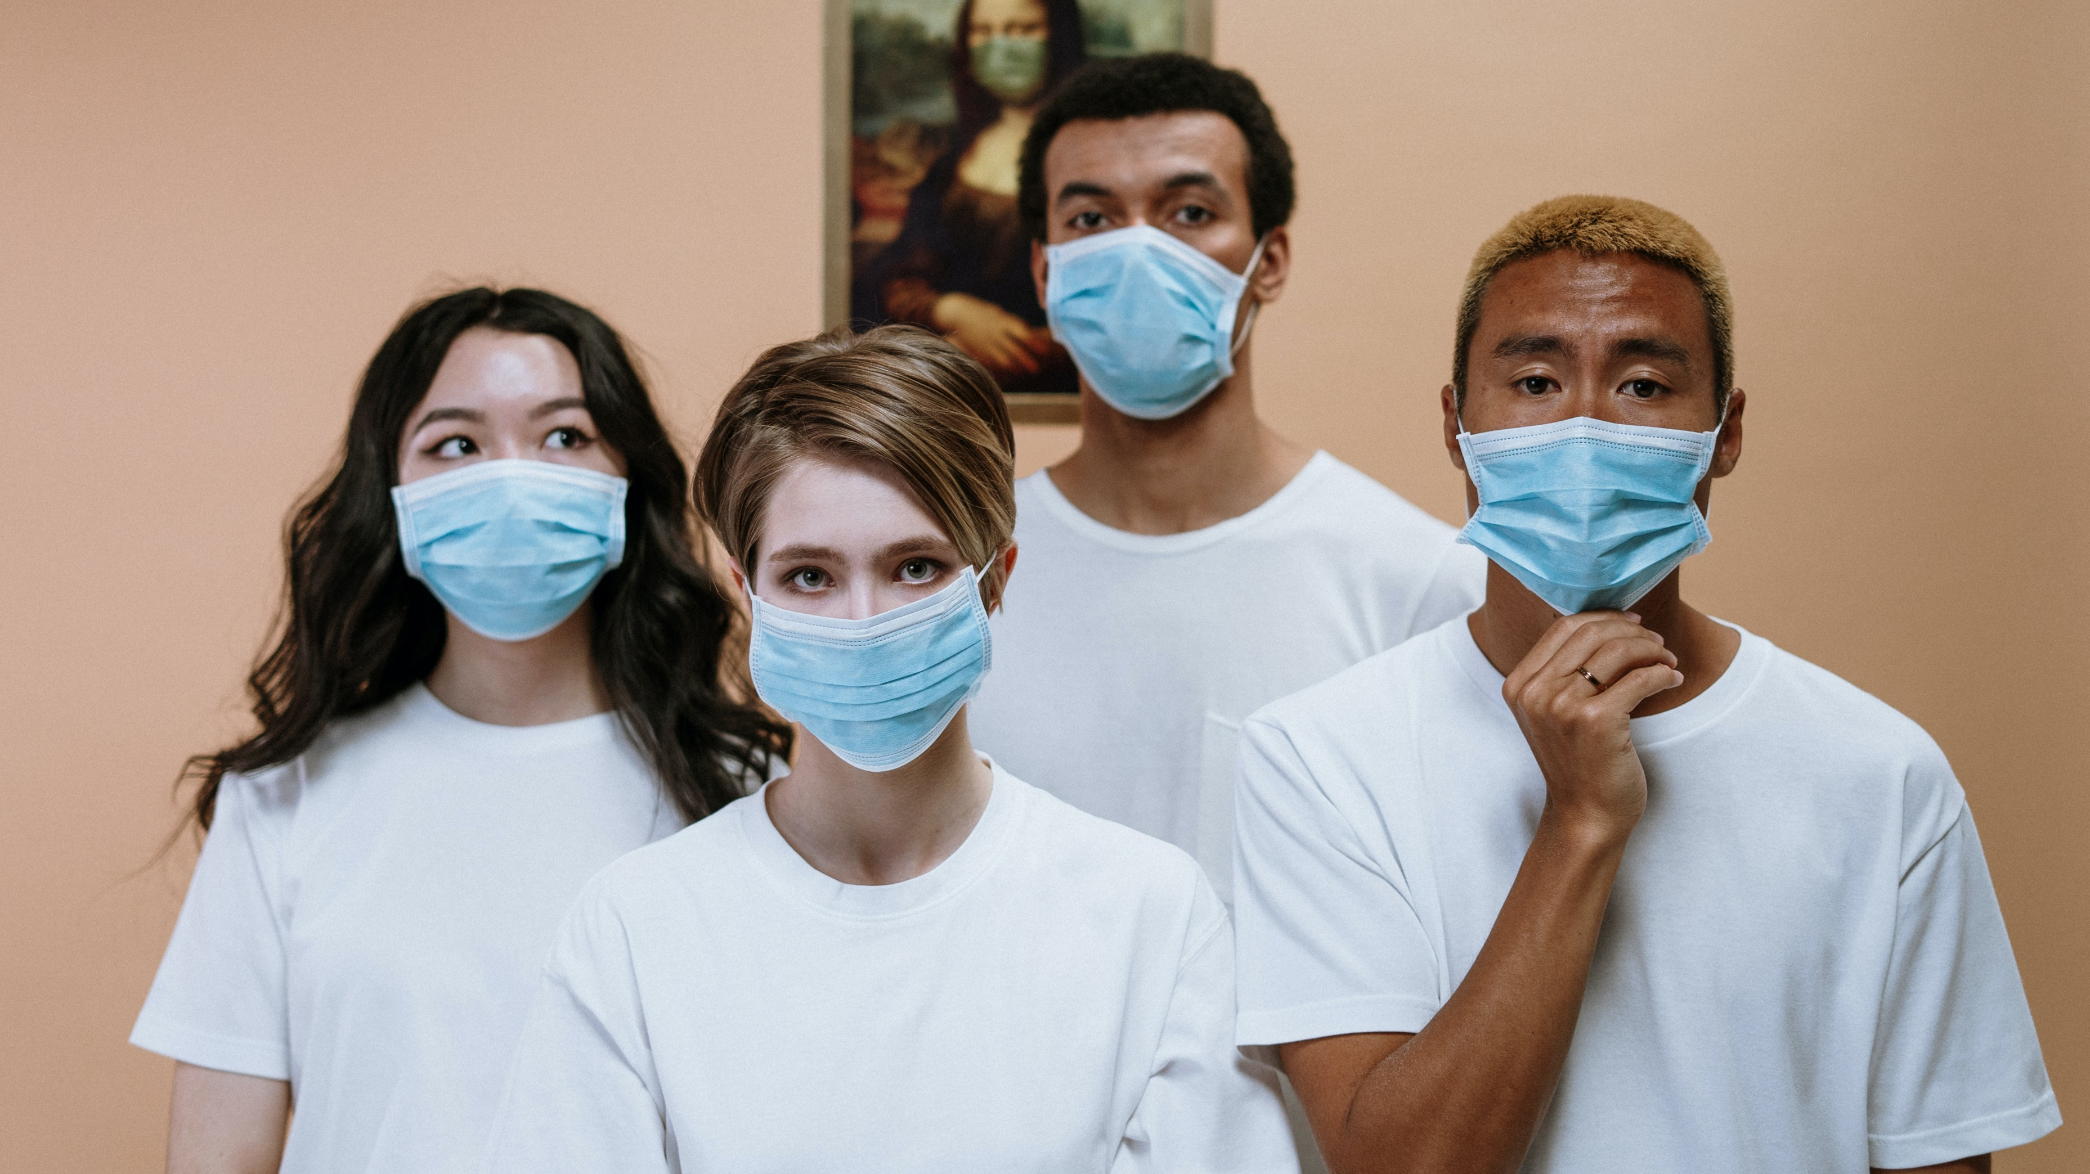
Cluster Quarantine
On entry after a negative COVID-19 test
Groups of up to 12
May share bathroom
May visit recreation as a group (with no one else there)
May eat together
Must wear mask
Must physically distance

Slide 14
Individual Quarantine
Response to COVID-19 Exposure
14 days, assessed for symptoms
Not permitted to mix with others (more like isolation)

Slide 15
Questions?
This Photo by Unknown Author is licensed under CC BY-NC-ND

