Slide 1
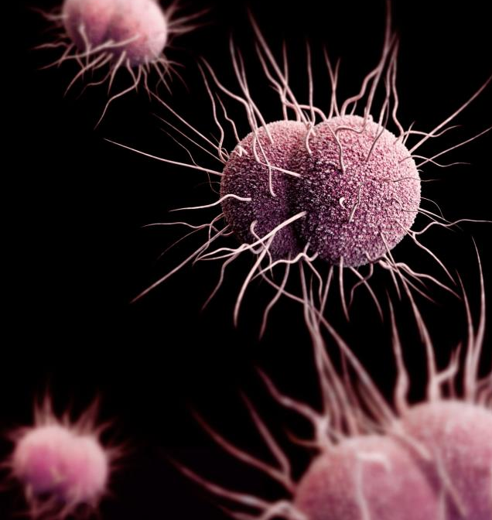
Sexually Transmitted Infections (STIs) Sara Mackenzie, MD, MPH Job Corps Regional Medical Specialist Humanitas
This Photo by Unknown Author is licensed under CC BY-SA

Slide 2
By the end of today, you should be able to:
Identify students at increased risk for sexually transmitted infection
Implement Job Corps & CDC recommended screening and treatment guidelines

Slide 3
Think & Share:
How do sexually transmitted
infections differ from other
infections?

Slide 5
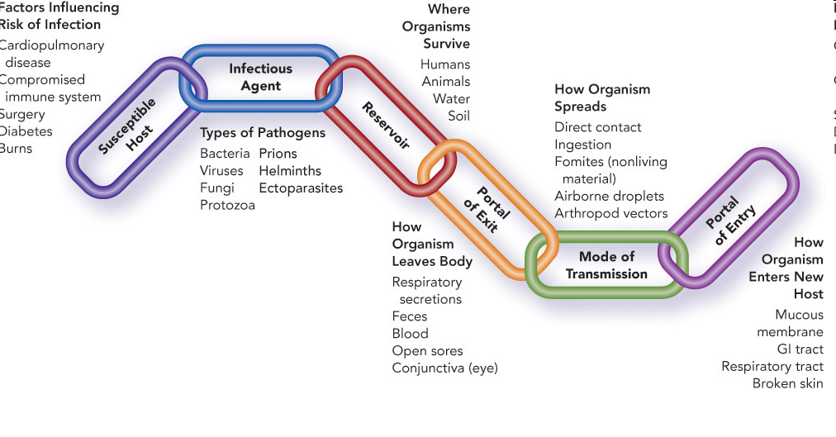
Why do we consider sexually transmitted infections differently from other infections?
Disease load
Type of sexual
behavior
You don’t get chlamydia from a toilet seat (or sitting next to someone in class)!
STIs
STIs

Slide 6
Population perspective:
15-24-year-olds represent
25% of the ever sexually active population
~50% all new STIs
2/3 of STIs occur among women
Men who have sex with men have higher rates
Transgender men and women have higher rates

Slide 7
STI prevalence by age

Slide 8
Contributing factors:
Partner factors
Concurrent partners
Short term relationships
Health care access
Parental insurance
Consent for care
Clinician behavior
Social factors
Stigma
Social networks
Condom use
https://www.cdc.gov/mmwr/volumes/66/wr/mm6609a1.htm

Slide 9
Who gets STIs?
Individually, it’s not your sexual identify, it’s what you do!
Certain behaviors = greater or lesser risk
More partners = more risk
No condoms = more risk

Slide 10
You don’t know who has risk if you don’t ask:
Sexual behaviors:
Type of sexual contact (anal, vaginal, oral)
Sex while intoxicated or high
Non-consensual
Sexual partners:
Known vs anonymous partner
Number of partners
Sex with person who injects drugs
Exchange sex for drugs/money/housing/food

Slide 11
Job Corps STI-related Basic Health Care Responsibilities (Chapter 2.3):
Provide students with information on HIV, STDs, safe sex and family planning
Entrance labs
Re-test for HIV upon diagnosis of another STI, if signs or symptoms, if suspicion of exposure or upon student request
Re-test for other STIs as indicated as part of routine care
Report cases of disease to state and local health departments in accordance with laws

Slide 12
The #1 most common “symptom” of STI’s?

Slide 13
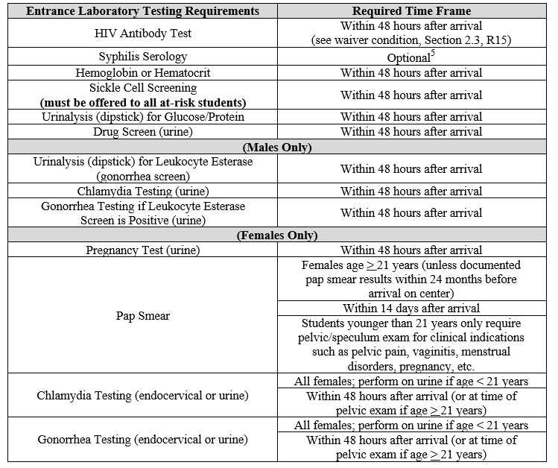

Slide 14
MCI lab ordering:

Slide 15
MCI lab ordering:

Slide 16
How to prevent STI’s:
Abstinence
Vaccination
Mutual monogamy
Reduce partner number
Testing
Treatment
For HIV- pre-exposure prophylaxis (PrEP) and Post exposure prophylaxis (PEP) if high risk
For HPV - vaccination

Slide 17
Get tested!

Slide 18
CDC Testing Recommendations
All people 13-64 should be tested for HIV at least once
All sexually active women <25 should be tested annually for gonorrhea and chlamydia
All pregnant women should be tested for syphilis, HIV and Hep B at start of pregnancy; women at risk should be tested for GC/CT
All sexually active gay and bisexual men should be tested at least once a year for syphilis, chlamydia and gonorrhea; they may benefit from more frequent HIV testing (3 to 6 months)
Anyone who has unsafe sex or shares injection drug equipment should get tested for HIV at least annually

Slide 19
Types of STIs
Bacterial Chlamydia Gonorrhea Pelvic inflammatory disease (PID) Syphilis Bacterial vaginosis | Viral HIV HPV Herpes Hepatitis B, C | Other Trichomoniasis - protozoa Candidiasis Public lice Scabies

Slide 20
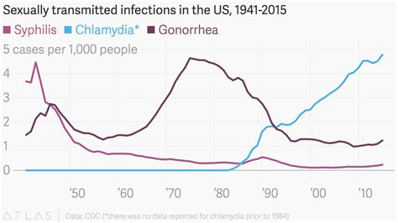

Slide 21
Chlamydia
Most commonly reported bacterial STI
If symptoms
1-3 weeks after exposure
Burning sensation with urination
Discharge clear
Leads to PID, scarring, epididymitis, infertility

Slide 22
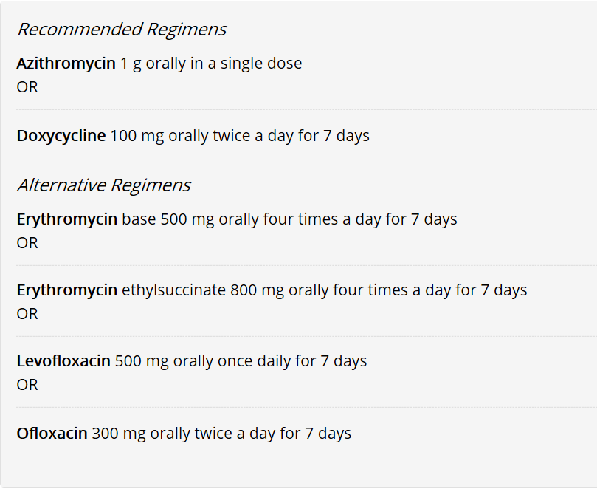
Chlamydia treatment:

Slide 23
Chlamydia
Abstain from intercourse until they and partner have been treated - 7 days after single dose or 7-day regimen
01
Partner evaluation & treatment
02
Retest for Chlamydia in 3 months
03

Slide 24
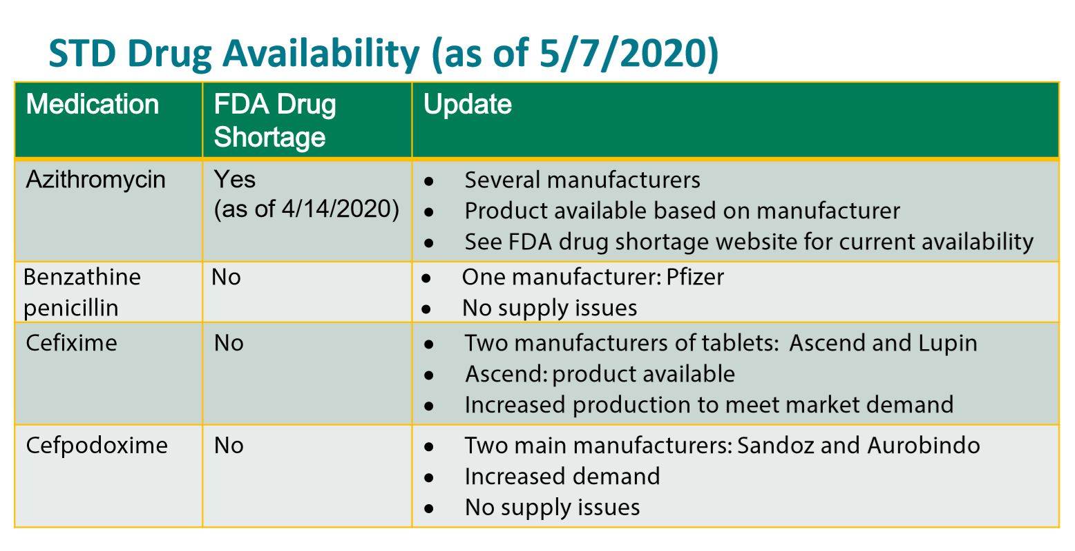
https://www.accessdata.fda.gov/scripts/drugshortages/dsp_ActiveIngredientDetails.cfm?AI=Azithromycin%20Tablets&st=c&tab=tabs-1

Slide 25
Gonorrhea
Second most commonly reported bacterial STI
If symptoms
1-14 days after exposure
Burning sensation with urination
Discharge white, yellow, or green
Leads to PID, epididymitis, infection blood and joints
Treatable with antibiotics – BUT…

Slide 28
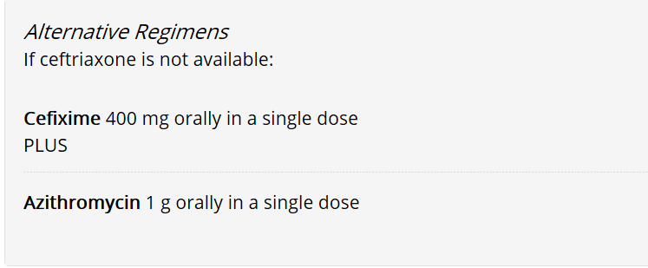
Gonorrhea treatment:

Slide 29
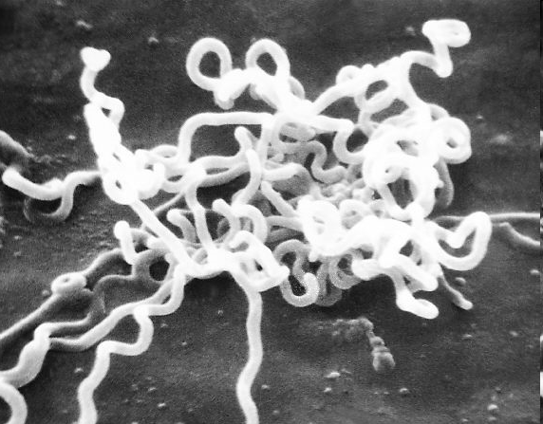
Syphilis
3 stages
Primary
Secondary
Tertiary
Mother-to-child-transmission
4.5 per 100,000
Treated with penicillin

Slide 30
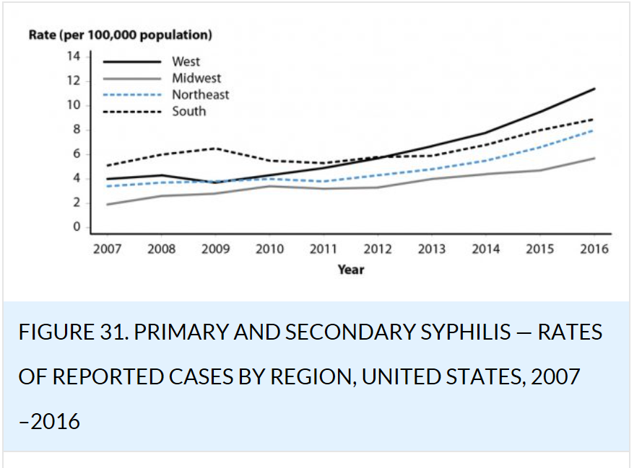
Syphilis:
https://www.cdc.gov/std/stats16/Syphilis.htm

Slide 31
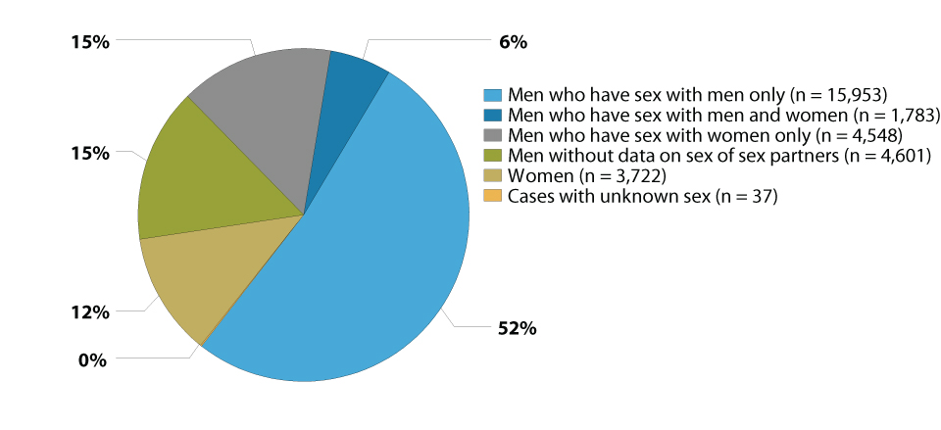
Primary and Secondary Syphilis — Distribution of Cases by Sex and Sexual Behavior, United States, 2017

Slide 32
Viral STIs
Viral STIs cannot be cured, making prevention even more critical
Vaccination is an option for some of the viral STIs, and symptoms can be treated
Human papillomavirus (HPV): Most common STI in the U.S.; more than 40 types
Genital herpes: No cure;
Hepatitis A and B: Vaccine available
Hepatitis C: not usually sexual transmission

Slide 33
Human Immunodeficiency Virus (HIV)
*See PrEP & PEP webinar

Slide 35
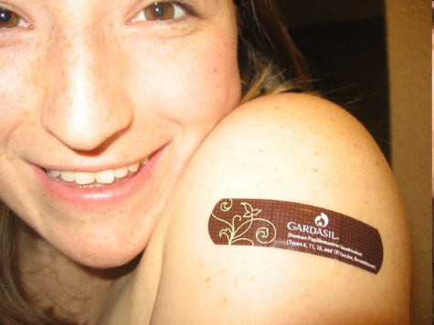
Human Papillomavirus
Over 100 types
Most common viral STI
Causes genital warts, cervical cancer
Usually transient & asymptomatic
Screening with Pap test
Vaccine recommended for men and women

Slide 36
QUESTIONS?

