Slide 1
Using Google Forms
Notes:
Welcome. In this presentation, we will provide information on how to use Google Forms to create the forms introduced in the Job Corps Program Instruction Notice 20-11, sent on November 3rd. We will focus on creating the Daily Emotional Wellness Checklist, but it is the same procedure for the COVID-19 Daily Symptom Tracker and Attestation form. The templates for the forms were included in the notice, so you can use those as a guide in creating the forms.
Please note that Google Forms is just one option for tracking and monitoring staff and students. Job Corps recommends utilizing Google Forms; however, centers can develop a strategy that works best for them. The points to consider when developing a strategy are outlined in the Program Instruction notice.

Slide 2
LEARNING OBJECTIVES
In today’s session, you will learn how to use Google Forms:
Create a New Form
Enter a Form Title/Description
Add Questions
Record Responses
Modify Form Settings
Add Collaborators
Notes:
In today’s session, you will learn how to use Google Forms to create a new form, enter a form title and description, add questions, record responses, modify form settings, and add collaborators.

Slide 3
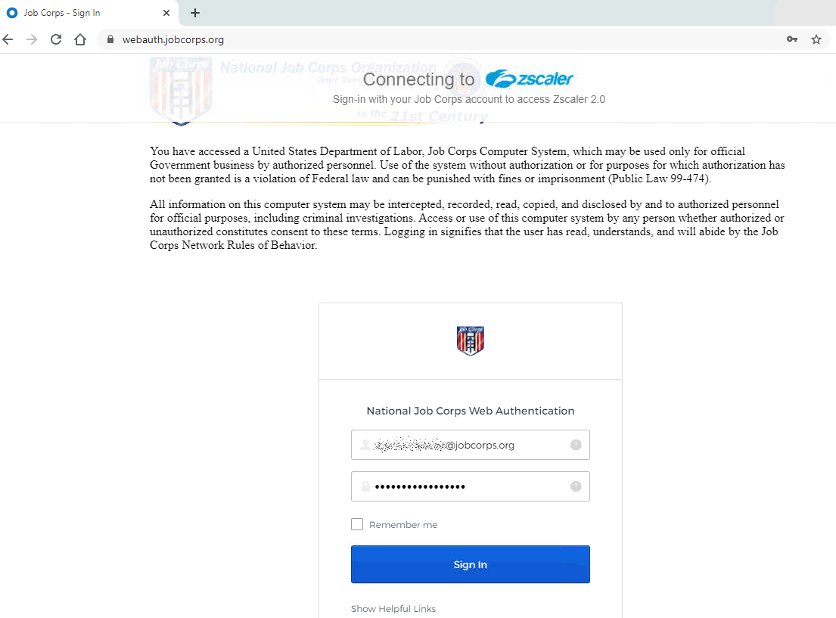
Google Login
To login, go to https://www.google.com/ in a Google Chrome browser.
On the “Connecting to zscaler” page, enter your Job Corps email address and Citrix password.
Notes:
You will first need to login to Google. You will need to do this in a Google Chrome browser. You will be prompted to connect to zscaler. Enter your Job Corps email address and Citrix password. Note that you do not have to be inside Citrix to login to Google.

Slide 4
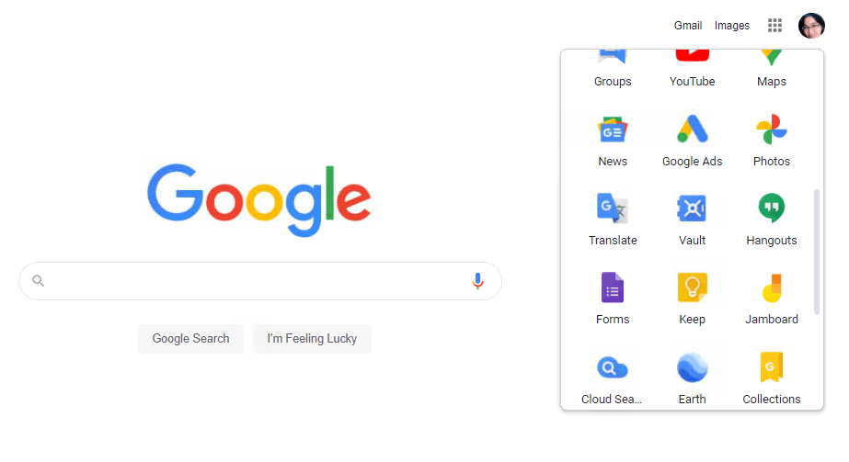
Google Forms
Select Forms from the upper-right Apps icon on the Google page.
Notes:
After you login to Google, select Forms from the upper-right Apps icon on the Google page. The Apps icon is represented by the 9 little dots.

Slide 5
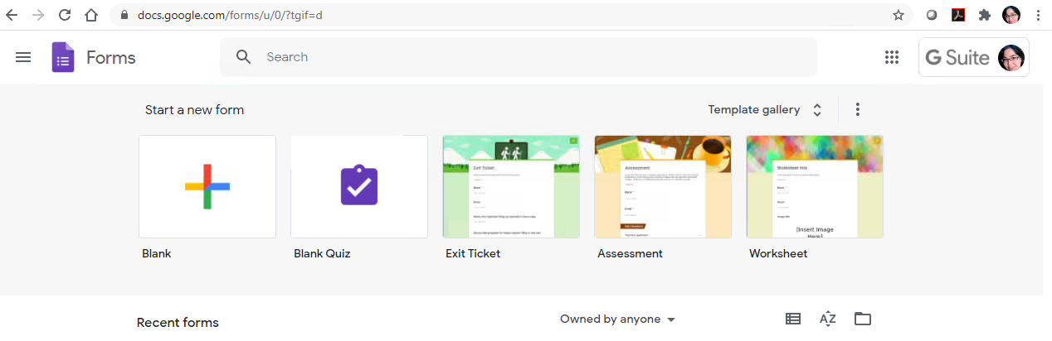
Creating a New Form
Click Blank to start a new form.
Notes:
On the Forms homepage, you will have several templates to choose from. The page will also display any recent forms you may have already created. Click Blank to start a new form.

Slide 6
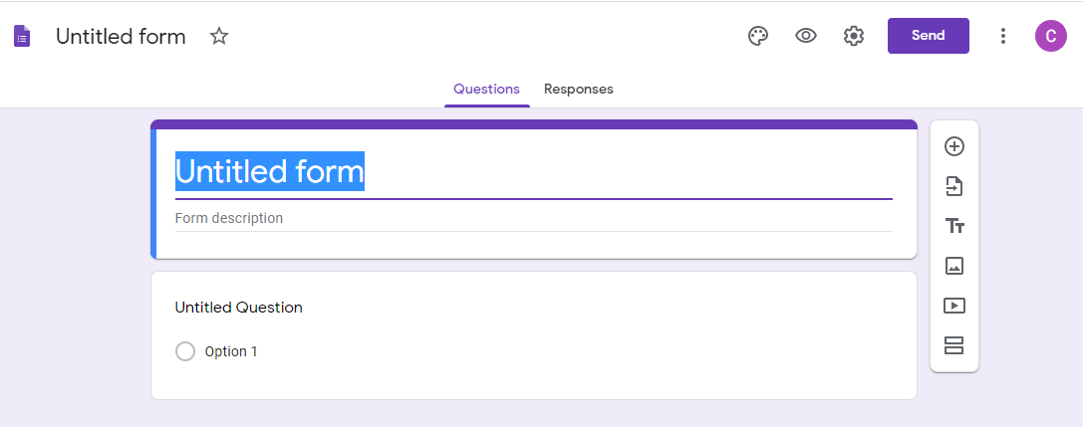
Entering a Form Title/Description
Click the Untitled form and Form description fields to enter the name and description of the form.
Notes:
A blank form will display on your screen. Here you can click the Untitled form and Form description fields to enter the name and a short description of the form. Both of these are on the template in the notice.

Slide 7
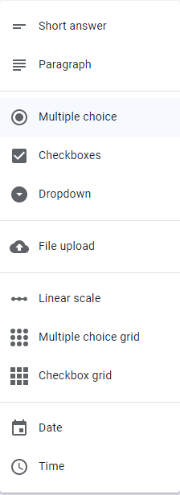
Entering a Form Title/Description
Click a field to make it active.
For each field/question, select the type from the drop-down list to the right of the question.
Notes:
After you enter the name (here we entered Daily Emotional Wellness Checklist), it will display at the top of the form. You can then click any field to make it active. For each field or question, you will select the type from the drop-down list to the right of the question field.
The screenshot on the right has a list of the types of questions or fields you can create.

Slide 8
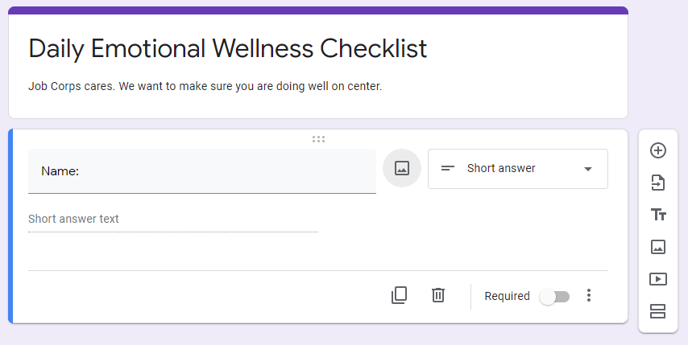
Adding Questions
For the Name and Student ID fields, select Short Answer as the question type.
Notes:
The first field on the form is Name, so you will click the question field and type Name. For both the Name and Student ID fields, select Short Answer as the question type. Google can often auto-detect the type of question and will automatically select it for you. If it selects the wrong type for you, click the drop-down list and select the correct one.

Slide 9
Making a Question Required
You also have the option to make a question Required in the lower-right corner of the question block.
Notes:
You also have the option to make a question Required in the lower-right corner of the question block. Go ahead and select Required for both the Name and the Student ID fields.

Slide 10
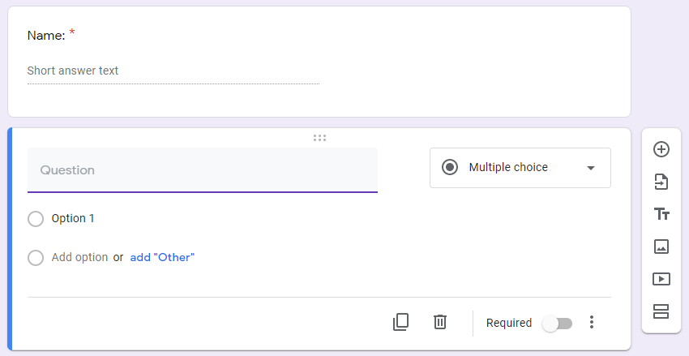
Adding Questions
Click the plus sign to add another question.
Notes:
Click the plus sign in the menu to the right, to add another question.

Slide 11
Adding Date/Time Fields
For the Today’s Date field, select Date from the drop-down list. For the Time field, select Time from the drop-down list.
Notes:
For the Today’s Date field, select Date from the drop-down list. For the Time field, select Time from the drop-down list. Also make both of these fields required. Note that these fields will not auto-fill. The date and time will have to be manually entered when completing the form.

Slide 12
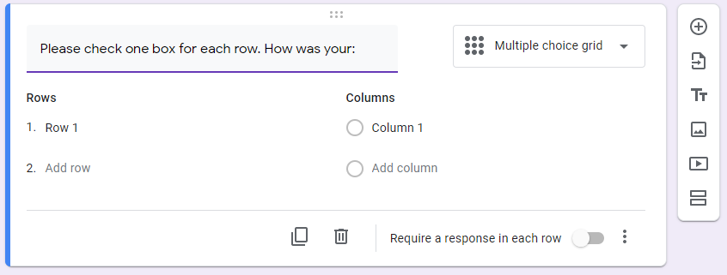
Adding Multiple Choice Questions
Select Multiple choice grid when the question has several options.
Notes:
Now you are ready to enter the questions in the checklist. In the question field, enter “Please check one box for each row. How was your:”. Since each row will have several answer options, select Multiple choice grid as the question type.

Slide 13
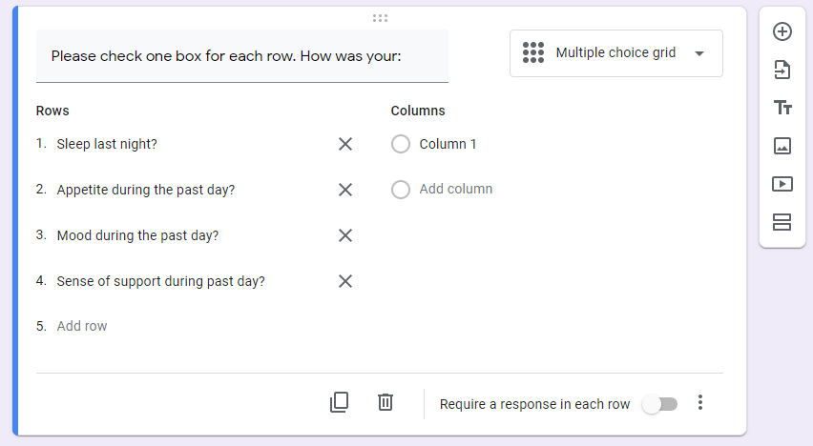
Adding Multiple Choice Questions
Under Rows, enter the questions – one per row.
Notes:
You will then add the 4 questions in the checklist under the Rows column. Enter one question, per row.

Slide 14
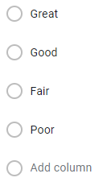
Adding Multiple Choice Questions
Under Columns, enter the answer options.
Notes:
Under Columns, you will enter the answer choices. These choices are the same for each of the questions. Enter one answer per column. The choices will be Great, Good, Fair, and Poor.

Slide 15
Adding Multiple Choice Questions
Do not select Require a response in each row.
Notes:
One thing to note here is that students have the option to not complete the checklist, so do not select Require a response in each row.

Slide 16
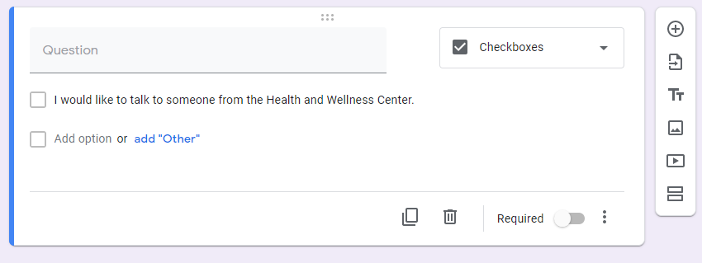
Statement Checkboxes
For the last two statements, leave the Question field blank and select Checkbox as the type from the drop-down list.
Type the statement in the Option 1 field.
Do not select Required.
Notes:
The last two entries on the form are statements that the student has the option to select. For these, you will leave the Question field blank and select Checkbox as the type from the drop-down list. Then type the first statement in the Option 1 field. Since this statement is optional, do not select Required.
Click the plus sign to add the second statement.

Slide 17
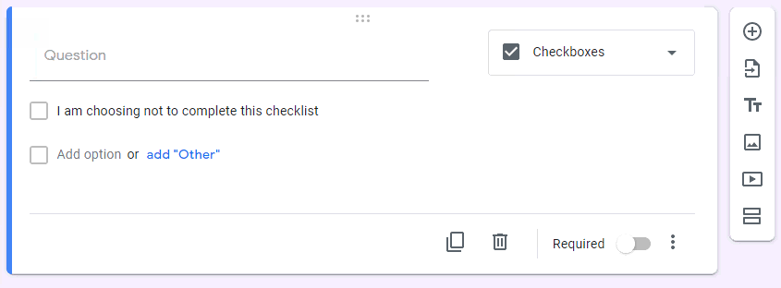
Statement Checkboxes
Leave the Question field blank and select Checkbox as the type.
Type the second statement in the Option 1 field.
Do not select Required.
Notes:
Here, too, you will leave the Question field blank and select Checkbox as the type. Then type the second statement in the Option 1 field. Do not make this field required since completing the checklist is optional.

Slide 18
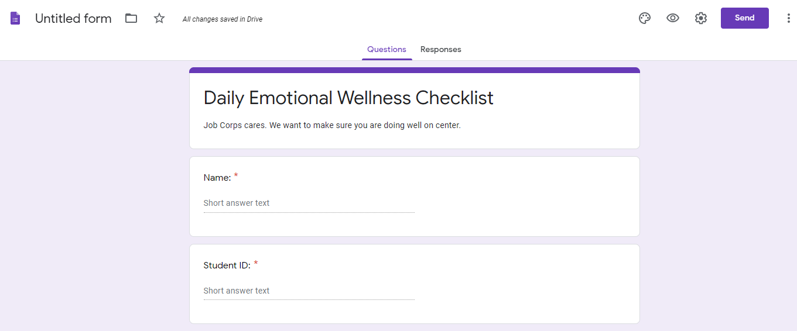
Form Title
Click the Untitled Form field to name the file.
Notes:
After you enter all of the questions, you can scroll back up to the top of the form and name the file. To do this, click the Untitled Form field, in the upper-left corner of the screen. Google will automatically update the name to what you entered when you first created the form. You can change it if you would like, but in this case, it would be better to leave it as is.

Slide 19
Form Title
All changes made to the form are automatically saved in Google Drive.
Notes:
Also note that all changes made to the form are automatically saved in Google Drive, as they are made. You don’t have to worry about losing changes, if the screen closes.

Slide 20
Form Responses
Once you have entered all of the questions, you can select the settings for the Responses.
Click the 3 dots next to the green plus sign.
Notes:
Once you have entered all of the questions, you can select the settings for the Responses. Click the Responses tab at the top of the form and then click the 3 dots next to the green plus sign.

Slide 21
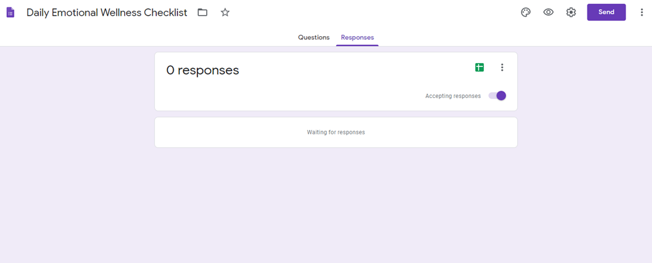
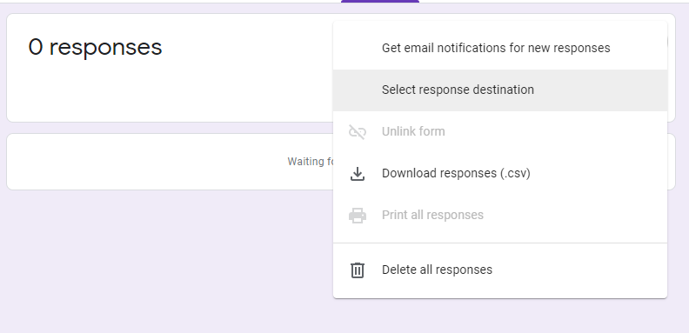
Form Responses
Click Select Response Destination.
Notes:
In the drop-down menu, click Select Response Destination.

Slide 22
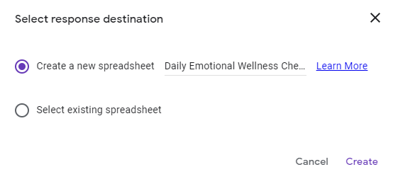
Response Spreadsheet
Select Create a new spreadsheet and enter the file name.
Click Create.
Notes:
In the pop-up, select Create a new spreadsheet and enter a name for the file and then click Create.

Slide 23
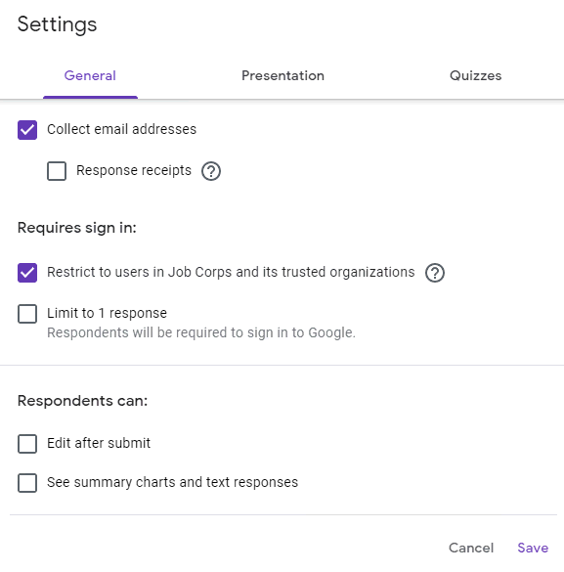
Form Settings
Click the Settings icon in the upper-right of the screen.
Select Collect email addresses.
Under Requires sign in, select Restrict to users in Job Corps and its trusted organizations.
Click Save.
Notes:
You will then click the Settings icon in the upper-right of the screen. It is the 3 dots. Select Collect email addresses.
Under Requires sign in, select Restrict to users in Job Corps and its trusted organizations and then click Save.

Slide 24
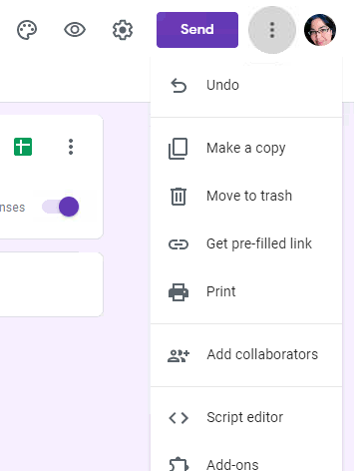
Adding Collaborators
Click the 3 dots in the upper-right of the screen and select Add collaborators.
Notes:
You will then click the 3 dots in the upper-right of the screen again and select Add collaborators to give others permission to modify the form and view the responses.

Slide 25
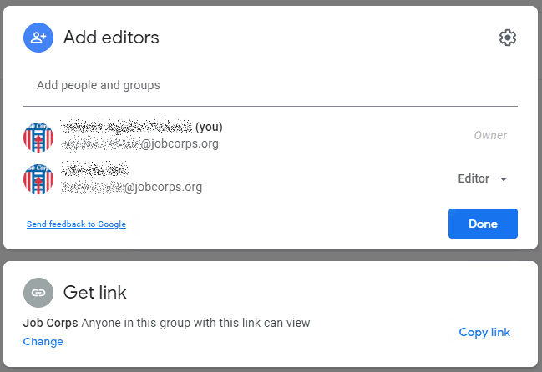
Adding Collaborators
Here you can give others permission to edit the form.
In the Add editors section, enter the names of the staff.
Make sure to click Done to save your changes.
On this screen, you can also get the link for the form.
Notes:
In the Add editors sections, enter the names of the staff that you want to give permissions to. The system will display a list of names, as you type. Note that only staff with Job Corps email addresses will be listed. Select the staff and then click Done to save your changes.
Note that on this screen, you can also copy the link for the form.

Slide 26
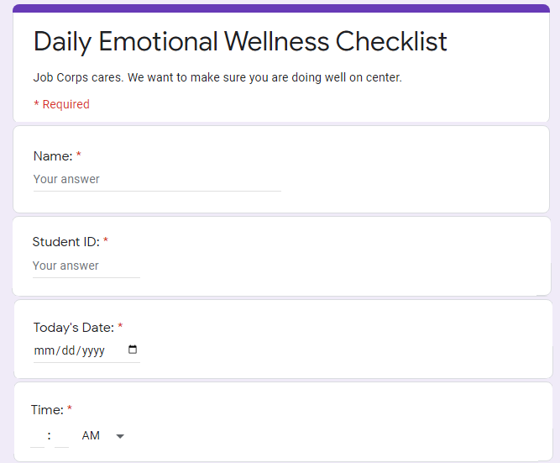
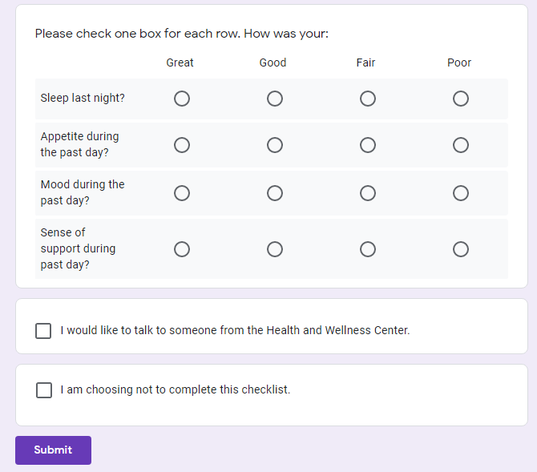
Preview Form
Click the Preview icon to see the form.
Notes:
To see the form you just created, click the Preview icon (it looks like an eye) at the top of the screen. A preview of the form will display in a new tab. After you review it, if you need to make any changes, click the previous Google tab that you were working in and make the changes. Google will automatically save any changes that you make.

Slide 27
Link to the Forms
In the Settings → Add Collaborators pop-up window, click Copy Link.
Provide the link to staff and students.
They must first login to Google www.google.com with their Job Corps email address, before going to the form.
Notes:
After the forms are setup, you can provide the links to the staff and students. You can get the link to the form on the same pop-up window that you entered the collaborators. This was through the Settings icon → Add collaborators. Click Copy Link and then paste it to an email or a notepad. Make sure to let staff and students know that they must first login to Google with their JC email address before they can open the form.

Slide 28
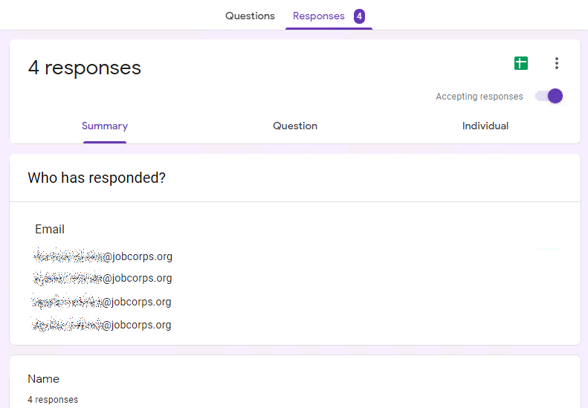
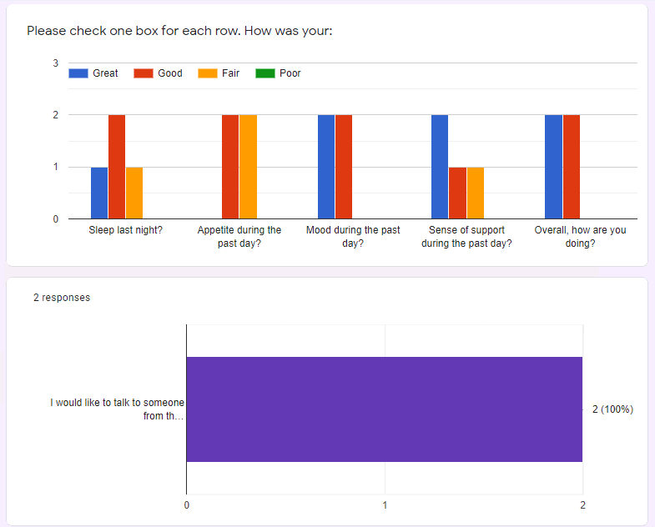
View Responses
To view the responses to the form, click the Responses tab.
Scroll to view the responses.
Notes:
To view the responses to the form, click the Responses tab at the top of the form. In this example, you will see that there is 4 responses. On the screen, you will be able to view the email address of who responded, their name, and if you continue to scroll down, you can see their responses. In this example, the 2nd screenshot is of the responses to the checklist.

Slide 29
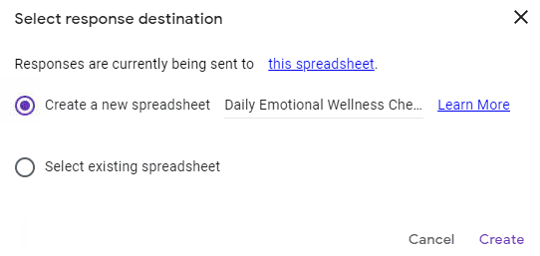
View Responses in the Spreadsheet
Click the 3 dots.
Click Select Response destination.
Click the this spreadsheet link.
Notes:
You also have the option to view the responses in an Excel spreadsheet format. To do this, click the 3 dots in the Responses tab and click Select response destination. Since there have been responses to the form, you will see at the top of the pop-up window that the “responses are currently being sent to” and there is a link to the spreadsheet. Click the link to view it.

Slide 30
View Responses in the Spreadsheet
The spreadsheet will open in a new browser tab.
Notes:
The spreadsheet will open in a new tab. From here, you can scroll thru the data to review it. You can also click File and download the spreadsheet or print it, if needed.

Slide 31
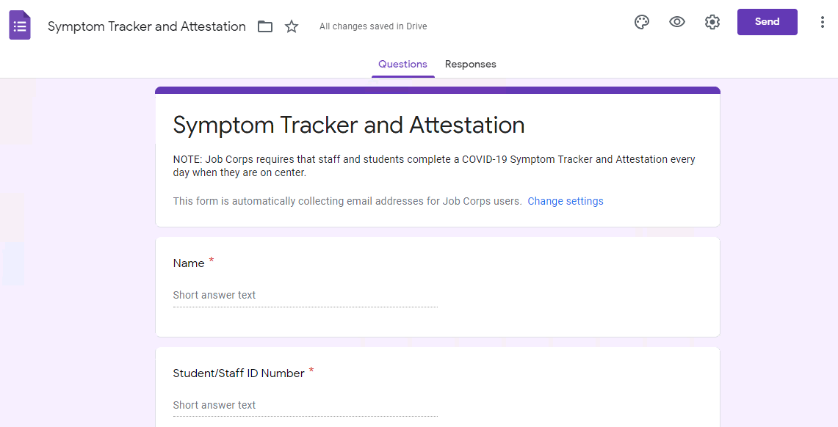
Creating Additional Forms
Use the same process to create the COVID-19 Daily Symptom Tracker and Attestation form.
Notes:
We went thru the process of creating the Daily Emotional Wellness Checklist. You will use the same process to create the COVID-19 Daily Symptom Tracker and Attestation form.

Slide 32
Notes:
That concludes the presentation. We are now going to take a look at the chat box and answer questions.

