Slide 1
Working Together: Suicide Awareness and Prevention in the time of COVID-19.
Valerie Cherry, PhD
Lead/Region 2 Mental Health Specialist
Eugia Meminger, PhD
Regions 1 and 3 Mental Health Specialist
Humanitas
December 15, 2020
Notes:
Val

Slide 2
Learning Objectives
Participants will be able to:
Identify populations among youth at risk for suicide.
Describe the COVID-19–specific threats to mental health and suicide risks.
Develop and implement a suicide prevention program for students on center and in distance learning.
Notes:
Val

Slide 3
Moment of Silence
Notes:
Val
Acknowledge centers that have had student and staff deaths – suicide, homicide, medical, COVID, substance.

Slide 4
What We Know About Suicide Among Youth And Young Adults!
Notes:
Eugia slides 4- 20

Slide 5
Suicide A form of self-directed violence
Suicidal Ideation: contemplation of doing something to harm oneself.
Suicide Attempt: non-fatally, instrumentally harming oneself [includes self-injurious behavior, overdosing, risky behaviors with high probability of harm to self (e.g., running in front of cars on a freeway)].
Suicide: Death caused by self-directed injurious behavior with any intent to die as a result of the behavior.
Notes:
In this presentation, we want to define suicide to include 3 aspects of the phenomenon: Suicidal ideation, Suicide Attempt, and Suicide.
Self-directed violence (SDV) encompasses a range of violent behaviors, including acts of fatal and nonfatal suicidal
behavior, and non-suicidal intentional self-harm (i.e., behaviors where the intention is not to kill oneself, as in self mutilation). Though not a behavior, we have chosen to include suicidal ideation (i.e., thinking about, considering, or planning for suicide) in this document due to its association with self-directed violent behavior.
The National Center for Injury Prevention and Control (NCIPC) has adopted the public health approach to systematically address the
problem of self-directed violence. The public health approach involves the following: defining and describing the
nature of the problem; studying the factors that increase or lower risk; developing and evaluating ways to prevent the
problem; and implementing interventions and disseminating information.
Each of these aspects will be talked about in terms of risk factors, prevalence rates, and prevention strategies. Let’s first talk about a few facts…

Slide 6
Brief Facts about Suicide
About 2.5% of the population makes at least 1 suicide attempt over the course of their life (Nock et al., 2008; Borges et al., 2010)
Second leading cause of death among
15-29 year-olds
Suicide among children and adolescents 10 to 17 years of age is the second leading cause of death
More men than women die by suicide
Most frequent cause of death among females ages 10-19(Rufino & Patriquin, 2019)
Notes:
READ slide
According to the World Health Organization, suicide is the second leading cause of death among 15-29 year-olds globally
Suicide among children and adolescents 10 to 17 years of age is the second leading cause of death, up from the 4th leading cause of death 10 years ago (Rufino & Patriquin, 2019)
Many more men than women die by suicide, but it is the most frequent cause of death among females ages 10-19
About 2.5% of the population makes at least 1 suicide attempt over the course of their life (Nock et al., 2008; Borges et al., 2010)

Slide 7
Number of deaths, age-adjusted death rates, and age specific death rates for suicide, by sex and race and ethnicity: United States, 1999-2017, per CDC [Rates per 100,000 population]
Race, ethnicity, Age group | Females |  |  |  |  | Males
 | 1999 |  | 2017 |  | % change in rate, 1999 & 2017 | 1999 |  |  | 2017 |  | % change in rate, 1999 & 2017
 | Number | Rate | Number | Rate
 | Number | Rate | Number | Rate |  | Number | Rate |  | Number | Rate
 | All Races
15-24 | 575 | 3.0 | 1225 | 5.8 | 93 | 3326 | 16.8 | 5027 |  | 22.7 | 35
 | Non-Hispanic white
15-24 | 414 | 3.4 | 746 | 6.4 | 88 | 2416 | 19.2 | 3328 |  | 27.2 | 42
 | Non-Hispanic black
15-24 | 55 | 2.0 | 145 | 4.5 | 125 | 408 | 14.8 | 565 |  | 16.8 | 14
 | Non-Hispanic Asian or Pacific Islander
15-24 | 35 | 4.1 | 87 | 6.6 | 61 | 82 | 9.5 | 228 |  | 16.9 | 78
 | Non-Hispanic American Indian or Alaska Native
15-24 | 13 | * | 43 | 20.5 | * | 77 | 39.1 | 116 |  | 53.7 | 37
 | Hispanic
15-24 | 53 | 1.8 | 200 | 4.2 | 133 | 338 | 9.9 | 780 |  | 15.6 | 58
Notes:
If you look closely at these data, you will see that across all races and genders, suicide rates have increased between 1999 and 2017.
The * means that the “figure does not meet standards of reliability or precision; based on fewer than 20 cases.”
The suicide death rate among Black youth has been found to be increasing faster than any other racial/ethnic group. In fact, one study’s findings indicated that suicide attempts rose by 73% between 1991-2017 for Black adolescents (boy and girls), while injury by attempt rose by 122% for adolescent Black boys during that time period. This would suggest that Black males are engaging in more lethal means when attempting suicide.
Another interesting trend arose from data on Black youth: African American youth have seen an exponential increase in rates of suicide while reports of suicidal ideation and attempts have decreased. This very startling trend in suicide rates suggests that Black youth are completing suicides though there are few indicators they are contemplating the act.
Hispanic
You’ll also note an increase in suicide among Hispanic males and females. Hispanic youth in the U.S. [Silva and van Orden, 2018) were more likely to report seriously considering attempting suicide, making a suicide plan, and attempting suicide than their non-Hispanic peers. Acculturation stress – difficulty associated with adapting to cultural differences in language, customs, values, nots of appropriate behavior and being of minority status-- has been linked to increased risk for suicide ideation, attempts and fatalities in U.S.-born Hispanics. And, Hispanics of Puerto Rican descent report the highest frequency of suicide ideation and attempts compared to Hispanics of Mexican or Cuban descent.
Asian and Pacific Islander – encompasses a large number of subgroups
In addition to acculturation stress, a 2015 study [Wyatt et al., 2015] suggested that, for Asian American and Pacific Island youth, vulnerability to social exclusion or marginalization (also know as racial triangulation theory not fully being able to integrate into U.S. society) contributes to decreased self-esteem and increased anxiety and depression, all of which are associated with increased rates of suicide. Other risk factors such as discrimination, low emotional support, conflict with family were risk factors for depression and increased suicidal behavior.

Slide 8
Suicide by State in the United States By state; per 100,000; 2018 Per CDC
Notes:
You might look at this map and identify your Region or state.
Dark Blue: 19.5 – 25.0 per 100,000 (e.g., Alaska)
Medium Dark Blue: 17.4 – 19.5 (e.g., Oregon)
Medium Blue: 15.1 – 17.4 (e.g., Florida)
Light Blue: 11.8 – 15.1 (e.g., Texas)
Pale Blue: 7.4 – 11.8 (e.g., California)

Slide 9
9 Suicides in PY19
Job Corps’ rate of death from suicide was 24.6 per 100,000.
1
2
3
4
4 -hanging/suffocation
(3 on center)
1- Gunshot
1- Struck by Train
3- Unknown
5 –White
2 – African American
1- Native Hawaiian/ Pacific Islander
1-American Indian/
Alaska Native
Age ranges 17-24
1- 17
1-18
3-19
1-20
1-21
2-24
All Males
42
Notes:
During 2017, the national rate of death by suicide for persons aged 15-24 was 17.5 per 100,000.
In PY 2019, Job Corps’ rate of death from suicide was 27.6 per 100,000.
Here, we see that one suicide was completed by an American Indian/Alaska Native student
Risk factors for this segment of the population include younger age, lower education and income, unemployment, parent psychopathology, childhood adversities, and presence of diverse mental disorders, some of which are consistent with other ethnic minority

Slide 10
Respond in the Chat Box
What might you hear or observe from a student who is thinking about suicide?
Notes:
So let’s think about this: READ slide
[Not just CMHCs- counselors, RAs, instructors]

Slide 11
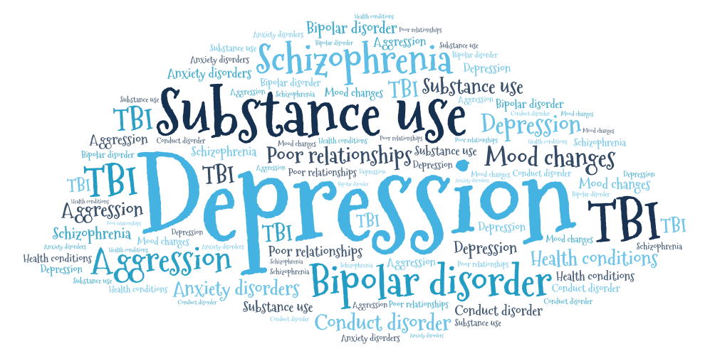
Health Factors
(Covert & Fraire, 2019)
Notes:
Health Factors: Mental health conditions & Symptoms
Depression, Substance use problems Bipolar disorder Schizophrenia
Personality traits of aggression, mood changes and poor relationships
Conduct disorder Anxiety disorders Serious physical health conditions including pain
Traumatic brain injury
We want to point to a few specific conditions that have emerged in recent literature that contribute to suicidal behaviors:
Anxiety Disorders including Social Anxiety and Generalized Anxiety Disorder (Covert & Fraire, 2019)
Anxiety Disorders are a major contributing factor. In particular, Social Anxiety and Generalized Anxiety Disorder (GAD) are thought to play a major role in placing youth at risk due largely to the experience of bullying and shaming that may prompt anxiety, but also due to comorbidity of anxiety disorders with depression. And, in a 2018 study [by Bilsen (2018)], it was reported that in 50-65% of suicide cases the individual met criteria for depression, which may not be that surprising because, when we think about contributing factors, we often think of depression.
Substance Use Disorders, specifically alcohol misuse, is strongly associated with suicide risk
Personality Disorders (Borderline or antisocial personality disorders) One researcher [Gould (2001)] in a 2001 study suggested that, in about 90% of suicides, the people who ultimately commit suicide suffered from at least one mental disorder. Though it was mentioned, not much in the literature about Antisocial PD).
Sleep disturbance is one of the most powerful predictors suicide outcomes. In other words, sleep complaints may be associated with elevated risk for suicidal ideation, suicide attempts, and death by suicide [ideation vs. attempt vs. death (Glenn et al., 2018)]. I might also mention that sleep problems are also quite prevalent in anxiety disorders. After controlling for depressive symptoms, poor sleep quality– due to insomnia (initiation and middle) or hypersomnia-- is significantly associated with an increased risk for death by suicide, suicidal behavior, and suicidal ideation. While some studies attempted to control for depressive symptoms, the link between sleep disturbance and mood disorders is almost inextricable.
Impulsivity, while the thought about suicide may develop over time, completed suicides often occur very unexpectedly, particularly in adolescents. Often the impulse that’s acted on is borne out of acute psychosocial stressors and the eventual act is not contemplated for long periods of time, but rather occurs impulsively.

Slide 12
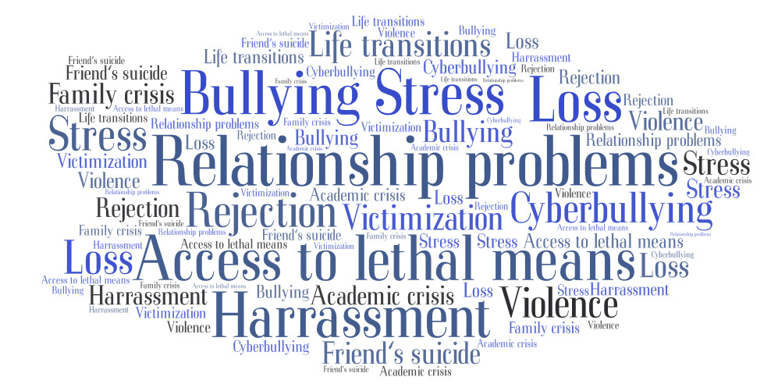
Environmental/Psychosocial Factors
(Bilsen, 2018; Tynes, et al., 2019)
Notes:
Environmental/Psychosocial Stressors
Prolonged stress, such as harassment, bullying, cyberbullying ,relationship problems
Stressful life events, like rejection, dignity, other life transitions or loss
Exposure to another person’s suicide, or to graphic or sensationalized accounts of suicide
Victimization/exposure to violence
Center crisis (disciplinary, academic)
Family crisis (abuse, domestic violence, running away, argument with parents)
Psychosocial stressors can be addressed through problem solving, however
Poor problem-solving effects the way young people deal with stressors: young adults may have dichotomous thinking (rigid, black/white, totally good or totally bad ways of looking at what challenges them). They also may have few memories of effective solutions or successful problem-solving in the past and, therefore, can’t see any other non-lethal solutions to their present concerns. The challenges can be overwhelming, and in JC students are often faced with many stressors including social, relational, and academic challenges.

Slide 13
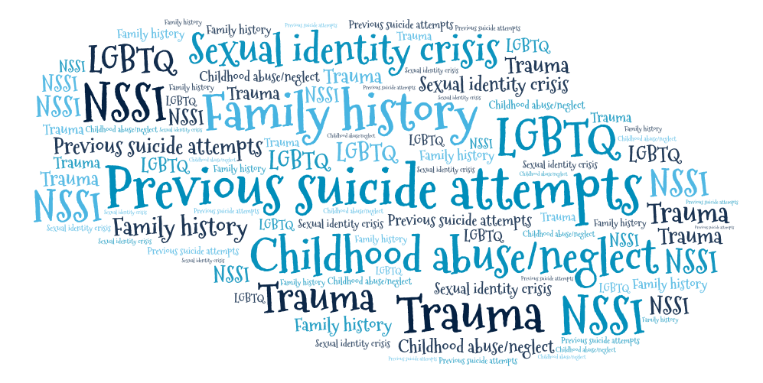
Historical/Identity Factors
(Zatti et al., 2017; Wilson et al., 2019)
Notes:
Historical Factors
Some historical factors that impact suicide are
Previous suicide attempts: 25-33% of all suicides are preceded by an earlier attempt
Family history of suicide
Non-Suicidal Self Injury
In young males, those with a previous attempt have a 30-fold increase in suicide risk compared with those who have not attempted
In young females, those with a previous suicide attempt have a 3-fold increase of suicide risk
As we assess our students, we should take special care to ask questions about prior suicide attempts especially when interviewing males. And, because students may be reluctant to answer candidly, this question should be revisited as greater rapport is established.
Sexual identity crisis
Youth who identify as lesbian, gay, bisexual, asexual, transgender, two-spirit, queer, intersex, non-binary, same-gender loving. LGBTQ+/SGL individuals are among those who belong to sexual minorities
Black & Hispanic/Latinx LGBTQ+/SGL youth have multiple identities which may increase their experiences of stress and isolation from their ethnic group and the LGBTQ+/SGL communities.
Research completed among sexual minority youth (SMY) found that Black and Latinx identities were associated with increased risk of suicide, but this elevated risk was not explained by mood or substance use disorders suggesting that Black SMY were at elevated risk for suicide attempts, even in the absence of traditional markers of depression.
TRAUMA
emotional, physical and sexual abuse, as well as violent victimization is related to suicidal ideation and attempts (Zatti et al., 2017; Wilson et al., 2019)
While there are many stressors that fall into this category, it may be more efficient to use the term TRAUMA.
TRAUMA: Can be experienced through adverse childhood experiences such as abuse and grief, but also exposure to racism, discrimination, neighborhood violence, and economic/housing insecurity to name a few. One recent study conducted an online survey of Black and Latinx adolescents found exposure to online racial traumatic events (e.g., seeing images or videos of others from their racial/ ethnic group being beaten) was associated with greater depression and post-traumatic stress symptoms which both have been associated with suicide risk (Tynes et al., 2019) –
Research of Black adolescents showed that, those who reported a history of trauma and adversity (e.g., physical abuse), were five times more likely to attempt suicide than those adolescents without a history.

Slide 14
Availability of Means as a Factor
The availability of an instrument to transition from suicidal ideation to actual suicide is crucial and can determine the lethality of the action.
Children: usually commit suicide by hanging, jumping from a high place or running into traffic.
Adolescents/young adults: use hanging, poisoning, and firearms (typically young men).
Notes:
There’s another Risk Factor that I want to talk about and, perhaps, it is one of the most obvious and fundamental components of suicide: Instrumentality, or Availability of Means
The availability of means when used to talk about suicide refers to the method that takes suicidal ideation to actual suicide and can be crucial in determining the lethality of the action.
For example,
Children: usually commit suicide by hanging, jumping from a high place or running into traffic
Whereas,
Adolescents/young adults: use hanging, poisoning, and firearms (typically young men)
As you can see in the descriptions, adolescents/young adults have access to different means of committing suicide and, therefore, may be more lethal
There’s one final Risk Factor I’d like to address and that’s Exposure to Modeled Behavior

Slide 15
Exposure to Modeled Behavior: A Risk Factor
Suicide Contagion
Notes:
If you recall from a Psychology 101 class, one way to modify behavior is to shape it through some method of reinforcement, physical guidance, or modeling. Suicide Contagion, as described by the CDC, is a process by which exposure to suicide or suicide behaviors of one or more people influences others to commit or attempt suicide. Here, “Suicide Contagion” refers to a type of modeling. This effect appears to be strongest among adolescents and young adults who are already vulnerable to suicide.
Pictures (5 seconds each)
For example…
Chester Bennington (2017), American singer and songwriter (Linkin Park), hanging, had struggled with drug abuse and depression
Lee Thompson Young (2013) a young star who took his life while struggling with bipolar disorder
Jadin Bell (2013), an Oregon teen who was taken off life support after he attempted suicide by hanging himself. He was driven to take his own life because he was bullied for being homosexual, according to his family.[
Goo Ha-ra (2019), South Korean singer and actress, former member of K-Pop group KARA, found dead at her home after being cyber-bullied by malicious commenters due to a scandal that involved her and her abusive ex-boyfriend.^{[109]}
Aaron Hernandez (2017), American football player and convicted murderer, died of suicide by hanging in his prison cell^{[121]}
Not surprisingly, media coverage of suicide has been associated the contagion effect.

Slide 16
Chester Bennington (2017), American singer and songwriter Linkin Park. His death occurred by hanging and he had struggled with drug abuse and depression.
Notes:
5 seconds

Slide 17
Lee Thompson Young (2013) a young star who took his life while struggling with bipolar disorder.
Notes:
5 seconds

Slide 18
Jadin Bell (2013), an Oregon teen who was taken off life support after he attempted suicide by hanging himself. He was driven to take his own life because he was bullied for being homosexual, according to his family.
Notes:
5 seconds

Slide 19
Goo Ha-ra (2019), South Korean singer and actress, former member of K-Pop group KARA, found dead at her home after being cyber-bullied by malicious commenters due to a scandal that involved her and her abusive ex-boyfriend.
Notes:
5 seconds

Slide 20
Aaron Hernandez (2017), American football player died of suicide by hanging.
Notes:
5 seconds

Slide 21
How Has COVID-19 Impacted Mental Health And Suicide Risks Among Youth And Young Adults?
Notes:
Val slides 21-33

Slide 22
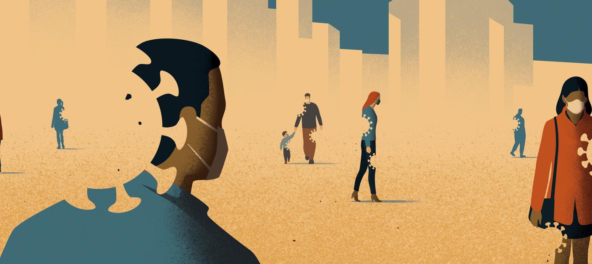
The Crisis within the Crisis
Spikes in interpersonal violence, suicide, and substance abuse!
“COVID-19 and Suicide: A Crisis Within a Crisis” published November 16, 2020. https://magazine.jhsph.edu/2020/covid-19-special-edition
Notes:
Historical parallels to the current public health crisis
25% of adults with no prior history of a mental health conditions experienced symptoms of psychological distress such as depression and sleep difficulties

Slide 23
How has your emotional health changed during COVID-19?

Slide 24
COVID-19 AND MENTAL HEALTH
Young adults, Hispanic persons, black persons, and those receiving treatment for preexisting psychiatric conditions.
Over 86 percent of 18-24 year-olds who took a depression screen scored for moderate to severe depression.
Centers for Disease Control and Prevention. Morbidity and Mortality Weekly Report. “Mental Health, Substance Use, and Suicidal Ideation During the COVID-19 Pandemic — United States, June 24–30, 2020” Accessed Nov. 21, 2020.
Mental Health America. “The State Of Mental Health In America”. Published Oct. 20, 2020. Accessed Nov. 20, 2020.
Notes:
From January to September 2020, over 86 percent of 18-24 year-olds who took a depression screen scored for moderate to severe depression

Slide 25
COVID-19 AND SUICIDES
The pandemic has created a convergence of suicide risk factors.
The perfect storm to put individuals and certain populations at higher risk of suicide.
Some groups that had an elevated risk BEFORE the pandemic could now be even more endangered.
Notes:
The pandemic has created a convergence of suicide risk factors that need a public health response.
The perfect storm to put individuals and certain populations at higher risk of suicide.
Some groups that had an elevated risk BEFORE the pandemic could now be even more endangered.

Slide 26
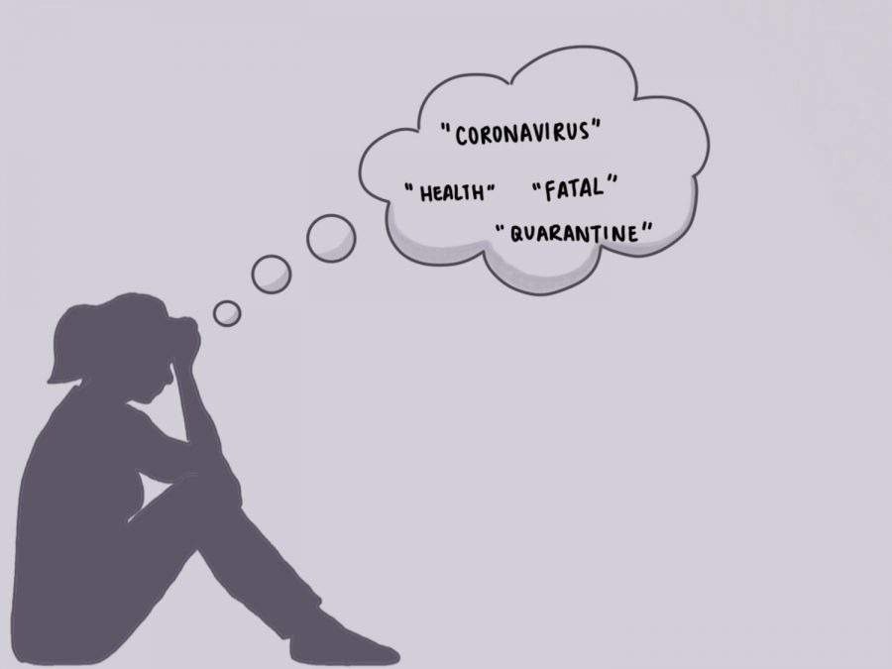
COVID-19 AND SUICIDES
The CDC has reported that at the end of June 2020, more than twice as many respondents reported seriously considering suicide in the previous month compared with adults in 2018.

Slide 27
Job Corps Suicide Data PY 2020-TD
Microcosm of a larger national crisis!
Region | Date of Incident | Method | Location | Race | Age | Sex | Notes
Reg 3 | 7/30/2020 | Gunshot | Off Center | Hispanic/Latino | 19 | M | COVID-19
Reg 4 | 9/23/2020 | Unknown | Off Center | White | 18 | M | COVID-19
Reg 6 | 10/8/2020 | Unknown | Off Center | American Indian/Alaska Native | 17 | M | COVID-19
Reg 4 | 10/19/2020 | Unknown | Off Center | White | 21 | M | COVID-19
Reg 5 | 12/7/2020 | Unknown | Off Center | Black/African American | 26 | M | COVID-19

Slide 28
Job Corps Opportunity For Suicide Awareness And Prevention
Notes:
Val

Slide 29
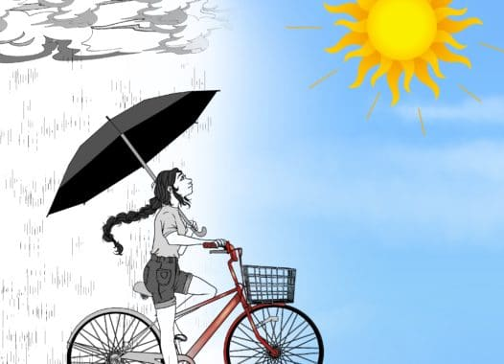
Grounds for Optimism
The pandemic is raising public consciousness of the importance of mental health.
The increasing availability of telemental health and virtual support.
Notes:
Val- Talking about mental health can reduce stigma and make it easier for students to seek help.

Slide 30
Suicide Prevention
Educating staff and students
Virtual environment and center culture that is SMART about Mental Health
Suicide Awareness Month
Depression Screening Day
Students are the EYES and EARS on/off center and on social media!
Notes:
Val

Slide 31
SUICIDE PREVENTION
Expand the MHWP with paraprofessionals ( counselors, residential staff, and peers)
Crisis/Help Lines
Use of evidence-based measures- C-SSRS, PHQ, GAD, ASQ
Evidence-based mental health responses—ranging from self-care strategies like meditation to formal treatments such as cognitive behavioral therapy
Culture and Gender
Notes:
Val
Cognitive behavioral therapy for suicide prevention article

Slide 32
Gender Specific Suicide Prevention Depression among Adolescent and Young Adult (AYA) Males https://www.partnershipformaleyouth.org/state-of-health-of-aya-males.html#_ftnref3
Depression is unrecognized, underdiagnosed, and misdiagnosed.
Depression is typically manifested by “externalization”.
Less likely to seek social support and more likely to try to distract themselves.
Promote help-seeking behaviors and other adaptive coping strategies in AYA males
Supplement self-report measures with one-on-one interviews to learn about their personal history.
Hearn, S. et al (2020). The State of Health of Adolescent and Young Adult Males in the United States. Unrecognized Depression: A Review of Research and Recommendations. Washington, DC: The Partnership for Male Youth
Notes:
Given these differences, many mental health prevention and intervention strategies and modalities could be more successful if tailored by gender.
Unrecognized Depression in Adolescent and Young Adult Males in the US.

Slide 33
Students in Distance Learning Off Center
WHAT CAN WE DO?
Notes:
Val

Slide 34
Notes:
Eugia
For students ON and OFF center we might observe these warning signs

Slide 35
https://supportservices.jobcorps.gov/health/Pages/COVID-19.aspx#mhr
Notes:
Eugia
National Suicide Prevention Designation Act Into Law
The National Suicide Hotline Designation will designate 988, as the new three-digit number for the National Suicide Prevention Lifeline, to be completed by July 2022.

Slide 36
Protective Factors Factors that make it less likely that students will consider, attempt, or die by suicide.
What are some protective factors?
Respond in Chat Box!
Notes:
Eugia
Contact with a caring adult
Access to and care for mental/physical/substance disorders
Awareness of crisis hotline resources
Strong sense of belonging and connection
Sense of positive connection or participation in a program
Restricted access to highly lethal means
Resilience/Positive self-esteem and strong problem-solving and conflict resolution skills
Cultural, spiritual and religious beliefs that discourage suicide and support self-preservation
Continue to remove access to means via thorough security checks and dorm room checks.
Consider break away rods for showers, closets, lockers.
Ensure students have information on national hotline.
*Free Wallet Cards- https://store.samhsa.gov/product/National-Suicide-Prevention-Lifeline-Wallet-Card-Suicide-Prevention-Learn-the-Warning-Signs/SVP13-0126

Slide 37
Suicide Assessment Evaluation & Triage
Identify Risk Factors
1
Identify Protective Factors
2
Conduct Suicide Inquiry
Ideations, Plan, Behavior, and Intent
3
Determine Risk Level/Intervention
Evidence Based Screening Tools
4
Outcome
Assessment of risk, rationale, intervention, and follow-up.
Off-center psychiatric evaluation
Possible MSWR
Notes:
Eugia
If CMHC or CP is not on center, student would be sent to crisis unit or ER for evaluation per center operating procedure. This model has been expanded to include the use of evidence-based screening tools for depression, anxiety, and suicide risk.
Patient Health Questionnaire – 9 (PHQ-9) and modified PHQ-9 for Adolescents
Generalized Anxiety Disorder Scale – 7 (GAD-7)
Columbia-Suicide Severity Rating Scale (C-SSRS)
Adolescent Suicide Assessment Protocol (ASAP-20)
Outcome
Assessment of risk, rationale, intervention, and follow-up.
Off-center psychiatric evaluation
Possible MSWR
Documentation.

Slide 38
Gate Keeper Training
New Students and Staff
SafetyNet
Trauma Informed Approach
Health Care Guidelines
Suicidal Threats and Behavior
Share this PowerPoint
Notes:
Eugia
Ensure CMHCs are conducting Gatekeeper training with ALL new students as part of CPP.
Training outline is on the Health and Wellness website.
Provide Gatekeeper training for non-health staff, especially the residential advisors, counselors, trade instructors, and academic staff at next all staff training and for new hires. There are many types of Gatekeeper trainings and one is Question-Persuade-Refer (QPR)
Anyone can learn to ask the right questions to help a depressed and/or suicidal student or staff member
Depression is an illness, like heart disease, and suicidal thoughts are a crisis in that illness, like a heart attack
You would not leave a heart attack victim lying on the sidewalk – many have been trained in CPR
QPR-SAMHSA’s National Registry for Evidence-Based Programs and practices (NREPP)
Ensure ALL staff complete the required annual online SafetyNet training per the Job Corps Program Instruction Notice 19-04: Promoting Student Safety Through Suicide Awareness and Prevention Reminder to Complete Mandatory SafetyNet Training.
TIA training for all staff – webinar available on the support services website
Review the Health Care Guidelines
Treatment Guideline for Health Staff and Symptomatic Management Guideline for Non-Health Staff for Suicide Attempts/Threats on the Health and Wellness website.
QPR Reference
Hangartner, R. B., Totura, C. M. W., Labouliere, C. D., Gryglewicz, K., and Karver, M. S. (2018). Benchmarking the “Question, Persuade, Refer” program against evaluations of established suicide prevention gatekeeper trainings. Suicide Life Threat. Behav. doi: 10.1111/sltb.12430 print].

Slide 39
How to Help Someone to Stay Alive
Listen to the problem and give them your full attention
Remember, suicide is not the problem, only the solution to a perceived insoluble problem
Do not rush to judgment
Offer hope in any form
Then say: “I’m concerned about you.”
Then ask:
“Will you let me help you get help?”
“I care about you and I want to take you to the Wellness Center to get more help…”
“I know you are not on center but will you let me make you an appointment with……today”
Notes:
Eugia

Slide 40
WHAT'S GOING ON? - RYAN'S STORY
Ryan - a 19-year-old who seemed to be doing well in distance learning initially. “When he was on center, he had friends, was a dorm leader and completed his GED before the COVID break. He really strived to be the very best that he could, since his father had died the past year and he wanted to be a good example for his younger siblings.
Since leaving the center, he needed to work and he filled out many applications, but just couldn't seem to get a job. His Mom thought that he should try harder and talked a lot about not having enough money. He was sounding more frustrated during calls and not keeping up with his JC work.
He talked about drinking. Ryan started to feel very anxious, sad, and desperate. He told his brother and sisters that "it just wasn't worth it anymore“.
Notes:
At-Risk Group:
Perfectionist
Financial Pressures/No job
Warning Signs:
Recent loss (father)/ Traumatic event
Depression (sad, anxious, desperate)
Change in chemical use
Verbal Warning:
"It just isn't worth it.“
Went for drive. His pickup was found, totaled. He had been thrown 50 feet and died instantly of a broken neck.

Slide 41
Suicide prevention is EVERYONE’S job.
Train staff and students to recognize the suicide warning signs and how to get students or other staff help.
Email/Distribute the CopeUp! Handout with coping strategies and helplines/peer texting.
If concerned about a student REFER them to Wellness/CMHC
Use evidence based mental health screening tools and treatment approaches.
DON’T BE AFRAID TO ASK THE SUICIDE QUESTION!
CULTURE AND GENDER MATTER!
Notes:
Val
Lead- system-wide culture change committed to reducing suicides
Train- a competent, confident, and caring workforce.
Identify -individuals with suicide risk via comprehensive screening and assessment
Engage -all individuals at-risk of suicide using a suicide care management plan
Treat -suicidal thoughts and behaviors using evidence-based treatments
Transition-individuals through care with warm hand-offs and supportive contacts
Improve- policies and procedures through continuous quality improvement

Slide 42
Notes:
Val

Slide 43
Gatekeeper Training
November 26, 2019
​Suicide Prevention In Job Corps — What’s Going On And What Can We Do About It?
Webinar slides with audio
Handout: Suicide Prevention Resources
Job Corps Webinars
43
Notes:
Val
Staff and student roles as gatekeepers in suicide prevention and intervention
Gatekeepers are responsible center staff who spend time with students that might be vulnerable to depression and suicidal thoughts and student peers.
Research indicates that gatekeeper training can impact four important factors—knowledge, perceptions about depression and suicide prevention, reluctance, and self-efficacy—and that changes in these factors can influence intervention behavior.
There are several programs: SOS, QPR, MHFA, Psychological First Aid and more!

Slide 44
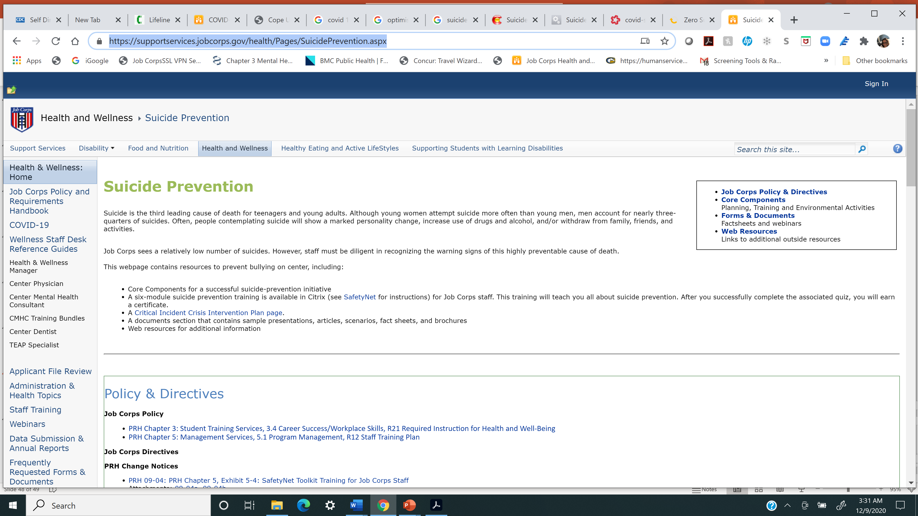
SUICIDE PREVENTION WEB PAGE
Notes:
Val- 5 sec

Slide 45
Helplines
Trevor Project
866-4-U-TREVOR
https://www.thetrevorproject.org/
National Lifeline
800.273.TALK
Suicide Prevention Resource Center(SPRC)
SPRC
Notes:
Val- 5 sec

Slide 46
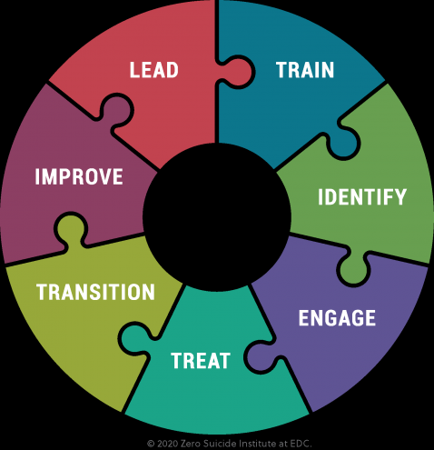
THE ZERO SUICIDE TOOLKIT
https://zerosuicide.edc.org/toolkit/zero-suicide-toolkit
Notes:
Val
Lead- system-wide culture change committed to reducing suicides
Train- a competent, confident, and caring workforce.
Identify -individuals with suicide risk via comprehensive screening and assessment
Engage -all individuals at-risk of suicide using a suicide care management plan
Treat -suicidal thoughts and behaviors using evidence-based treatments
Transition-individuals through care with warm hand-offs and supportive contacts
Improve- policies and procedures through continuous quality improvement

Slide 47
COVID GUIDANCE: Screening for Suicide Risk during Telehealth Visits
COVID SUICIDE SCREENING FOR TELEHEALTH
Notes:
Val
In 2018, the National Action Alliance for Suicide Prevention (Action Alliance) published Recommended Standard Care for
People with Suicide Risk: Making Health Care Suicide Safe. The report suggested suicide screening, with indicated care as needed, for all individuals receiving
care for behavioral health conditions as a core responsibility for health care organizations
An Addendum to the 2018 Recommended Standard Care for People with Suicide Risk: Making Health Care Suicide Safe. The COVID-19 pandemic has prompted a rapid shift
from traditional face-to-face health care encounters to various forms of virtual care, including telephone encounters, video encounters, asynchronous or “chat”
Meetings.
.

Slide 48
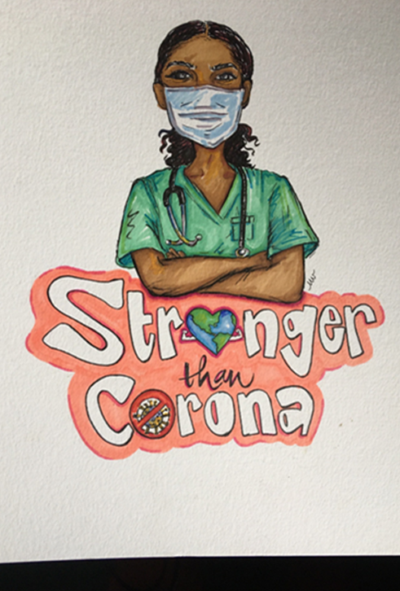
Questions?
Notes:
Val and Eugia

