Slide 1
Making Anxiety Work for You
Helena Mackenzie, PhD & Julie Klinger-Luht, MPH
This Photo by Unknown Author is licensed under CC BY-SA-NC
Notes:
Helena
Decided to do this webinar prior to coronavirus pandemic and the killing of George Floyd last week and it seems even more necessary than ever to have a webinar on anxiety right now. All in tough space.

Slide 2
What makes you feel anxious?
This Photo by Unknown Author is licensed under CC BY-SA
Notes:
Julie--- ask Helena what makes her feel anxious
Start with chat box question: What makes you feel anxious? What frightens you or makes you feel stressed or afraid? (chat box)

Slide 3
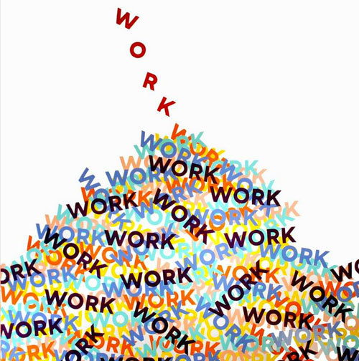
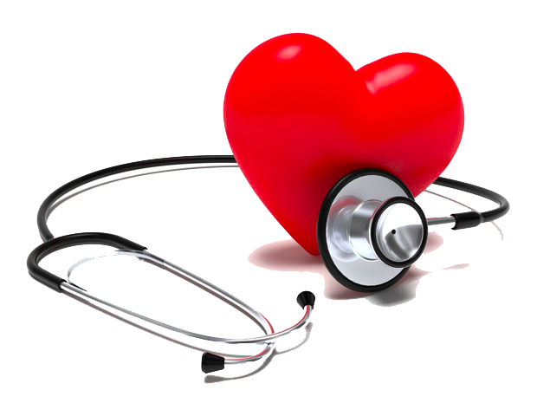
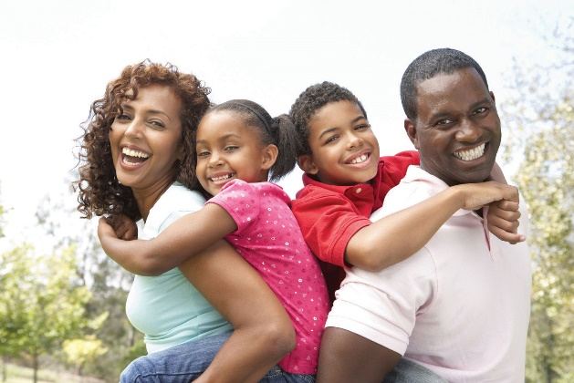
Notes:
Helena
Surveys prior to COVID-19 indicate top things that people worry about are money, work, economy, family responsibilities, health. With other worries include healthcare, relationships, violence/crime, and climate change.

Slide 4
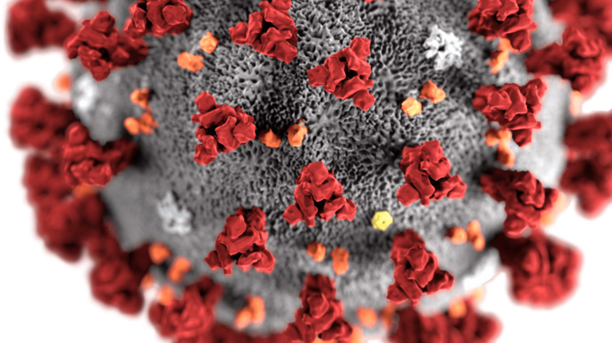
Current Events
This Photo by Unknown Author is licensed under CC BY-SA
Notes:
Helena
And then there's current events such as COVID-19—which has exacerbated many of the usual things we worry about--now anxious about whether we or loved ones get ill; what will happen to the economy; whether we'll lose our jobs? I live in the twin cities and, as you all probably know, our community was upended last week with the police killing of George Floyd, which has led to peaceful protests, as well as looting, fires and destruction of businesses that were already struggling with the pandemic. There is so much going on right now that makes people anxious.

Slide 5
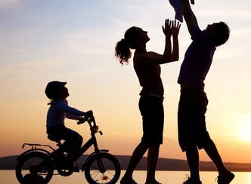
What do you care about?
This Photo by Unknown Author is licensed under CC BY-SA-NC
This Photo by Unknown Author is licensed under CC BY-SA
This Photo by Unknown Author is licensed under CC BY
Notes:
Helena-ask audience and ask Julie what she cares about
When feeling overwhelmed by anxiety and worry, it can sometimes be helpful to step back and ask: What do you care about? What's most important to you in life? (chat box)

Slide 6
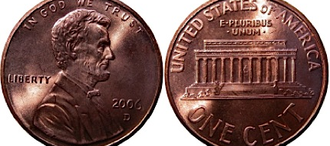
What we care about and what we fear.
This Photo by Unknown Author is licensed under CC BY-ND
Notes:
Helena
We often find that we worry about and what we care about are two sides of the same coin. Reflect on the things that create anxiety (work, relationships, children, social justice, climate change). Those very things are what matter to us, what make our lives rewarding and full. My husband recently reflected that if we didn't have kids, we wouldn't have any anxiety. But we obviously, most days, don't want to get rid of the kids...and I reminded him before kids I worried about whether I'd ever finish graduate school and he worried about work projects...maybe we begin to recognize that we can't get rid of worry or anxiety...

Slide 7
What does anxiety do for you?
It motivates me.
It shuts me down.
It makes me angry.
d. It takes away my energy.
e. It keeps me up at night.
f. It makes me want to run away.
Notes:
And, yet when we're anxious, we tend to respond in certain ways, some of which aren't helpful...What does anxiety do for you? (chat box vote)

Slide 8
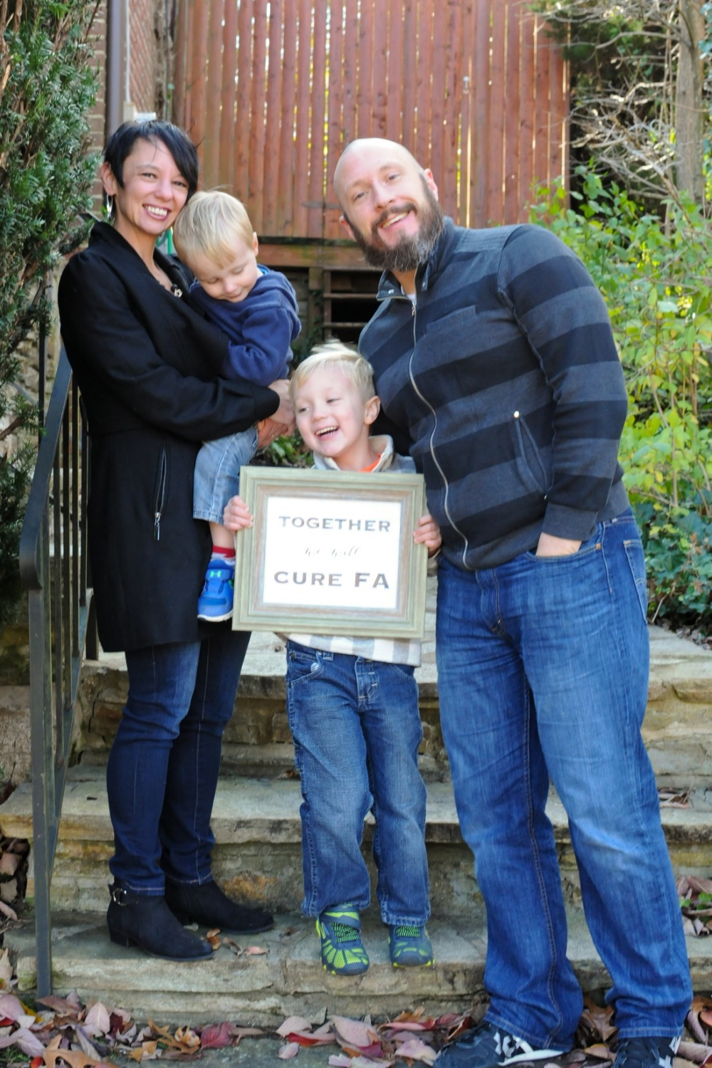
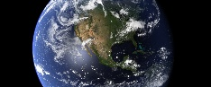
Julie’s Story
Notes:
I've always had my fair share of anxiety. It's come and gone throughout my life. I remember getting sick in the morning before going into my 3rd grade classroom, I was so nervous about what the day would bring.
The last couple of years have been pretty intense for my anixety. This story begins in the summer of 2018. It had been raining everyday for two weeks. One morning my husband and I were awoken by a loud crash at 6 am. We looked around the house and couldn't see anything wrong.

Slide 9
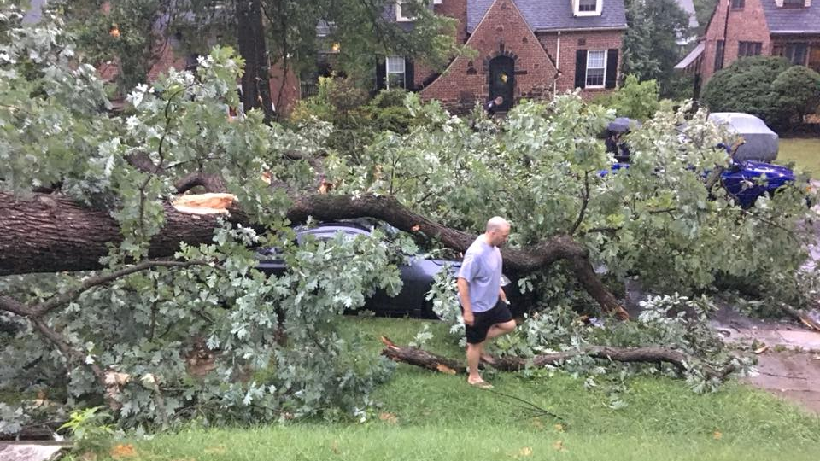
Notes:
My husband opened the front door. There was usually a huge oak tree blocking of view of the street. It wasn’t there. We walked outside and saw this.

Slide 10
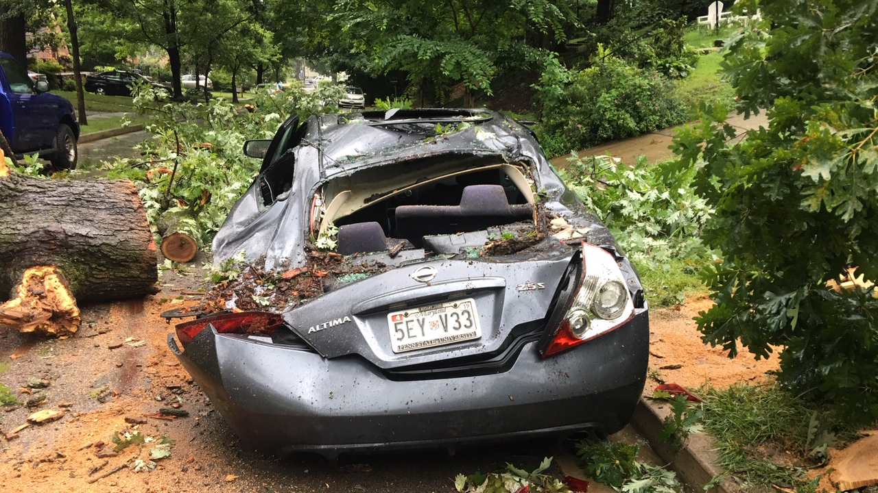
Notes:
- what was left of my car
- if it had been a monday or thursday I would have been in my car getting ready to head to work.
- I'm super lucky. And that's how I felt that day.

Slide 11
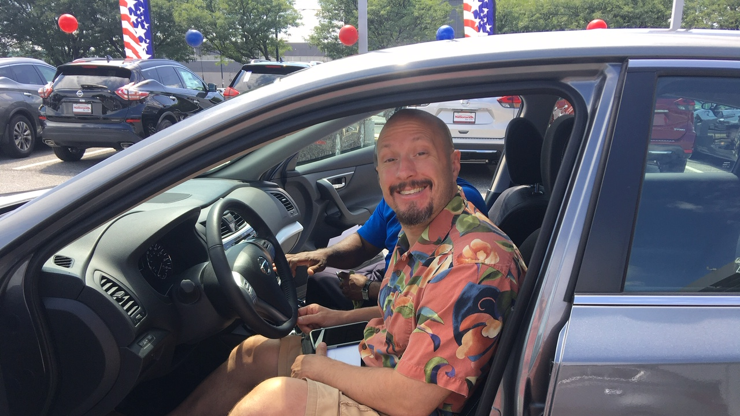
Notes:
Because everything turned out alright. Insurance paid. We got a new car. Everything was fine.
Until it wasn't.
I kept seeing news articles on climate change. Climate change causes more rain. It has a particularly bad effect on oak trees. I had two other oak trees in my yard. What if they fell?

Slide 12
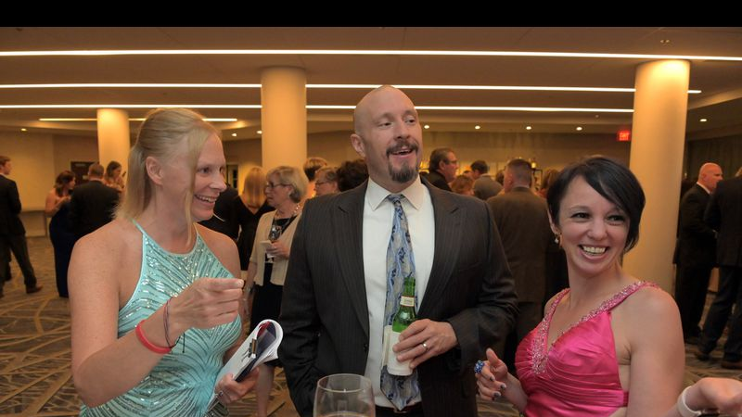
Notes:
I look happy here, but this was the beginning of my panic. My husband and I were at this LLS gala, raising money for blood cancer. We got to the gala a little early, and we at the bar chatting.

Slide 13
Notes:
He mentioned an article he read about 2030 being a very important deadline in making large-scale changes. Or we’re all doomed, right? That’s really close.

Slide 14
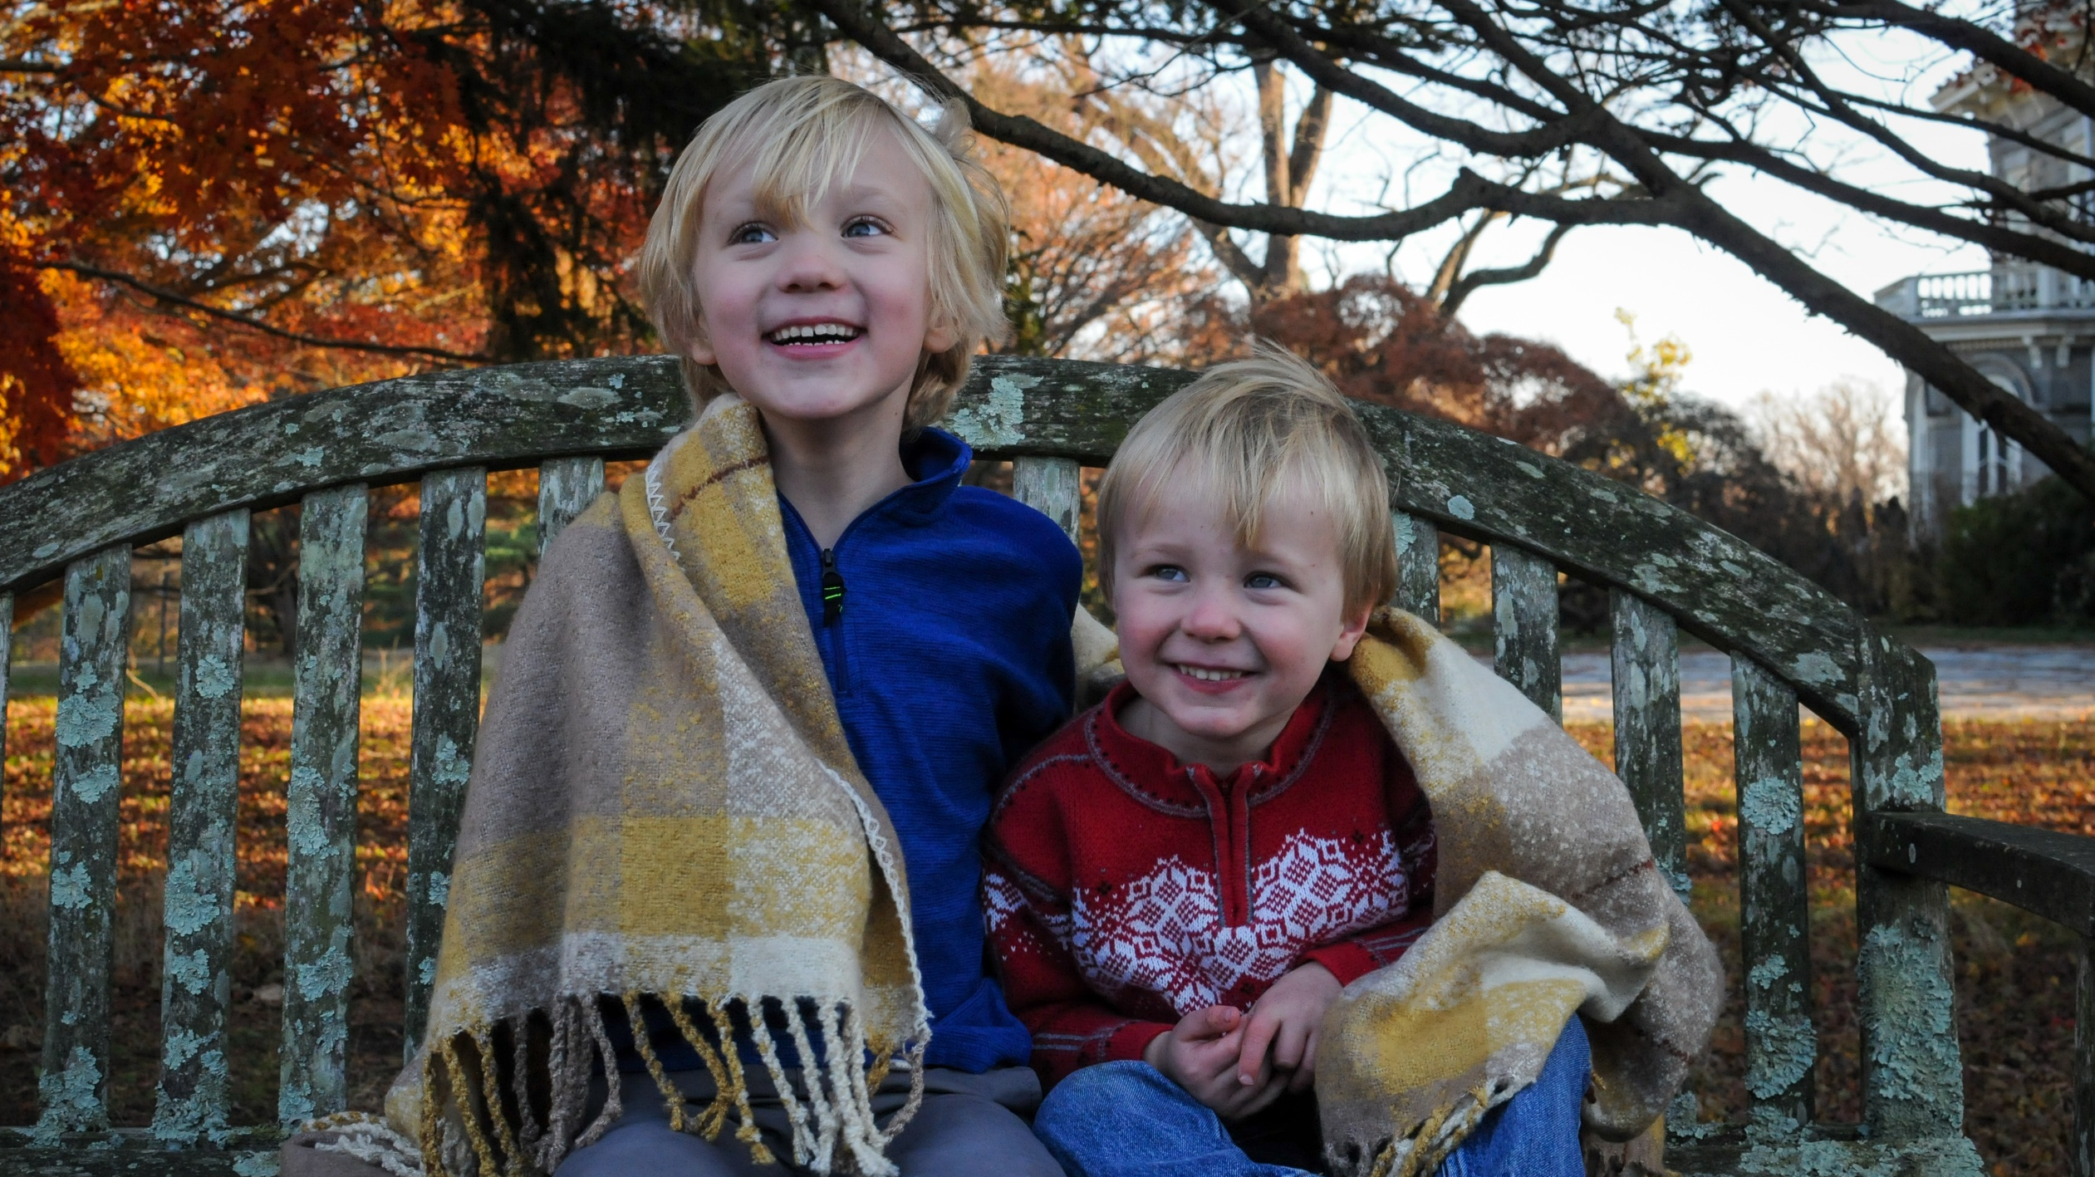
Notes:
Then we started talking about our boys. Perry is 6 and finishing first grad. Maddox is 4 and in preschool. They are going to be teenagers in 2030. This isn’t some far off distant future. I mean, we’re saving for college already, why not try to avoid going extinct while we’re at it?
I spent the next week really struggling with this. Every time I looked at my boys, I just felt despair. It was like we’d all received a terminal diagnosis. And I didn’t tell anyone. I just got stuck in my head. Paralyzed by this.

Slide 15
We fear things that we perceive as threats. Stress response can be super uncomfortable
This Photo by Unknown Author is licensed under CC BY
Notes:
Most of us can relate to the intense anxiety Julie felt, whether because we've been through a traumatic event ourselves, share her climate change anxiety, or feel afraid of the current pandemic, or frustrated with racial injustice and generally feeling overwhelmed and anxious about the future. When we perceive a threat or think about frightening things, our bodies tend to kick into a stress response, which can be really uncomfortable and it's one of the reasons anxiety we tend to hate anxiety and see it as a "negative"emotion.

Slide 16
Evolution
This Photo by Unknown Author is licensed under CC BY-ND
Notes:
It's important to remember that anxiety and fear evolved millions of years ago and were actually our best friends—they kept us alive. Imagine that you’re an early human happily gathering berries on the savannah and a saber tooth tiger shows up. Those who had a strong fear response—survived. They had the adrenaline and cortisol rush that got them out of there before they were eaten. So the fear response—fight, flight, freeze, faint—is really important—our heart racing, rapid breathing, muscle tension, sweating, hypervigilance, rumination/honing in on danger, all helped us survive and not be eaten, but....

Slide 17
Our Threats Have Changed
This Photo by Unknown Author is licensed under CC BY-NC-ND
Notes:
Problem today is that the world has (thankfully) changed, but our stress response hasn't. While our stress response is great at protecting us from true immediate danger (e.g. run away from wild animal), most of the things we fear today and that keep us up at night don’t fit into the "immediate danger" category. Sometimes we have a faulty smoke alarm, like situations where...
1) We imagine a threat, but it's not really something that's life threatening: (performance anxiety--Helena: before give presentation my mind perceives threat and my body responds by--heart racing, hand shaking, dry mouth, restless. Super uncomfortable. Our minds can’t tell the difference between something we’re imagining or something that's actually happening.

Slide 18
Lemon Exercise
This Photo by Unknown Author is licensed under CC BY-SA
Notes:
To get a sense of this...EXERCISE: Lemon—imagine you’re holding a lemon in your hand, notice the intense yellow color and how firm or soft it is. Now imagine bringing it up to your nose and scratching the rind a bit and soaking in the aroma of lemon. Now imagine cutting open the lemon and seeing the juice and seeds inside. Pick up a lemon wedge and imagine squeezing the juice on your tongue and the tart flavor. What did you notice? (chat box!!) If we’re really able to pull up that sensory experience in our imagination, our bodies respond as if there is actually a lemon. You might have noticed yourself beginning to salivate.
SO: when our anxious mind pulls up a fear of something in the future (like being hospitalized with COVID and dying alone), our bodies can’t tell the difference between an imagined threat and a real threat—we will feel scared, our fight and flight system may kick in. We might panic and spend weeks or months not sleeping, ruminating, and agonizing over something that never happens.

Slide 19
Survival Instinct
This Photo by Unknown Author is licensed under CC BY-SA-NC
Notes:
2) Second kind of situation where our stress response kicks in is when there's an actual threat or problem that exists today, but it’s not an immediate personal danger (e.g. impact of climate change, having realistic worries about becoming ill from COVID19; ). These are real problems that will increasingly impact us in the future if we don't problem solve and take action now (so we don't want to ignore our anxiety!). But, these are situations where having our bodies kick into a flight or fight or highly anxious response isn't helpful because...

Slide 20
“I can’t think”
This Photo by Unknown Author is licensed under CC BY-SA-NC
Notes:
We DON’T think or problem solve well when we’re highly anxious or in fight/flight mode. In fact, as all the blood is running to our big muscles and heart, our brain gets very little so we are not our best selves—we tend to snap at people, get irritable, angry, aggressive, defensive, ruminate, avoid things, try to control things we can't control, get defensive, or stuck in inaction. And overtime we get depleted.

Slide 21
Drop The Struggle
Notes:
What's the way through? What if we can change our relationship with anxiety, fear and stress. Not see anxiety or stress as something that we necessarily need to struggle with and get rid of or fix, or fight against or numb out from. But as something that is normal and will likely happen when we take risks, step outside our comfort zone, or confront things that are frightening and complex, but that need to be addressed (global warming, COVID).

Slide 23
“Negative emotions are a call to action.” –The Subtle Art of Not Giving a &%^!
This Photo by Unknown Author is licensed under CC BY
Notes:
Helena and I are actually going to spend the rest of this hour trying to convince you that anxiety is a good thing, as long as you harness it correctly.
Last summer, we read this book in my book club. At this point, I was going through all of this anxiety, and starting to come out the other end- which we'll get to in a few minutes. I saw this quote and it stuck with me. "Negative emotions are a call to action." What if, every time we feel bad about something, that negative feeling is there to get us to do something?

Slide 24
How to Make Anxiety a Friend, Not Enemy... Concrete steps
This Photo by Unknown Author is licensed under CC BY-SA
Notes:
So...How to Make Anxiety a Friend Not an Enemy in FIVE steps.

Slide 25
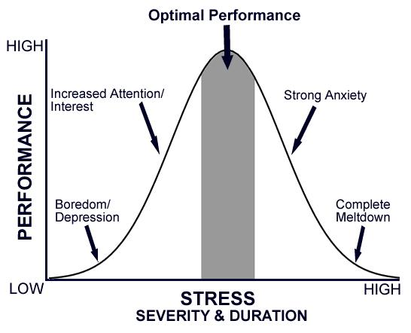
Find the Sweet Spot
Notes:
One big picture thing to keep in mind is that Making anxiety work for you relies on one overarching thing—finding the sweet spot--where anxiety is motivating without being debilitating. Where anxiety doesn't have to be a "negative" emotion, even if it's still a "difficult" emotion to sit with. How do we do this?

Slide 26
Step 1: Notice and Label Your Feelings
This Photo by Unknown Author is licensed under CC BY-ND
Notes:
-identifying and understanding your emotions clearly is the first step
- being unaware feelings or denying these feelings may prevent you from using emotions effectively (Gohm, Corser, & Dalsky, 2005).
I've done this with my kids since they were toddlers to help them communicate about their emotions. I said the name of the emotion and had them make a face. Both of my kids can call on this pretty easily now and label their feelings with specific words like frustrated on annoyed, vs more vague feelings like happy or sad.
Journal or chat box.

Slide 27
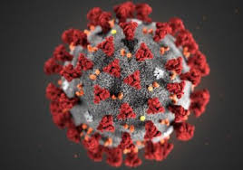
Anxiety is Normal and Natural Right Now
This Photo by Unknown Author is licensed under CC BY-ND
Notes:
Apply this to COVID-19 (or recent police violence): remember it's normal and natural to feel anxious. There is nothing wrong with you for feeling anxious during a time of uncertainty, ambiguity, loss, change, and physical distancing. It's normal to worry about the economy or job security or how long this will last, or what the future will look like. So, it's important to know that it's okay to feel anxious and that you're NOT alone in it. Label your anxiety and try to accept it's there and it's okay.

Slide 28
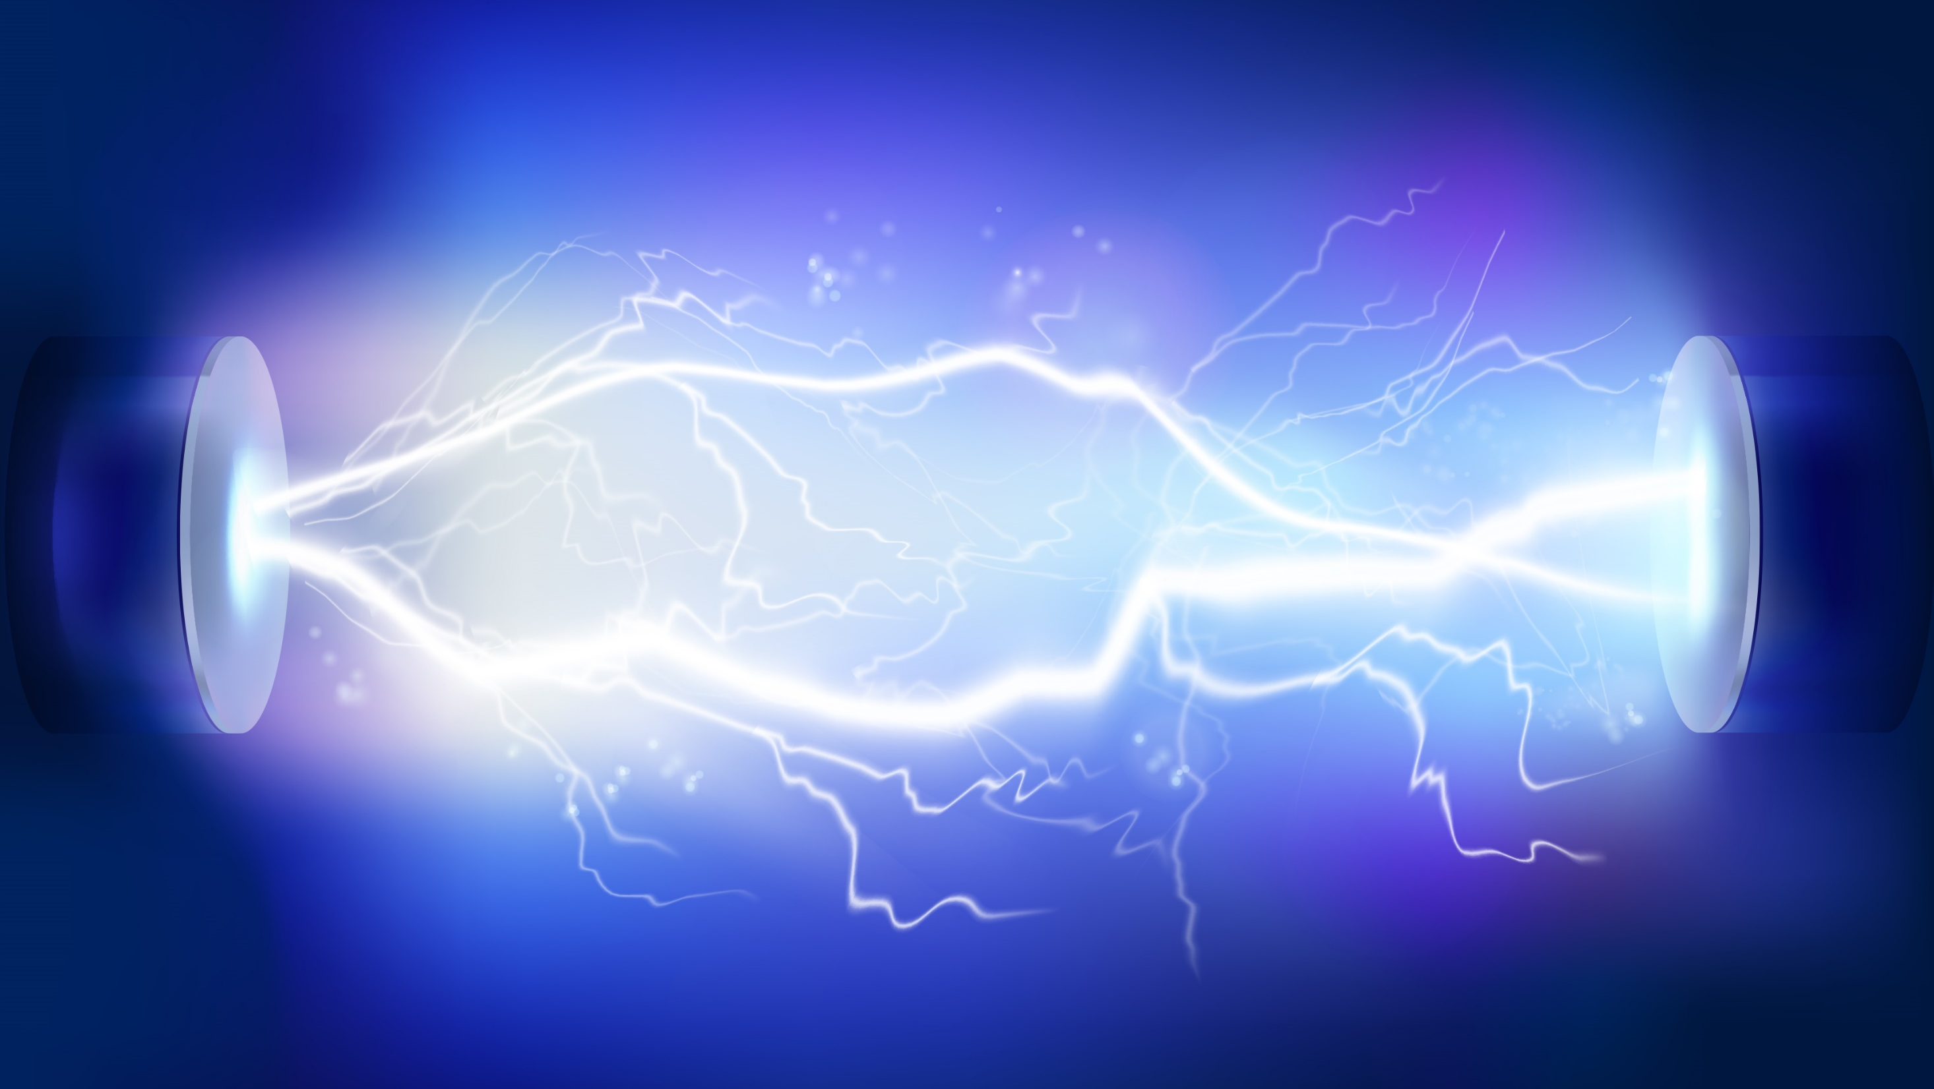
Step 2: Draw on the Energy that Stress Provides
This Photo by Unknown Author is licensed under CC BY-SA-NC
Notes:
When we asked you what anxiety did for you, I noticed a lot of you said that it kept you up at night. You are familiar with this energy, especially at 3 am. This is the flight or flight and it’s really normal.

Slide 29
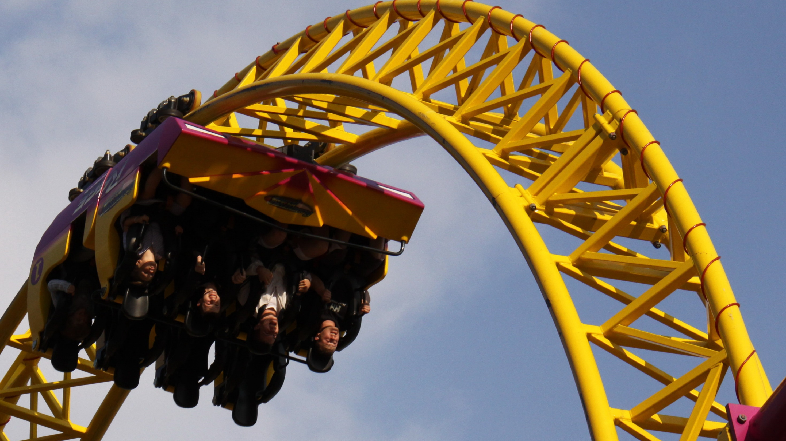
Eustress = Positive Stress
This Photo by Unknown Author is licensed under CC BY-SA
Notes:
We all actually seek out the energy stress provides. Stress can clearly be positive. We like to be a little scared. We like to take on challenges. In the chat box, tell us what types of exhilaration you seek out.
Helena, what stressful situations do you seek out? (adventure/travel without clear plans; intellectual challenge—figuring something out)

Slide 30
Notes:
Here's mine. I like to do obstacle course races. This is me climbing a rope at the Ocean City Maryland Spartan race.
This particular race is a 5k with 23 obstacles. At every challenging obstacle, like the rope climb, I get a little nervous, even though I've done a lot of races.
I'm actually nervous a lot leading up to this too. Sometimes I have trouble sleeping the night before. I'm jittery and have butterflies in the morning. This isn't necessarily a positive feeling.
Why do I do this? After it's over, I can't wait until the next one. I feel accomplished and strong, and when I look back on it, I describe it as fun, even though it doesn't feel that way at the time.
This anxiety is a rush. It makes me perform better. I'm faster and stronger during a race than I am in real life.
Have them reflect on their own thrill seeking.

Slide 31
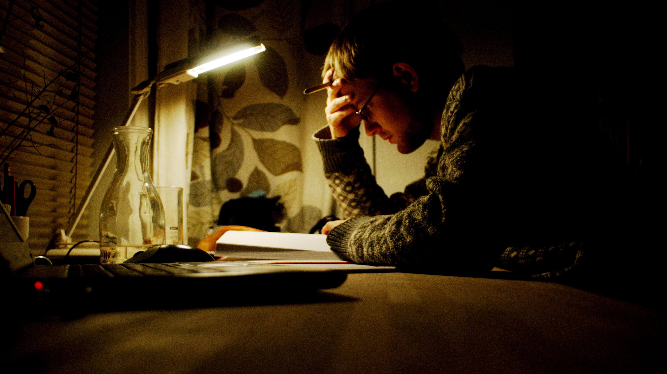
This Photo by Unknown Author is licensed under CC BY-NC-ND
Notes:
In a little more of a mundane way, we all know this energy on a regular basis.
Most of us are familiar with the experience of feeling motivated when we’re on a deadline. That feeling you got in school when you had a test the next day and weren’t prepared for it. That’s anxiety motivating you.
“feeling anxious about a deadline helps me to get the work done on time” and “feeling anxious about my goals keeps me focused on them.”

Slide 32
A Positive Mood Undermines Performance
Notes:
Positive mood can undermine performance
- good move = intense effort is unnecessary
- esp if doing the task would undermine a good mood
There's obviousy a place for a good mood. It's all about finding a balance.

Slide 33
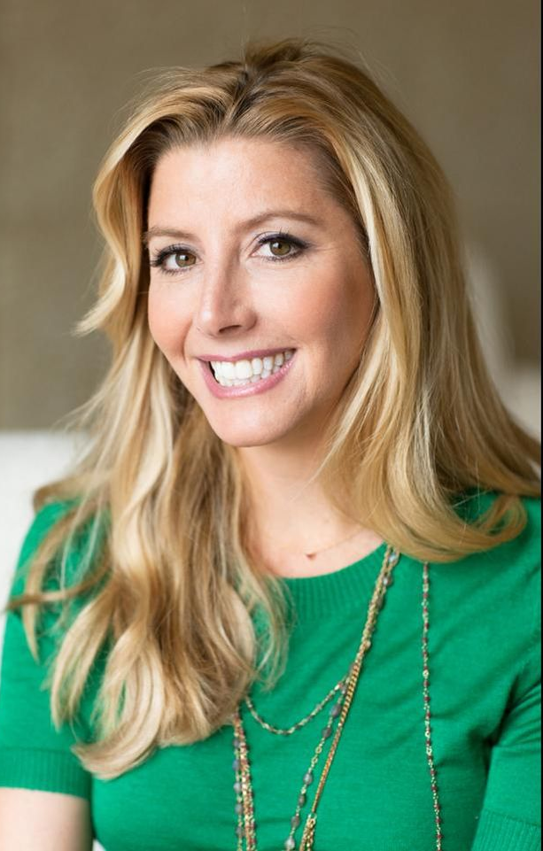
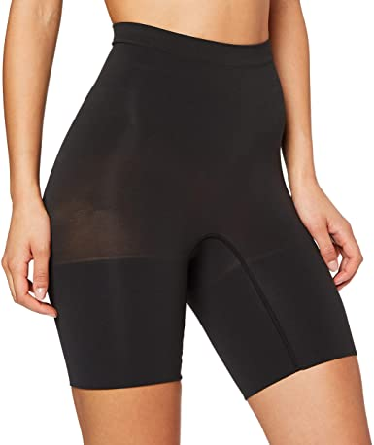
Notes:
This is Sara Blakely the creator of Spanx. Helena and I both listened to her on the "How I built this podcast." Before inventing Spanx, Sara sold fax machines door to door. She said it was the most miserable job. Her father urged her to go work somewhere corportate, but she stuck it out with selling fax machines.
In Sara's words:
"And I know this sounds crazy, but when I was selling fax machines door to door, I kept feeling like I'm in the wrong movie. You know, like, where's the director? Where's the - where's the producer? This is not my movie. And I was really determined to create a better life for myself."
She goes on to say that she credits this terrible job and place she was in with her success. If she had been content, she wouldn't have worked so hard and she wouldn't have had her success.

Slide 34
Notes:
Anger=confront rather than run away, anxiety prompt for positive emotion
Fear and anger lead to greater perseverance
Assertive – point for interation
Idea that connecting to anger that arises from anxiety can be empowering if channeled the right way—for people who tend to have difficulty with assertiveness (e.g. the flight and freeze responders), anger can be fuel to step up and stand up for themselves or what they believe in. However, for people with anger management problems (the fight stress response) need to be careful how anger from anxiety is channeled (aggression). Punch today in the face, but not the person you're angry with.

Slide 35
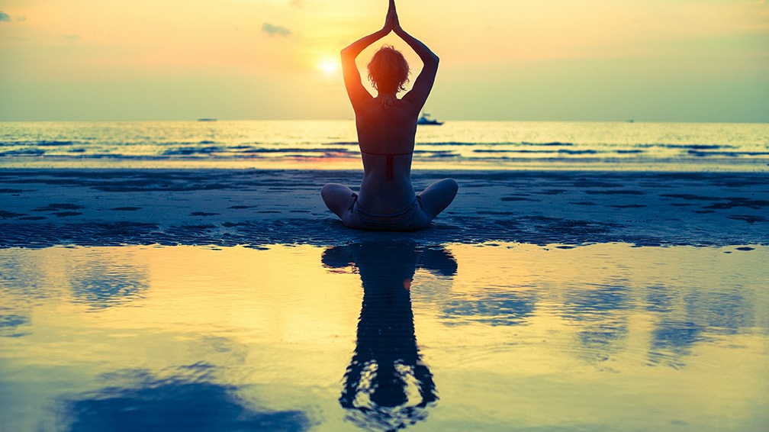
How To Draw On Anxiety Energy
Calm Your Nervous System/Release Body Stress.
This Photo by Unknown Author is licensed under CC BY-NC-ND
Notes:
How do we balance the energy of anxiety and the stress response that can make us feel overwhelmingly activated or shut down at times. How do we use or channel it?
If in stress response (activated—fight, flight): help your brain know that you are physically safe at this moment, soothe the brain so it knows you don’t need fight/flight response by calming the nervous system:
"Rectangle" breathing (next slide)
3 senses exercise (come back to present): I am safe now
Mindfulness
Soothing imagery
Cuddling w/ animal or someone you love

Slide 36
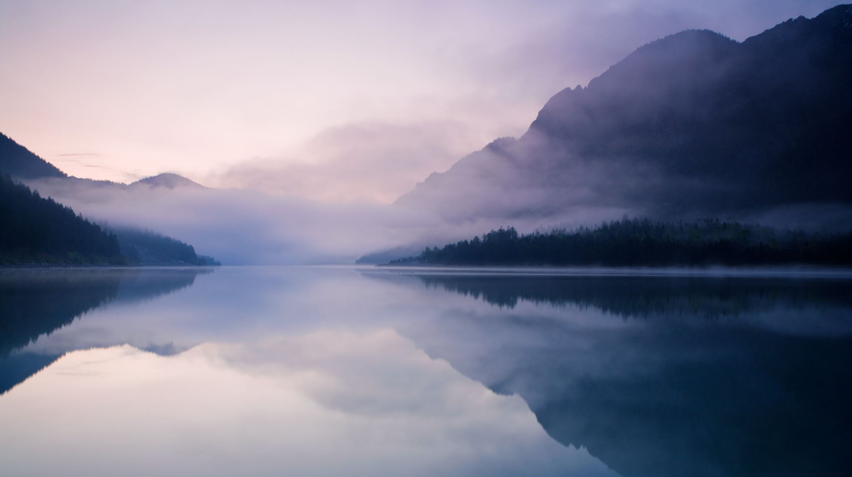
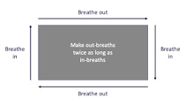
Notes:
Rectangle breathing—similar to square breathing, but simpler. Start bottom left corner. Deep breath in (count of 4), longer exhale....count of 6), repeat.
Sometimes, we get so overwhelmed by anxiety and fear that we freeze or become paralyzed. Most important thing at those times is to MOVE: shift in your seat, get up, go for walk, jog, dance. MOVE.

Slide 37
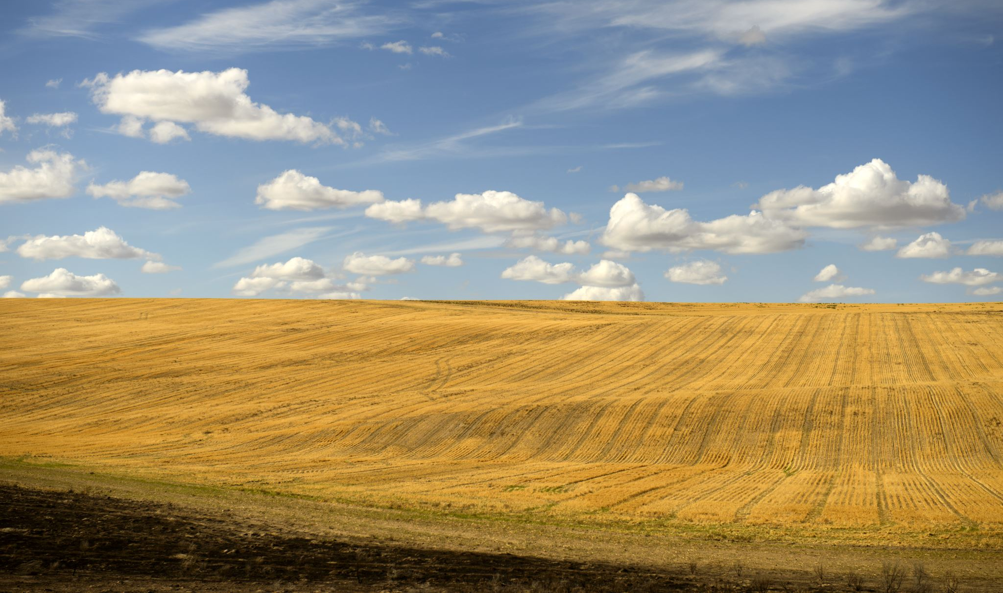
Step 3: Notice your thoughts: "Decatastrophize"
Notes:
Step Three: check in with your thoughts... remember that the mind hates uncertainty and tends to create a lot of "what-if's" and worst case scenarios when faced with ambiguity. Ruminating on things that may never happen or are not within your control isn't helpful and leads to more anxiety and pain. Recently, paralyzed by anxiety around what kind of future I'm leaving my kids—climate change, injustice and intolerance, utterly overwhelmed. Skills to help "decatastrophize:"
Call it out when you're doing it--name your anxiety/worries--say "I'm having catastrophic thoughts right now" or "I'm worrying about something that may or may not ever happen. This isn't helpful" And bring yourself back to the present (look around you what do you see?).
Get some space from your thoughts by imagining your thoughts are floating by on fluffy white clouds—they're separate from you—they're not you and they're not necessarily true or helpful.
Some Simple concrete strategies that can also help:
Worry box/tree/journal;
Daily set aside 10-20 min to "worry." No problem solving, just writing down worries. If you have worries at other times, let it go, remind yourself you'll write it down during your worry time.

Slide 38
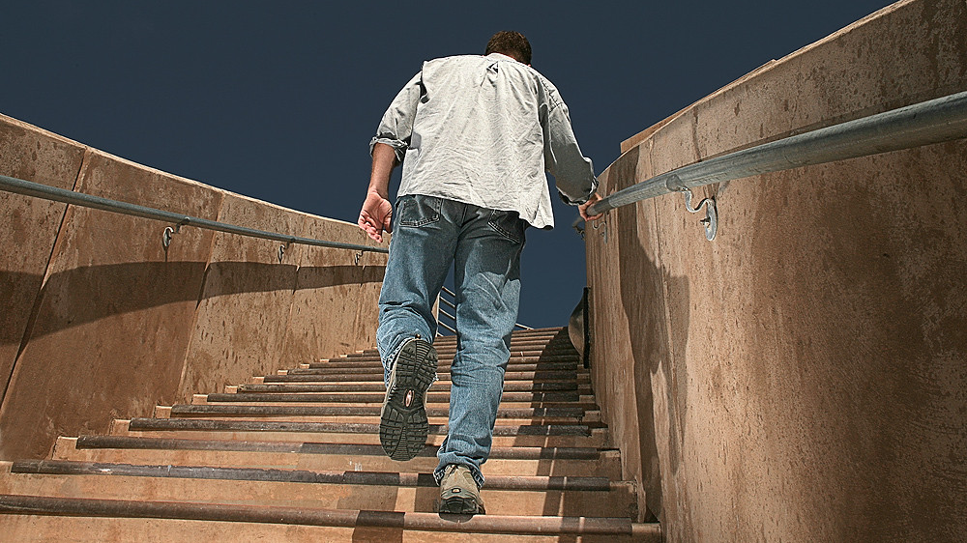
Step 4: Take Action
This Photo by Unknown Author is licensed under CC BY
Notes:
Just do it.
It’s inevitable and part of the routine.
Take away its power.

Slide 39
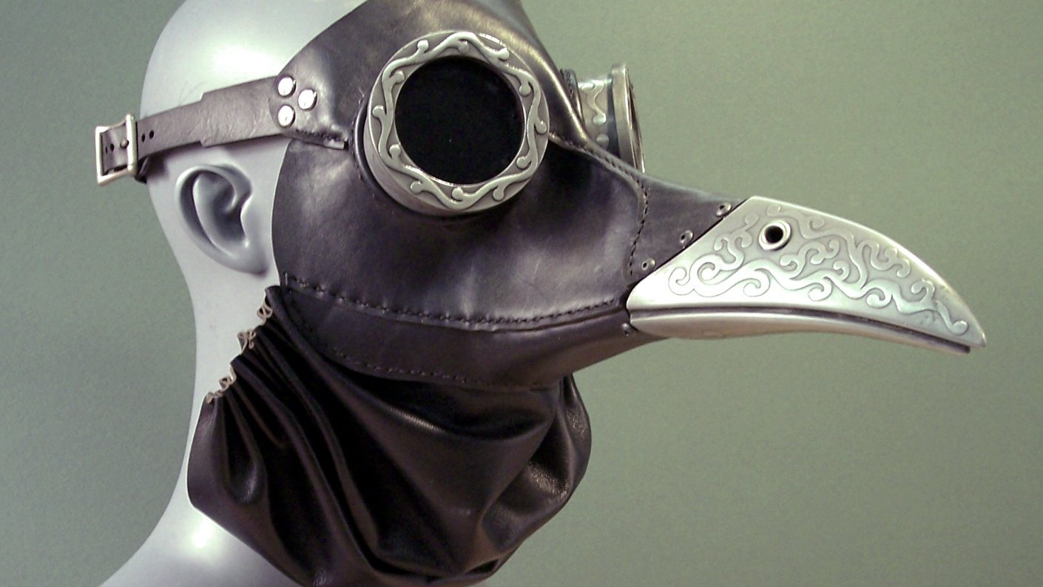
How about with COVID-19?
Take Action Based on What's Important to You
This Photo by Unknown Author is licensed under CC BY-NC-ND
Notes:
Remember anxiety and the two sides of the coin? When we're anxious about something—we can ask ourselves what's important behind that anxiety and then take action related to that rather than focusing on the anxiety.
For instance, one ongoing worry over the last few months has been on whether my mom, who lives in the epicenter of where the pandemic started—Kirkland, WA (and then my sister when she tested positive) will be okay. I realize my anxiety is all about my love for them and wanting to have time with them. I also know that I can't "protect" them from COVID and if I try to control something I can't control, I'll end up feeling more anxious and overwhelmed. So I've started reaching out to them in creative ways more than I normally would. I've taken my anxiety, understood it's about love and connection, and acted on that. Regarding COVID-19 or police brutality, or other current worries, where can you take action when you feel anxious (chat box) and then show chart on next page....

Slide 40
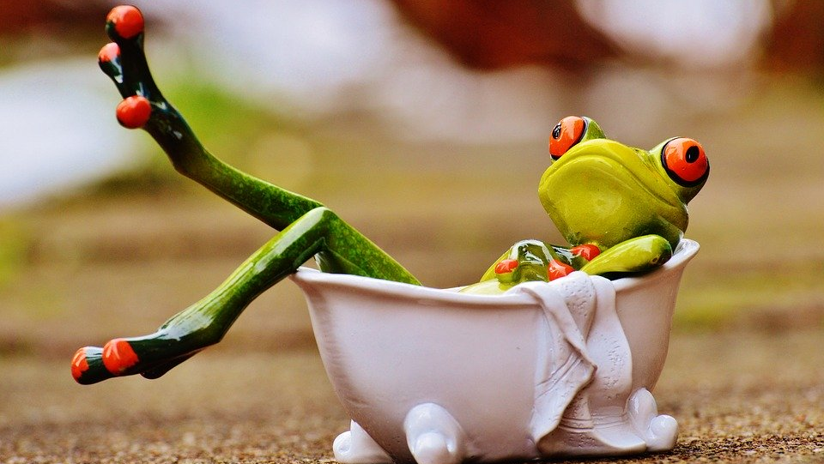
Focus on what you can control
Wear mask, stay 6 feet apart, follow health guidelines
Minimize your news intake to once or twice daily
Get good sleep
Get physical/move (garden, walk, knit, build something)
Volunteer/help a neighbor
Go outside/connect with nature
Let go of perfectionism!
Create a routine/ritual for your day
Be kind to yourself and others
Notes:
Focus on controlling what you can control! Don't get caught putting your energy into things that are beyond your power to change... for instance, when the pandemic will end is beyond your control and focusing on this will drain you and likely leave you feeling overwhelmed. Focusing on what you can do to decrease the spread yourself is helpful (washing your hands, wearing a mask, etc).

Slide 41
#5: Find Connection
This Photo by Unknown Author is licensed under CC BY
Notes:
Fifth, find connection. Physical distancing can naturally lead to social distancing, but it doesn’t have to. Fear and anxiety love isolation. Find ways to connect to people and connect around things that are important to you. How do you connect during times of physical distancing and face masks? {Ask Julie—discussion and/or Chat box?]. Research shows that connection releases oxytocin--known as the cuddle or love hormone b/c it's released when close social bonding occurs—AND studies show it is a natural stress reliever. When we're stressed, our bodies release oxytocin to trigger us to bond with others....which then can decrease our stress.

Slide 42
What happened with Julie’s Ecoanxiety?
This Photo by Unknown Author is licensed under CC BY-NC

Slide 43
Notes:
And then, the very next day, I see this on a Baltimore-based mommy facebook group. This is the same event you’re here for tonight, just the Baltimore City one. I heard Matt and some other speakers present. I learned so much. I enjoyed being with like-minded people. And I felt really hopeful. Like I could make a difference. I enjoy connecting people, and I decided to take Matt up on his suggestion to host a house party. I sent him an email the next day. We talked and I told him about my health communication background, and one thing lead to another, and here I am speaking to you tonight. I really feel like the universe conspired to bring here to talk to you all.
Grateful for being asked to speak tonight.

Slide 44
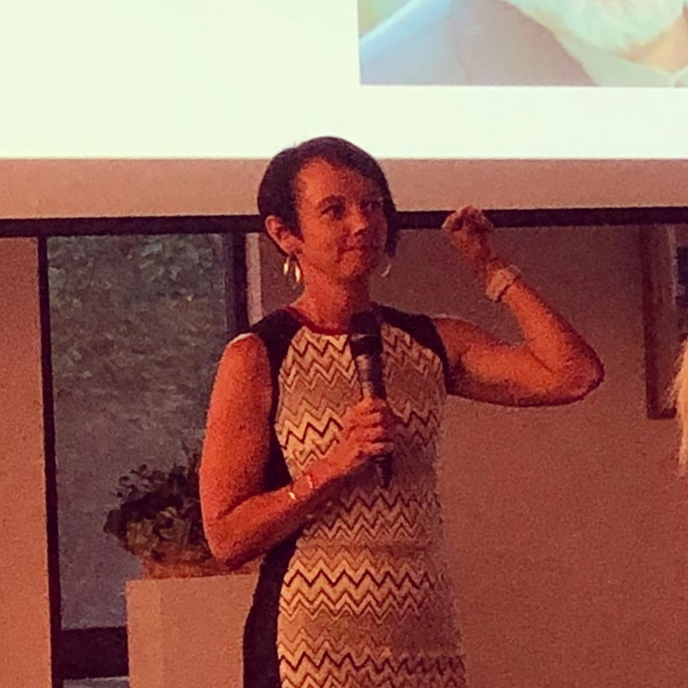
This Photo by Unknown Author is licensed under CC BY

Slide 45
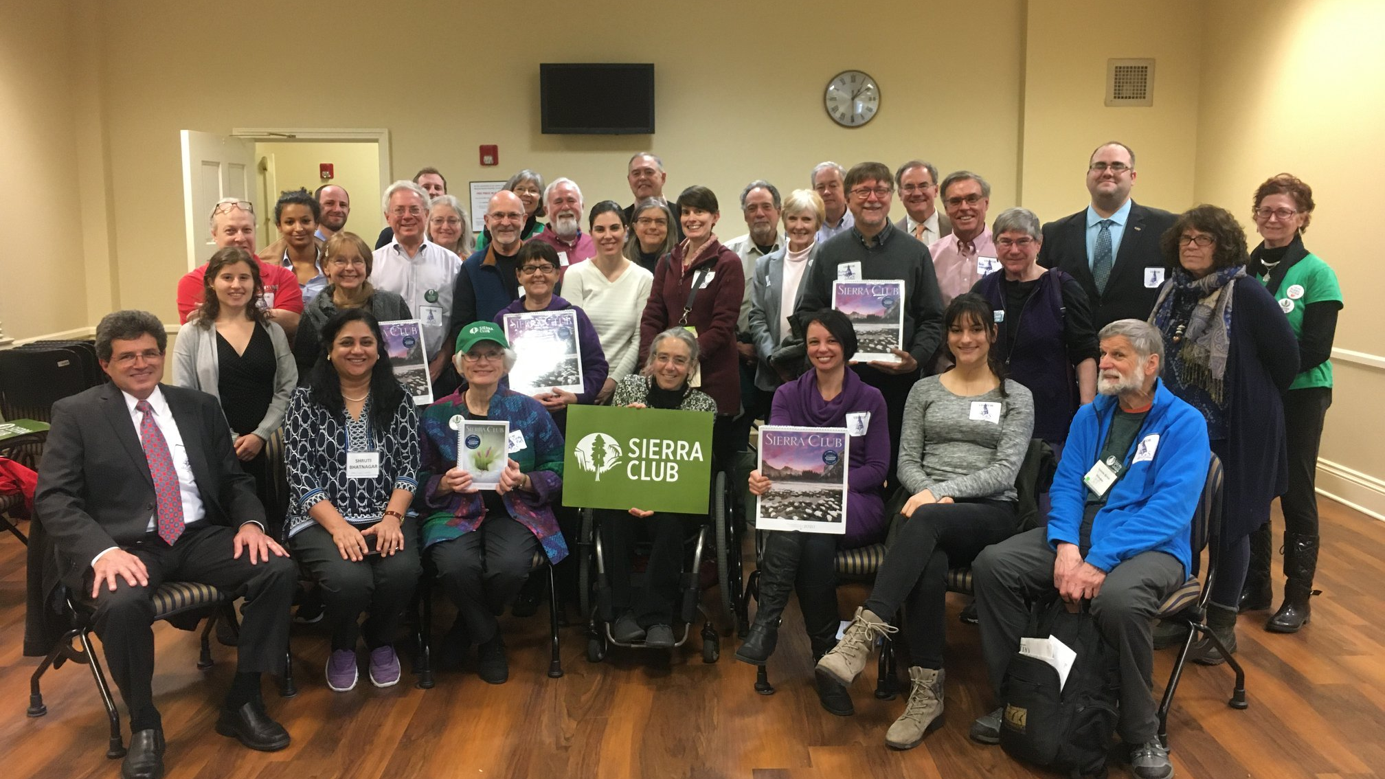

Slide 46
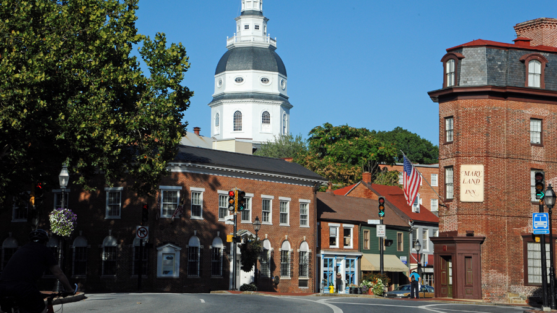
This Photo by Unknown Author is licensed under CC BY-NC-ND

Slide 47
“Above all, don’t fear difficult moments. The best comes from them.”– Rita Levi-Montalcini
“
This Photo by Unknown Author is licensed under CC BY-SA
Notes:
Julie will talk about what this quote means to her.
Helena:
Remember that fear, anxiety, stress all evolved as our friends. We don't have to be afraid of these difficult emotions—we can learn how to notice when we're feeling them, accept the natural way our bodies respond, learn to calm our bodies and minds, and find the sweet spot that allows us to make a difference in the world in ways that are important to us! This leads to hope—and an ability to move towards what's important to us.

Slide 48
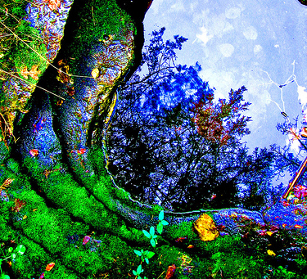
What makes you feel hopeful?
Questions or Comments
This Photo by Unknown Author is licensed under CC BY-SA

