Slide 1
Reemergence of Childhood Infectious Disease
John Kulig MD MPH
Lead Medical Specialist
Office of Job Corps
June 23, 2020

Slide 2
Learning Objectives
With the arrival of COVID-19 and the decline in well visits for childhood immunizations, clinicians should be aware of the increased risk of childhood infectious diseases.
Participants will be able to:
1. Describe the epidemiology of vaccine-preventable infectious diseases of childhood
2. Recognize the clinical presentation of measles, mumps, rubella, pertussis and varicella
3. Implement age-appropriate CDC recommended immunizations for all Job Corps students

Slide 3
Recent outbreaks
In July 2019, the initial identification of two cases of measles in Fort Bliss, Texas led to a coordinated effort by federal, state, city, and army public health agencies to locate others who may have been exposed and to prevent further spread. Ultimately, six cases were found. Three cases occurred in children age 1–4 years, none of whom had received any vaccines; the other three were adults.
In August 2019, 30 attendees at a Nebraska wedding developed mumps after being exposed to one asymptomatic index patient who was fully vaccinated according to Advisory Committee on Immunization Practices (ACIP) recommendations, resulting in a multistate outbreak.

Slide 4
Vaccine orders via VFC
On January 20, 2020, the first US case of COVID-19 was reported. Compared with 2019 vaccine data, use of vaccines fell by approximately 750,000 nationally until mid-March 2020.
By the week of April 13, 2020, the deficit in comparing vaccine orders and administration for children between 2020 and 2019 had swollen to 3 million orders.
The steep decline in vaccine application after March 13 primarily resulted from a decline in vaccination among children and adolescents older than 24 months.
The healthcare team needs to promote routine vaccination, particularly among children and adolescents older than 24 months, and devise systems-based solutions to increase vaccine coverage for these young people.

Slide 5
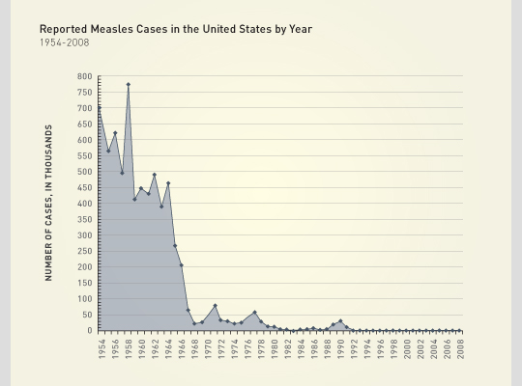

Slide 6
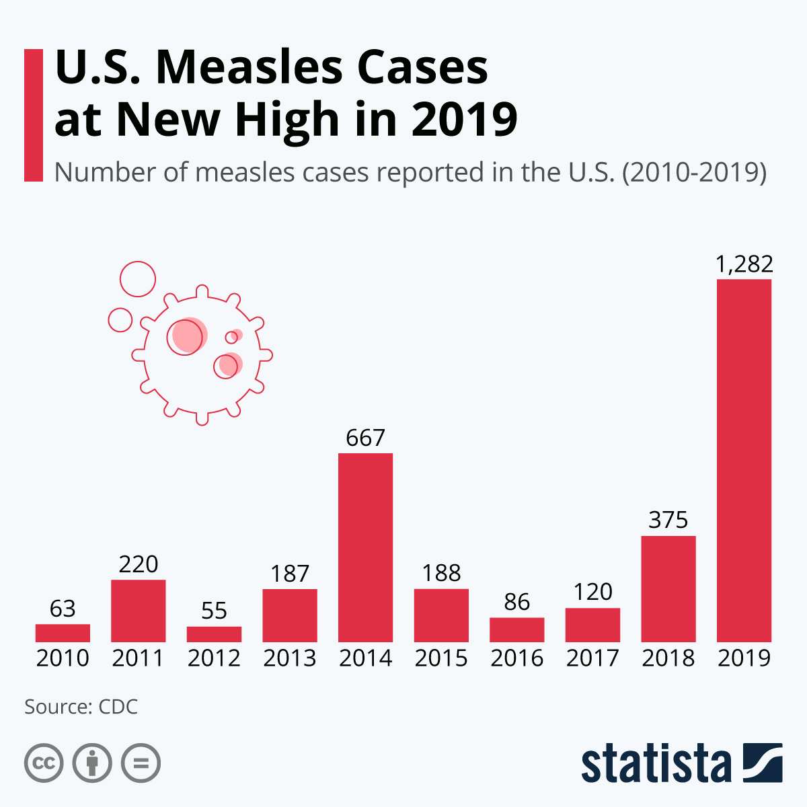

Slide 7
Clinical presentation of measles (rubeola)
A highly contagious infectious disease caused by the measles virus, a paramyxovirus.
Symptoms usually develop 10–12 days after exposure to an infected person and last 7–10 days. Rash appears on day 4-5.
Initial symptoms typically include fever, often greater than 40 °C (104.0 °F), dry cough, runny nose, and inflamed eyes.
The 3 Cs:
cough
coryza
conjunctivitis

Slide 8
Clinical sequence
Prodrome of fever (as high as 105°F) and malaise, cough, coryza, and conjunctivitis - the three “C”s -, a pathognomonic enanthema (Koplik spots) followed by a maculopapular rash
Rash usually appears about 10-14 days after a person is exposed
Rash spreads from the head to the trunk to the lower extremities
Patients are considered to be contagious from 4 days before to 4 days after the rash appears

Slide 9
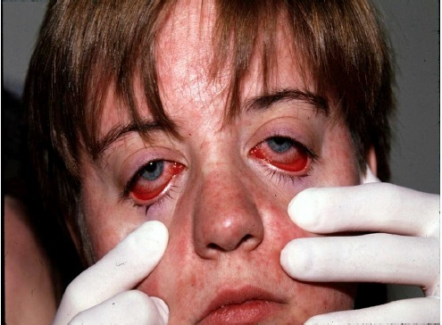
Clinical presentation

Slide 10
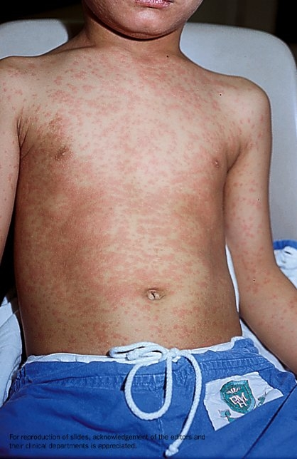
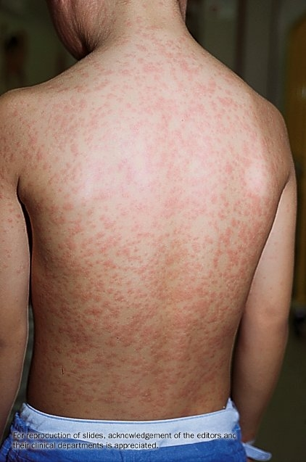
Source: Princess Margaret Hospital, Hong Kong

Slide 11
Clinical presentation
Maculopapular rash – cephalocaudad progression (head-to-toe)
Koplik spots
Dry, non-productive cough
Clear rhinitis
Non-purulent conjuntivitis

Slide 12
Complications from measles
otitis media
bronchopneumonia
laryngotracheobronchitis (croup)
diarrhea
acute encephalitis => permanent brain damage
1-2 deaths per 100,000 with respiratory and neurologic complications
subacute sclerosing panencephalitis (SSPE) – rare but fatal, 7-10 years

Slide 13
Transmission of measles
Measles is one of the most contagious of all infectious diseases; approximately 9 out of 10 susceptible persons with close contact to a measles patient will develop measles
The virus is transmitted by direct contact with infectious droplets or by airborne spread when an infected person breathes, coughs, or sneezes
Measles virus can remain infectious in the air for up to two hours after an infected person leaves an area

Slide 14
Post-exposure prophylaxis
Goal to provide protection or modify the clinical course of measles among susceptible persons
Either administer MMR vaccine within 72 hours of initial measles exposure -OR-
Immunoglobulin (IG) within six days of exposure
Do not administer MMR vaccine and IG simultaneously, as this practice invalidates the vaccine
No specific antiviral therapy for measles

Slide 15
Recognition of measles in adults
Maculopapular rash spreads from head to trunk to lower limbs
Fever to 105º F with malaise
The three Cs: cough, coryza, conjunctivitis
Pathognomonic enanthema (Koplik spots)
Incubation period 7-21 days – averages 14 days
Contagious period 4 days before and 4 days after onset of rash

Slide 16
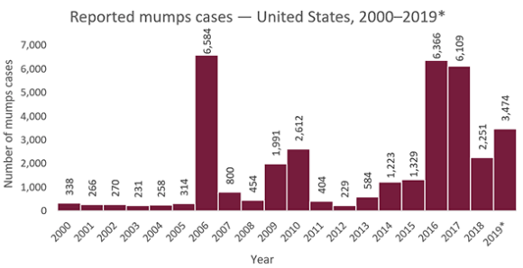

Slide 17
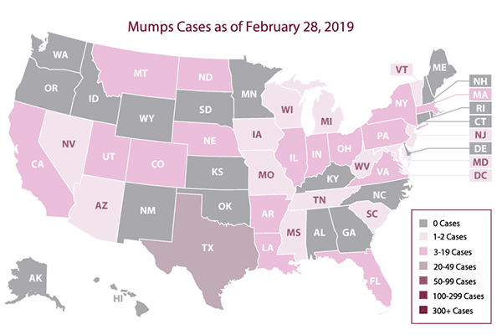

Slide 18
Mumps
Suspected
Parotitis, acute salivary gland swelling, orchitis, or oophoritis unexplained by another more likely diagnosis, OR
A positive lab result with no mumps clinical symptoms (with or without epidemiological-linkage to a confirmed or probable case).
Probable
Acute parotitis or other salivary gland swelling lasting at least 2 days, or orchitis or oophoritis unexplained by another more likely diagnosis, in:
A person with a positive test for serum anti-mumps immunoglobulin M (IgM) antibody, OR
A person with epidemiologic linkage to another probable or confirmed case or linkage to a group/community defined by public health during an outbreak of mumps.

Slide 19
Mumps
Confirmed
A positive mumps laboratory confirmation for mumps virus with reverse transcription polymerase chain reaction (RT-PCR) or culture in a patient with an acute illness characterized by any of the following:
Acute parotitis or other salivary gland swelling, lasting at least 2 days
Aseptic meningitis
Encephalitis
Hearing loss
Orchitis
Oophoritis
Mastitis
Pancreatitis

Slide 20
Mumps
Mumps is a viral illness caused by a paramyxovirus, a member of the Rubulavirus family.
The average incubation period for mumps is 16 to 18 days, with a range of 12 to 25 days.
Pain, tenderness, and swelling in one or both parotid salivary glands.
Swelling usually peaks in 1 to 3 days and then subsides during the next week. The swollen tissue pushes the angle of the ear up and out. As swelling worsens, the angle of the jawbone below the ear is no longer visible and cannot be felt because of swelling of the parotid.
One parotid may swell before the other, and in 25% of patients, only one side swells.

Slide 21
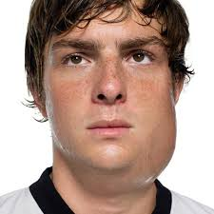
Mumps

Slide 22
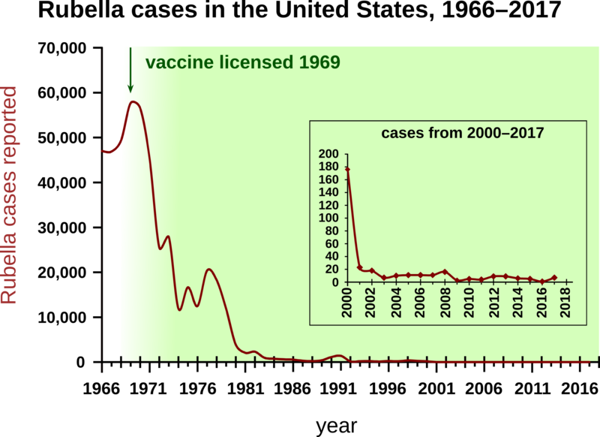

Slide 23
Rubella (German mealses)
Characterized by a mild, maculopapular rash with lymphadenopathy, and a slight fever.
The rash usually starts on the face, becomes generalized within 24 hours, and lasts a median of 3 days; it occurs in 50% to 80% of infected people.
Lymphadenopathy, which may precede rash, often involves posterior auricular or suboccipital lymph nodes, can be generalized, and lasts between 5 and 8 days.
About 25% to 50% of infections are asymptomatic.

Slide 24
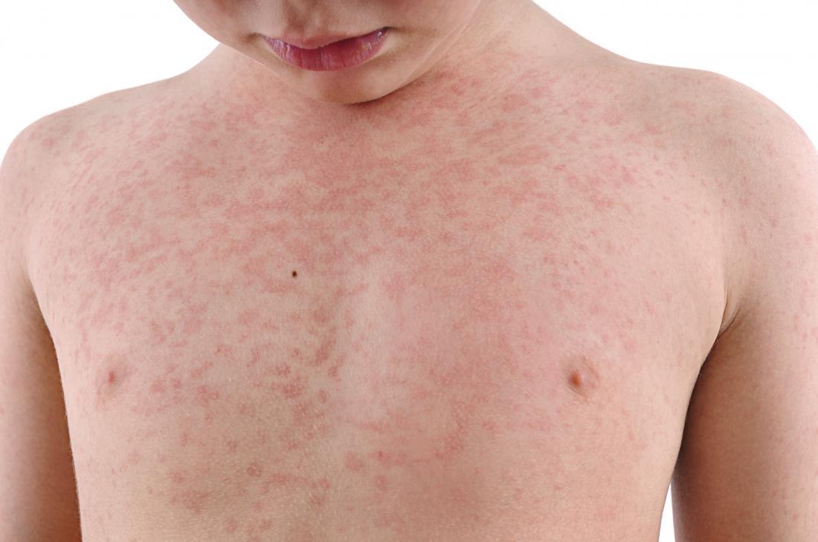

Slide 25
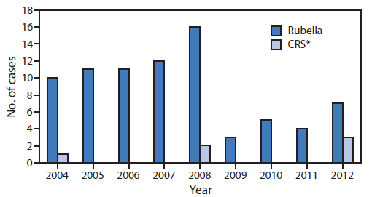

Slide 26
Congenital Rubella Syndrome
Rubella is believed to invade the upper respiratory tract, with subsequent viremia and dissemination of virus to different sites, including the placenta.
The fetus is at highest risk of developmental abnormalities when infected during the first 16 weeks of gestation, particularly the first 8 to 10 weeks.
Early in gestation, the virus is thought to establish a chronic intrauterine infection. Its effects include endothelial damage to blood vessels, direct cytolysis of cells, and disruption of cellular mitosis.
Although specific symptoms can be treated, there is no cure for CRS. Since there is no cure, it is important for women to get vaccinated before they get pregnant.

Slide 27
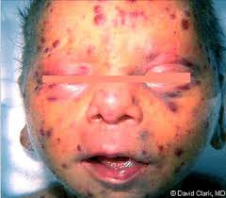
Congenital Rubella Syndrome
In the fetus, there may be no effects, death in utero, or multiple anomalies referred to as congenital rubella syndrome (CRS). The most frequent abnormalities include:
Intrauterine growth restriction
Microcephaly
Meningoencephalitis
Cataracts
Retinopathy
Hearing loss
Cardiac defects (patent ductus arteriosus and pulmonary artery stenosis)
Hepatosplenomegaly
Metaphyseal bone radiolucencies
Thrombocytopenia with purpura
Dermal erythropoiesis resulting in bluish red skin lesions
Hemolytic anemia
Immune deficiencies such as hypogammaglobulinemia.

Slide 28
Pertussis (Whooping cough)
Pertussis, a respiratory illness commonly known as whooping cough, is a very contagious disease caused by Bordetella pertussis. These bacteria attach to the cilia (tiny, hair-like extensions) that line part of the upper respiratory system and release toxins, which damage the cilia and cause inflammation.
Known in China as the “100 day cough.”

Slide 31
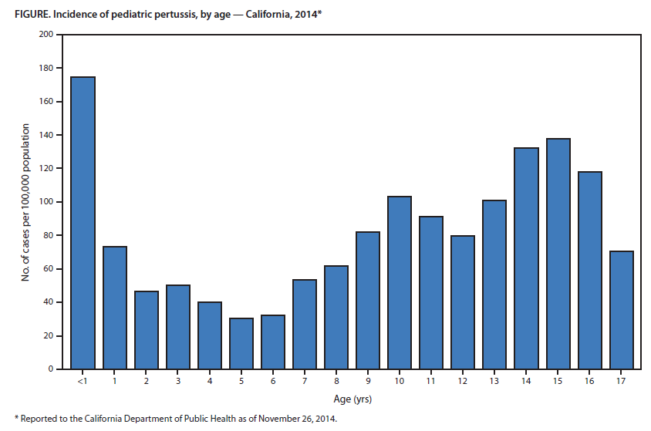
9,935 cases
26.0/100,000

Slide 32
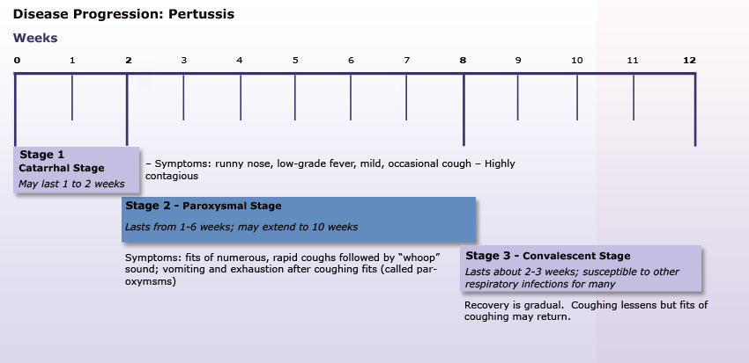

Slide 33
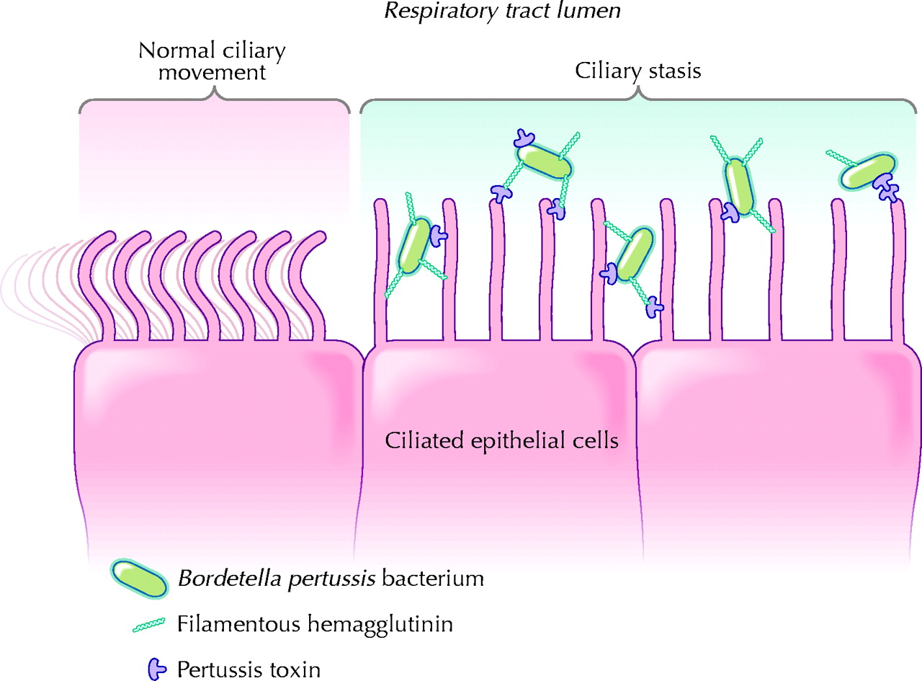

Slide 34
Pertussis
Clinical Criteria
In the absence of a more likely diagnosis, a cough illness lasting ≥2 weeks, with at least one of the following signs or symptoms:
Paroxysms of coughing; OR
Inspiratory whoop; OR
Post-tussive vomiting; OR
Apnea (with or without cyanosis)
Laboratory Criteria
Confirmatory laboratory evidence:
Isolation of B. pertussis from a clinical specimen
Positive Polymerase Chain Reaction (PCR) for B. pertussis

Slide 35
Pertussis
Pertussis is only found in humans and is spread from person to person by coughing or sneezing while in close contact with others, who then breathe in the pertussis bacteria.
Symptoms of pertussis usually develop within 5–10 days after being exposed, but sometimes as long as 3 weeks.
Waning immunity associated with use of acellular pertussis vaccine (Dtap/Tdap).
Cyclical peaks every 3-5 years in US.

Slide 36
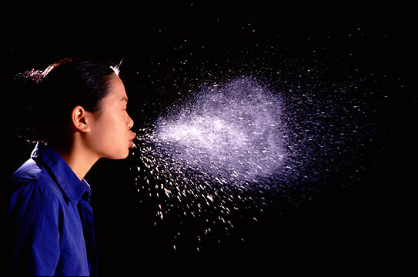

Slide 37
Pertussis clinical presentation
Symptoms
Runny nose
Sneezing
Mild cough
Paroxysmal cough
Chronic cough
Fatigue
Signs
Low-grade fever
Apnea in infants
Post-tussive whoop
Post-tussive vomiting

Slide 38
Pertussis (Whooping cough)

Slide 39
Pertussis complications
Pneumonia (2%)
Weight loss (33%)
Urinary incontinence (28%)
Syncope (6%)
Rib fractures from severe coughing (4%)
Other complications include anorexia, dehydration, epistaxis, hernias and otitis media
More severe complications include encephalopathy, pneumothorax, rectal prolapse, subdural hematomas and seizures

Slide 40
Pertussis diagnosis
Culture – up to two weeks
Polymerase chain reaction (PCR)
Serology

Slide 41
Obtaining a nasopharyngeal swab

Slide 42
Pertussis treatment and prophylaxis
Azithromycin 500 mg orally on the first day, then 250 mg once daily on days 2-5 -OR-
Clarithromycin 500 mg twice daily for 7 days
Initiate treatment or prophylaxis within 21 days of onset of cough
Initiate treatment within 7 days of onset of cough to reduce symptoms

Slide 43
Varicella
* In thousands.
In four states (Illinois, Michigan, Texas, and West Virginia), the number of cases reported in 2011 was 16% lower than 2010 and 94% less than the number reported during the pre-vaccine years 1993–1995.

Slide 44
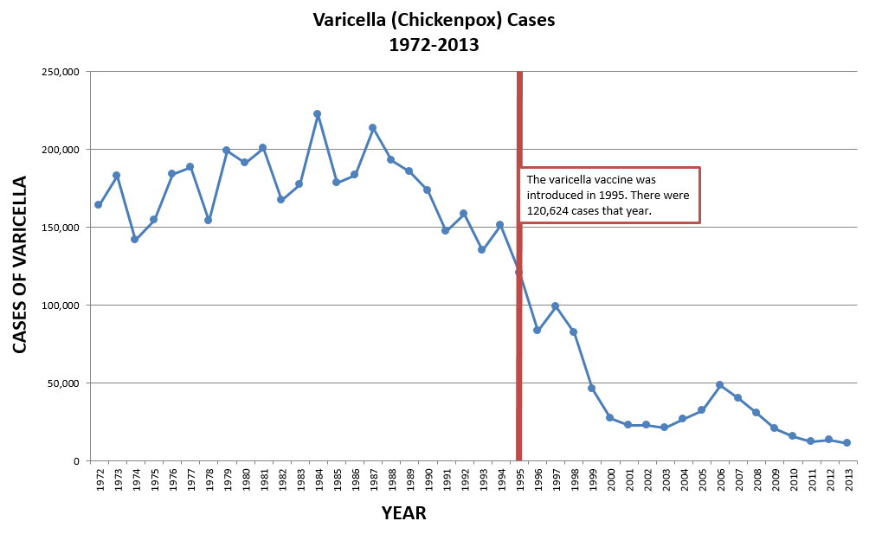

Slide 45
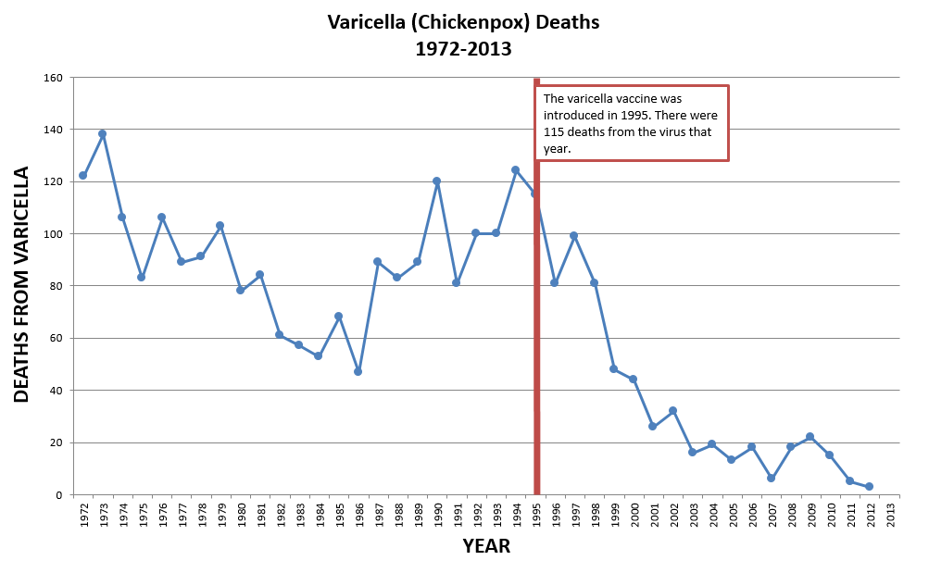

Slide 46
Varicella/Chickenpox
Caused by the varicella-zoster virus (VZV).
Virus spreads in the air when an infected person coughs or sneezes.
Also spread by touching or breathing in the virus particles that come from chickenpox or shingles blisters.
A person with chickenpox can spread the disease from 1 to 2 days before they get the rash until all their chickenpox blisters have formed scabs.
It takes from 10 to 21 days after exposure to a person with chickenpox or shingles for someone to develop chickenpox.

Slide 47
Varicella clinical presentation
Symptoms
Fatigue
Nausea
Anorexia
Headache
Myalgia
Signs
High fever
Rash – “dew drop on rose petal”
Crops of lesions in all stages of development

Slide 48
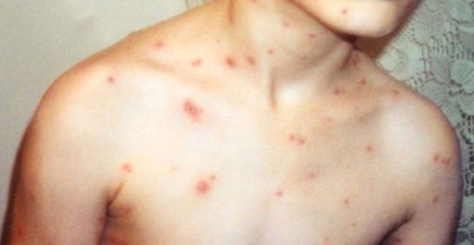

Slide 49
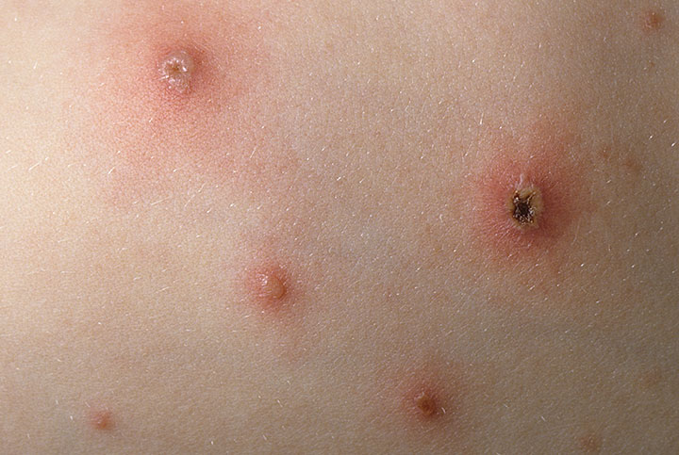

Slide 50
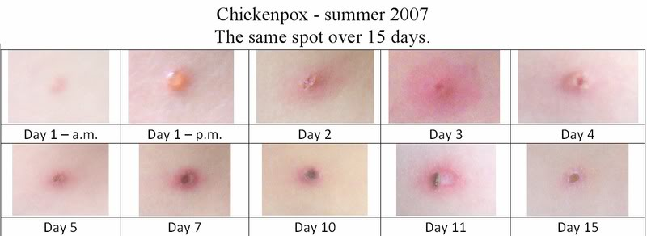

Slide 51
Varicella complications
Dehydration
Pneumonia
Thrombocytopenia/purpura
Infection or inflammation of the brain (encephalitis, cerebellar ataxia)
Bacterial infections of the skin and soft tissues including Group A streptococcal infections
Blood stream infections (sepsis)
Toxic shock syndrome
Bone infections
Joint infections
Shingles (zoster) - late

Slide 52
Varicella diagnosis
PCR to detect VZV in skin lesions is the most sensitive method for confirming a diagnosis of varicella
IgM testing is considerably less sensitive
Paired acute and convalescent sera showing a four-fold rise in IgG antibodies have excellent specificity
A single positive IgG ELISA result indicates that a person has antibodies to VZV either from current or past varicella disease or vaccination

Slide 53
Varicella treatment
Antiviral medications are recommended for people with chickenpox who are more likely to develop serious disease including:
otherwise healthy people older than 12 years of age
people with chronic skin or lung disease
people receiving steroid therapy
some groups of pregnant women
Antiviral medication for treatment of chickenpox
acyclovir 800 mg orally five times a day for 5 days -OR-
valacyclovir 1000 mg orally three times a day for 7 days
varicella-zoster immune globulin (VariZIG) is indicated for use in highly susceptible, VZV-exposed immunocompromised or immunosuppressed patients
Avoid using aspirin for symptomatic treatment (Reye syndrome risk)
Initiate therapy within 24 hours of onset of rash for best results

Slide 54
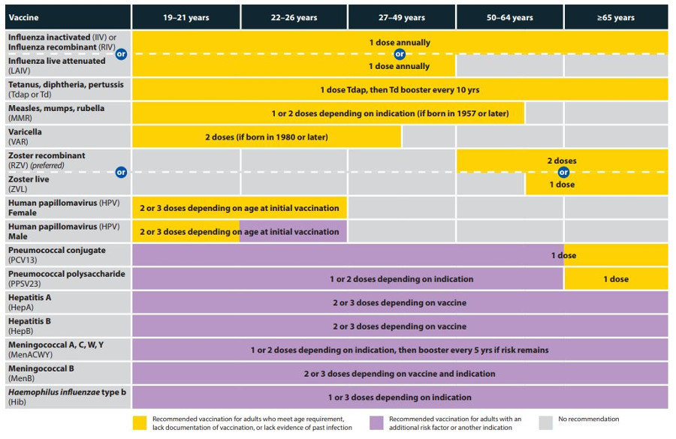

Slide 55
Resources
For the most current information for clinicians, visit the following CDC websites:
https://www.cdc.gov/measles/hcp/index.html
https://www.cdc.gov/mumps/hcp.html
https://www.cdc.gov/rubella/hcp.html
https://www.cdc.gov/pertussis/clinical/index.html
https://www.cdc.gov/chickenpox/hcp/index.html

