Slide 1
Important considerations in supporting students during this difficult time.
Alec Mendelson, Ph.D.
Center Mental Health Consultant

Slide 2
From the American Psychological Association
With the heightened anxiety and stress on families due to COVID-19, psychologists might see an exacerbation of symptoms in children and teens. Youth already struggling with anxiety or depression might experience higher levels of symptoms given the increased anxiety in society as a whole and increased isolation from physical distancing.

Slide 3
From the American Psychological Association
Students with behavioral difficulties might exhibit increased externalizing behaviors with the higher stress levels and reduced positive outlets. For children with a trauma history, the current health crisis might trigger them and re-activate earlier trauma symptoms.

Slide 4
From the American Psychological Association
Due to increased stress on families, school closures and children being at home full time, it is important to be aware of the potential for child abuse and neglect.
Yet a recent artilce noted an approximately 50% drop in reports to child abuse hotline in Illinois. Children’s interaction with mandated reporters, such as teachers and pediatricians, is more limited, and it is critical for mental health providers to be alert to signs of potential abuse and neglect. Children might also witness an increase in domestic violence.

Slide 5
Individual differences
When faced with any stress, each person copes in their own way.
It is no different with COVID-19 and the circumstances that arise from that.
Think about you and your partner, siblings or friends. Are you coping with this so called “new normal” the same or differently?

Slide 6
How we communicate:
Let’s look at options for communicating when in person, face to face interactions are not possible.
Texting
Email
Phone Call
FaceTime or Video chat
Social Media options – Facebook, Snap Chat, Instagram, Twitter

Slide 7
Phone Calls:
A phone call allows for words to be exchanged and listening to occur.
When a person speaks or communicates verbally, we derive meaning not only from the content being expressed, but also nonverbal factors as well.

Slide 8
Nonverbal communication:
Types of nonverbal communication you can discern in a phone call include:
Tone of voice
Volume
Pace or rhythm

Slide 9
Nonverbal communication:
Other types of nonverbal communication you can not perceive in a
phone call include:
Facial expression
Eye contact
Body language

Slide 10
Ok, so what about Communication with our students?
One last thing, before moving on to talking about communicating with Springdale students wherever they may be.
In your conversation, there is the student and YOU.
Be aware how you have been coping, both positively and otherwise.
Be clear your intent. Does your intent interfere with your listening?

Slide 11
Knowing who you are connecting with
Remember, each of us has our own preferred methods of coping.
So it is important to know the person you are connecting with and have some ideas about the kind of person they are, their personality and how they interact in general.

Slide 12
Framework:
Those of you who have worked with me probably know that I try to refrain from using labels or categorizing people. I generally do not find that helpful.
Today I am making an exception.

Slide 13
My “take” on knowing who you are calling.
Categorizing students:
Independent
Depressed
Anxious
Angry
Meek

Slide 14
Independent:
An independent student wants to rely on oneself. Thus, he, she or they are usually reticent to acknowledge the need for assistance much less accept it from another person.

Slide 15
Independent:
A self-reliant student who wants to project competency and being self-sufficient when asked, “How are you doing”? will reply:
“I’m fine.”
“Good.”

Slide 16
Independent:
This type of student will often say little about themselves, even when asked directly. They may ask about you or steer the conversation away to other topics.
By stating they are fine, they tend to be disconnected from inner emotion. This is the preferred coping method.

Slide 17
Depressed:
Depressed students can vary in their coping. Some may distance themselves, becoming socially and emotionally isolated. Others may cope by sleeping a lot. Some may engage with others sharing their depressed perspective and talking about how they are struggling with current events. Their outlook could be quite negative, powerless and despondent.

Slide 18
Depressed:
A depressed student when asked, “How are you doing”? might reply:
“Terrible.”
“Awful, I’m so depressed.”
“I don’t know.”
Hear the mood not ionly in content but also in low volume, slow pace of talking and lack of energy in tone of voice.

Slide 19
Depressed:
This type of student may have a lot to say from the position of being despondent and powerless. He, she or they may say that things will never get better (COVID-19, family, something else) suggesting that the future is destined to be terrible. They may talk about things not being worth it or not being sure why they try. This may imply being unsure about coming back to the program.

Slide 20
Anxious:
Anxious people may suffer from ongoing unease. This may result in dread, nervousness, jitteriness, apprehension and fear. They often have physiological reactions/experiences associated with heightened anxiety. Their discomfort may ebb and flow. Yet even in the absence of the discomfort, they can worry about when they might/will feel it again.

Slide 21
Anxious:
An anxious student when asked, “How are you doing”? might reply:
“I don’t know.”
“Horrible, I have been having panic attacks.”
“My anxiety is out of control”.

Slide 22
Anxious:
Some anxious people can become consumed by the helplessness of feeling they lack any control and/or the situation is out of control. They can verbalize concern that things will never get better or it’ll always be this way. Others may express preoccupation with their body reactions to high levels of anxiety.

Slide 23
Angry:
Angry people tend to project responsibility and blame. They may speak to how they do not deserve the negative situation at hand. They can take a stance that they are fine but are negatively impacted by other people’s poor choices, behaviors or decisions.

Slide 24
Angry:
An angry student when asked, “How are you doing”? might reply:
“OK, I guess.”
“This whole thing is stupid!”
“Pissed” followed by a blaming statement.

Slide 25
Angry:
Angry people can become consumed by their rage over how they have been negatively impacted by other people, something they did not do or an external event such as the pandemic.

Slide 26
Meek:
Students who tend to be meek have tended to be unassuming and typically cope by staying under the radar. When stressed by external events, they may be relatively silent and withdrawn. In general, meek persons adopt a passive stance in relation to people and the world.

Slide 27
Meek:
A meek student when asked, “How are you doing”? might reply:
With a shrug of one’s shoulders.
“I don’t know.”
“OK” with low volume and soft voice.
“Bad” with a questioning tone.
Meek people can sound depressed. They may or may not be.

Slide 28
MEEK:
In general, a meek person often feels ill equipped to deal with the world and one’s surrounding environment. This is exacerbated in a time of crisis. Meek people can be so passive as to be unnoticed. They may suffer in silence hoping that someone else will help or take care of them. Others may hide hoping for (bad) things to go away.

Slide 29
So How to engage:
From the preceding slides, you can see some ways people struggle differently. This was true before the pandemic and it is still the case today.
But it is also true that some of our challenges are the same.
Dealing with the unknown
Future uncertainty
Loss

Slide 30
In general:
Be aware that there is a grieving process going on for many.
Grieving has its stages:
Denial
Anger
Depression
Bargaining
Acceptance

Slide 31
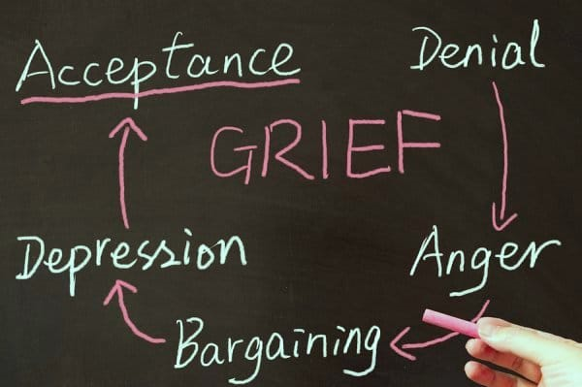

Slide 32
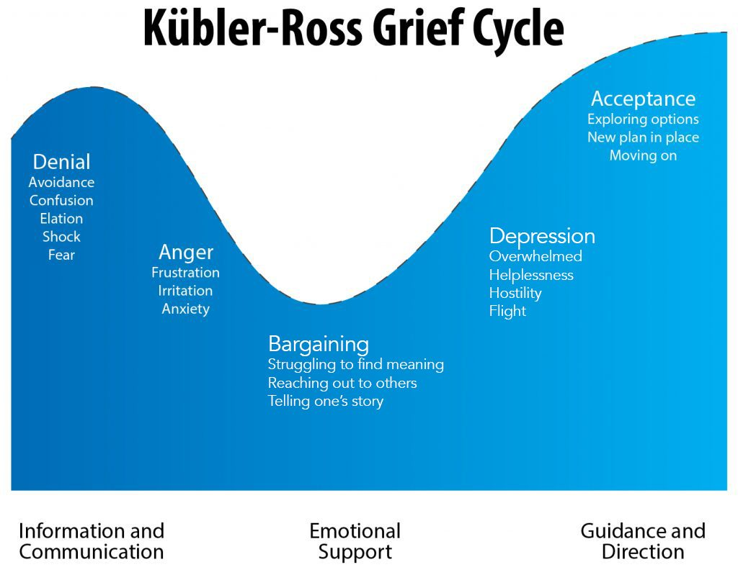

Slide 33
The independent:
Meet the presentation of competent, confident, I am good with:
An affirmation of their presentation.
Follow with questions as to how they are achieving that; what they are doing.
Take a future perspective: Ask how things could improve from here; be even better for them.
Then convey what you want them to know.

Slide 34
The depressed:
Meet the presentation of low mood, lack of energy and sense of powerlessness with an acknowledgement that they are not alone in having a tough time with the pandemic and its impact on how we live.
The current crisis has produced a “collective sorrow”. Many of us are mourning are former lives including what we did and how we connected to others.
Ask about “individual loss”; that is what they are personally grieving.
Address feeling overwhelmed and powerless with small things that a person can put in their control.

Slide 35
The Anxious:
Meet the presentation of worried, preoccupied and scared by:
Validating their apprehension and fear.
Indicating while there is a lot we can’t control, there are some things each of can individually do to soothe our discomfort and regain a sense of composure.
Helping to empower by identifying behaviors that the person can do to promote well-being even in this difficult time.

Slide 36
The angry:
Meet feeling outraged and any resulting hostility and negativity with:
An admission that none of us asked for this., predicted this or wanted this.
That despite how impacted the person is, we are still carrying on with the same intentions we had prior to the virus becoming an obstacle. (present)
Focusing on the future in a joining manner by soliciting cooperative action that results in being on the same team to achieve the desired goals/outcomes they have in relation to Job Corps.

Slide 37
The Meek:
Meet passivity, withdrawal and silently ruminating with:
Acknowledging that they are important as are their goals (which are still doable).
Inviting inclusion: You are not alone. We are in this together. We will get through.
Empowering and energizing toward becoming more active (in small steps).

Slide 38
While talking & Interacting:
Model calmness. Be aware of your own feelings and how you’re communicating.
Promote normalcy by choosing structure and a routine.
Encourage limiting news exposure. Be informed enough.
Listen actively. Validate feelings while moving to a more internal locus of control.
Use empathy and compassion where appropriate.
Avoid promising and reassuring about things you have no authority over.

Slide 39
Looking forward to:

