Slide 1

Communication for Conflict Resolution:
Being Right vs. Building Relationship
Prevention
Tamara D. Warner, Ph.D.
Regional Mental Health Specialist
Regions 4 (Dallas) and 6 (San Francisco)
April 2020

Slide 2
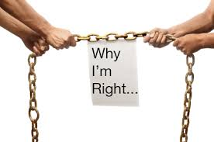
Why Conflict Prevention?
Conflict is a battle where no one wins.
Shift your focus from “being right” to
“building relationship”.
Notes:
Why Conflict Prevention? I’m sure most of you have heard the old saying, “An ounce of prevention is better than a pound of cure.” Conflict is a battle where no one wins. At the end of an argument or conflict, who feels good? No one. All you have are two losers who are frustrated and nothing has been solved.
Believe it or not, most conflicts are entirely preventable. The goal of the presentation is to show you how. While I will focus on our Job Corps students today, the principles you will learn apply to any kind of interpersonal conflict – with co-workers, with spouses. It all starts with a shifting your focus from on “being right” to “building relationship.”

Slide 3
Learning Objectives
Develop a new perspective about why students (and others) display the challenging behaviors that often lead to conflict.
Prevent and decrease conflict by avoiding common mistakes.
Reduce conflict/resistance by modeling self-control using 3 counterintuitive strategies
Notes:
I want to introduce a framework that I think will give you a new perspective and understanding about why some of our students display intense emotions and challenging behaviors that often lead to conflict.
Then I want to outline the common mistakes that most of us make, which causes the conflict to escalate. This may be the most valuable part of the presentation.
Finally, I will share some simple but powerful behavioral techniques to neutralize potential conflict or deescalate rising tensions in a situation in which conflict has already started. In doing so, you will see that you will be teaching and modeling the skill many of our students lack – self-control.

Slide 4
Develop a New Perspective
Trauma Informed Care
Lagging Skills (“Can” vs. “Want to”)
Unmet Expectations

Slide 5
Framework: Trauma-Informed Care
Trauma: abuse, neglect, loss, witnessing family or community violence, surviving a life-threatening illness/event, disaster, war & emotionally harmful experiences
Very common: 61% of men and 61% of women
When traumatic events happen to children and adolescents, there are significant and dramatic effects that can last a lifetime.
Notes:
Trauma is broadly defined – abuse, neglect, loss witnessing family or community violence, disaster, war and emotionally harmful experiences. Do you think this describes the majority of the Job Corps students?
In the United States, 61 percent of men and 51 percent of women report exposure to at least one lifetime traumatic event, and 90 percent of clients in public behavioral health care settings have experienced trauma.
When traumatic events happen to children and adolescents, there are significant and dramatic effects that can last a lifetime.

Slide 6
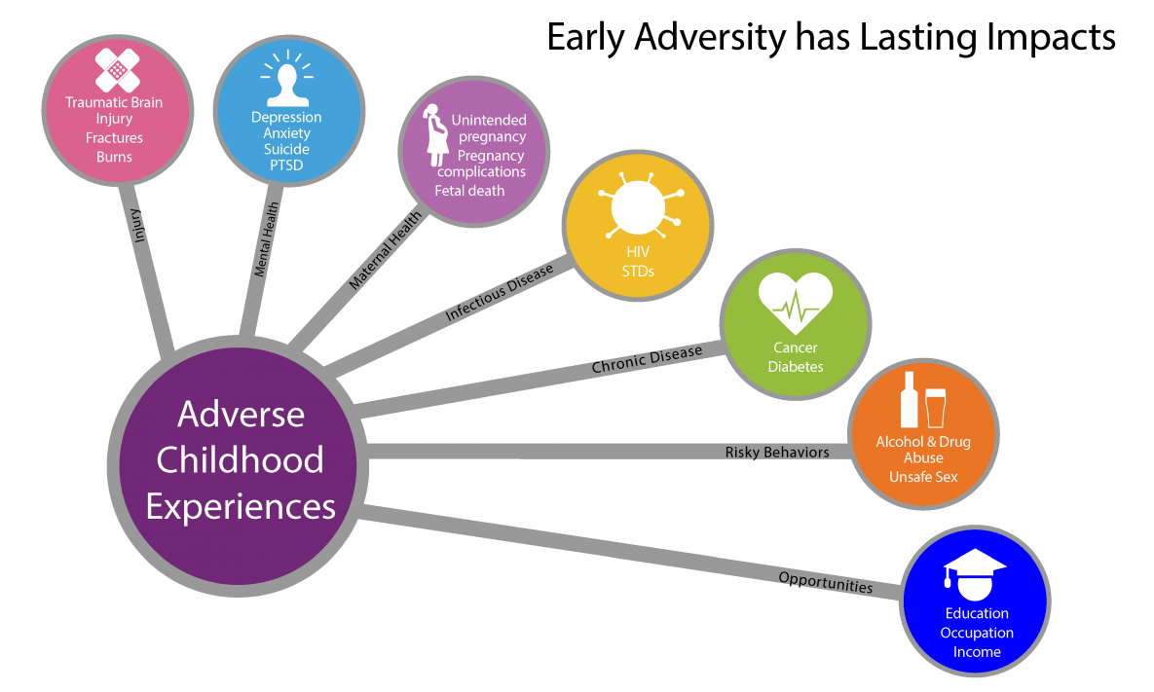
ACEs have Long-Lasting Effects
Notes:
Among researchers, traumatic events that occur during childhood are called ACEs – Adverse Childhood Experiences. Research during the past 10-15 years has conclusively shown that trauma experiences before the age of 18 have long-lasting effects on development and life outcomes. We would all expect that ACEs would be associated with a greater likelihood of mental health and substance abuse problems. You might even expect that ACEs are associated with health risk behaviors such as smoking, sexually transmitted infections and a greater risk of injuries such as TBI, fractures and burns. But here’s the shocking part (took the scientific world by storm): ACEs are associated with a greater risk for chronic health conditions like cancer and diabetes. ACEs even affects pregnancy outcomes and pregnancy complications including the death of baby before delivery. It results in early death. Your lifespan is likely to be shorter after exposure to trauma in childhood and adolescence.
** As the number of ACEs increases, so does the risk for these outcomes.** Think about our Job Corps students. What percentage of our students do you think have experienced 1 ACE? 2 to 5 ACEs? 6 to 10 ACEs? We don’t know, but based on my experiences, the overwhelming majority have.

Slide 7
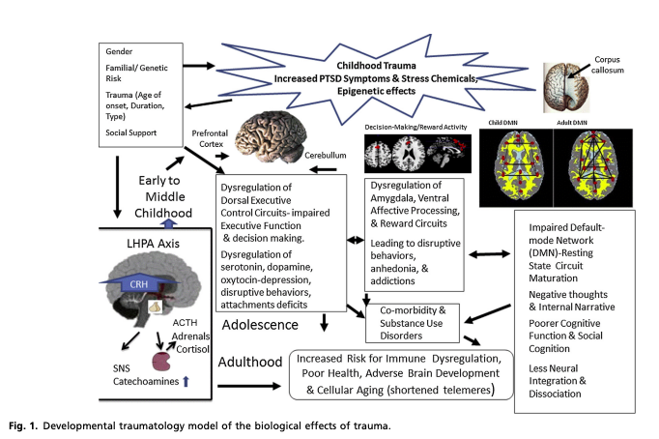
The Negative Lifelong Consequences of ACEs
Alters brain development the body’s “fight or flight” system.
Notes:
One final thing (and this is where I got interested in this topic as a neuropsychologist): Adverse Childhood Experiences alter brain development. ACEs alters brain development and the system that controls the fight or fight response in response to stress, which in turn is which is related to have a poorer functioning immune system. It changes brain development – and this has been showing using neuroimaging techniques – where they put people in an MRI scanner and take pictures of the brain or when look at the functioning of the brain while the person is doing a task. There is now a whole new field of study called developmental traumatology.
I am not going to try to explain this diagram which comes from a scientific paper published in 2014 titled “The biological effects of childhood trauma”. It was written by Dr. Michael deBellis, who is the Director of the Duke University Healthy Childhood Brain Development- Developmental Traumatology Research Center at Duke University Medical Center. Remember this slide in a few minutes when I start to talk about strategies for managing conflict.

Slide 8
Trauma-Informed Care
Most survivors do not receive needed services, intervention and supports to overcome trauma.
A strengths-based organizational service delivery approach:
  That is grounded in an understanding of and responsiveness to the impact of trauma,
  That emphasizes physical, psychological, and emotional safety for both providers and survivors
  That creates opportunities for survivors to rebuild a sense of of control and empowerment.
Notes:
As most of us know, most survivors of trauma do not receive the services, intervention and supports they need to overcome trauma, and that certainly includes many of our Job Corps students. This trauma affects how our students interact with the health care system, the educational system, the criminal justice system, and at Job Corps.
So this is where trauma-informed care comes in. Trauma-informed care is an approach that applies to the organizations that delivery of health services of any care, from hospitals and clinics to first responders to mental health and substance abuse treatment agencies. It a strengths-based approach which means that we identify and bulld on the strengths of the individual. It has 3 components:
It is grounded in an understanding of and responsiveness to the impact of trauma,
It emphasizes physical, psychological, and emotional safety for both providers and survivors
It opportunities for survivors to rebuild a sense of of control and empowerment.
There is a whole lot more that I could say about trauma-informed care, but for the sake of time, I want to emphasize that one of its guiding principles is SAFETY. A trauma-informed approach seeks to resist re-traumatization of clients as well as staff. Based on the statistics that I showed you earlier, it is likely that many staff members have experienced trauma of their own whether as a child or as an adult. So the first step is to establish safety. I’ll say more about that shortly.

Slide 9

A Scenario: Not Again?!
It’s a hectic Monday morning and you are trying to catch up with what happened on center over the weekend.
You get a call from a career technical instructor, Mr. Williams who tells you that Dylan has just “flipped out” again in class, so he’s sending him down to you.
It’s the 3rd time in 2 weeks that this has happened.
What’s the deal with this young person?

Slide 10

Why Do Students Display Challenging Behaviors?
They want to.
They are attention-seeking.
They don’t care.
They are not motivated.
They are being manipulative.
They need clear consequences.
They have a mental illness.
Notes:
Before we can talk about how to reduce conflict, let’s start with our assumptions – why we think things are the way they are? Please type in the chat box the reasons that you think students display challenging behaviors. In talking with staff, these are some of the answers I most commonly hear:

Slide 11
Another Theory
People do well
if they want to.
People do well
if they can.
Your role:
Make the student want to then try to teach them something.
Your role:
Figure out what skills are lacking so
you know what to teach.
Notes:
If you believe a student is not doing well because he doesn’t want to, then the your primary role in the life of a challenging student is to MAKE him or her want to do well – and you’ve got 2 tools at your disposal – punishments such as negative write-up or loss of off-center privileges OR you have rewards/incentives. But these don’t seem to work or don’t seem to work for very long --- I’ll show you why in a minute.
What is there was a different theory to explain the problem.. What if you assume instead that a person would do well if she could do well, then your primary role is to teach the person the skills she is lacking. You start by assuming that the person already knows right from wrong and what they are supposed to do and that they have already been punished enough. Now you role is to figure out what skill he/she is lacking you so know what skills to model and teach.

Slide 12
Old Explanations Don’t Make Sense
He just wants his way. She just wants attention. He’s just being manipulative. | We all want attention. We all want our way. The problem arises when you do not have the skills to get what you wants in an adaptive way.
She’s not motivated. | People do not choose to fail. If she has the skills to do well, why would she choose not to do well?
He has a bad attitude. | “Bad attitudes” are the by-product of years of being misunderstood and over-punished by adults.
She has a mental disorder. | “Mental disorder” is a term to describe people with social, emotional and behavioral challenges.
Notes:
Let’s assume for a minute, that our assumptions are correct. If those are the problems, then what are the solutions that we are implementing now?

Slide 13
Lagging Skills
Lagging skills are the first (and main) factor behind challenging behaviors.
Lagging skills are self-regulatory skills which have not developed to an age-appropriate level.
  Attention
  Emotion Regulation
  Impulse Control
  Planning/Organization
  Flexibility of thinking
  Social Skills
Challenging students often have lagging skills in several, overlapping areas.

Slide 14
2 Important Areas of Lagging Skills
Emotion Regulation
Difficulty managing emotional response to frustration so they can continue to think rationally
Sudden shifts in mood, especially irritability that results in reactive aggression and outbursts
Chronic irritability and/or anxiety that lowers the capacity for problem-solving or heighten frustration
Cognitive Flexibility (difficulties with)
Handling transitions, shifting from one mindset or task to another
Handling unpredictability, ambiguity, uncertainty, novelty
Shifting from original idea, plan, or solution
Considering a range of solutions to a problem
Seeing the “grays”/concrete, literal, black-and-white thinking
Inflexible inaccurate biases or interpretations (“I always get blamed for everything!”)
Notes:
Other areas:
Cognitive flexibility – last bullet, examples of cognitive distortions or biases (“Everyone’s out to get me,” “Nobody likes me,” “You always blame me,” “It’s not fair,” “I’m stupid”)
Other areas of lagging skills: attention, organization/sequences/planning, social skills. Specific examples:
Attention
Difficulty maintaining focus
Difficulty persisting on challenging or tedious tasks
Poor sense of time
Organization/Sequencing/Planning – difficulties with:
Doing things in a logical sequence or prescribed order
Considering the likely outcomes or consequences of actions (impulsive)
Social Skills – difficulties with:
Seeking attention in appropriate ways
Appreciating how his/her behavior is affecting other people
Appreciating another person’s perspective or point of view
Appreciating how s/he is coming across or being perceived by others

Slide 15
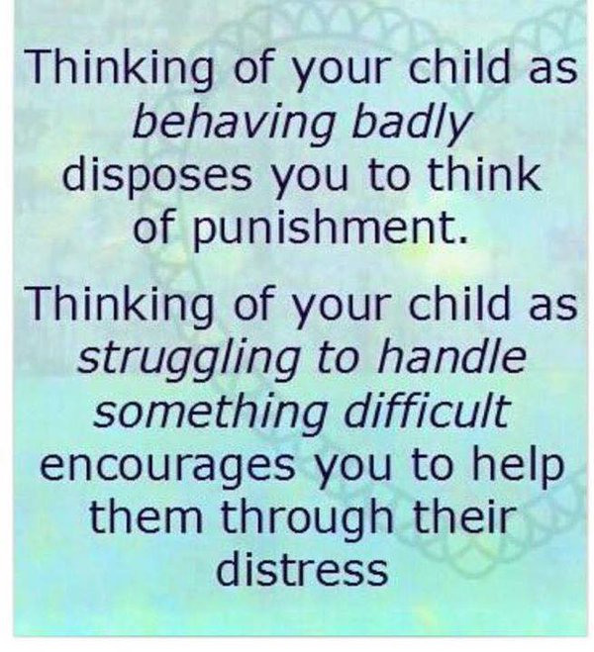
How to deal with Dylan?

Slide 16
Student Blow Ups are Predictable
Q: When is challenging behavior most likely to occur?
A: When the demands being placed on a student exceed his/her skills or capacity to respond adaptively.
Some students have the skills to hold it together under stress; others don’t.
DEMANDS
SKILLS
Notes:
When the environment (us, Job Corps) is demanding skills that a student does not have (or does not have very well)
-- or --
when the environment is presenting problems that a student is not able to solve.
social, emotional, and behavioral challenges are very likely to occur.

Slide 17
Stress Responses
Behavioral challenges represent maladaptive responses to situations of high stress
Spectrum of responses to high stress
MILD
Cry, sulk, pout, whine, withdraw
MODERATE
Screaming, swearing, hitting, kicking, destroying property, truancy
EXTREME
Self-induced vomiting, cutting, drinking, using drugs, stabbing, shooting
Notes:
Understand that when you hear the swearing and banging on the desk that those are maladaptive stress responses. It always surprises me when staff get out of sorts when a student is swearing while they are upset. If the swear when they’re not upset and those don’t have the skills to inhibit that behavior then. Think how much more so that is when the student is upset. At the point, the student’s ability to inhibit behaviors has gone completely out the window. Smetimes we get so focused on the “disrespectful” behaviors like swearing that we miss what really going on in that moment for that student.

Slide 18
Assumptions and Expectations
Stop assuming that students have the skills and resources to meet our expectations. Unmet expectations fuel conflict.
If a student is not:
  Making progress & learning employability skills needed to do well (TABE up, get certifications)
  Conducting him/herself in a safe & respectful manner towards you or other students, with professionalism
It’s very likely because the student can’t.
If the student had the skills and resources, there would be no conflict in the first place.

Slide 19
CONFLICT PREVENTION
Drop Assumptions, Expectations and Hidden Agendas
Most Common Mistake to Avoid with 4 Examples

Slide 20
Hidden Agendas
Students do well
if they want to.
Students do well if they can.
You’ve dropped your assumptions and expectations (problem #1).
Not really. Now we have the problem #2 -- hidden agendas.
Notes:
So now we’re starting with the assumption that students do well not if they want to, but if they can. We’ve already dropped our assumptions about what the student or what we should be doing and we’re dropped out expectations. Are we ready to proceed?
Not really. There is another problem that we have to tackle if we want to be effective in preventing or deescalating conflict. That is the problem of hidden agendas.

Slide 21
Conflict and Resistance
Conflict = competing or opposing actions of incompatible needs, demands or expectations
Resistance is at the heart of all conflict.
Resistance to hearing the other’s person point of view.
Investment in proving that we are “right.”
Insistence to advance some hidden agenda.
  “Respect” or “Authority”
What is your agenda with students/other stuff/family?
Is it the right agenda for the situation?
Notes:
Let’s go back to the beginning. You may have noticed that I failed to define “conflict” until now. Conflict occurs when there are competing or opposing actions of incompatible needs, demands or expectations. The differing needs, demands and expectations only oppose each other when there is RESISTANCE. from one or both parties. Resistance is at the HEART OF ALL CONFLICT.
What do I mean by resistance? This can be resistance to hearing the other’s person point of view – because we believe that we are right and they are wrong and we get INVESTED in proving that we are right.
Or – and this is the tricky one – we become insistent on advancing some hidden agenda. You think a student is disrespecting you or not showing you the proper “respect.” Or you need to show them that you are in authority, you need to show them who’s boss. Now let’s think about that for a minute. We are making the assumption that our students students actually grew up in environments where they were taught how to show respect the way you and I expect a young person to show respect. I don’t mean Leave it to Beaver or even the Cosby Show. No, most were yelled at and punished not talked to and taught. It gets even better. You know what students say? They say they aren’t given the respect they deserve.
The next time you find yourself in conflict – with students, other staff, family -- ask yourself – What is your hidden agenda? Why is it so important to be right or to be heard or make a point? The funny thing is that even if you you prove that you are right, will that solve the problem at hand? I can almost guarantee you that the is answer is “no.” So, ask yourself, “What is my agenda and is the right agenda for the situation?”

Slide 22
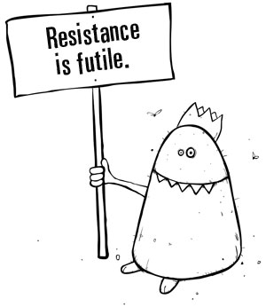
Conflict Prevention Step 1
Drop Your Expectations
Students does not need to behave a particular way
You don’t need to make the student do anything (lower voice, calm down, sit down)
Drop Your Agenda
“Prove” to the student who’s right or who’s boss
Make a student follow the rules
Notes:
Dropping your expectations is not just about expectations for the student to behave a particular way -- but also for yourself in terms of thinking you have to MAKE a student do something like lower her voice or sit calm down or sit down (BTW, telling someone to “calm down” has never helped anyone to calm down. Just take those two words out of your vocabulary entirely.)
Dropping your agenda is related to he expectations you have about your behavior – having to prove to the student who’s right or who’s boss or “make” a student follow the rules. Put these two changed behaviors/mindsets together and you have Conflict Prevention step 1.

Slide 23

Conflict Prevention Step 2
“It takes two to tango.”
You don’t have to
attend every
argument you’re
invited to.
Conflict requires two participants.
Notes:
This is the moment of prevention. It takes two to tango. Simply do not engage the student. If the student is loud, our knee-jerk reaction to match their volume. Remember, the student is emotionally dysregulated, doesn’t have the skills to modulate his/her emotions. Why would you want to join that?
If you choose NOT to argue, there won’t be an argument because no one can argue very long by himself. Conflict requires two participants.

Slide 24
Conflict Prevention Step 3
Instead of engaging, drop back and just OBSERVE.
  How is the student communicating?
  Behaviors, gestures, physical stance
  Words
  Emotions
Get curious. Go into detective mode.
Why? Taking a 3rd person “observer stance” will help you not to take the student’s words or behaviors personally.
Notes:
Step 3: You’re not engaging student. Instead, you drop back and observe. Observe the behavior, the words, the intensity. Is the student gesturing? Pacing? Visibly shaking? Pounding her fist on a table or wall?
Then you get curious. Go into detective mode. Get out your magnifying glass and start looking for clues to answer the question: What is going on here?
These are very important steps because observing and getting curious will help you not to take the student’s words or behaviors personally. When someone is yelling (seemingly at you), it is natural for your flight or flight response to kick in, for your adrenaline and cortisol levels to rise. Taking a 3rd person “observer stance” will help you not to take the student’s words or behaviors personally. Whatever is going on is NOT ABOUT YOU. Do not take personally any words and behaviors of a student when he/she is in meltdown mode. This is common trap so you want to avoid it at all costs. Once you fall down that rabbit hole, it is very hard to get back on track.
A story from my graduate training.

Slide 25
Conflict Prevention Step 3
Detective mode does not mean INTERROGATION!
You do not need to know the who, what, where, when, or why. Save that for later.
Your main job during first 2 minutes is preventing or deescalating conflict.
OBSERVE
GET CURIOUS
GATHER INFORMATION USING ONLY YOUR EYES (not your mouth).

Slide 26
Most Common Mistake
Do NOT try to use rational problem-solving strategies
Lessons from the past:
  “Don’t you remember what happened the last time you had an outburst in Mr. Johnson’s class?”
Lessons for the future:
  “Now, what is going to happen if you keep having outbursts in Mr. Williams’ class?”
  “Do you think that this kind of outburst will be acceptable in the workplace?
Notes:
Now, what you have all been waiting for. The most common mistake made by staff when trying to manage an emotionally-charged situations is trying to use rational problem-solving strategies. When conflict is escalating is NOT the time to go into teacher/lecturer/educator mode. So avoid asking questions like…. When a student is upset, it is NOT a teachable moment.

Slide 27
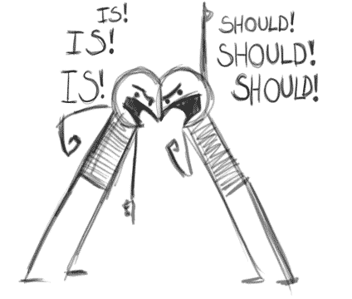
Most Common Mistake
Do NOT try to use rational problem-solving strategies
Start “should-ing” all over the student:
  “You shouldn’t have gotten so upset about a little thing like that.”
  “You should have just asked to leave the room.”
Start “coaching” to prevent the next incident:
  “The next time this happens, what should you do?”
Notes:
Here are 2 other examples of how we try to rational problem-solving strategies. We start should-ing all over the student to shame or guilt the student into what we consider “appropriate” behavior. We say brilliant things like “You shouldn’t have gotten so upset about a little thing like that.” OR “You should have just asked to leave the room.” ”Should” is a toxic word because it can only make the person feel disappointed, guilty or frustrated. It’s like kicking a person when she’s already down. But we do it all the time. We love telling other people – especially subordinates -- what they should have done or how they should have felt.
Or sometimes we seem to think it will be help to move on to preventing problems in the future without even solving the one at hand. We say things like, ”Now the next time this happens, what should you do?”
Why do rational problem-solving strategies not work? Think about the last time you did your best problem—solving under conditions of high emotional arousal? The term for that state is “hot” cognition. “Hot” cognition refers to thinking (or perhaps lack thereof) that occurs under conditions of strong feelings or arousal. ” Cold” cognition, on the other hand is the thinking and problem-solving that occurs when we are under conditions of low emotions and/or arousal – in other words this is “rationale” thinking that we can do when we’re not upset or revved up physically. Here’s the key: It is very difficult to manage during “hot” cognition using “cold” cognition strategies. Decisions made under conditions of strong emotion are difficult to influence by cool rational thought alone.

Slide 28
Conflict RESOLUTION
Building Relationship
3 Steps for Resolving Conflict

Slide 29
Building Relationship
If you want to help a student, you are going to need to develop a helping relationship.
Goals of this helping relationship:
  Help students not just better manage a given problem but to apply the learning to sorting out other problems and to preventing problems from occurring in the first place.
  Provide students with the tools to become more effective “self-helpers” and more responsible “agents of change” in their own lives.

Slide 30
Building Relationship
Helping is a working alliance, a two-way collaborative process. It is not something that staff “do” to students; it is a process that teachers and students work through together.
Think about the qualities that you’d seek in someone you hope to help you?
Someone who cares
Who you feel you can trust
Who takes time to listen to you
Who asks the right questions and truly tries to understand your concerns
Who has the wisdom and know-how to help in ways that are effective and long-lasting
Who involves you in the process
Notes:
The most reliable factor leading people to change (by far) is the relationship they have with the person helping them change.
Someone who cares?
Who you feel you can trust
Who takes time to listen to you
Who asks the right questions and truly tries to understand your concerns
Who ahs the wisdom and know-how to help in ways that are effective and long-lasting
Who involves you in the process

Slide 31
Strategies: Calming & Connecting
“Connecting and Calming”
Step 1: Keep your cool
  Don’t fall into the trap of “matching” the student’s emotions.
  Drop back and start observing.
  Use a lower than normal volume or don’t talk at all.
  Your frontal lobe has to work for both of you.
Step 2: Listen with a focus on emotion (not behavior)
  Don’t focus on what happened, focus on how it happened.
  What is the student feeling? What triggered that emotion?
Notes:
I want to acknowledge that step one may be difficult for you if you yourself have experienced any kind of trauma, especially childhood trauma. Your own flight or fight response might kick in.

Slide 32
Strategies: What to TRY
Try “Connecting and Calming”
Step 3: Show Empathy
  Reflect what you hear (helps student to organize thoughts).
  “So you were embarrassed when you saw your grade.”
  “You were feeling overwhelmed when you saw the assignment.”
Acknowledge the emotions and how hard the situation must be from the student’s perspective.
  “I can see why you got so upset. I probably would have been frustrated, too.”
Notes:
Tamara

Slide 33
Strategies: What to TRY
Try “Connecting and Calming”
Step 4: Calm
  Help the student regain control over his/her physiology
    Take a walk (“walk and talk”)
    Breathing exercises
    Music – creating a “calming” playlist
    Use apps like “Calm,” “Relax Melodies”, “Virtual Hope Box”
These strategies also can be accommodations on a student’s
Job Corps Accommodation Plan!
Notes:
Tamara

Slide 34
Conflict Resolution Strategies
“Connecting and Calming”
Do the opposite of what’s expected.
Step Back (and Sit Down)
Whisper
Listen, Listen & Repeat
60-70% of Communication is NON-VERBAL.
Take control of the situation by what you DO, not what you SAY.

Slide 35
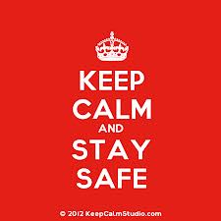
1. TAKE ONE SMALL STEP BACK.
  Provides some distance and gives you a moment to take a breath & assess the situation for safety.
Safety factors to consider:
If you do not feel safe at any point, CALL Security.
  Is there a risk of harm or danger to self or to others (including yourself)
    Is student agitated or demonstrating erratic behavior or a dramatic change in behavior?
  Are there other people around or nearby?
  Can you get to a position where you can easily exit or get to a phone if needed?
SAFETY FIRST!
Notes:
Conflict Resolution step 1 is to take one small step back. Stepping back serves several functions:
1. Gives you a moment to take a breathe and assess the situation and see the whole situation more clearly.
2. The first thing you want to do is assess the safety of the situation. If if you think there may be a risk of violence or harm to self or others (including you)– for example the person Is agitated (not just angry) or demonstrate erratic or dramatic change in behavior, you want to be sure that there are other people around or nearby. You also want to position yourself where you can easily exit (for example, keep your back to the door) or get to a or a place where you can get to a phone or to the door In most cases, safety will not be an issue, but you should always do a quick assessment to make sure.
It is the opposite of approaching someone, getting closer, getting in someone’s face. Approaching an

Slide 36

1. TAKE ONE SMALL STEP BACK.
  Assessed the situation for safety.
  Signals safety/lack of threat to the student.
  Serves as a reminder to you to not take the bait.
  Helps you control the space.
Notes:
Now that you have assessed the situation and put some space between you and the student if needed, I want to point out how stepping back is preventative:
3. Stepping back non-verbally signals to the student that you are the lack of threat, which is so important given how many of our students have experienced trauma. Stepping forward would be an act of aggression, it would heat up the situation, cause it to escalate. Stepping back signals to the student that you are not going to engage his/her in an aggressive way. Stepping back can calm the situation down all by itself.
4. Stepping back is also a reminder to you not to take the bait and respond the way every other unhelpful adult has responded. You are stepping back to lead and be helpful.
5. Stepping back helps you to control the space. This is where the power of stepping back comes from.
One concern I’ve heard is that stepping back It is passive or submissive. It is not. It is a posture of being receptive and assuming a helping role. We are not trying to feed or fuel the fire. Our goal is to extinguish it.

Slide 37
1. TAKE ONE SMALL STEP BACK.
  Control the Space
  Job Interview Tip
  When an interviewee moves his chair just a couple of inches in any direction before sitting down, it allows him to exert some control over the space.
  Stepping back serves the same function.
Notes:
The best way to talk about “controlling the space” is to give you an analogy. Research has shown that When an interviewee moves her chair just a couple of inches in any direction, it is a subtle but powerful way to exert some control over the space. The interviewee feels more confident and the the interviewer perceives the interviewee as more confident. It works both ways!

Slide 38


1. SIT DOWN SLOWLY (if possible)
If you are in a natural place where you can sit down and the student is not highly agitated, then slowly take a seat. Using a gesture, gently invite the student to also sit down.
If still upset, the student may not choose to accept your invitation. It’s OK. Remember, you have no specific expectations right now.
After the student has calmed down some, he/she may choose to sit down or you can extend another invitation. If the student has not sat down after a while and it feels awkward, you can stand again if you want.
Notes:
This is another method for controlling the space and taking the lead using nonverbal behaviors.
If you are in a natural place where you can sit down and the student is not highly agitated, then slowly take a seat. It is important that both criteria are met – a natural place to sit and the student is not highly agitated. If it appears forced, awkward or unnatural, it will not work. If the student is highly agitated, then they are not in a state where sitting down will feel comfortable. It is also important to do it casually and slowly – no sudden moves which might startle the student (remember the trauma?)
Using a gesture – it is important not to interrupt the student or to start or lead the conversation, gently invite the student to also sit down. A gesture could be putting the area on the bench you’re sitting on or using an open hand to wave in the direction of a nearby chair. You should fully expect that the student student will not likely follow your lead – remember that many have social skill deficits and will not pick up on subtle nonverbal cues.
After the student has calmed down some, he/she may choose to sit down or you can extend another invitation with a gesture or with words. If you choose to invite the student sit down using words, you want to be sure that you ASK, not TELL, the student to sit down. Telling the student is a power play, then the situation will become contentious and you will lose. Using inviting words: “Why don’t you come sit here with me so we can talk?” It’s OK if the student says “no” or chooses not to sit down.
Avoid a seating arrangement where you are seated directly face-to-face and definitely do not sit where there is a large object between you like a desk. Sit at an angle, in an L shape or even side-by-side. Think about how you would want someone sitting with you if you needed someone to talk to.
If after a while the student still has not chosen to sit, it make begin to feel awkward. In that case you can stand again if you want.

Slide 39
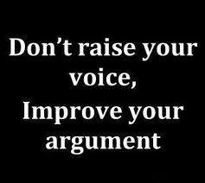
2. WHISPER (low voice)
Do the opposite.
  If the student has a raised voice or is yelling, the student is expecting you to yell back.
  If you whisper, the other person has to stop yelling eventually.
  They may move in closer to hear what you are saying.
  You can now engage the student on your terms.
    “I can see you’re really upset. What happened?
    “You seem really upset. Start from the beginning.”
    “I can see that something has gotten you upset. What is the problem?”
Notes:
If the student has a raised voice or is yelling, the student is expecting you to yell back.
If you whisper, the other person has to stop yelling eventually.
They may move in closer to hear what you are saying.
You can now engage the person on your terms.
“What were you saying?”
“Start from the beginning.”
“What is the problem?”
Now people have asked me do you really mean I should whisper. The answer is “no.” I’m suggesting that you use a low and soft tone of voice. Using the term “whisper” is an easy way to remember that and emphasize that you are doing the opposite of yelling. In fact, if you really whisper, it could be considered quite annoying if the other person can’t hear you at all.

Slide 40
3. LISTEN, LISTEN then REPEAT
Listening requires nonverbal skills.
  GOAL: Make the person feel respected, accepted, and understood. This will put them at ease.
  Make sure your posture is open and inviting (UNcrossed arms/legs)
  Nod or make another indication that you are actively listening and paying attention.
  Make comfortable eye contact. Do not force eye contact. A student can listen without making eye contact.
  Avoid foot tapping, looking at your watch or the clock, etc. These signal impatience or anxiety on your part and will not help put the person at ease.
Notes:
Remember that I indicated earlier that 60% to 70% or more of communication is NONVERBAL.

Slide 41

3. LISTEN, LISTEN then REPEAT
The hardest part about listening is not talking.
The second hardest part is actively listening.
Active Listening includes:
NOT asking questions
NOT thinking about the next thing you are going say
NOT offering advice
NOT letting your mind wander off
Notes:
Listening is a spectator sport not a participatory sport. You will be tempted to ask questions. You will be tempted to think about the next thing you are going to say. You will be tempted to offer advice. You may find that you mind wanders off to what you need to pick up from the grocery store on the way home. Don’t.

Slide 42
3. LISTEN, LISTEN then REPEAT
Let them talk (and talk and talk…)
  Blow off steam, drains the fuel from the fire
They can no longer claim that they were not heard.
Challenges of Active Listening
Being patient.
  Keep open body language.
Not getting bored.
  Really listen.
  Following the story line as best you can (no interrupting).
Staying engaged.
  Try to take their perspective.

Slide 43

3. LISTEN, LISTEN then REPEAT
Repeat the main concern that you heard.
  Forces you to really listen.
  Demonstrates to the student that you were actually listening.
  Use a gentle and reassuring tone of voice that indicates concern not judgment.
  If you get it wrong when repeating or summarizing, it’s OK. Let them make corrections.
    “You were upset when…”
    “I wasn’t upset. I was furious.”
Notes:
So the first thing that comes out of your mouth is not a question or command or a suggestion or advise. It is an empathic statement. It is this compassionate communication that makes a difference.

Slide 44
Compassionate Communication
“Connecting and Calming”
Now you are the student are on the same problem-solving team.
Now the student is calm enough to actually listen and learn.
The student will be much more likely to receive (instruction, advice) from you and do some basic problem-solving.

Slide 45
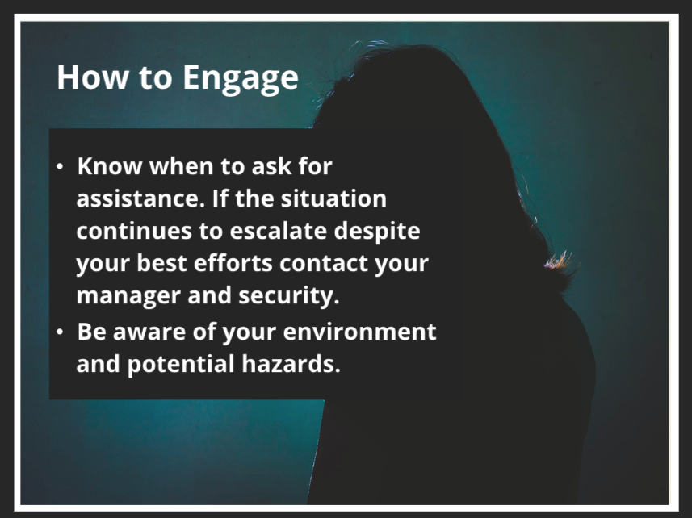
An Important Caveat
No strategy will be effective all of the time.
Notes:
There will likely be times when the strategies I have outlined do not work. The situation may continue to escalate. In that case, know when to ask for assistance. If you’re feeling threatened or uncomfortable, get help right away. Don’t hesitate.

Slide 46
Summary: Background
Many students (and staff) have experienced trauma, which affects their responses, particularly to emotionally charged events. We need to be mindful of our students’ traumatic backgrounds when we response to them.
If a student is not doing well, assume that it is due to lagging skills.
Our job is to model and teach self-regulatory skills.
Students do well if they can.

Slide 47
Summary: Conflict Prevention
Many conflicts are predictable and preventable.
DEMANDS
Conflict = demands > skills.
SKILLS
Drop your assumptions, expectations, and hidden agendas. Drop them completely.
  Remember that 2 of the common lagging skills: emotional self-regulation and cognitive flexibility. That’s why this student is experiencing conflict.
Our job is to model and teach self-regulatory skills.
Notes:
Remember the scales.

Slide 48
Summary: Conflict Prevention
It takes two to tango. Do not engage.
Instead, drop back and observe.
Get curious. Go into detective mode.
Do not try to use rational problem-solving strategies.
No “teaching” using lessons from the past.
No “teaching” about lessons for the future.
No “should-ing” on students.
No “coaching” to prevent the next incident.

Slide 49
Summary: Conflict Resolution
You’re dropped the focus on “Being Right,” which only serves to push students away.
And you’ve started working to “Build Relationship” to model and teach self-regulatory skills.
“Connecting & Calming”
using
Compassionate Communication

Slide 50


Summary: Conflict Resolution
Do the opposite of what’s expected.
ASSESS SAFETY FIRST!
&
Notes:
I hope that this was helpful to you. I think we have some time for questions. While answering questions, I want to share a couple of slides with quotes that are relevant to our discussion today.

Slide 51
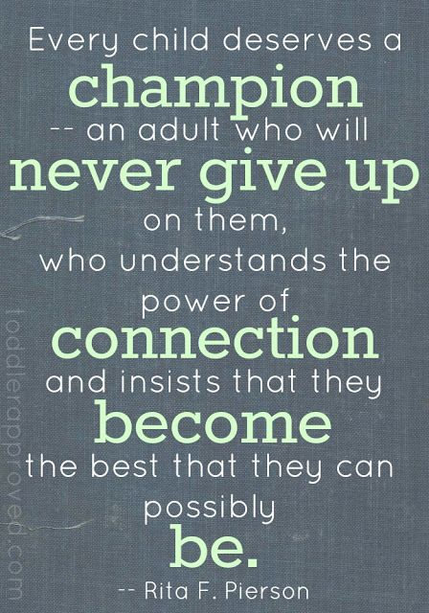
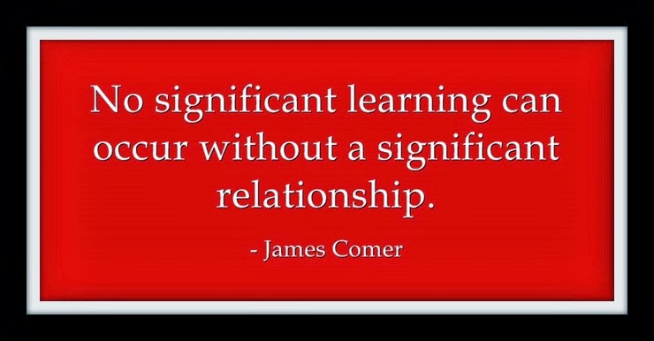
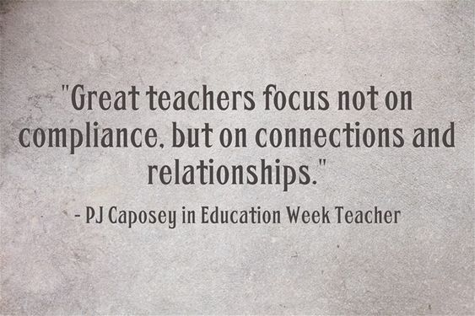
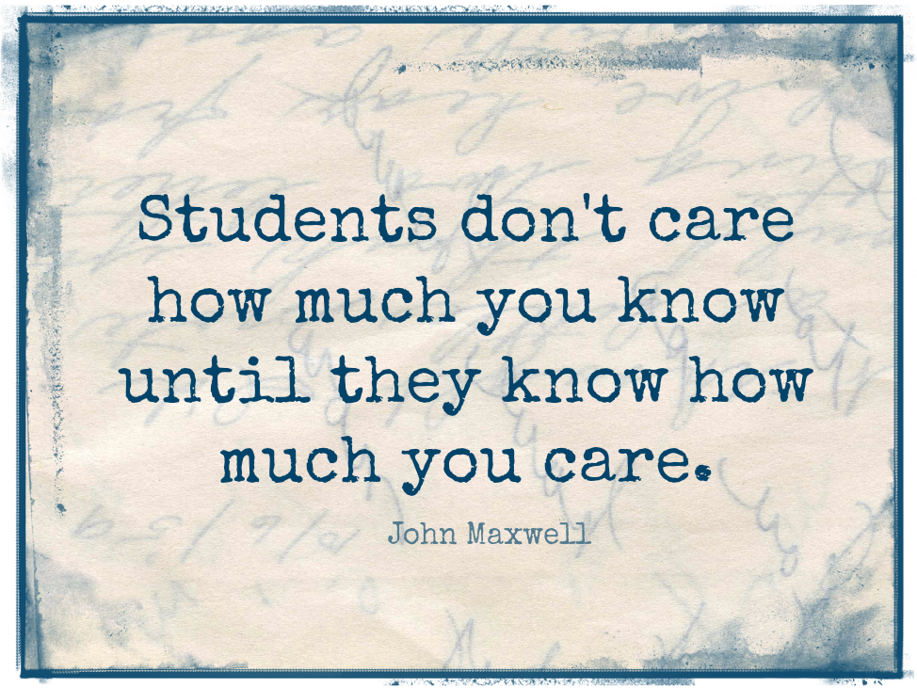

Slide 52
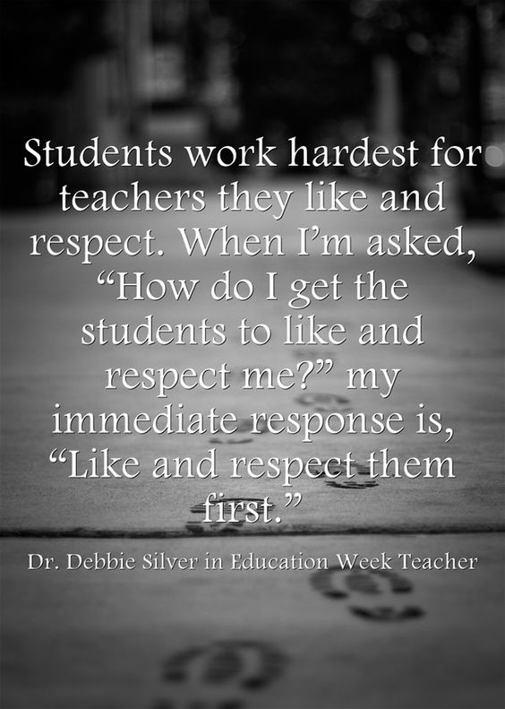
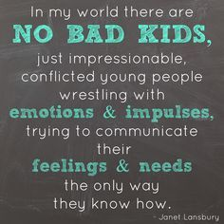
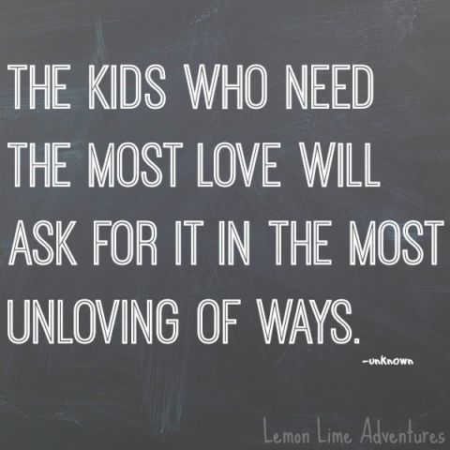

Slide 53
Resources
Trauma Information (SAMHSA):
https://www.integration.samhsa.gov/clinical-practice/trauma
Greene, Ross W. Lost At School (Revised & Updated): Why Our Kids with Behavioral Challenges Are Falling Through the Cracks and How We Can Help Them. New York, NY: Scribner, 2014.
Body Language: https://www.thebalancecareers.com/active-listening-skills-with-examples-2059684

Slide 54
Why Current “Interventions” Don’t Work
Consequences (rewards or punishments) only work to:
  Teach someone basic lessons about the right and wrong ways to behave
  Give people the incentive to behave the right way
Most challenging students already know how we want them to behave & most are already motivated to behave the right way.
They simply do not have the skills to do so.
Notes:
Consequences fail because they are based on faulty assumptions. In a traditional school setting, sending a student to detention over and over and over again or suspending them or expelling them does not work. (Many of us have had the experience of meeting with a student after an altercation. I have never had a student tell me that they didn’t know they should not have yelled or pushed or hit another student. They will say things like, “I just couldn’t help it when she got in my face (impulse control) or “I just got so angry” (emotion regulation) Difference between knowing what to do and know how, when and under what circumstances to do it.

