Slide 1
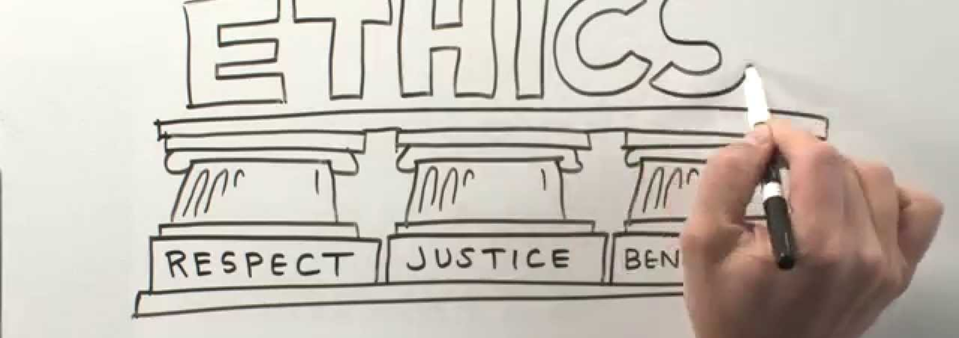
Ethical Decision Making For Center Mental Health Consultants In Job Corps
Valerie R. Cherry, PhD
Lead /Region 2Mental Health Specialist

Slide 2
Objectives
After this presentation, participants will be able to:
List
List basic ethical principles for mental health consultants as it applies within the Job Corps Health and Wellness program.
Identify
Identify common ethical dilemmas that arise in the Job Corps environment for CMHCs.
Apply
Apply an ethical decision-making model to scenarios that might arise within Job Corps settings.
Notes:
Over the next hour we will list basic ethical principles, identify common ethical dilemmas, and discuss several scenarios which require ethical decision making.

Slide 3
Chat Box Questions
Please indicate your licensure
Psychologist
LCSW
LPC
LMFT
Please indicate # of years licensed
0-2
2-5
> 5
Other
Notes:
Before we get started, i would like to have some idea of who is on the webinar today- In the chat box type in your licensures and how many years you have been–licensed. –Let’s get started!

Slide 4
The goal of ethics education is to ensure that participants are:
Classically conditioned to avoid future ethics presentations
More vigilant about catching their fellow psychologists doing unethical things
None of the above
Frightened

Slide 5
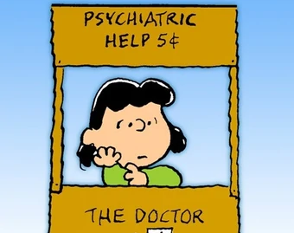
Warning!
The presenter may inadvertently inject humor into the presentation.

Slide 6
Values, Morals, and Ethics Matching Game
.
Term | Definition
Values | 1. Standards by which behaviors are evaluated to determine what the right course of action in a situation is.
Morals | 2. Beliefs or attitudes about what should be judged as good or ideal or right or wrong in a given culture.
Ethics | 3. Prescribes what is or is not considered appropriate behavior in living one's life. Rules that govern a person's behavior.
Notes:
Whenever we talk about ethical decision making these terms are sort of thrown around- Values, Morals, and Ethics. Let’s define them. In the chat box, type which definition by number describes values (2). Morals ( 3) and Ethics (1).

Slide 7
Identify the TOP three qualities that you think are most important to be an effective mental health provider.
Good judgment
Conscientious
Technically proficient
Culturally Competent
Empathic
Self-reflective
Polite
Intelligent
Notes:
Look at this slide- type in the top 3 qualities you think are important to be an effective mental health provider – these will more than likely also reflect your values.

Slide 8
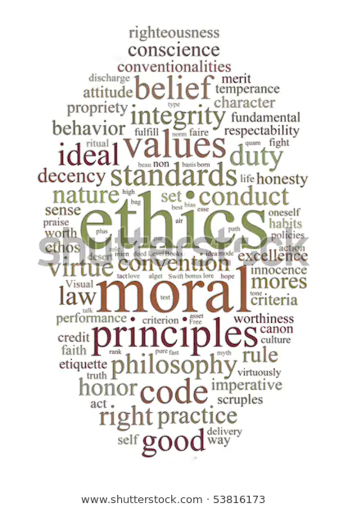
Ethics in Organizations
All human service disciplines follow a professional code of ethics
They are required to be followed by members of professional organizations which include:
American Association for Marriage and Family Therapy
American Mental Health Counselors Association
American Psychological Association
National Association of Social Workers
National Board of Certified Counselors
Notes:
Codes of ethics are developed to protect the individuals and the group the members belong to. It provides a road map. All behavioral health organizations have a professional code of ethics as you know and typically it is broken down into 2 areas – Ethical Principles and Code of Ethics

Slide 9
Ethical Principles
Code of Ethics
Law
Federal Laws – HIPAA
State Laws/Regs – Minors
Board Regs/Statutes – Practice Across State Lines/Telehealth
Notes:
When we think of ethical decision making – in addition to ethical principles and code of ethics we have to be mindful of the relevant laws involved.

Slide 10
Basic Ethical Principles for Mental Health Consultants
Notes:
Let’s start with ethical principles – These are different from ethical codes. General ethical principles are aspirational goals to guide mental health professionals toward the highest ideals of their field ( psychology., social work, or counseling).

Slide 11
Principles of ethical practice
APA Ethical Principles
Kitchener’s Moral Decisions
Principle A: Beneficence and Nonmaleficence.
Principle B: Fidelity and Responsibility
Principle C: Integrity.
Principle D: Justice.
Principle E: Respect for people's rights and dignity.
NASW Ethical Principles
Service • Social Justice •Dignity &Worth • Importance of Human Relationships
• Integrity •Competence
ACA Ethical Principles
Autonomy • Nonmaleficence •Beneficence • Justice • Fidelity •Veracity
Notes:
Handout - So in Job Corps we have licensed mental health providers across a few groups- most fall within the 3 on this slide- Psychologist Social Workers, and Counselors. Let’s review the ethical principals.. These principles are the foundation for ethical behavior and decision making provided by each professional organization.

Slide 12
Standards of the Ethical Code
Resolving Ethical Issues
Competence
Human Relations
Privacy and Confidentiality
Advertising and Other Public Statements
Record Keeping and Fees
Education and Training
Research and Publication
Assessment
Therapy
Notes:
Most ethical standards are very similar across disciplines. The Ethical Standards set forth enforceable rules for conduct as psychologists, social workers, and counselors, etc.

Slide 13
What is an ethical dilemma?
An ethical dilemma arises when two or more of the values found in the ethical principles conflict.
No one clear course of action.

Slide 14
Common CMHC Ethical Challenge AREAs
Informed Consent
Confidentiality and Privacy
Boundaries
Evidence-based practices
Respect for individual culture and values (cultural competency)
Documentation
Use of Technology
Responding to emergencies
Referrals
Resolution of ethical problems

Slide 15
Ethical Decision-Making Model
Positive Ethics Perspective
Notes:
Positive ethics can focus on individual conduct (whether articulated as virtues such as generosity or ethical principles such as beneficence- do good) as well as on how institutions can promote high standards.
Does your professional association have a recommended model of ethical decision making to address ethical conflicts? Type in the chatbot
Yes
No
Unsure
Type in the chat box
Neither the APA or NASW have recommended ethical decision making models.

Slide 16
Ethical Decision Making Model (Koocher & Keith-Speigel, 2008)
Determine that the matter is an ethical one
Consult guidelines already available (ethics code, state board etc.)
Consider sources that might influence decision
Consult with trusted colleague
Evaluate rights, responsibilities, and vulnerability of all affected parties
Generate alternative decisions
Enumerate consequences of making each decision
Make the decision
Implement the decision
Notes:
Using this as an example – there are others - but likely will have many of the same steps

Slide 17
Positive Ethics
Anchoring our behavior on overarching ethical principles
Does not mean ignoring the laws or standards of the profession
But striving to fulfill our highest ethical aspirations within the context of the rules of our professions

Slide 18
POSITIVE ETHICS EXAMPLE
Informed Consent
APA Standards 3.10, 10.02 and others.
Requires certain information is given to students at the start of therapy or as early as feasible.
What ethical principles are involved?
Informed Consent -3
Ceiling (positive) ethics: In addition to following Standard 3.10, you strive to find ways to involve students in as many treatment decisions as possible through out the course of brief treatment.
You search for opportunities to maximize respect for student’s autonomy.
Informed Consent-2
Base ethics: You get students to sign the informed consent document consistent with 3.10.
You are showing respect for student’s autonomy.

Slide 19
One view of ethics
Clinical issues | Ethical issues
Meet with student, do intake, get background data, formulate treatment plan, check on comorbid medical conditions, consult with referral source, go over treatment goals, start brief therapy, get student to open up, look for symptom patterns, etc. | Maintain boundaries with students, get forms signed, provide appropriate record keeping (documentation in the SHR)

Slide 20
Another view of ethics
Clinical and ethical issues
Meet with student and engage student in discerning their brief treatment goals and experiences, formulate a brief treatment plan collaboratively with the student (showing respect for student autonomy), develop a treatment plan that would likely be effective (beneficence) and not harmful (nonmaleficence).
To some mental health professionals, being ethical is merely following the laws and avoiding punishment; for positive ethics - being ethical means adhering to a foundational standard of principles or virtues.

Slide 21
Scenarios That Might Arise Within Job Corps Settings
Notes:
OK Let’s take a look at some scenarios.
Feel free to add twists and turns from your own experience.
There may be no single right answer and there may be no good answer!

Slide 22
Dilemma
Mandatory disclosures of information, such as child abuse reporting or when a client threatens to harm a third party in a jurisdiction with a duty to protect or warn.
Know your state regs/laws
Consult with professional organization
Speak with a mental health law attorney
Consult with another mental health practitioner with expertise in risk assessment

Slide 23
Dilemma
You have a student who was referred to you because she reported to her counselor that she sometimes hears voices of deceased relatives. In your assessment you find there is a strong cultural component and that many in her family also hears voices. You note that the voices are comforting and encouraging and are not “command type.”
The Acting CD hears about this and is adamant that the student be medically separated. You disagree.
What’s your next step?
Notes:
Before we talk about principles - What standard applies? Click to next slides
What Principle applies here - Principle E: Respect for People's Rights and Dignity
Psychologists respect the dignity and worth of all people, and the rights of individuals to privacy, confidentiality, and self-determination. Psychologists are aware that special safeguards may be necessary to protect the rights and welfare of persons or communities whose vulnerabilities impair autonomous decision making. Psychologists are aware of and respect cultural, individual, and role differences, including those based on age, gender, gender identity, race, ethnicity, culture, national origin, religion, sexual orientation, disability, language, and socioeconomic status, and consider these factors when

Slide 24
APA 1.03 Conflicts Between Ethics and Organizational Demands
If the demands of an organization with which psychologists are affiliated or for whom they are working are in conflict with this Ethics Code, psychologists clarify the nature of the conflict, make known their commitment to the Ethics Code, and take reasonable steps to resolve the conflict consistent with the General Principles and Ethical Standards of the Ethics Code. Under no circumstances may this standard be used to justify or defend violating human rights.
Notes:
A reminder from the APA. You will find something similar is any behavioral health profession code of ethics
APA 1.02 Conflicts Between Ethics and Law, Regulations, or Other Governing Legal Authority APA 1.02 - If psychologists’ ethical responsibilities conflict with law, regulations, or other governing legal authority, psychologists clarify the nature of the conflict, make known their commitment to the Ethics Code, and take reasonable steps to resolve the conflict consistent with the General Principles and Ethical Standards of the Ethics Code. Under no circumstances may this standard be used to justify or defend violating human rights.

Slide 25
NASW 3.09 Commitments to Employers
c) Social workers should take reasonable steps to ensure that employers are aware of social workers' ethical obligations as set forth in the NASW Code of Ethics and of the implications of those obligations for social work practice.
(d) Social workers should not allow an employing organization's policies, procedures, regulations, or administrative orders to interfere with their ethical practice of social work.
Notes:
Let’s go back to the scenario

Slide 26
Dilemmas
An adult student discloses in your individual session that they were sexually assaulted over the weekend by the current boyfriend who is also a student. She does not want to report it.
What do you do?
Notes:
If competent adult in most states– it is the student’s choice but JC policy states that all allegations of sexual assault must be reported
You are afraid of also breaking confidentiality. – What is the ethical dilemma here- code regarding confidentiality and privacy and – then there are the ethical principles related to

Slide 27
Dilemmas
In your individual session, a student tells you that his girlfriend Valerie is applying to the program and he is so happy because she recently was discharged from the hospital for suicidal ideations and was diagnosed with Bipolar disorder. She’s doing better but needs a place to live. You get the file and the 6-53 is clean and no mental health information in the file.
What happens now?

Slide 28
dilemma
You have started to see a new student who is a recent immigrant from Ethiopia.
Although he was reluctant to come to see you, he did so because an older relative told him it would be a good thing to do.
During your first meeting he asked a lot of questions about you, such as where you are from, what your parents did for a living, and how much you get paid.

Slide 29
dilemma
How would you respond to his questions?
FYI– in Ethiopian culture, people tend to know each other well, rely heavily on friends and family members for advice, and tend to distrust outsiders.
Notes:
APA is silent on self-disclosure -

Slide 30
Competence & Self-Reflection
Studies with health care professionals have shown implicit (unrecognized) biases among some health care professionals against patients who are:
Non-White
Overweight/Obese
Less attractive
More attractive
Women
Notes:
FitzGerald, C., & Hurst, S. (2017). Implicit bias in healthcare professionals: a systematic review. BMC medical ethics, 18(1), 19.
Cultural competence can be enhanced by
Readings
Workshops
Supervision or consultation
All of the above

Slide 31
Dilemma
All Wellness staff have full access to a student’s health record. It has come to your attention that there has been discussion in the breakroom about some of the information in your mental health notes in a casual manner. You now decide to restrict what session or clinical information you put in the progress note.
Thoughts?
Notes:
Record entries must be considered with a balance of utility and need to know. Staff may not need to know that student was born prior to his parent’s marriage but it would clearly help student if Wellness staff understood that student tends to withdraw socially when stressed, Education to other staff about confidential information.

Slide 32
Dilemma
A student on your case load had a verbally aggressive incident with another student. You are asked by the non health administrator to provide access to your mental health notes in the student health record to a local policeman that sometimes volunteers with your Job Corps center in a manner that seemed contrary to your ethics code. The non health administrator tells you “ Those ethical principles do not apply since you are a consultant at a federal program.”
Notes:
Simply untrue -

Slide 33
Dilemma
A student whom you really like and who is referred off site for mental health services, can’t get transportation to get him to his appt on time. There is a problem locating the driver. You are leaving center you see him waiting and he asks you if you can give him $5.00 to catch the bus so he can make the appt.
What do you do?

Slide 34
Dilemma
A student with a chronic mental health condition stops taking medication and the CMHC has concerns it may impact their behavior on center.
Can the CMHC share this with Counselors and Residential Living Staff?
Notes:
Yes, the HIPAA Authorization signed by students indicates that we may share this information with them. However, following "need to know" as a guide, only the counselor and residential staff who work with this student need to be informed, not all counselors or all residential staff.

Slide 35
Dilemma
As CMHC you have been seeing a 16-year-old student for the past month who has recently stopped taking psychotropic medication.
Can you contact parents?
Notes:
Disclosure To Parents Of Minor:

Slide 36
Dilemma
You have a 20-year-old student who tells you she wants to get pregnant to keep her boyfriend (she already has 2 children –both of whom are in foster care). You have strong feelings about this being the wrong decision to continue to have children and find it difficult to remain neutral. You feel you have an obligation to try to dissuade her from following through with this decision which you believe is not in her best interest or the future child.
Is this an ethical dilemma? If so, how do you manage it?
Notes:
Clash between ethics and morals/values

Slide 37
Dilemma
You receive a call from someone who says they are calling from the Law Office of West and Company and they have a complaint about an applicant who was denied admission. They state they have a Release to speak with you and start demanding information about your credentials and your phone assessment of the applicant 6 months ago. You are caught off guard and begin to respond and then realize you don’t have an authorization in hand and direct them to the Regional Office, They respond they will see you in court.
Did you do the right thing?

Slide 38
Dilemma
Monday morning the CMHC receives a message from the mother of an 18-year-old student who wants to talk about behaviors observed over the weekend pass. You look in the SHR and there is no release to share information with the mother.
Can you call the mother?
Notes:
Yes, HIPAA in no way prevents health care providers from listening to family members or other caregivers who may have concerns about the health and well-being of the patient, so the health care provider can factor that information into the patient’s care. But you can't share any information, only listen and thank the mother for the call.

Slide 39
dilemma
You have a new student who you have just assessed. They tell you that they researched you on the internet because they wanted to know more about you and saw that you are divorced and have 2 children and are active in a local theater group. They said they researched you because they have been “burned before” by therapists and wanted to make sure you weren’t crazy.
Is this an ethical dilemma?
Notes:
I would say no but it is probably uncomfortable.
How do you respond?

Slide 40
Dilemma
Brian is disruptive in class and is constantly in trouble in his dorm with several write-ups. You suspect he has ADHD, but he doesn’t have a diagnosis and you have only seen the student once after this recent incident in the class. Your Center Director is fed up with Brian’s behavior and asks you to put Brian out on a MSWR. You don’t agree with a MSWR. The next day you are back on center you find out Brian has been placed on MSWR.
What should you do in this situation?

Slide 41
Difficult DECISION
You are seeing a student for anxiety and she tells you that one of her friends has talked about wanting to kill herself. She adamantly refuses to give you the student’s name because she doesn’t want to betray her confidence and lose her friendship. She asks you not to say anything but that the situation increases her anxiety.
Is this an ethical dilemma?
Notes:
So the other student is not your patient

Slide 42
Difficult Decision
Student just took their 45-day test and begins to express suicidal ideations. You evaluate and send them to the ER for evaluation. The hospital admits him and student is placed on MSWR. You also learn that student has attempted suicide in the past. The results of the 45 test is now back and is positive and student should be ZT’d. Hospital plans to release student on same day.
How would you handle this?
Notes:
If you decide to tell him the truth, could you do something to minimize the impact?
Bring student back to center to let him know about ZT? Tell family about his threat and your concerns? Ask for RO to get involve RE: MSWR versus ZT?

Slide 43
dilemma
Did Dr. Wilkins abandon a student if she:
Was so busy that she did not have time in her schedule to see a student in a crisis?
Took a vacation and did not arrange for back up coverage?
Terminated a student who needed more treatment and did not give a referral off center?
All of the above

Slide 44
Dilemma
A male student informs you in session that a female student had reported to a teacher, in front of him and others at lunch, that she had been forced to perform oral sex on another student. The student stated that the teacher said they would address the issue with the alleged perpetrator.
You report this information to the Wellness Manager, the SART is convened and you are asked to meet with the alleged victim. You document the conversation in the SHR and share statements with the HWM. The matter was then turned over to the Safety Officer and the Administrator on Duty.
In the meantime another staff member tells the alleged perpetrator the name of the student who reported the incident. The alleged perpetrator is later seen bullying the student who reported.
Notes:
What is the conflict here?
What are some of the ethical issues here?
Confidentiality
What do you do when a coworker breaks policy, etc.

Slide 45
Keep In Mind
You will make mistakes
You can’t help everyone
You don’t know everything
You can’t go it alone
Humility and a sense of humor are critical in keeping perspective

Slide 46
Important Resources
Your State Board
National And State Professional Organizations
Your Malpractice Carrier
Your Regional Mental Health Specialists

Slide 47
Regional Mental Health Specialists
Region 1 Maria Acevedo, PhD (Puerto Rico)
Acevedo.Maria@jobcorps.org
Regions 1 and 3 Eugia Meminger PhD
Meminger.Eugia@jobcorps.org
Lead/Region 2 Valerie Cherry, PhD
Cherry.Valerie@jobcorps.org
Region 4 & 6 Tamara Warner, PhD Warner.Tamara.D@jobcorps.org
Region 5 Helena Mackenzie, PhD Mackenzie.Helena@jobcorps.org
Notes:
On this slide, you will find current contact information by region for your regional mental health consultants.

Slide 48
References
Knapp, S. J., VandeCreek, L. D., & Fingerhut, R. (2017). Practical ethics for psychologists: A positive approach (3rd ed.). American Psychological Association.
Koocher, G.P. & Keith-Spiegel, P. (2008). Ethics in Psychology and the Mental Health Professions: Standards and Cases (3 rd e d.). New York: Oxford University Press
National Association of Social Workers. (approved 1996, revised 1999). Code of Ethics of the National Association of Social Workers. Washington, DC: Author.
Pope, Kenneth S. (1991) Ethics in psychotherapy and counseling. San Francisco : Jossey-Bass,
Walsh, R. T. G. (2015). Introduction to ethics in psychology: Historical and philosophical grounding. Journal of Theoretical and Philosophical Psychology, 35(2), 69-77.
American Counseling Association (2014). ACA Code of Ethics. Alexandria, VA: Author.
American Psychological Association. (2017). Ethical principles of psychologists and code of conduct. Washington, DC: Author
Bipeta R. (2019). Legal and Ethical Aspects of Mental Health Care. Indian journal of psychological medicine, 41(2), 108–112. https://doi.org/10.4103/IJPSYM.IJPSYM_59_19
FitzGerald, C., & Hurst, S. (2017). Implicit bias in healthcare professionals: a systematic review. BMC medical ethics, 18(1), 19. https://doi.org/10.1186/s12910-017-0179-8
George, R., Dogra, N. and Fulford, B. (2015), "Values and ethics in mental-health education and training: a different perspective", The Journal of Mental Health Training, Education and Practice, Vol. 10 No. 3, pp. 189-204. https://doi.org/10.1108/JMHTEP-08-2014-0024

Slide 49
Comments/Questions

