Slide 1
Mental Health and Wellness Program (MHWP) in the Virtual Learning Environment
Dr. Valerie Cherry, Lead Mental Health Specialist
Dr. Karyn Felder Moore, Center Mental Health Consultant Woodstock JCC
Dr. Callie Scott, Center Mental Health Consultant Pittsburgh JCC
May 2020

Slide 2
After this webinar participants will be able to:
Identify MHWP-related PRH requirements that can be implemented via the Virtual Learning model.
Develop mental health and wellness activities and meetings using virtual technology.
Implement acceptable documentation strategies for the student health record (SHR).

Slide 3
JOB CORPS PROGRAM INSTRUCTION NOTICE NO. 19-17 Released 4/24/2020 Virtual Operating Status
Goal: Students to remain connected to the program by engaging in distance learning activities that support gains in learning and career skills training.
Distance Learning
online (web-based) courses
mobile learning
Webcasts/podcasts
video learning, computer-based instruction, and other innovative tools
mail but this is not ideal according to the PIN
Notes:
Spring Break began on 03/16/2020
During the Spring Break, CMHCs (and other staff) have checked in with and supported students by calling, texting and other means of communication.
05/11/2020 Job Corps transitioned from Spring Break to Virtual Operating Status for COVID-19.
Distance learning (DL) phase will last until students return to centers (date to be determined).

Slide 4
What does virtual or distance learning look like for the MHWP?

Slide 5
WORK IN PROGRESS
WE DON’T HAVE ALL THE ANSWERS

Slide 6
JCDC Notice 19-197 Google Classroom Available and Other Platform Options
Job Corps has been approved for an educational license for Google Classroom for staff and students at each center. https://support.google.com/edu/classroom/?hl=en#topic=6020277)
Other Platform Options?
Telemental health or meetings with staff that include PHI
( HHS/OCR Notification of Enforcement Discretion regarding COVID-19)
Other Platform Options?
Notes:
Doxy.Me -All individual providers get a free Business Associate Agreement (BAA) with Doxy.me. Sign up for free to download your BAA.
Lifesize Healthcare Solutions and HIPAA Compliance
TikTok, Facebook Live, Twitch, or a public chat room are NOT acceptable
Which parts of the HIPAA Rules are included in the Notification of
Enforcement Discretion regarding COVID-19 and remote telehealth
communications?
Covered health care providers will not be subject to penalties for violations
of the HIPAA Privacy, Security, and Breach Notification Rules that occur in
the good faith provision of telehealth during the COVID-19 nationwide public
health emergency. This Notification does not affect the application of the
HIPAA Rules to other areas of health care outside of telehealth during the
emergency. 6. When does the Notification of Enforcement Discretion regarding
COVID-19 and remote telehealth communications expire?
The Notification of Enforcement Discretion does not have an expiration date.
OCR will issue a notice to the public when it is no longer exercising its
enforcement discretion based upon the latest facts and circumstances. Use of public-facing remote communication products, such as TikTok,
Facebook Live, Twitch, or a public chat room, which OCR has identified
in the Notification as unacceptable forms of remote communication for
telehealth because they are designed to be open to the public or allow
wide or indiscriminate access to the communication.

Slide 7
Mental Health and Wellness Program (MHWP) PRH 2.3, R4
Assessment
Mental Health Promotion and Education
Treatment

Slide 8
Special Considerations to Consider when Implementing the MHWP
In your state do you need certification to provide Telemental health services?
Does your current professional liability insurance cover Telemental health?
Do you need an additional informed consent?
https://www.apa.org/practice/programs/dmhi/research-information/informed-consent-checklist
https://www.socialworkers.org/LinkClick.aspx?fileticket=fN67-dWQReM%3d&portalid=0
Practice Across State Lines
Psychology
https://www.apaservices.org/practice/clinic/covid-19-telehealth-state-summary
https://www.asppb.net/page/covid19
Social Work
https://www.aswb.org/regulatory-provisions
Notes:
Let’s talk about a few important considerations in our work to provide MH services virtually. This will be important as we discuss the treatment section of the MHWP. Type your answer in the chatbox
Read slide – 1. In many states you can’t just go and start telemental health- you have to get training.
2. There are potential benefits and risks of video-conferencing (e.g. limits to student confidentiality) that differ from in-person sessions.
Confidentiality still applies for telepsychology services, and nobody will record the session without the permission from the others person(s).
We agree to use the video-conferencing platform selected for our virtual sessions, and the CMHC will explain how to use it.
It is important to be in a quiet, private space that is free of distractions (including cell phone or other devices) during the session.
We need a back-up plan (e.g., phone number where you can be reached) to restart the session or to reschedule it, in the event of technical problems.
We need a safety plan that includes at least one emergency contact and the closest emergency room to your location, in the event of a crisis situation.
If you are not an adult, we need the permission of your parent or legal guardian (and their contact information) for you to participate in telepsychology sessions. In NY Providers of telemental health services can collect consent for
services verbally so long as the consent is informed (i.e. providers
are informing patients about the services provided, their right to
refuse, right to revoke consent at any time, etc.), and the verbal
consent is recorded by the provider in the patient’s treatment record
3. As you may know, when a client and clinician are located in different states, each state has jurisdiction over the therapeutic relationship. Of course, multiple states means multiple regulatory systems, many of which are in flux during this time. In some cases due to the COVID-19 emergency, states have eased requirements, allowing all licensed mental health clinicians in good standing to practice teletherapy across state lines. In other cases, states require clinicians to apply for permission to practice in-state. And, in a number of other states, clinicians continue to be required to be licensed where they’re located and where the client is located. You have to check.

Slide 9
Applicant File Reviews
CIS access
Telephone interviews, Video conference
Upload DTA or HCNA assessments to CIS
NEW STUDENTS
Review of Social Intake Form (SIF)
An online mechanism to conduct and review the Social Intake Form (SIF) .
Mental-health assessments and recommendations for referred students.
Telephone
Video conference
Medical Separation with Reinstatement Rights (MSWR) or medical separation
Justification or documentation to support MSWR
HIPAA Compliant
Notes:
CIS – Select
“Update Health efolder” and then follow this process.
Ø Select the folder you want to upload something into.
Ø Click on “add new document”.
Ø Box pops up and you have to select either the “scan” or “attach” tab.
Ø To use the scanner you must have one that will be detected when you “select scanner”.
Ø To attach you can browse and attach from your computer.

Slide 10
Mental Health Promotion and Education
CPP presentation for new students
Google Classroom
CPP PowerPoint on JC Health and Wellness website
Center wide mental health and promotion activity
Google Classroom
Center Facebook Page
YouTube
Emails
Clinical consultation with Center Director, management staff, and Health and Wellness Manager
Teleconference calls
GoToMeetings
WebEx Trainings
Notes:
Review the CPP template.
Coordinate with other staff to determine how to schedule time with the new students
Will you do this presentation as a group or individually?
Consider conducting joint presentation with HWM and/or CMHC.
Determine whom to refer students to when there are questions about distance learning and Job Corps.
Preliminarily – consider what is going to be most receptive to students.
What platform?
What message?
Consider using Motivational Interviewing techniques
Possible Examples:
Create a presentation on YouTube that is provided to all the students
Send out a center-wide email with information and resources
Get “guest” speakers to prepare information (or presentations) that can be sent out
Find online and available recovery stories that you can share

Slide 11
Treatment
Short-term counseling with mental-health checks as needed.
Telephone
Telemental Health
Google Voice – Texting (Check-ins only)
Collaboration with TEAP specialist
Teleconference Calls
Videoconference

Slide 12
Treatment
Collaboration with center physician and Health-and-Wellness staff on psychotropic medication monitoring of stable students
Teleconference Calls
Videoconference
Collaboration with counseling staff in developing and/or leading psycho-educational skill-building groups
Teleconference Calls
Google Classrooms

Slide 13
Treatment
Information exchange through regular case conferences between the Center Mental Health Consultant and counselors
Teleconference Calls
Videoconference
Crisis intervention
Have student identify a “support person” in case of an emergency and provide you with their contact information.
Location of the nearest hospital
Mobile crisis unit
Local law enforcement contact info, if needed
Safety/Help Lines
Notes:
1) identifying local emergency resources and phone numbers;
2) becoming familiar with location of nearest hospital emergency room capable of
managing psychiatric emergencies; and
3) having student’s family / support contact information. request the contact information of a family or community member who could be called upon for
support in the case of an emergency. This person will be called “the Student Support Person” an individual selected by the student. In the case of an emergency, the professional may contact the Student Support Person to request assistance in evaluating the nature of the emergency and/or initiating 9-1-1.

Slide 14
Treatment
Referral to off-center mental-health professionals or agencies
A written referral/feedback system
Use of Forms/Emails (JC to JC email)
Notes:
1) identifying local emergency resources and phone numbers;
2) becoming familiar with location of nearest hospital emergency room capable of
managing psychiatric emergencies; and
3) having student’s family / support contact information. request the contact information of a family or community member who could be called upon for
support in the case of an emergency. This person will be called “the Student Support Person” an individual selected by the student. In the case of an emergency, the professional may contact the Student Support Person to request assistance in evaluating the nature of the emergency and/or initiating 9-1-1.

Slide 15
DOCUMENTATION EXAMPLES For Distance Learning

Slide 16
Considerations for Distance Learning Documentation
Documentation is still a requirement – even when services are provided via distance learning.
Confidentiality Issues:
How are your notes secured if you are working from home.
Do the notes remain with you or do you send them (via JC email) to center.
Who is listening when you are online with students?
Options for format include using fillable SF-600; handwriting on SF-600 or using computer to document in separate password protected file for each student.
Use of mental health forms on JC website
Other options you have considered?

Slide 17
Brief Disclosure Statement Example - (Informed Consent)
To be placed in the SHR
On date, 2020 at AM/PM student gave verbal consent for services through ongoing telehealth modality. Telehealth modality is being used during the COVID-19 (Coronavirus) pandemic.
Student was informed of the inherent limits of confidentiality when using technology. Student was contacted via phone number, (xxx-xxx-xxxx)
During Telehealth session, the following individuals were also present with the student: ______________________
Signed: CMHC Specialist
Thanks to Karen and Kim at Philadelphia Job Corps
Check with your professional organizations!

Slide 18
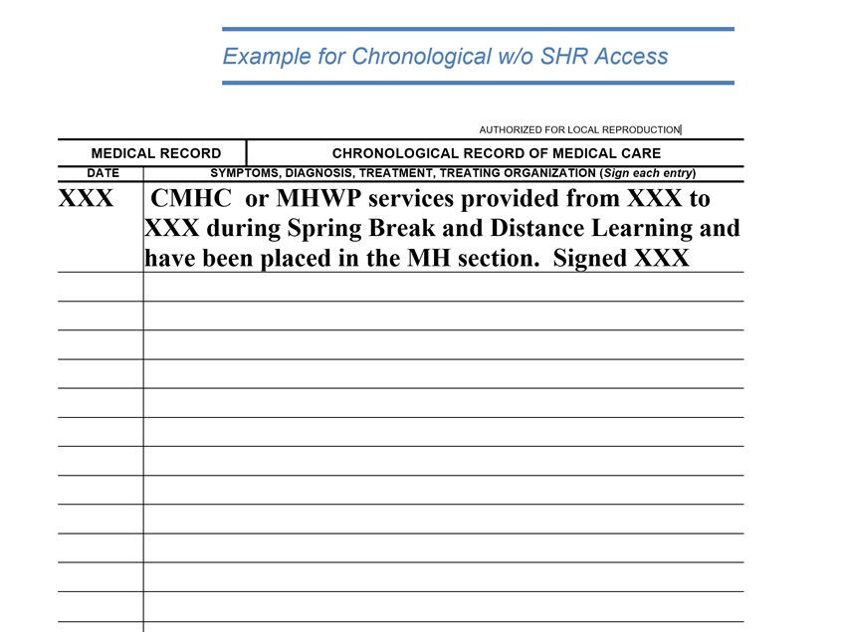

Slide 19
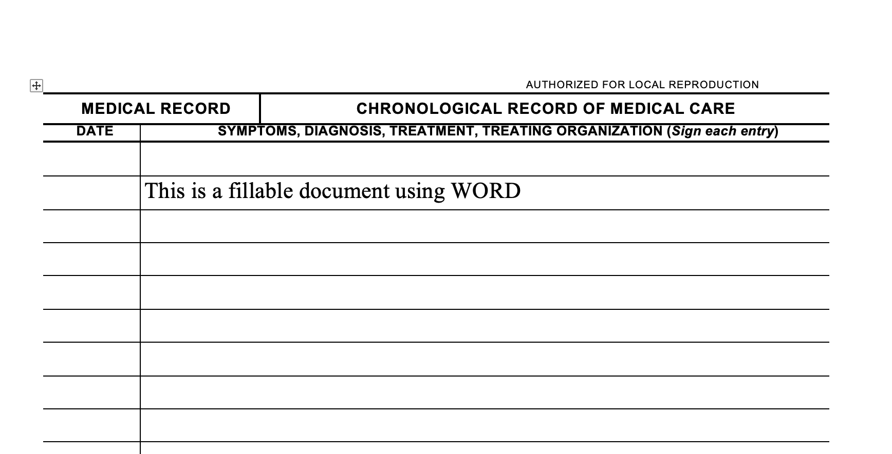

Slide 20
Karyn Felder Moore, PhD, LCPC, NCC
Center Mental Health Consultant Woodstock JCC

Slide 21
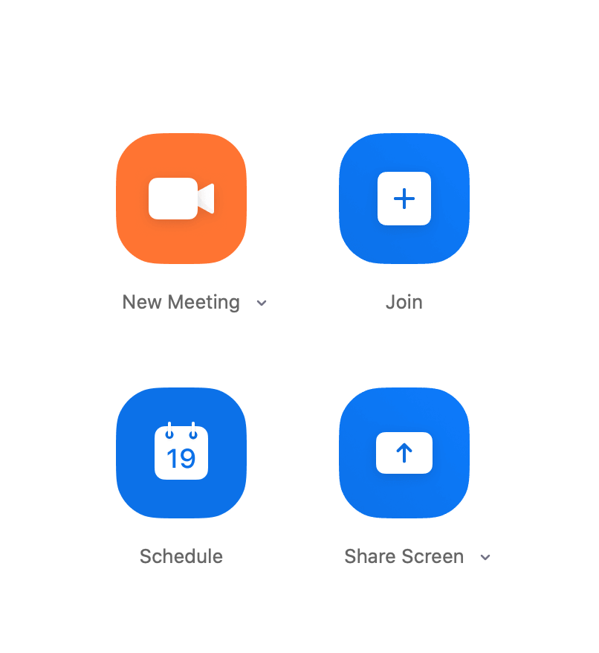
Staff Development & Consultation
CMHC and counselors continue to meet weekly to discuss any students in crisis or needing assistance (academic, technology, encouragement, food/housing, etc.)
CMHC and TEAP specialists meet weekly via video conference.
These meetings have been via Zoom.
An hour for us to share ideas, brainstorm and assist each other with meeting student needs.

Slide 22
May is Mental Health Month “Real Talk
In Real Time”
Every Wednesday PM and Friday AM
Opportunities for students to pop in and chat with CMHC & TEAP specialists.
Informal - to maintain connection and engagement. This is NOT telemental health.
Discussion question each “session”.

Slide 23
H.Y.P.E. News
Helping Young People Excel in Life & Work
Online newsletter to inform, encourage, inspire, motivate, and educate our students.
May 2020 was the kick-off issue.
Newsletter will focus on mental, emotional, physical and spiritual well-being; with contributions from all Wellness Staff.

Slide 24
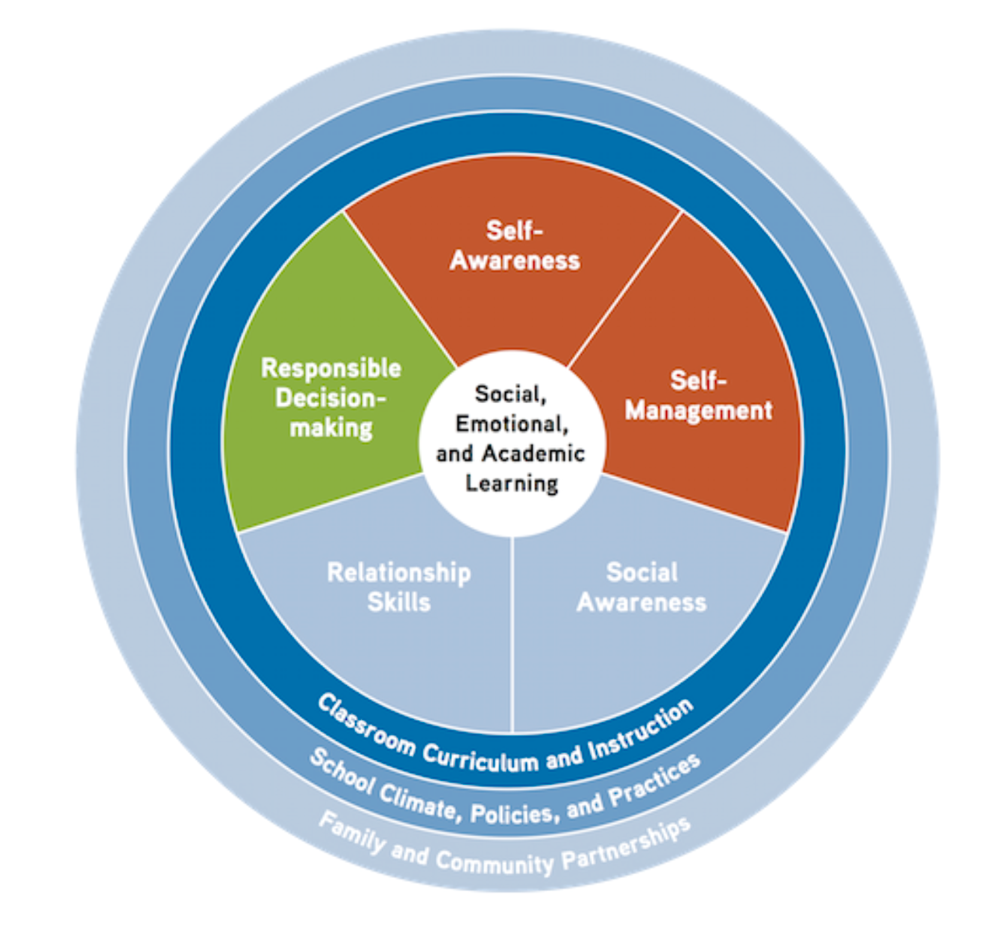
Coming soon:
Social Emotional Learning (SEL) in 15
CMHC and counselors will collaborate together to focus on Social Emotional Learning in the “Google Classroom”.
15-minute mini-groups to introduce a skill (Self-Awareness, Self-Management, Social Awareness, Relationship Skills, Responsible Decision Making) and integrate activities to reinforce that skill. Anticipating 6-8 wks.

Slide 25
Callie Scott D.Ed., M.S., NCC, LPC
Center Mental Health Consultant Pittsburgh JCC

Slide 26
Focus on Virtual Learning Activities Through:
Continuing Education
Student Outreach
Student Re-Integration
Continuing Education
Participate in trainings that meet counseling licensure and certifications.
American School Counselor Association
National Board of Certified Counselor
PA Board of Professional Counselors
Search for trainings that are free or low-cost.
Focus on trainings on tele-mental health (phone, text, video) counseling and other relevant mental health topics that will benefit Job Corps students.

Slide 27
Student Outreach
“Mental Health & Wellness Google Classroom”
24-hour access
This resource tool should be used to: Promote positive mental, emotional, and physical well-being. Develop positive coping skills to handle stressful life events. Be an additional support to counseling or mental health services received.
Assignments will assist with student mental health and personal development.
Topics in the areas of: anger, anxiety, community resources, COVID-19 resources, coping skills, depression, mental health resources, sleep hygiene, stress, time management and self-care.

Slide 28
Student Re-Integration
Promoting the “Stress-Free Initiative” through the “Mental Health & Wellness Internship Program.”
Goal: For every Job Corps student to have their own personal “Coping Skills Kit.”
Purpose: For students to use this kit to positively respond to stressful life events.

Slide 29
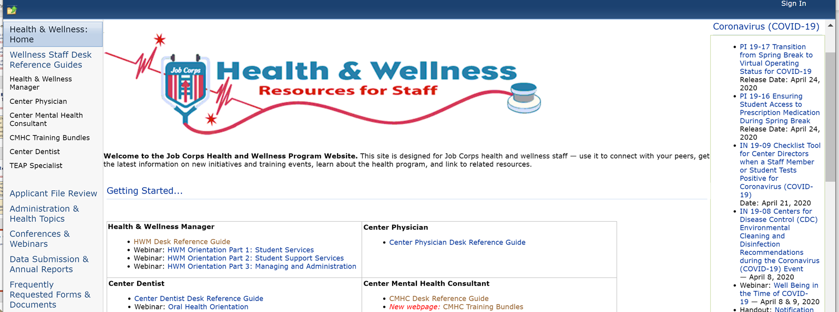
Where to Find Content?
Support Services Website:
https://supportservices.jobcorps.gov/health/Pages/default.aspx

Slide 30
Regional Mental Health Specialist
Regions 1 (Boston) & 3 (Atlanta) Eugia Meminger, PhD Meminger.Eugia@jobcorp.org
Region 1 (Puerto Rico) Maria Acevedo, PhD Acevedo.Maria@jobcorps.org
Region 2 (Philadelphia) Valerie Cherry, PhD Cherry.Valerie@jobcorps.org
Regions 4 (Dallas) & 6 (San Francisco) Tamara Warner, PhD Warner.Tamara.D@jobcorps.org
Region 5 (Chicago) Helena Mackenzie, PhD Mackenzie.Helena@jobcorps.org
Notes:
Have more questions or need more help===contact your regional health specialist.

