Slide 1
Virtual Learning and TEAP
Diane Tennies, PhD, LADC
Christy Hicks, LCADC, CSW
May 2020

Slide 2
Learning Objectives
Acquire information to develop customized TEAP-related presentations.
Identify TEAP-related PRH requirements that they can be implemented via the Distance Learning (DL) model.
Implement three strategies to enhance student's responsiveness to information.
Recognize acceptable documentation strategies for the SHR.

Slide 3
JOB CORPS PROGRAM INSTRUCTION NOTICE NO. 19-17
Spring Break began on 03/16/2020
During the Spring Break, TEAP specialists (and other staff) have checked in with and supported students by calling, texting and other means of communication.
On 04/24/2020 PIN 19-17 was released which indicated that on 05/11/2020 Job Corps transitioned from Spring Break to Virtual Operating Status for COVID-19.
This distance learning (DL) phase will last until students return to centers (date to be determined).
Goal: Students to remain connected to the program by engaging in distance learning activities that support gains in learning and career skills training.
Distance learning can be delivered through online (web-based) courses, mobile learning, webcasts, podcasts, video learning, computer-based instruction, and other innovative tools. Also mail but this is not ideal according to the PIN.

Slide 4
What does virtual or distance learning look like for TEAP ?

Slide 5
Logistical Elements to Consider when Implementing the TEAP
What do you tell the student about why you are contacting them?
Clarify the intent of the contact
Make a disclosure statement about nature of contact (see example in documentation)
Get agreement to provide services in this manner
Document if students refuse contact (as well as what happened during the contact)
Make sure method of communication protects confidentiality.
Collaborate with CMHC and others for joint interactions with students.
Involve other departments such as Recreation for activities.

Slide 6
JCDC Notice 19-197 Google Classroom Available and Other Platform Options
Job Corps has been approved for an educational license for Google Classroom for staff and students at each center. (For Google Classroom help on setting up classes, assignments, etc., go to: https://support.google.com/edu/classroom/?hl=en#topic=6020277)
Facebook Live
Doxy
YouTube videos
Other Platform options?

Slide 7
Specific PRH Requirements to Fulfill with Distance Learning
Focus on four parts of the PRH and then Documentation
Relapse Prevention
Center-wide Activities
Intervention Services
For new students:
CPP Presentations
Review of SIF
Assessment for higher risk students
Documentation

Slide 8
Prevention and Education Activities
Recall what the PRH in 2.3 R5 says:
a. The general emphasis of TEAP must be on prevention, education, identification of substance use problems, relapse prevention, and helping students overcome barriers to employability.
b. Substance use prevention and education, to include:
1. Minimum of a one-hour presentation on substance use prevention for all new students during the Career Preparation Period.
3. At least three annual center-wide substance use prevention and education activities
4. Clinical consultation with Center Director, management staff, Center Mental Health Consultant, and Health and Wellness Manager regarding substance use prevention and education efforts for students and staff
5. Coordination with other departments/programs on center, to include, but not be limited to, residential, recreation, student government association, and HEALs, to develop integrated prevention and education services

Slide 9
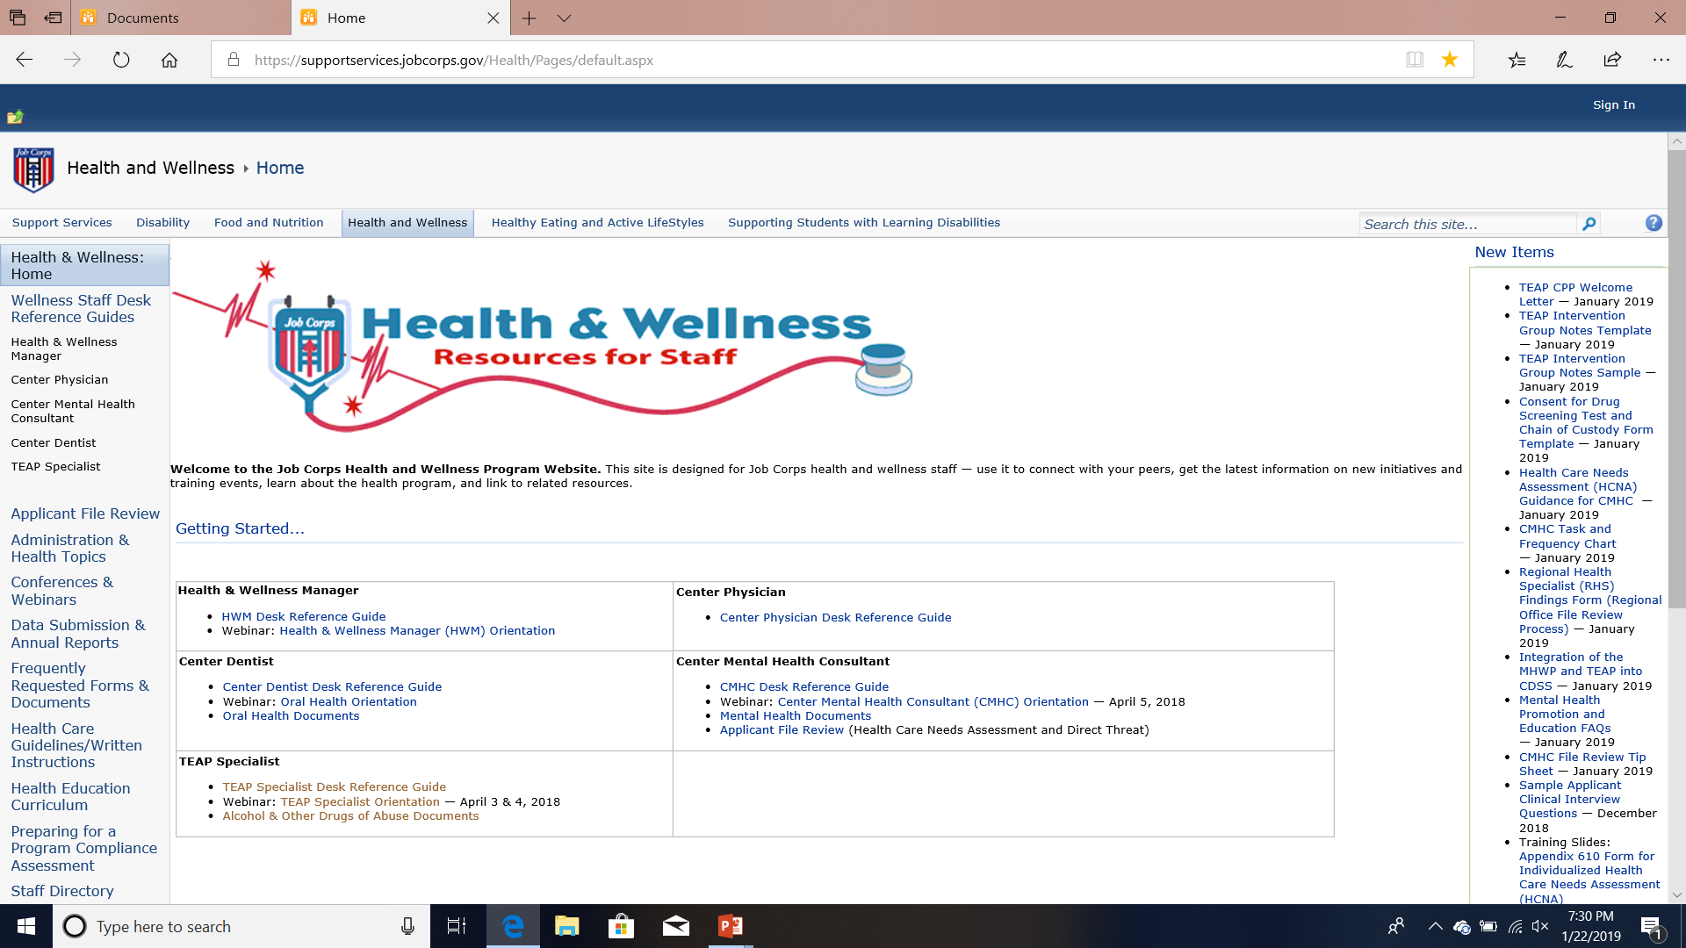
Where to Find Content?
SupportServices Website: https://supportservices.jobcorps.gov/health/Pages/default.aspx

Slide 11
What are Possible Ways to Provide Relapse Prevention via DL?
Individual meetings via telehealth.
Are group RP meetings possible? (Possibly, if this was an established group before the Spring Break).
Emailing resources to students.
Encourage use of online supports (see next slide).
Work to student around “positive distractions” for their time.
Google to find other free resources that you can either show students or encourage them to review as homework.
SAMHSA
National Institute of Drug Abuse (NIDA)
https://www.addictionsandrecovery.org/relapse-prevention.htm

Slide 12
Online Supports
Alcoholics Anonymous Groups
https://www.aa-intergroup.org/index.php
AA Telephone Meetings
AA Audio/Video Meetings
12-Step Forums
AA Online Meeting
AA Family Group Online Meeting
Narcotics Anonymous
Narcotics Anonymous Online Meeting List
Never Alone Club
Never Alone Club Online Chat
Marijuana Anonymous
Marijuana Anonymous Online Meeting Schedule
See document for more resources at the Support Services Website

Slide 13
Center-Wide Activities
Preliminarily – consider what is going to be most receptive to students.
What platform?
What message?
Consider using Motivational Interviewing techniques
Possible Examples:
Create a presentation on YouTube that is provided to all the students
Send out a center-wide email with information and resources
Get “guest” speakers to prepare information (or presentations) that can be sent out
Find online and available recovery stories that you can share

Slide 14
What About Intervention Services and Drug and Alcohol Testing?
Drug or alcohol testing cannot occur during distance learning.
However, students who were in the intervention period before the Spring Break, should continue to be provided intervention services via distance learning.
Individual or group meetings with students via telehealth that focus on employability barriers.
There are many resources on-line.
Use the CDP and CTP templates (on website) for other material.
SAMHSA has new materials on marijuana (https://www.samhsa.gov/marijuana), including brief videos and handouts.

Slide 16
Career Preparation Period Presentation
Use the CPP template on the website.
Introduce yourself as the TEAP Specialist and describe your role.
Emphasize importance of confidentiality and how it is maintained; explain you are available to assist students and what they tell you is kept confidential (except for exceptions such as self-harm); define “need to know” (42 CFR Part 2 and HIPAA) and who would ordinarily on your center has information about the drug testing results.
Explain Job Corps’ zero tolerance (ZT) policy and under what conditions a student might be a ZT separation.
Explain your center’s specific education and prevention activities that are available for ALL students (e.g., Red Ribbon Week; Drug and Alcohol Fact Week; Substance Abuse Awareness Month).
Define “at-risk” and explain how risk is determined and why determining risk is important (e.g., use the example of CAR question on CRAFFT and the number of deaths associated motor vehicle accidents).
Provide students with TEAP CPP Welcome letter; available here: https://supportservices.jobcorps.gov/health/Pages/Alcohol.aspx
(THE REST OF THE TEMPLATE IS ON THE WEBSITE)

Slide 17
CPP Development for Online Format
Review the CPP template.
Determine which topics fit with online presentation and which need to be deleted.
Coordinate with other staff to determine how to schedule time with the new students.
Will you do this presentation as a group or individually?
Consider conducting joint presentation with HWM and/or CMHC.
Determine whom to refer students to when there are questions about distance learning and Job Corps.

Slide 18
Assessment
You will still need to have an online mechanism to review the Social Intake Form (SIF) and score the CRAFFT.
Schedule an online meeting with each new student to discuss results of the CRAFFT.
For those scoring 2 or more on Questions 4-9 of the CRAFFT then administer formalized assessment measures (DAST, MAST, AUDIT, or SASSI3) by either emailing protocol to student or administer it while talking with student.
Review recommendations with student and encourage them to check-in with you as needed.
Remember to document (more on this later).
If you have significant concerns about a student’s substance use then collaboration with the Center Mental-Health Consultant to determine when a MSWR or medical separation is appropriate and should be recommended.

Slide 19
Enhancing Responsiveness
This is going to be challenging for our students and ourselves.
Remember goal: Students to remain connected to the program by engaging in distance learning activities that support gains in learning and career skills training.
Spend time in preparation of materials.
We need to meet student where they are each day.
Flexibility.
Humor and more humor.
Consider reviewing TIP 35: Enhancing Motivation for Change in Substance Use Disorder Treatment (Download at SAMHSA).
Use Brief Intervention Strategies or Awareness Raising Interventions (see SBIRT at https://www.samhsa.gov/sbirt).

Slide 21
DOCUMENTATION EXAMPLES For Distance Learning

Slide 22
Considerations for Distance Learning Documentation
Documentation is still a requirement – even when services are provided via distance learning.
Confidentiality Issues:
How are your notes secured if you are working from home.
Do the notes remain with you or do you send them (via JC email) to center.
Who is listening when you are online with students?
Options for format include using fillable SF-600; hand writing on SF-600 or using computer to document in separate file for each student.
Other options you have considered?

Slide 23
The Five Elements are Still Required
Content of interaction
Student’s response
Plan
Date
Signature with credentials

Slide 24
Disclosure Statement Example
Entry into TEAP section of SHR:
On date, 2020 at AM/PM student gave verbal consent to services for through ongoing telehealth modality. Telehealth modality is being used during the COVID-19 (Coronavirus) pandemic.
Student was informed of the inherent limits of confidentiality when using technology. Student was contacted via phone number, (xxx-xxx-xxxx)
During Telehealth session, the following individuals present were also present with the student: ______________________
Signed: TEAP Specialist
Thanks to Karen and Kim at Philadelphia Job Corps

Slide 25
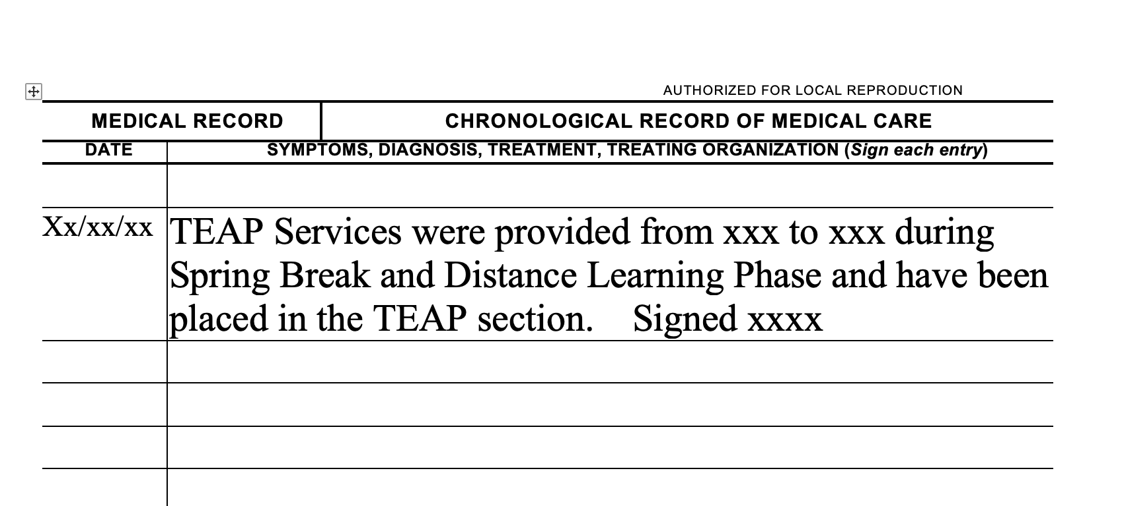
Example for
Chronological when no Access to SHR

Slide 26
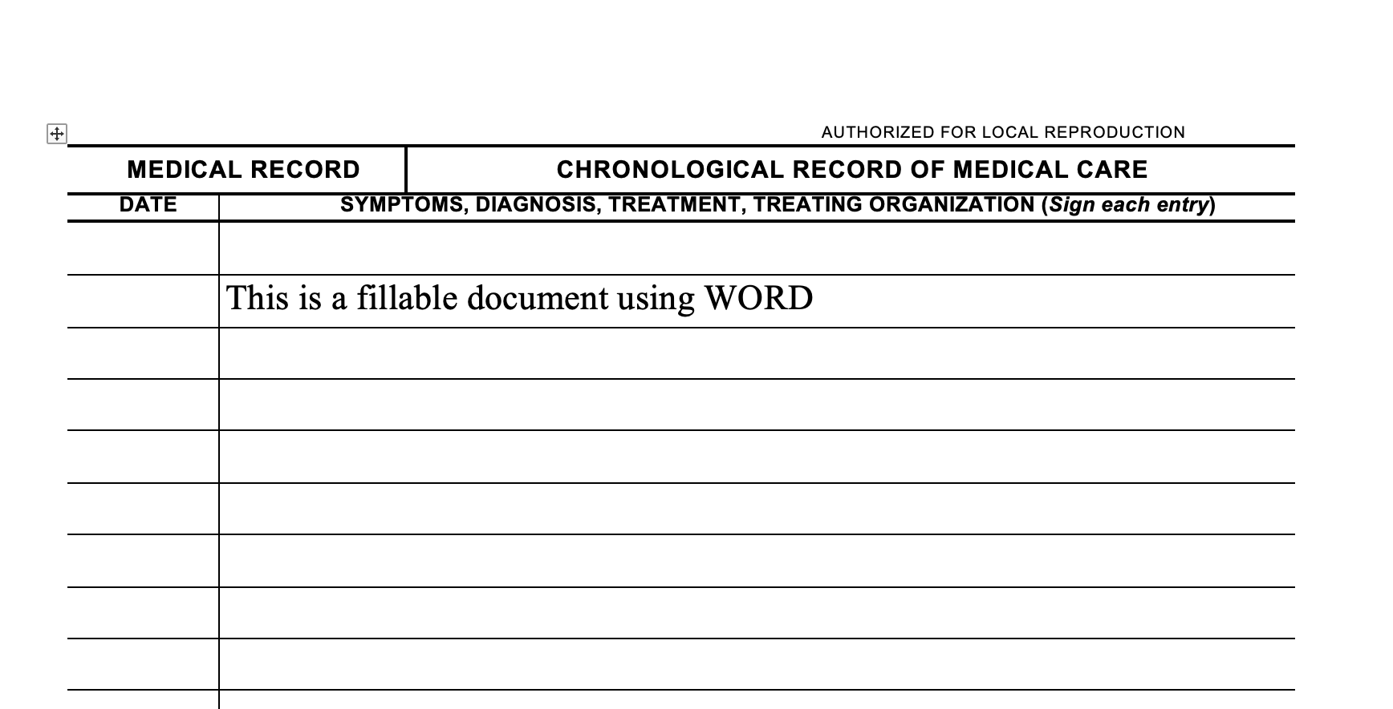

Slide 27
Questions
Contact your Regional TEAP Specialist
Diane A. Tennies, PhD, LADC
Boston, Philadelphia, and San Francisco Regions
datphd@aol.com
Christy Hicks, LCADC, CSW
Atlanta, Dallas, and Chicago Regions
Christy.hicksmsw@gmail.com

