Slide 1
ASTHMA UPDATE
GARY STROKOSCH, MD
October 13, 2021

Slide 3
ASTHMA OVERVIEW
Asthma affects more than 25 million Americans:
About 1 in 13 Americans
8% of adults and 7% of children
More women than men / more boys than girls
In 2018 asthma accounted for 178,530 hospital discharges and 1.6 million ED visits
Black Americans are 5 times more likely than whites to visit the ED for asthma

Slide 4
ASTHMA OVERVIEW
3,524 people died from asthma in 2019, many deaths were avoidable with proper treatment and care
Black Americans are nearly 3 times more likely to die from asthma that whites

Slide 5
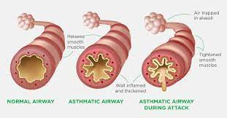
ASTHMA OVERVIEW
There is no cure for asthma ☹ !!!
It is a chronic disease that causes airways to become inflamed, making it hard to breathe

Slide 6
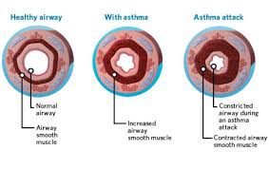
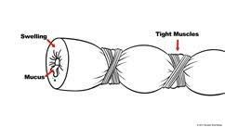
ASTHMA OVERVIEW

Slide 7
ASTHMA OVERVIEW
Education, education and education ☺
The next best way to manage asthma:
is to avoid known triggers,
take medications to prevent symptoms and
prepare to treat asthma episodes if they occur.

Slide 8
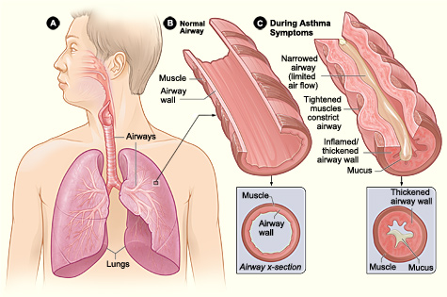
Job Corps Chronic Care Management Plan
ASTHMA: A FACT SHEET FOR STUDENTS
TOPICS
What is asthma?
Overview
Outlook
Asthma is one of 23 fact sheets found at:
https://supportservices.jobcorps.gov/
health/Documents/CCMPs/FactSheets/
AsthmaFactSheet.docx
Figure A shows the location of the lungs and airways in the body. Figure B shows a cross-section of a normal airway. Figure C shows a cross-section of an airway during asthma symptoms.
2014

Slide 9
JOB CORPS HEALTHCARE GUIDELINES (HCGs)
SYMPTOMATIC MANAGEMENT GUIDELINES (SMGs)
Medial - 26 (including asthma)
Mental Health - 3
TEAP/TUPP - 2
Oral Health - 3
TREATMENT GUIDELINES (TGs)
Medical - 57 (including asthma)
Mental Health - 8
TEAP/TUPP - 3
Oral Health - 4

Slide 10
NATIONAL GUIDELINES
ASTHMA TREATMENT GUIDELINE – Updated June 2020
This 2020 guideline is an update from July 2015
Guidelines from the National Asthma Education and Prevention Program (NAEPP) of the National Heart, Lung, and Blood Institute (NHLBI) were first published in 1991.
Updates were published in 1997, 2002, 2007 and 2020.

Slide 11
JOB CORPS HEALTHCARE GUIDELINES
ASTHMA SYMPTOMATIC MANAGEMENT GUIDELINE – November 2019
SYMPTOMATIC MANAGEMENT GUIDELINES FOR NON-HEALTH STAFF
ASTHMA
Authorized non-health staff may manage asthma as follows:
Any student with severe wheezing, gasping, blue color or other signs of respiratory distress requires immediate medical attention. Call 911 for emergency transport. Offer the student oxygen by facemask if available. Albuterol HFA treatments (2 inhalations) may be offered to the student every 15-20 minutes while awaiting transport.
Any student with wheezing who does not respond within 10-15 minutes to two inhalations from an albuterol HFA should be referred immediately to the health and wellness center.
Students known to have asthma should have access to an albuterol HFA at all times on center.
WHEN TO CONTACT THE ON-CALL HEALTH AND WELLNESS STAFF
If the student’s wheezing does not respond to two inhalations within 10-15 minutes from an albuterol HFA

Slide 13
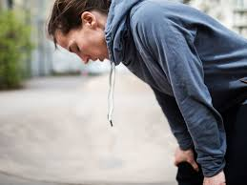
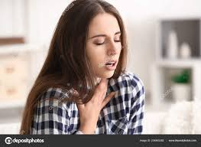
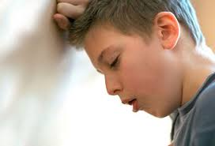

Slide 14
ACUTE MANAGEMENT OF ASTHMA
MILD-MODERATE BRONCHOSPASM
↕ ↕ ?? ↕ ↕
SEVERE BRONCHOSPASM

Slide 15
MILD-MODERATE BRONCHOSPASM
In the absence of signs of severe respiratory distress needing immediate medical attention, students with asthma who experience acute mild to moderate bronchospasm should be instructed to initiate “Rescue Therapy”

Slide 16
MILD-MODERATE BRONCHOSPASM
- Rescue Therapy -
Administer inhalation of a short-acting β₂-agonists (albuterol) at a dose of 2 to 4 puffs of 90 mcg (albuterol base) every 20 minutes.

Slide 17
SEVERE BRONCHOSPASM
Obtain vital signs and pulse oximetry.
Any student with severe wheezing, muscle retractions, gasping, blue color or other signs of respiratory distress requires immediate medical attention - call 911 for emergency transport.
Administer oxygen by facemask if available.
Initiate Rescue Therapy.

Slide 19
SEVERE BRONCHOSPASM
Rescue Therapy –
Provide the Inhalation of a short-acting β₂-agonists (albuterol):
Administer a nebulizer solution with a concentration of 2.5 to 5 mg every 20 minutes for three cycles,
--- or ---
Have the student administer 4 to 8 puffs of 90 Mcg (albuterol base) every 20 minutes with a metered-dose inhaler.

Slide 20
CHRONIC MANAGEMENT OF ASTHMA
Classify all students with asthma according to the NHLBI severity guidelines:
Intermittent
Mild Persistent
Moderate Persistent
Severe Persistent

Slide 21
INTERMITTENT ASTHMA
Symptoms < 2 days a week
Nighttime awakenings < 2 times a month
Use of short-acting β₂-agonist < 2 days a week
No interference with physical activity

Slide 22
MILD PERSISTENT ASTHMA
Symptoms > 2 days a week but not daily
Nighttime awakenings 3-4 times a month
Use of short-acting β₂-agonist > 2 days a week, but not daily, and not more than once on any day
Minor limitation of physical activity

Slide 23
MODERATE PERSISTENT ASTHMA
Symptoms daily
Nighttime awakenings > 1 time a week but not daily
Use of short-acting β₂-agonist daily
Some limitation of physical activity

Slide 24
SEVERE PERSISENT ASTHMA
Symptoms throughout the day
Nighttime awakenings often 7 times a week
Use of short-acting β₂-agonist several times a day
Extreme limitation of physical activity

Slide 25
TREATMENT OF ASTHMA
Treat all students with asthma according to the NHLBI guidelines (however, 6 does not equal 4):
Step 1 ≈ (intermittent asthma)
Step 2 ≈ (mild persistent asthma)
Step 3 ≈ (moderate persistent asthma)
Step 4 ≈ (moderate-severe persistent asthma)
Step 5 ≈ (severe persistent asthma)
Step 6 ≈ (severe persistent asthma)

Slide 26
STEP 1 Rx (intermittent asthma)
Daily medication is NOT needed
As-needed short-acting β₂-agonist (albuterol) for rescue therapy

Slide 27
STEP 2 Rx (mild persistent asthma)
Daily low-dose inhaled corticosteroid and
As-needed short-acting β₂-agonist (albuterol) for rescue therapy
-̶ OR –
As-needed concomitant use of low-dose inhaled corticosteroid and short-acting β₂-agonist (e.g., 2-4 puffs of albuterol immediately followed by 80-250 Mcg beclomethasone equivalent) every 4 hours

Slide 28
STEP 3 Rx (moderate persistent asthma)
(SMART: Single Maintenance AND Rescue Therapy)
Daily (1-2 puffs once to twice daily) and as needed (1-2 puffs every 4 hours) combination low-dose inhaled corticosteroids and long-acting β₂-agonist (fomoterol) (to a maximum total daily maintenance and rescue dose of 12 puffs (54 Mcg)

Slide 29
STEP 4 Rx (moderate-severe persistent asthma)
(SMART: Single Maintenance AND Rescue Therapy)
Daily (1-2 puffs once to twice daily) and as-needed (1-2 puffs every 4 hours) combination medium-dose inhaled corticosteroids and long-acting β₂-agonist agonists (fomoterol) (to a maximum total daily maintenance and rescue dose of 12 puffs (54 Mcg)

Slide 30
STEP 5 Rx (severe persistent asthma)
Daily medium- to high-dose inhaled corticosteroids combined with long-acting β₂-agonist (fomoterol) plus an add-on long-acting muscarinic antagonist
As-needed short-acting β₂-agonist (albuterol) for rescue therapy

Slide 31
STEP 6 Rx (severe persistent asthma)
Daily high-dose inhaled corticosteroids combined with long-acting β₂-agonist (fomoterol) PLUS oral corticosteroids
As-needed short-acting β₂-agonist (albuterol) for rescue therapy

Slide 32
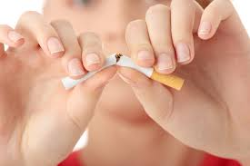
TWO ADDITIONAL ISSUES TO ADDRESS

Slide 33
JC ASTHMA TREATMENT GUIDELINE CONTINUED
At each visit monitor adherence to treatment plan, efficacy of the current treatment plan, inhaler use technique, environmental factors, and any comorbid conditions.
All students known to have asthma should have access to an albuterol inhaler at all times for Rescue Therapy on center and for off-center trips.

Slide 34
JC ASTHMA TREATMENT GUIDELINE CONTINUED
Increasing use of Rescue Therapy to > 2 days per week for symptom relief (not prevention of exercise-induced bronchoconstriction) generally indicates inadequate control and the need to step up treatment.

Slide 35
JC ASTHMA TREATMENT GUIDELINE CONTINUED
The differences of albuterol (ProAir, Ventolin and Proventil) compared to levalbuterol (Xopenex) for rescue are negligible. It is recommended to prime the rescue inhaler before using for the first time and in cases where the inhaler has not been used for more than 2 weeks by releasing four “test sprays” into the air. Also, it is important that the mouthpiece be washed and dried thoroughly at least once a week.

Slide 36
NOTE: CFC and HFC INHALERS
CFC-propelled inhalers were no longer be available after December 31, 2008 due to their environmentally harmful effects on the ozone layer.
The HFA propellant hydrofluoroalkane is stickier than the CFC propellant chlorofluorocarbons. The HFA propellant may build up where the metal canister meets the plastic case of the MDI.
Several studies have shown that HFA MDIs deliver albuterol and other medications more effectively into the lung tissue than do CFC MDIs.

Slide 37
JC ASTHMA TREATMENT GUIDELINE CONTINUED
Formoterol is a long-acting β₂ agonists but because it has a fast onset of action it can also be used as a rescue medication. Salmeterol causes bronchodilation in a slower manner. Both drugs are long-acting.
The combination of inhaled corticosteroids and a long-acting β₂ agonists (fomoterol) is available and preferably used in a single inhaler.

Slide 38
JC ASTHMA TREATMENT GUIDELINE CONTINUED
Cromolyn, nedocromil, leukotriene receptor antagonists (zileuton and montelukast), and theophylline were not considered for the 2020 update; limited availability and increased need for monitoring side-effects make their use less desirable. The FDA issued a black-box warning for montelukast in March 2020 due to adverse serious behavior- and mood-related changes.

Slide 39
JC ASTHMA TREATMENT GUIDELINE CONTINUED
Consult with asthma specialist if Step 4 or higher is required.
Step 1 (intermittent asthma)
Step 2 (mild persistent asthma)
Step 3 (moderate persistent asthma)
Step 4 (moderate-severe persistent asthma)
Step 5 (severe persistent asthma)
Step 6 (severe persistent asthma)

Slide 40
EXERCISE-INDUCED ASTHMA
Short-Acting β₂-agonist (albuterol):
Use 5 to 20 minutes (optimally 15) minutes before exercise. The bronchodilation is of rapid onset and can last 2 to 4 hours. Tolerance can develop with frequent use but are the preferred first-line treatment and have limited side effects.

Slide 41
JC ASTHMA TREATMENT GUIDELINE CONTINUED
WHEN TO REFER TO THE CENTER PHYSICIAN
If the student’s wheezing does not respond within 10-15 minutes to 2-3 inhalations from an albuterol inhaler
If the student presents with severe wheezing, muscle retractions, gasping, blue color or other signs of respiratory distress
Students with increasing use of short-acting inhaled β₂ agonists
Students who require daily medication for asthma management should be seen at least monthly

Slide 42
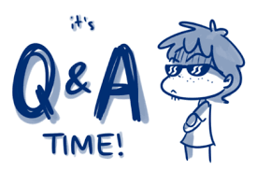
I hope they don’t ask me about all those asthma drugs.

Slide 43
REFERENCES
JAMA 2020; 324(22): 2301-2317: “Managing Asthma in Adolescents and Adults - 2020 Asthma Guideline Update From the NAEPP”
J Allergy Clin Immunol. 2020; 146: 1217-1270: “Expert Panel Working Group of the NHLBI. Focused updates to the asthma management guidelines: a report from the NAEPP Coordinating Committee Expert Panel Working Group.”

