Slide 1
COVID-19: Reducing risk for on-center outbreaks
Sara Mackenzie, MD, MPH
Region 6 Regional Medical Specialist
Humanitas
This Photo by Unknown Author is licensed under CC BY-SA

Slide 2
After this presentation, participants will be able to:
Define a COVID-19 outbreak
Identify ways to reduce risk of a COVID-19 outbreak on your center

Slide 4
What is a “COVID-19 outbreak”?
Two or more contacts are identified as having active COVID-19
OR
Two or more people with COVID-19 are discovered to be linked
Managing Investigations During an Outbreak | CDC

Slide 5
SARS-CoV-2:
Symptoms
Incubation:
2-14 days
(median 5 days)
Viral shedding:
for up to 10 days after symptom onset (for most)
Some will have mild to no symptoms
May shed 48 hours PRIOR to onset of symptoms
Exposure:
“Close contact” – within 6 feet for >15 minutes/24 hours
*health care worker in PPE excluded from this definition

Slide 6
Notes:
Poll Title: Within the last 48 hours, how many people have you been within 6 feet of for more than 15 minutes while off center? https://www.polleverywhere.com/multiple_choice_polls/HdH495aG3NbGvVdtKf5xp?flow=Default&onscreen=persist

Slide 7
Notes:
Poll Title: In the last 48 hours, how many people have you been within 6 feet of for more than 15 minutes while on center? https://www.polleverywhere.com/multiple_choice_polls/26GvRWq8yCTIFRS7Cm5E2?flow=Default&onscreen=persist

Slide 8
COVID & Job Corps Centers
October 26, 2020 --------------January 14, 2021
1,242 TOTAL COVID-related SIRS
1,022 had 0 close contacts on center
82%!
IN 20-02: Updated checklist tool Nov 13, 2020
When positive case – SIR must be completed and include “close contact”
Must be filed within 24 hours
One per COVID positive case

Slide 9
Number of close contacts identified on review of SIR | Number of SIRS with students identified as CCE | Number of SIRS with Staff identified as CCE
Zero | 1,099 | 1,043
One | 21 | 84
Two | 8 | 37
Three | 5 | 23
Four | 2 | 14
Five | 2 | 6
Six | 2 | 6
Seven | 1 | 5
Eight | 1 | 6
Nine of more | 2 | 13

Slide 11
Notes:
Poll Title: Which of the following is evidence of a COVID outbreak on center? https://www.polleverywhere.com/multiple_choice_polls/7WbwmX7VuqvjJ9ReZnbql?flow=Default&onscreen=persist

Slide 12
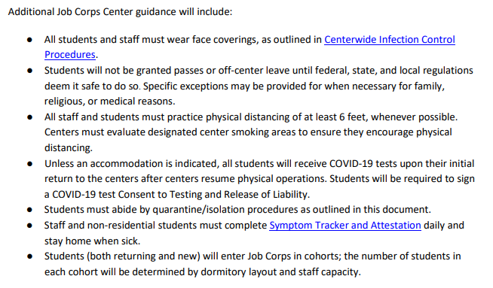
COVID-19 Medical, Mental Health, Trainee Employee Assistance Program (TEAP), and Oral Health Protocols
COVID-19 (jobcorps.gov)

Slide 13
Early Identification: Daily Symptom Tracker & Attestation
Do you have any symptoms of COVID-19 (fever of greater than 100.4 or feeling feverish), new cough, difficulty breathing, sore throat, muscle aches or body aches, nausea, vomiting or diarrhea, new loss of taste or smell, congestion or runny nose?
Have you had close contact with a person who has a diagnosed or suspected case of COVID-19 in the last 14 days?
If yes, stay home (or in room)
Low threshold for COVID-19 testing!

Slide 14
COVID case investigation:
Be curious!
Who else is at risk?
Where was the exposure?

Slide 15
SARS-CoV-2:
Symptoms
Incubation:
2-14 days
(median 5 days)
Viral shedding:
for up to 10 days after symptom onset (for most)
Some will have mild to no symptoms
May shed 48 hours PRIOR to onset of symptoms
Exposure:
“Close contact” – within 6 feet for >15 minutes/24 hours
*health care worker in PPE excluded from this definition

Slide 16
Who else is at risk (focused on center):
Contact tracing addresses this!
Who have they been within 6 feet of for greater than 15 minutes in the 48 hours PRIOR to onset of symptoms?
If no symptoms, can you deduce when they were exposed to know when they might have been contagious? If not, focus on 48 hours prior to positive test
Lessons learned on center
For staff: consider meetings, shared workspaces, carpooling, meals/snacks
For students: consider shared areas – recreation, cafeteria, classrooms, trades, smoking areas
For staff/student: consider classrooms, communal workspaces
Staff and students should NEVER eat together

Slide 17
Contact Tracing Courses:
Every Contact Counts: Contact Tracing for Public Health Professionals | Northwest Center for Public Health Practice (nwcphp.org)
COVID-19 Contact Tracing | Coursera

Slide 18
Where was the exposure (focused on center):
Consider for staff and students but if a student in the general student body, must figure out!
Exposure was 2-14 days prior to onset of symptoms (incubation period)
Ask what person has done- create a log – over past 14 days (2-7 days most likely)
Review prior known cases on center – any possible interaction?

Slide 19
When can someone return to work or general student body?
If confirmed COVID-19 – isolation for 10 days from onset of symptoms with resolution of fever for at least 24 hours and improvement in other symptoms
No medical note or provider visit required for clearance to return to work or to general student body
If someone is very ill – requires hospitalization and oxygen supplementation – they should have clearance for return (RARE)

Slide 20
Some other random covid-19 thoughts and lessons

Slide 21
How might the new COVID-19 strains impact Job Corps?
More transmissible – appears to require lower number of viral particles to cause infection
Same physical factors apply but even more important
Masks & distancing & hand washing

Slide 22
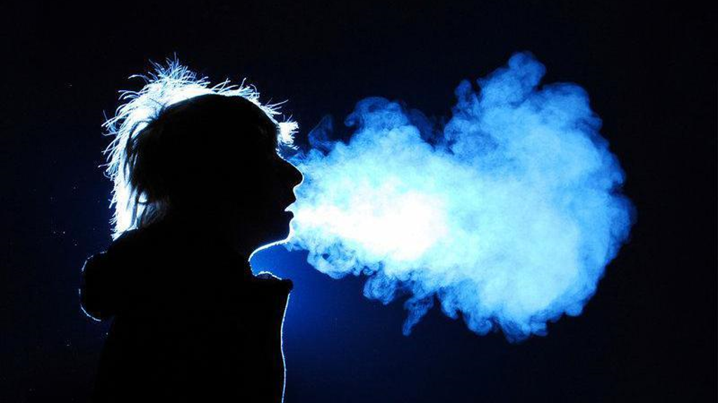
Why are masks (and distancing) required on center?
Exit Transmission Entry

Slide 23
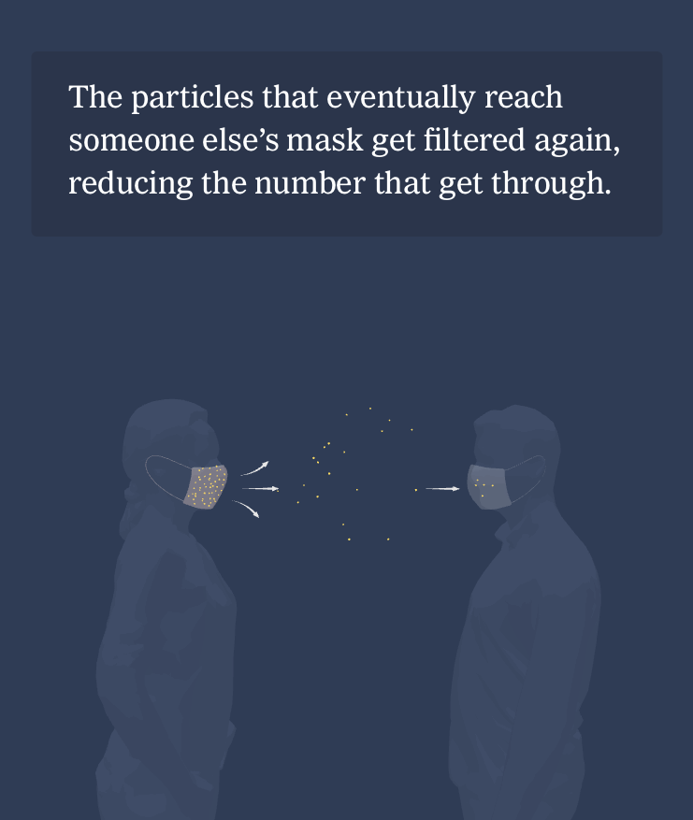

Slide 24
Vaccines:
Pfizer-BioNTech COVID-19 vaccine and the Moderna, Inc approved by FDA for Emergency Use Authorization
Johnson & Johnson – not yet approved
Oxford Astra-Zeneca Vaccine – not yet approved

Slide 25
Pfizer vaccine:
mRNA vaccine
Approved for age 16 and over
5-6 doses per vial
2 dose series with 21 days between the first and second dose
There are three storage options for this vaccine:
Storage Option | Shelf Life of Vaccine
Ultra-low-temperature freezer | Up to 6 months
Keep in Pfizer thermal shipper and refill dry ice every 5 days | Up to 30 days
Store in refrigerator at 2 ˚ to 8˚ C degrees | Up to 5 days

Slide 26
Moderna vaccine:
mRNA vaccine
Approved for age 18 and over
10 doses per vial (do not dilute)
2 dose series with 28 days between the first and second dose
There are two storage options available for this vaccine:
Storage Option | Shelf Life of Vaccine
Freezer at -25˚ to -15˚ C (similar to other vaccine storage but tighter temperature range) | per expiration date (likely 6 months)
Refrigerate at 2˚ to 8˚ C | Up to 30 days

Slide 27
After this presentation, participants will be able to:
Define a COVID-19 outbreak
Identify ways to reduce risk of a COVID-19 outbreak on your center

