Slide 1
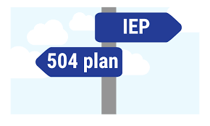
Clinical Review of School Disability Documents for Applicant File Review (AFR)
Presenters: Maria Acevedo, Ph.D. and Tamara D. Warner, Ph.D.
Regional Mental Health Consultants
1
Notes:
Thanks Julie. Good morning to all of you!! Thanks for taking the time to join us. We have a lot of information to present, so let’s jump right in.

Slide 2
OBJECTIVES
Review AFR process: Sources of Information
Provide an overview of the Individualized Education Plan (IEP) and Section 504 Plan
Identify the basic components of an IEP and Section 504 Plan
Demonstrate where to find on IEPs or Section 504 Plans relevant information for AFRs
2
Notes:
Our intention with this webclass is to provide information that will facilitate the AFR process in terms of understanding school-based disability documents.
We will briefly review the sources of information – clinical and non-clinical.
We will then discuss what Individualized Education Plans (IEPs) and Section 504 Plans are; their similarities and differences.
And we will identify their basic components and will demostrate where to find information that could be relevant for AFRs.

Slide 3

AFR Process: Identification of the
File Review Team (FRT)
Only if applicant has a disability
HWM
Disability Coordinator (DC)
+
Center Physician
CMHC
TEAP Specialist
Center Dentist
Notes:
The first part of the AFR process that we want to review is the identification of the File Review Team (FRT). At a minimum, the FRT consists of the HWM and, IF the applicant has a disability, the Disability Coordinator. The HWM does the initial review of each file and determines which licensed/certified clinicians need to be a member of the FRT.
The clinician or clinicians on the FRT review all sources of clinical and behavioral information, decides whether an applicant interview is needed, conducts the applicant interview and then determines whether to recommend the applicant for approval or whether to recommend denial.

Slide 4
Sources of Clinical/Behavioral Information
e-Folder
ETA 6-52 Job Corps Data Sheet
Criminal Background Check
Basic
Health e-Folder
ETA 6-53 Job Corps Health Questionnaire
CCMP - Chronic Care Management Plan Form
Medical/Mental Health Records
Clinical
Disability e-Folder (School Disability Documents)
Individualized Education Plan (IEP) *or*
Section 504 Plan
Non-Clinical
Notes:
This a summary of the different sources of information to review as part of AFR.
In the e-Folder, you will find:
ETA 6-52 Job Corps Data Sheet, which will give you applicant’s date of birth, if they are homeless or readmit
In the Behavior tab, you will review the Criminal Background Check
In the Health e-Folder, you will find:
ETA 6-53 Job Corps Health Questionnaire
You may also find:
Chronic Care Management Plan Provider Form(s)
Applicant’s medical and mental health records
In the Disability e-Folder:
School Disability documents: INDIVIDUALIZED EDUCATION PLAN (IEP) or SECTION 504 PLAN
In many cases, you will not have all pieces of information.
I will like to know - How comfortable are you when it comes to reviewing an IEP or Section 504 Plan? On a scale from 1 to 5, 1 being very uncomfortable to 5 very comfortable.

Slide 5

Reviewing School Disability Documents
Disability Coordinator (non-health):
Reviews all school disability documents
Notifies HWM if there is information relevant for a clinician to review
However, CMHCs are encouraged (as a best practice) to review school disability documents for all applicants with a disability.
Notes:
School Disability Documents - IEPs or Section 504 Plans are another potential source of information to review as part of AFR.
The role of the non-health Disability Coordinator or DC in AFR is to review the school disability documents and notify the HWM if there is information that may be relevant for a clinician to review. If the information involved mental health or behavioral concerns, the HWM will ask the CMHC to review the school disability documents.
We want to emphasize, however, that it is considered a best practice for CMHCs to review all IEPs or 504 Plans – and especially for applicants on the spectrum, who have intellectual disability and special education classifications of emotional behavior disorders (EBD).

Slide 6

What is an IEP? A Section 504 Plan?
Similarities and Differences
6
Notes:
Now let’s talk about what an IEP is and what a Section 504 Plan is, including their similarities and differences.

Slide 7
IEP and Section 504 Plan
Similarities
Legal documents mandated by federal laws
Ensure that students with disabilities have access to a free and appropriate public education (FAPE) in grades K-12
Provide formal assistance and support for students with disabilities
Provide accommodations and related services at no cost
Require review of student progress on a yearly basis
Require reassessment of student eligibility/progress every 3 years
Notes:
In terms of similarities, both an IEP and a 504 Plan are:
Legal documents mandated by federal laws
They ensure that students in grades K-12 with disabilities have access to a free and appropriate public education
Provide formal assistance and support for students with disabilities
Provide accommodations and related services at no cost
Require review of student progress on a yearly basis
Require reassessment of student eligibility/progress every 3 years

Slide 8
Differences | Individualized Education Plan (IEP) | Section 504 Plan
Type of federal law | Education: Individuals with Disabilities Education Act (IDEA). Department of Education. | Civil Rights: Section 504 of the Rehabilitation Act of 1973 banning discrimination against individuals with disabilities. Office of Civil Rights.
Purpose | Provide individualized special education, accommodations, and related services | Provides services and changes to the learning environment (including regular classroom) to enable students to learn alongside their peers.
Eligibility | One or more 13 specific disabilities that adversely impact academic performance and require specialized instruction | Any disability that substantially limits one or more major life activities (e.g., hearing, seeing, speaking, learning, reading, concentrating, thinking, communicating).
Written plan required? | Yes, with very specific sections outlined by law | No, but most plans are written
Age limits | 3 years-old – until the year of the 22nd birthday | 3 years old and upwards; no age limits
Where is the plan used? | Until exited from special education or “officially” graduates. Does NOT transfer to college. | Applies across settings -- school, college, and employment settings.
Notes:
There are a number of important differences between IEPs and 504 Plans
Which federal law applies?
The IEP is derived from the Individuals with Disabilities Education Act (IDEA), a special education law, whereas a 504Plan is under the Rehabilitation Act of 1973, a civil rights law.
As for their purpose
An IEP is designed to provide individualized special education, whereas 504 Plan does not require individualized special education.
Who’s Eligible?
IEP - One or more of 13 specific disabilities that adversely impact academic performance and require specialized instruction
504 - Any disability that substantially limits one or more major life activities (e.g., hearing, seeing, speaking, learning, reading, concentrating, thinking, communicating).
Do they require a written plan?
An IEP requires a very specific sections outlined by law but there is no requirement for a written 504 Plan although most plans are written.
Those are the differences that we wanted to highlight. You will see a couple more on the slide, which you can review later.

Slide 9
Basic Components - Section 504 Plan
Referral reasons and eligibility determination (disability)
Resulting problem (functional limitations, e.g., working memory, caring for oneself or learning)
Specifics on how modifications or accommodations will be provided and by whom.
Notes:
Let’s start with the basic components of Section 504 Plan because it is much simpler than an IEP.
[Read info on slide.]
Some plans may include name of the person who will be responsible for ensuring that all components of the plan are implemented (case manager).
In the Resources section at the end of this presentation, there is a weblink where you can go to see an example of a form that can be used for 504 Plan. Because there are no legal requirements for a written plan, 504 Plans differ tremendously from school district to school district.

Slide 10
Basic Components of an IEP
Student information and IEP team
Present level of educational performance
Annual goals
Progress reporting
Services
Supplementary aids and services
Participation
Consent
Some information is repeated in multiple sections.
Notes:
Understanding the basic components of an IEP will help you wade through all the information and figure out what would be helpful to include in a recommendation of denials.
Please know the 8 components listed here are NOT all of the components you will see, in part because IEPs differ in format from state to state and even from school district to school district.
In addition, some of these areas may overlap and you will see information repeated in multiple sections.

Slide 11
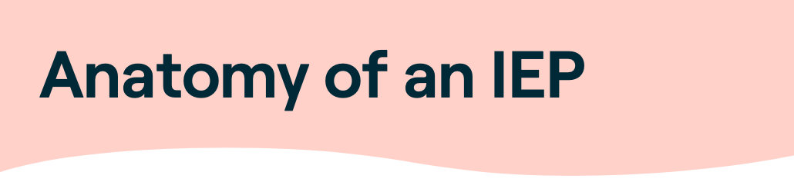
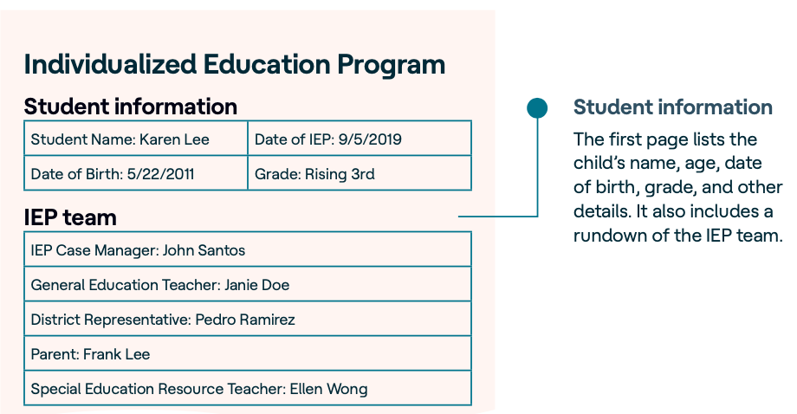
What To Pay Close Attention To
Date of IEP
Date first eligible/initial IEP (if available)
Grade or Academic Year to which IEP applies (e.g., 2020-2021)
Type of IEP:
  Annual
  Transition
  Reevaluation
  Other
© 2015 Understood for All, Inc.
https://assets.ctfassets.net/p0qf7j048i0q/24s5adt3xYto4Ri8QwBJxo/3121f047b5e8882dd2dc706d40be17b2/Anatomy_of_an_IEP_Understood.pdf
Notes:
As we discuss the basic components of an IEP, I will highlight the areas that provide relevant information for AFR.
I know that the text in the pinkish-orange is difficult to read, but it is not important to see because this is an IEP for a 3rd grader.
The first component is the student Information and IEP team. The student’s disability classification (and there can be more than one) are also usually listed. The pieces you want to include in a recommendation of denial is:
Date of the IEP (you may also see the date that the student was initially eligible for services)
Grade or academic year to which the IEP applies
The type of IEP – there are 3 main kinds
Annual – each IEP is reviewed every year
Transition -- which must be put in place by the time the student turns 16 (or earlier in some states)
Reevaluation – conducted every 3 years to determine is student is still eligible and what services are needed
Other – if an IEP meeting is called for any other reason – such as a need to change placements. This is fairly rare, so if you see it, there is likely something going on.

Slide 12
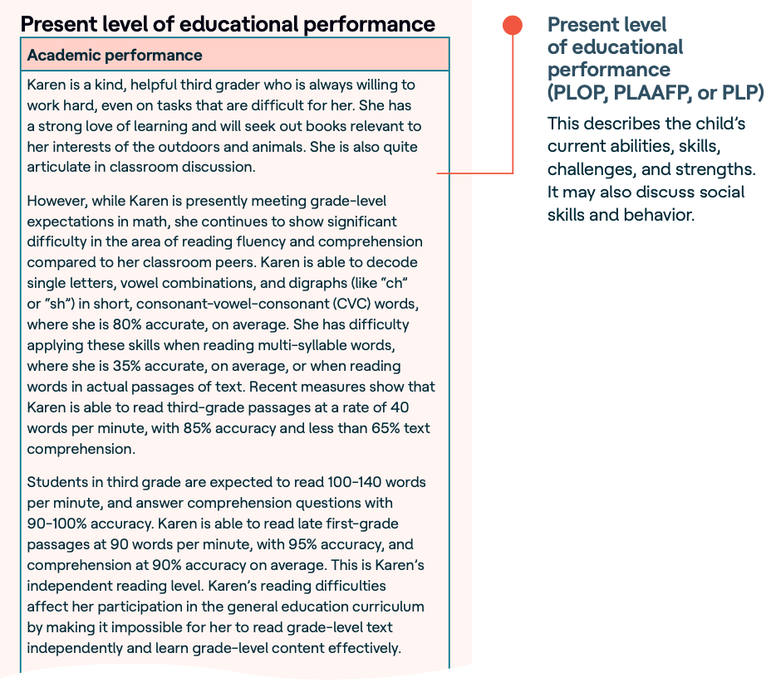
What To Pay Close Attention To
Challenges
Activities of daily living
Social skills
Behavior
Do not include information about academic performance unless it is related to a behavioral concerns (frequent absences, refusal to do work in class, etc.)
It can be useful to take excerpts or direct quotes, especially if there are quotes from teachers.
© 2015 Understood for All, Inc.
Notes:
The second component of an IEP is the “Present Levels of Performance” (PLP or PLOP)”. It also referred to by other names such as Present Level of Academic Achievement and Functional Performance (PLAAFP) or Present Levels of Educational Performance (PLEP).
This section summarizes how the student is currently doing in school and how the student’s disability affects their performance in class. It also describes the student’s current academic abilities/skills, challenges, and strengths. It may also discuss daily functioning including activities of daily living, social skills and behavior, etc.
This section can be a gold mine for information about behavioral and emotional functioning.
Examples:
“Student has had multiple mental health hospitalizations and was recently referred to the PR Public School Safety Center due to significant concerns around her safety and that of others.”
“Student needs requiring specialized instruction are peer conflicts, accepting responsibility for her behavior, depressive symptoms, symptoms of anxiety.”
“He has a difficult time building and maintaining peer and adult relationships. When frustrated, he can become verbally and physical aggressive and at times will leave the assigned area.”

Slide 13
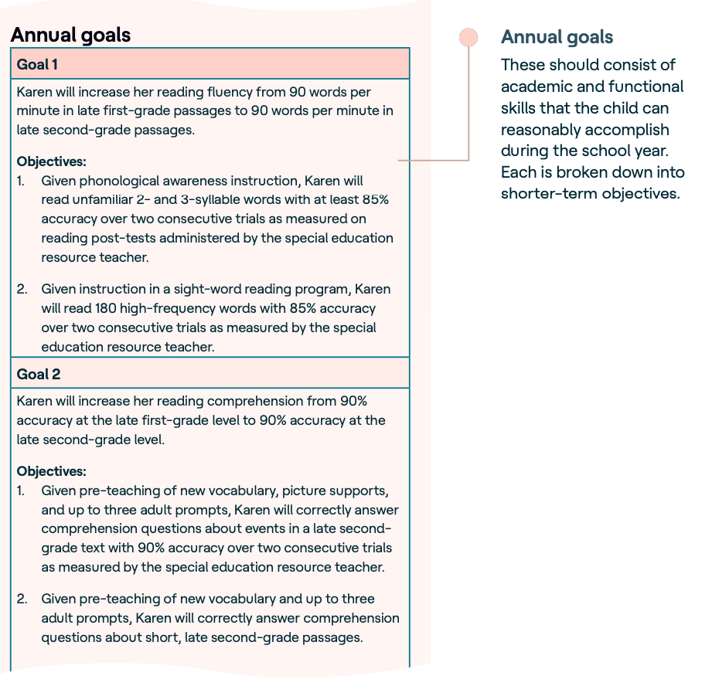
What To Pay Close
Attention To
Social/Emotional Annual Goal(s)
  Mood regulation
  Anger control
  Impulsivity/aggression
  Peer interactions
Communication Annual Goal
  Social skills/pragmatic language
Include baseline behaviors (if available)
Shorter-term objectives may or may not be useful
© 2015 Understood for All, Inc.
Notes:
The next component of an IEP is the Annual Goals:
The annual goals are designed to address the needs identified by the IEP team. These goals are usually academic, but often times there will be a goal related to Social/Emotional functioning which could be related to mood, anger control, impulsivity or peer interactions. The annual goal for Social/Emotional should be included in a recommendation for denial. Another annual goal that may be relevant is any Communication goal. This is where you can sometimes find information about social skills challenges.
If the goals includes a description of the baseline behaviors, they may be helpful to include as well. If the goals are broken down into specific short-term objectives, look at them and decide whether useful.

Slide 14
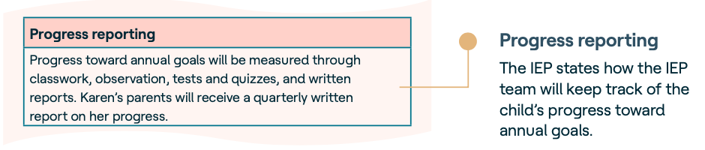
What To Pay Close Attention To
This section is generally not useful, but if a reference is made to counseling or a counselor, definitely include it!
Notes:
Progress Reporting:
A student's IEP must also contain a description of how his or her progress toward meeting the annual goals will be measured and when it will be reported to parents.

Slide 15
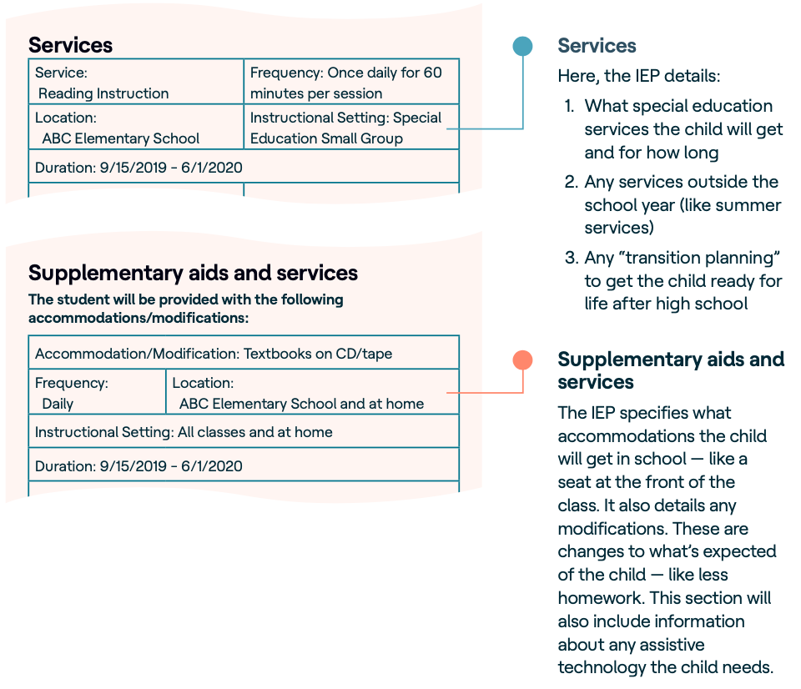
What To Pay Close
Attention To
Services: Special education, transportation, counseling, consultation with school psychologist, etc.
Supplementary Aids & Services: Paraprofessional, reason(s) for aide & total hours
Location: Look for alternative school/programs and services provided outside of the school.
Notes:
These are 2 very important sections of the IEP for AFR to get information about behavioral and social-emotional functioning.
Special Education & Related Services:
This section lists the special education and related services to be provided to the student, the number of minutes or hours per week, and where the services will be provided. Transportation needs may be included; if a student is provided transportation services, it could be due to safety concerns or low adaptive functioning. Related services may include individual or group counseling and consultation with the school psychologist as well as speech and language therapy and occupational therapy.
Supplementary Aids & Services:
This is section where the accommodations/modifications are specified. It is also where any assistive technology paraprofessional services are listed. As in the Services section, the number of minutes or hours per week and where the services will be provided is also included. If a paraprofessional is assigned, be sure to look for the reason one has been assigned and number of hours.
Location:
It is important to look at where the services will be provided -- at the school, in the community, at another facility. Look here for alternative school/programs and which services are provided outside of the school.

Slide 16
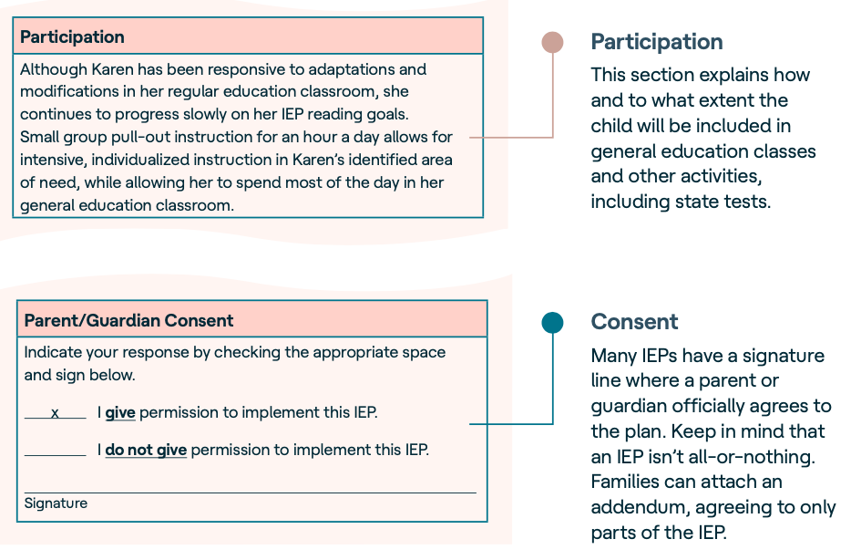
What to Include in HCNA/DTA
Percentage of time that student is not in regular education setting (sometimes list as a range rather than a single number)
Include if plan includes a different or alternative school or placement in a residential treatment facility
© 2015 Understood for All, Inc.
Notes:
Extent of Nonparticipation:
IEPs must also include an explanation of the extent, if any, to which the student will not be included in regular education classes and in other school settings and activities. We will explain more in the next slide.
This section may provide more detail on the setting or location of the services or supplementary aids in the previous list. Be sure look here to see if the plan includes a different or alternative school or program or placement in a residential treatment facility.
Finally, the Parent/Guardian Consent indicates that the parent agrees with the plan and its implementation.

Slide 17
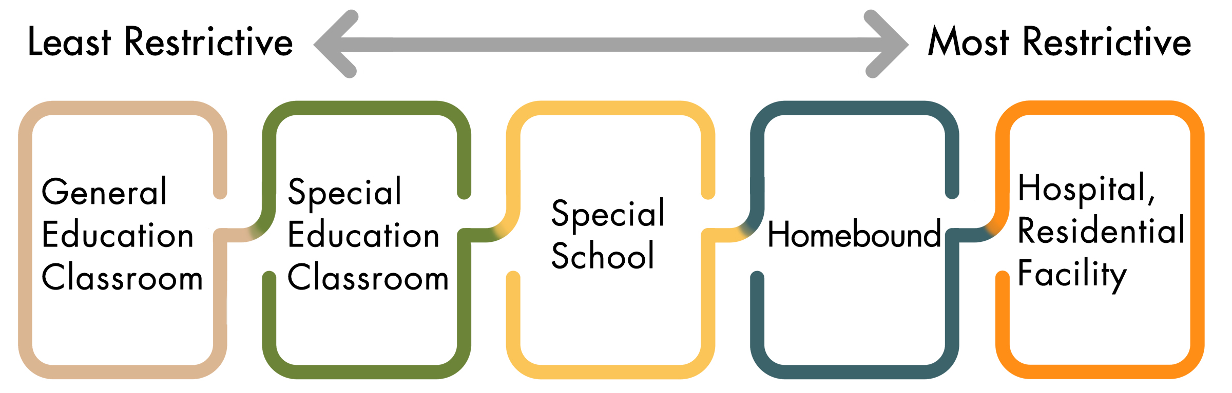
Extent of Nonparticipation and Least Restrictive Environment (LRE)
Notes:
Let’s dedicate a with minutes to explain the relationship between “extent of nonparticipation” as a component of the IEP and a principle called Least Restrictive Environment or LRE – which you will see on every IEP.
LRE refers the idea of keeping a student with a disability in an educational setting alongside peers without disabilities to the maximum extent possible – as long as the student can receive an appropriate education designed to meet their educational needs. In other words, removal of a student with disabilities from regular education class may only occur if the student cannot be satisfactory educated in the regular educational environment with the use of supplementary aids and services.
The amount of time in special education vs regular education is typically listed as percentages, such as 23% in special ed and 77% in regular ed. A good rule of thumb is that if a student has approximately 80% or more time in special education, then the student is likely in a self-contained special education classroom or in an alternative setting.

Slide 18
Justification Statements
Special education 60% of time
“Student’s pattern of aggressive behavior can pose a threat to his safety and the safety of other students in general education. Student needs specialized, direct instruction and practice of social skills on a daily basis in addition to an individualized behavior intervention program that provides immediate feedback on behavior and provides social skills instruction across the school day.”
Special education for > 60% of time
“Due to student’s emotional impairment, she requires the majority of her academic instruction to be provided in small group setting outside of the general education setting, with access to therapeutic support throughout the day. The team rejected a less restrictive placement, as student demonstrates a need for a high level of therapeutic support to process interactions with peers as well as to deal with internal stressors and emotional distractions during the school day."
Notes:
When a student is taken out of regular education, a Justification Statement must be provided. This can be a great source of information.
In the first example on the left, the student will be in special education services for 60% of the total school time.
Take a moment to read the Justification Statement.
In the second example on the right, the IEP services are provided outside the general education classroom for more than 60% of the time.
Take a moment to read the Justification Statement.
So, if you were to write a recommendation of denial for either of these applicants, these Justification Statements provide specific information that can be used as excerpts in the “Applicant File Review” section of a recommendation of denial.

Slide 19

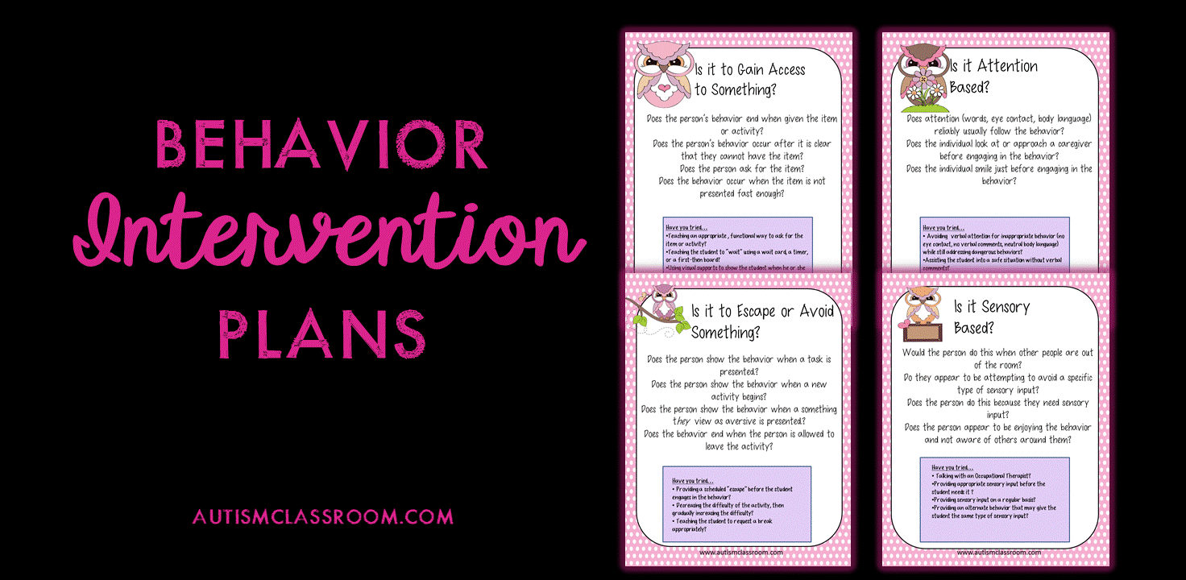
Additional Components for School Disability Documents
IEPs only (not 504 Plans)
Can be part of an IEP or 504 Plan
Can also stands on its own
Notes:
The Transition Plan is a federal requirement for IEPs that go into effect when student reaches age 16 (some states can require younger age). The 504 Plans do not have this requirement, but they can provide other types of transition planning.
In contrast, a Behavior Intervention Plan can be part of either IEP or a 504 Plan. It can also stand on its own.

Slide 20
Transition Plan
Components
Goals related to education/training, employment and, where appropriate, independent living skills
Lists services to reach goals
Timeframe
Persons Responsible/Agencies
Sample Applicant Interview Questions
HCNA Question #4 ”Daily assistance with ADLs”
Notes:
A Transition Plan is designed to help the student set goals for after high school and provide services to help them meet those goals.
The Transition Plan has several components which may vary among states and individual districts.
Based on student’s preferences, interests and needs (that can be behavioral related & therefore relevant to AFR) transition goals are set related to education/training, employment and, where appropriate, independent living skills. This is where you might see Job Corps listed as a post-secondary goal.
In the ”Independent Living Skills” section, there may be important information about activities of daily living or ADLs or instrumental activities of daily living (iADLs such as transportation use and money management). If so, there are some questions at the end of the Sample Applicant Interview Questions that ask about ADLs and iADLs that you may want to use to assess these areas. Also, I want to remind you that question #4 on the HCNA about functional limitations includes an item for “Daily assistance with activities of daily living.” This is the box that you would want to check to capture the applicant’s difficulties in these areas.
Again, you want look at the services and the Persons Responsible/Agencies, which could include outside agencies such as Vocational Rehabilitation.

Slide 21
ADLs, iADLs, and Functional Limitations
ADLs to pay close attention to include:
Judgment challenges including victimization due to limited judgment capacity
Needing assistance with hygiene activities (not to related to physical limitations but cognitive ones)
Severe cognitive challenges that indicate an inability to live and/or perform independently even with accommodations
Notes:
ADLs that you want to pay close attention to if you see them in a Transition Plan or other part of the IEP include:
Judgment challenges and victimization related to limited judgment capability
Need assistance with hygiene activities (not due to physical limitations but cognitive ones)
Severe cognitive challenges that indicate an inability to live and/or perform independently even with accommodations
Not based on IQ but based on consistent patterns of challenges and levels of support currently or typically provided

Slide 22

Behavior Intervention/Support Plan (BIP/BSP)
When behavior interferes with learning
Typically includes:
    Statement of Problem Behavior(s)
    Functional Behavior Assessment/Analysis (FBA)
    Strategies and Supports
Requires ongoing monitoring
Notes:
A Behavior Intervention Plan, sometimes called a Behavior Support Plan, or Positive Behavior Support Plan is added to an IEP or 504 Plan when a student’s behavior interferes with their learning or the learning of others.
A BIP has 3 components:
A statement of the problem behaviors
A Functional Behavioral Assessment or Analysis which assess the antecedents or prompts for the behavior and the function of the behavior in terms of consequences such as avoidance or escape from a task
The strategies and supports that the adults will use to modify the behavior

Slide 23
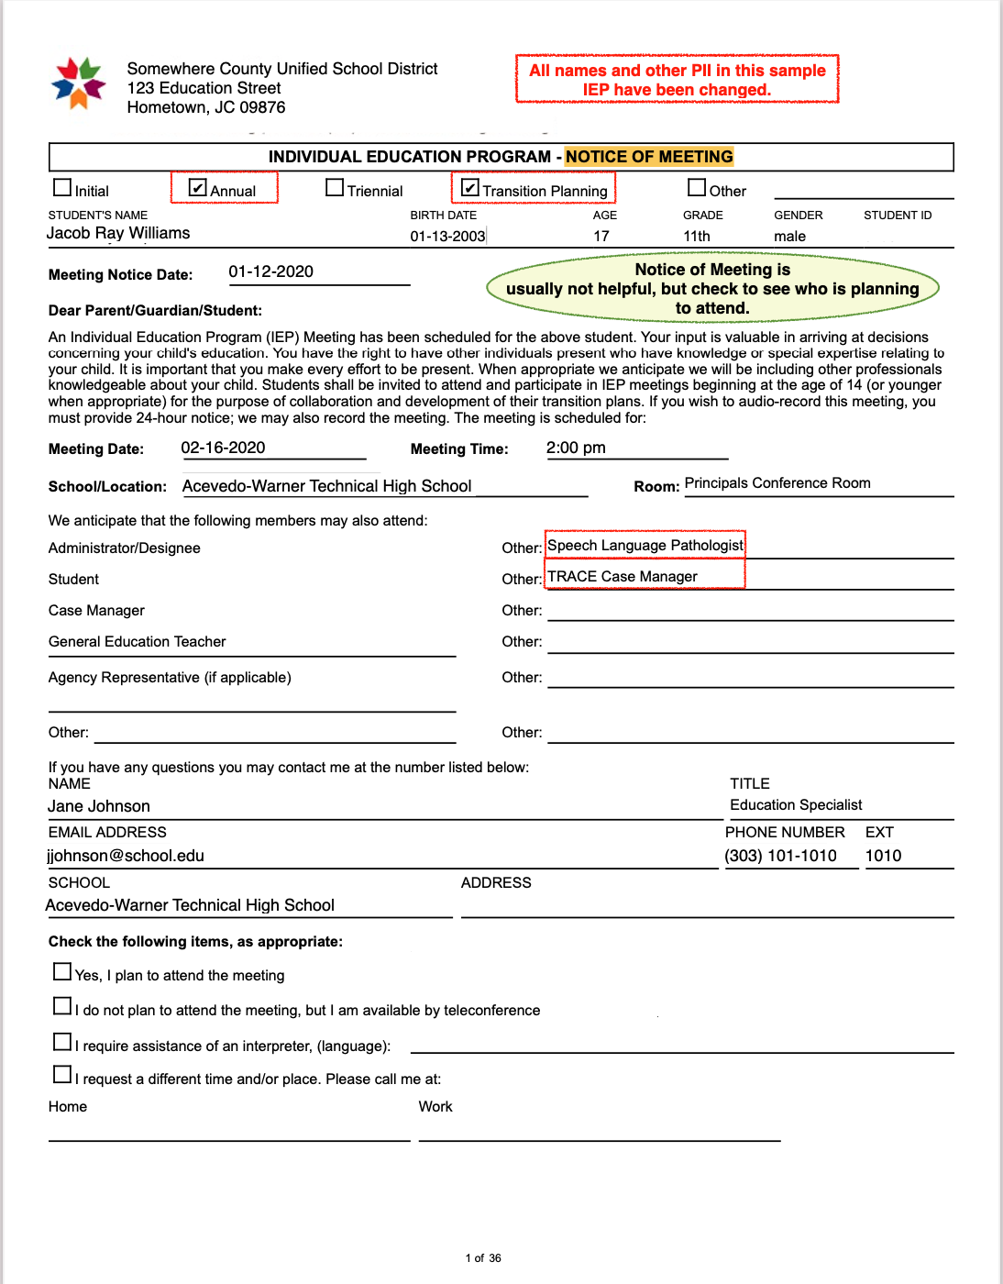
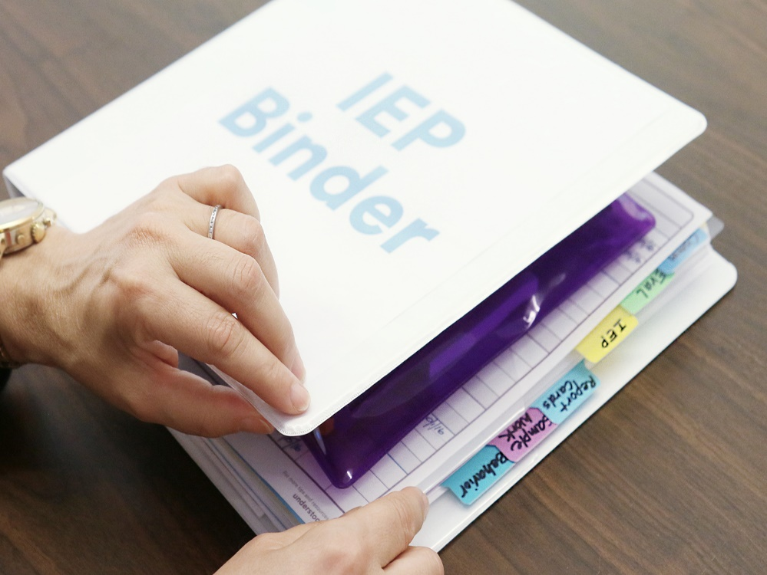
IEP Example
Applicant “Jacob Williams”
Somewhere County Unified School District

Slide 24
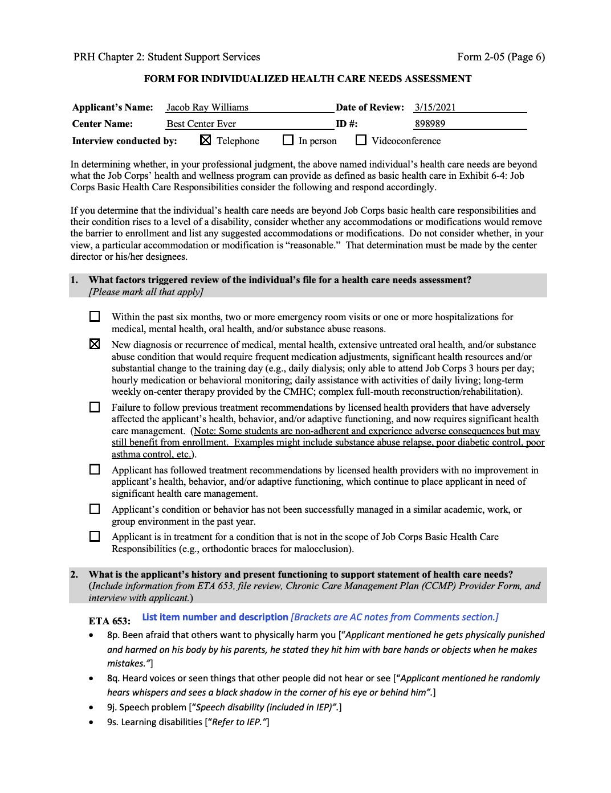
IEP
Information Integrated
on HCNA
Form 2-05 Health Care Needs Assessment for Applicant Jacob Williams

Slide 25
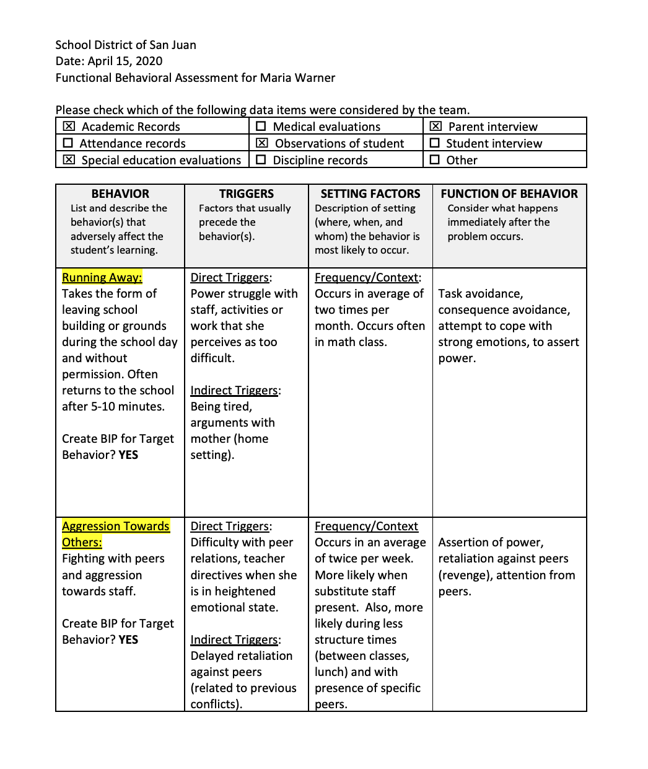
Functional Behavioral Assessment (FBA) Example
Maria Warner Example

Slide 26
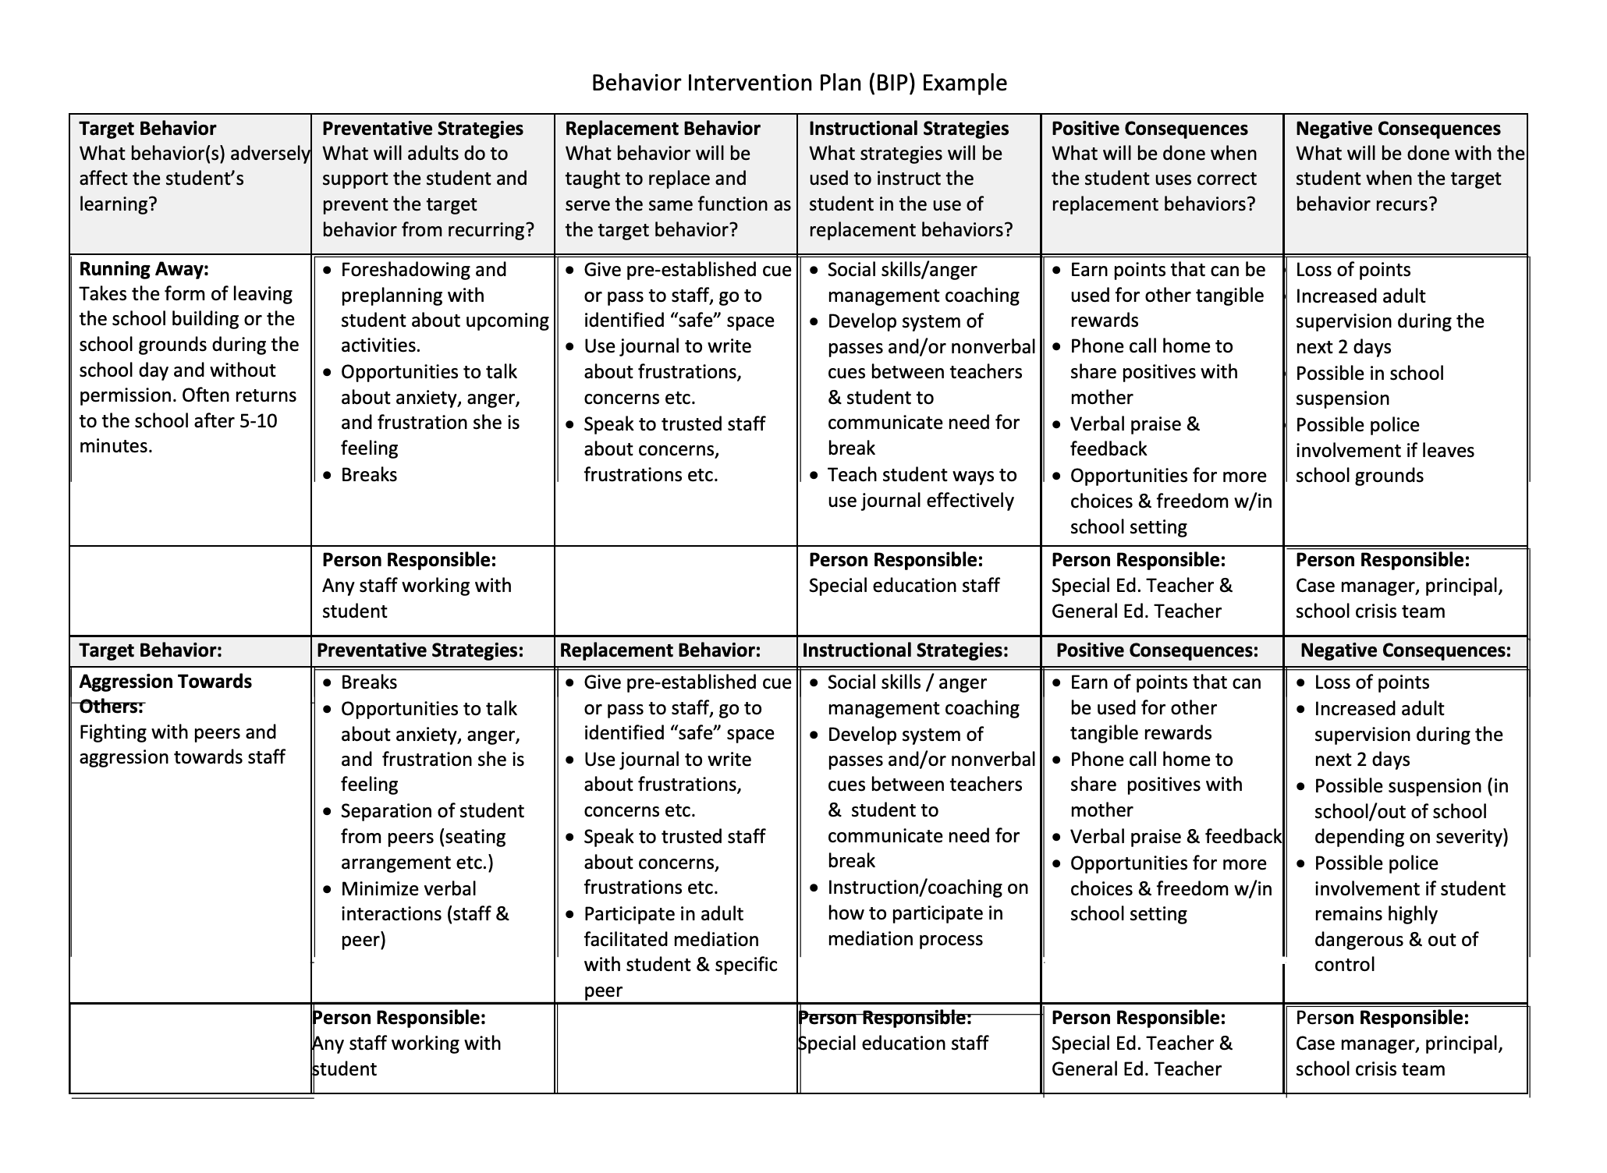
Behavior Intervention Plan (BIP)
Maria Warner Example

Slide 27
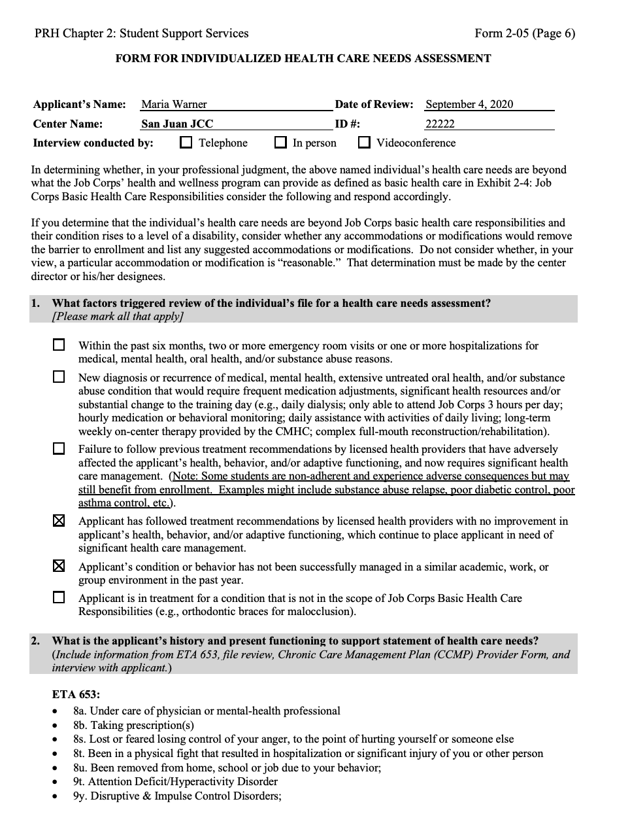
FBA & BIP Integrated into hcna
Maria Warner Example

Slide 28
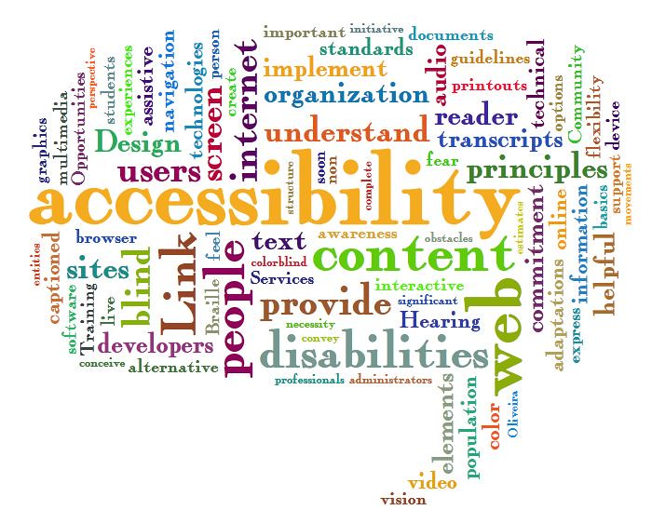
Section 504 Plan
Joe Joseph Example

Slide 29
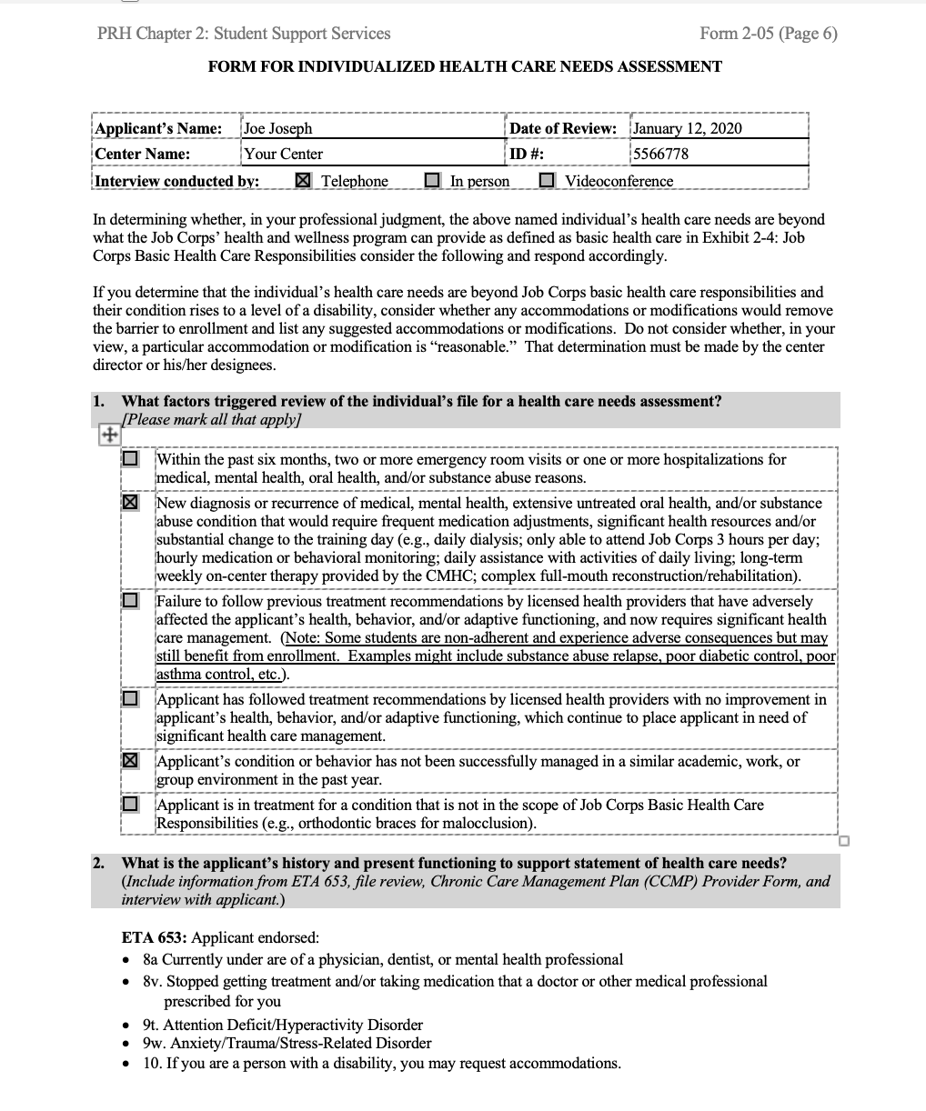

504 Plan Info Integrated
Into HCNA
Joe Joseph Example

Slide 30

Take Home Points
School disability documents: important source of information for AFR!
Most relevant IEP sections
  Disability Classification(s)
  Services (Accommodations/Modifications)
  Supplemental Services and Aids
  Location of Services/Least Restrictive Environment
  Transition Plan (ADLs, iADLs)
  Behavioral Intervention Plan (including FBA, if included)
Holistic approach, not relying on any one piece
We did it!
Hooray!

Slide 31
Resources

Slide 32
What to Include from Psychological Assessments
Pertinent background information about mental health/behavioral problems (e.g., when problems started, how chronic problems are, recent escalation)
Briefly summarize behavioral/MH measures (e.g., BASC-2, Conners) and any adaptive functioning scales.
IQ scores are not as relevant as adaptive functioning scores. Health care needs can be tied to low adaptive functioning. “Daily assistance with activities of daily living” is one of the choices for HCNA question #4.
Do not include academic functioning scores because they do not represent a health care need or a direct threat for making a recommendation of denial.
For a neuropsychological eval, include scores that are relevant to the functional limitations listed in HCNA question #3 (e.g., concentration, memory problems, organization, etc.).

Slide 33
Job Corps Policy on Assessment
Job Corps Educational and Psychological Assessment Guidelines
Providing educational and psychological testing is NOT considered part of the routine tasks of the Center Mental Health Consultant (CMHC) and is NOT accounted for in the PRH required hours/100 students/week. Students who need educational and psychological testing to document suspected Learning or Cognitive Disorders or Attention Deficit Hyperactivity Disorder (ADHD) should be referred to vocational rehabilitation or other appropriate agency. For centers that have public school or charter school partners, the center may be able to access appropriately trained and qualified staff to assist with the assessments (i.e., school psychologists).
These guidelines are for appropriately licensed and trained CMHCs (or practicum students/interns under their supervision) who elect to be involved in the assessment of educational and/or psychological difficulties on center. Evaluations to document any mental health or learning disorder must meet community standards and be included in the Student Health Record.
Center licensed health professionals may be qualified to diagnose/assess dependent upon their credentials.
See guidance document “Job Corps Educational and Psychological Assessment Guidelines”
https://supportservices.jobcorps.gov/health/Documents/MentalHealth/Educational_and_Psychological_Assessment_Guidelines.docx

Slide 34
Related IEP and Section 504 Plan Acronyms
Acronyms
ARD | Admission, Review and Dismissal (Committee)
BIP | Behavioral Intervention Plan
BSP | Behavioral Support Plan
CDOS | Career Development and Occupational Studies
ELA | English Language Acquisition
FEPA | Free Appropriate Public Education
FERPA | Family Educational Rights and Privacy Act - Federal law protects privacy of student education record
ICS | In Class Support
LRE | Less Restrictive Environment
PBIS | Positive Behavioral Intervention and Support
PLAAFP | Present Level of Academic Achievement and Functional Performance
PLOP/ PLP | Present Level of Performance
“SMART” | Specific, Measurable, Attainable, Results-oriented, and Time-bound (for transition goals)
RTI | Response to Intervention
TCI | Technical Career Institute
UGS | Undergraduate Student

Slide 35
13 Disability Categories Under IDEA
Specific Learning Disability – reading (dyslexia), math (dysgraphia & dyscalculia), Auditory Processing Disorder, Nonverbal Learning Disability (NVLD)
Other Health Impairment (ADHD, asthma, etc. )
Autism Spectrum Disorder
Emotional Disturbance (Anxiety Disorder, Schizophrenia, Bipolar Disorder,
Obsessive-Compulsive Disorder, and
Depressive Disorder)
Speech or Language Impairment (stuttering, expressive language, receptive language/ comprehension)
Visual impairment (Blindness)
Deafness
Hearing Impairment (hearing loss, having problems with auditory or laguage processing)
Deaf-Blindness
Orthopedic Impairment
Intellectual Disability
Traumatic Brain Injury
Multiple Disabilities
Notes:
IDEA requires public schools to provide special education services to eligible students. But not every student who struggles in school qualifies. To be covered, a child’s school performance must be “adversely affected” by one of the following 13 disability categories:
Specific Learning Disability – conditions that affect a child’s ability to read, write, listen, speak, or do math.
Other Health Impairment – covers conditions that limit a child’s strength, energy, or alertness. Includes asthma and ADHD.
Autism Spectrum Disorder
Emotional Disturbance
Speech or Language Impairment- Includes stuttering, and trouble pronouncing words or making sounds with the voice. Also covers language problems that make it hard for the student to understand words or express themselves.
Visual Impairment – Includes partial sight and blindness. If eyewear can correct a vision problem, then it doesn’t qualify.
Deafness
Hearing Impairment – hearing loss not covered by the definition of deafness
Deaf-Blindness
Orthopedic Impairment
Intellectual Disability
Traumatic Brain Injury
Multiple Disabilities

Slide 36

https://youtu.be/0J8q6i7LtMs

Slide 37

https://youtu.be/Sf3R3iGi4FY
37
Notes:
IEP & Transition Plans
At what age transition plans are placed vary from state to state; for some states is at 14 and for others16 years old.
Student’s strengths related to his/her preferences & interests for academic and/or job future plans are documented.
In some Transition Plans you will find NEEDS enumerated (some times are behavioral related).
Based on needs, preferences and interests transition goals are set, and the IEP team will decide what services student needs to meet those goals. The range of possible services is very broad.
Related services
Community experiences, like volunteer work, youth employment programs, summer jobs, local vocational centers.
Career and college counseling.
Help with daily living skills, if needed
These services must be reviewed and updated each year to support your child’s transition goals.
How elaborate plans are varies from state to state/district to district.
One way to make sure a student has appropriate transition goals is to see if they are “SMART.” This stands for specific, measurable, attainable, results-oriented and time-bound. (For more information, visit the National Technical Assistance Center on Transition, a program funded by the U.S. Department of Education.)
Keep in mind that student’s transition goals may change several times as his/her interests develop. Transition goals are reviewed and updated every year, along with the rest of the IEP. When leaving high school, they’ll get what’s called a summary of performance. This document lists academic and functional skills, and offers recommendations for achieving postsecondary goals.

Slide 38
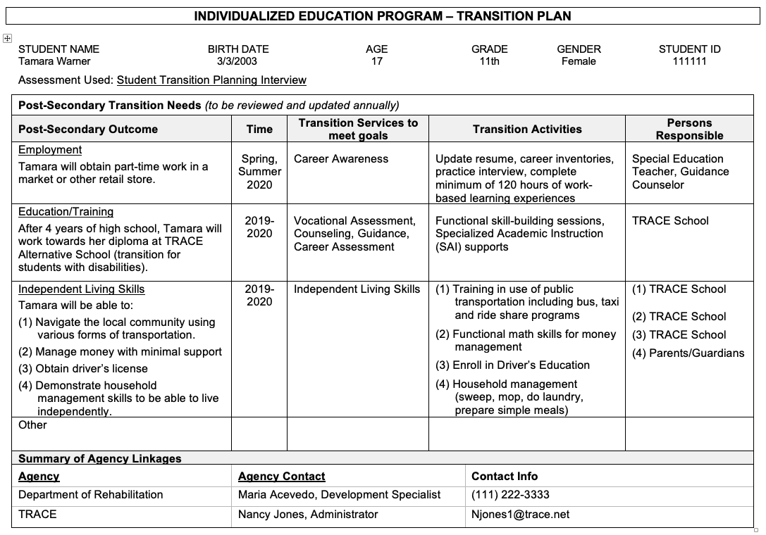
Sample Transition Plan
Notes:
First, we will find demographic information at the top, followed by the assessment used to develop the plan. Sometimes you will see a questionnaire with scores listed for independent living skills, and those can be very helpful for AFR. Most often interviews and career inventories are used.
You can find sections for employment goal, an education/training goal and independent living skills goals.
The employment goal is not very remarkable.
The education/training goal can let us know that the student will not be receiving a diploma upon graduation. A quick Google of “TRACE” and the school district name revealed that TRACE is a separate school that specifically provides transition services to students with disabilities in this large urban school district.
Most interesting, however, are the Independent Living Skills goals. These goals suggest that this student is somewhat low functioning as she requires specific training on using public transportation and money management. As you all know students who are low functioning may or may not have mental health problems requiring management.
Finally, note that this student will be getting vocational rehabilitation services based on the list of agency linkages.

Slide 39

Behavioral Intervention /Support Plan (BIP/BSP)
https://youtu.be/jSI4nxfC49U.

Slide 40
Examples
Section 504 Plan Example
https://www.yumpu.com/en/document/read/53160538/section-504-student-services-plan
Behavior Intervention Plan (BIP) Examples
https://www.pbisworld.com/wp-content/uploads/Oppositional-Defiant-Disrespectful-BIP.doc
Example of BIP - http://forms.dadeschools.net/webpdf/6287.pdf
What is an IEP?
40

