Slide 1
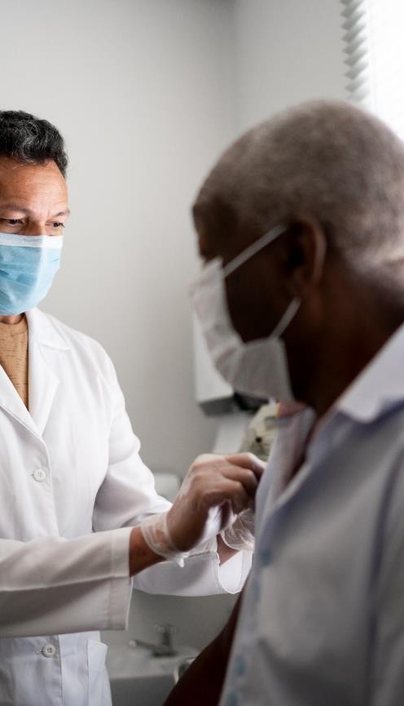
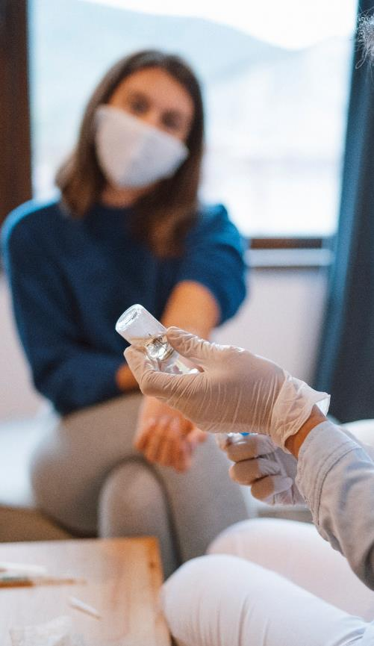
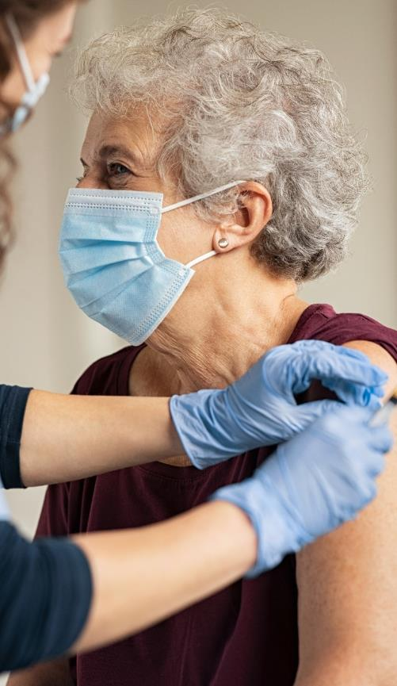
LET’S TALK ABOUT THE COVID-19 VACCINES
Sara Mackenzie, MD, MPH
Valerie Cherry, PhD

Slide 2
OBJECTIVES Participants will be able to:
Describe
Describe the COVID-19 vaccines
Answer
Answer common questions about the vaccines
Identify
What impacts vaccine uptake?
Apply
Begin to apply basic motivational interviewing strategies to increase vaccine confidence

Slide 3
Part 1: Understanding the COVID- 19 Vaccines

Slide 4
Mini-science lesson: Sars-CoV-2

Slide 5
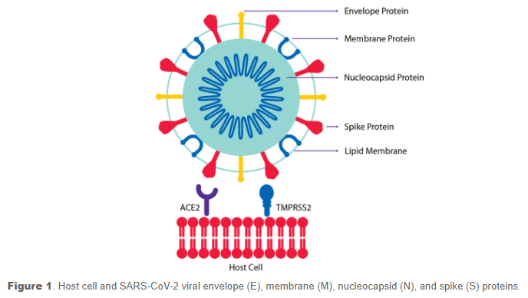
Mini-science lesson: SARS-CoV-2 spike protein
https://www.sigmaaldrich.com/technical-documents/protocols/biology/ncov-coronavirus-proteins.html
Notes:
With infection:
Spike protein necessary to bind to mucosal cells in your body
Then the viral RNA injected into cell

Slide 6
Mini-science lesson: Sars-CoV-2
Antibody to spike protein

Slide 7
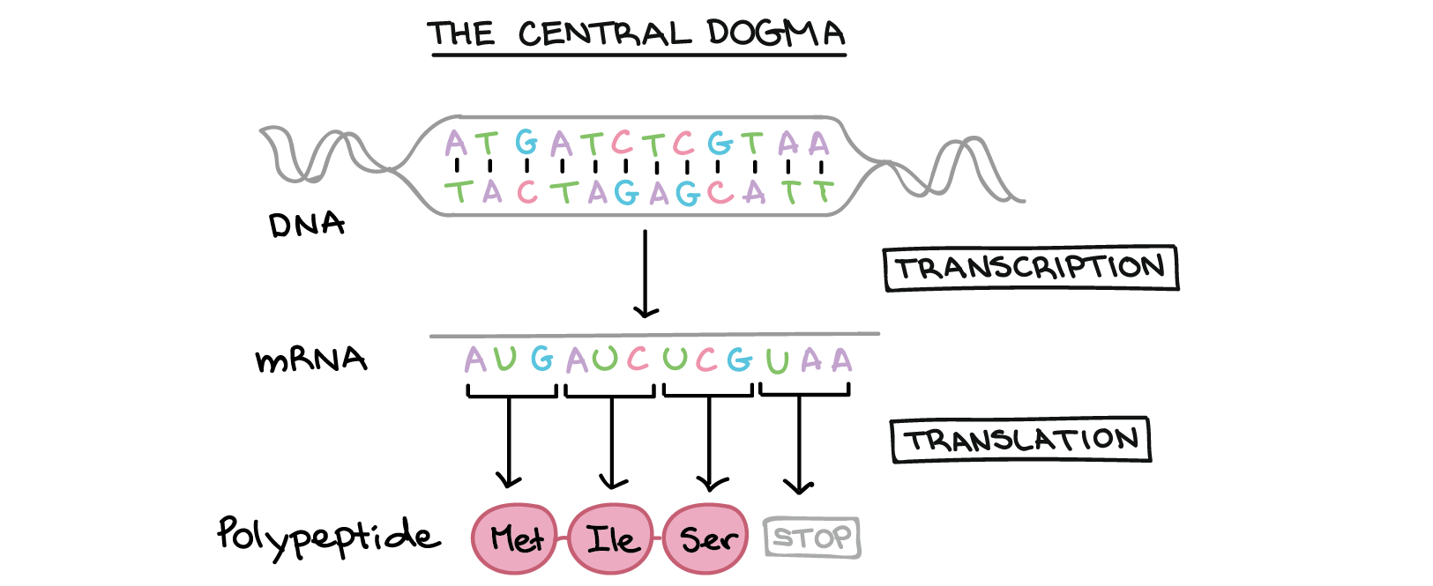
Mini-science lesson: what is mRNA?
mRNA= messenger RNA – instructions for spike protein

Slide 8
Mini-science lesson: two types
messenger RNA (mRNA) for the spike protein
mRNA vaccine:
Pfizer & Moderna
vector vaccine:
Johnson & Johnson (also AstroZeneca)

Slide 9
mRNA vaccine (simplified):
mRNA wrapped in oily substance
Spike protein antibodies released
Picked up as foreign
Spike protein picked up by immune cells
Spike proteins made in cytoplasm
Spike proteins released

Slide 10
vector vaccine (simplified):
mRNA converted to tiny spike protein DNA
Spike protein antibodies released
Spike DNA put into modified adenovirus
Spike protein picked up by immune cells
Adenovirus attaches to cells, enters, pushes spike DNA into the nucleus
Engineered so ONLY spike protein DNA can be read and turned into mRNA, mRNA travels to cytoplasm where spike protein made…
Spike proteins released

Slide 11
The Clinical Trials Process
During clinical trials, some participants receive vaccines, and some receive placebos (no active ingredient) to compare outcomes.
Phase 1 trial:
A small group of healthy volunteers receive the vaccine to test for safety and potential side effects
Phase 2 trial:
Several hundred participants representative of the U.S. population receive the vaccine to test response of diverse immune systems
Phase 3 trial:
Thousands of volunteers receive the vaccine to test widespread efficacy, side effects, and safety
To ensure a COVID-19 vaccine is safe and effective for all people regardless of their age, race, ethnicity, or gender, vaccine studies included age, gender, and racial diversity among the trial participants.

Slide 12
COVID VACCINES approved:
Pfizer- BioNTech
2 doses
21 days between
95% efficacy
Moderna
2 doses
28 days between
95% efficacy
Johnson and Johnson
1 dose
Easier to store
72% efficacy

Slide 13
Ongoing Monitoring:

Slide 14
Lymph node swelling
https://www.cdc.gov/coronavirus/2019-ncov/vaccines/expect/after.html

Slide 15
https://www.cdc.gov/coronavirus/2019-ncov/vaccines/expect/after.html

Slide 16
Serious side effects:
Rare
Anaphylaxis
11.1 cases per million doses
History of allergies
Treatable with epinephrine
No deaths have been clearly linked to COVID-19 vaccine
https://www.nature.com/articles/d41586-021-00290-x
Notes:
It may be the polyethylene glycol (PEG) component causing anaphylaxis – it is linked to the lipid nanoparticles to help them avoid detection by immune system
https://www.nature.com/articles/d41586-021-00290-x
80% Pfizer & 86% Moderna

Slide 17
Part 2: Common Questions about the COVID-19 Vaccines

Slide 18
Will COVID-19 vaccination cause me to test positive on COVID-19 test?
No – if you test positive on an antigen, NAAT or PCR test, you have infection

Slide 19
If I have been vaccinated, do I still need to wear a mask and distance?
Congratulations on reducing risk to yourself, your friends, you colleagues
You do still need to follow mask and distancing policies!

Slide 20
Who is eligible for vaccines? CDC tiers:
1a: health care personnel & residents of long-term care facilities
1b: frontline essential works & people age 75 and older
1c: people age 65-75, people age 50 and older with underlying medical conditions & other essential workers

Slide 21
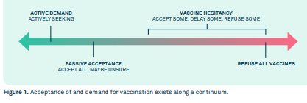
https://publichealthcollaborative.org/wp-content/uploads/2021/01/VACCINEMISINFORMATIONFIELDGUIDE_eng.pdf

Slide 22
Notes:
Poll Title: Which of the following best describes where you are in regards to vaccines? https://www.polleverywhere.com/multiple_choice_polls/gjoXwuAaquCfwwe02Dkmr?flow=Default&onscreen=persist

Slide 23
Part 3: What Impacts COVID-19 Vaccine Uptake?
Notes:
A Historical Perspective
Vaccine Hesitancy has existed for as long as there have been vaccines. Beginning with the first smallpox vaccine in the 1700’s, people have expressed fear and mistrust of vaccines.

Slide 24
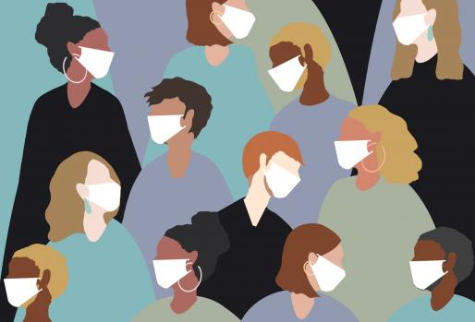
The divides along racial, urban-rural, political, and generational lines are significant when it comes to vaccine acceptance!
Notes:
The findings of a new national poll conducted by the de Beaumont Foundation and pollster Frank Luntz in partnership with the American Public Health Association, the National Collaborative for Health Equity, and Resolve to Save Lives, an Initiative of Vital Strategies "The Language of Vaccine Acceptance," reveal the urgent need for political and health leaders to adjust their messaging to improve confidence in COVID-19 vaccines. The poll identifies the language that will be most effective in reaching all Americans, especially those who are currently less likely to take a vaccine "The divides along racial, urban-rural, political, and generational lines are significant when it comes to vaccine acceptance.

Slide 25
WHAT IMPACTS VACCINE CONFIDENCE?
Possible side effects
Lack of trust
Vaccine too new
Role of politics
KFF COVID-19 Vaccine Monitor: December 2020
Published: Dec 15, 2020
Notes:
Animation
KFF COVID-19 Vaccine Monitor: December 2020
Focus on Lack of Trust and Role of Politics
Published: Dec 15, 2020
“Among those who are hesitant to get a COVID-19 vaccine, the main reasons are worries about possible side effects (59% cite this as a major reason), lack of trust in the government to ensure the vaccines’ safety and effectiveness (55%), concerns that the vaccine is too new (53%), and concerns over the role of politics in the development process (51%)., confidence, trust, and safety concerns
Social

Slide 26
THE GOOD NEWS
Notes:
The Kaiser Family Foundation - Looking across racial and ethnic groups, there has been an increase in vaccine willingness among Black, Hispanic, and White adults alike. The change is perhaps most dramatic among Black adults, among whom willingness to get vaccinated increased from 50% in September to 62% in December. While Black adults were about evenly split in September on whether or not they would get a COVID-19 vaccine that was free and determined to be safe by scientists, they are now almost twice as likely to say they would get vaccinated as to say they would not (62% vs. 35%).

Slide 27
Part 4: Building Vaccine Confidence with Motivational Interviewing

Slide 28
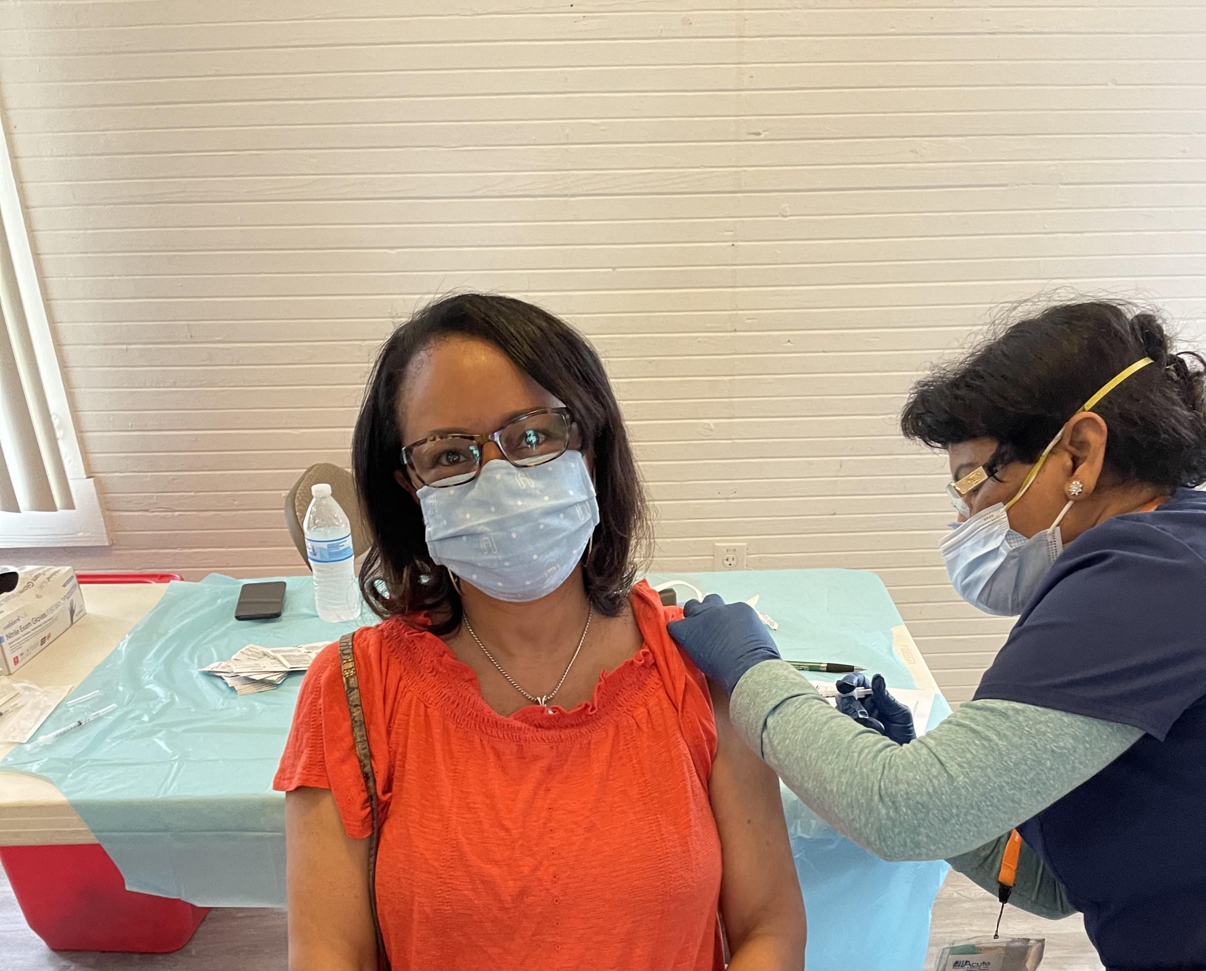
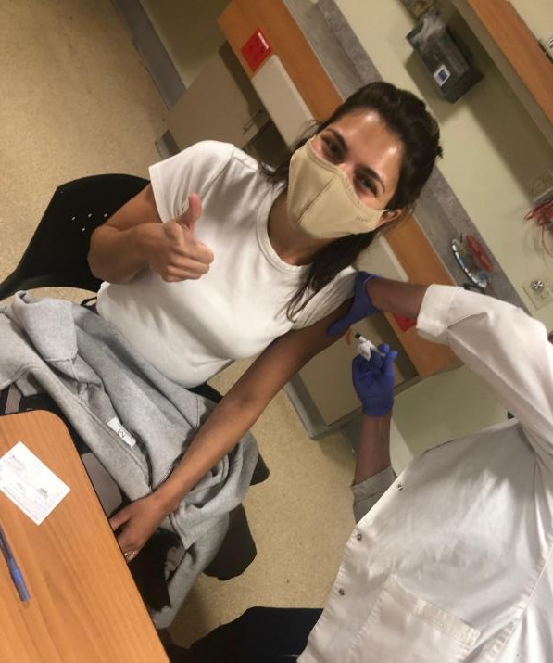
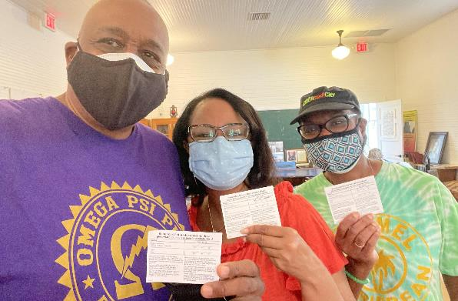
WE GOT VACCINATED!
Notes:
Vaccine confidence starts with you!

Slide 29
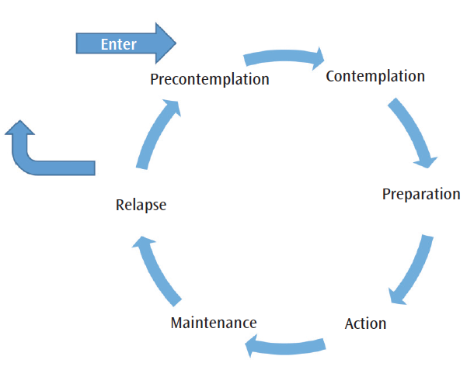
Precontemplation: What’s the big deal about the vaccine?
Contemplation: Aware of the vaccine, but not quite ready…
Preparation: Plan to sign up for vaccine in next month
Action: Signs up and receives 1st vaccine
Maintenance: Goes back for 2nd vaccine
Stages of Change (Prochaska & DiClemente)
Notes:
How do we change a behavior?

Slide 30
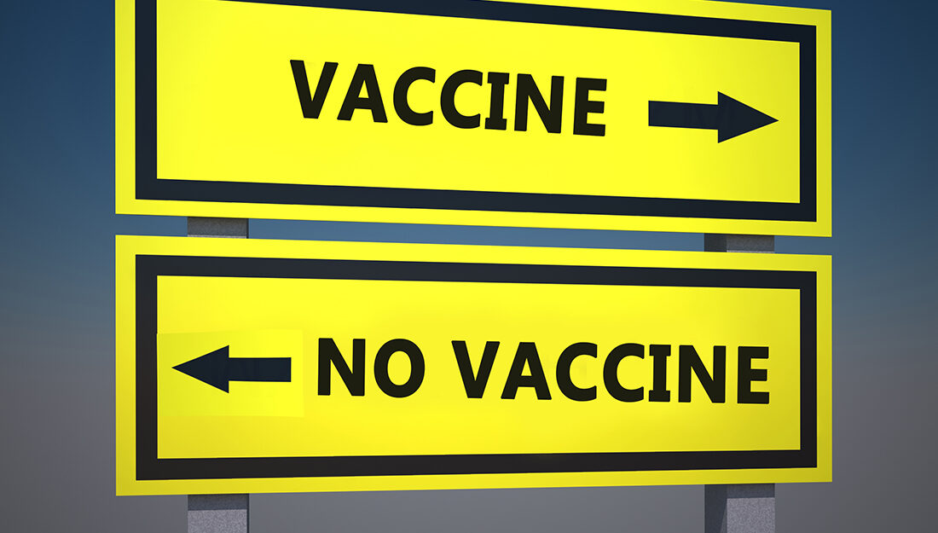
How Do You Increase Someone’s Confidence in the Vaccines?

Slide 31
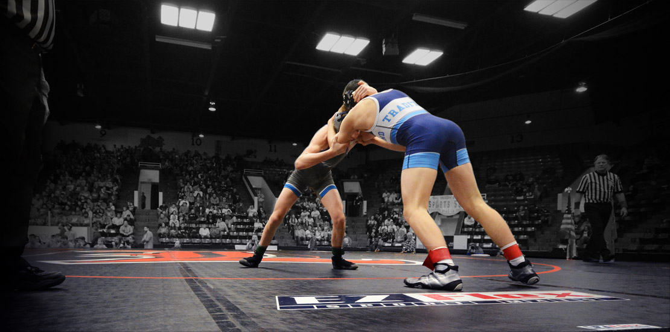
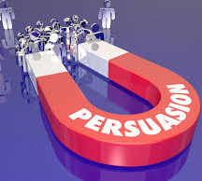
WHAT DOES NOT WORK
Persuasion
Righting reflex
Not Rolling with Resistance
Not Respecting Ambivalence
Notes:
When seeing someone headed down the wrong path, helpers will usually want to get out in front of the person and say, “Stop! Turn back! The natural desire of helpers to set things right, to prevent harm and promote client welfare. Persuasion is not an effective method for resolving ambivalence. It usually only increases client resistance and decreases the probability of change.
Ambivalence is a state of mind in which a person has co-existing but conflicting feelings about something Fundamental and NORMAL part of the change process
“I want to, but I don’t want to…”
“You tell me a reason to change, I’ll tell you a reason not to…”

Slide 32
Notes:
Which brings us to MI

Slide 33
What is Motivational Interviewing (MI)?
Collaborative, goal-oriented style of communication
Designed to strengthen personal motivation
An atmosphere of acceptance and compassion.
(Miller & Rollnick, 2013)
Notes:
Allows the individual to identify and verbalize their own reasons for change… We serve as the guide…
Miller, W. R., & Rollnick, S. (2013). Applications of motivational interviewing. Motivational interviewing: Helping people change (3rd edition). Guilford Press.
It is most helpful to understand MI in two ways: its spirit and its techniques.

Slide 34
Spirit of MI
O.A.R.S.
Elicit-Share-Elicit
Notes:
Cover these 3 areas.

Slide 35
The Spirit of MI
Autonomy (vs. Authority)
Collaboration (vs. Confrontation)
Evocation (vs. Education)
Notes:
Collaboration – Using Use Handout Page 14S Is this MI Spirit student: I know my RA told you I’m depressed, but I’m not.
Helper: You don’t believe you’re depressed. What do you think she’s seeing that is making her worry this way?
Student: I had no idea I weighed that much. I guess that’s why everyone tells me I shouldn’t eat so much.
Helper: Right. You need to cut down on your eating and I know some good ways to get you started.
Student: I think your BMI thing is wrong because I am not “obese.”
Helper: You don’t think of yourself as someone who has a weight problem.
Partnership
Active collaboration
Acceptance
Non-judgmental
Compassion
Focus on well-being
Evocation
Strengths and resources

Slide 36
How to Develop a Motivational Conversation

Slide 37
O – Open ended questions
A- Affirmations
R- Reflective Listening
S- Summarization
“What concerns do you have about the vaccines?”
“You have thought a lot about this.”
“I hear you saying that….”
“Let me summarize…..”
Notes:
Animation on the slide - Let’s give it a try – Type in example of O –A – R

Slide 38
Exchange of Information Technique Elicit- Share – Elicit
Elicit
“May I ask what you already know?”
Share
“May I give you more information?”
Elicit
“So, what do you think of that?
“Studies show or what we know is….”
What is the next step for you?”

Slide 39
SCENARIO

Slide 40
You are a member of the health and wellness team and talking with another non-health staff member on center who has not received the COVID vaccine. When you said,
“This weekend I had my first COVID vaccine shot”
COVID-19 Vaccination Conversation
the colleague replied,
“I don’t want the COVID vaccine.”
How can you respond?

Slide 41
Step 1: Ask the colleague to share concern(s)
MI Conversation
“So, you seem to have questions about the COVID vaccine. What are your particular concerns?” (Note: open ended and non-threatening)
Colleague “Well, I think the vaccine was created too quickly to be trustworthy just yet.”

Slide 42
MI Conversation
Step 2: Ask permission to share information
You reflect back what the colleague is saying to be sure you understand (empathy), summarizes, asks permission to share their own perspective.
Example: “So I can hear that you’re concerned that the COVID vaccine was created too quickly, and you are not sure you can trust it. I’ve also heard others say this, but you know I follow vaccine safety closely. Is it okay if I go over what I know about the vaccines?”

Slide 43
MI Conversation
Step 3: Provide information to enlighten the colleague’s perspective (Elicit-Share-Elicit)
“Its true the COVID-19 vaccines are authorized for emergency use and tested more quickly, but there has been extensive clinical trials to show their effectiveness. The need for a vaccine was urgent. Did you know the technology the vaccines uses MrNA was actually developed long before the virus that causes COVID-19 began to circulate? Tell me what you’ve heard about COVID vaccine complications.”
- Colleague “Well, I have heard that people get sick after getting it.
.
Notes:
Type in the chatbox what you might could say next to your colleague – give example here.
Avoid arguing and focus on COVID prevention

Slide 44
MI Conversation
Step 4: Share your personal recommendation. (Elicit-Share-Elicit)
– Provider: “I strongly believe in this important vaccine to help us get back to a normal way of life, which is why I got the vaccine and I am recommending all of my family get the vaccine. I trust it as a health care provider. Having said that, I know you already have some knowledge about this (affirmation) and this is a decision that only you can make ( autonomy). What do you think?”

Slide 45
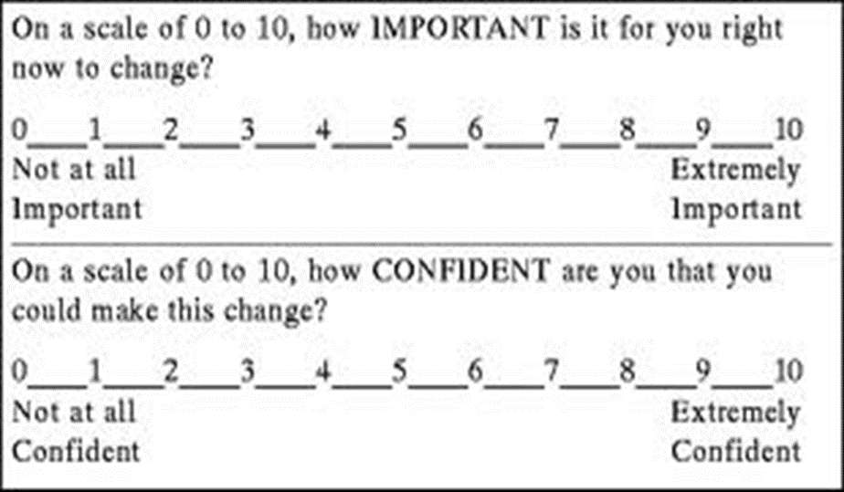
IMPORTANCE AND CONFIDENCE HOW READY ARE YOU TO GET THE COVID-19 VACCINE ?
Notes:
Ask about importance and confidence around specific change…
Follow up questions to elicit change talk:
Why did you pick ____ instead of _____(slightly lower number)?
What would have to happen to make you move up to a ____ (slightly higher number)?

Slide 46
R.U.L.E.
R
RESIST TELLING THEM WHAT TO DO
U
UNDERSTAND THEIR MOTIVATIONS
L
LISTEN WITH EMPATHY
E
EMPOWER THEM
MOTIVATIONAL INTERVIEWING
TAKEAWAYS

Slide 47
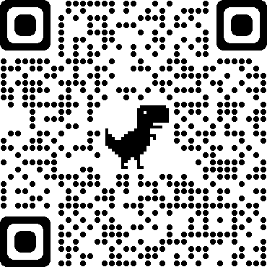

Slide 48
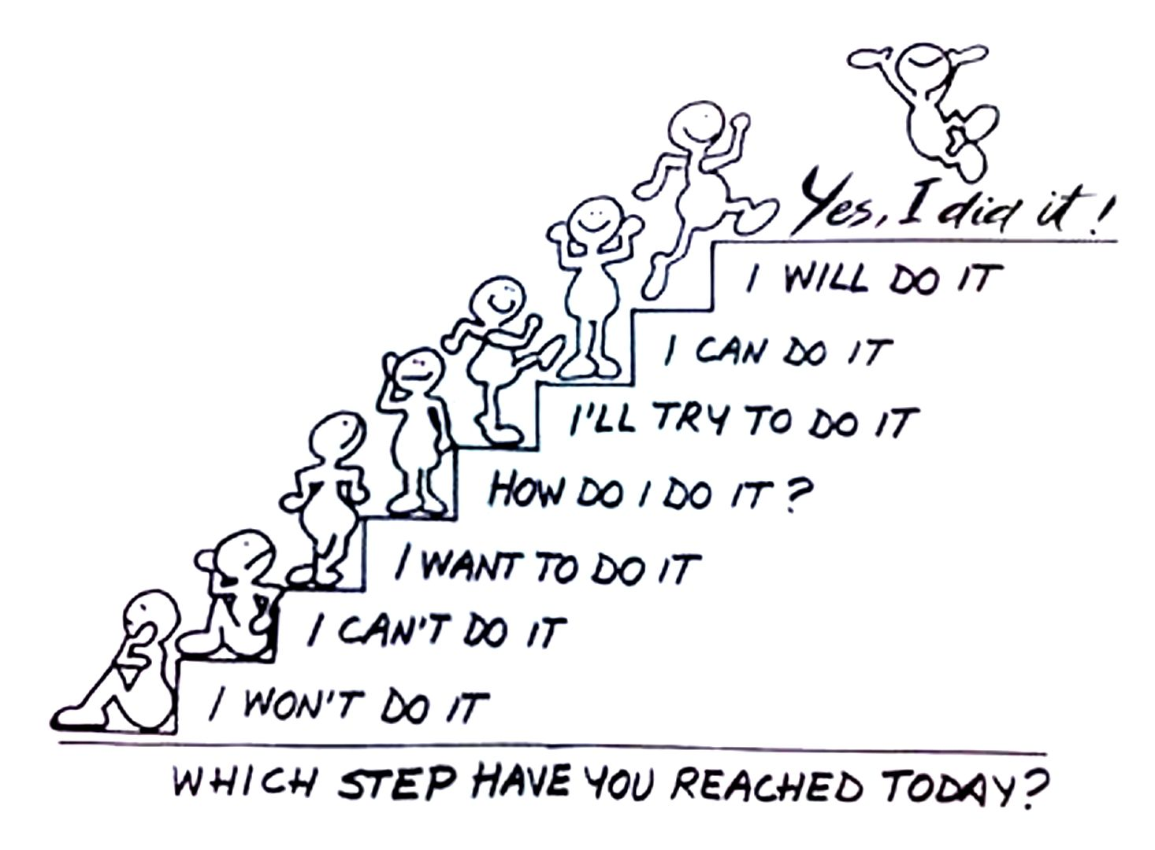

Slide 49
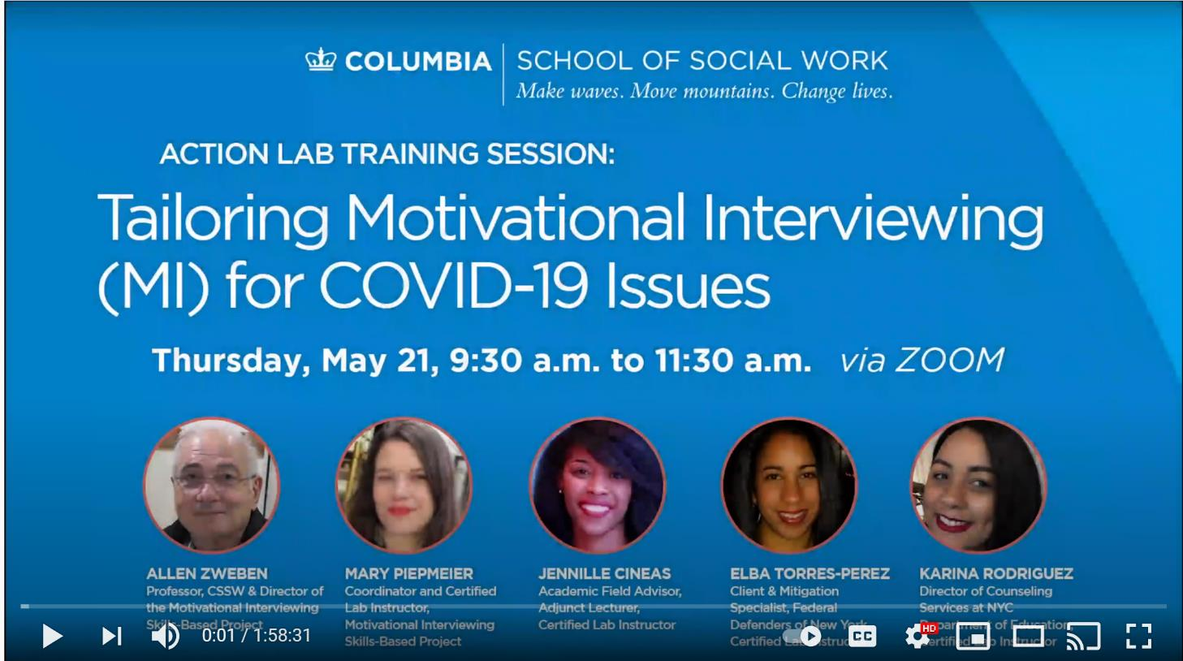
https://youtu.be/z14_f97QybQ

