Slide 1
Formalized Assessment Measures for TEAP Specialists
Christy Hicks, LCADC, CSW

Slide 2
Learning Objectives
After this webinar, participants will be able to:
1) Discuss the use of different screening and assessment tools to be used on center.
2) Evaluate a student’s level of care needed based on their assessment and clinical judgment.
3) Verbalize appropriate resources in their community to support students while on center or needed resources for students to use while on MSWR.

Slide 3
Why do we do assessments?
Assess- needs, use, history
Diagnosis- if they meet the criteria
Treat or determine treatment level

Slide 4
Assessment Protocol Process
Goal: Identification of ALL students at high risk, meaning those at risk for not completing JC
PRH 2 R5 is silent about the specifics of the assessment process
Historically this occurred as part of the intake process with students coming down to HWC
Those elements included:
Review of the SHR (and the 653)
Review of the SIF (and the CRAFFT)
Formalized assessment measures administered to those with 2 or more on CRAFFT
Interview the Student (inform them of drug and alcohol testing policy, procedures, and consequences of positive Urine drug screen)
Initial UDS results
Offer voluntary TEAP services to those with 2 or more on CRAFFT and those with other identified risk factors
Your clinical judgment based on all of the above

Slide 5
Who needs assessment?
New incoming students and return students (MAST and DAST).
But what about current students who are in-person or virtual?
What do we know about COVID-19’s impact?
Assessment process should include both new and current students.

Slide 6
Transferring in-person assessment process to a virtual assessment or vice versa.
Review of the SHR (and the 653) – how will this occur?
Review of the SIF (and the CRAFFT) – how do you get access?
How do you set up to interview the student?
Administer formalized assessment by either emailing protocol to student or administer it while talking with student
Review of UDS (there will be some type of initial test but no specifics yet).

Slide 7
Same steps but could be a different mechanism or many mechanisms.
Bottom Line
Must develop an assessment process that can be completed virtually for new incoming students that allows you confidence that you are identifying students who need additional support to be successful at Job Corps.

Slide 8
Formalized Assessment Measures
PRH requires that for those scoring 2 or more on Questions 4-9 of the CRAFFT that formalized assessment measures/clinical judgement are administered.
Formalized Assessment Measures (FAMs) are defined as an empirically established standardized instrument that allows comparison between the student you are assessing and a normative group
Examples of FAMs that are in the public domain are:
Michigan Alcohol Screening Test (MAST) (for adolescents and adults)
Drug Abuse Screening Test (DAST - 10 or 20) (for adolescents and adults)
The Cannabis Use Disorders Identification Test – Revised (CUDIT-R)
Alcohol Use Disorders Identification Test (AUDIT) (for adolescents and adults)
SASSI- Substance Abuse Subtle Screening
GAIN- Global Appraisal of Individual Needs
ASAM- American Society of Addiction Medicine

Slide 9
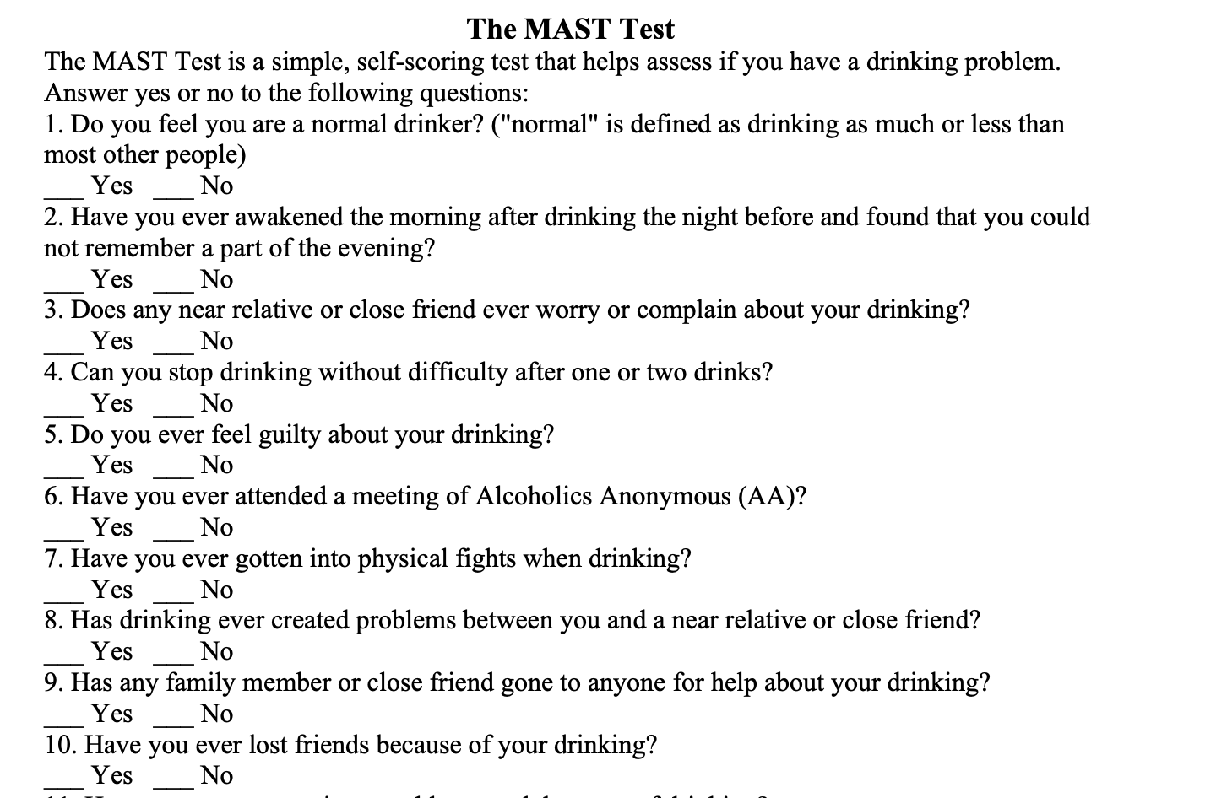
FAM Specifics
The Michigan Alcohol Screening Test (MAST) is a 22-item measure used to detect emerging alcohol problems. When scoring the MAST, a score of 4 or more indicates a student is at higher risk for problematic alcohol use.

Slide 10
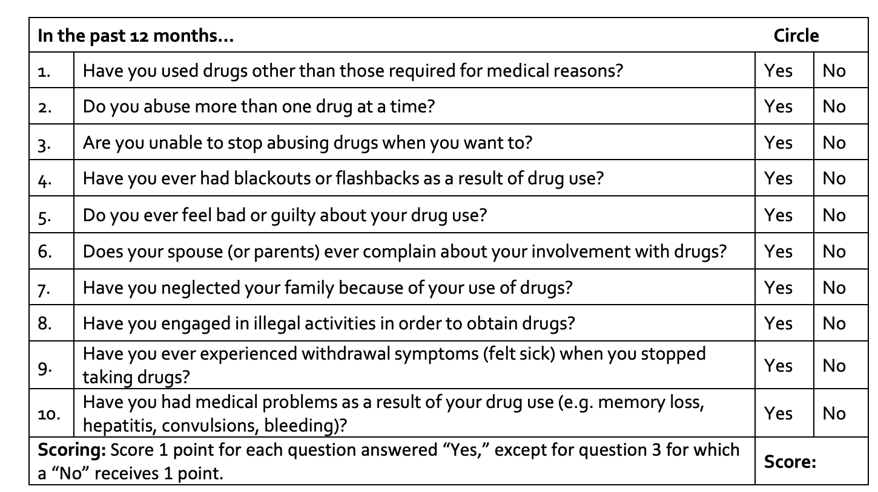
FAMs continued
The Drug Abuse Screen Test (DAST-10) is a 10-item measure used to detect emerging drugs use issues. When scoring the DAST-10, a score of 3 or more indicates a student is at higher risk for problematic drug use.

Slide 11
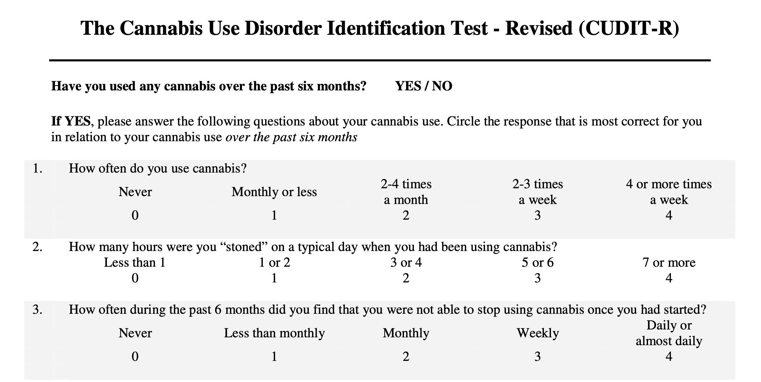
FAM Specifics continued
The Cannabis Use Disorders Identification Test – Revised (CUDIT-R) is an 8-item measure for identification of cannabis misuse. Available for download at several sites online. Scores of 8 or more equal at-risk use of marijuana and may suggest more support is needed.

Slide 12
FAM Specifics continued
Alcohol Use Disorders Identification Test (AUDIT) (for adolescents and adults). Available for download at several sites on line. Score of 8 or more is considered harmful/hazardous alcohol use and warrants more support is needed.

Slide 13
SASSI

Slide 14
SASSI

Slide 15
ASAM

Slide 16
ASAM

Slide 17
Preparation for Administering FAMs
Obtain copies of instruments you are going to use.
Have FAMs that address both drugs and alcohol.
If using a new-to-you FAM, then review ahead of time and practice.
Determine how to administer virtually or in person.
Some FAMs have interview version or send them to students ahead of time. But if doing this – how are you going to get them back?

Slide 18
Time-Out for Documentation

Slide 19
The Five Elements are Still Required
Content of interaction
Student’s response
Plan
Date
Signature with credentials

Slide 20
Disclosure Statement
Entry into TEAP section of SHR:
On date, 2020 at AM/PM student gave verbal consent for video conferencing as modality for services due to current COVID-19 pandemic and current operations being virtual.
Student was informed of the inherent limits of confidentiality when using technology. Student was contacted via phone number, (xxx-xxx-xxxx)
During the session, the following individuals present were also present with the student: ______________________.

Slide 21
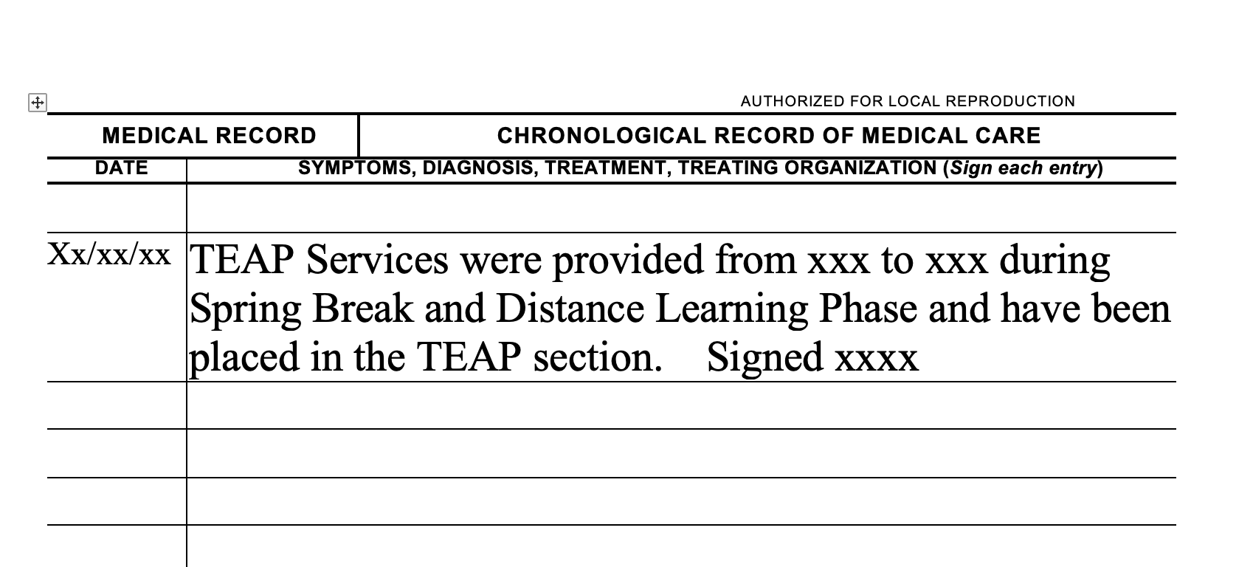
Example for
Chronological when no Access to SHR

Slide 22
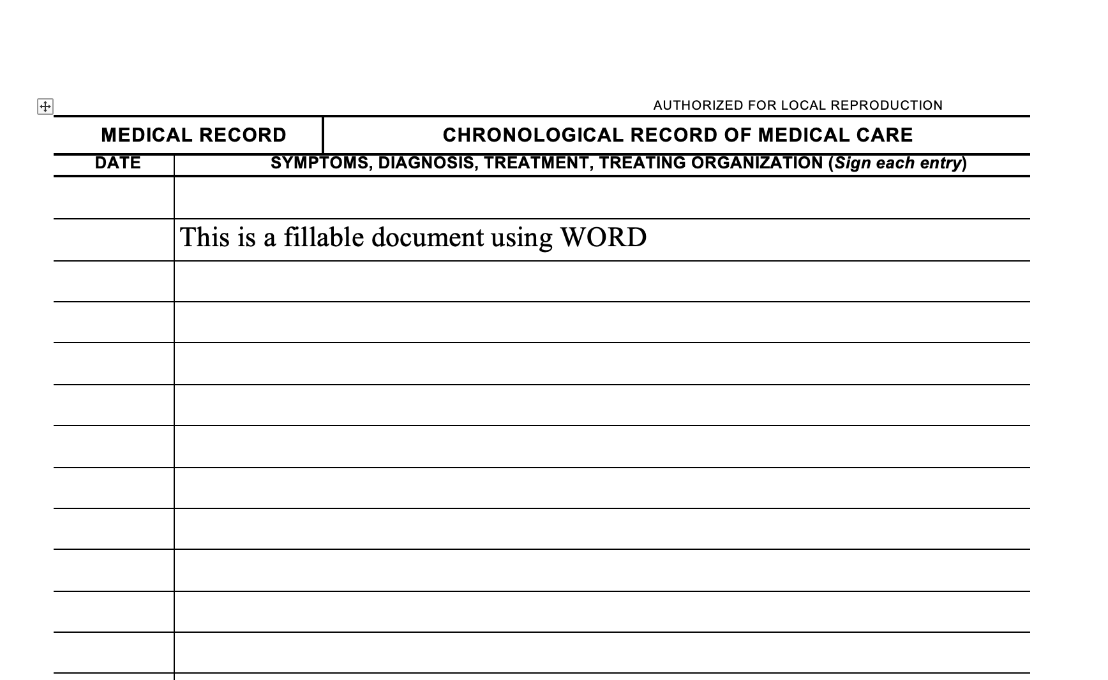

Slide 23
Next Steps: Providing Support
For those who tested positive on entrance (intervention services).
Also includes those who did not have an initial positive UDS but scored 2 or more on CRAFFT.
Any other students you identified through the assessment process that may be at increased risk due to their history, current use or other factors.

Slide 24
What to do?
Remember goal is connection and support during this time.
Individual or group meeting in google classroom.
Dropping into other classrooms (with permission).
Telephone calls.
Enrich your google classroom with materials.
HEALs and collaboration with CMHC/HWC staff
Email with specific images, memes, homework and other information.
Old fashion means of communication – USPS.
Do your research – what online supports are there.

Slide 25
Online Supports
Alcoholics Anonymous Groups
https://www.aa-intergroup.org/index.php
AA Telephone Meetings
AA Audio/Video Meetings
12-Step Forums
AA Online Meeting
AA Family Group Online Meeting
Narcotics Anonymous
Narcotics Anonymous Online Meeting List
Never Alone Club
Never Alone Club Online Chat
Marijuana Anonymous
Marijuana Anonymous Online Meeting Schedule
See document for more resources at the Support Services Website

Slide 26
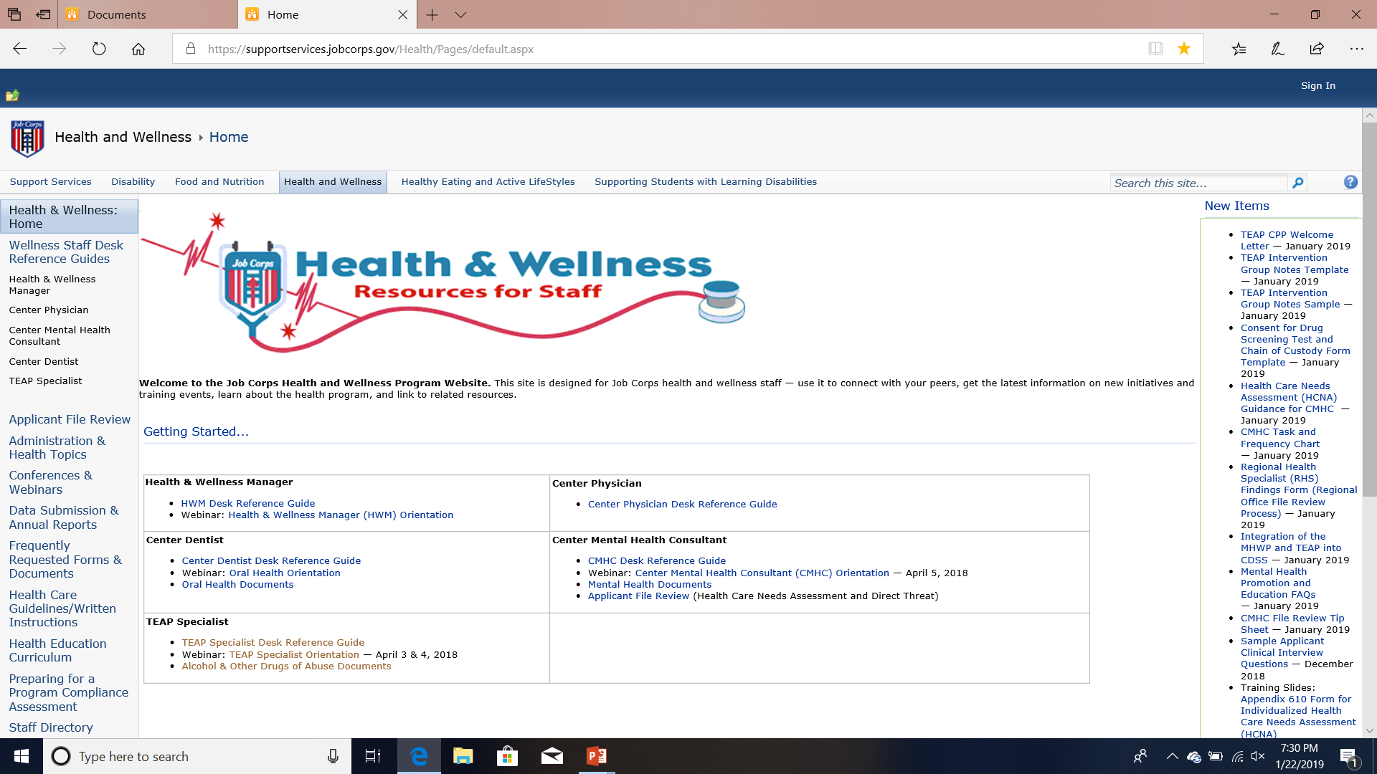
Where to Find Content?
SupportServices Website: https://supportservices.jobcorps.gov/health/Pages/default.aspx

Slide 27
Motivation
This will continue to be challenging for everyone.
Remember goal: Students to remain connected to the program by engaging in virtual learning activities that support gains in learning and career skills training.
Remember to your flexibility.
R3emember your humor and more humor.
Consider reviewing TIP 35: Enhancing Motivation for Change in Substance Use Disorder Treatment (Download at SAMHSA).
Use Brief Intervention Strategies or Awareness Raising Interventions (see SBIRT at https://www.samhsa.gov/sbirt).

Slide 28
A Few More Reminders
Drug or alcohol testing is not occurring right now except for suspicion screens.
Students in the intervention period before the Spring Break, should continue with virtual intervention services.
Use the CDP and CTP templates (on website) for other material.
SAMHSA has new materials on marijuana (https://www.samhsa.gov/marijuana), including brief videos and handouts.

Slide 29
Case Study # 1
Marc was a 17-year-old White male adolescent who was came to Job Corps today. Marc had been home from an acute care hospital for six months prior to coming to JC an completed a 30-day residential substance abuse treatment center prior to admission to JC. Marc stated that he began snorting heroin secondary to peer pressure. He resided in a low-income city, and drug abuse was rather rampant in his community and school. He was encouraged by his peers to try snorting heroin. He did it for the first time, and although he was not certain if he really liked the effect of the drug, it did not do him any harm, so at another outing, he decided to try to use it again when encouraged by his peers. This time, when he snorted heroin, a terrible thing happened. Marc’s only memory is that he passed out and, when he awoke, he was in a critical care unit in his community’s hospital on a ventilator. Upon snorting the heroin, Marc developed a spontaneous bilateral tension pneumothorax. Thank goodness, some of his peers were coherent. They immediately dialed 911, and Marc’s life was saved by two paramedics. Besides the ventilator, Marc had two chest tubes in place to pleurovac drainage. The chest tubes remained in place for around 4 days. Marc was fortunate in that he was still alive and in that he had only used heroin for the second time. My question to him was ‘‘Do you then realize how close you came to your maker?’’ He answered in the affirmative. My second question followed, which was ‘‘Are you going to ever snort or use heroin again?’’ He responded that he would not. He had learned his lesson. Marc did well in treatment and was able to be discharged 2 weeks later. To this date, I have not seen Marc back in treatment. This incident happened several years ago, and my belief is that Marc is a success story from a treatment standpoint.

Slide 30
Let’s talk about Mark
What issues do you see with Mark coming to Job Corps?
What positives do you see with Mark?
Could we use more information about Mark? If so, what?
Could Mark make it at your center?
What supports could we use on center to assist Mark?

Slide 31
Case Study # 2
Sandy is a 21 year old female. On her 653 she reported extensive marijuana use since she was 13 years old. Sandy currently lives in an apartment with three young ladies her age and he is employed at a dress shop full-time. Sandy eats dinner every week with her parents on Tuesdays and Sundays and on her days off she babysits for a neighbor that works third shift. Sandy reports that using marijuana daily helps her with her anxiety and helps her to sleep. Sandy has had many times that she has quit to acquire a job or retain a job but currently rates her use as moderate (daily use). Sandy would like to come to Job Corps to become a CNA and Phlebotomist.

Slide 32
Let’s talk about Sandy
What issues do you see with Sandy coming to Job Corps?
What positives do you see with Sandy?
Could we use more information about Sandy? If so, what?
Could Sandy make it at your center?
What supports could we use on center to assist Sandy?

Slide 33
Contact Us
Diane A. Tennies, PhD, LADC
Boston, Philadelphia, and San Francisco Regions
datphd@aol.com
Christy Hicks, LCADC, CSW
Atlanta, Dallas, and Chicago Regions
Christy.hicksmsw@gmail.com

