Slide 1
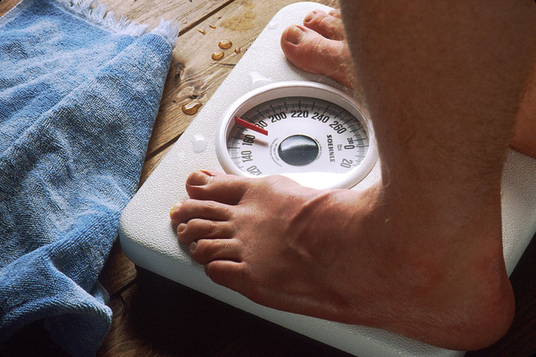
Healthy Eating and Active Lifestyles
Ingredients for a Successful Program
Notes:
Welcome to the Healthy Eating and Active Lifestyles webinar. The HEALs program was released in 2009 and was based on recognition of overweight and obesity as a significant health problem among adolescents. Today we will…(next slide)

Slide 2
Shopping List
PRH Requirements
HEALs Committee Members
Healthy Center Culture
HEALs Program Evaluation
Student Education Curriculum
Documents
Notes:
We will review PRH Chapter 2, 2.3, R9.
Identify specific disciplines required to contribute to the HEALs committee with specific guidance for each
What it takes to create a healthy center culture in order to have a successful HEALs program
How to evaluate your HEALs program for continuous quality improvement
We will talk about the Student Education Curriculum and required instruction for health and well-being and
Review some of the documents located in the support services website under the healthy eating and active lifestyles tab that will help you in developing a successful HEALs program.

Slide 3
PRH Requirements – getting started
PRH Chapter 2, Section 2.3, R9. Healthy Eating and Active Lifestyles
Centers must provide students with an environment that supports healthy eating and active lifestyles and provides students with education and experiences that promote lifelong health and physical well-being. At a minimum, this program must include the following components:
Planning
Assessment
Environment
Education and counseling

Slide 4
PRH Requirements – Planning
PRH Chapter 2, Section 2.3, R9 (a)
Establish a Healthy Eating and Active Lifestyles Committee to oversee and coordinate this program. At a minimum, this committee must include:
Health and Wellness Manager
Food Services Manager/Supervisor
Recreation Supervisor or Specialist
TEAP Specialist
Residential Manager/Counseling Manager
Student Representative
Center Director
Notes:
It is the Center Director’s responsibility to form the committee to lead the HEALs program. What commonly happens is the CD will appoint the Health and Wellness Manager to spearhead this task. This does not mean the Health and Wellness Manager is the HEALs committee chairman. The list that you see is only the minimum required for the committee. Other disciplines may also serve as members such as the CMHC, academic instructors, trade instructors, the dental hygienist, residential advisors, the TUPP coordinator. The committee should incorporate student interests and preferences when planning activities as well as demonstrate collaboration between various departments on center. Committee members should be enthusiastic, popular with students, and passionate about nutrition and exercise. Once the HEALs committee has been selected send contact information to Julie Luht (Julie.Luht@humanitas.com) at the national office to receive HEALs updates.

Slide 5
PRH Requirements – Environment
PRH Chapter 2, Section 2.2, R4. Recreational Activities
Centers must provide a wide variety of activities open to all students. Activities should reinforce and provide time to practice communication skills, to demonstrate positive attitudes and behaviors, and to work and participate in groups.
Recreation Supervisor
Recreation Specialist
Residential Manager
Counseling Manager
Group fitness classes
Individual fitness activities
Organized sports
Exercise groups or clubs
Group sessions
Entrepreneurship classes
Resume writing
Volunteering, mentoring
Cultural events
Dancing and theater
Radio/TV mockups
Rap, poetry seminars
Physical education
Conditioning classes
Arts and crafts
Reading/computer resources
Notes:
Per PRH Chapter 2, Section 2.3, R9(b) the HEALs committee must provide a variety of fitness activities open to all students, as outlined in PRH Chapter 2, Section 2.2, R4
Must include but not limited to: group fitness classes, individual fitness activities, organized sports, exercise groups or clubs, group sessions with employers or career professionals, entrepreneurship classes, evening resume writing and interview techniques and volunteering, mentoring or tutoring.
May include: cultural events, dancing and theater, radio and/or television mockups, playwright, rap and poetry seminars, physical education and condition (yoga, spinning, etc.), arts and crafts, reading and computer resource facilities.

Slide 6
PRH Requirements – Environment
PRH Chapter 5, Section 5.10, R3. Food and Nutrition
Centers must provide food services to students, to include:
Food Services Manager
Food Services Supervisor
Student Representative
Meal Service
Food Options
Nutrition
Notes:
Meal Service: provide 3 meals/day, except on holidays and weekends and during this time healthy snacks must be available to students. Meals must be planned, and menus for the month must be available to students. Meal service must be made available to accommodate work-based learning, off-center activities and late arrivals.
Food Options: there must be at a minimum two choices of meat or non-meat protein sourced for lunch and supper, 5 choices of fresh/frozen fruits/veggies, 4 servings of grains and low-fat and/or fat-free milk/dairy alternatives and water must be available at all meals. Some centers incorporate into their menu’s ethnic dishes on curtain days like Taco Tuesdays or Fish Fridays supporting the diversity of the student population and to provide a variety of foods to encourage students to develop healthy eating habits.
Nutrition: meals must reflect the definition of a “Health Diet”. Emphasis on fruits, vegetable whole grains, fat-free/low fat milk, foods in low saturated fats, low sodium and low added sugars. Monitoring portion sizes and serving less food with minimal nutritional value such as soda, and candy. Water Wednesdays has been a popular activity to encourage students to drink more water and less sugary drinks like sodas and juices with high sugar content.

Slide 7
PRH Requirements – Education and counseling
PRH Chapter 2, Section 2.3, R9(c). Healthy Eating and Active Lifestyles
Provide educational activities and materials to all students that support regular physical activity, nutrition and achieving a healthy weight, as outlined in PRH Chapter 3, Section 3.4, R21.
Provide individualized weight management programming and/or counseling . Student participation in this program is highly recommended.
Incorporate motivational interviewing and goal setting at student’s level of readiness for change.
Health & Wellness Manager
TEAP Specialist
Recreation Manager
Recreation Supervisor
Residential Manager
Counseling Manager
Student Representative
Notes:
Centers must have a documented weight management program for students (this is a requirement and will be reviewed for compliance during the PCA). Referrals made to the center physician for the student to be approved to attend weight management class, weekly weigh-ins documented in the SHR. The program may be supported by the recreation department or assigned to anyone on center who has an enthusiastic interest in health and exercise. Center activities “The Greatest Losers” contest. Students are awarded gift cards in 1st, 2nd and 3rd place for loosing the most weight over a predetermined period of time. Outside speakers such as nutritionists, and dieticians may also be an option.

Slide 8
PRH Requirements – Education and counseling
PRH Chapter 3, Section 3.4, R21. Required Instruction for Health and Well-Being
Centers must provide instruction to all students in the following subjects:
Center wide
Health education and good decision-making models
Emotional and social well-being
Depression, grief, and suicide
Relationships and sexuality
Relationship aggression
Reproduction and birth control
Sexually transmitted diseases
Consumer health
Nutrition and fitness
Alcohol and other drugs of abuse
Relationship of a healthy lifestyle to successful job retention
Sexual assault
Sleep hygiene
Oral disease prevention and oral hygiene instruction
Notes:
This requirement is not limited to the HEALs committee or the responsibility of the Health and Wellness Department but should be a center wide endeavor. Relationship aggression classes may be provided by the counselors in the dorms, depression, grief, and suicide by the CMHC and counselors, oral disease prevention and oral hygiene instruction provided by the dental hygienist and dentist. Some centers have managed this requirement by providing a health class to students during the academic day.

Slide 9
PRH Requirements – Assessment
PRH Chapter 2, Section 2.3, R9(d). Healthy Eating and Active Lifestyles
Document
Monitor
Assess program
HEALs Committee
Notes:
HEALs program must also include documentation that the program is being facilitated – meeting minutes, activities provided,
Monitoring the program to make sure the students needs are being met by conducting the Student Program Evaluation
Assessing the program by completing the Making the Grade questionnaire at 6-month intervals

Slide 10
HEALs Committee Members
HEALs Committee
Health and Wellness
Manager
Dental Staff
Residential
and Counseling Managers
Student Representative*
TEAP Coordinator
Recreation
Manager/ Supervisor
Food Service Manager/Supervisor
Schedule your first committee meeting
Assess current activities on center using the HEALs Implementation Self Assessment or Making the Grade
Review PRH requirements as a group
Schedule your second meeting
Notes:
As a member of the Healthy Eating and Active Lifestyles (HEALs) Committee, you are responsible for the overall implementation and evaluation of the program. This includes collaborating with each other and with center staff to meet PRH requirements, foster a culture that supports healthy eating and active lifestyles, and evaluating and improving upon your center’s program.
Assess current activities on center using the Healthy Eating and Active Lifestyles Implementation Self Assessment or Making the Grade to determine priorities. The Healthy Eating and Active LifeStyles implementation Self Assessment is a much shorter form. Making the Grade is longer, but it will provide you with more detained information.
Review PRH requirements as a group. Delegate responsibilities and develop a timeline.
Schedule your second meeting. It is recommended that committee meetings are held monthly or bimonthly. It will be more helpful to meet more frequently during the program launch, especially if you do not currently have a nutrition, exercise, or weight management program. See the Healthy Eating and Active Lifestyles Implementation Self Assessment for additional guidance which can be found on the support services webpage under the HEALs tab then go to documents and the forms are located under General.

Slide 11
Health and Wellness Staff
Administer an intake questionnaire
Use the Obesity Chronic Care Management Plan to help obese students.
Check out the BMI and Waist Circumference Considerations to learn about individual and cultural considerations surrounding BMI
View components for the TEAP specialist/CMHC and oral health staff. Determine how your team can collaborate
Review the student education curriculum. Various parts of the Curriculum, including Weight Management and Orientation to Center Life can help you expand your role with this program
Notes:
When students first visit the health and wellness center for their cursory examination, consider using the Health Eating and Active Lifestyles Questionnaire to determine their needs. To help you interpret this intake questionnaire and begin an initial conversation with students, we have provided a guide entitled Working 1:1 with Students. This guide will help you identify both physical and mental health issues surrounding diet and body image and provide initial counseling for students.
The Obesity Chronic Care Management Plan can be found on the Health and Wellness Resources for Staff web page. Co-morbid conditions may be identified that would require further follow-up with your medical provider such as hypertension, diabetes type 2, sleep apnea, and cardiovascular disease. A referral to the CMHC due to a history of binge-eating and depression maybe required.
BMI and Waist Circumference Considerations on the Health and Wellness website under the HEALs tab reviews why the BMI and waist circumference is measured and when, what the appropriate BMI categories are and provides a BMI calculator. Instructions are provided on how to measure for a BMI and is BMI valid for all racial groups.
Collaboration is key to a successful HEALs program. Getting your TEAP Specialist and CMHC involved gives them a unique opportunity to use their knowledge and expertise about addiction to help students develop healthy habits related to nutrition. Be aware of students who trade additions. Sometimes after giving up smoking or drugs, people start to overeat. The dentist, dental hygienist and dental assistant have an opportunity to contribute to center-wide health eating initiatives through education at the chair side.
The Healthy Eating and Active Lifestyles curriculum is designed to make health eating and active lifestyles part of a Job Corps students' life from the time they arrive on center. There are 3 modules which contain discussion topics, classroom lessons, worksheets and projects.

Slide 12
Food Service Manager
Review Meal Service PRH changes
Plan how to implement these changes
Review the Food and Nutrition website
Get involved in educating students
Notes:
Stay up to date with any PRH changes that would involve meal services and make plans to implement the changes as soon as possible
The Food and Nutrition website will help you serve budget-friendly healthy food and keep your students happy. You will find tips to plan healthy meals, information on vegetarian diets, food safety information, farm-to-cafeteria programs, forming food committees where Job Corps students can offer valuable input into meal planning and addressing unhealthy requests.
Get involved in educating students, conduct nutrition and food lessons and groups. Cooking or Food Clubs where students can learn about different types of foods. Survival cooking teaching students how to prepare easy, healthy and inexpensive meals after they graduate and they’re on their own.

Slide 13
Recreation Supervisor
Review PRH changes for Recreation. Plan to apply program enhancements to meet requirements, if needed.
Complete the Sports and Fitness Self Assessment. This can be used to evaluate what you are already doing and set goals to make your program even better
View the Physical Education Class Curriculum for ideas on how to enhance students’ physical activity
Tip sheets are provided on the Healthy Eating and Active LifeStyles website under Recreation Supervisor: Making Physical Activity Fun, Conducting a Fitness Assessment, Recreation for Students with Disabilities and Exercise safety.
Notes:
Put out a monthly recreation calendar for students providing them with a list of scheduled, on-center, organized/supervised activities they can choose from and participate in at the rec center that would promote physical activity and weight management.

Slide 14
TEAP Specialist
Be familiar with weight bias, binge eating disorders, the correlation between obesity and depression, and food as an addiction
Conduct monthly weight management groups focusing on the link between stress and the drive to eat
Assess students for eating disorders, including binge eating disorders (BED)
Provide training for other staff members around weight bias, emotional eating , or motivation
Center Mental Health Consultant
(CMHC)
Notes:
Weight issues, including those attributed to poor nutrition and lack of exercise, can lead to negative psychological consequences such as lowered self-esteem and anxiety as well as depression and eating disorders. We know that being overweight is more than a health and appearance issue – it can lead to weight stigma, social discrimination and may even affect employability
Take advantage of the Foods and Moods Curriculum that focuses on family, health, and food, stress relief and setting goals as well as relaxation techniques
Those with BED are more likely to be diagnosed with Axis I and Axis II mental disorders, especially depression, generalized anxiety disorder, and panic attacks, than obese people who do not binge eat. They are also likely to use alcohol, act impulsively feel isolated , feel out of control and have suicidal thoughts. They are more likely to be female, white and have a higher BMI than obese individuals who do not binge eat. Its important that you’re aware that may of your obsess students, especially those with co-occurring depression or anxiety, may binge eat.
Provide training for other staff members around weight bias, emotional eating or motivation “it takes a village” so involve others on center that can also support students with weight issues.

Slide 15
Dental Staff
Help students identify their risks to caries from their diets and eating patterns
Educate groups of students about healthy eating, good nutrition and oral health
Be aware of students who trade addictions
Notes:
What better group to identify early signs and symptoms of poor nutrition and poor eating habits than your dental staff who are looking at the students mouth every time the student comes in for a dental visit. Incorporate a Caries Management by Risk Assessment (CAMBRA) protocol with a menu of options.
Approach the Health and Wellness Director and the Academic Manager to inquire if there are opportunities to speak with groups of students on topics from an oral health perspective.
Sometimes after giving up smoking or drugs, students start to overeat through excessive snacking. Early signs and symptoms may be caries lesions. A referral to the CMHC may be in order.

Slide 16
Social Development Coordinator
Start by reviewing the full curriculum if you have not done so already
If you teach any part of the wellness curriculum in CDP, take a look at modules:
Dormitory Curriculum
Enhance Education in Other Classes/CSS Curriculum
How Our Health Choices are Affected by the World Around Us/Advocacy Curriculum
Teachers
Residential Advisors
Notes:
Even though you are not in a role that we typically rely on to provide health education, you are in a great position to make an impact on center.
(Dormitory Curriculum) Students can learn a lot about healthy lifestyles during evening programs in the dormitories
(CSS Curriculum) Health education does not have to occur only during wellness classes; it can be integrated throughout a student’s stay in Job Corps.
(Advocacy Curriculum) Part of our role in Job Corps is to help students become knowledgeable consumers of health services in the future and learn to take care of themselves
Any one of the three training modules found on the HEALs tab: Healthy Eating 101, Move It! and Tying it Together: Body Weight, Body Image, and Goal Setting found on the HEALs website could be presented to the students during these already designated training periods.

Slide 17
HEALs Committee Work
Assess center culture and develop a plan to make healthy eating and active lifestyles part of the center culture.
Determine a feedback and referral system
Update progress on PRH requirement implementation as needed
Respond to National Office data requests
Hold a kick-off event if you haven’t done so already – make it fun! This should be a positive experience for students
Evaluate your program – determine what is working, what is not, and make changes accordingly
Monthly or Bimonthly
Notes:
Assess center culture and develop a plan to make healthy eating and active lifestyles part of the culture. Use the Assessing Center Culture worksheet to get started. Review the tools provided, and formulate your plan.
Determine a feedback and referral system. Student’s first experience with this program will probably be at their cursory examination. Students will complete an intake form and speak with a nurse and/or center physician. After this brief initial meeting, they will want to learn more about recreation, food service portions, and clubs. Students whose BMIs are 35 or more will be referred to the weight management program by the medical providers. Think about how you will collaborate with other members on the committee to offer students the services that they need while at Job Corps.
Remember to self evaluate your program every six months. If you think your center has what it takes, apply for Grade A Status by scoring 90% or greater on Making the Grade and submit it to Julie Luht at Humanitas to receive a certificate of recognition.

Slide 18
Creating a Healthy Center Culture
Making Healthy Eating and Exercise Part of the Center culture
Assessing Center Culture
The Live Healthy! Club
Involving the SGA
Community Liaisons
Garnering Support for Healthy Foods and Fitness
Integrating Healthy Living throughout the Day
Motivating Students
Notes:
A center culture that embraces health, especially with a Center Director who is supportive of the program, was found to be the most important predictor of successful nutritional and physical activity programs.
Start by building a team of staff and students who you know will be supportive. Remember, there is strength in numbers. Be sure not to only target overweight students, this can be stigmatizing. Focus on the health aspect.
Assessing Center culture – a self-assessment and planning worksheet is provided on the website for you to use to help assess your centers culture toward health life styles
The Live Health! Club (or whatever students decide to call it) is an organization run by students, for students. A member of the HEALs committee, or other staff advisor, should mentor students.. The purpose of the club will promote healthy eating and physical activity to staff and students. Live Health! Club members will serve as positive role models to others on center and will spread a positive message about physical activity and health eating.
Involve the SGA in decision making every step of the way. The student government can be a powerful ally in adopting a healthy center environment.
Partnering with outside organizations can provide students with services that they would otherwise go without. Consider partnerships with hospitals and health departments who have a Diabetic Coordinator or local universities with dietetics programs, personal trainers or fitness facilities who are willing to donate time to the community. Contact local food growers associations for donations or reduced fees to provide health and natural nutrition , farmers markets or other large local fruit and vegetable distributers for donations of ripe fruits and vegetables for student use.
Everyone from the Center Director to the social development coordinator, to RAs and counselors (and of course, Health and Wellness, Food Service and Recreation) play a part in this.
In order for your center to truly embrace a healthy lifestyle, activities can’t be limited to the cafeteria, recreation, and the health and wellness center. Challenge staff and students to find ways to support health through out the day.
Motivating students – T-shirts, movie nights, their peers, positive support…

Slide 19
Evaluating Your Program
Complete Making the Grade at 6 month intervals
Enter student’s height, weight and waist circumference in CIS
See what your students think – Student Program Evaluation
Tell us what could be better – Toolkit Feedback form
Notes:
We have provided several tools for continuous quality improvement of the Healthy Eating and Active Lifestyles program. Taking the following steps will give us the feedback necessary to make the program effective and appropriate for your students and center.
Let us know what works, what does not work, and how we can help you better

Slide 20
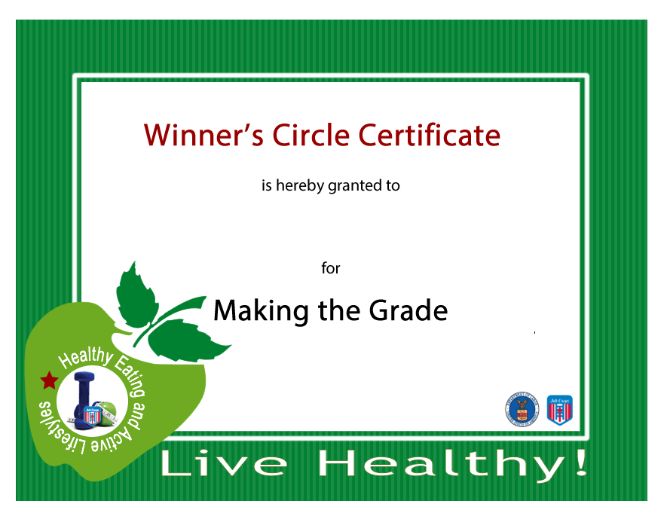
You Did It!!
If you score a 90% or better on Making the Grade, submit it by email to Julie Luht at:
luht.Julie@jobcorps.org
Your center will receive a certificate of recognition!

Slide 21
Student Education Curriculum
Healthy Eating 101
Help students evaluate the risks associated with eating unhealthy foods
Increases awareness of the benefits of health eating food
Decrease the barriers to health eating
Increase students confidence that they are capable to make healthy food choices.
Move It!
Help students evaluate the serious health risks of inactivity
Increase awareness of the benefits of physical activity
Decrease the barriers to living an active life
Increase students’ confidence that they are capable of incorporating activity into their lives
Tying it Together: Body Weight, Body Image and Goal Setting
Notes:
The Healthy Eating and Active Lifestyles curriculum is designed to make healthy eating and active lifestyles part of a Job Corps student’s life from the time they arrive on center.
There are three modules in the training curriculum: Healthy Eating 101, Move It! And Tying it Together: Body Weight, Body Image and Goal Setting.
The modules contain discussion topics, classroom lessons, computer lab activities, worksheets and projects.
So center staff members such as your instructors, RAs, TEAP specialists, counseling managers, recreation supervisors, and food service manager will have the option of delivering all curriculum components or choose which will benefit their students most. What we would like to see happen and a goal of the HEALs program is for the student to learn about nutrition and physical activity throughout their time in Job Corps.

Slide 22
Student Education Curriculum
Tying it Together: Body Weight, Body Image and Goal Setting
Help students evaluate the influence of the environment (built and social) on weight
Increase awareness of the benefits of achieving and maintaining a health weight
Decrease the barriers to achieving and maintaining a health weight
Increase students’ confidence that they are capable of achieving and maintaining a health weight
Encourage a healthy body image
Notes:
The third module focuses on body weight, body image and goal setting.
Students can identify their body mass index or BMI and classification, set and review exercise and physical activity goals, triggers for unhealthy behavior and identify strategies to lose, gain or maintain weight.
I broke the third module out by it self because it is an important step to leading into your weight management program

Slide 23
Weight Management
Weight Management Program
Is the BMI recorded in the Student Health Record (SHR)
Has a referral been made for the student to be evaluated by the CP
Is a Chronic Care Plan for Obesity completed and filed in the SHR
Is a weight flow sheet with weekly weights being recorded
Is the student being followed by the Healthcare Provider regularly
Is the student attending weekly weight management classes
Any best practices – Biggest Losers Contest
Notes:
There is a Weight Management Curriculum which follows the same 3 modules as the Student Education Curriculum – take a look at them, as a member of the Health and Wellness team, you may find yourself leading weight management groups and using the discussion topics, classroom lessons and worksheets/projects will help in meeting students needs.
We talked about this earlier in the presentation but it’s worth repeating; Every center should have a weight management program. This is one of the programs we look for as assessors during a PCA (Program Compliance Assessment) is the center compliant with having a weight management program.
Students with a BMI of 40 and higher should receive a referral to see the CP to be included in the weight management program.

Slide 24
Documents
Directives
General
Module worksheets
Newsletters
Training slides
Notes:
Documents are also provided on the HEALs website for you to take a look at – directives such as PRH Change Notices, Information Notices, and Program Instruction notices can be found, under general documents (forms) such as Making the Grade and Student Program Evaluation forms can be found here. Module worksheets for health Eating 101, Move It! And tying It Together: Body Weight, Body Image, and Goal Setting are here, Examples of HEALs newsletters that may spark your creativity to maybe start a newsletter on your center and PowerPoint slides such as Fast Facts About Physical Activity and Let’s Play Nutrition Jeopardy that can be used for classes. All this information is on the HEALs website for you to use.

Slide 25
supportservices.jobcorps.gov/HEAL/Pages/default.aspx
Notes:
Questions?

