Slide 1
Hot Topics in TEAP: Kratom, TUPP, and Vaping
Diane Tennies, PhD, LADC
Regional Health Specialist
Boston, Philadelphia and San Francisco Regions
April 20 and 22, 2021

Slide 2
After this presentation, participants will be able to:
Identify
1.) Identify why kratom poisonings are increasing in the United States.
Name
2.) Name the four or more elements of a successful TUPP on center
Describe
3.) Describe why vaping remains a public health emergency.

Slide 3
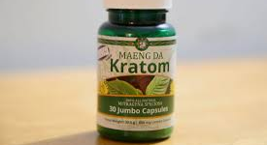
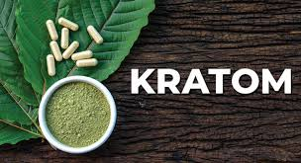
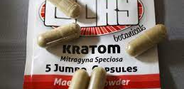

Slide 4
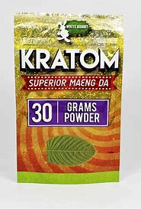
Kratom
Kratom is a tropical tree (Mitragyna speciosa) native to Southeast Asia (same family as coffee plant), with leaves that contain compounds that can have psychotropic (mind-altering) effects.
Not approved for any medical use and not regulated.
Easy to order on the internet.
Sold as a green powder in packets labeled "not for human consumption.
Also sold as an extract or gum.

Slide 5
Known by Other Names
Products containing kratom leaves are known by different commercial names (depending on the region):
Herbal Speedball
Biak
Ketum
Kakuam
Krathom
Thang
Thom
Happy Drug

Slide 6
Specifics
Most people take kratom as a pill, capsule, or extract.
Doses in grams and measured with a scale
Effects occur within 5 to 10 minutes of ingesting and lasts 4 to 6 hours
Two compounds in the leaves mitragynine and 7-hydroxymitragynine, interact with opioid receptors in the brain, producing sedation, pleasure, and decreased pain.

Slide 7
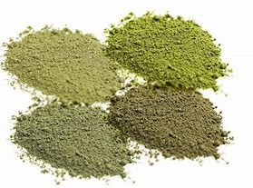
Kratom: Not Regulated and State Laws Vary
Kratom illegal to buy/possess/sell/use in:
Alabama
Arkansas
Indiana
Rhode Island
Vermont
Wisconsin
Kratom legal but regulated in most other states.

Slide 8
Main effects of kratom when consumed
Kratom consumption has a psychological, opioid-like reaction
Opioid receptors in the brain are activated causing sedation in lower doses
Euphoria and pain relief in higher doses
Users of kratom report:
An increase in energy, focus and alertness
A decrease in depressed mood and anxiety
A decrease in symptoms related to Post-traumatic stress disorder (PTSD)
A decrease in pain

Slide 9
Drug Testing
Not at Job Corps
Half-life reportedly is 24 hours
Not routinely tested for in the workplace
Other laboratory tests available that use urine and blood to detect the compounds found in kratom, mainly mitragynine (Mitragynine is a compound naturally occurring in the leaves of the kratom tree. It is classified as a psychoactive substance)

Slide 10
Health Impact – Acute and Long-term
Acute
Anxiety
Irritability
Itching
Sweating
Loss of appetite
Dry mouth
Constipation
Confusion
Nausea and vomiting
Seizures
Hallucinations/ delusions
Increased urination
Chronic
Anorexia
Weight Loss
Insomnia
Skin darkening
Rapid heartbeat
Liver damage
Seizures
Overdose

Slide 11
Withdrawal Symptoms
Withdrawal symptoms may occur when consumption of kratom is interrupted:
Muscle aches
Aggression
Irritability
Emotional changes, such as mood swings

Slide 12
Overdose Potential
Yes, consuming kratom poses a risk of overdose and potential death.
Fatal overdoses have been reported in conjunction with kratom usage
Most involved kratom in combination with other substances (opioids, alcohol and over-the-counter medications)

Slide 13
Implications for Job Corps
Know state and federal laws
Discuss in CPP
Integrate into education/prevention activities
Discuss in intervention services
Education for Security and Safety staff

Slide 14
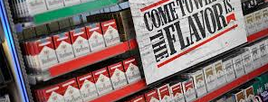
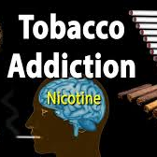

Slide 15
History of Tobacco Regulation
First law in US regulating tobacco by age was passed in New Jersey (1883) with minimum age of 16
By 1920, 46 states had implemented an age limit for tobacco sales, of which 14 set the limit at 21
During the interwar period, state laws trended towards a limit of 18 years. All states with a minimum tobacco age of 21 decreased the limit
In 2015 Hawaii signed a bill raising the state's tobacco age restriction to 21 (first state in 21st century)
18 other states soon did the same
Over 54% of the country's population lived in states that had signed legislation setting 21 as the tobacco restriction age prior to the federal law setting the nationwide tobacco age restriction

Slide 16
Current Tobacco Regulation
Dec. 20, 2019, the President signed legislation amending the Federal Food, Drug, and Cosmetic Act, and raising the federal minimum age of sale of tobacco products from 18 to 21 years (includes cigarettes, cigars, and e-cigarettes). Now illegal to sell any tobacco product to anyone under 21.
Fun Fact: Mitch McConnell introduced legislation in 2019.
What is your state law regarding possession and use?
TUPP must comply with these laws.
https://tobacco21.org/state-by-state/

Slide 17
Tobacco Use and Prevention Program PRH 2.3 R6
Implement a program to prevent the onset of tobacco use and to promote tobacco-free environments and individuals. To support this program, a TUPP Coordinator must be appointed (he or she need not be a health services staff member).
At a minimum, this program must include:
a. Educational materials and activities that support delay and/or cessation of tobacco use
b. A smoke-free, tobacco-free environment that prohibits the use of all tobacco products in center buildings and center-operated vehicles
c. Designated outdoor smoking areas located a minimum of 25 feet, or as required by state law, away from the building entrance
d. Prohibition of the sale of tobacco products on center
e. Adherence to federal and state laws regarding the use of tobacco products by minors
f. Minors who use tobacco products must be referred to the TUPP g. All services provided should be documented in the student health record

Slide 18
TUPP Services for Students Returning to Campus
A center TUPP Coordinator will need to be identified.
Centers are encouraged to be entirely tobacco-free or at least during the training day.
Physical distancing will be maintained in tobacco use areas due to high risk of COVID-19 exposure due to tobacco-related behaviors.
Nicotine replacement products shall be available to students (see NRP TG).
Support services and online resources will be provided.
Centers will identify an evidence-based nicotine cessation program designed for adolescents and young adults (i.e. Not On Tobacco by the American Lung Association).

Slide 19
NRT Treatment Guideline (Updated 11/2019)
Authorized health and wellness staff may provide students with a weekly supply of Nicotine Replacement Therapy product under the following conditions:
Nicotine Replacement Therapy (NRT) risks, benefits, alternatives and side effects should be thoroughly reviewed with student before initiation of therapy.
NRT is indicated for students with physiologic dependence on nicotine, generally defined as smoking 10 cigarettes (1/2 pack) or more daily.
The student should be counseled on the potential for nicotine withdrawal.
Student should be actively enrolled in Tobacco Use and Prevention Program (TUPP).
Student should verbalize a serious commitment to cease use of tobacco products.
Student should understand the correct use of nicotine replacement product (nicotine patch, gum, inhaler, nasal spray or lozenge).
Student should be educated in the proper and safe disposal of nicotine patches (as these can be toxic to children and pets).
Students should be routinely scheduled for weekly follow-up visits for monitoring and tapering of NRT.
Although students aged 16 to 21 years may be prohibited from purchasing or possessing tobacco products, depending upon state law, a physician may prescribe NRT to students of any age.

Slide 20
Criteria for Whom Might Benefit from NRTs
Research does not support that minors benefit from NRT and they tend to keep using tobacco while using the NRT
Students on NRT = TUPP.
Students who want NRT should be smoking more than 10 cigarettes per day (a half pack per day), to be eligible for the NRT program.
The students should be willing to set a quite date and use NRT for support of cessation.
NRT students should be followed weekly (minimum) with check-in with staff and to receive their supply of NRT.

Slide 21
Implications for Job Corps: COVID Challenges
The updated TUPP
What do the ‘new’ tobacco use areas look like?
Education for students before return to campus re: access
Certification
If can’t do groups, then what?
Documentation

Slide 22
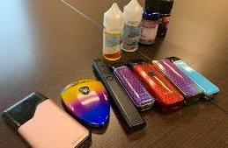
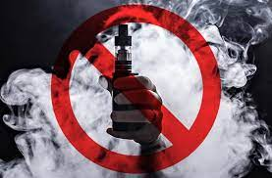
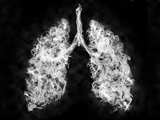
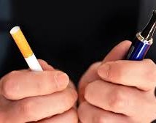

Slide 23
Vaping: History
James Robinson obtained patent on “electronic vaporizer” in 1927.
He dreamed the device made it easier to inhale vapors "without any possibility of being burned.”

Slide 24
Vaping: Another Attempt
1963 Herbert Gilbert proposed the “smokeless non-tobacco cigarette” – filed for a patent in April 1963.
But he could not find any manufacturers interested.

Slide 25
Modern Vaping
In 2003 Chinese smoker and pharmacist Hon Lik introduced the modern e-cigarette and is credited with being the “inventor.”
He smoked three packs per day and said he was motivated to find a ”safer” alternative to cigarettes after his father died of lung cancer.
He had the idea to use a high frequency ultrasound-emitting element to vaporize a forced stream of liquid containing nicotine into a vapor.

Slide 26
Modern Vaping Evolution
Around 2006, vaping was introduced in Europe and quickly spread to United States.
In 2008 the World Health Organization (WHO) wrote: “As far as WHO is aware, no rigorous, peer-reviewed studies have been conducted showing that the electronic cigarette is a safe and effective nicotine replacement therapy".

Slide 27
Into the United States
N’Joy was an early manufacturer and introduced the product in the United States.
They went bankrupt in 2016 as they struggled to find a strong consumer base as adult smokers were not interested.
Early e-cigarettes were cost-prohibitive for most.

Slide 29
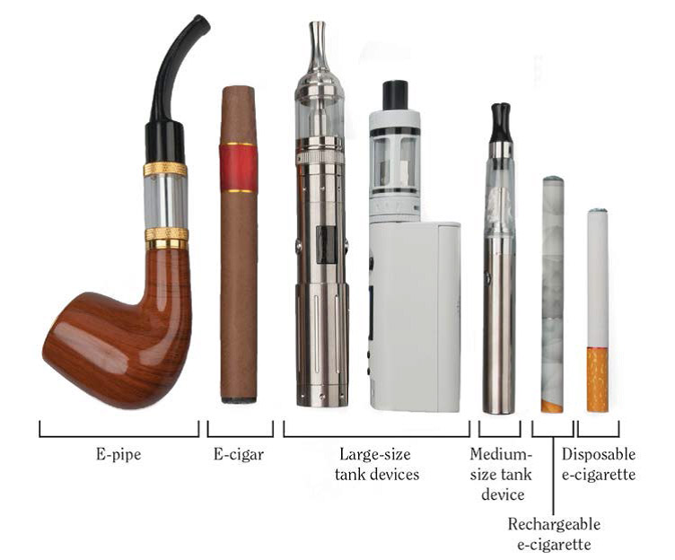

Slide 31
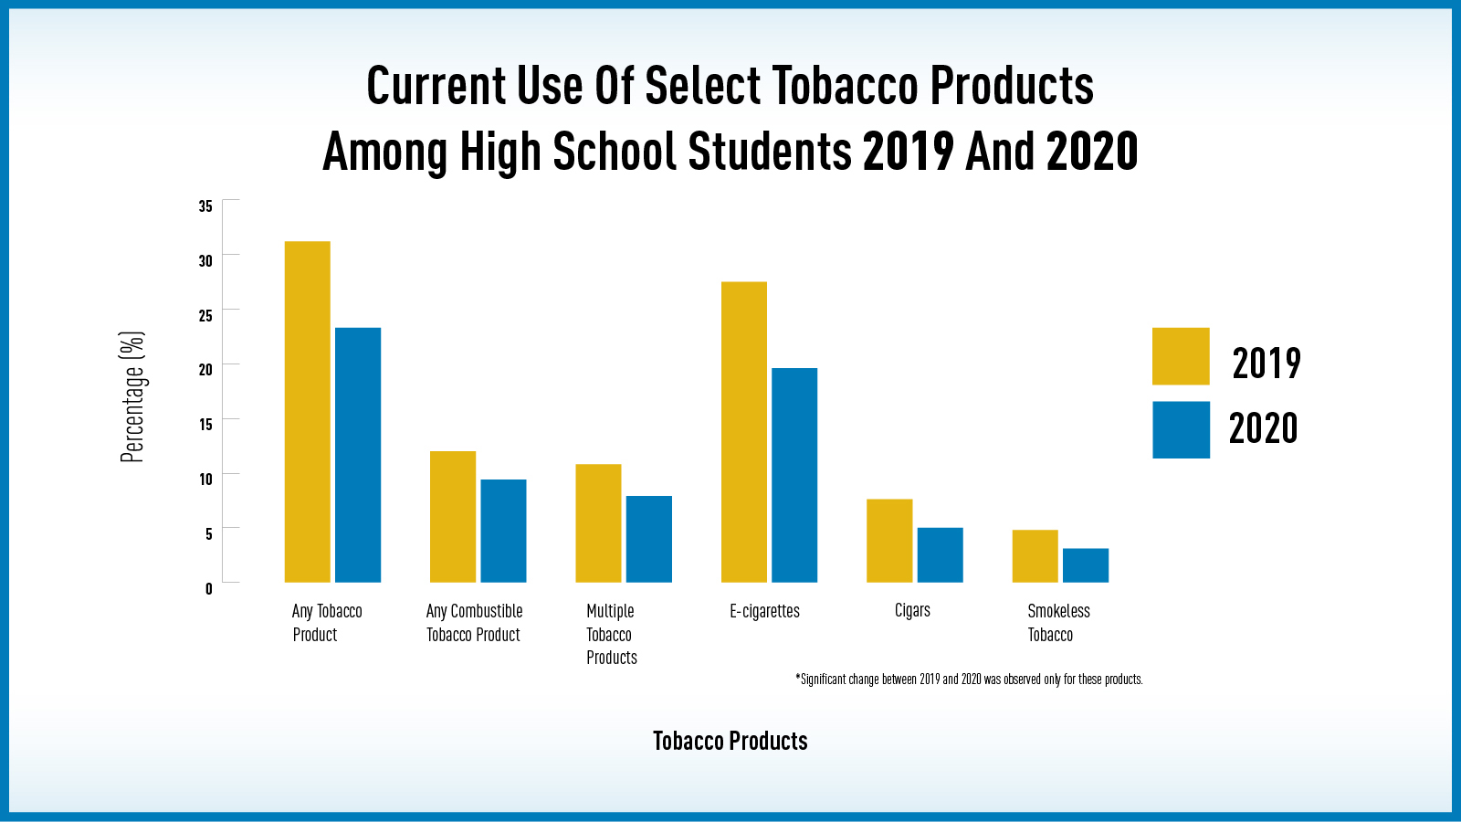

Slide 32
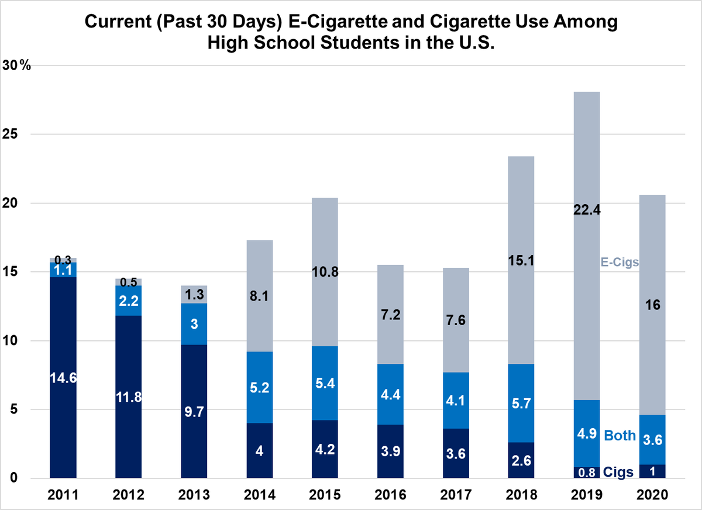

Slide 33
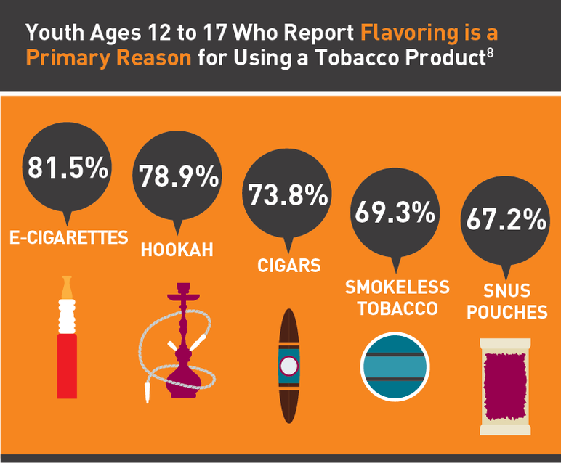

Slide 34
Risks from Vaping
Besides nicotine, e-cigarettes can contain harmful ingredients, including:
ultrafine particles that can be inhaled deep into the lungs (EVALI)
flavorants such as diacetyl, a chemical linked to serious lung disease
volatile organic compounds
heavy metals, such as nickel, tin, and lead

Slide 35
Tobacco Cessation?
E-cigarette aerosol generally contains fewer harmful chemicals than the smoke from burned tobacco products. Most e-cigarettes contain nicotine, the highly addictive drug found in tobacco.
In youth and young adults, nicotine can harm brain development, which continues until about age 25.
Introduced as tobacco cessation device however, research is uncertain on whether e-cigarettes, in general, increase smoking cessation.

Slide 36
Marketed as Harm Reduction
Vaping is less harmful than smoking BUT still not safe.
E-cigarettes are just as addictive as regular cigarettes.
While marketed to help quit smoking, e-cigarettes are not Food and Drug Administration (FDA) approved as smoking cessation device.
A recent study found that most people who intended to use e-cigarettes to kick the nicotine habit ended up continuing to smoke both traditional and e-cigarettes.
In the light of the EVALI outbreak, the CDC advises adults who use e-cigarettes for smoking cessation to weigh the risks and benefits and consider use of other FDA approved options.

Slide 37
Conclusions
"E-cigarettes may serve to re-normalize the use of combustible cigarettes, decreasing the motivation to quit.”
Dr. Heather Kimmel - NIDA’s Epidemiology Research Branch
"The evidence clearly shows that e-cigarettes do not help smokers cease tobacco use and are expanding the tobacco epidemic by attracting low-risk youth, many of whom advance to conventional cigarettes. Harm reduction, the fundamental assumption used to justify e-cigarettes, is wrong.”
Kulik, M.C., Lisha, N.E., and Glantz, S.A. E-cigarettes associated with depressed smoking cessation: A cross-sectional study of 28 European Union countries. American Journal of Preventive Medicine 54(4):603-609, 2018.
Smoking cessation medications approved by the FDA and behavioral counseling are effective treatments for quitting tobacco use, particularly when used in combination.

Slide 38
Implications for Job Corps
What is in the cartridge? Nicotine or something else?
Recent SIRS center found vaping cartridge with THC (available online)
Safety of e-cigarette units
Allowed on Campuses?

