Slide 1
Oral care beyond the chair: teledentistry Strategies for whole-person care
Job Corps Oral Health Program | February 10, 2021
Caroline McLeod, RDH, MS
Carolyn Brown, DDS, MEd

Slide 2

Chat Question
In what state are you located and what is your current role?

Slide 3
Objectives
After the session, participants will be able to:
Define teledentistry and describe the various modalities.
Use teledentistry to engage your patient population in the dental care delivery process.
Apply presented teledentistry workflows to clinical practice in order to deliver emergency and preventive services during the pandemic.

Slide 4
Introduction to teledentistry

Slide 5

Chat Question
What comes to mind when you think about teledentistry?
Teledentistry Student Group (unc.edu)
Notes:
What comes to your mind when you think about teledentistry? It can be a word, phrase, definition.... put your answer in the chat!
While you all are chatting, I wanted to let you know that there are a few places during the presentation where we have embedded QR codes that you can use to access some different resources. To prepare, we ask that you have your phone nearby and que up your QR code reader or the camera app...either will work to scan the QR codes!

Slide 6


Teledentistry
“the use of technology to communicate health information, provide oral healthcare, screen, and educate remotely between oral healthcare providers and patients.”
Source: Chen JW, Hobdell MH, Dunn K, et al. J Am Dent Assoc. 2003.
Notes:
A distinction I want to make is that teledentistry as a way to enable delivery of dental care, not the dental care itself. So not the screenings, exams, education, scheduling themselves… but when these services, amongst other services, are facilitated by technology they are considered teledentistry. And that is teledentistry. Over the course of the pandemic I think we’ve thrown around the term teledentistry in so many different ways that what it actually means can become confusing.
Teledentistry doesn’t take away from what practices are doing in-person, but enhances the services that you offer

Slide 7




Modalities
Live video
(synchronous)
Store-and-forward
(asynchronous)
Remote patient monitoring (RPM)
Mobile health (mHealth)
Source: https://www.ada.org/en/about-the-ada/ada-positions-policies-and-statements/statement-on-teledentistry
Notes:
Live video (synchronous): Live, two-way interaction using audiovisual technology between two people (patient, caregiver, or providers)
Store-and-forward (asynchronous): Transmission of recorded health information (for example, radiographs, intraoral images, charting, digital impressions) electronically to a dentist or specialist, who uses the information to evaluate a patient’s condition in non-real time.
Remote patient monitoring (RPM): collection of personal health data from an individual in one location via electronic means, which is transmitted to a provider in a different location for use in a care plan (ex. An blue-tooth enabled electric toothbrush)
Mobile health (mHealth): Health care supported by mobile communication devices such as cell phones, tablets or computers

Slide 8

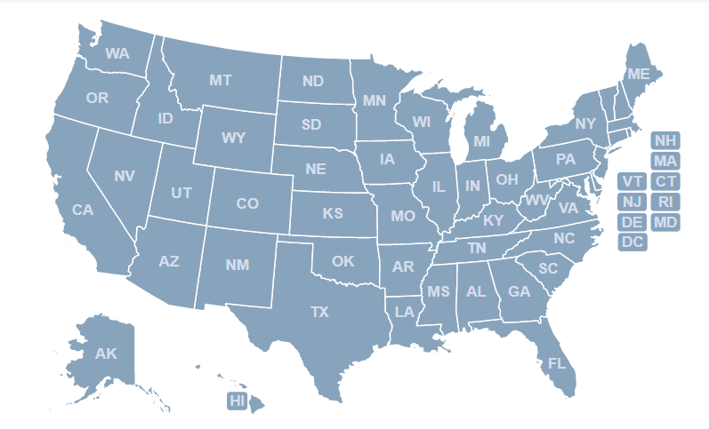
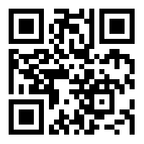
Disclaimer: Teledentistry Regulations
What States Allow Teledentistry? Teledentistry in Your State Quick Facts. - MouthWatch
Notes:
Because this audience is so diverse in terms of location, we want to mention a disclaimer that states have different parameters around the use of telehealth technology. Some states incorporate teledentistry under wider telehealth legislation and state Dental Boards have widely varying policies on scope of practice and expanded functions. Additionally, Medicaid reimbursement for teledentistry differs from state to state.
This interactive map made by the teledentistry company, MouthWatch is a quick reference guide to the status of teledentistry regulation in each U.S. state as part of asking those beginning regulatory questions. You can use the QR code on screen… scan it through the camera or QR reader on your phone and that will take you to the map. You can click on your state in the interactive map to find out what level of teledentistry regulations exist in your state, how different dental professionals may use teledentistry, if there is public coverage available for telehealth, and if payment parity laws in place.

Slide 9
Workflows
Notes:
Now that we're all on the same page about what teledentistry is, we want to go into some use cases for teledentistry and practical workflows to get you started in thinking how you will use the technology to enhance your delivery of oral health care.

Slide 10
Versatility of Teledentistry
T
E
A
C
H
Triage patients, emergency and new patients
Educate Patients, Families, Caregivers
A-level training for new staff
Comprehensive Care
Home Care + Coordinate Care
Notes:
CB transition to CM –
Telehealth and teledentistry is being used in all sorts of ways, in urban and rural locations
care coordination in a hybrid teledentistry model or medical-dental model

Slide 11
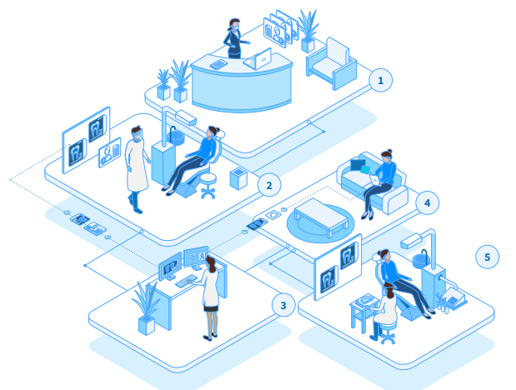
Teledentistry: A Visual
Source: in-office-teledentistry-workflows-mjl-20200707 (mouthwatch.com)
Notes:
For all our visual learners out there, I wanted to start with a visual of how teledentistry might look as you put it into practice in your office setting. The subsequent workflow we'll walk through is a hybrid model, meaning teledentisty is used to assist in the care of patients remotely, with you in office and the patient in another location or to facilitate in-office/in-person care. I'll walk through different parts of the visual as we go, but wanted you to see the big picture first.

Slide 12
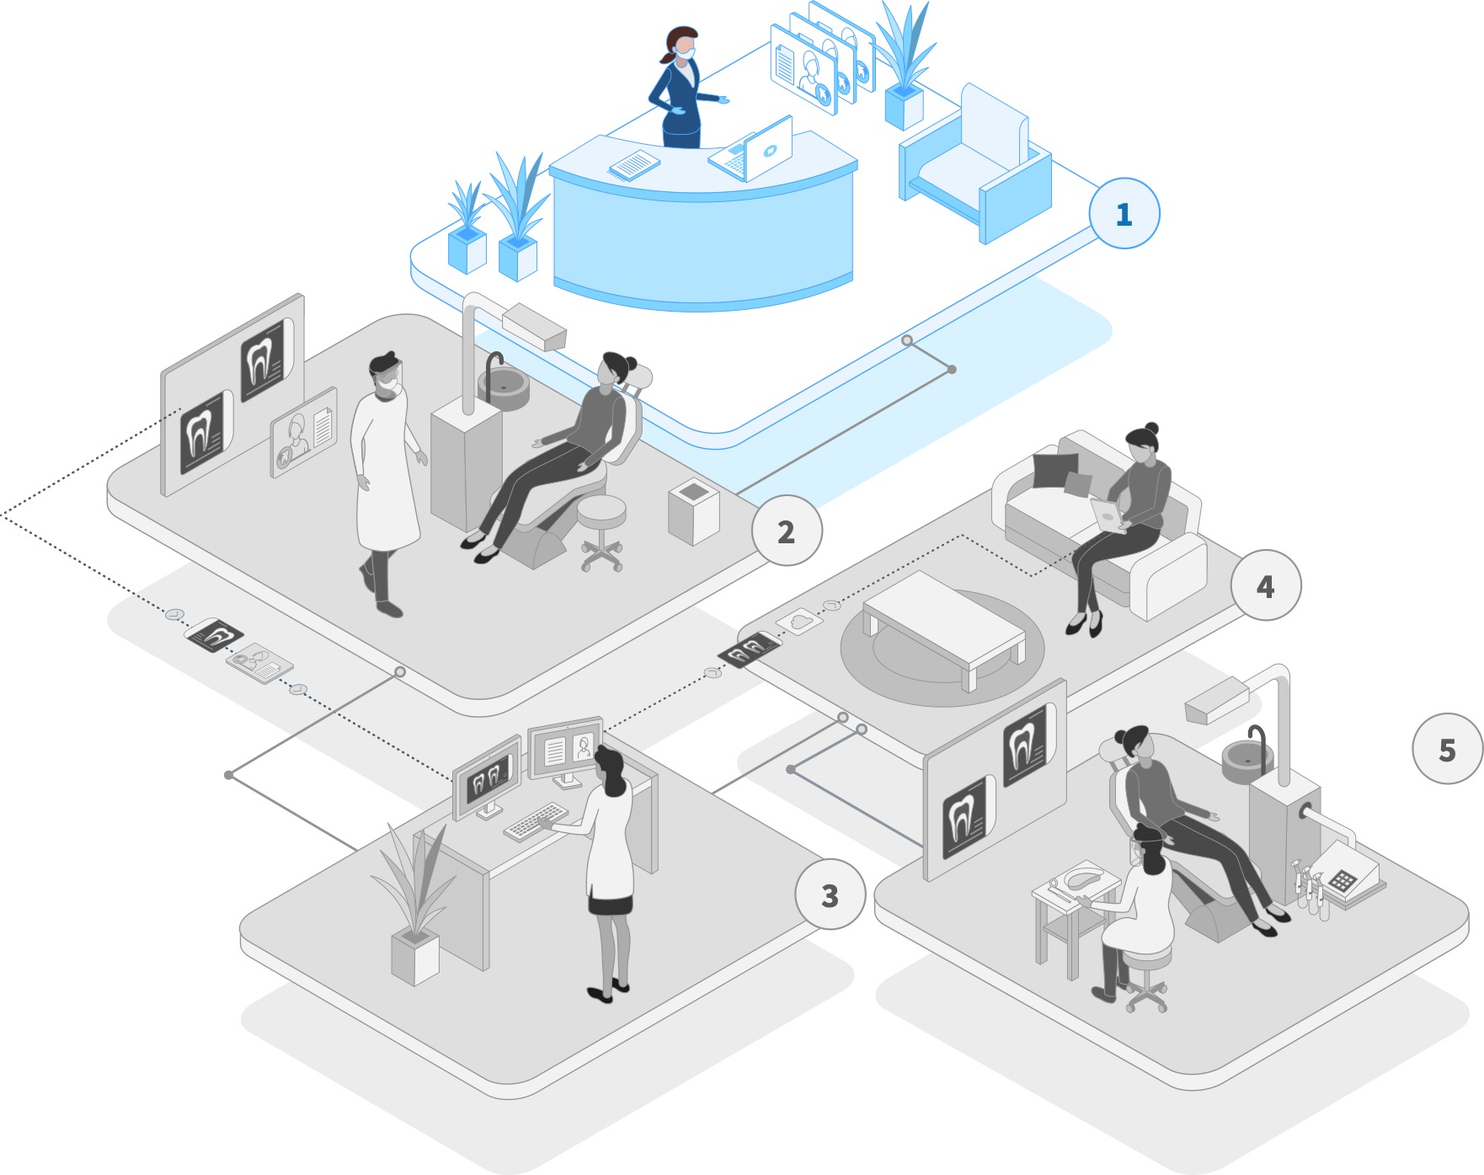
Emergency Workflow
Initiate and consent for teledental visit
Notes:
The beginning of the workflow describes use of teledentistry for emergency care, which has become more widely used in dentistry since the pandemic started.
Initiating a teledental visit to screen/assess/triage an emergency does involve the entire dental team. If we look at the first step, the front office staff can field the patient’s emergency concerns via email, phone call or practice website (which is teledentistry, using available technology to facilitate dental care) and then determine if the patient is eligible for a virtual visit with the dental provider.
The office staff may also collect photos from the patient of the problem area and put them in the patient’s chart to assist the dentist in the first steps of triage. They can also set up the dentist or dental hygienist’s schedule with virtual appointments and link to a video call with the patient ahead of time. Front office staff are key to efficient use of teledentistry and lessen the burden on the dental clinician.

Slide 13
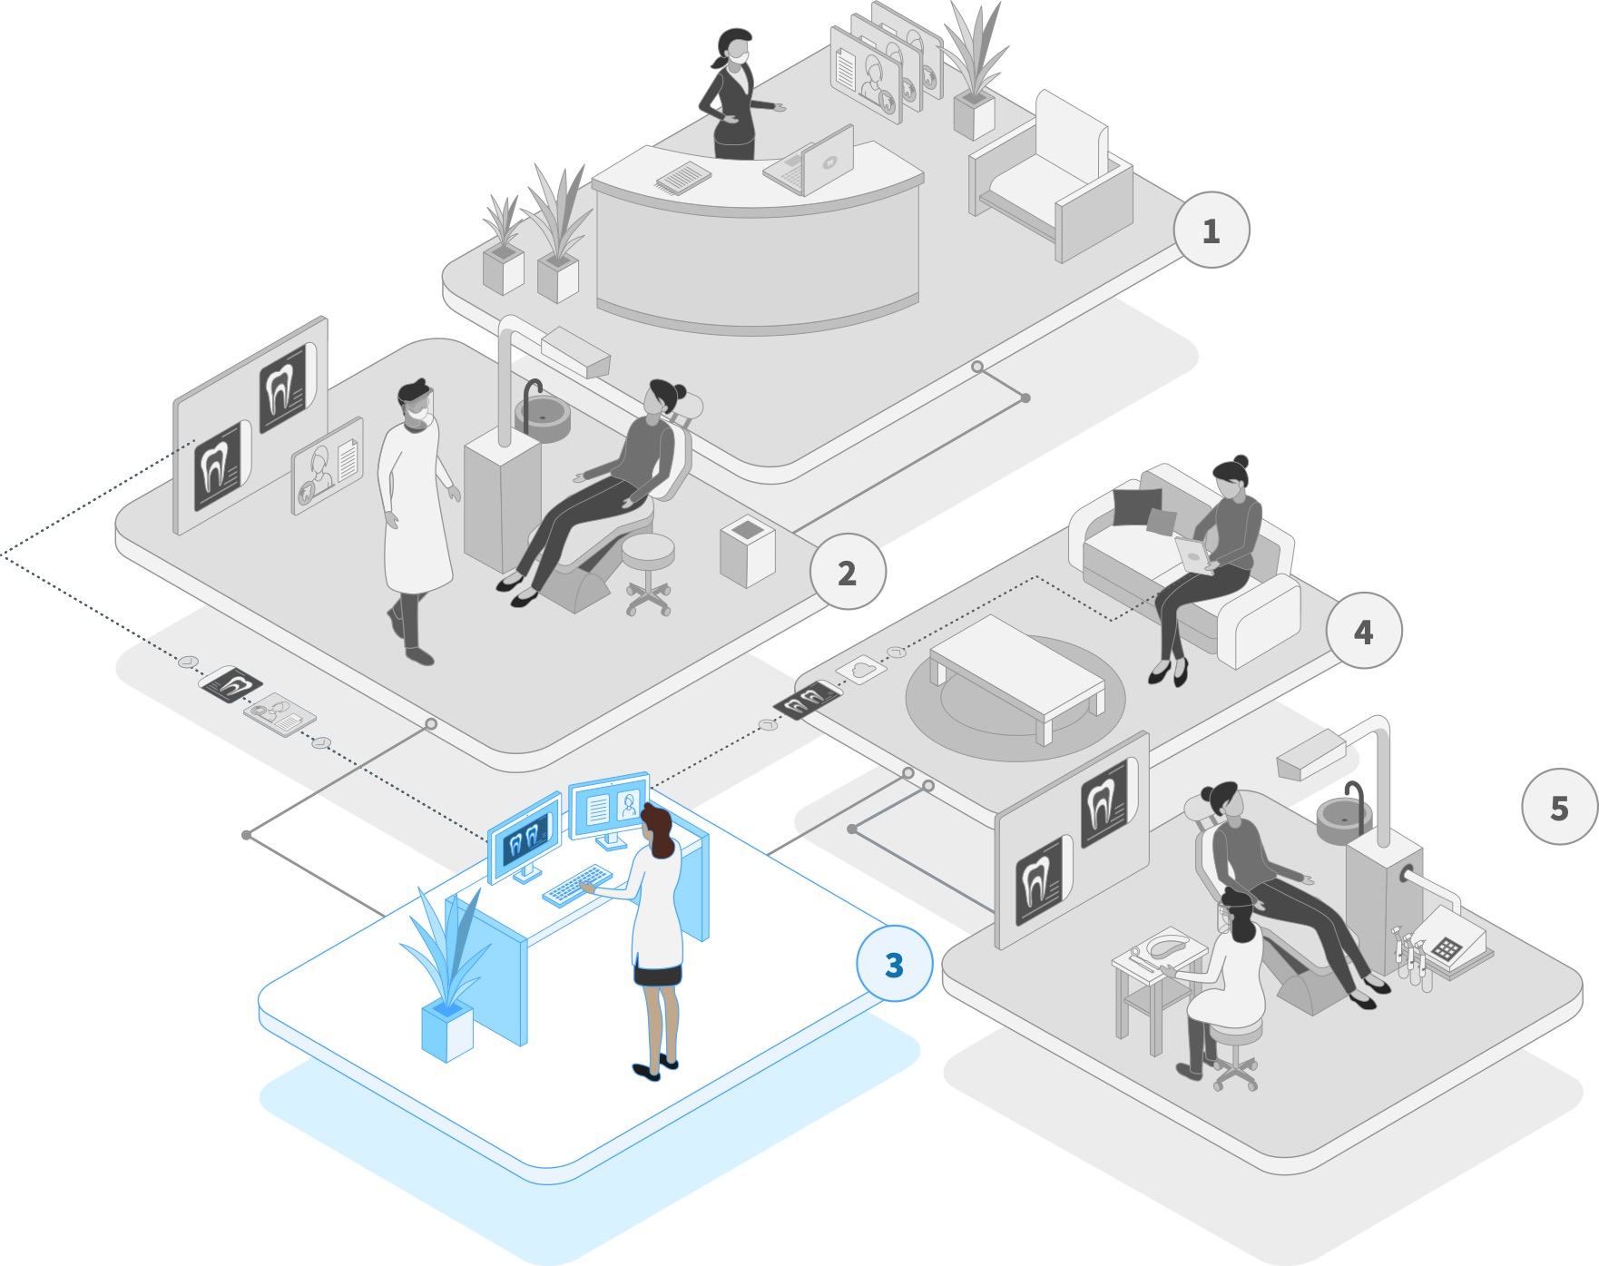
Emergency Workflow
Initiate and consent for teledental visit
Review, update
clinical records
Collect today’s records:
via interview, photos/video
Minimizes exposure risk
Screen, assess
or triage
Notes:
As exemplified in room 3, the dental provider can then review the patients record, including past records and any photos or notes collected by the front office staff to prepare for the virtual appointment with the patient.

Slide 14
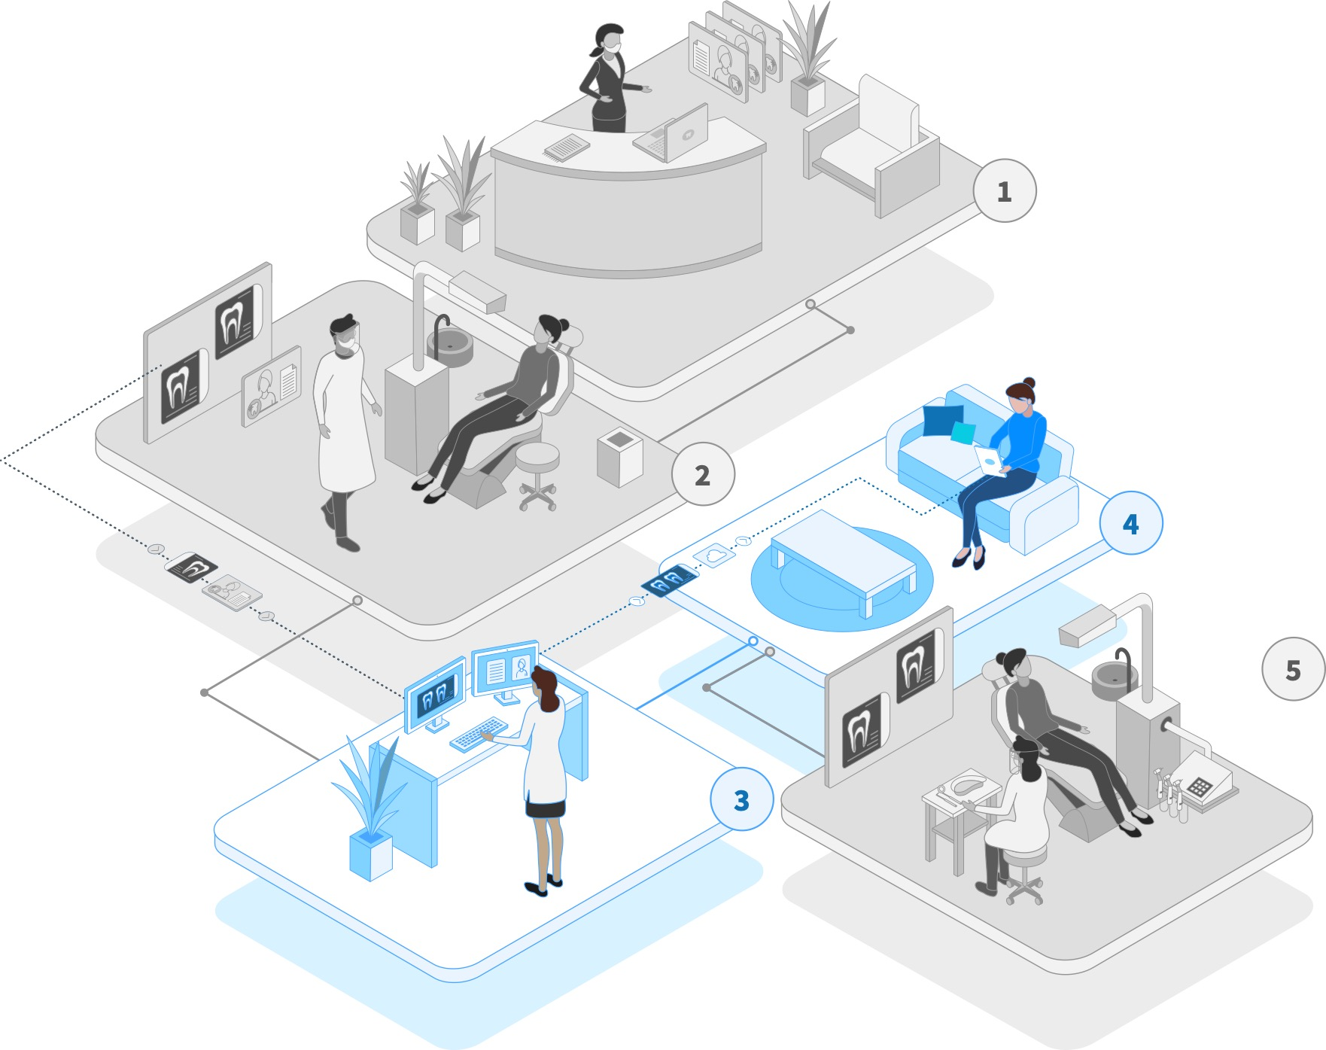
Emergency Workflow
Initiate and consent for teledental visit
Review, update
clinical records
Collect today’s records:
via interview, photos/video
Minimizes exposure risk
Screen, assess
or triage
Notes:
The provider can then initiate contact with the patient via asynchronous methods such as text messaging or email or synchronous methods such as a video or phone call. As is exemplified in rooms 3 and 4, this remote appointment will allow the provider to triage the patient's need and make a decision about their care.

Slide 15
Emergency Workflow
Initiate and consent for teledental visit
Review, update
clinical records
Collect today’s records:
via interview, photos/video
Minimizes exposure risk
Screen, assess
or triage
Determine
if in-person visit
is needed
Notes:
Now comes a critical part in the workflow. The pink diamond represents a decision point for the provider. Based on the information they have collected they will decide whether the patient's need can be treated remotely with a prescription, oral hygiene instructions or counseling, or if the patient must come into the office for follow-up treatment. If they do need to come into the office, the benefit to using teledentistry is that a large portion of the exam is already complete and the patient will spend less time in your office when they come in. Additionally, during a virtual appointment, the patient is able to speak comfortably with you, without all your PPE on, which is a stark contrast to the reality of a dental office during the pandemic.
This entire workflow allows you to triage patient's needs in a manner that is easy and comfortable to them and minimizes exposure risk.

Slide 16
A Prevention Capable Workflow
Prevention
Initiate and consent for teledental visit
Review, update
clinical records
Varies based on diagnosis and patient preferences
Collect today’s records:
via interview, photos/video
Minimizes exposure risk
Caries Risk Assessment
Screen, assess
or triage
OTC or Rx Medication
Determine
if in-person visit
is needed
Self Management Goals
No
If yes
Patient Education
Determine visit type
and location
Care plan until in-office visit
Self Care Tips
COVID-19 Care Plan
Notes:
Next we’ll talk through how this workflow incorporates preventive care
After making a decision that the patient does not need to come into the office and their need can be taken care of remotely or at a later time, it is vital to engage them in preventive activities to keep them healthy.
Keeping focus on rooms 3 and 4, eledentistry can help you do this! For example, dentists and dental hygienists can engage the patient in a caries risk assessment, self-management goals and patient education. This can be done through a simple video chat with the patient. Even when doing preventive visits, it is vital to engage your front office staff in scheduling and billing to reduce provider burden.
I want to take a second to think a little more broadly about preventive care. CMS and the WHOs highly recommend prioritization of prevention during the pandemic to help reduce the development of disease. Thinking about the patient populations you see in the Job Corps clinics, these first two steps of the workflow can be used with your identified high-risk patients and routinely engage the them in their care plan to prevent disease and emergency between in-person visits. Because these preventive appointments take place remotely, they are convenient and accessible to the patient and minimize exposure risk.
j

Slide 17
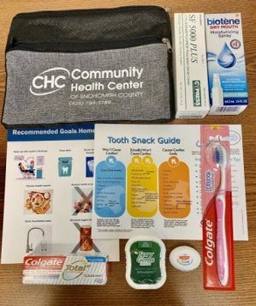
Tele-Prevention
Source: https://whatsnew.dentaquest.com/what-happens-when-a-dentist-embraces-teledentistry/?utm_campaign=DentaQuest%20Newsletter&utm_medium=email&_hsmi=97389049&_hsenc=p2ANqtz-_D1OYoOWJNA1FprgYAeOCrUoWL1MJlstJbgaYNxki1Yzk-s2T91sH98-DvQAb9dTJH_oomvWc-KZ4ejmkm3w_A2SVQQMw1qc09N_zl35s7RW_CU_M&utm_content=97389049&utm_source=hs_email
Notes:
A health Center in Washington launched a series of virtual classes on family oral hygiene to teach families with young children how to take care of their oral health during the pandemic. The dental team sent oral hygiene kits to patients’ homes with toothbrushes, toothpaste, and floss and gave kids OHI via live-video teledentistry since they were unable to come to the dentist due to the pandemic.
Additionally, the dentists there work this OHI into teledentistry visits with patients that are at high caries risk, those who are immunocompromised or patients with a disability.; Teledentistry is a good way to reach high-risk patients to prevent disease; Could be a good check-in tool between hygiene visits for these patient populations.

Slide 18
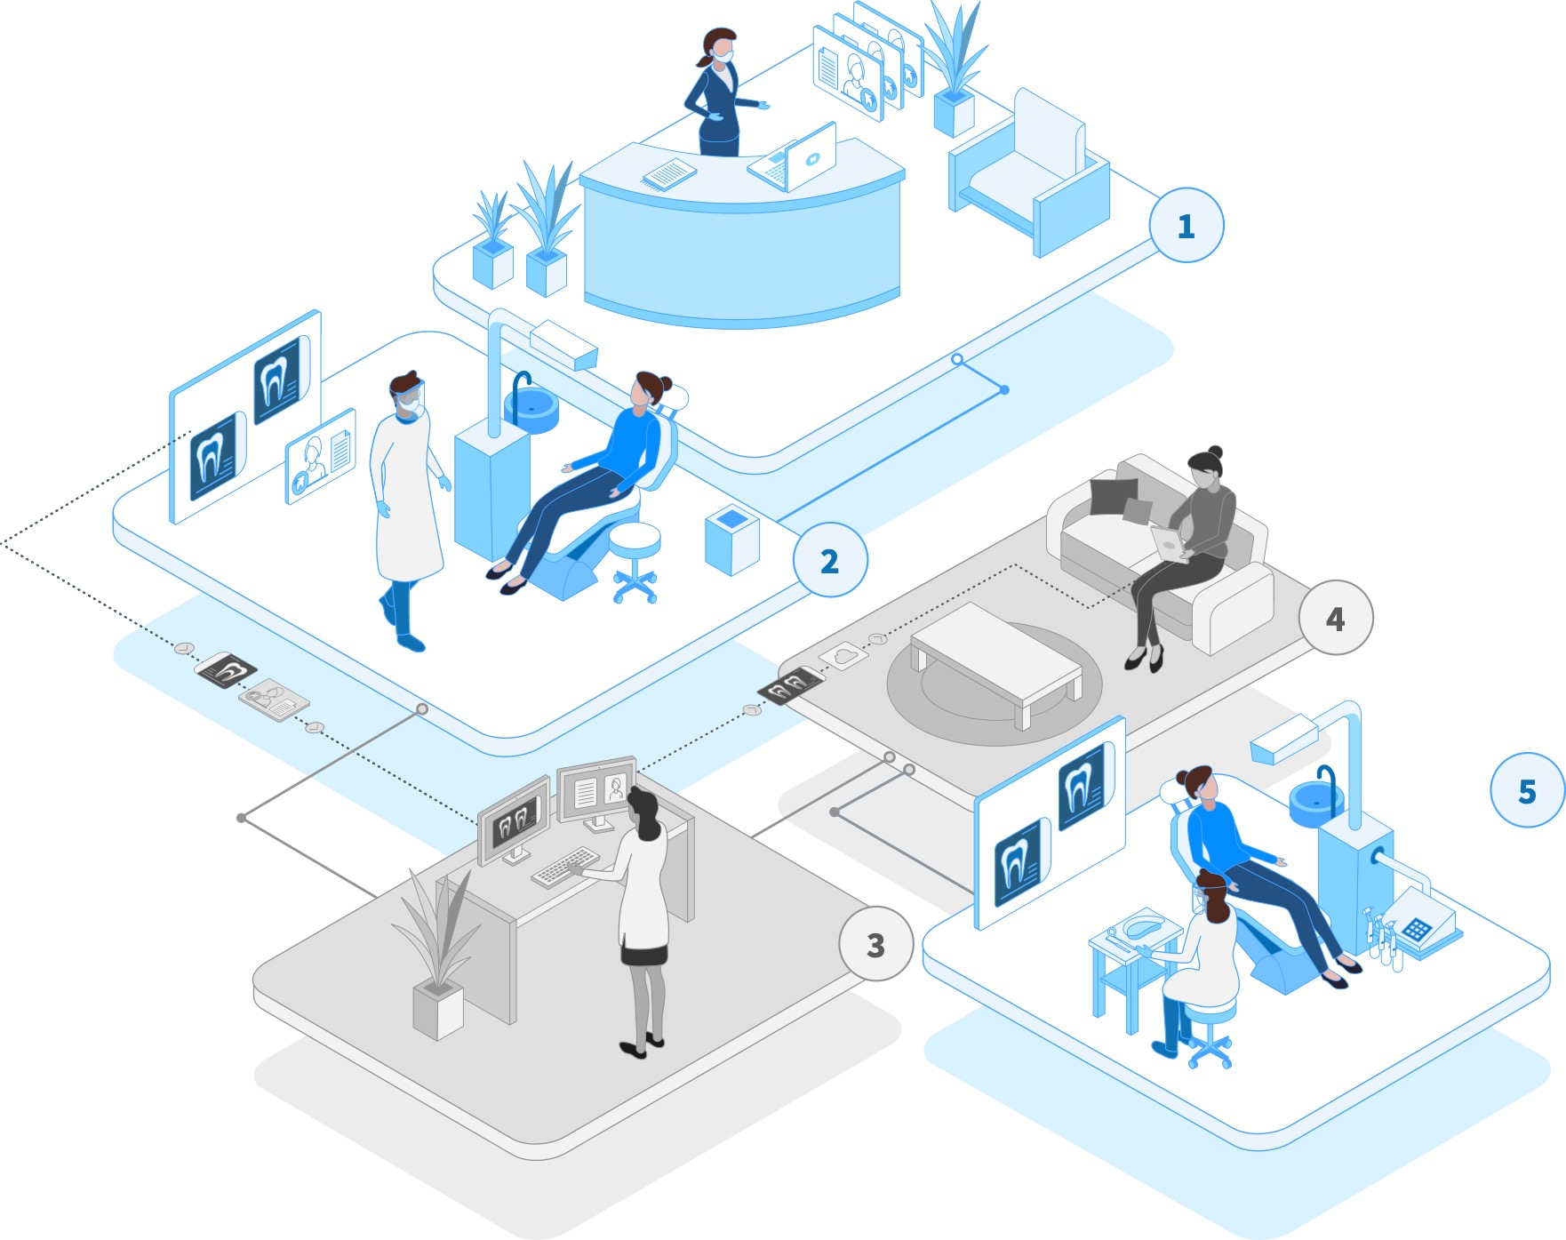
Varies based on diagnosis and patient preferences
A Prevention Capable Workflow
Caries Risk Assessment
OTC or Rx Medication
Self Management Goals
Patient Education
Self Care Tips
COVID-19 Care Plan
Determine
if in-person visit
is needed
If yes
Determine visit type
and location
Care plan until in-office visit
Notes:
If you have made the determination that the patient does need to come into the office for care, you can still engage them in preventive services provided via teledentistry during the period of time between the initial triage and their in-office appointment. Additionally, having collected patient information and triaging their needs via teledentistry, the in-office appointment will be shorter in duration. This again minimizes exposure risk for the patient and providers as well as frees up chair time to see more patients.

Slide 19
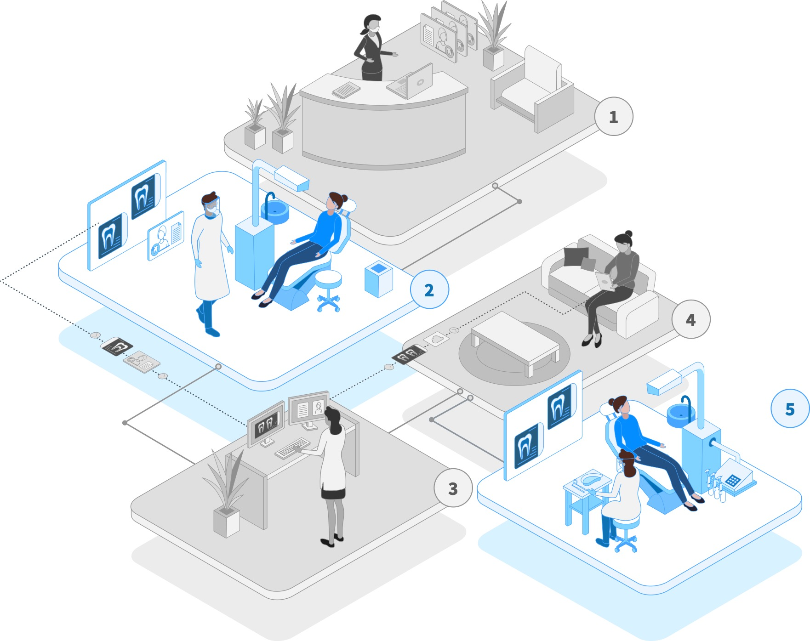
Varies based on diagnosis and patient preferences
A Prevention Capable Workflow
Caries Risk Assessment
OTC or Rx Medication
Self Management Goals
Patient Education
Self Care Tips
COVID-19 Care Plan
Determine
if in-person visit
is needed
If yes
Determine visit type
and location
Care plan until in-office visit
Schedule for next visit or refer
Refer to medical professional or ED
if needed
Dental office visit
Via teledentistry
Consider minimally invasive or low aerosol-producing procedures
Notes:
When the patient comes to the office for their visit, as you can see in room 2 and room 5, we encourage you to choose minimally-invasive or low aerosol-producing procedures where possible. This minimizes your exposure risk and keeps everyone safe.
After treating the patients needs in-person, if the patient does need a referral, you can choose to use teledentistry to do a live-video consultation or even a warm handoff with the provider that will accept the referral. This minimizes exposure risk but more importantly aids in continuity of care for the patient.
Additionally, follow-up oral health care also be done via teledentistry. This includes office staff scheduling via phone call or asynchronous messaging, provider follow-up of a healing site via photographs or live video call and even those preventive care options we walked through.
j

Slide 20
A Prevention Capable Workflow
Prevention
Initiate and consent for teledental visit
Review, update
clinical records
Varies based on diagnosis and patient preferences
Collect today’s records:
via interview, photos/video
Minimizes exposure risk
Caries Risk Assessment
Screen, assess
or triage
OTC or Rx Medication
Determine
if in-person visit
is needed
Self Management Goals
No
If yes
Patient Education
Determine visit type
and location
Care plan until in-office visit
Self Care Tips
Schedule for next visit or refer
Refer to medical professional or ED
if needed
Dental office visit
Minimally Invasive
COVID-19 Care Plan
Via teledentistry
Consider minimally invasive or low aerosol-producing procedures
Notes:
Since we have looked at this workflow in pieces, I wanted to show the entire thing again to make sure we have the big picture of how your office can treat a patient’s needs using teledentistry. I also want to raise the point that teledentistry is not a one-size fits all model where every office will use it in the same ways. Your state regulations and physical office or staffing circumstances dictate how you customize a teledentistry workflow to fit your office needs.
Further, I think it is important to remember that as you get started using teledentistry there will definitely be hickups because learning how to provide the care you all are experts on virtually is a learned skill. It takes time to learn the skills of remote care but we encourage you to push yourselves past what you are already good at and adopt teledentistry to improve the experience and health outcomes of your patients

Slide 21
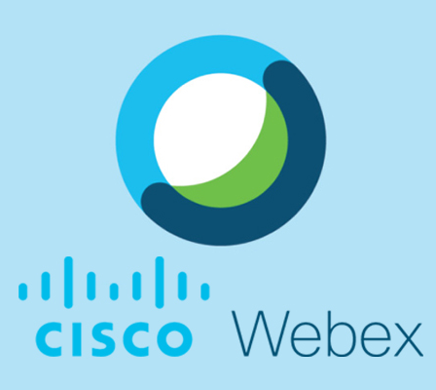
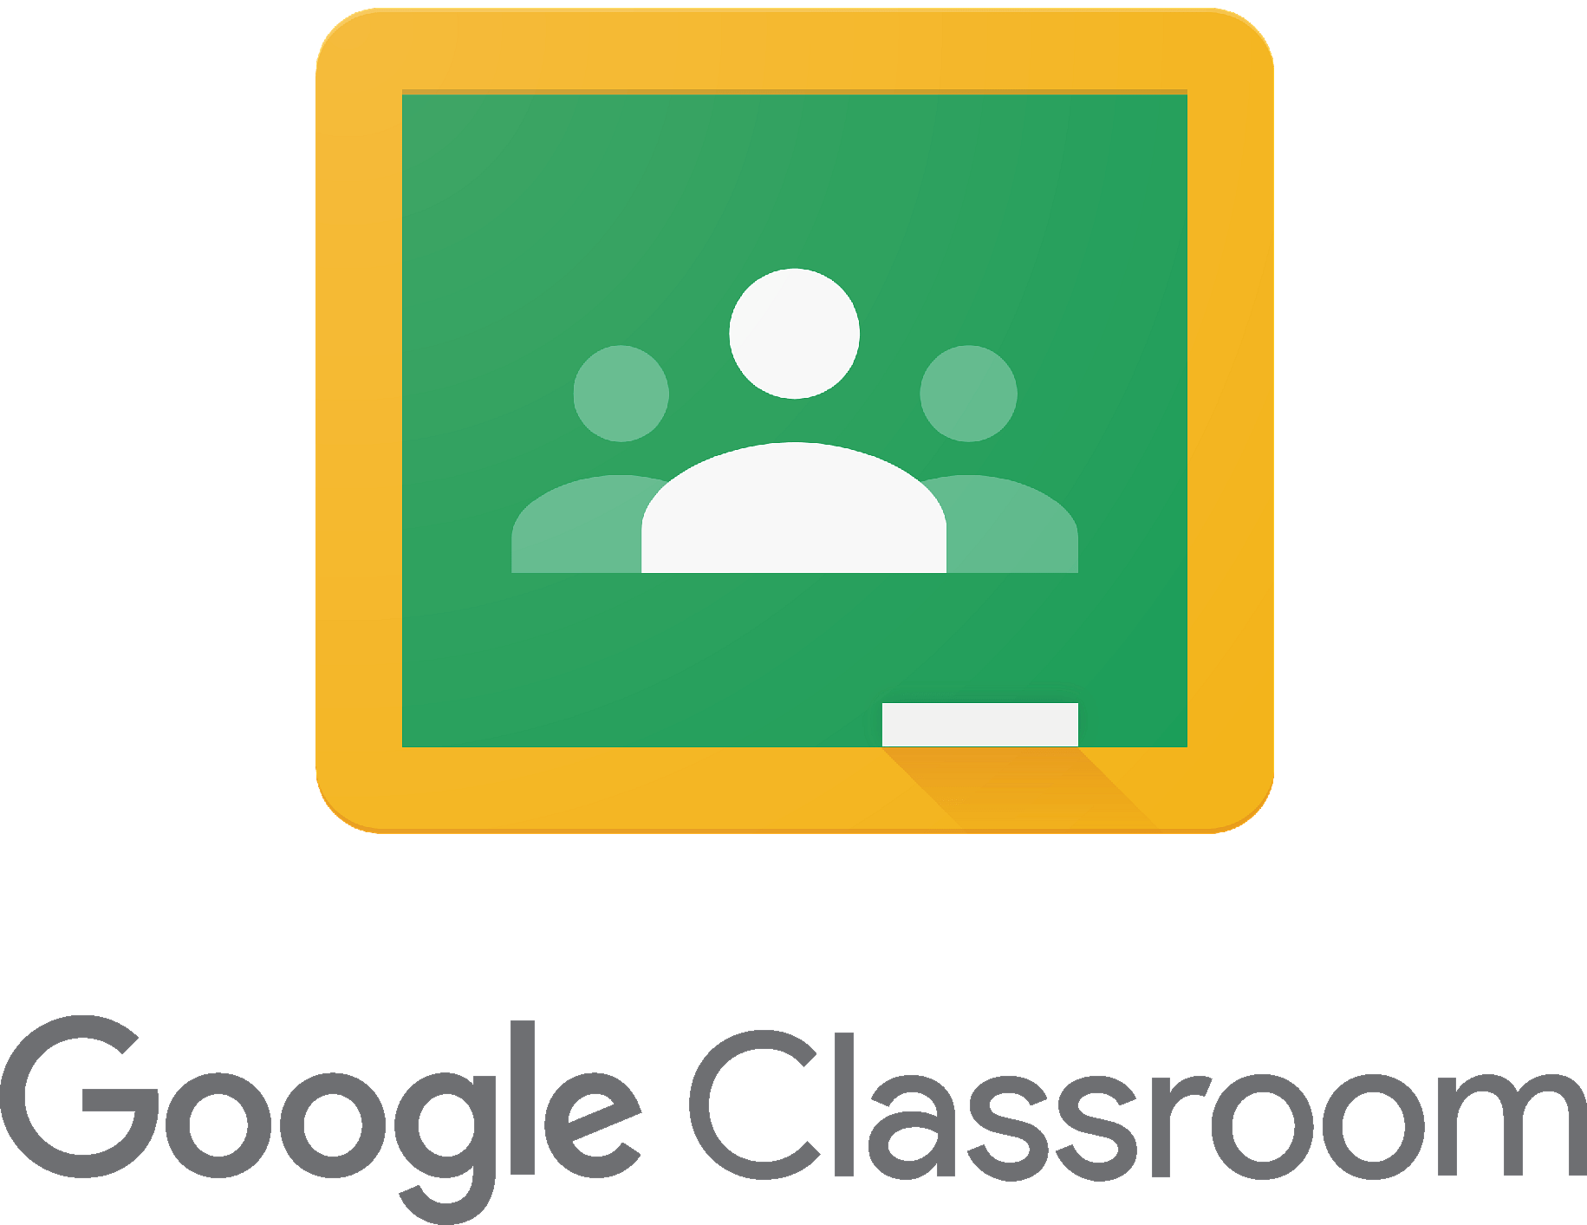
Teledentistry Platforms
Synchronous video calls
Group education
Notes:
Webex-
-Webex could be used primarily for synchronous, or live, video calls with a patient to triage their needs, engage them in personalized preventive care or follow-up after a in-office visit. For example, the front office staff could schedule a video call for a provider and patient. Then the patient and provider could both join the room in webex for the call when it’s time for it on the schedule.
Google classroom
-Looks like g-suite (drive, docs, etc.), so if you are familiar with those, google classroom should be an easy transition
-The “classroom” is equivalent to a dental office. Staff and providers are “teachers/admins” and patients as “students”
-Because the program was designed to function for groups of people, we recommend that you use it for group education---- you can send messages, posts, and attachments of educational materials to groups of patients and asynchronously interact with them for group learning. Great for engaging patients in some of the preventive aspects of the workflow like OHI or self management goals.
Additionally, you can send messages to individual patients and treat the platform as an asynchronous messaging forum to collect patient information such as chief complaint or photos to aid you in the workflow we just talked about! I know google has a video-call software as well and it may be able to link to classroom.

Slide 22

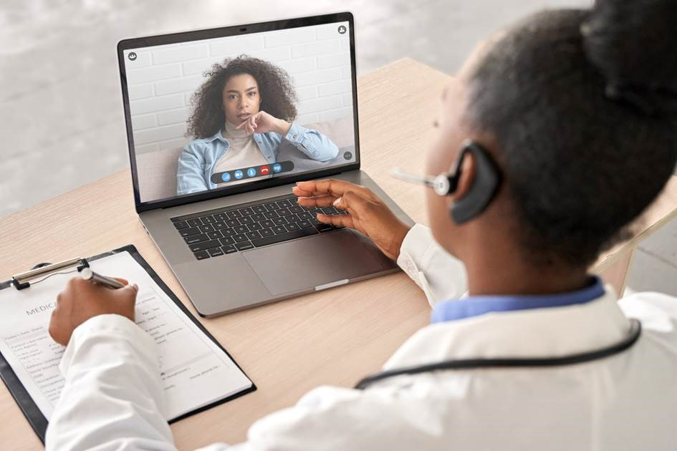
Medical-Dental Integration
20 year old female, Donna, presents to the dental clinic with
extreme dental phobia, and needs a tooth extracted.
The dental team suggests a dual-visit with a counselor on-call.
The patient, counselor, and dental team agree to
a whole-person care plan via Doxy.me.
Chat Question
If you are familiar with these platforms, what ways can you see them being used to provide patient care?
Notes:
Webex, G-Suite and Doxy.me all advertise that they provide HIPAA-compliant video communication products and that they will enter into a HIPAA BAA according to the Department of Health and Human Services. Notification of Enforcement Discretion for Telehealth | HHS.gov
Chat question: If you are familiar with these platforms, what ways can you see them being used to provide patient care?
- Webex: video call consultations with referring providers
- Exchange of patient case info with a referring provider via google classroom

Slide 23
Teledentistry: a patient perspective

Slide 24
Patients like Teledentistry
Made it easier for patient to get care
Avoided cancellations or delays due to distance, work, or childcare
Easier to access to in-person care if needed
https://www.dentaquestpartnership.org/system/files/DQP_Teledentistry_Survey_Communications_Brief_0.pdf
Notes:
The results on this slide come from a DentaQuest Partnership Survey designed to assess patients’ perceptions of their teledentistry experience
The DentaQuest Partnership conducted a survey of 111 patients (ages 18 and older) who had a synchronous teledental visit from an Advantage Dental provider in Oregon between April and May of 2020.
Read slide graphics, then bullets

Slide 25
Key Findings from COVID-Era Survey
86% said they were satisfied with their overall teledentistry experience
95% said they were “able to speak freely with the dentist and ask questions”
https://www.dentaquestpartnership.org/system/files/DQP_Teledentistry_Survey_Communications_Brief_0.pdf

Slide 26
Key Findings from COVID-Era Survey
69% reported that their concern was taken care of during the teledental visit
https://www.dentaquestpartnership.org/system/files/DQP_Teledentistry_Survey_Communications_Brief_0.pdf

Slide 27
The best use cases for teledentistry according to patients
65%
50%
27%
Health Promotion
& Education
Diagnosis & Dental Disease Risk Management
Preventive Procedures
https://dentavox.dentacoin.com/blog/teledentistry-surteledentistry-survey-shows-patients-are-ready-to-welcome-it/
Notes:
According to those same patients, there are many uses for teledentistry!
We can build our telepresence with patients while using the technology for prevention, health promotion, diagnosis and risk assessment and preventive procedures in ADDITION to using teledentistry for triaging emergencies. – just liked we talked about in the workflow. Patients desire preventive care enabled by technology

Slide 28
Stress-related oral health conditions in the COVID-19 era
COMPARED TO BEFORE THE COVID-19 PANDEMIC, how has the prevalence of the following conditions changed among patients in your dental practice?
INCREASED
PREVALENCE
59.4%
BRUXISM
53.4%
CHIPPED TEETH
53.4%
CRACKED TEETH
53.4%
TMD SYMPTOMS*
26.4%
CARIES
29.7%
PERIODONTAL DISEASE
https://www.ada.org/en/publications/ada-news/2020-archive/september/hpi-poll-dentists-see-increase-in-patients-stress-related-oral-health-conditions
Notes:
CB transtion

Slide 29
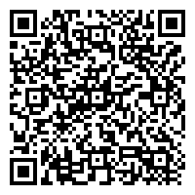
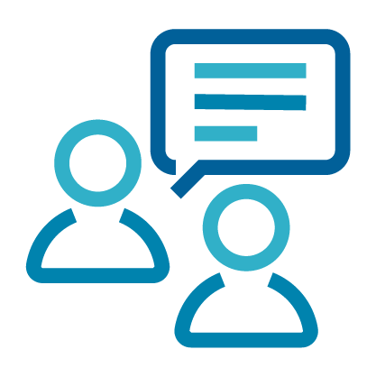
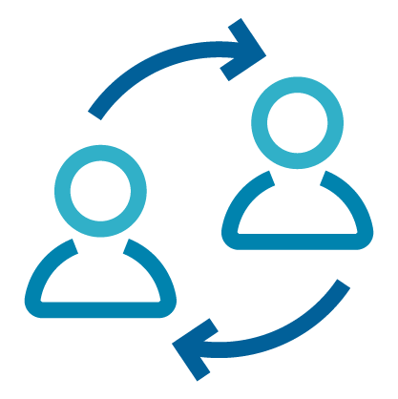

Learning to SHARE: Five Essentials for Patient-Centered Communication During Synchronous Teledentistry
Setting and Speech
Hold eye contact
Ask
open-ended questions
Relationally share information
Express gratitude
and warmth
Allen, M., Brown, C. Five essentials for patient-centered communication during synchronous teledentistry. BDJ In Pract 33, 23 (2020). https://doi.org/10.1038/s41404-020-0447-z
Notes:
You can use the QR code to watch the full video

Slide 30
Notes:
Here we have self-management goals for teledentistry that DQP has developed and will be available on the website.

Slide 31
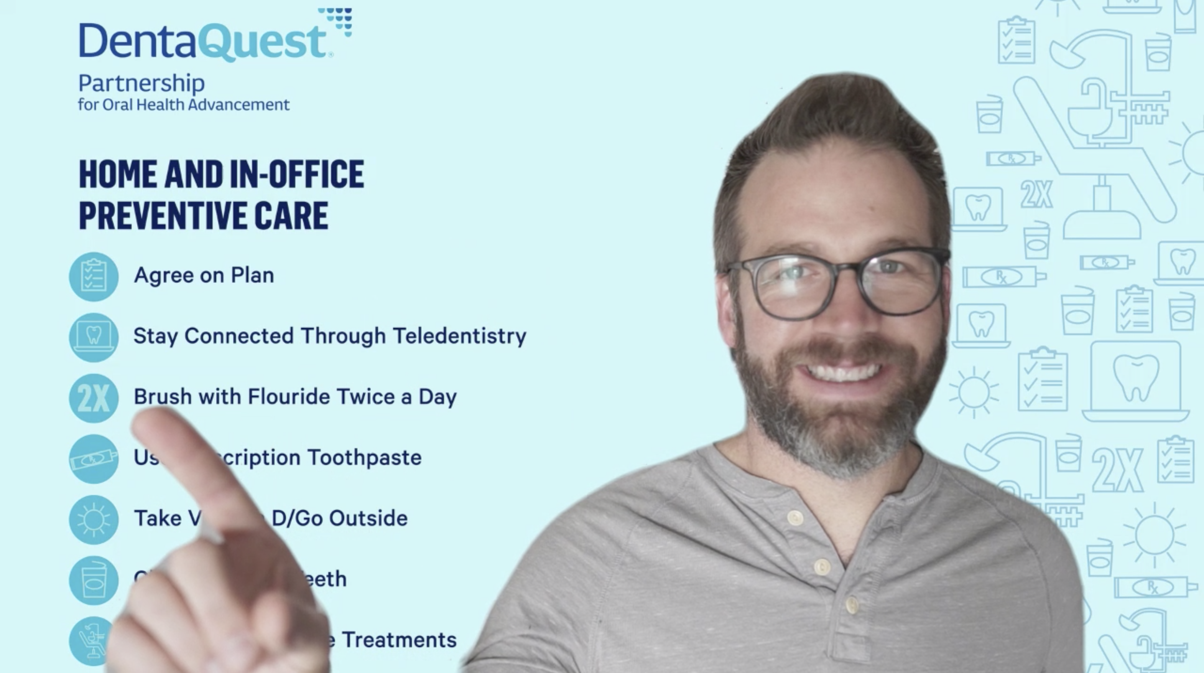
www.dentaquestpartnership.org/
customized-screens-patient-self-management
Notes:
Carolyn
Use green screens, virtual backgrounds to support your practice + practice logo, self-mngt or oral health education…. Here, I am speaking with a parent and child about a pea-sized amt of fl tp… change virtual backgrounds for diff patients, can also use green screens, health education props that you would use in the clinic.

Slide 32
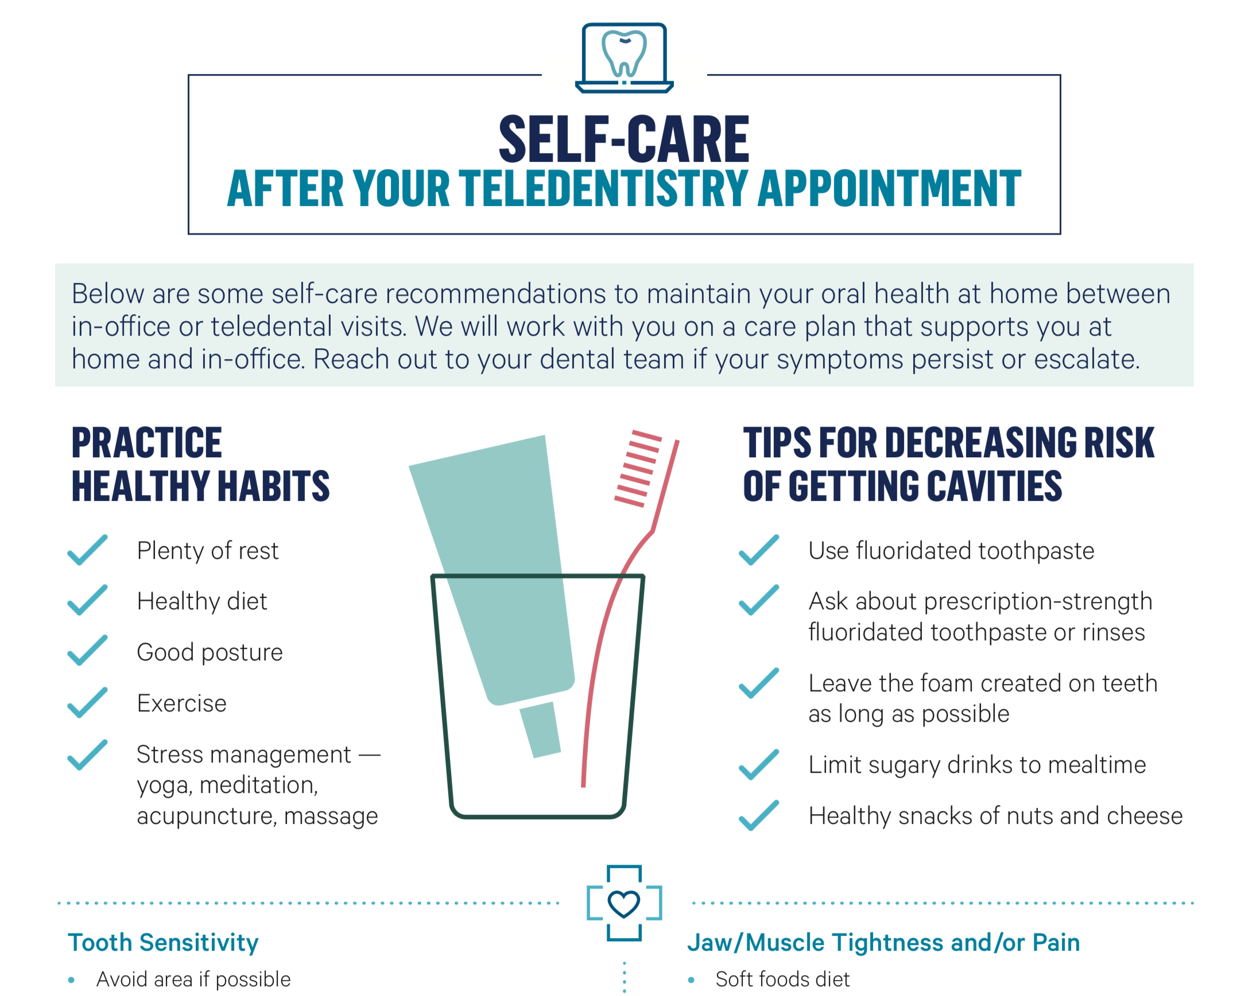

Slide 33
Teledentistry for Patient Education and Engagement
Allows for whole family, blended family, home care team participation
Shows home care tools, regimen in-home
Cost is not a barrier
Traditional "triggers" are absent (smell, sounds of a dental office)
People/Parents/Caregivers can engage differently
Utilize virtual tools (virtual screens, share screen)
Varies based on diagnosis and patient preferences
Caries Risk Assessment
OTC or Rx Medication
Self Management Goals
Patient Education
Self Care Tips
Care Plan

Slide 34
Coding and Billing for Teledentistry
Teledental Codes
D9995 – synchronous;
real-time encounter
D9996 – asynchronous; information stored and forwarded to Dentists for subsequent review
Procedure Codes
Emergency: D0140, D0160, D0170, D0171
Evaluation: D9430, D0170, D0171
Palliative: D9910, D9630
Preventative: D1310, D1320, D1330
Assessment: D0190, D0191
Caries Risk Assessment Codes
D0601 – low risk
D0602 – moderate risk
D0603 – high risk
Case Management Codes
D9992 – care coordination
D9994 – patient education
Refer to ADA https://success.ada.org/~/media/CPS/Files/COVID/ADA_COVID_Coding_and_Billing_Guidance.pdf
Notes:
When coding for dental services provided through teledentistry, you must always include at least two codes....
- one must be the teledentistry modality you used whether that is synchronous (indicated by D9995) or asynchronous (indicated by D9996)
- the other must be the procedure code or codes of the services you provided during the teledentistry encounter. Thinking back to that workflow those could be an emergency exam code, an evaluation code or prevention codes.
Refer to ADA https://success.ada.org/~/media/CPS/Files/COVID/ADA_COVID_Coding_and_Billing_Guidance.pdf

Slide 35

Chat Question
What is one thing you learned from today that you can put into action going forward?

Slide 36
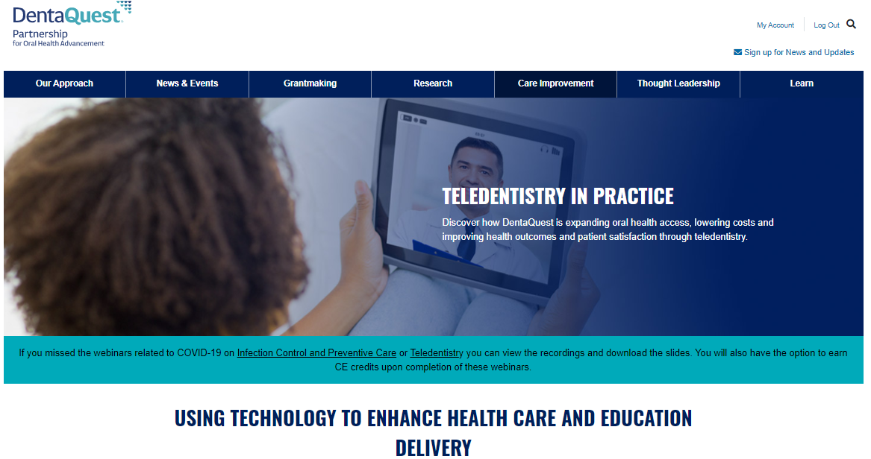
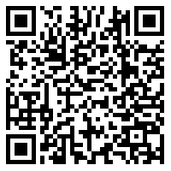
Resources
Notes:
The DentaQuest Partnership for Oral Health Advancement has a page dedicated to helping you put teledentistry into practice on our website. You can use the QR code to go directly to the website. There you will find all the resources we talked about today including the example workflows, virtual backgrounds, patient self-management goals and tip sheets.

Slide 37
Questions?

