Slide 1
Mental Health Documentation: Everything You Wanted to Know (and MORE!)
Helena Mackenzie, PhD
Region 5 Mental Health Specialist

Slide 2
How to Meet PRH Documentation Requirements for the Mental Health and Wellness Program
Objectives:
Identify two ways to document mental health chronic care management
Describe how to document clinical information from meetings with counselors
Identify ways to document your promotion, prevention and consultation activities
**Caveat: This webinar will focus on key, but not all, documentation areas — refer to the PRH, DRG, CMHC Orientation webinars, and HW website for additional guidance.
Notes:
Welcome! CHAT BOX: Get sense of who is on the webinar. This webinar will focus on how to meet key PRH documentation requirements for the Job Corps Mental Health and Wellness program. We will cover things like (read slide). As we only have an hour--we can’t cover everything. As we already have two webinars for CMHCs focusing on the AFR process and related documentation, those topics won’t be covered here. We also won’t cover HCGs, as those are discussed in the initial CMHC Orientation Webinar. If you haven’t recently reviewed the CMHC DRG, CMHC Orientation webinars, AFR webinar and HW website, you might want to do so periodically to ensure you are aware of any program changes and related documentation needs. All the resources discussed on the webinar today can be found on the HW website—the link will be provided at the end of the webinar.

Slide 3
Mental Health and Wellness Program PRH Chapter 2.3, R4
General Emphasis
(a)
Mental Health & Wellness Program
PRH 2.3, R4
Treatment
(d)
Assessment
(b)
Mental Health Promotion/Education
(c)
Notes:
The requirements for the MHWP are described in Chapter 2.3 section R4 of the PRH. The MH section is divided into four subsections (a-d). The first describes the General Emphasis of the program, while the other three describe the major tasks of your position: Assessment; MH Promotion and Education and Treatment. This webinar will walk you through the documentation requirements related to each of these areas. We’ll start with the General Emphasis of the program.

Slide 4
Mental Health and Wellness Program General Emphasis
Early Identification and diagnosis
Basic mental health care
Mental health promotion, prevention and education
Employee Assistance Approach
Short-term therapy with employability focus
Referral to center support groups
Crisis intervention
Notes:
As you likely understand, the JC MHWP focuses on—(READ SLIDE). Your documentation should always reflect this general emphasis. We’ll discuss practical ways you'll do this for the different areas of the program.

Slide 5
Mental Health and Wellness Program PRH Chapter 2.3, R4
General Emphasis
(a)
Mental Health & Wellness Program
PRH 2.3, R4
Treatment
(d)
Assessment
(b)
Mental Health Promotion/Education
(c)
Notes:
Let's start with Assessment responsibilities. An important part of the CMHC role focuses on Assessment, which includes a lot of different tasks—from reviewing the SIF to conducting initial intake interviews, administering self-report assessment instruments, conducting MSWRs, AFRs, and much more.

Slide 6
Mental Health and Wellness Program Assessment
Social Intake Form (SIF): NEW Students (Virtual or Traditional)
Must be completed by counselors within 48 hours of enrollment
Reviewed and signed by CMHC within 1 week of enrollment
Filed in student health record (SHR)
Notes:
One of the first assessment related tasks that occurs when a student arrives on center is the Social Intake Form or SIF. For NEW students, whether in virtual CPP Enrollment or Traditional Enrollment, Career counselors are required to complete the SIF within 48 hours of enrollment. Your role is to review and sign the SIFs of NEW STUDENTS within a week of enrollment to see if there are any MH items or concerns that you should follow up on. If so, make sure the box on the last page of the SIF, which indicates the student will be referred to you, is checked and then f/u with the student. Whether or not you plan to f/u with a student, make sure the SIF is signed and dated by you and filed in the MH section of the SHR within a week of the student's enrollment. (If asked discuss that PRH only requires you sign off if MH related items are checked)

Slide 7
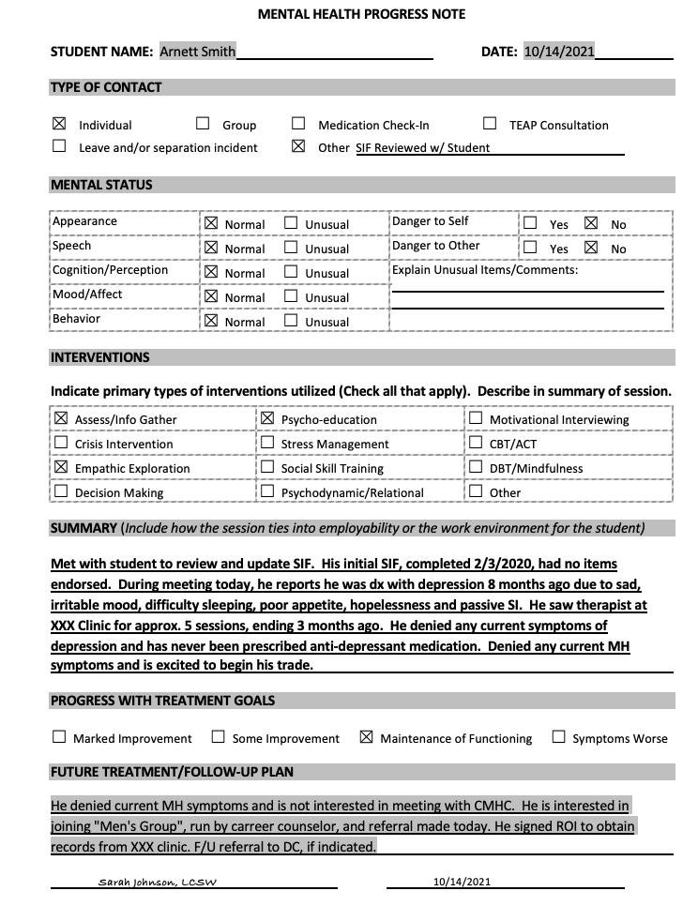
Mental Health and Wellness Program Assessment
SIF for RETURNING Students
Must review original SIF
Meet with student to identify any changes to SIF or current MH needs
Document using Mental Health Progress Note, SF-600 form
No specified time frame.
Notes:
The SIF protocol for RETURNING students (students that were on center prior to the COVID-19 pandemic; but who are now returning to center) is different. You are required to review the original SIF of students who are returning to center AND meet with the student to determine whether there have been any changes to the SIF or if mental health support is needed. You will then document this in the MH section of the SHR using a MH Progress Note or SF-600 form. You can also re-sign the SIF with the current date to indicate it’s been reviewed, although that is not necessary as your MH note should state this. The COVID protocol does NOT state a specific time frame that you must complete this re-review of SIF within; however, ideally you should review the SIFs of returning students prior to their return, prioritize meeting ASAP with students with MH risk factors as soon they return to center, and consult with counselors to help identify students who may need immediate attention, which might not be indicated via their original SIF. This updated SIF process is voluntary—a student CAN decline. Make sure you document this if it occurs.

Slide 8
Mental Health and Wellness Program Assessment
Daily Emotional Wellness Checklist (DEWC)
Completed once daily by all students in quarantine or isolation (voluntary)
CMHC (or designee) must follow up on responses marked poor/fair same day
Filed in SHR (individual forms OR print out of electronically collected data)
Document your follow up contact in SHR
Notes:
The COVID-19 Medical, Mental Health, TEAP and Oral Health Protocol describes some additional requirements to the MHWP during the COVID 19 pandemic. Please refer to this protocol (on HW website) for all the required tasks. One key assessment related task is that students who are in quarantine or isolation are asked to voluntarily complete the DEWC once each day. The HW team then reviews these results daily, with the CMHC, or designated HW staff, following up on any "poor" or "fair" responses on the same day. If centers use paper DEWC forms, these should be filed in the SHR MH section. If a google or excel form is utilized, each student's results should be filed in the SHR at the end of the quarantine/isolation period. Make sure to document results of f/u with students due to positive responses on the DEWC using a MH Progress Note or SF600 (Chronological Record of Medical Care form), filed in the MH section of the SHR.

Slide 9
Assessment continued…
Intake/Initial Assessment:
Strongly recommend use intake form on HW website
Intakes should include:
Reason for referral
Presenting problem/current symptoms
Mental & chemical health history
Relevant medical history & medications
Mental Status Exam
Strengths & Barriers to employability
DSM diagnosis, if applicable
Intervention/Education provided & recommendations
Referral to Reasonable Accommodation Committee, if indicated
**MH Intake Assessment form updated July 2021
Notes:
If a student is referred to you based on SIF responses, the DEWC, or request by staff or the student, you’ll likely complete an initial intake assessment. With the expanded CMHC hours, we strongly recommend you consider doing an intake/initial assessment with all students referred to you. If the student doesn’t have a significant MH history or serious concerns, your intake assessment might be abbreviated, but should still cover key areas. We strongly recommend you use the Intake Assessment Form (snapshot here). If you use an alternative form, make sure your intakes include key elements such as (READ SLIDE):

Slide 10
Use of Evidence Based Screening Tools
Patient Health Questionnaire-9 (PHQ-9) to assess depression (PHQ-A is adolescent version)
Generalized Anxiety Disorder-7 (GAD-7) to assess anxiety
Columbia Suicide Severity Rating Scale (C-SSRS) for suicide assessment
Mood Disorder Questionnaire (MDQ) to assess bipolar symptoms
PTSD Checklist for DSM-5 (PCL-5) for PTSD/Acute Stress symptoms
Notes:
We recommend you consider using evidence-based screening tools as part of your MH intake assessments and during follow up therapy sessions, as needed (for instance, to help document an improvement in symptoms, or worsening symptoms that might result in a medication referral). There are many free evidence-based screening tools (see slide). If you use a screening tool, MAKE SURE you include an interpretation note in the SHR and indicate the plan. You might document your interpretation within you MH Progress Note, MH Intake Assessment note or on a SF600 form.

Slide 11
Assessment continued…
MSWR or Medical Separations
Note in MH section of SHR must include:
Current symptoms and behaviors and how they interfere with the student’s participation in Job Corps
Diagnosis, which must be supported by clinical information
Plan, with clear statement that you’re recommending MSWR/Medical Separation
If a student disagrees with MSWR, you should complete a HCNA or DTA and file in SHR (you don’t submit this to region, unless requested)
Notes:
Sometimes a student might have a mental health condition that significantly interferes with or precludes further training in Job Corps. In these situations, a health staff member may initiate the medical separation process. As CMHC you should be involved with all mental health related medical separations. Job Corps has two types of medical separations: a “straight” Medical Separation and a Medical Separation with Reinstatement Rights/MSWR. Most mental health related medical separations are MSWRs because typically, with appropriate treatment, mental health conditions can be stabilized within six months,
To determine whether a medical separation/MSWR is clinically necessary, you should conduct an assessment with the student. Your assessment should include the current symptoms and behaviors and how they are interfering with the student’s participation in Job Corps; a diagnosis, supported by the clinical information; and a plan, which should clearly state that you are recommending the student be placed on MSWR. You might document this assessment on a Mental Health Progress Note, SF 600 form, or intake assessment form. File this assessment in the MH section of the SHR and put a dated note in the Chronologic Record, which states “See CMHC MSWR Note.”
In some cases, the CMHC may not be on center when a student is placed on MSWR. If this happens, the HWD should alert the CMHC ASAP and, when next on center, the CMHC should review all the information relating to what happened (e.g., medical staff notes, CIS notes, hospital records, etc) and write a note in the SHR documenting this information, diagnosis, and a plan (e.g., MSWR).
Occasionally, a student may disagree with an MSWR. If a student (or guardian if the student is a minor) is not in agreement with the MSWR, you should complete a HCNA or DTA, which should be filed in the SHR. You should NOT send this form to the RO, unless it’s requested as part of an appeal process.
It’s also important to remember that, per NO guidance, students should be allowed to use their available leave prior to the initiation of the MSWR (e.g., PTO, or Admin with Pay, etc).

Slide 12
Assessment continued…
MSWR or Medical Separations
MSWR Letter/Form (template on HW website)
Reason for MSWR
Specific treatment instructions
Referrals (at least one)
Steps to return from MSWR
Documentation of monthly contact by HWD/RN or CMHC for students on MSWR
Use Sample MSWR Monthly Contact Sheet or SF 600
Notes:
In addition to documenting your clinical MSWR assessment in the SHR, it’s important that the student and/or guardian be provided written documentation explaining the purpose of the Medical Separation/MSWR and what the student must do to return. Your HWD will work with you to create the MSWR Letter/Form. A MSWR template/letter can be found on the HW website. Make sure a copy of the letter is placed in the SHR. Your input on the letter will include:
Reason for MSWR: Clearly describe the symptoms/behaviors that are interfering with functioning and must improve prior to returning to center.
Specific Treatment Instructions: Specify what providers/types of treatment you recommend (e.g., evaluation by psychiatric provider and follow recommended treatment; evaluation and treatment by licensed mental health provider; Stabilization of specific symptoms/behaviors (e.g., suicidal ideation, SIB, anger outbursts, etc.)
Referral/s: provide at least one referral (unless the student has indicated they plan to f/u with their own provider).
Steps to Return from MSWR: Criteria you will use to decide if student is ready to return. You might request documentation of treatment received; documentation of what medications are recommended ongoing; recommendations related to ongoing health care needs and/or accommodations. You should also add that the CMHC (or designee) will review necessary documentation and interview the applicant to assess their stability prior to returning to JC.
While a student is on MSWR, the HWD/RN or CMHC should be checking in monthly regarding progress and document these calls using the MSWR Monthly Contact Sheet or SF600.
PLEASE SEE the DRG, CMHC Orientation Part 2 and CMHC Training Bundles—MSWR—for additional details and an example MSWR letter.

Slide 13
Mental Health and Wellness Program PRH Chapter 2.3, R4
General Emphasis
(a)
Mental Health & Wellness Program
PRH 2.3, R4
Treatment
(d)
Assessment
(b)
Mental Health Promotion/Education
(c)
Notes:
Now we are going to shift from Assessment related tasks to those focusing on MH Promotion and Education. Any questions about Assessment documentation before we do that?

Slide 14
Mental Health and Wellness Program Mental Health Education and Promotion
One-Hour CPP Presentation
Introduce MHWP, available services, self-referral AND teach basic skills for identifying and responding to mental health crisis
On-center, a CPP PPT template is available on HW website
Virtual Enrollment, a CPP presentation has been designed for new students in the initial 60-day virtual phase. Ask your HWD, CPP coordinator
Document set day/time for CPP presentation
Annual Center-Wide Mental Health Promotion Activity
Keep folder/binder/computer file with information and dates of activities
Notes:
The MH Education and Promotion elements of the CMHC position focus on the important consulting role you play on center. As CMHC, your influence should reach ALL students, not just those who present with MH difficulties. The most obvious way you’ll be introduced to students is through the required one-hour CPP presentation you give to all new students. The easiest way to document this presentation is to have a set day/time when you meet with new students. There are separate PPT CPP presentation templates for on-center and Virtual Enrollment. Ask your HWD or CPP coordinator if you don't have a copy of the VE CPP PP.
In addition to the CPP presentation, you are required to do an ANNUAL Center Wide MH Promotion activity. We recommend you document these activities in a binder/folder or computer file—include the date it was conducted and a description of the activity. Photos, handouts, PowerPoints showing what you did can also be kept.

Slide 15
Mental Health and Wellness Program Mental Health Education and Promotion
Monthly Consultation/Meeting with Center Director (CD)
Meeting Minutes (with date, attendees, topics)
Meeting may also include HWD and/or Center Physician (CP)
Consultation/training with HWD, management staff, recreation, residential, SGA, HEALS to develop integrated programming
Meeting minutes and/or binder of trainings
Notes:
Another important piece of your consultant role is meeting regularly with the CD. Sometimes your meeting with CD may also include your CP and HWD. It’s important that you (or CD) create a binder and keep minutes from your meetings, including who attended, topics discussed and any action plans).
Finally, as the CMHC, you will likely be asked to consult with and provide staff training. All staff are required to have 5 hours of Adolescent Growth and Development training each year and you will likely provide some of these hours, which will talk about later in the webinar. You'll be providing other staff trainings, such as the COVID protocol required trainings on a Trauma Informed Approach and Managing Staff Anxiety with Students Return (during COVID). You may conduct additional trainings with residential or recreation staff or you may be involved in different integrated programming such as the SART (sexual assault response team) and HEALS (health eating active lifestyles). Again, make sure you keep track of different trainings you conduct in a binder, folder or computer file. Make sure any teams you are a part of (e.g., SART) maintain meeting minutes.

Slide 16
Mental Health and Wellness Program PRH Chapter 2.3, R4
General Emphasis
(a)
Mental Health & Wellness Program
PRH 2.3, R4
Treatment
(d)
Assessment
(b)
Mental Health Promotion/Education
(c)
Notes:
Any question on MH Promotion and Education b/f we move onto documentation of treatment-related tasks?

Slide 17
Mental Health and Wellness Program Treatment
Short term therapy with an employability focus
Recommend use MH Progress note
Can also use SOAP, DAP format, if preferred
Document in MH section of SHR
Note on chronological record (SF600), “CMHC Visit on DATE” and sign
Notes:
Treatment within Job Corps follows an EAP, short-term therapy model focusing on employability. Individual sessions typically focus on identifying and exploring the impact of current MH problems on employability and generally intervening using brief therapy and skills-based approaches. We recommend you document your individual therapy sessions with the Mental Health Progress Note. You can also use SOAP, DAP notes on SF600 form, if preferred. You should file your notes in the MH section of the SH record AND place a note on the chronological care record at front of SHR indicating "CMHC visit on DATE" and sign.

Slide 18
Treatment continued…
Collaboration with TEAP regarding co-occurring conditions
Document via counseling meeting using the Mental Health Feedback and Case Management Form
Document using SF600 (lined paper)
Document using the Mental Health Progress Note
All should be filed in the MH or TEAP section (and referenced in other section)
Collaboration with CP—Psych Meds
Standard meeting with CP/wellness staff
Note on chronological record or in MH section of SHR
Consider using the Medication Review, Rationale, and Monthly Case Mgmnt Form
Notes:
In addition to individually meeting with students, your collaboration with the TEAP specialist and Center Physician is also a key component of meeting students’ mental health (and often co-occurring) treatment needs. You might document coordination with the TEAP specialist in different ways-–some TEAP specialists attend the counseling meeting and coordination might be documented on the MH Feedback and Case Management Form in the individual SHRs. Sometimes meetings with TEAP might be documented using the SF600 form, or on a MH Progress Note (checking box indicating TEAP consultation at top of form). Whichever form you decide to use, it should be filed in the MH or TEAP section (and referenced in the other section). Collaboration with the CP regarding psych meds or other issues can be documented on the SF600 or your center might choose to use the Medication Review, Rationale and Monthly Case Management Form, shown here. If this documentation is placed in the MH section of the SHR, make sure to also place a note referencing this collaboration on the SF600 at the front of the SHR where the nurses and CP document.

Slide 19
Treatment continued…
Collaboration with Counseling in Developing/Leading Psycho-Educational Groups
Document group referrals in MH section of SHR
Maintain list of groups on center provided by counseling
Document CMHC-led group activities using the MH Progress Note or SOAP/DAP format in the MH section of the SHR
Notes:
Psychoeducational groups are part of the career counselors job responsibilities. Your role is to make sure you assist counselors in developing and leading groups and that you’re aware of the groups being conducted and actively refer students, as needed. You should document referrals to counseling groups in the MH section of the SHR, perhaps as part of a mental health progress note, case management meeting note, or on the SF600, which you can file in your section of the SHR. If a counselor referred the student to you using the Ref and Feedback Form, you might indicate a group referral recommendation in your feedback. You may choose to run process or therapy groups yourself. If you do, document CMHC-led group activities using the MH Progress note or SOAP/DAP format in the MH section of the SHR.

Slide 20
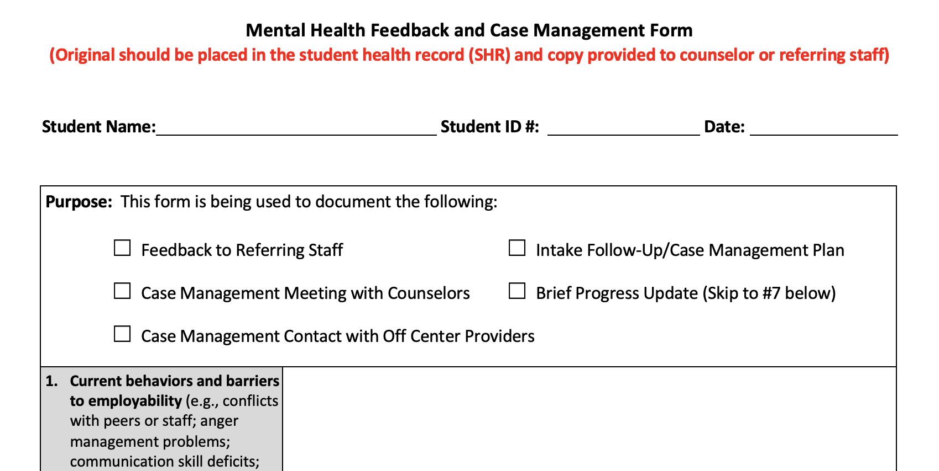
Treatment continued…
Case Management: Information exchange between staff
Documentation of Case Conferences with Counselors
Binder with Meeting Minutes including sign-in sheet and students/topics discussed
Documentation of clinically relevant material discussed must also be filed in SHR
Use Documentation of Case Management and Feedback Form, or
Progress note/pre-printed adhesive labels that allow room for brief update, signature and date
Case Management Meeting
Student continues to attend anger mgt. group and is doing well. No further MH services needed at this time.
9/20/2021 CMHC, PhD
Notes:
When we talk about case management in Job Corps, we are simply referring to how you document information exchange and collaboration with different staff on center about a student’s mental health needs. The career counselors often know students well and your case conference meeting with counselors, which happens weekly on most centers, is one of the most important ways you gather and share information. There are two PRH documentation requirements related to the counselor case conference—first, you need to make sure you document that the meeting occurred, who attended, and general topics/students discussed. Second, any clinically relevant information discussed must be filed into the individual student’s health record. You can document clinically relevant info from case management meeting using the “Case Management and Feedback Form” or by creating a progress note/or using pre-printed adhesive labels that allow room for a brief update, signature and date. Remember: clinically relevant information about an individual student MUST be placed in that SHR.

Slide 21
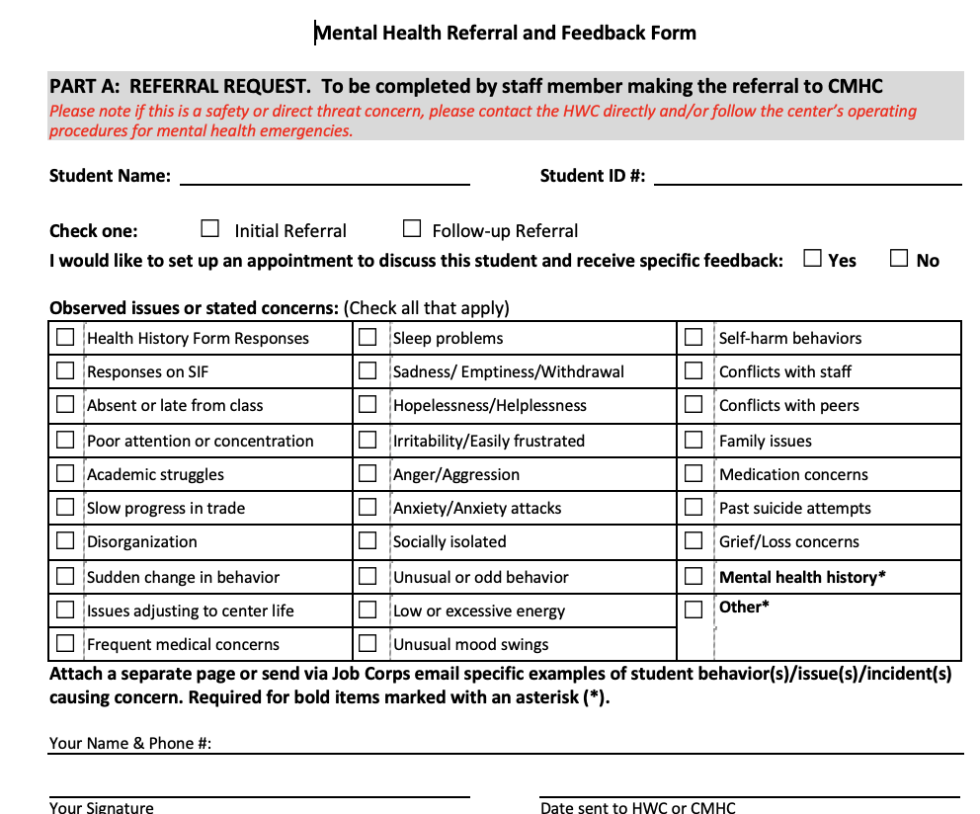
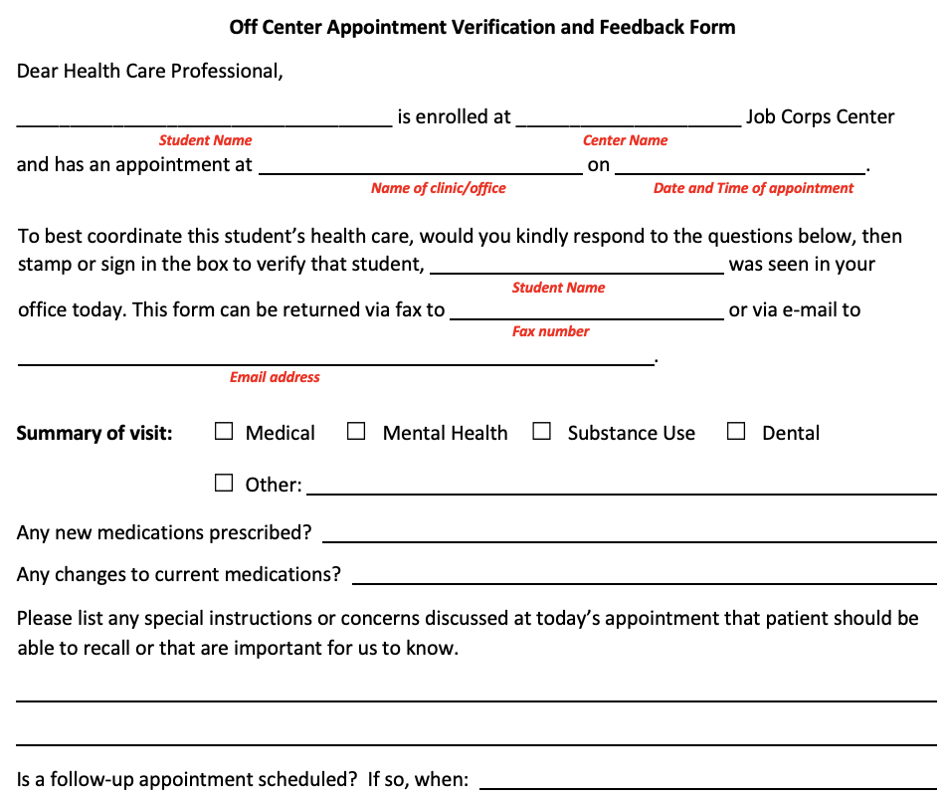
Treatment continued…
Case Management, continued:
Written Referral and Feedback System for On-Center Care
Use the Mental Health Referral and Feedback Form—
Include Feedback to Referral and file in SHR
Follow up on feedback in case management meeting, if indicated
Referral for Off-Center Care
Request student sign ROI
Use the Off-Center Appointment Verification and Feedback Form
Work with HWD to develop system of documenting information from off-center visits in SHR
Notes:
Another way Information exchange (case management) commonly occurs on center is via a Written Referral and Feedback System. You must have a way for staff to refer students to you and for you to provide feedback. We strongly recommend you use the MH Referral and Feedback Form, which allows the referring provider to describe what they are concerned about by checking boxes indicating symptoms/behaviors of concern. The form has a section for the CMHC to provide feedback to the referring source, including ways the referring staff can help support the student. The original of this form MUST be filed in the SHR, with a copy sent to the referring source. If your center provides referrals using JC email, make sure you print out the email referral and your response/feedback to the referral source and file in the SHR. If referrals are provided via phone, make sure you document these phone conversations and any clinically relevant information in the SHR on Mental Health Progress Note or SF600.
Off center Care: There are times when a student must be referred OFF-CENTER for additional care. It’s important that you request a student sign a ROI so that you can speak with and obtain updates from off-center MH providers to best coordinate care and ensure the student’s health needs are being met. You can use the Off-Center Appointment Verification and Feedback Form, which the student can take to each appointment and request the provider provide feedback on the appointment, which can then be reviewed by appropriate health staff and filed in the SHR. You should make sure you and your HWD develop a system to document information from off-center visits in the SHR.

Slide 22
Treatment continued…
Chronic Care Management
PRH 2.3, R2 requires monitoring of students identified as having chronic health problems.
Mental health care management is NOT a single, specific document or form—it is the ongoing, individualized documentation of care received by the student in the SHR.
Examples of Chronic Care Management
Provider completed CCMP may give background and help guide care/interventions at entry
Student At A Glance (Problem List) will identify diagnoses
CCMP Student Fact Sheets might help student understand their diagnosis
Diagnostic intake
Standardized assessment measures (e.g., GAD7, PHQ9)
Progress Notes
Consultations with on/off center providers (e.g., case management activities)
Referrals to center groups
Notes:
The PRH requires chronic care management of students with MH conditions. Chronic care management is key b/c we know that chronic mental health conditions, if not appropriately managed, can have a major impact on employability. It’s important to remember that documentation of chronic care management of mental health is not a single document. For physical health conditions, like diabetes, the CP may utilize a chronic care management flow sheet to track different labs or data. However, for mental health, documentation of chronic care management is the ongoing, individualized record of care received by the student throughout their time with Job Corps.
An example: let’s say an applicant has a history of depression and you conduct an AFR including a clinical interview and review of a provider completed CCMP. If that applicant becomes a student, the documentation of your AFR clinical interview, filing of the provider completed CCMP in the SHR, and ensuring that any MH related diagnoses are added to the “Student at a Glance” or Problem List in the SHR are all considered MH care management. Documentation that you reviewed this student’s SIF and decided to meet with them based on your AFR and SIF is more care management. Based on their history of depression, you might ask them to complete the PHQ9 (depression screen), as part of your intake assessment. Your intake assessment and brief description of the PHQ9 results and plan of care are more care management activities. Let’s say the plan is to provide education about depression (perhaps with a CCMP Student Fact Sheet) and then meet with the student weekly for 4 sessions to focus on CBT skills—your Progress Notes are more chronic care management documentation. If you decide to refer the student to the CP for a medication consultation, that case management is also part of your overall care management documentation. Finally, let’s say the counselors lead a peer support group, which you believe this student could benefit from—documentation of that referral and that the student attends that group is more care management. You get the idea—make sure all the care provided to the student AND behind the scenes collaboration, referrals, so forth are documented--all of that is your MH care management documentation.
A question that frequently comes up is what to do If you meet with a student who has a MH condition—say anxiety disorder-- but they are currently doing well, they’re stable, and they don’t need or desire any current services? You should document your assessment with the student, indicating that they're stable and do not want or need current services. You should describe the plan is they can f/u with you at any time. You might also then discuss this student briefly at your counselor case management meeting—letting the counselor know you’d like them to f/u with you if the student begins to have difficulties (or perhaps exhibits certain symptoms). Filing this case management in the SHR is part of documenting care management. One thing to keep in mind though-- if a student has a MH diagnosis that qualifies them as having a MH disability, even if stable, the DC should be looped in to document the diagnosis in CIS and engage in interactive discussion about whether any accommodations are needed now or in future.
To summarize, when we talk about care management of MH conditions, we're looking for documentation that we’ve supported a student’s mental health throughout their time in Job Corps. For mental health, this can’t be done well via a single form or document, but rather in the different ways listed on this slide (this list is not exhaustive).

Slide 23
Mental Health and Wellness Program PRH Chapter 2.3, R4
General Emphasis
(a)
Mental Health & Wellness Program
PRH 2.3, R4
Treatment
(d)
Assessment
(b)
Mental Health Promotion/Education
(c)
Notes:
Now that we’ve talked about ways to document key assessment, MH Promotion and Education and Treatment-related aspects of the CMHC role, we’re going to shift back to the “General Emphasis” of the program and how to document a few tasks that fall under this broader heading.

Slide 24
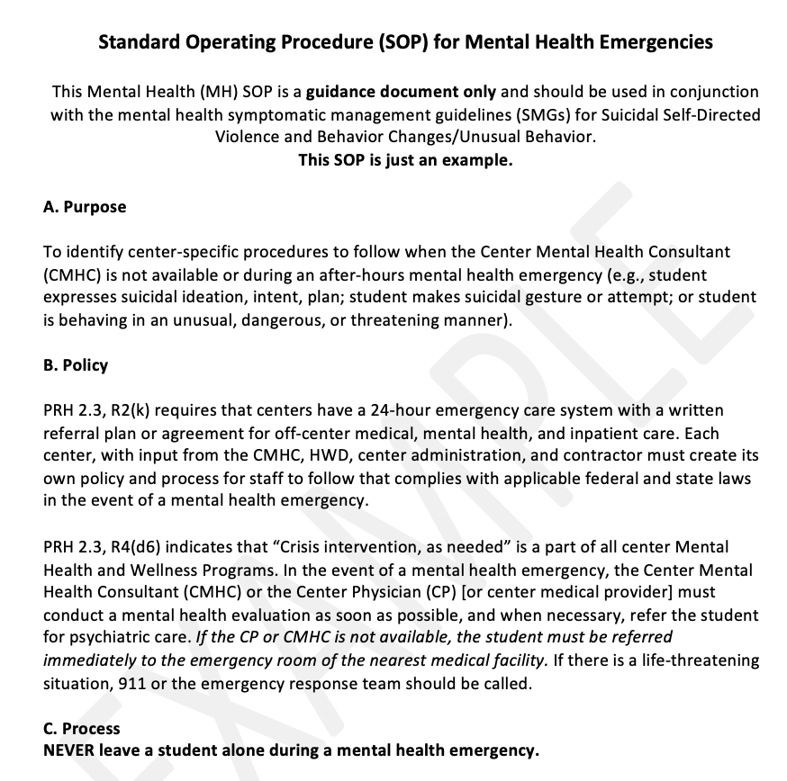
Mental Health and Wellness Program Crisis Intervention
Mental Health Emergencies
Use the Mental Health Emergency Standard Operating Procedure (SOP) guidance document to develop a center specific plan.
All HW staff interacting with a student who is in crisis should document their findings in the SHR
If the CMHC is not on center during MH emergency, the CMHC should be informed when next on center and document follow-up with the student and/or disposition, as indicated.
Notes:
The PRH requires that centers have a written plan for how to respond to after-hours MH emergencies (Each center must have a written plan for 24-hour off-center emergency care (PRH 2.3, R2), including a crisis intervention plan for mental health emergencies (PRH 2.3, R4)
Make sure you have reviewed your center’s MH emergency plan and we strongly encourage you to review the recently released Mental Health Emergency Standard Operating Procedure (SOP) guidance document—which will help you decide whether areas of your plan might want to be strengthened.
Strong documentation of events surrounding MH emergencies is key. Make sure that ALL Health and Wellness staff interacting with a student in crisis clearly document their findings in the SHR. Staff outside of HW can document concerns utilizing the referral and feedback form, a confidential email, and/or in CIS, if appropriate. If you are not on center during the MH emergency, you should immediately be informed when next on center. If the student is available, you should meet with the student and complete either an intake assessment (if you haven’t previously met with the student) or a MH Progress Note, focusing on description of the events surrounding the MH emergency and current symptoms/behaviors. If the student is in the hospital or not available for interview, then your description of events and symptoms may be based largely on documentation from other staff and/or hospital records. It is still important, however, that as the CMHC you pull together information from different sources and providing your clinical opinion based on this information.

Slide 25
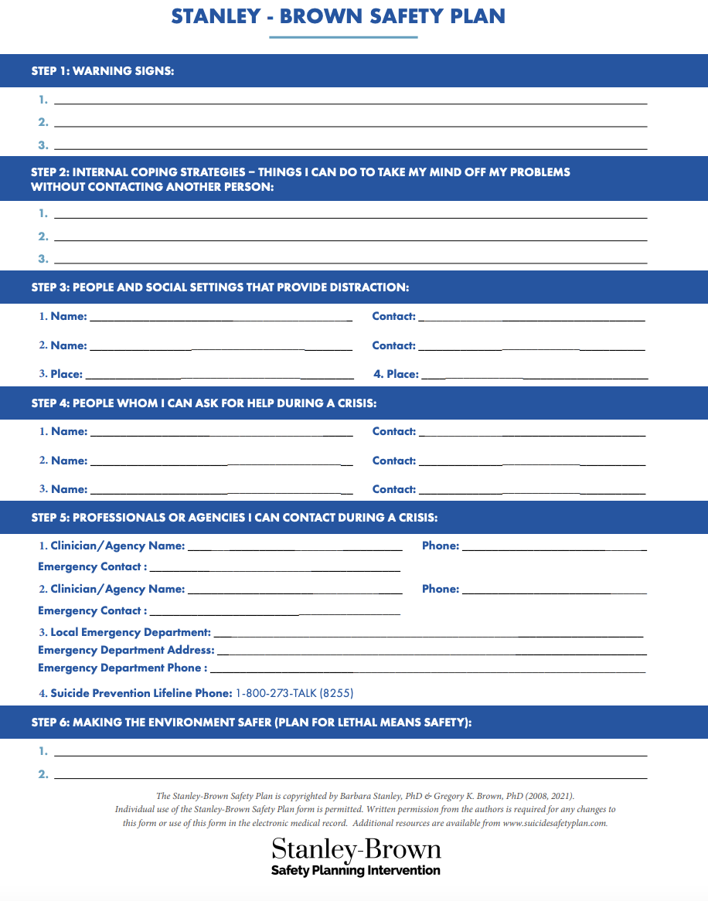
Mental Health and Wellness Program Crisis Intervention
Additional Crisis-Related Documents
Stanley-Brown Safety Plan*
Free Suicide Safety Plan App https://www.suicidesafetyplan.app
Critical Incident Crisis Intervention Plan: provides guidance for responding to critical incidents, traumatic events, disasters on center
Mental Health SMGs
Behavior Change
Non-Suicidal Self-Injury Behavior
Suicidal Self-Directed Violence
*Copyrighted by Barbara Stanley, PhD & Gregory K. Brown, PhD (2008, 2021). Individual use permitted. Permission required from authors to make changes.
Notes:
Some additional crisis related resources and documents in the HW website that you should be aware of: a paper safety plan that can be used with at-risk students (Stanley Brown Safety Plan). Please note this is under copyright, only for individual use, and can't. be altered without permission from the authors. There is also a link to a free Suicide Safety Plan App that can be downloaded on iPhone or android. You'll also find the Job Corps “Critical Incident Crisis Intervention Plan,” which provides guidance for how to respond to critical incidents and traumatic events or disasters on center, and the Mental Health SMGs. All of these resources can be found on the HW website.

Slide 26
Additional PRH Requirements to Document...
Notes:
Let's shift and talk about staff training.

Slide 27
Mental Health and Wellness Program Staff Training
PRH Exhibit 5-4: All staff require 5 hours of annual training in adolescent growth and development
Topics could include effective communication, anger management, sexuality, suicide prevention, behavior management system, zero tolerance policy, appropriate staff/student boundaries, sexual assault prevention and response, sexual harassment and related social skills training, crisis intervention techniques, bullying prevention, violence prevention, and safety issues.
Maintain binder of adolescent growth and development trainings you’ve conducted, including topic and date
HR should maintain attendance/sign-in sheets
Notes:
Read Slide—remember 3 of these 5 hours can be from SafetyNet—prevention of suicide, bullying and relationship violence.

Slide 28
In A Nutshell…
SHR—Mental Health Section
Social Intake Form (SIF)
DEWC
Referral/Feedback Form
MH Intake Assessment Form
MH Progress Notes
Employability Focus
Case Management Docs
On/Off Center
Collaboration w/ TEAP, CP (medication monitoring), RNs, etc.
MSWR Assessment/Recs
Crisis Intervention CMHC Notes
Group notes
Chronological Record/SF600
Document date student received MH service with corresponding note in MH section
Student At A Glance/Problem List
Document MH diagnoses
MH Promotion and Education and Staff Training Binder/s
CPP presentation information
Annual Center Wide Activity
Staff Training
Meeting Minutes
Counselor/case management Meeting
Monthly Meeting with CD
Notes:
In a nutshell, these are the different areas we touched on today, with recommendations provided on how to document each.

Slide 29
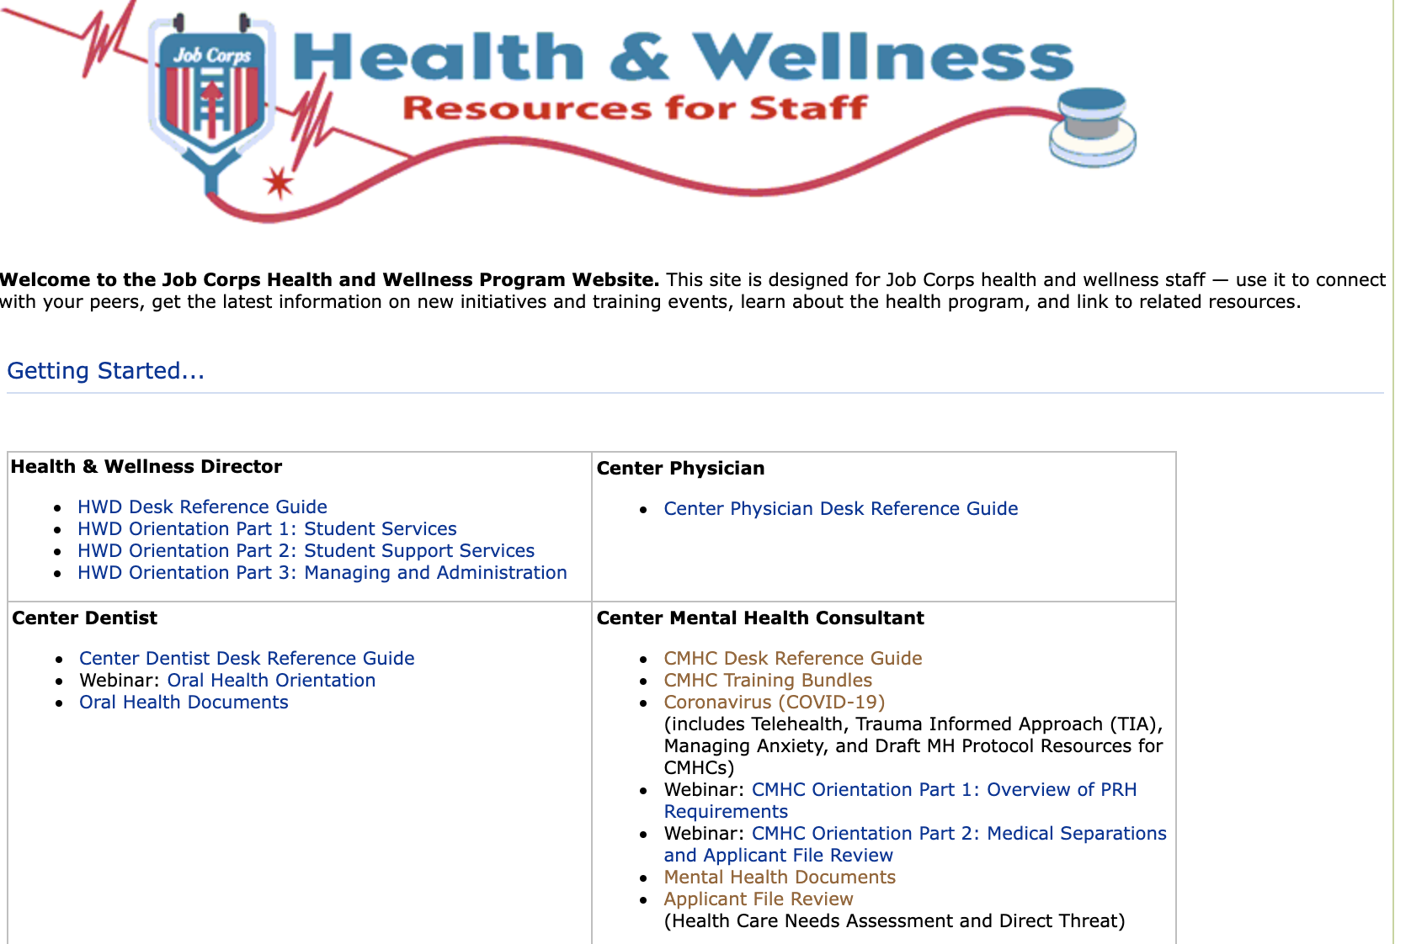
KEY RESOURCE: Job Corps Health and Wellness Website
https://supportservices.jobcorps.gov/health/Pages/default.aspx
Notes:
This is a screen shot of the H&W website, which can be accessed outside of Citrix, at this link: https://supportservices.jobcorps.gov/Health/Pages/default.aspx
You can also just type: ”Job Corps Health Support” into your internet search engine (outside of Citrix) and the first hit will be the H&W website.
All the MH related documents discussed today can be found under “Mental Health Documents” on the H&W website (see arrow). If you haven’t yet explored the H&W website, please do b/c there are SO many resources for you here on how to best do your job.
The next page is a snapshot of the CMHC Training Bundles.

Slide 30
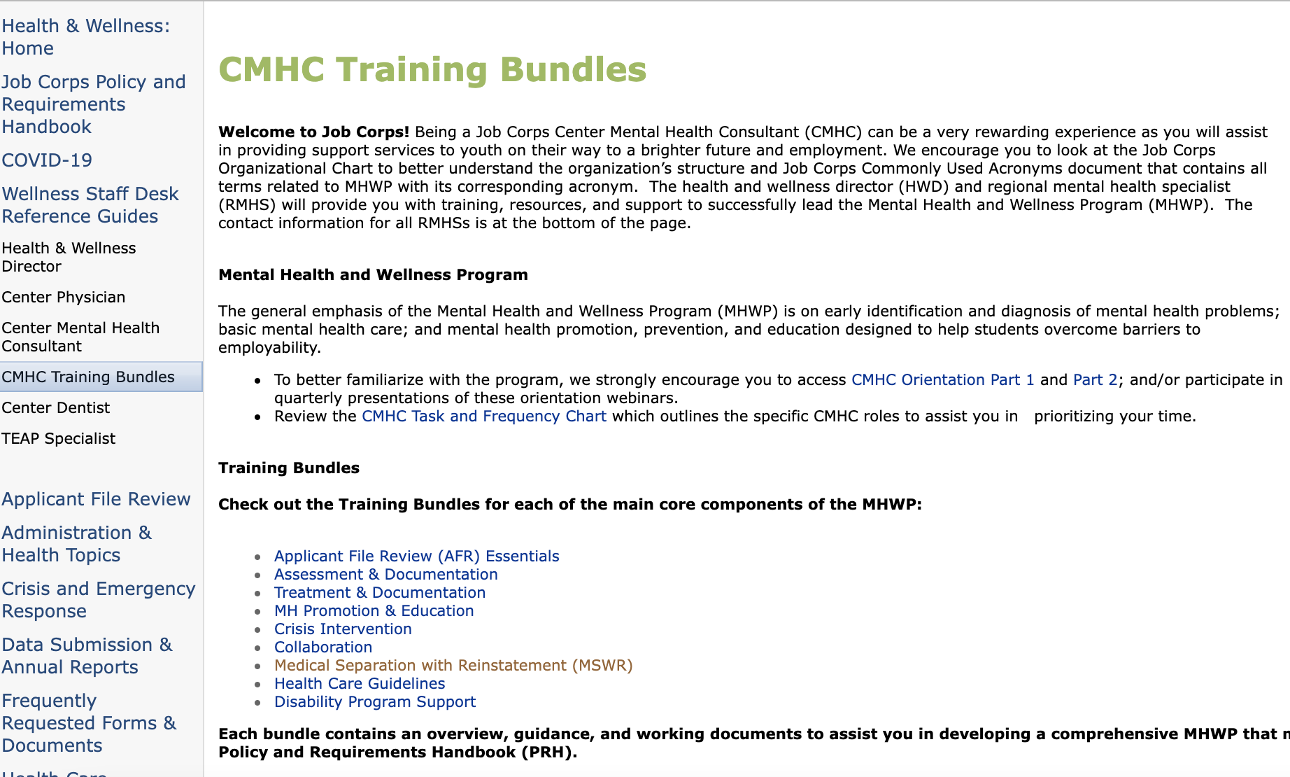
Notes:
The training bundles group together key resources for components of the MHWP and can be extremely helpful to review. Each bundle includes an overview, guidance, and working documents to assist you in meeting PHR requirements.
Always know you can reach out to your regional MH specialist for assistance in finding a document or with other questions--next slide.

Slide 31
Regional Mental Health Specialists
Region 1 (Boston)
Eugia Meminger, PhD
ememinger@gmail.com
Maria Acevedo, PhD (PR centers)
macevedo.correa@gmail.com
Lead/Region 2 (Philadelphia)
Valerie Cherry, PhD
vcherryphd@gmail.com
Region 3 (Atlanta)
Eugia Meminger, PhD
ememinger@gmail.com
Region 4 (Dallas)
Tamara Warner, PhD
tamarawarnerphd@gmail.com
Region 5 (Chicago)
Helena Mackenzie, PhD
helena.mackenzie530@gmail.com
Region 6 (San Francisco)
Tamara Warner, PhD
tamarawarnerphd@gmail.com

Slide 32
Thank You for Joining! Questions???

