Slide 1
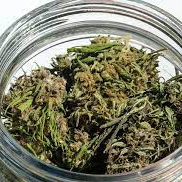
Marijuana Hot Topics
Diane A Tennies, PhD, LADC Lead TEAP Health Specialist
July 20 and 22, 2021

Slide 2
Learning Objectives
1.) Describe the two major differences between Delta 8 and Delta 9 THC.
01
2.) Understand why Delta 8 is federally legal however not allowed at Job Corps.
02
3.) Describe four motivational enhancement strategies to assist when providing intervention services to students coming from states where marijuana (THC-9) is legal for recreational use.
03

Slide 3
Brave New World (1932) by A. Huxley
Prediction of the future
The totalitarian government gives Soma, a chemical designed to provide a calming and euphoric effect
People are urged to take Soma whenever they feel any negative emotion and thus are kept docile
People don’t rebel against the government because they are too “calm” to care

Slide 4
Brave New World: Hemp
More names for one plant family than you could imagine
Cannabis, hemp, and marijuana – all plants in the Cannabaceae family
Hemp is Cannabis sativa L. Low levels of THC (tetrahydrocannabinol- psychoactive) and high levels of CBD (cannabidiol – non-intoxicating)
Legally defined as <0.3 percent THC
While the legal definition described above had not been legitimized until the Agricultural Act of 2018 changed many things (more on this later)
This act defined HEMP as non-intoxicating Cannabis that is harvested for the industrial use of its derived products (CBD, skin care, rope, clothing, etc)
Must be “Derived from Hemp”

Slide 5
Brave New World: Marijuana
Cousin of Hemp (taxonomically speaking)
Mainly from the Cannabis Sativa plant
Contains intoxicating and psychoactive effects of THC-9
Main compound in cannabis causes: euphoria, happiness, sedation, symptom relief, and much more
Large amounts of THC are found in majority of cannabis strains

Slide 6
Why Delta 8 now?
2018 Farm Bill made it legal to grown hemp
Defined hemp as: “All derivatives, extracts, cannabinoids, isomers, acids, salts, and salts of isomers, whether growing or not, with a delta-9 tetrahydrocannabinol concentration of not more than 0.3 percent.”
This language made delta-8 legal, because it does not contain any delta-9 THC
Delta-8 is extracted/derived from Hemp
Making delta-8 legal in states where delta-9 THC is illegal (sometimes)
Producers/retailers of delta-8 sell only in states that have laws mirroring the farm bill’s language
08/2020 DEA released Interim Final Rule to update and confirm the differences between hemp and cannabis which said: “All synthetically derived tetrahydrocannabinols remain Schedule I controlled substances,” which would make delta-8 illegal because it is a tetrahydrocannabinol that is extracted, or synthetically derived
Conflicts with farm bill language making delta-8’s federal legality hazy

Slide 7
Delta-8-tetrahydrocannabinol versus Delta-9-tetrahydrocannabinol
Delta-8 and delta-9 are both forms of THC
Delta-8 THC іѕ a minor cannabinoid occurring in the plant in very small concentrations
Delta-8-THC called “THC lite” and produces a weaker psychoactive result
Delta-8 (like delta-9), binds to the body’s endocannabinoid system = intoxicating effects
Both cannabinoids have a chain of carbon atoms, but delta-8 has the double bond (what causes intoxication) on the eighth carbon, whereas delta-9 has it on the ninth
THC can cause negative effects (bringing on anxiety or paranoia). Delta-8 may offer a smoother and milder high (theoretically)
Very little research on delta-8 as compared to Delta 9 THC

Slide 8
If Delta 8 is Legal Federally - Why Not at JC?
Exhibit 2.1 Zero Tolerance Infractions (see page 3)
Drugs: Possession or distribution of drugs on center or under center supervision Knowingly possessing, using, or distributing any of the following:
Illegal drugs, as defined by the Controlled Substances Act including seeds and residue, except when the drug is possessed and/or used in accordance with a valid prescription (Note: Under Federal law, no valid prescription can be provided for Schedule I drugs, including marijuana)
Synthetic drugs
Legalized marijuana
Prescription drugs not prescribed for the individual
Substances used for the purpose of intoxication
Over-the-counter medications for the purpose of intoxication
Drug paraphernalia
Drug sale ledger or distribution list

Slide 9
What about Drug Testing?
Will someone using Delta 8 test positive for cannabis?
Short Answer is Yes.
Those using Delta-8 have a high probability of having a positive drug test (unlike CBD where the likelihood is lower of testing positive).

Slide 10
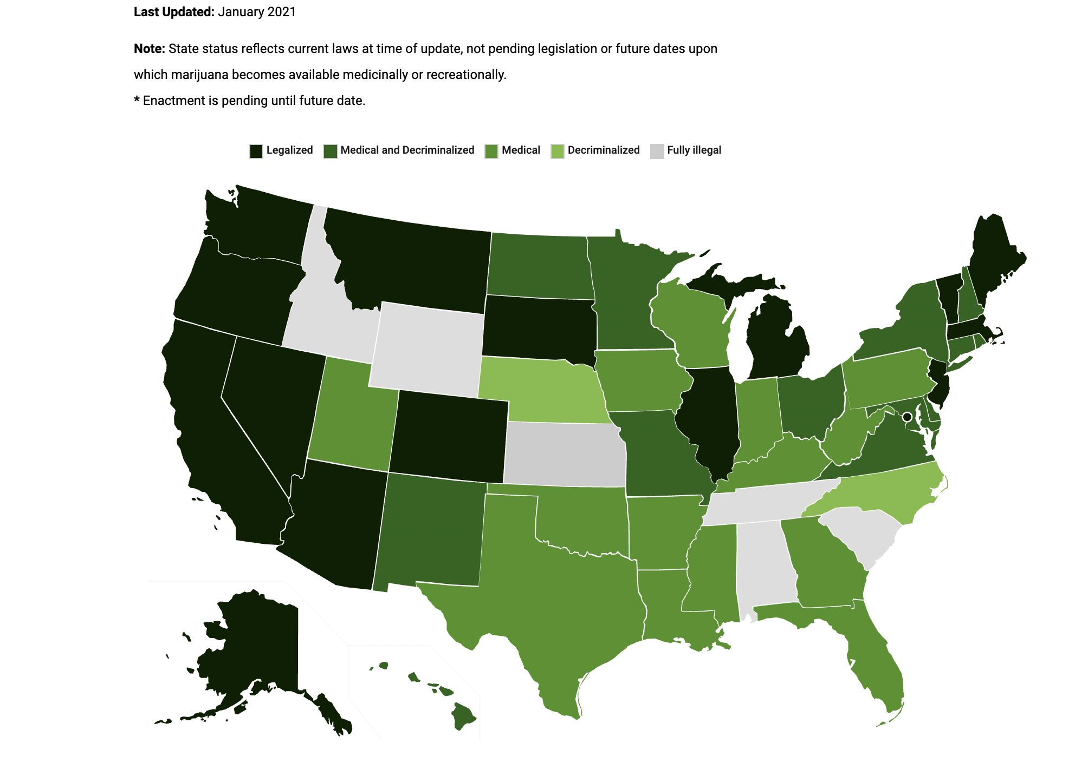

Slide 11
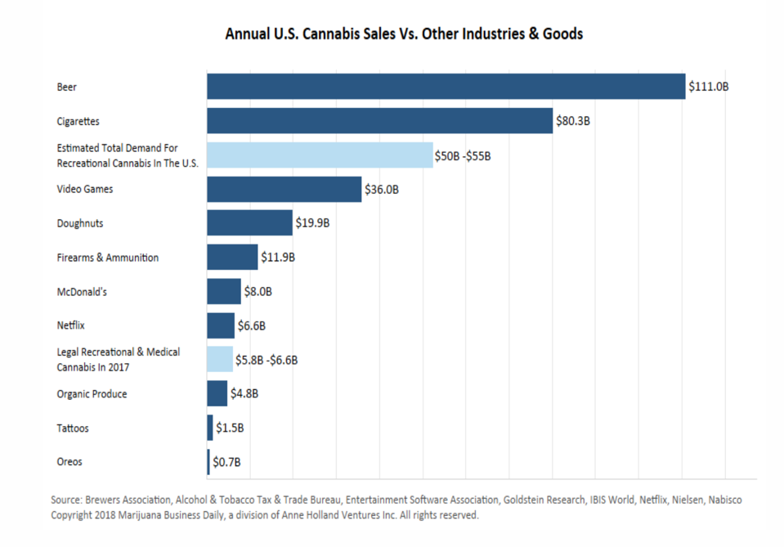

Slide 12
Motivational Interviewing (MI)/Enhancement
History with Job Corps (JOB CORPS INFORMATION NOTICE NO. 09-68) 2/24/2010
Refers to a counseling approach that recognizes and accepts the fact that people who need to make changes in their lives view counseling from different levels of readiness to change their behavior.
MI is non-judgmental, non-confrontational, and non-adversarial.
The approach attempts to increase a person’s awareness of the problems caused, consequences experienced, and risks faced as a result of the behavior in question.
The MI skill can be learned and utilized by Job Corps staff at all levels.
National Office of Job Corps is interested in integrating the concept into every aspect of the Job Corps program.

Slide 13
Early History of MI
In 1983, William R. Miller wrote about an interpersonal process in working with problem drinkers.
Then addiction counseling was confrontational and elicited denial.
MI developed as an intuitive approach to confronting denial in counseling alcoholics by using well-established principles of motivation and social psychology.
Based in Carl Rogers's client-focused counseling approaches from the 1950s.
Miller incorporated Roger's nondirective, yet person-centered principles and developed a motivation process using Prochaska and DiClemente's stages of change model.

Slide 14
Motivational Enhancement
A person-centered directive method for enhancing internal motivation for change by exploring and resolving ambivalence.
Miller & Rollnick, 1991 and 2002

Slide 15
Motivational Interviewing
is a collaborative, goal-oriented method of communication with particular attention to the language of change.
It is designed to strengthen an individual’s motivation for and movement toward a specific goal by eliciting and exploring the person’s own arguments for change.

Slide 16
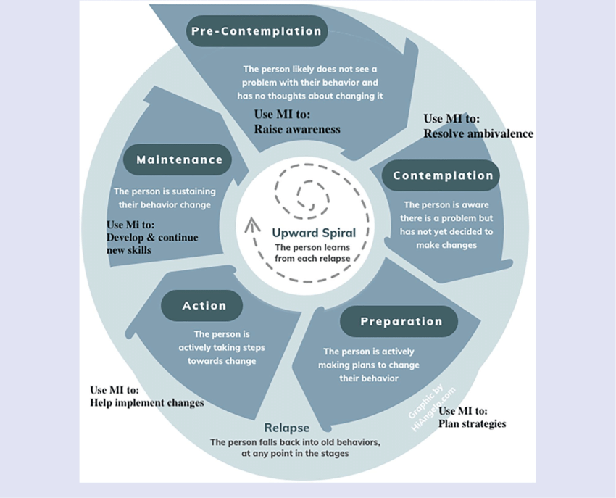

Slide 17
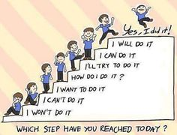

Slide 18
Principles of Motivational Interviewing (MI)
Express Empathy
Developing Discrepancy
Rolling with Resistance
Support self-efficacy

Slide 19
Gather information – OARS
Open-ended questions
Affirmations
Reflective listening
Summarizing
Next: Eliciting change talk – self-motivation
Rolling with resistance
Assess 0-10 importance/confidence
Probe higher/lower

Slide 20
Examples of MI
Four opened ended questions
Why would you want to make this change?
How might you go about it, in order to succeed?
What are the three best reasons to do it?
On a scale from 0-10, how important would you say it is for you to make this change?
Follow up: “And why are you a ____ and not a zero”
“So what do you think you’ll do?” and just listen

Slide 21
Examples that are NOT MI
Explaining (in detail) why the person should make the change
Unsolicited advice
Give at least three specific benefits that would result from making the change
Fall into the question/answer trap – student should do most of the talking
Tell the person how they could make the change
Emphasize how important it is to make the change
Persuade the person to do it
If you meet resistance, repeat the above
Focus prematurely on the solution

Slide 22
Typical Reactions to Directive/Teaching Style
Invalidated | Resist | Withdraw
Not respected | Arguing | Disengaged
Not understood | Discounting | Disliking
Not heard | Defensive | Inattentive
Angry | Oppositional | Passive
Ashamed | Denying | Avoid/leave
Uncomfortable | Delaying | Not return
Unable to change | Justifying

Slide 23
Typical Responses to Listening and Empathic Style
Affirmed | Accept | Approach
Understood | Open | Talk more
Accepted | Non-defensive | Liking
Respected | Interested | Engaged
Heard | Cooperative | Activated
Comfortable/safe | Listening | Come back
Empowered
Hopeful/Able to change

Slide 24
After Empathy comes Developing Discrepancy
problem
Positives things about making the change
Positives things about keeping things the way they are
Negative things about making the change
Negative things about keeping things the way they are
Notes:
Have audience give an example of a dilemma (drinking, med. Adherance, safe sex)

Slide 25
Interested? Next Steps…
MI requires time and practice to do well
Review of training methods in MI found that while most methods promoted motivational interviewing skills, those using an objective system of evaluation and feedback (coding and coaching) promoted broader, deeper learning with persistent effects on practitioner skills.
Studies suggest that for many practitioners, MI skill development can be developed through:
Reviewing motivational interviewing concepts either by reading or participating in a workshop
Followed by practicing motivational interviewing skills
Subsequent clinical supervision and coaching

Slide 26
Motivational Interviewing References
https://motivationalinterviewing.org/
https://www.stephenrollnick.com/
www.groupmiforteens.org

