Slide 1


Sexually Transmitted Infection Treatment Guidelines 2021
John Kulig MD MPH
Lead Medical Specialist
Humanitas/Office of Job Corps
September 14, 2021

Slide 2
Learning Objectives
After this presentation, participants will be able to:
  Implement current Job Corps requirements for STI screening
  Recognize clinical indications for STI testing
  Incorporate recent CDC modifications to STI treatment guidelines

Slide 3
Evolution in Terminology
Venereal Disease (VD) =>
  Sexually Transmitted Disease (STD) =>
    Sexually Transmitted Infection (STI) =>
      Sexually Acquired Infection (SAI)

Slide 4
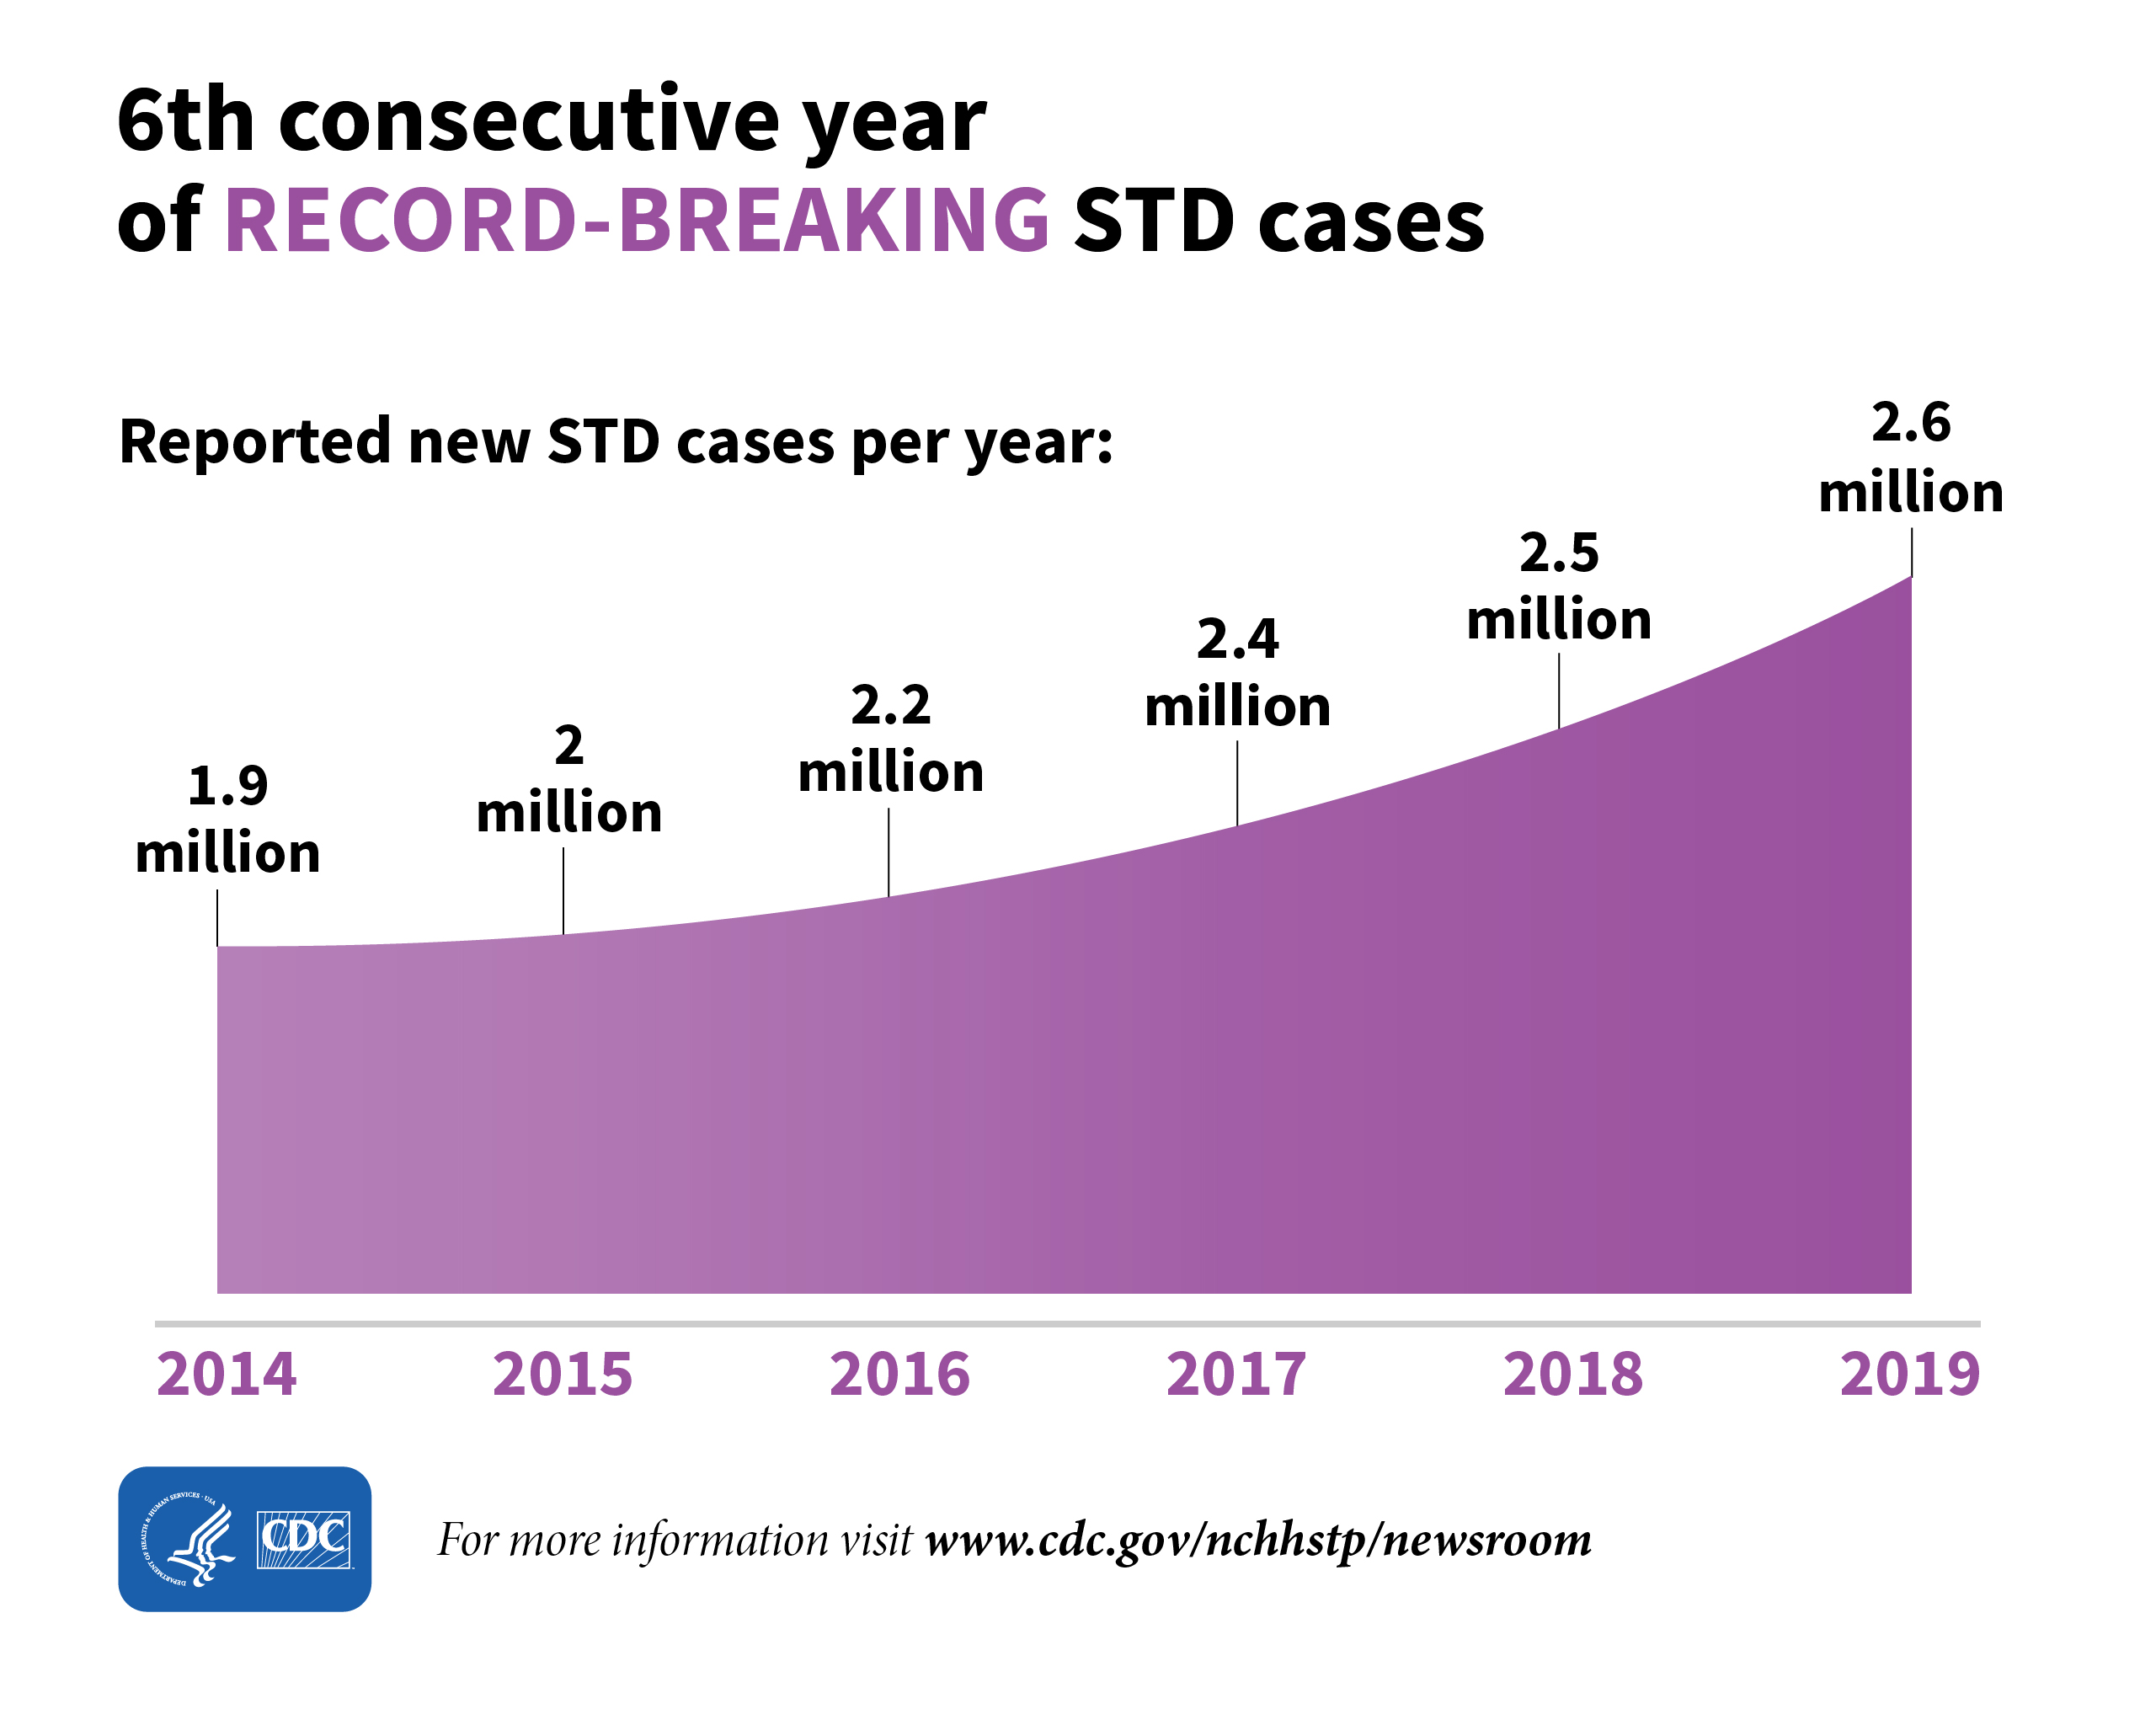

Slide 5
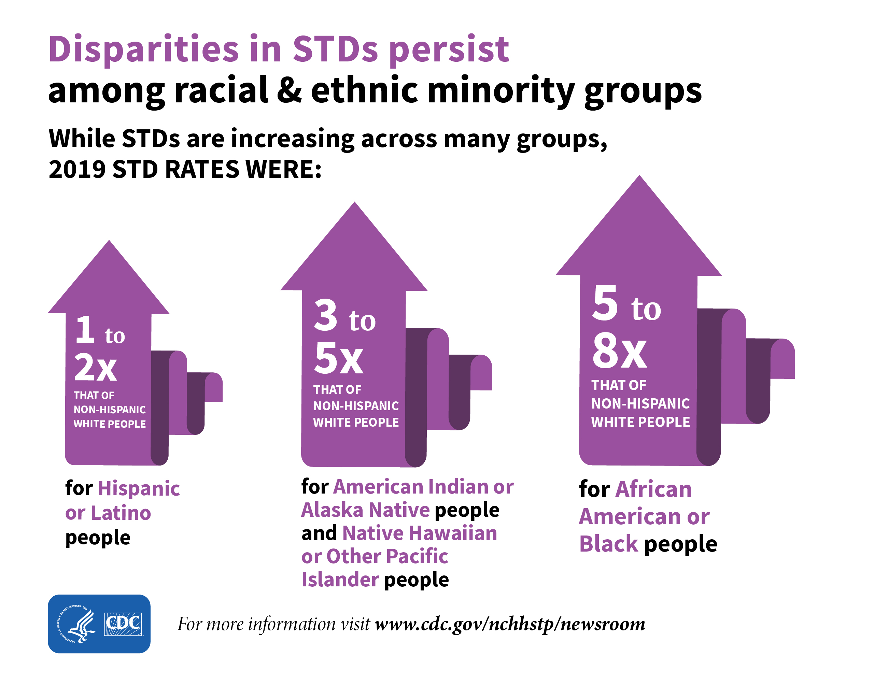

Slide 6
PRH requirements for STI screening upon entry
Females
HIV antibody
Chlamydia:
urine or vaginal swab
Gonorrhea:
urine or vaginal swab
Optional:
Syphilis serology
Males
HIV antibody
Urine dipstick
Chlamydia: urine
Gonorrhea: urine
if leukocyte esterase +
Optional:
Syphilis serology

Slide 7
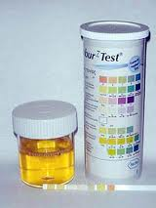
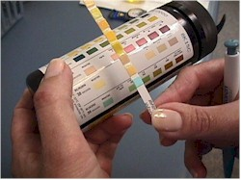
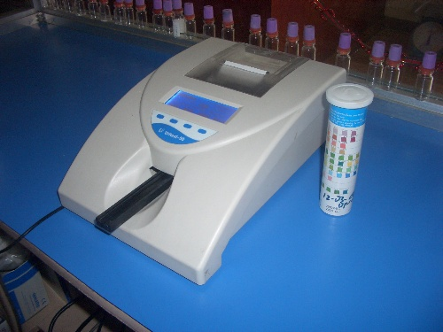
Urine dipstick testing on center

Slide 8
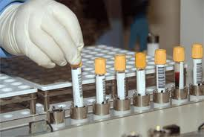
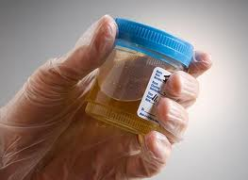
Job Corps nationally contracted laboratory:
MCI Diagnostic Center – Tulsa OK & Dallas TX

Slide 9

Health Care Guidelines
Treatment Guidelines
https://supportservices.jobcorps.gov/health/Pages/HCGuidelines.aspx

Slide 10
Diseases Characterized by Urethritis and Cervicitis
Chlamydial Infections
Gonococcal infections

Slide 11
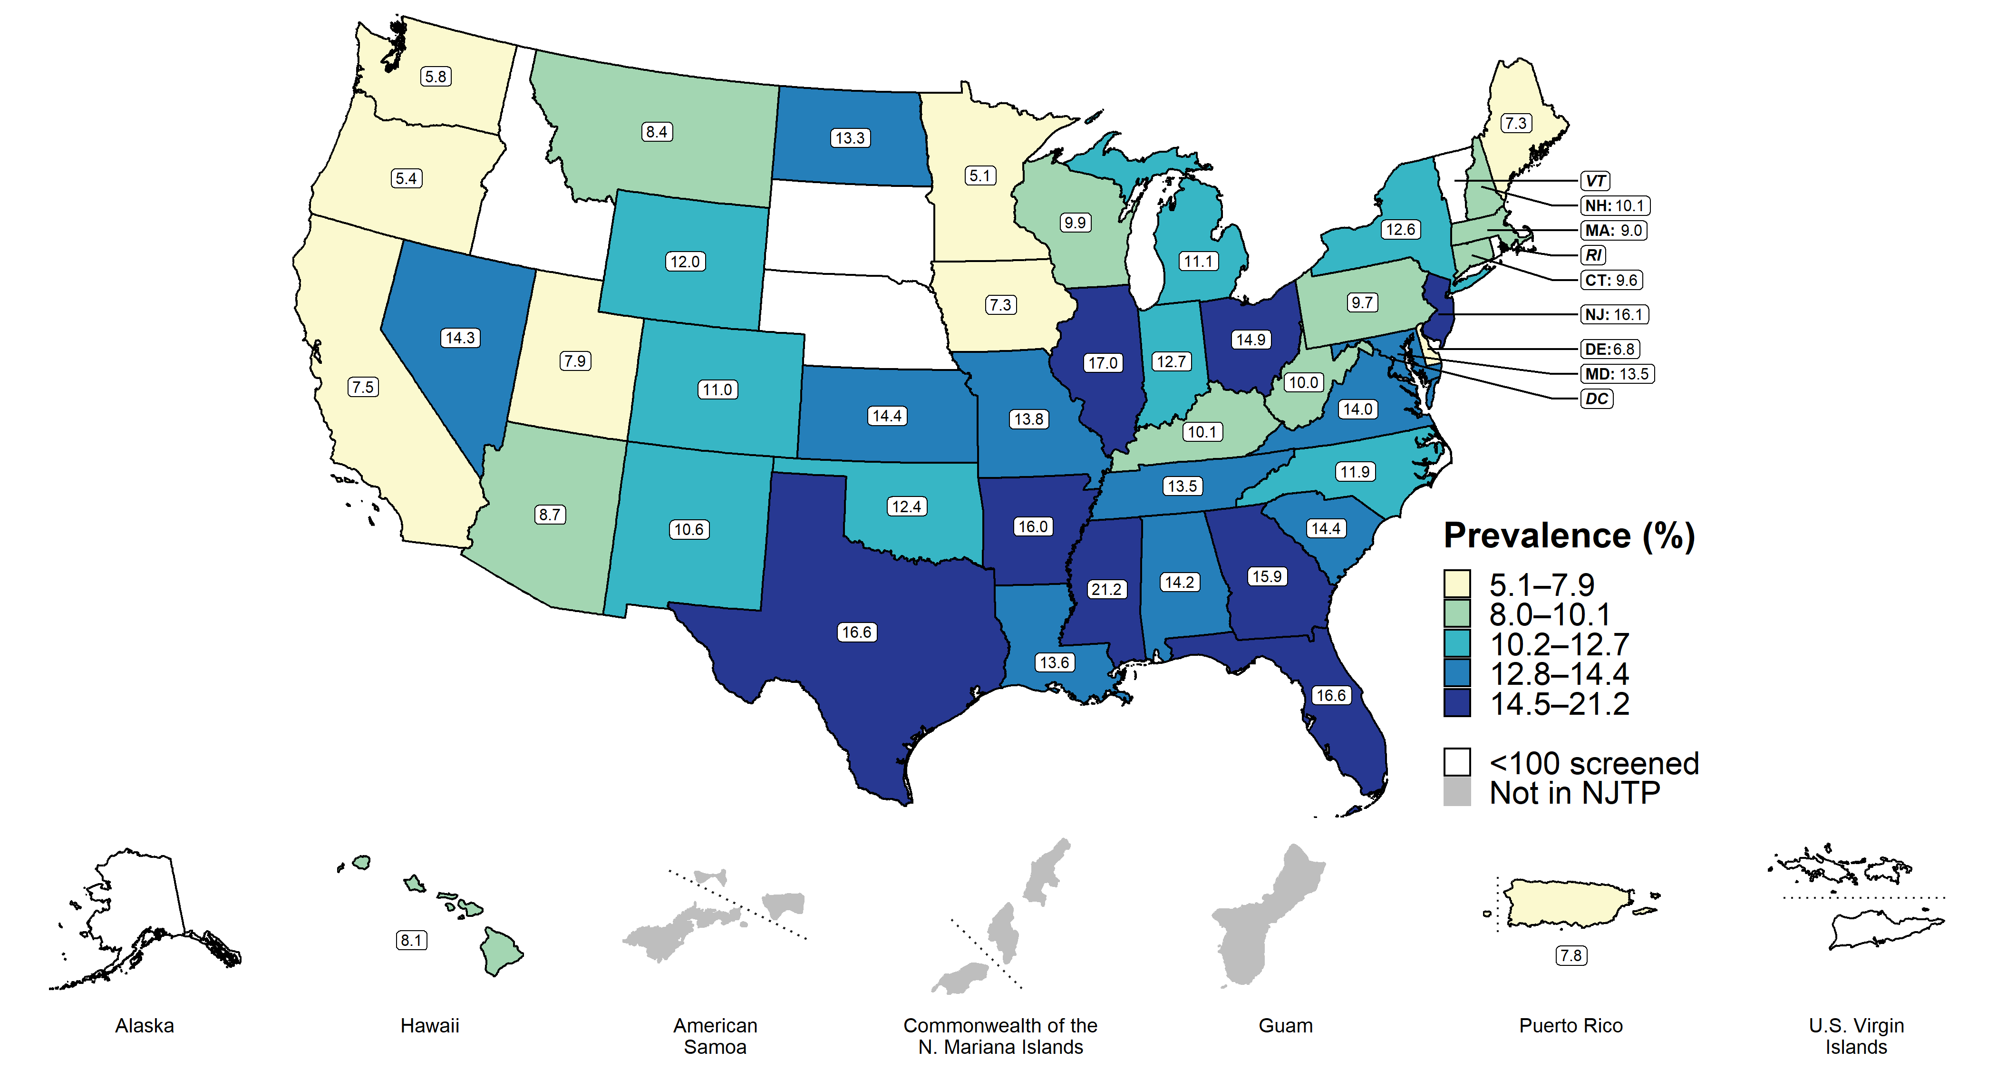
Chlamydia — Prevalence Among Females Aged 16–24 Years Entering the National Job Training Program by State of Residence, United States and Territories, 2019
* Fewer than 100 females who resided in these states/areas and entered the National Job Training Program were screened for chlamydia in 2019.
Notes:
Among females aged 16–24 years entering the National Job Training Program in 2019 in 41 states and the District of Columbia, the median state-specific chlamydia prevalence was 11.9% (range: 5.1% to 21.2%).
See Technical Notes (www.cdc.gov/std/statistics/2019/Technicalnotes) for information on the National Job Training Program methodology.
Data points are available at www.cdc.gov/std/statistics/2019/data.zip

Slide 12
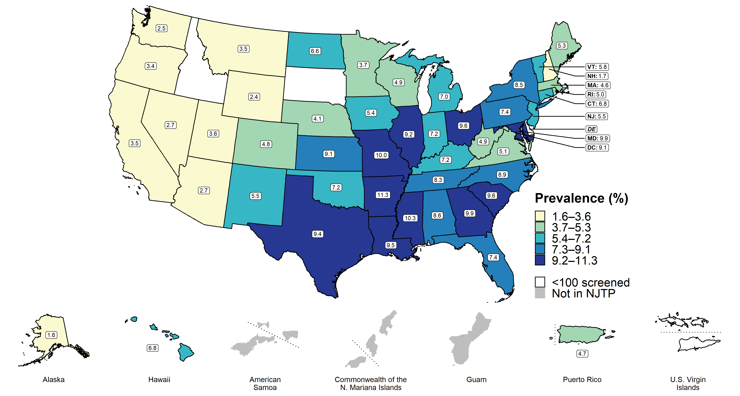
Chlamydia — Prevalence Among Males Aged 16–24 Years Entering the National Job Training Program by State of Residence, United States and Territories, 2019
* Fewer than 100 males who resided in these states/areas and entered the NJTP were screened for chlamydia in 2019.
Notes:
Among males aged 16–24 years entering the National Job Training Program in 2019 in all 50 states, the District of Columbia, and Puerto Rico, the median state-specific chlamydia prevalence was 6.6% (range: 1.6% to 11.3%).
See Technical Notes (www.cdc.gov/std/statistics/2019/Technicalnotes) for information on the National Job Training Program methodology.
Data points are available at www.cdc.gov/std/statistics/2019/data.zip

Slide 13
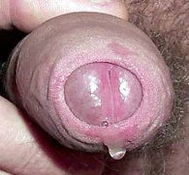
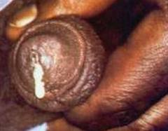
Mucoid discharge with Chlamydia
Purulent discharge with gonorrhea

Slide 14
Treatment recommendations for Chlamydia urogenital infection
Recommended regimen: administer doxycycline 100 mg po twice daily for 7 days directly observed therapy (DOT) with fluids or snack.
Alternative regimens: administer azithromycin 1 g po once as a single dose or levofloxacin 500 mg po once daily for 7 days.
If pregnant administer azithromycin 1 g po once as a single dose. Alternative regimen: amoxicillin 500 mg po three times a day for 7 days.

Slide 15
Expedited Partner Therapy (EPT)
Expedited Partner Therapy (EPT) is the clinical practice of treating the sex partners of patients diagnosed with Chlamydia by providing prescriptions or medications to the patient to take to his/her partner without the health care provider first examining the partner. http://www.cdc.gov/std/ept/
Legal status of EPT https://www.cdc.gov/std/ept/legal/default.htm
  permissible in 46 states as of April 2021
  potentially allowable in AL/KS/OK/SD/PR
  prohibited in no states

Slide 16
Notification and follow-up
Patient
Partner(s)
Health Department – state and/or local
Test-of-cure vs test for reinfection
  NAAT may remain positive for 4 weeks
  after treatment

Slide 17
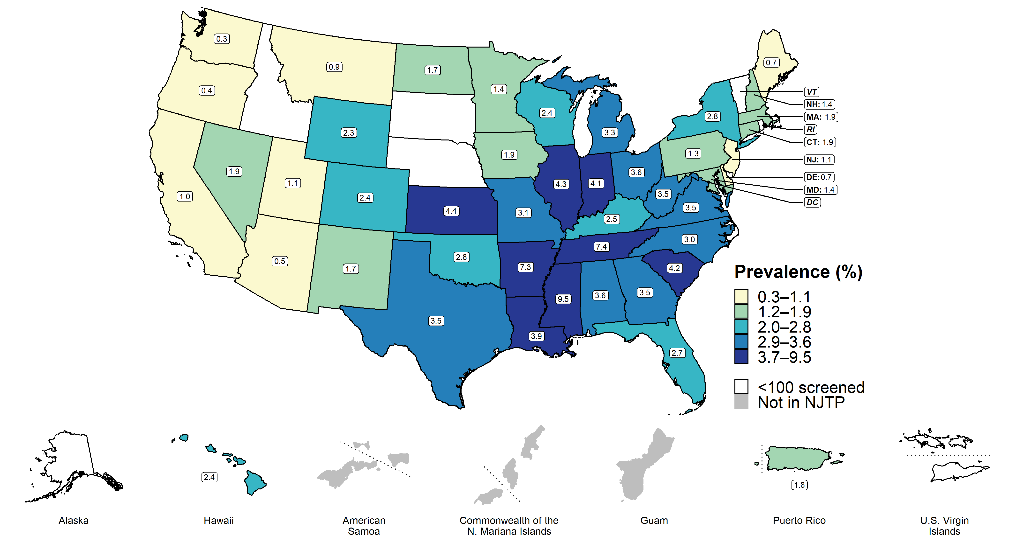
Gonorrhea — Prevalence Among Females Aged 16–24 Years Entering the National Job Training Program by State of Residence, United States and Territories, 2019
* Fewer than 100 females who resided in these states/areas and entered the National Job Training Program were screened for gonorrhea in 2019.
Notes:
Among females aged 16–24 years entering the National Job Training Program in 41 states and the District of Columbia, the median state-specific gonorrhea prevalence in 2019 was 2.4% (range: 0.3% to 9.5%).
See Technical Notes (www.cdc.gov/std/statistics/2019/Technicalnotes) for information on the National Job Training Program methodology.
Data points are available at www.cdc.gov/std/statistics/2019/data.zip

Slide 18
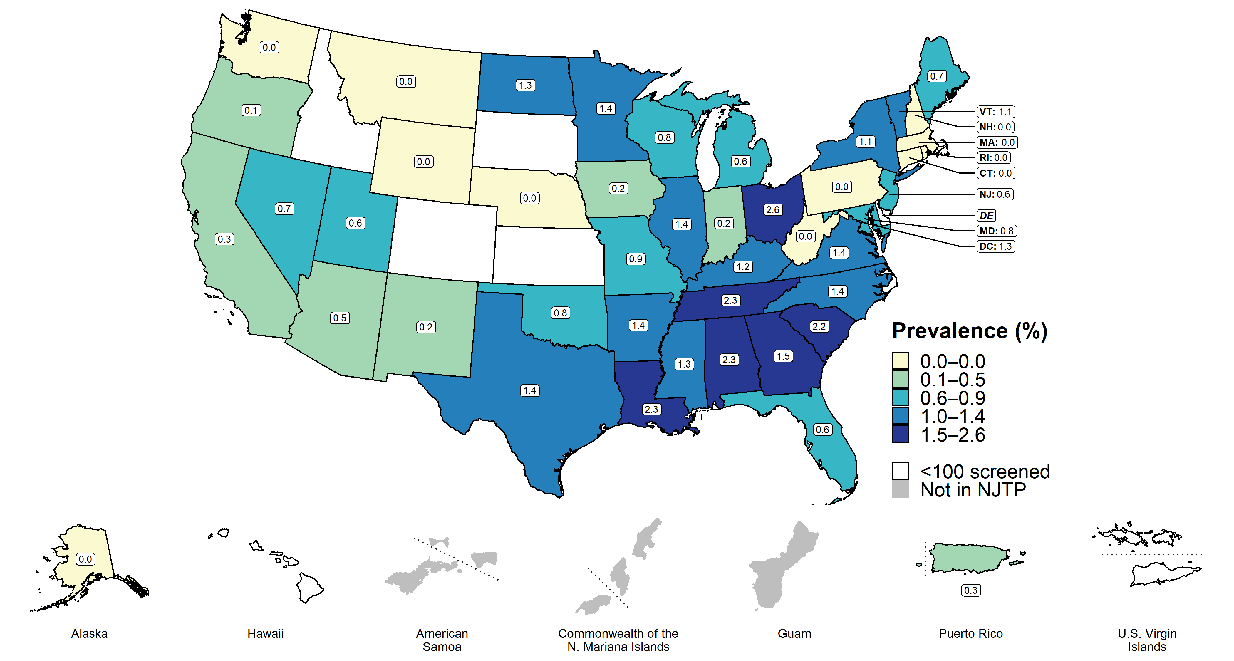
Gonorrhea — Prevalence Among Males Aged 16–24 Years Entering the National Job Training Program by State of Residence, United States and Territories, 2019
* Fewer than 100 males who resided in these states/areas and entered the National Job Training Program were screened for gonorrhea in 2019.
Notes:
Among males aged 16–24 years entering the National Job Training Program in 46 states, the District of Columbia, and Puerto Rico, the median state-specific gonorrhea prevalence in 2019 was 0.7% (range: 0.0% to 2.6%).
See Technical Notes (www.cdc.gov/std/statistics/2019/Technicalnotes) for information on the National Job Training Program methodology.
Data points are available at www.cdc.gov/std/statistics/2019/data.zip

Slide 19
Treatment of uncomplicated Neisseria gonorrhoeae infection
Administer intramuscular ceftriaxone 500 mg once for persons < 300 lb or 1 g for persons > 300 lb.
If ceftriaxone IM is not available, substitute cefixime 800 mg po once, though oral cefixime treatment has limited efficacy for pharyngeal gonorrhea.
If chlamydia infection has not been excluded, concurrent treatment with doxycycline 100 mg po bid for 7 days is recommended.
During pregnancy, azithromycin 1 g as a single dose is recommended to treat chlamydia.
If there is cephalosporin allergy, a single 240 mg intramuscular dose of gentamicin plus a single
2 g po dose of azithromycin is an option.

Slide 20
Diseases Characterized by Genital Ulcers
Syphilis
Genital herpes infection

Slide 21
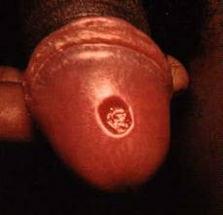
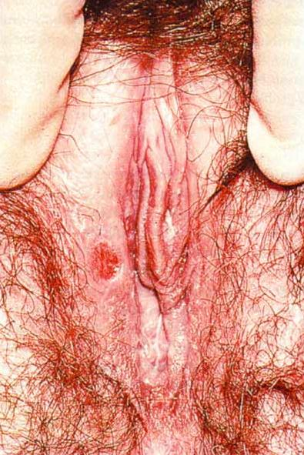
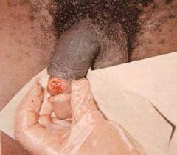
Primary syphilis

Slide 22
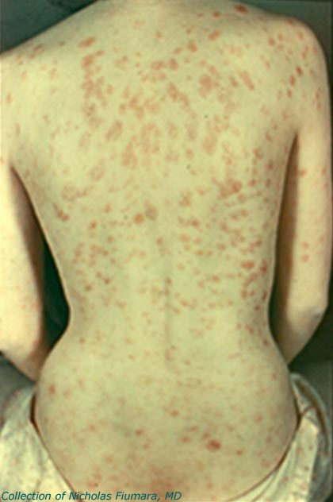
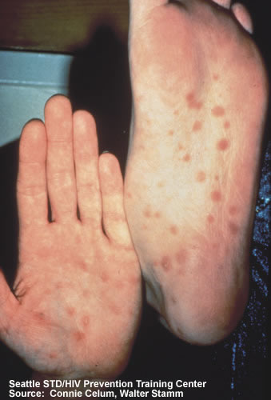
Secondary syphilis

Slide 23
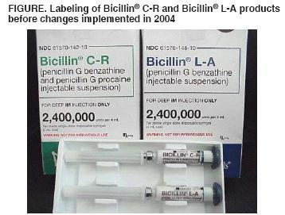
Treatment recommendations for primary and secondary syphilis
Administer benzathine penicillin G 2.4 million units IM in a single dose
NO
YES
If student is allergic to penicillin, prescribe doxycycline 100 mg po bid for 14 days.

Slide 24
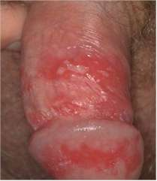
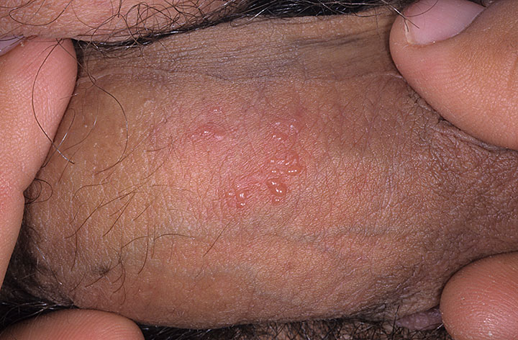
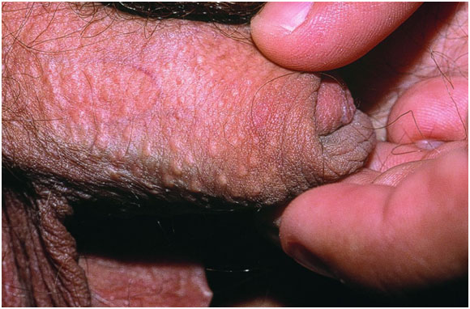
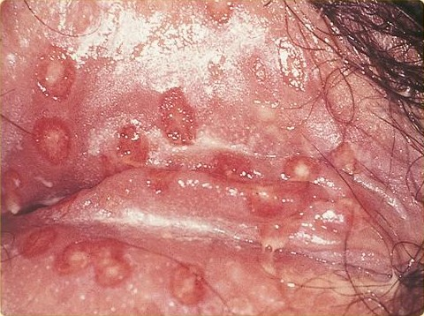
HSV
HSV
HSV
Ectopic sebaceous glands

Slide 25
Treatment recommendations for genital herpes infection
First clinical episode: administer valacyclovir 1 g po twice per day for 7-10 days or acyclovir 400 mg po three times per day for 7-10 days.
Recurrent episodes: administer valacyclovir 1 g po once per day for 5 days or acyclovir 800 mg po twice per day for 5 days, best if started within one day of onset.
Suppressive therapy to prevent recurrence (if > 6 episodes per year): administer valacyclovir 1 g po once daily or acyclovir 400 mg po twice per day. Reassess the need for continued prophylaxis by discontinuing therapy after 1 year.

Slide 26
Diseases Characterized by vulvovaginal itching, burning, irritation, odor or discharge
Bacterial vaginosis
Trichomoniasis
Vulvovaginal Candidiasis

Slide 27
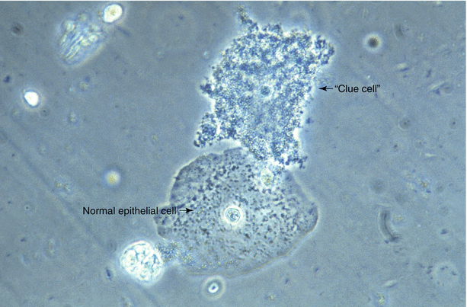
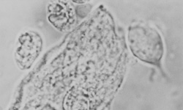
Trichomonads
Clue cells
Saline wet mount examination of vaginal discharge

Slide 28
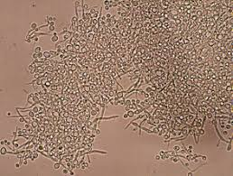
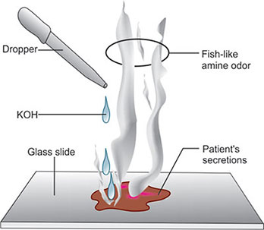
Whiff test for bacterial vaginosis
Hyphae and budding yeast
Potassium hydroxide (KOH) wet mount examination of vaginal discharge

Slide 29
Diagnostic criteria for bacterial vaginosis
3 of the following 4 symptoms or signs:
homogeneous, thin, white discharge that smoothly coats the vaginal walls
presence of clue cells on microscopic examination
pH of vaginal fluid > 4.5
a fishy odor of vaginal discharge before or after addition of 10% KOH (i.e. the whiff test)

Slide 30
Treatment recommendations for bacterial vaginosis
Administer metronidazole 500 mg orally with fluids or snack twice daily for 7 days or metronidazole gel 0.75%, one full applicator (5 g), intravaginally once daily for 5 days or clindamycin cream 2%, one full applicator (5 g), intravaginally at bedtime for 7 days.
Alternative treatments with lower efficacy: administer clindamycin 300 mg po twice daily for 7 days or clindamycin ovules 100 mg intravaginally at bedtime for 3 days.

Slide 31
Treatment recommendations for trichomoniasis
Recommended regimen for women:
Administer metronidazole 500 mg po twice daily for 7 days directly observed therapy with fluids or snack.
Recommended regimen for men: Administer metronidazole 2 g po once as single dose.
Alternative regimen for women and men: Administer tinidazole 2 g po once as a single dose.
Pregnant students who are symptomatic may be treated with metronidazole 2 g in a single oral dose. Metronidazole use during pregnancy is not associated with teratogenic or mutagenic effects in infants. Tinidazole should not be used during pregnancy or breastfeeding.

Slide 32
Treatment recommendations for Candida vulvovagintiis
Administer fluconazole 150 mg po once as a single dose directly observed therapy with fluids or snack. WARNING: Fluconazole is not recommended for use during pregnancy.
An alternative treatment is intravaginal and external topical treatment with an antifungal cream such as butoconazole 2%, clotrimazole 1%, miconazole 2%, or terconazole 0.8% once daily for the duration specified by the manufacturer. May be used during pregnancy.

Slide 33
Diseases Characterized by Human Papillomavirus Infections
External genital warts

Slide 34
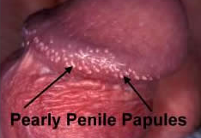
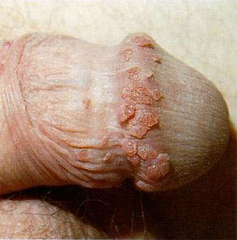
Genital warts

Slide 35
Treatment recommendations for external genital warts
Student-administered imiquimod 5% cream (Aldara) applied once daily at bedtime three
times per week for up to 16 weeks.
Instruct student to wash treated areas with soap and water 6-10 hours after treatment or
next morning.
Alternative treatments include provider-administered:
  Trichloroacetic acid (TCA) 80%-90%, repeated weekly as necessary
  Cryotherapy
  Surgical excision/curettage/laser

Slide 36
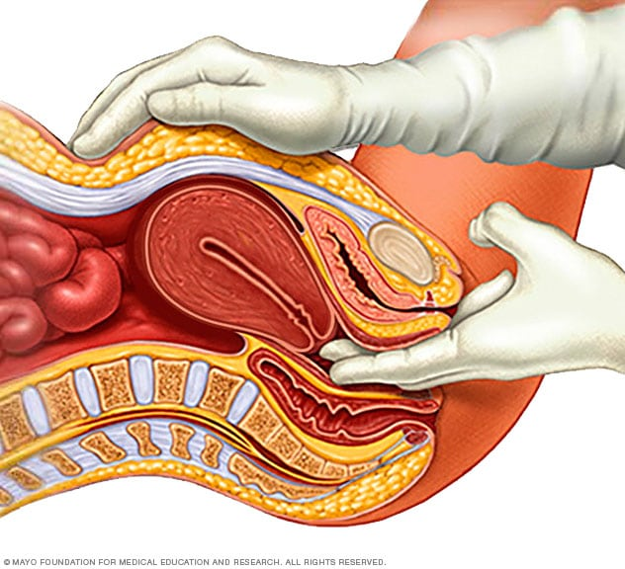
Pelvic inflammatory disease
One or more of the following three minimum clinical criteria
are present on pelvic examination:
Cervical motion tenderness
Uterine tenderness
Adnexal tenderness
Additional criteria:
Oral temperature >38.3°C (>101°F)
• Abnormal cervical mucopurulent discharge or cervical
friability
• Presence of abundant numbers of WBCs on saline
microscopy of vaginal fluid
• Elevated erythrocyte sedimentation rate
• Elevated C-reactive protein
• Laboratory documentation of cervical infection with
N. gonorrhoeae or C. trachomatis

Slide 37
Treatment recommendations for pelvic inflammatory disease
Administer one of following combined intramuscular and oral options:
ceftriaxone 500 mg IM* in a single dose plus doxycycline** 100 mg po twice daily for 14 days with metronidazole 500 mg po twice daily for 14 days OR
cefoxitin 2 g IM in a single dose and probenecid 1 g po concurrently in a single dose plus doxycycline** 100 mg po twice daily for 14 days with metronidazole 500 mg po twice daily for 14 days
    * ceftriaxone 1 g IM for persons weighing > 150 kg
    ** doxycycline is contraindicated in pregnancy

Slide 38
Diseases Characterized by Ectoparasitic Infections
Pediculosis pubis
Scabies

Slide 39

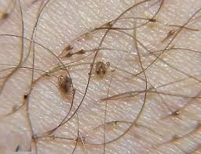
Pediculosis pubis

Slide 40
Treatment recommendations for pubic lice
Pharmacologic regimens include:
Permethrin 1% creme rinse (Nix) applied topically to infested area until entirely wet, then thoroughly washed off after 10 minutes.
OR
Pyrethrins with piperonyl butoxide (Rid) applied topically to infested area until entirely wet, then thoroughly washed off after 10 minutes.
Alternative regimen: Ivermectin 250 µg/kg po once with food, repeated in 7-14 days.
Petrolatum ointment (Vaseline) applied topically twice daily for 10 days for infestation of the eyelashes.
Oral antihistamines (diphenhydramine/Benadryl or hydroxyzine/ Atarax, Vistaril) can be given to reduce itching.

Slide 41
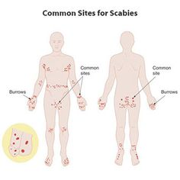
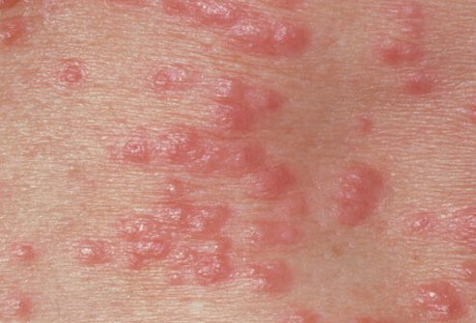
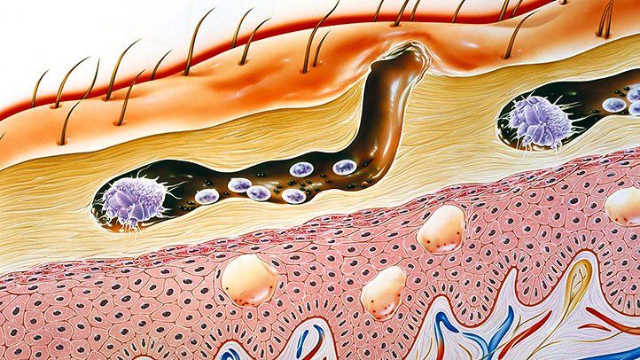
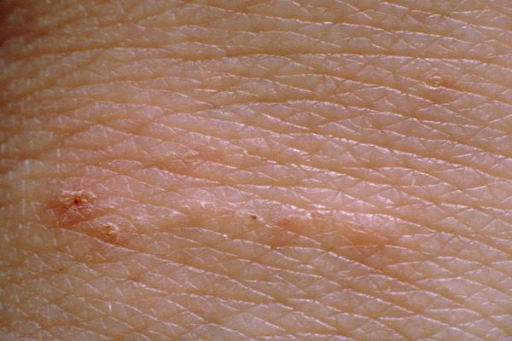
Scabies

Slide 42
Treatment recommendations for scabies
Pharmacologic regimens include:
Permethrin 5% cream (Elimite) applied topically in a thin layer to the entire body from the neck down and washed off after 8-14 hours.
OR
Ivermectin 200 µg/kg po once with food, repeated in 14 days.
Oral antihistamines (diphenhydramine/Benadryl or hydroxyzine/ Atarax, Vistaril) can be given to reduce itching. Cool baths (Aveeno) and topical 1% hydrocortisone cream topically may also relieve itching.
Topical or systemic antibiotic therapy is indicated ONLY for secondary bacterial infection of excoriated lesions.

Slide 43
Sexual transmission of hepatitis
hepatitis A via fecal-oral transmission – vaccine preventable
hepatitis B via unprotected sex and injection drug use – vaccine preventable
hepatitis C via injection drug use and unprotected sex (10%) – not currently vaccine preventable

Slide 44
STI prevention approaches
education and counseling of persons at risk on ways to avoid STIs through changes in sexual behaviors and use of recommended prevention services
identification of asymptomatically infected persons and of symptomatic persons unlikely to seek diagnostic and treatment services
effective diagnosis, treatment, and counseling of infected persons
evaluation, treatment, and counseling of sex partners of persons who are infected with an STI
pre-exposure vaccination of persons at risk for vaccine-preventable STIs – HPV, HAV, HBV

Slide 45
STI prevention counseling: The Five Ps
Partners – gender and number
Prevention of pregnancy
Protection from STIs
Practices – vaginal, oral, anal sex – condom use – injection drug use – sex for money or sex for drugs
Past history of STIs – patient and partner(s)

Slide 46
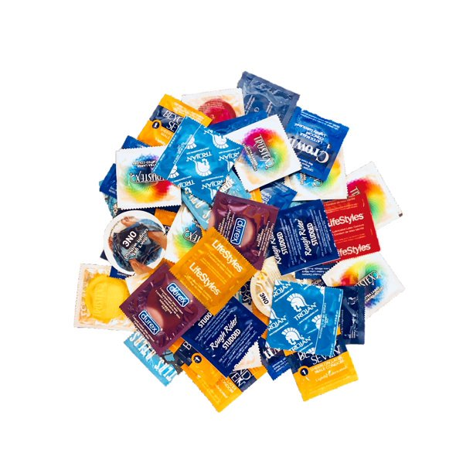

Slide 47

Questions?

