Slide 1
TEAP Documentation
Diane A. Tennies, PhD, LADC
LEAD TEAP Health Specialist
October 2021

Slide 2
Learning Objectives
Participants will:
1.) Understand the ethics of proper documentation and identify the PRH associated with this requirement.
2.) Articulate 2 ways the Desk Reference Guide (DRG) provides guidance for documentation.
3.) Identify 3 ways that standardizing documentation requirements improves documentation and contributes to best practices.

Slide 3
ETHICS: NAADAC Principle II–2 - Documentation
Addiction Professionals shall create and maintain appropriate documentation. Providers shall ensure that records and documentation kept in any medium (i.e., cloud, laptop, flash drive, external hard drive, tablet, computer, paper, etc.) are secure and in compliance with HIPAA and 42 CFR Part 2, and that only authorized persons have access to them. Providers shall disclose to client within informed consent how records shall be stored, maintained, and disposed of, and shall include time frames for maintaining active file, storage, and disposal.
How Translates to Job Corps: 1.) You must document your clinical interactions (NOT prevention and education activities – maintain binders with sign-in sheets instead).
2.) Maintain security of documentation within the HWC.
What does this mean? In SHR; double locked cabinet; NOT IN CIS or in your desk or computer.
3.) What do you tell students about records maintenance and later access?

Slide 4
What about the PRH?
Documentation is NOT mentioned in R3 under TEAP at all!
In R4 for TUPP: “All services provided should be documented in the student health record.”
Do we need direction from the PRH?
This is an ethical requirement for the profession.
But is there direction in the PRH?
YES

Slide 5
PRH Chapter 2.3?
R13. Professional Standards of Care
All center health staff and providers must follow accepted professional standards of care and are subject to prevailing state laws, including but not limited to:
Maintaining a copy of current provider’s license, Drug Enforcement Agency (DEA)
registration, and proof of liability insurance, if applicable, in center health facility.
Documenting all prescribed medications and treatment in student health record.
Documenting all laboratory procedures ordered and recording the results in student health record.
Following current standards of care when providing health services and treating illnesses and injuries.

Slide 6
New and Improved as of October 2021!

Slide 7
What does the DRG say about Documentation?
All services provided shall be documented in the SHR.
See PRH 2.3, R13 for more specific information.
There are established clinical standards that should be met that include, using pen for entries and then dating and signing each entry with your name and credentials.
Centers frequently have a separate section in the SHR, for TEAP entries. If this is the case, then there should also be a brief note in the chronological section of the SHR indicating there is a TEAP note with date.
The use of stamps or labels is encouraged as a time-saving measure.

Slide 8
More from the DRG
Professional Standards of Care—PRH 2.3, R13 The medical practice standards for Job Corps HWCs are comparable to those for other health facilities found in communities nationwide.
All health and wellness staff in the Job Corps setting should follow accepted professional standards of care and are subject to state laws.
Documentation of current credentials, licenses, and liability insurance (if applicable) for all health care providers must be available for review in the HWC.

Slide 9
More from the DRG: Disability Program—PRH 2.4
Because it is a federally funded training program, Job Corps is required to ensure its program and facilities are accessible and provide reasonable accommodation to individuals with disabilities to prevent discrimination on the basis of disability.
There are times when the TEAP Specialist collaborates with the Disability Coordinator(s) to assist students with alcohol- and drug-related disabilities.
See the Job Corps websites for additional guidance

Slide 10
Other Documentation Requirements from the DRG
TEAP Specialists must review and sign the SIF within one week of the student’s arrival at Job Corps. These forms are filed in the SHR. Meetings with students, your assessment results, and their decision about involvement in the TEAP should be documented in the TEAP section of the SHR
Staff Training Requirements for Alcohol Testing Health and Wellness staff is responsible for training designated center staff, including documentation procedures. This training should be provided based on manufacturer-supplied materials.
Quarterly Alcohol Testing Reporting Procedures Centers must submit a quarterly report on center alcohol testing (PRH 5.1, R4). This report must be submitted by the tenth day following the end of each quarter (i.e., January 10, April 10, July 10, and October 10). The Alcohol Screening Report is available on the Data Submission webpage.

Slide 11
Documentation Review
Why document?
Important for other health staff to know what happening
PRH requires that students receive intervention services
Required by ethics code and Federal Laws
Needs to ”tell the story”
Where do you document?
SHR – TEAP section and make a note in chronological section
What are the elements to documentation?
Date/signature/credential (can use initials if key available in each SHR)
Content of session (if group note this can be templated)
Individual student response and the plan

Slide 12
Documentation Dilemmas: Actual Situations
You have limited hours on center and no clerical support. You barely have time to meet with students and complete other responsibilities. You don’t have any documentation time.
What are some options?
Since you have limited time for filing, you keep the TEAP records in your desk until the student graduates from the intervention phase and then you file it which saves time.
Are there concerns with this approach?
The easiest and fastest way to do your group notes is to do one note for everyone and use initials for group members.
What are the concerns with this approach?

Slide 13
DOCUMENTATION EXAMPLES

Slide 14
Five Required Elements
Content of interaction
Student’s response
Plan
Date
Signature with credentials

Slide 15
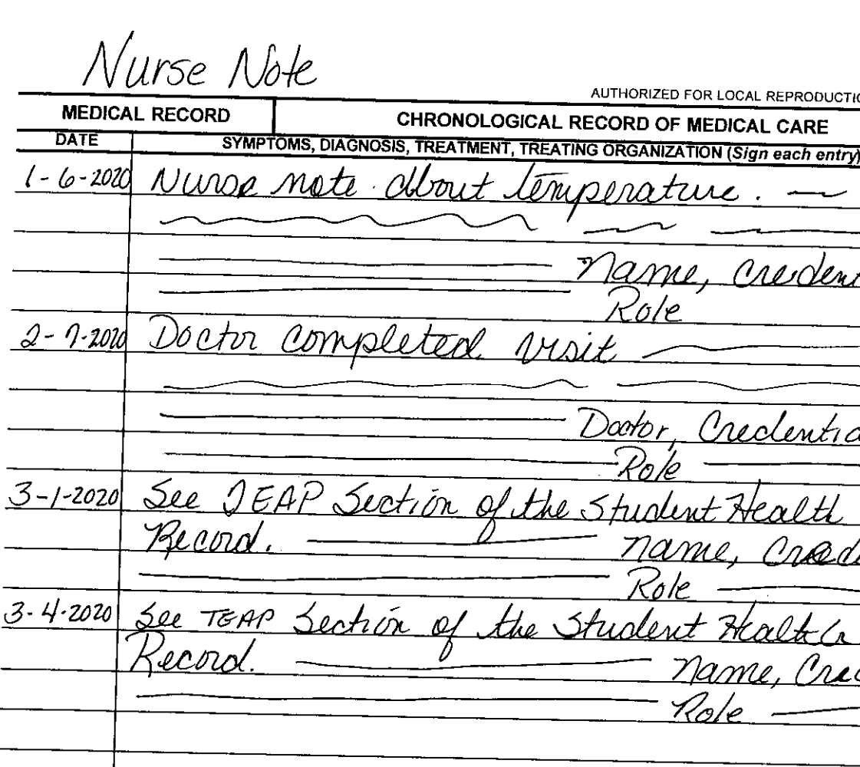
Example for
Chronological

Slide 16
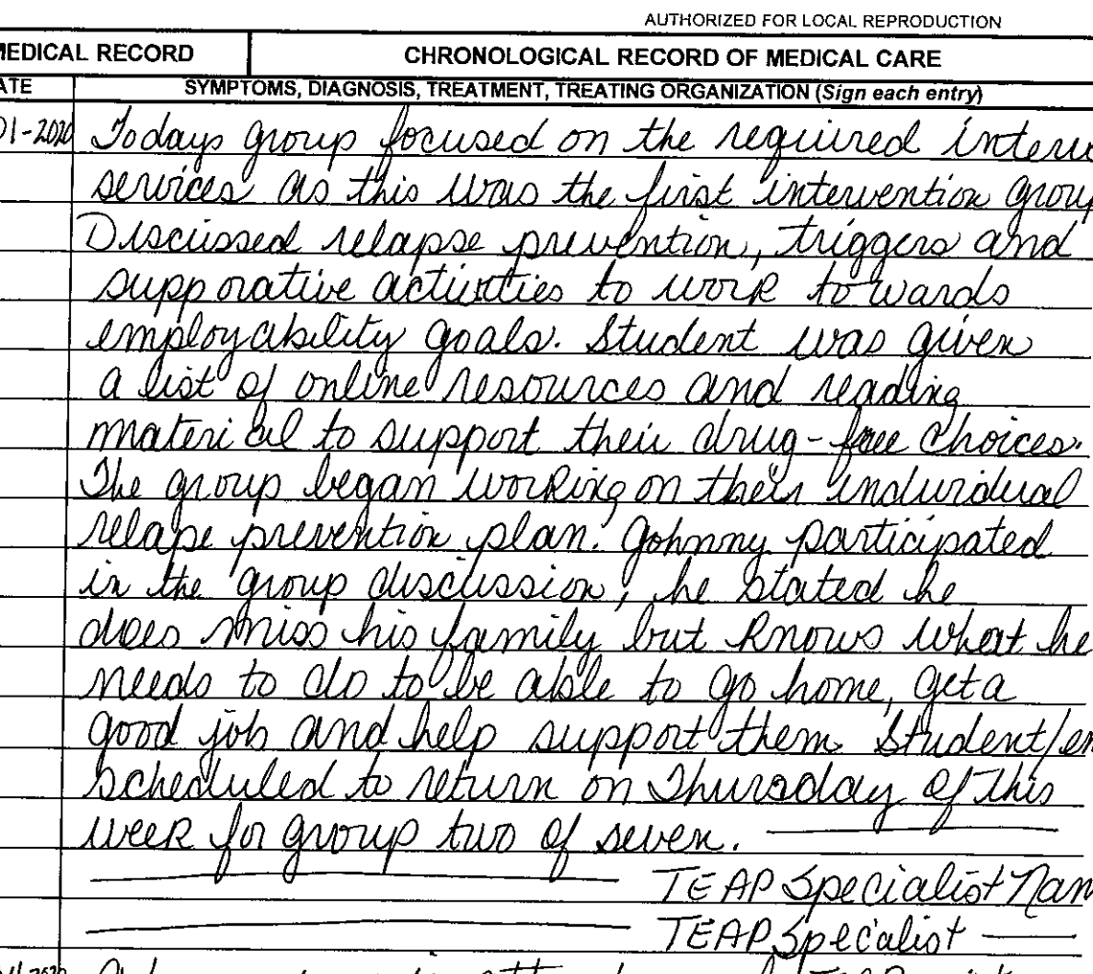
Group Note
Version 1:

Slide 17
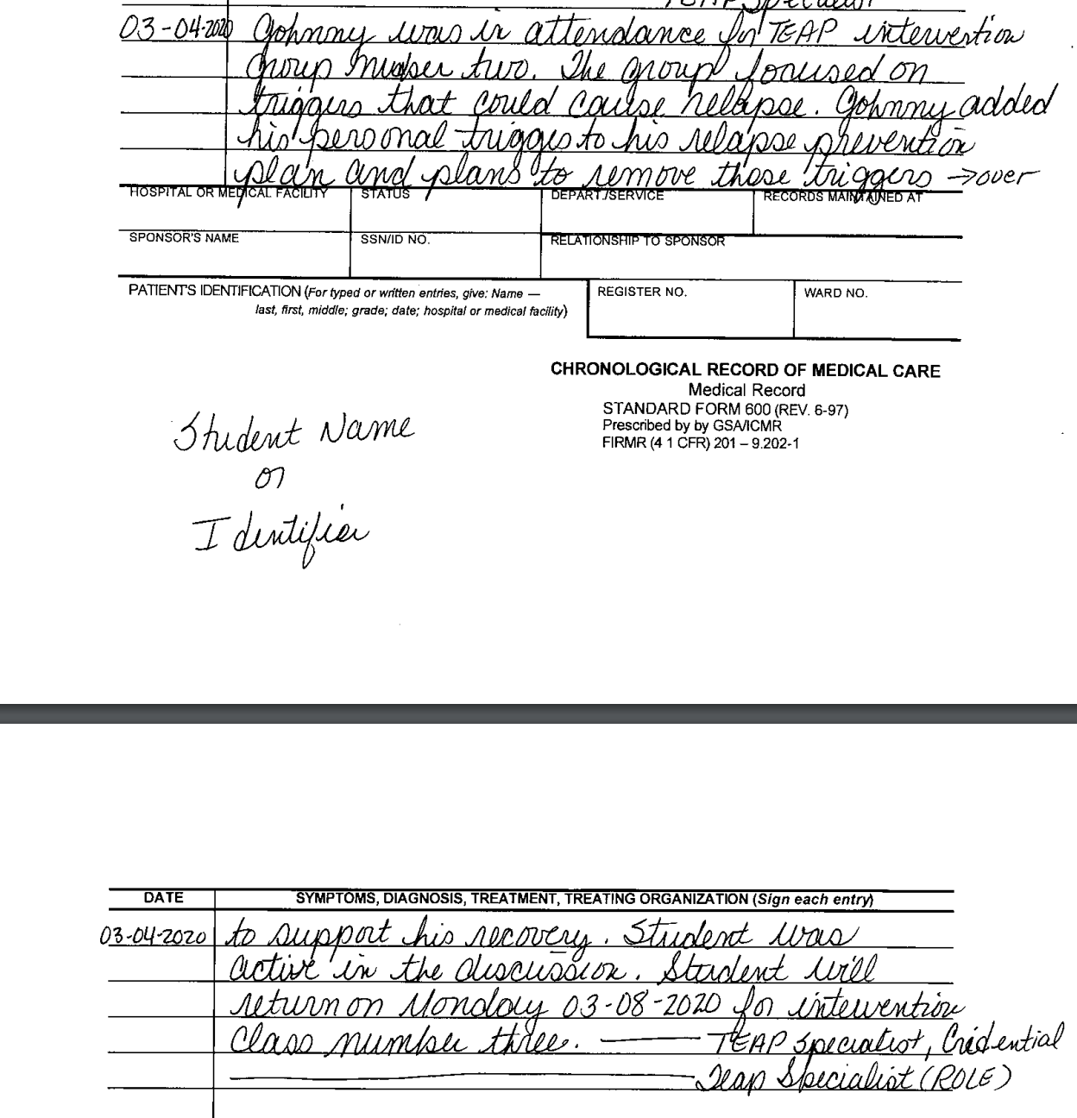
Group Note
Version 2:

Slide 18
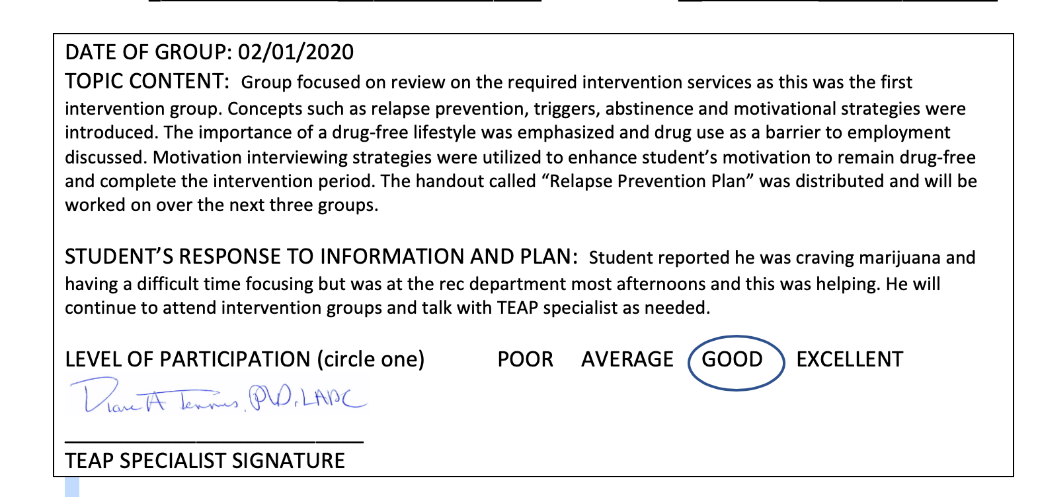
Group Note Version 3:

Slide 19
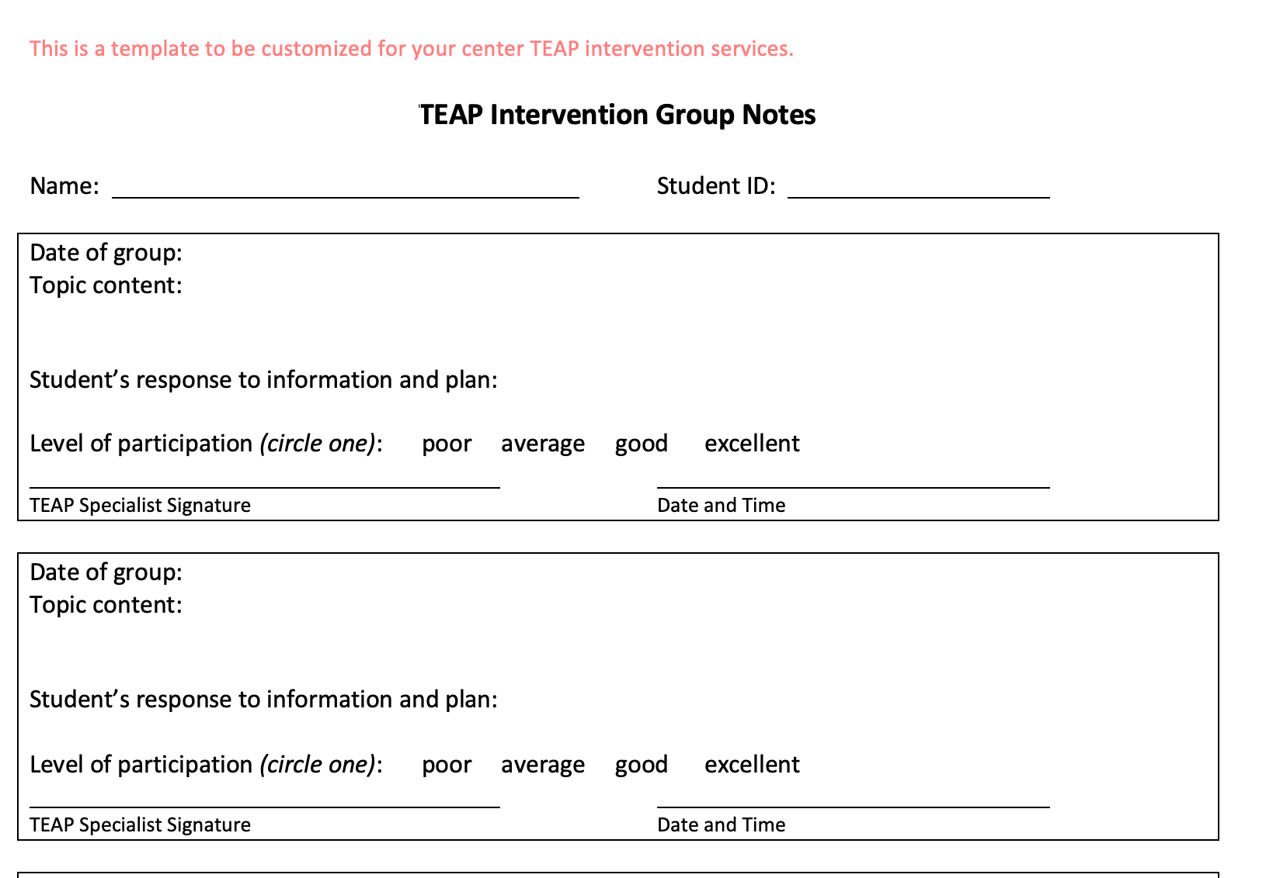

Slide 20
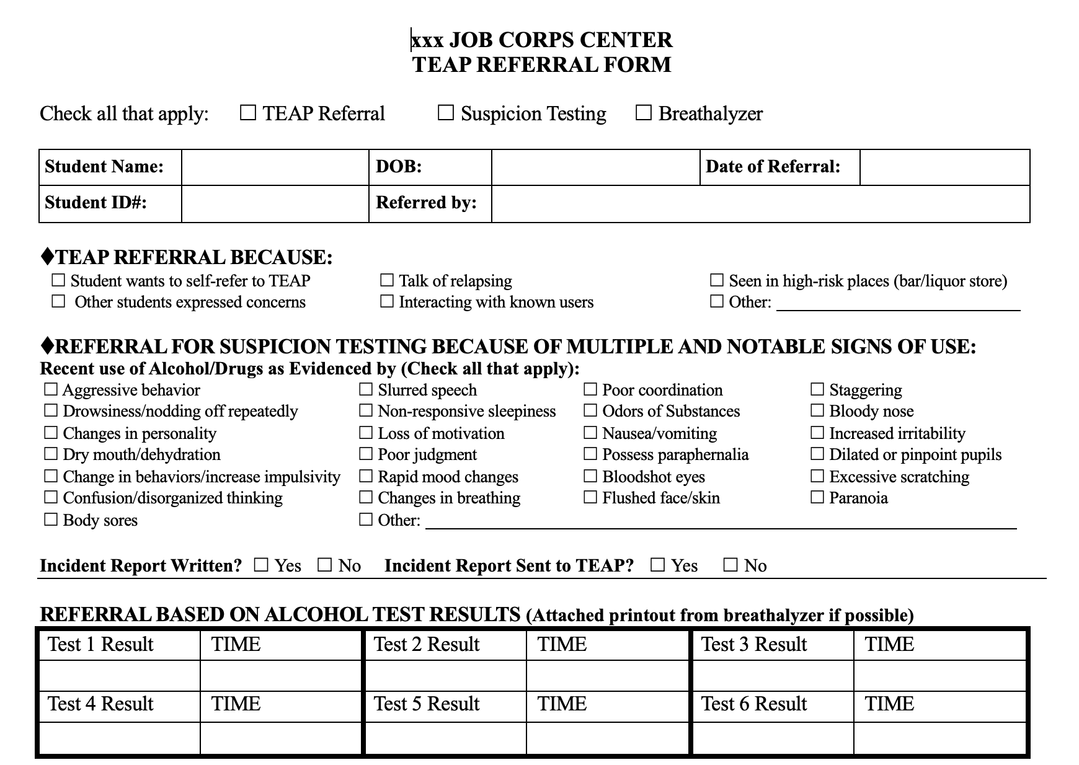

Slide 21
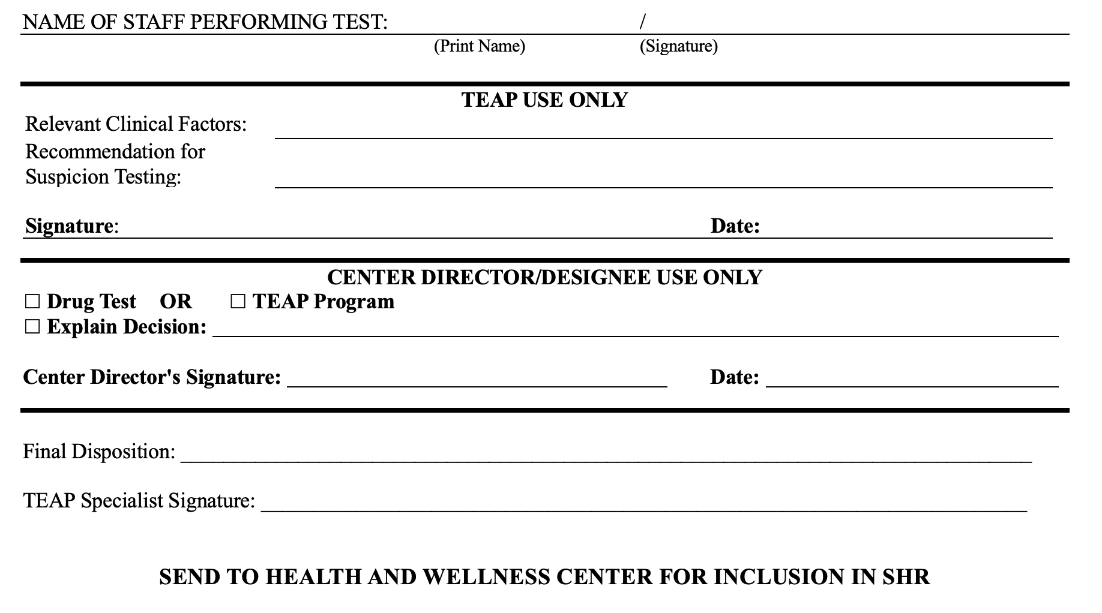

Slide 22
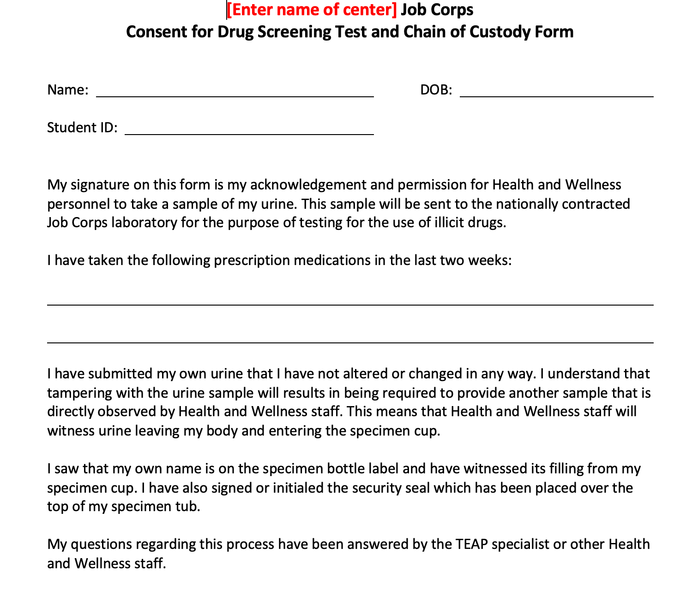

Slide 23
Why Standardize Documentation?
More efficient
More in-depth or thorough documentation
Easier to read for other HWC staff and reviewers
Higher quality services

Slide 24
Specialized Topic: MSWR
Students may be given a MSWR for a diagnosed substance use condition, allowing the student to return to Job Corps to complete their training within 180 days. To return to Job Corps, proof of treatment completion from a qualified provider must be received.
A MSWR for substance use conditions can only be given if the following conditions are met:
The TEAP specialist and center director agree.
There is a documented assessment of the student’s diagnosed substance use condition by the TEAP specialist in collaboration with the center mental health consultant.
A MSWR cannot be granted in lieu of ZT separation when a positive 45-day intervention period follow-up test is reported.
If a student is placed on a MSWR during the 45-day intervention period, the intervention period is suspended and resumes the day the student is scheduled to return to the center.

Slide 25
Specialized Topic: Documentation For Virtual Enrollment

Slide 26
Considerations
Documentation is still a requirement – even when services are provided via distance learning.
Confidentiality Issues:
How are your notes secured if you are working from home.
Do the notes remain with you or do you send them (via JC email) to center.
Who is listening when you are online with students?

Slide 27
The Five Elements are Still Required
Content of interaction
Student’s response
Plan
Date
Signature with credentials

Slide 28
Disclosure Statement Example
Entry into TEAP section of SHR:
On date, 2020 at AM/PM student gave verbal consent to services for through ongoing video conferencing modality. This modality is being used during the COVID-19 (Coronavirus) pandemic.
Student was informed of the inherent limits of confidentiality when using technology. Student was contacted via phone number, (xxx-xxx-xxxx)
During video conferencing session, the following individuals present were also present with the student:
Signed: TEAP Specialist
Date: xxxxxxx

Slide 29
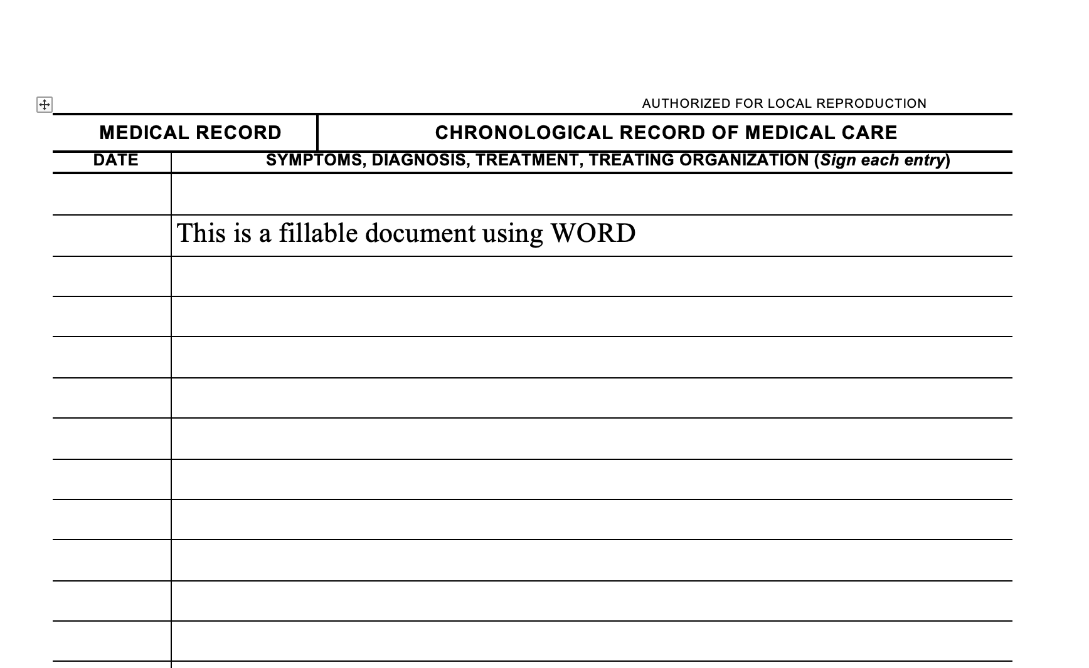

Slide 30
Learning Objectives - Revisited
Understand
1.) The ethics of proper documentation and identify the PRH associated with this requirement.
NAADAC Principle II–2 – Documentation and Chapter 2.3 R13
Articulate
2.) Two ways the Desk Reference Guide (DRG) provides guidance for documentation.
SHR and chronological.
Reminder of the various documentation requirements including SIF, AFR and credential maintenance.
Identify
3.) Three ways that standardizing documentation requirements improves documentation and contributes to best practices.
Better quality of services because: more efficient; more in-depth; and easier to read.

Slide 31
Questions?
Contact your Regional TEAP Specialist
Diane A. Tennies, PhD, LADC
Boston, Philadelphia, and San Francisco Regions
datphd@aol.com
Christy Hicks, LCADC, CSW
Atlanta, Dallas, and Chicago Regions
Christy.hicksmsw@gmail.com

