Slide 1
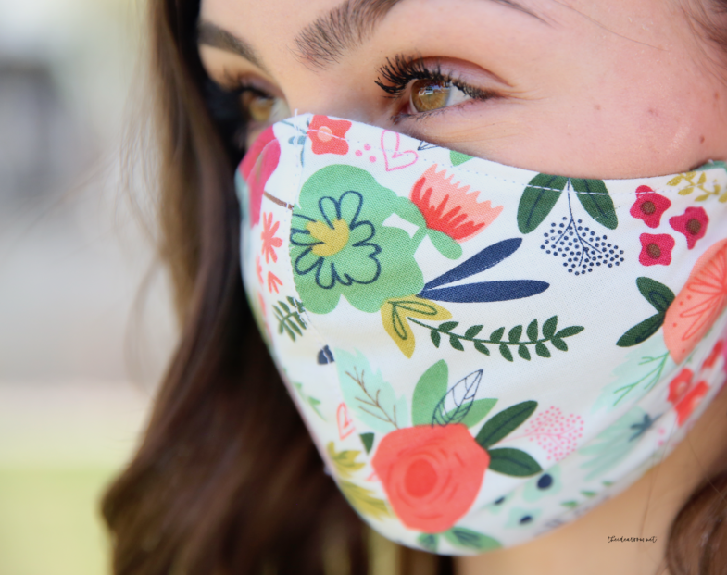
Wear the Darn Mask: Changing COVID Behavior
Helena Mackenzie, PhD
Julie Klinger-Luht, MPH
This Photo by Unknown Author is licensed under CC BY-NC-ND

Slide 2
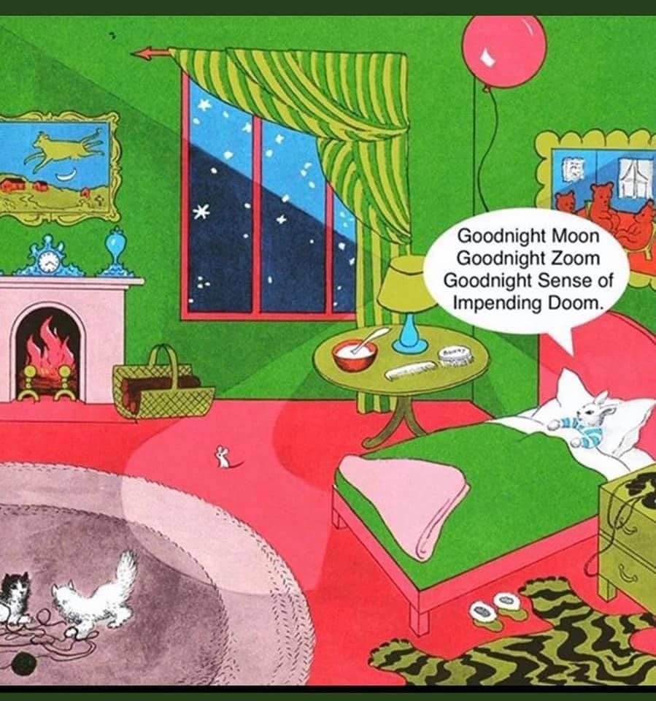
Describe why some people are resistant to protective measures.
Explain communication strategies to use to confront unsafe behavior.

Slide 3
This Photo by Unknown Author is licensed under CC BY

Slide 4
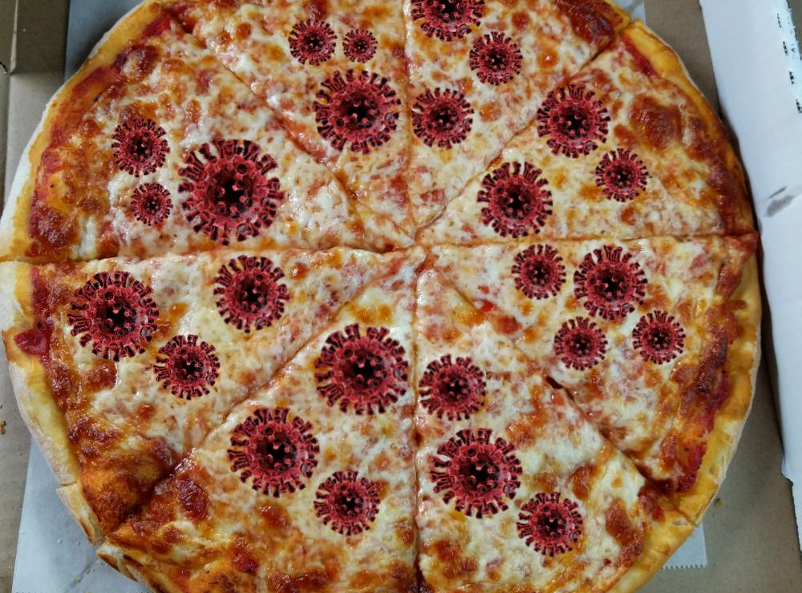

Slide 5
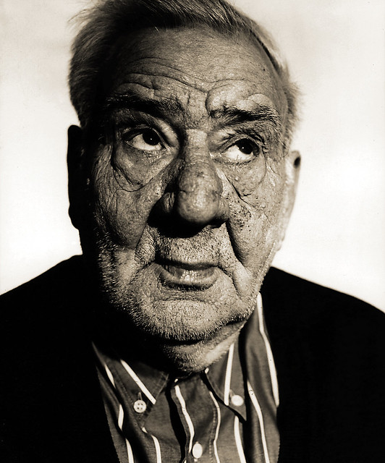
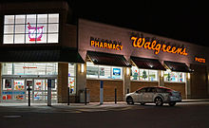
This Photo by Unknown Author is licensed under CC BY-SA-NC
This Photo by Unknown Author is licensed under CC BY-SA

Slide 6
Share an uncomfortable situation… If you’re comfortable
This Photo by Unknown Author is licensed under CC BY-NC-ND

Slide 7
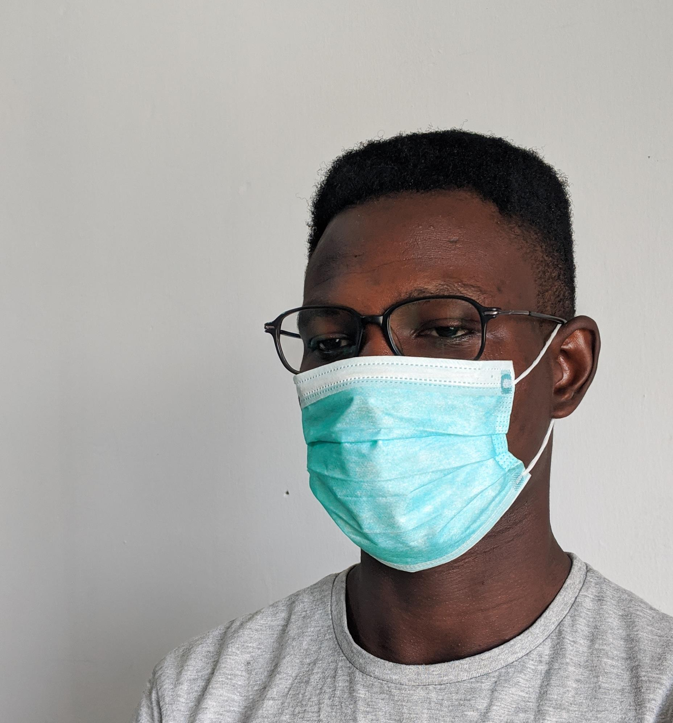
Why do you wear a mask?
Want to prevent myself from getting COVID
Scared of giving COVID to a family member
I’m a rule follower
Don’t want my center to have an outbreak
Mask, what mask?

Slide 8
What are some reasons people don’t follow guidelines?

Slide 9
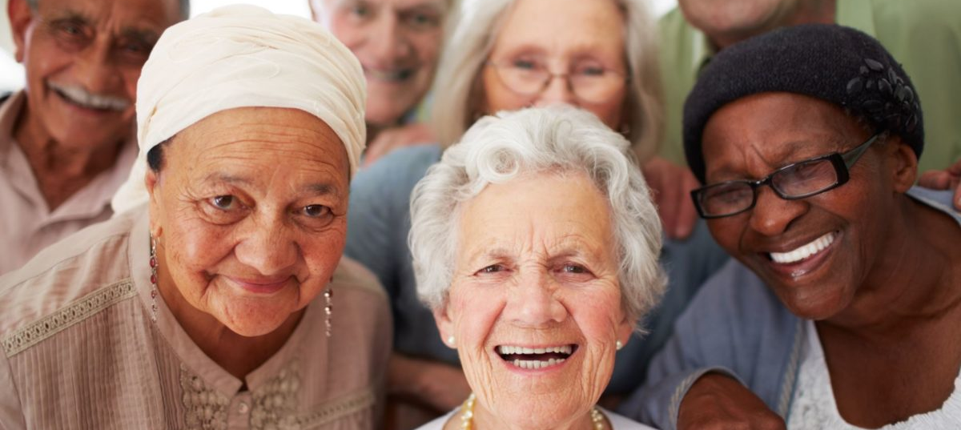
Individual Assessment of Risk
This Photo by Unknown Author is licensed under CC BY-NC
This Photo by Unknown Author is licensed under CC BY

Slide 10
COVID Test Creates a Sense of Security
This Photo by Unknown Author is licensed under CC BY-NC-ND

Slide 11
Feel Like Must Come to Work
This Photo by Unknown Author is licensed under CC BY-ND

Slide 12
Loneliness/Need Companionship
This Photo by Unknown Author is licensed under CC BY-ND

Slide 13
Don’t Like Masks
This Photo by Unknown Author is licensed under CC BY-NC-ND

Slide 14
Don’t Believe in Precautions/ Don’t Believe COVID is a Threat/ Government Control
This Photo by Unknown Author is licensed under CC BY-SA

Slide 15
Too Tough to Show Vulnerability
This Photo by Unknown Author is licensed under CC BY-SA-NC

Slide 16
The Dilemma
You care about health and safety
You believe others should follow certain rules for the wellbeing of all of us
You’re worried about you or loved ones getting ill
It can be awkward to encourage others to follow health guidelines
Don’t want to be the COVID police
Afraid of how people might respond

Slide 17
Why do people change their behavior?

Slide 18
Three Conditions
They know what to do
They decide why they want to do it—motivation
They see people like themselves doing it successfully
This Photo by Unknown Author is licensed under CC BY-ND

Slide 19
Knowing What to Do
Reminders
“Friction points”=locations where protocols break down

Slide 20
Knowing Why to Do It
This Photo by Unknown Author is licensed under CC BY-SA-NC

Slide 21
See People Doing It
Staff example and explanation
SGA/students
Images

Slide 22
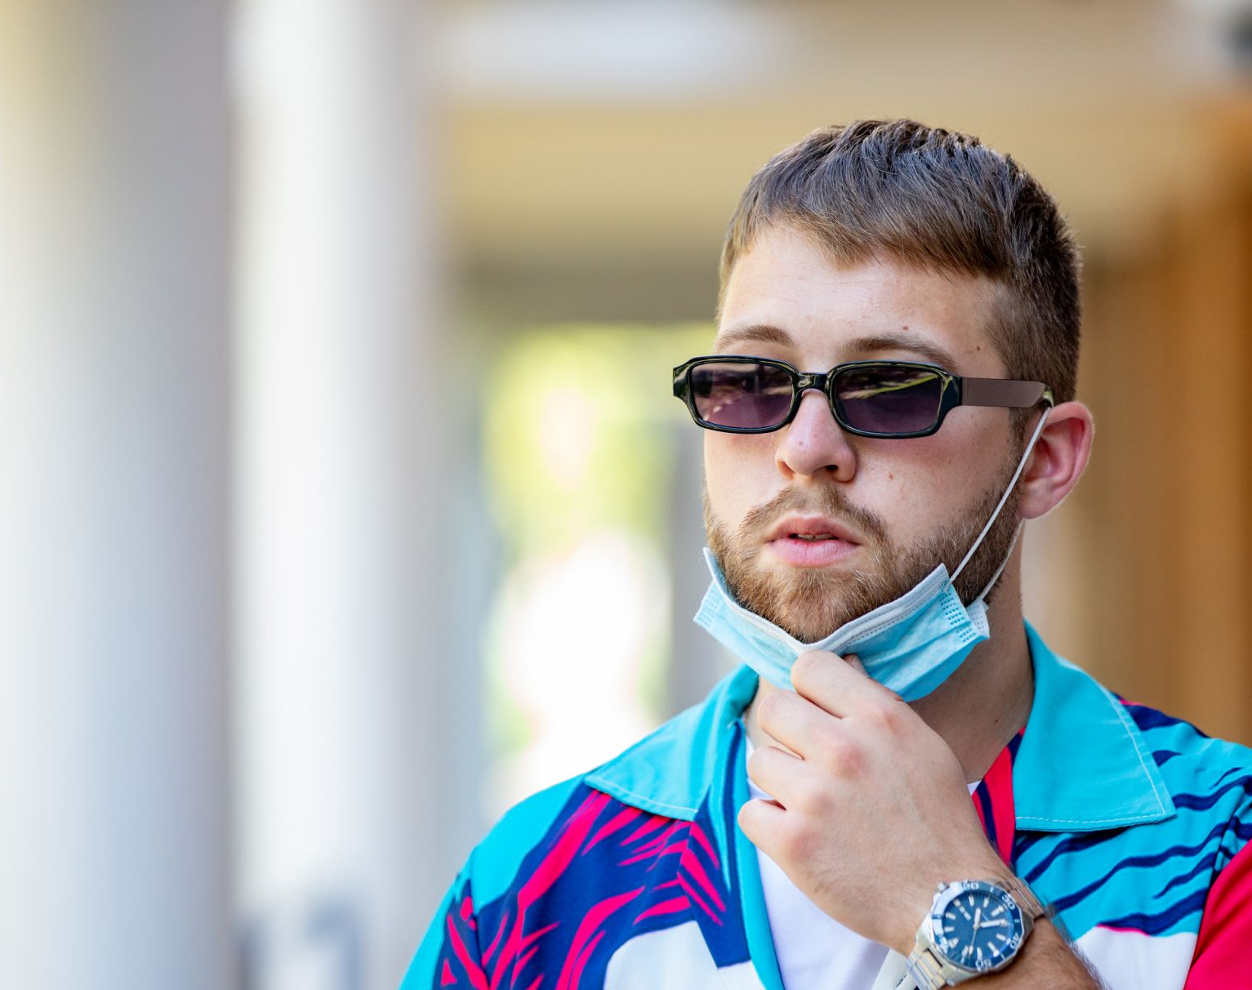
What do we do with the rule breakers?

Slide 23
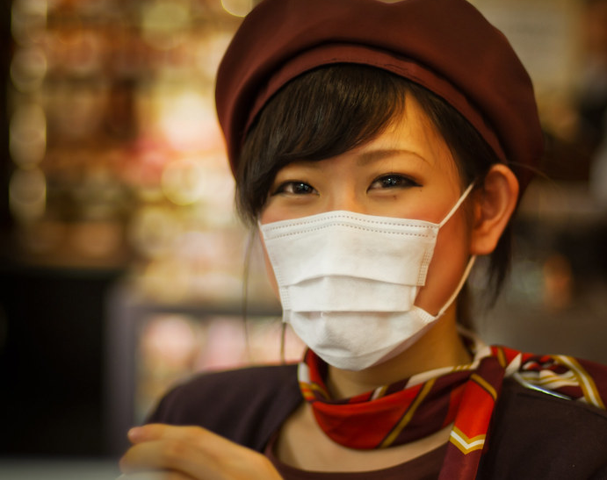
Soft Start Up
“Hey, I’m nervous about potentially getting you sick, can we stand farther apart?”
“I’m not comfortable with attending that meeting in person because the room is too small to socially distance and I don’t want to jeopardize anyone’s health.”
This Photo by Unknown Author is licensed under CC BY-SA-NC

Slide 24
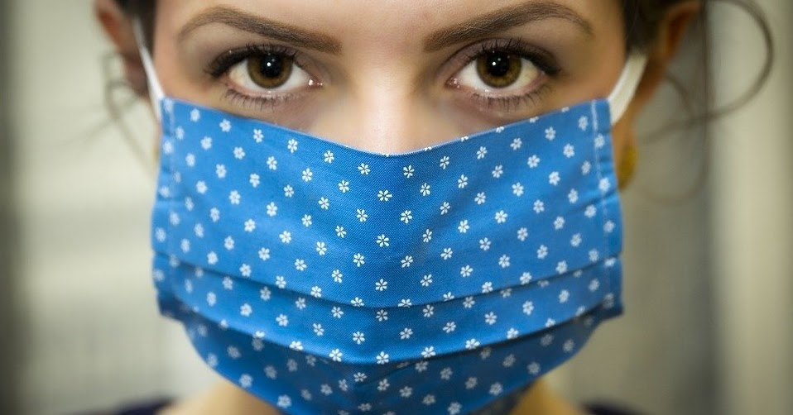
“My understanding…”
“My understanding is we have to wear face coverings at all times to protect each other and our students.”
“I understand that we all need to wear masks to keep the center open.”
This Photo by Unknown Author is licensed under CC BY-NC-ND

Slide 25
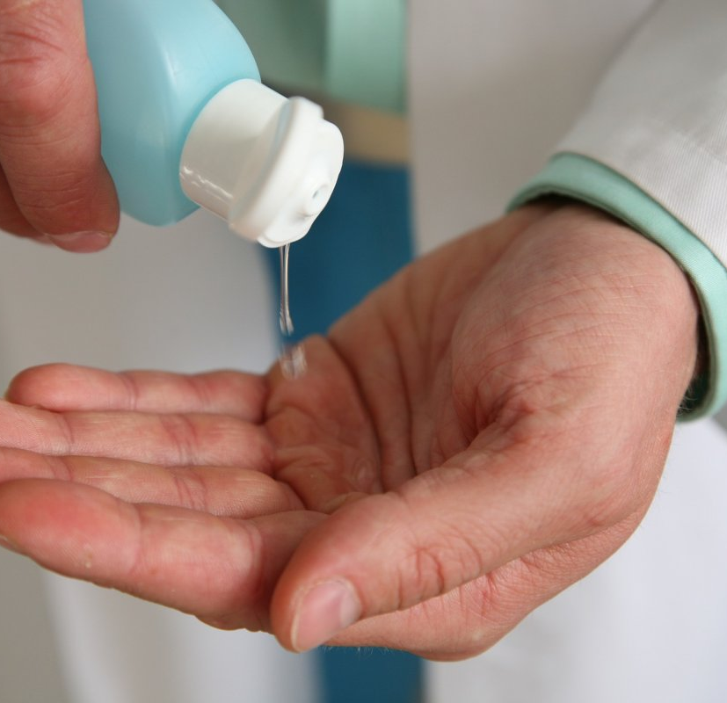
Offer Resources
“Do you need a face covering?”
“The hand sanitizer is over here.”
This Photo by Unknown Author is licensed under CC BY-SA

Slide 26
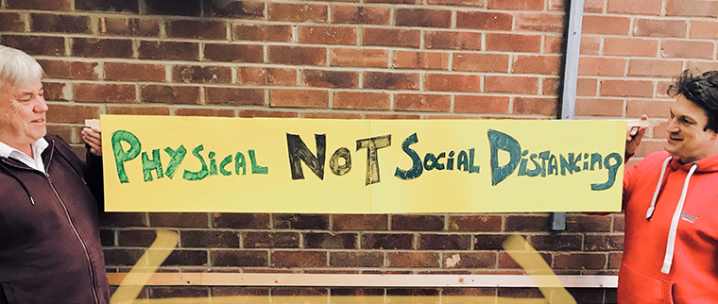
Show Empathy
“I know it’s hard to stay 6 feet apart.”
This Photo by Unknown Author is licensed under CC BY-NC-ND

Slide 27
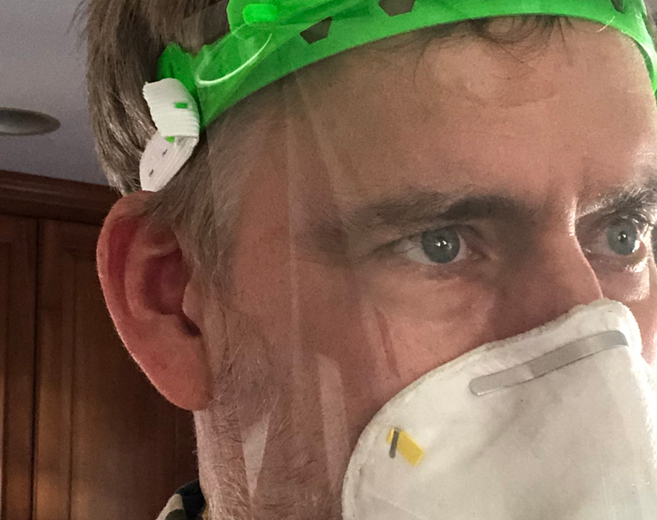
Be Direct
“It would make me feel better if we were both wearing masks.”
“Since you’re not comfortable wearing a mask, I’d prefer to talk on the phone.”
This Photo by Unknown Author is licensed under CC BY-NC

Slide 28
Enlist Others’ Support: don’t gang up, but back up those following COVID precautions

Slide 29
Leave the Space
Don’t get heated
Walk away and consider your options

Slide 30
PI 20-12 COVID-19 Safety Requirements and Student Conduct

Slide 31
Responding to Fellow Staff Members
Talk with HR/Administration
Report to Job Corps
This Photo by Unknown Author is licensed under CC BY-NC

Slide 32
Scenario: Your supervisor invites you to a meeting in small conference room. What do you do?
This Photo by Unknown Author is licensed under CC BY

Slide 33
My Response....
“I’m not comfortable attending the meeting in-person because the room is too small to follow COVID precautions, but I’m happy to virtually join.”
This Photo by Unknown Author is licensed under CC BY

Slide 34
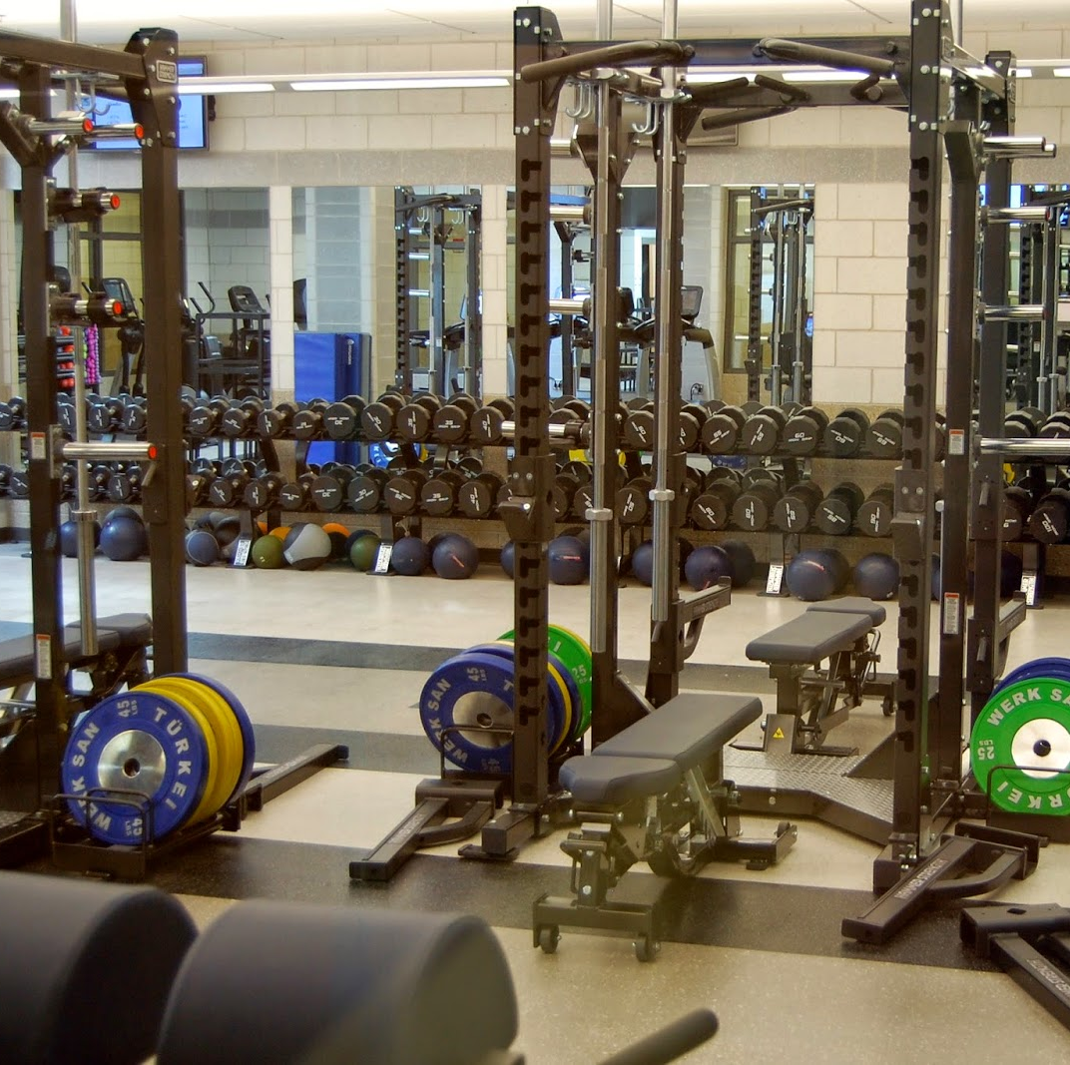
Scenario: Students in recreation are wearing their masks under their chins. What do you do?
This Photo by Unknown Author is licensed under CC BY-SA-NC

Slide 35
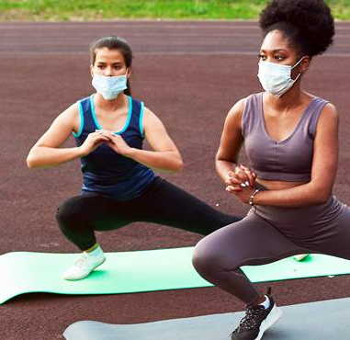
My response….
“I know wearing a mask while exercising can be uncomfortable, but it’s important to do in order to keep recreation and the center open. Please put your mask on.”

Slide 36
Scenario: You’re heating up lunch in a small break room and your coworker enters without a mask
This Photo by Unknown Author is licensed under CC BY-SA

Slide 37
Our response…
Keep your mask on and leave the room as quickly as you can. Talk with your supervisor about reiterating breakroom rules and posting on door (e.g., only one person in breakroom at time).

Slide 38
Scenario: You are highly concerned because center leadership repeatedly disregard COVID-19 precautions, and nothing seems to change…

Slide 39
Our Response
Talk with your supervisor about your concerns.
If this doesn’t create change or you don’t feel comfortable talking with your supervisor, then report violation.
Reflect that you also find wearing masks/keeping distance hard, yet really think it’s important in order to keep the center open and everyone healthy and employed.

Slide 40
Scenario: You wake up with cold symptoms but haven’t had any high-risk exposures. What do you do?
This Photo by Unknown Author is licensed under CC BY-SA-NC

Slide 41
Our Response
Do not go to work!
Inform your supervisor that you’re having possible COVID-19 symptoms and seek advice/testing from your healthcare provider or community testing site.
Low threshold for COVID-19 testing!
This Photo by Unknown Author is licensed under CC BY-NC-ND

Slide 42
Questions
This Photo by Unknown Author is licensed under CC BY-NC

