Slide 1
Working With Students
During
Times
Tamara D. Warner, Ph.D.
Licensed Psychologist
Mental Health Specialist for Regions 4 and 6
Notes:
Welcome to “Working With Students During Frustrating Times” webinar.
Reminder: We encourage you to use the chat box to share your questions, thoughts/ideas, and even strategies that you might be using to work with our students right now.

Slide 2
What I Hope You Get Out Of This Webinar
Identify the signs that you are not using active listening skills and communicating empathy
OBJECTIVES
Identify the important differences between empathy and sympathy and their effectiveness when communicating with students
Learn specific strategies to motivate rather than persuade students to remain committed to their Job Corps goals
Notes:
Here are a few of the things that I hope you will get out of participating in today’s webinar: …(slide)
Identify the signs that you are not using active listening skills and communicating empathy. If we are not something very well right now, then it is important to be aware of that so we can correct it.
Identify the important differences between empathy and sympathy and their effectiveness when communicating with students. We can only truly be effective with connecting and engaging our students when we communicate genuine caring and empathy, not sympathy.
Learn specific strategies – including what not to do – in order to help our Job Corps students remain committed to their goals during these trying times.

Slide 3
Poll Question 1
During the past month, how frustrated you have been feeling about things in general?
1 = Not at all Frustrated
2 = A Little Frustrated
3 = Somewhat Frustrated
4 = Very Frustrated
5 = Extremely Frustrated
🙂
😕
☹️
😡
🤬
3
Notes:
I’d like for you to reflect for a moment and let me know by typing in the chat box -- On a scale of 1 to 5 where 1 is “Not at all frustrated” (you’ve got a smile on your face most of the time) to 5 “Extremely frustrated” (where you want to say things that you would never say in front of your grandmother) -- During the past month, how frustrated have you been feeling about things in general? This includes the pandemic in general, how things are going at work, and how things are going on in other areas of your life. What has your general level of frustration been like?

Slide 4
Poll Question 2
During the past month, how frustrated you have been feeling about working with students/trainees?
1 = Not at all Frustrated
2 = A Little Frustrated
3 = Somewhat Frustrated
4 = Very Frustrated
5 = Extremely Frustrated
🙂
😕
☹️
😡
🤬
4
Notes:
Now, please let me know on a scale of 1 to 5 where 1 is “Not at all frustrated” to 5 “Extremely frustrated,” during the past month, how frustrated have you been feeling about working with our students and trainees? Think about your interactions with students on center, students in distance learning and students in virtual CPP.

Slide 5
The Struggle is REAL
COVID-19 pandemic & restrictions have taken a serious toll on our mental health during the past year.
On Job Corps centers, the restrictions have weighed heavily on staff and even more on students.
Notes:
COVID-19 – the pandemic itself and its restrictions have taken a serious toll on our mental health during the past year. It has turned our lives upside down. The pandemic has touched virtually every aspect of our everyday routines, social interactions, ability to travel or go to a restaurant and our holiday gatherings have all been disrupted by the pandemic.
On our Job Corps centers, we know – we hear from you – about the stresses associated with the COVID-19 restrictions have been really hard for staff and students alike. So, if you’ve been feeling stressed and even frustrated by our current circumstances, please know that the struggle is real and you are NOT the only one.

Slide 6
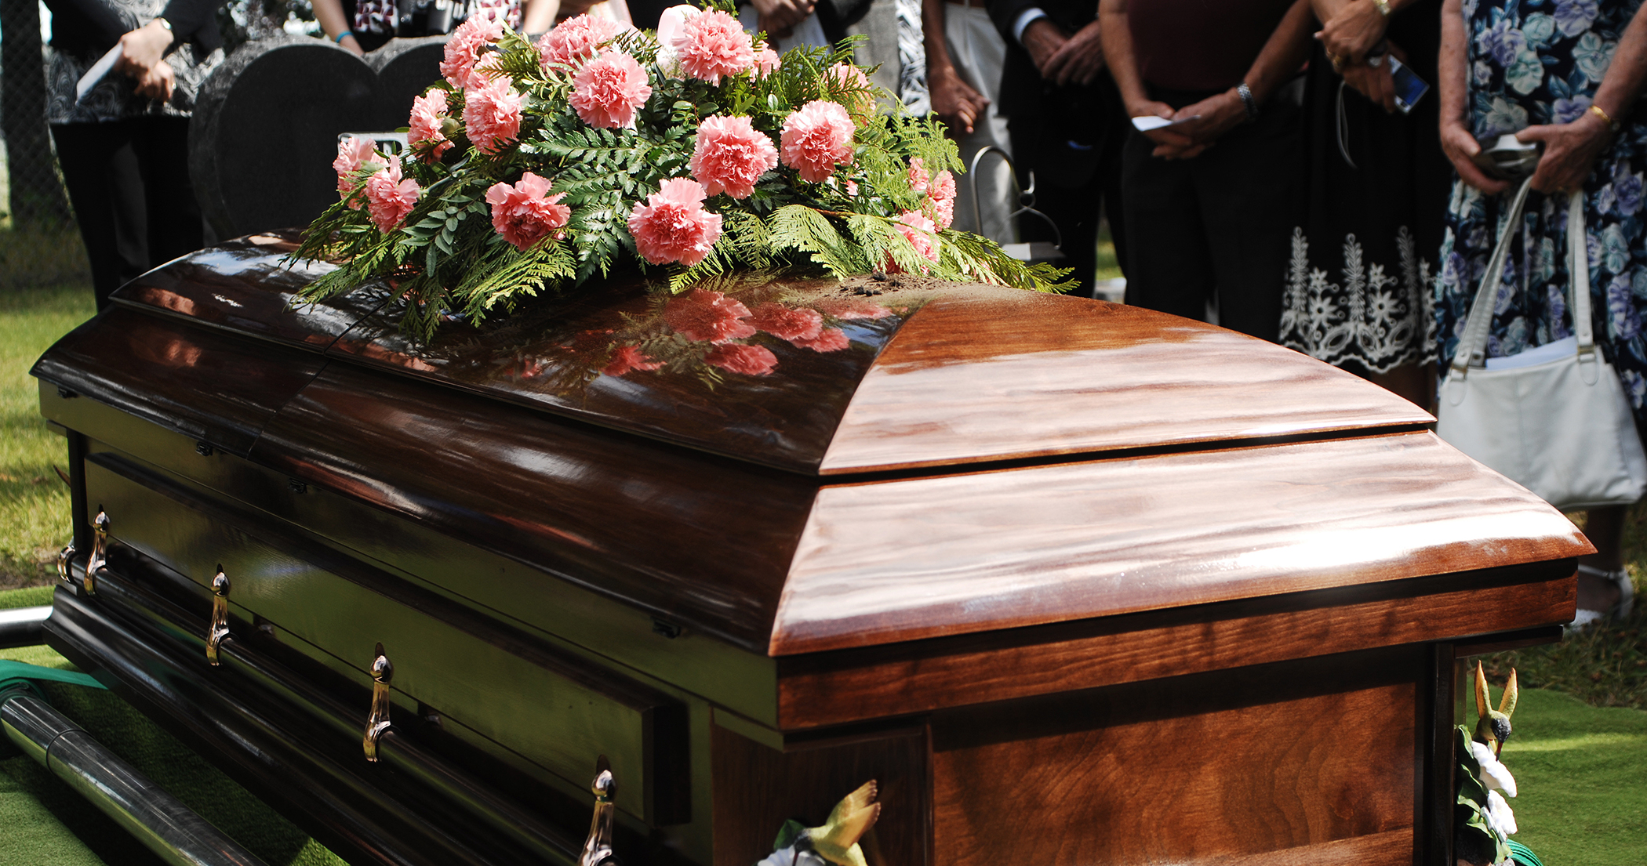
The Student Perspective
Notes:
Let’s take a closer look at the student perspective. Those on center have described it as feeling like prison – and I know Job Corps students have been saying things like that LONG before the pandemic. But think about it, they have missed family birthdays, funerals, Memorial Day and 4th of July barbeques. They miss hanging out with their friends, and from a developmental perspective, they have missed the comfort of human touch, a hug to say “hello” or a hug during down times. Our students have truly been the ones in a so-called “lock down.”

Slide 7
What Students Think
“Staff just don’t get it.
They don’t understand what it’s like to be on center day in and day out.
They get to go home every day.”
“I miss my family so bad.”
“I feel like I’m losing my mind. I’m bored. We eat the same thing over and over.
I don’t care anymore. I’m just ready to quit.”
“I just wish someone would listen…I mean, really listen.
All they want to is tell you want to do all the time.
Do they even care?”
“I can’t even remember the last time I touched somebody … or had a hug.
Do you have any idea what that’s like?”
“My friends are hanging out, and I’m stuck here – for what?”
Notes:
These are just a few of the student comments that have been shared with me by staff. I’ll read a few….What is the underlying theme here. Students feel like we don’t get it, they do not feel heard and, more importantly, they do not feel understood. That feeling of not being understood leads to a sense of isolation, which can lead to angry and frustration on one end and to hopelessness and despair on the other end. When you hear statements like, “I don’t care anymore. I’m just ready to quit,” it means we need to stop and connect. Otherwise, students resign even if they are only days or weeks away from completing the program.

Slide 8
What are the qualities that you would look for in someone you hope will help you?
Someone
Who cares
Who you feel you can trust
Who takes time to listen to you
Who asks the right questions and truly tries to understand your concerns
Someone
Who has the wisdom and know-how to help in ways that are effective and long-lasting
Who involves you in the process
Notes:
So, putting ourselves in our students’ shoes, let’s think about this: What are the qualities that you would look for in someone you hope will help you. Our students are looking to us for help, and they are looking for the same qualities that we would want in a helper.
You would want someone
Who cares
Who you feel you can trust
Who takes time to listen to you
Who asks the right questions and truly tries to understand your concerns
Who has the wisdom and know-how to help in ways that are effective and long-lasting
Who involves you in the process
When we look at the research on helping relationships – whether it is doctor/patient or psychologist/client -- the single most reliable factor leading people to change (by far) is the relationship they have with the person helping them change.

Slide 9
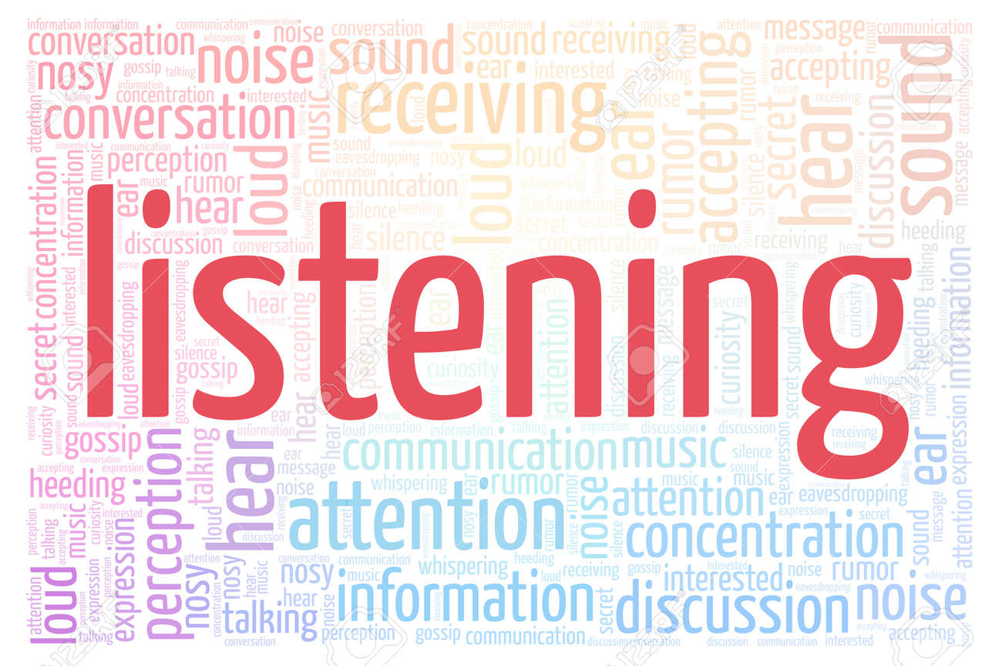
Two Ways to Communicate Caring
Notes:
The first quality on the list was caring – wanting someone who cares. How do you communicate caring? There are two primary tools:
Empathy – the ability to understand and share in the feelings of another. It’s not just understanding, it’s also SHARING in the feelings of the other person. That means you have to put some skin in the game. Empathy is not a spectator sport. You have to get in there are play the game with the person.
How to communicate empathy – by listening, truly listening so that you can understand that other person’s experience and put your feet in the other person’s shoes. In fact, we typically call this “active listening.” And the goal of active listening is to make the person feel respected, accepted, and understood.

Slide 10
Brené Brown on Empathy vs Sympathy
Notes:
I’d like to show a brief but powerful video clip by Dr. Brené Brown that can explain what empathy is in less than 3 minutes. If you are not familiar with Dr. Brené Brown, I would encourage you to look her up on YouTube or watch her TED Talks.
Type in the chat box: what did you get from the video? What stuck with you that you can keep long after this webinar is over?

Slide 11
Common “Helping” Mistakes
1. Trying to “fix” the problem
Empathy
2. Telling the student to “look at the bright side”
3. “Should-ing” on the student
4. Teaching a lesson/coaching
11
Notes:
Before we get into the process of listening and how it communicates empathy, let’s start with a few “don’ts.” These are common “helping mistakes” that
Trying to “fix” the problem – offering solutions, advice and suggestions. Usually these are used in an attempt to change the other person’s feelings. You don’t want them to feet upset or angry or sad, so you jump right into trying to fix the problem. The problem is that if often doesn’t help the person feel better at all. In fact, people feel like they have not been heard when the listener focuses more on the problem than how they are feeling.
Telling the student to “look at the bright side.” We’ve all done this when trying to cheer someone up. We say things like, “It’s not that bad. Well, at least you have a roof over your head and food to eat.” Statements like this feel dismissive, as though you are not taking the person’s problems and their feelings seriously. It’s really a subtle way of trying to change the subject, often to make yourself feel better.
“Should-ing” on the student is passing judgment in disguise. Saying things like, “You should have known it was going to be like this. You shouldn’t be so upset.” We can ”should” on students in other ways: saying things like “calm down” (which rarely, if ever, helps anyone actually calm down)or “get over it” or “you’re blowing this all out of proportion.” All of these statements communicates to the student that how they are feeling is wrong and should be changed. I don’t know about you, but judgmental statements never make me feeling better. They make me feel worse.
Teaching a lesson. When someone is upset or frustrated, it is NOT a “teachable moment.” Don’t ask things like, “Don’t you remember the last time this happened? Or what do you think will happen in the future? Or “what are you going to do the next time this happens.” Save the coaching for later.

Slide 12
Signs that You Are NOT Engaging in Active Listening
Notes:
So let’s pretend that maybe you’ve engaged in one of those common “helping” mistakes. We all do it. Type in the chat box: What are the signs that you are NOT engaging in active listening? What behaviors on the part of the student will you see? Hint: think about the things you start to do when you know the other person is not listening to you.
Student:
Looking away
Rolling their eyes
Sighing
Crossing their arms
Arguing with you
Interrupting you
Defensiveness
Getting more upset
When you see signs like this, just stop and start listening. Say something like, “I really want to hear what you have to say.”

Slide 13
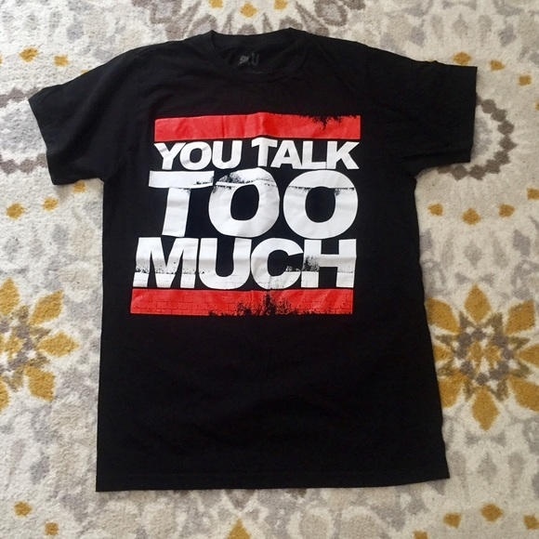
Active Listening
Tip #1
Notes:
The most important part of active listening is to listen. Sounds simple, right? The truth is, as adults, as teachers, as counselors, as administrators, we all TALK TOO MUCH. So if you remember the rap artists RUN DMC from the 1980s, the song starts, “Shut up! You talk too much.” This is your #1 tip for how to engage in active listening. Stop talking and start listening. If you get nothing else out of the webinar, I hope you get that listening means listen, not talk.

Slide 14
Active Listening => HUNGRY LISTENING
The hardest part about listening is NOT TALKING.
The second hardest part is ACTUALLY LISTENING.
Ask questions
Think about the next thing you are going say
Offer advice
Let your mind wander off
Notes:
I really don’t like the term “active listening” because the word “active” implies that you should be DOING something when, in fact, the opposite is true. So instead let’s think of it as “hungry listening” – hungry in this case means that you are eager, you are yearning, you are striving to hear what the other person has to say. You really want to understand how they are feeling.
As I mentioned on the hardest part is NOT TALKING. The second hardest part is ACTUALLY LISTING.
You will be tempted to ask questions. Don’t do it.
You will be tempted to think about the next thing you are going to say. Don’t do it.
You will be tempted to offer advice or engaging in those other so-called “helping” behaviors I mentioned earlier. Don’t do it.
You may find that you mind wanders off to the next meeting you have to go to or what you need to pick up from the grocery store on the way home. Don’t do it.

Slide 15
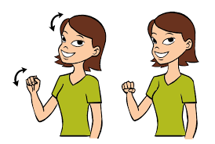
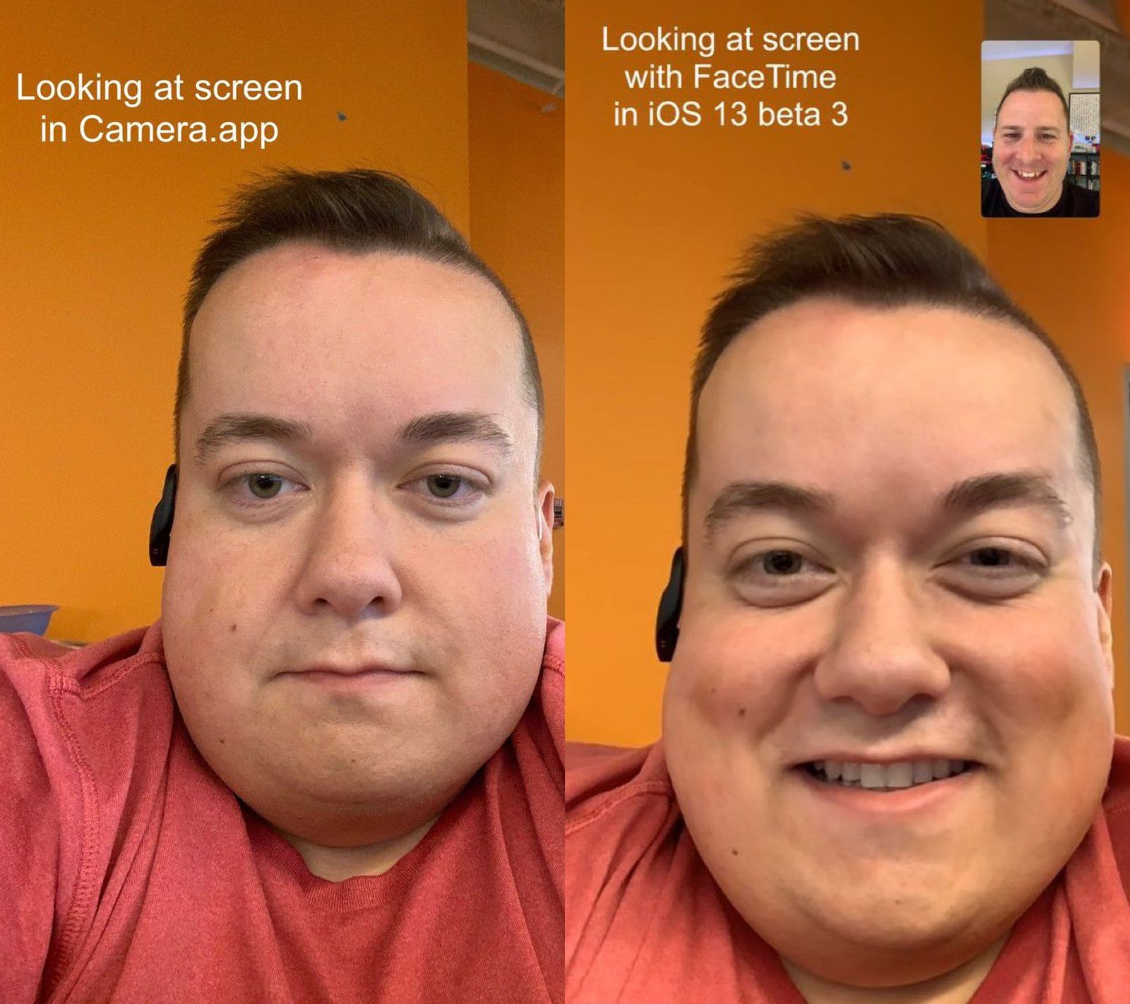
Hungry Listening Involves Non-Verbal Skills
Communication is 60-70% BODY LANGUAGE!
Nod, say “uh-huh” or do something to show that you are listening & paying attention
Notes:
Hungry listening involves non-verbal skills – “verbal” just means words. Communication is about what you do with your body, not what you say. Many years of research has demonstrated over and over again that communication is 60% to 70% body language -- not our words but how we move our bodies while the other person is talking. It explains why we can communicate with another person even if we don’t speak the same language.
3 tips about communicating with your body:
It’s important to keep an open posture. In the cartoon on the left, the guy in the blue shift has an open, receptive posture that indicates openness and a willingness to listen. In contrast, the woman on the right has a closed posture. Usually we think of arms crossed over the chest – which can indicate defensiveness or being closed to what the other person has to say. Just be relaxed and open.
Nod, say “uh-huh” or do something that you are listening and paying close attention. Have you ever been talking to someone and they are sitting there like a bump on a log, you can tell they are tuned out and not listening. Show some hunger when you’re listening.
Make comfortable eye contact. We’ve all hear about the importance of eye contact, but it’s important to know that you can overdo it. Do not force eye contact. Students can talk & listen without making eye contact. The graphic at the bottom – when we’re on Zoom or other videoconference platforms, we look at the picture of the person rather than the camera, so it looks like we are not making eye contact. Apple has developed a program to auto-correct this so it looks like you are looking at the camera even when you’re not. Interesting, huh?
Summary: open posture, do something to show you are engaged and make comfortable eye contact.

Slide 16
Signs that You Are NOT Engaging in Hungry Listening
Notes:
Earlier I showed this picture to talk about the signs the that you are not engaging in hungry listening.

Slide 17
Notes:
Now let’s look at this picture, which from the perspective of the person listening. Identify and type in the chat box what you think this listener is doing well in this picture.

Slide 18
Challenges of HUNGRY LISTENING
Being patient
Keep open body language
Following the story & emotion
Don’t interrupt or ask questions
Listen for emotion, not content/words
Not getting bored
Difficult not to let your mind wander off
Staying engaged
Set aside judgment
Try to take their perspective even if it doesn’t seem logical or reasonable to you.
Notes:
Hungry listening takes effort and it can be challenging. Here are a few of the challenges:
Being patient, especially when the student is going on and on and on. It’s important to keep open body language. Avoid foot tapping, tapping your pen, drumming your fingers, or looking at your watch or the clock, etc. These signal impatience or anxiety on your part.
Another challenge is not getting bored. I will admit to you as a psychologist, that it can get boring to listen to someone and you find your mind wandering off.
Sometimes it difficult to follow the story the student is telling. They are all over the place and you can’t even figure out what exactly the issue is. You may be thinking, “What is the person talking about?” Still, do not interrupt or ask questions to try figure out what is going on – as tempting as that might be. Instead, my best advice is drop down (so to speak) and listen for the emotion stirring beneath all those words. Remember, empathy requires connecting with the emotion not the words.
The main challenge is to stay engaged. Set aside judgment as you’re listening and try to take the studeents perspective even if it doesn’t seem logical or reasonable to you. You may be thinking, “Well what did you think was going to happen when you….” No, your job is to get inside their mental and emotional universe just for a little while so you can understand how they are feeling.

Slide 19
Bringing Empathy & Listening Together: The Art of Reflection
Reflection
repeating the main feelings and concern(s)
that you heard
Demonstrates to the student that you are actually listening.
Helps the student to feel understood.
Use a gentle, reassuring tone of voice that communicates concern not judgment.
Notes:
Showing empathy and using active or “hungry” listening are the foundational communication skills, but to really connect and help a student feel understood, you need to bring them together and use a powerful technique called “reflection.” Reflecting is simply repeating or summarizing the main concern or concerns that you heard. You can think of it as being a reflection in a mirror for a student to help them to identify their emotions and clarify their thoughts.
Reflection is the compassionate communication that makes a difference. It demonstrates to the student that you are actually listening. You want to use a gentle, reassuring tone of voice that communicates empathy and concern, not judgment. It’s the comforting voice of a parent or the voice of a concerned counselor. If there is a lot of tense emotion, it can be especially powerful if you use a lower tone of voice than the student. It can lower the temperature of the situation and put the student at more ease.

Slide 20
The Art of Reflection
Focus on EMOTION
If you get it wrong when repeating or summarizing, it’s OK. Let them make corrections.
“You were upset when…”
“I wasn’t upset. I was furious.”
Acknowledge the emotions and how hard the situation must be from the student’s perspective.
“I can see why you got so upset. I probably would have been frustrated, too.”
Rather than focus on what happened, focus on the underlying emotion(s).
Try to identify what the student is feeling
Frustration?
Disappointment?
Anger?
Sadness?
20

Slide 21
French mathematician, physicist & philosopher
Motivate, Not Persuade
Notes:
So now we get to the challenging part. The student starts talking about wanting to leave. Our first instinct is to say, “No” and to convince them to stay. To tell them all the reasons why resigning would be a bad idea. It would just be giving up, etc. The problem with that approach is that, generally speaking, it is not very effective.
”People are usually more convinced by reasons they discovered themselves than by those found by others.” It’s the difference between being told what to do versus figuring out for yourself what is best for you. When you ask the student questions until she arrives at the answer herself, she is much more to act on her own advice.”
Ask questions like,
“What would it mean for you if you left now?
How would you feel if you didn’t finish what you started, if you didn’t accomplish what you came for?
What would you say to a friend who is in the same situation?
Imagine that you are 40. What advice would you older, wiser self say to you now?

Slide 22
Asking Questions that Motivate
Open-Ended: Cannot be answered with one word or yes/no
Not Why: Requires justification, makes student defensive
“What would it mean for you if you left now?
How would you feel if you didn’t finish what you started, if you didn’t accomplish what you came for?
What would you say to a friend who is in the same situation?
Imagine that you are 40. What advice would you older, wiser self say to you now?
22
Notes:
How do you ask question to motivate rather than persuade.
There are only 2 things to remember:
The questions must be open-ended. These are questions that cannot be answered with one word or yes/no. Why is this important? You can’t get a conversation going and delve into feelings with closed-ended questions like “Are you thinking about resigning?”
The questions cannot be ”why” questions because ”why” questions put people on the defensive, makes them feel like they have to justify why they think, believe or feel a certain way. Why questions imply judgment – and that shuts everything down.
Instead, you want to ask questions like “How” questions or hypothetical questions that make the student think. Such as:
“What would it mean for you if you left now?
How would you feel if you didn’t finish what you started, if you didn’t accomplish what you came for?
What would you say to a friend who is in the same situation?
Imagine that you are 40. What advice would you older, wiser self say to you now?
You may not always get the answers you want, but it helps you to explore with the student what is going on in their head and in their hearts. Learning to do this type of question takes some practice so I would encourage you to practice with other staff in your department to get the hang of it.

Slide 23
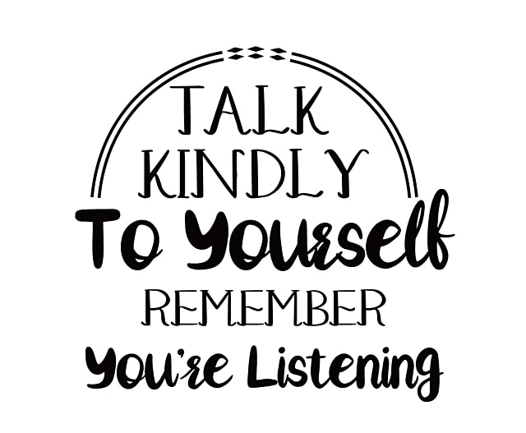
SELF-CARE
Notes:
I would be remiss if I did not go back to the beginning. This has been a difficult, a frustrating time for all of us. So I want to urge you to take good care of yourselves. You can’t pour into our students if you yourself feel like you are running on empty. So take some time to slow down, get enough sleep, eat well, move your body and exercise when you can, count your blessing knowing this “this, too, shall pass.” And please take to heart this saying: “Talk kindly to yourself. Remember you’re listening.” How you talk to yourself is how you will also talk to others.

Slide 24
Thank you.
I hope this was helpful.

