Slide 1
COVID-19: Where are we now?
Sara Mackenzie, MD, MPH
Regional Medical Specialist, Humanitas

Slide 2
At the end of this webinar, you will be able to:
Describe current COVID-19 trends
01
Implement mitigation measures to reduce risk of COVID-19 on center
02
Develop plans for COVID-19 vaccination in fall
03

Slide 3
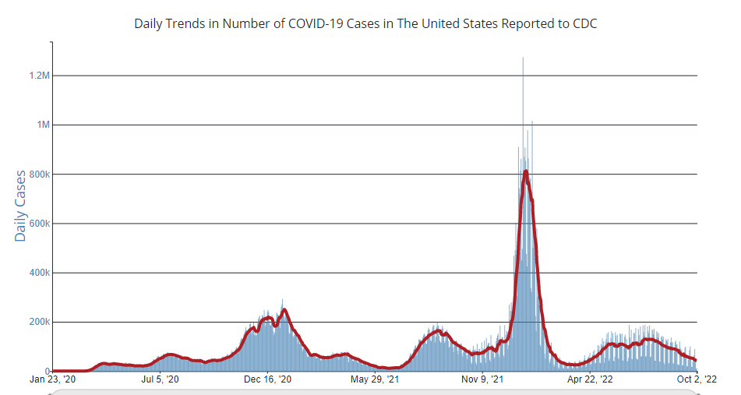

Slide 4
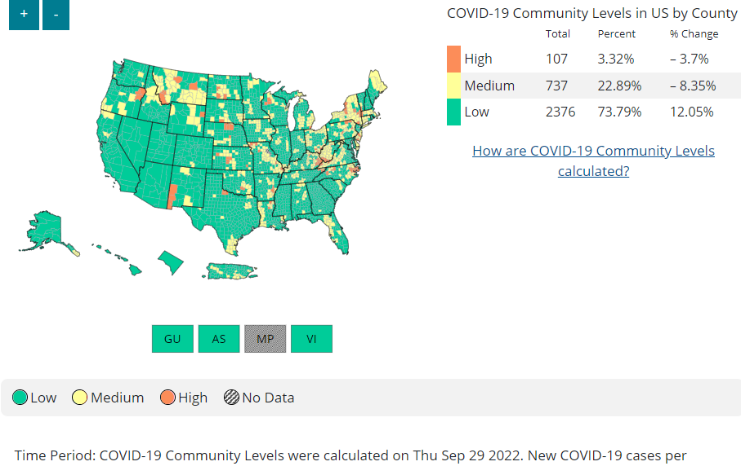
CDC COVID-19 Community Levels:
Guides General Center Masking:
required on center when Community Level High
Screening testing:
No longer required based on community level

Slide 5
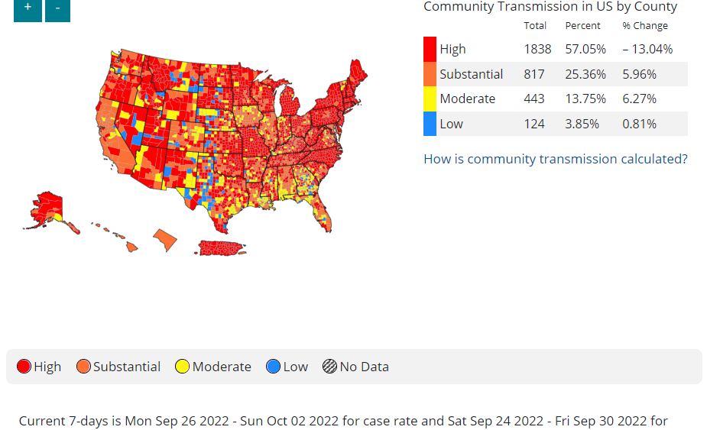
CDC COVID-19 Community Transmission:
Guides CDC Health Facility Masking:
High: Universal Masking
<High: Universal Masking no longer mandatory

Slide 6
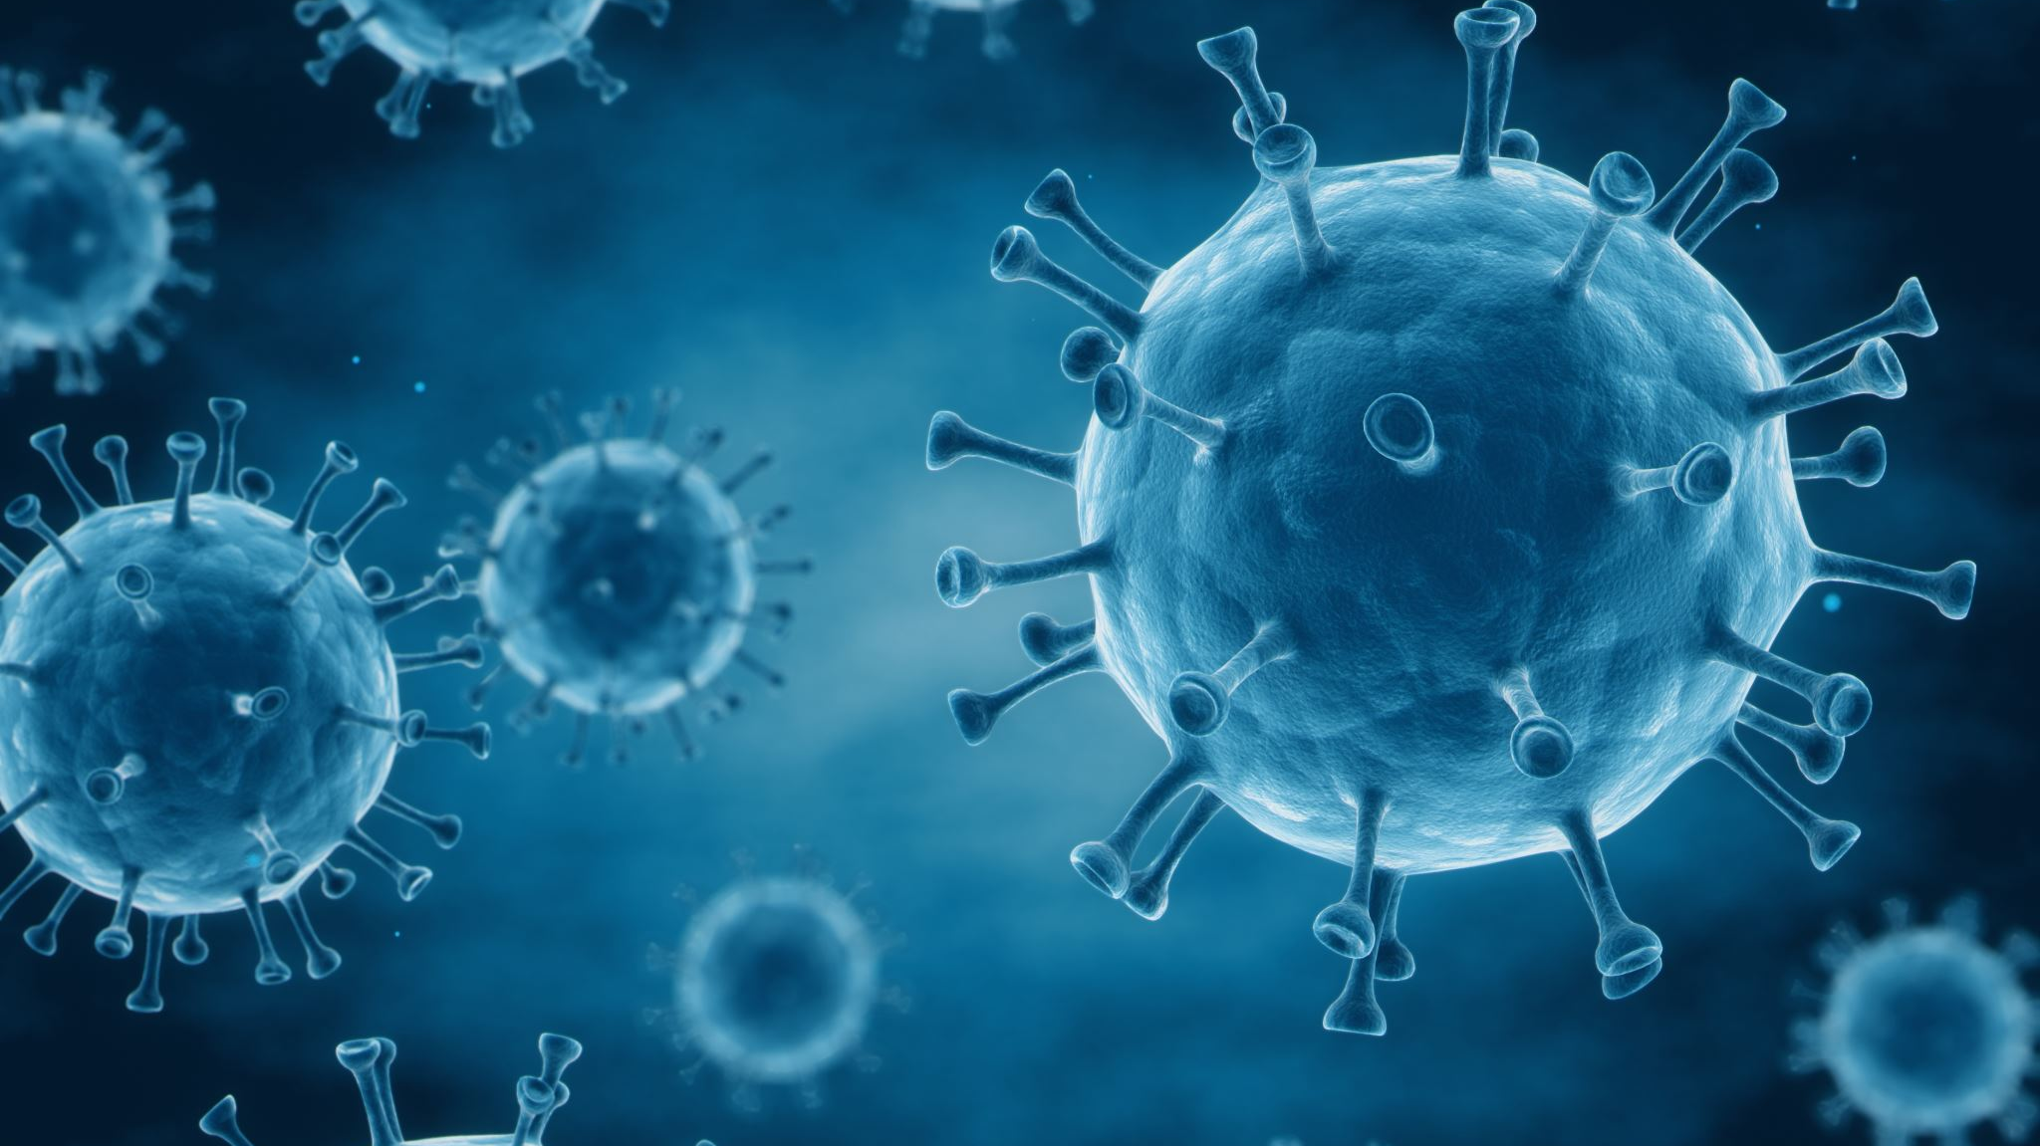
When does a pandemic “end”?

Slide 7
Pandemic ends when:
The infectious agent goes away
It becomes “endemic” - harm caused by the infectious agent is deemed “acceptable”
Value judgement: balances harm from disease against harm from interventions
325 deaths per day from COVID-19
251 deaths per day from overdose
33-142 deaths per day from influenza (average year)
90 deaths per day motor vehicle crashes

Slide 8
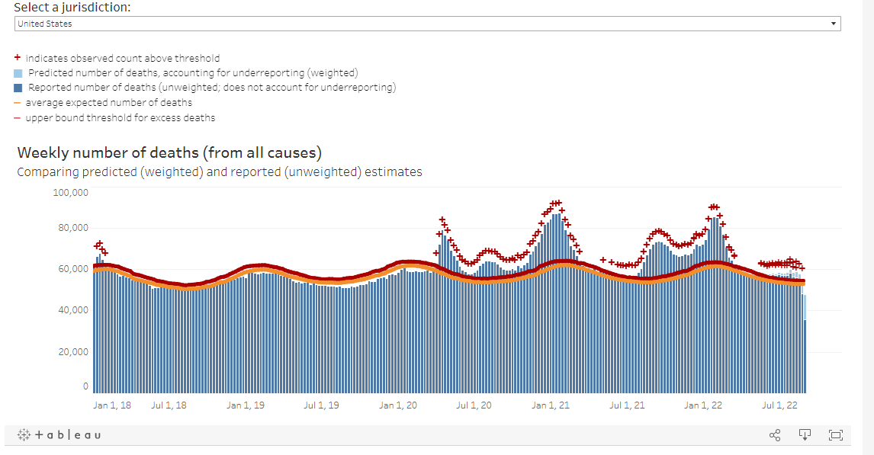
Excess Deaths Associated with COVID-19 (cdc.gov)

Slide 9
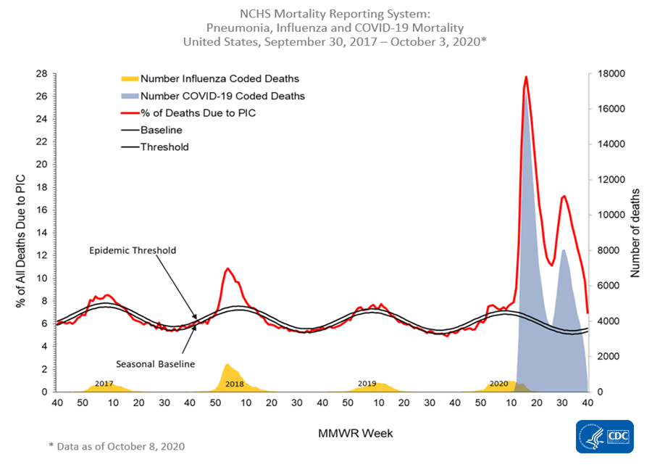

Slide 10
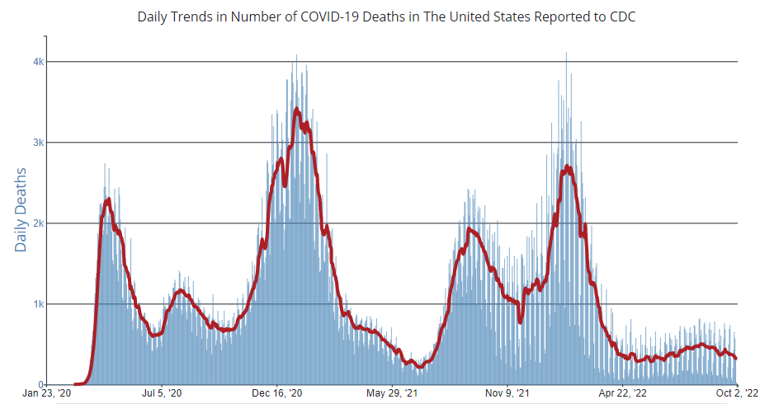

Slide 11
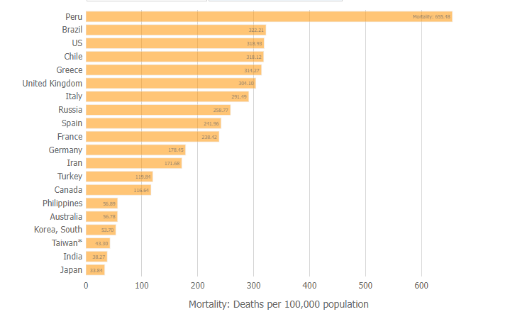
Mortality Analyses - Johns Hopkins Coronavirus Resource Center (jhu.edu)

Slide 12
What contributes to the U.S. having a higher mortality rate from COVID-19 than many other countries?

Slide 13
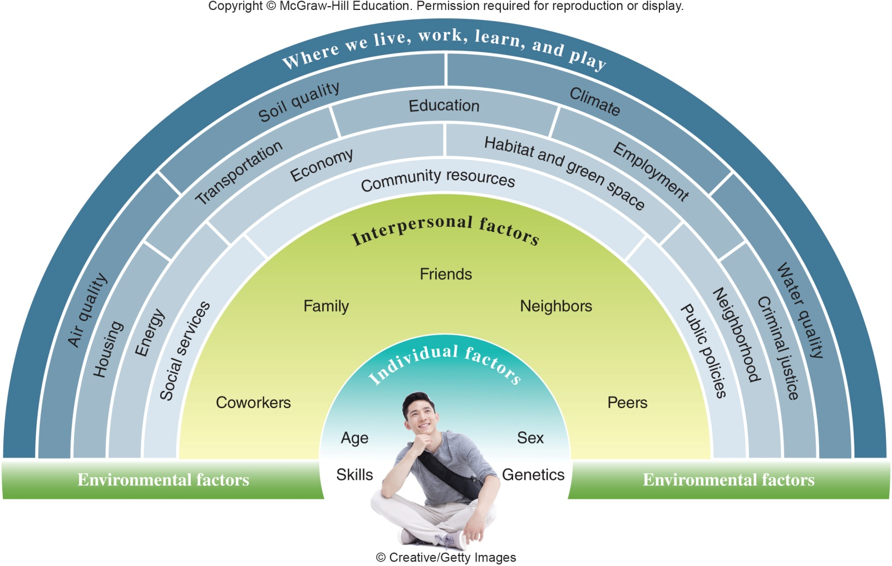
Social-ecologic model of health:

Slide 14
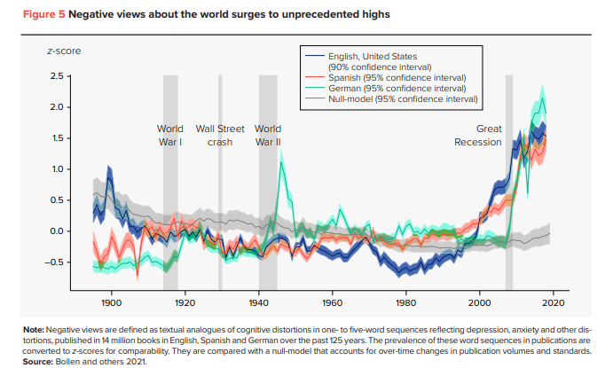

Slide 15
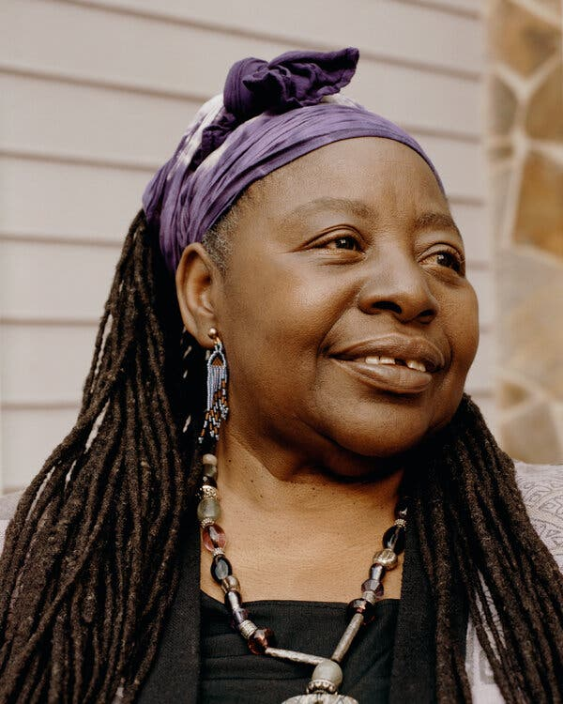
“I am challenging the call-out culture. I think you can understand how calling out is toxic. It really does alienate people and makes them fearful of speaking up.” “The antidote to that outrage cycle is “calling in.” It’s a call out done with love.” Loretta Ross
Loretta J. Ross: Don't call people out -- call them in | TED Talk

Slide 16
Why is COVID-19 likely to continue circulating?

Slide 17
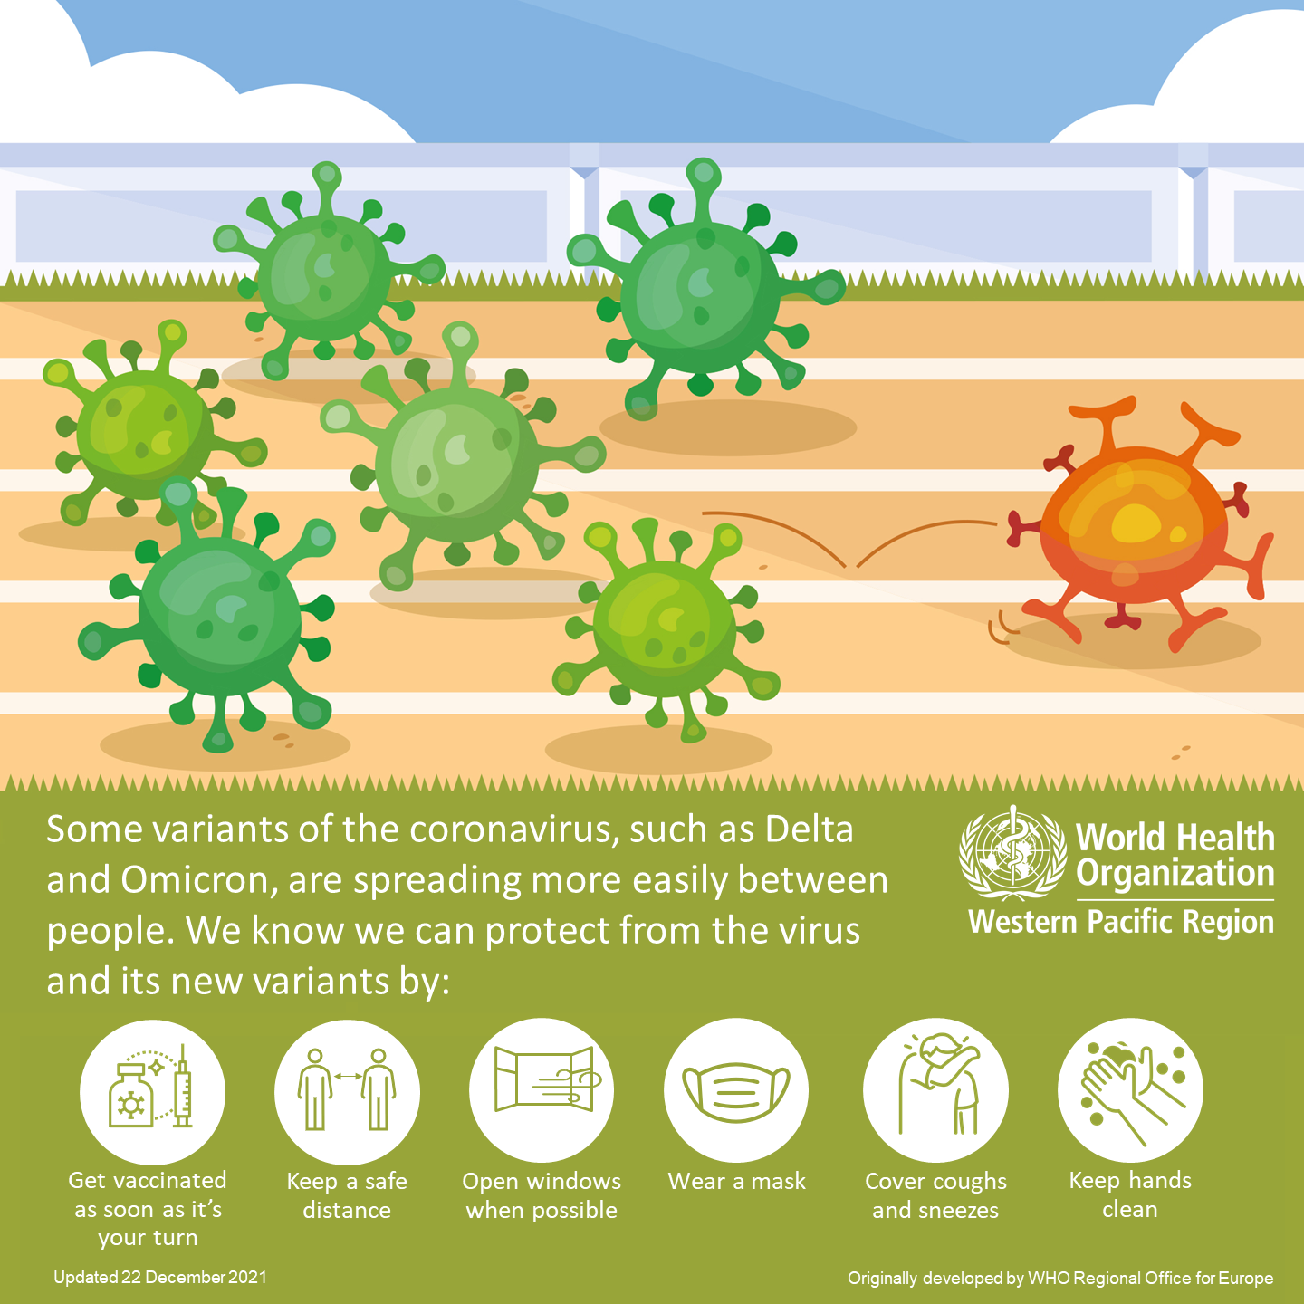

Slide 18
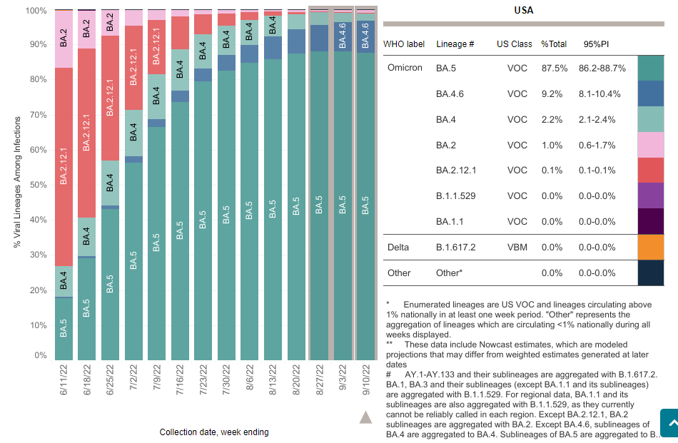
CDC Genomic Surveillance: Monitoring Variants

Slide 19
Who is COVID-19 most impacting still?

Slide 20
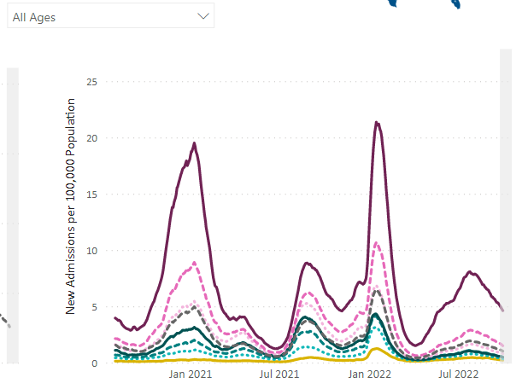
By age:
CDC COVID Data Tracker: Hospital Admissions

Slide 21
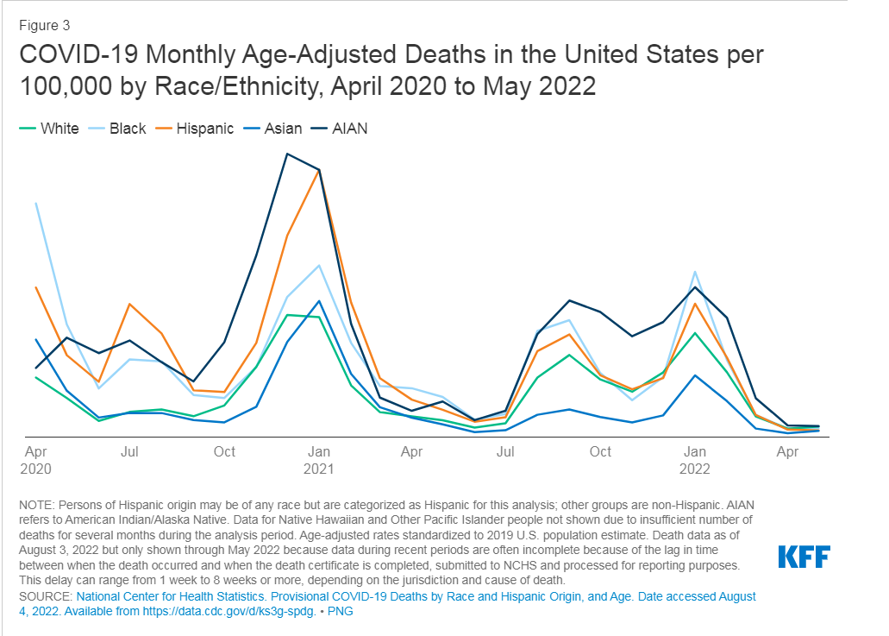
COVID-19 Cases and Deaths by Race/Ethnicity: Current Data and Changes Over Time | KFF
Notes:
Black, Hispanic and AIAN people have experienced higher rates of infection and death compared to White people; people of color disproportionately impacted by surges with new variants
Higher rates infection – increased exposure risk due to working, living, transportation situations
Living in larger households,
Death rates have decreased with vaccination rates and boosters increasing;
May continue disparities in access to treatments

Slide 22
What factors contribute to differences in rates of infection, severe illness, and death?

Slide 23
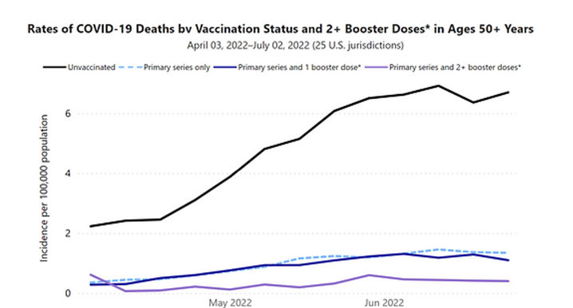

Slide 24
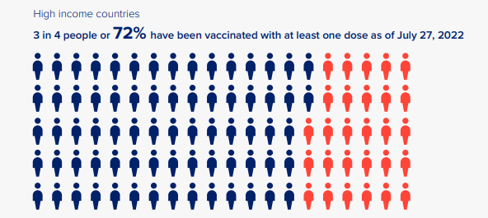
Human Development Report 2021/2022 hdr2021-22pdf_1.pdf (undp.org)

Slide 25
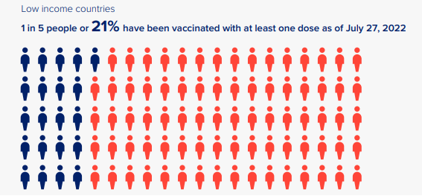
Human Development Report 2021/2022 hdr2021-22pdf_1.pdf (undp.org)

Slide 26
What has most helped your center control or avoid outbreaks?

Slide 27
Total Cases Since 1/1/2022

Slide 28
2022- much bigger toolbox

Slide 29
Shift from broad sweeping community measures to targeted community measures & individual measures

Slide 30
Chain of Infection
SARS-CoV-2
Novel
RNA virus
Mutates – new variants
Exits the body
Respiratory droplets
Transmission
Primarily droplets
(cough, sneeze, talking)
Less common:
Aerosol
Surfaces
Enters the body
Contact with mouth or nose mucosa
Person factors
Age
Underlying health conditions

Slide 31
Breaking links – slows or stops the spread!
Cover cough
Masking
Hand washing
Distancing
Cleaning and disinfection
Air flow
Testing
Cover cough
Masking
Handwashing
General health
Vaccination
Antivirals
Vaccines
Cover cough
Masking
SARS-CoV-2
Exits the body
Transmission
Enters the body
Person factors

Slide 32
SARS-CoV-2:
Symptoms
Incubation:
2-14 days
(median 3-5 days)
Viral shedding:
for up to 10 days after symptom onset (for most)
Some will have mild to no symptoms
May shed 48 hours PRIOR to onset of symptoms
Exposure:
“Close contact” – within 6 feet for >15 minutes/24 hours

Slide 33
Center Masking Requirements
General Center Masking: Required at Community Level High
Health facility specific:
PIN 21-02 links to the CDC guidance: Infection Control: Severe acute respiratory syndrome coronavirus 2 (SARS-CoV-2) | CDC
Job Aid will be updated soon to align
Important to note: CDC Health facility guidance links to COVID-19 Community TRANSMISSION

Slide 34
Assessing Individual Risk
Vaccination status
Age
Underlying health conditions
Pregnancy
Health behaviors
Notes:
Underlying health conditions: asthma, cancer, cva, chronic kidney disease, chronic lung disease, chronic liver disease, cystic fibrosis, diabetes, disabilities (e.g. ADHD, CP, developmental delay), heart conditions, HIV, mental health disorders (e.g. mood disorders, schizophrenia spectrum), obesity

Slide 35
Reducing Individual Risk
Physical distancing
Masking
Wash hands/hand sanitizer
Clean & Disinfect
Vaccination
Antiviral Medications

Slide 36
Anti-Viral Medications
Paxlovid (ritonavir-boosted nirmatrelvir) and Veklury (remdesivir)
Consider if:
Test positive for SARS-CoV-2 (with PCR or antigen test, including at-home tests)
Have symptoms consistent with mild-to-moderate COVID-19.
Are within 5 days of symptom onset for Paxlovid or 7 days of symptom onset for Veklury
Have one or more risk factors for severe COVID-19
Interim Clinical Considerations for COVID-19 Treatment in Outpatients | CDC

Slide 37
Risk Factors for Severe COVID-19
Age over 50 years, with risk increasing substantially at age ≥ 65 years
Being unvaccinated or not being up to date on COVID-19 vaccinations
Specific medical conditions and behaviors

Slide 38
What are your successes with COVID-19 student vaccination?

Slide 39
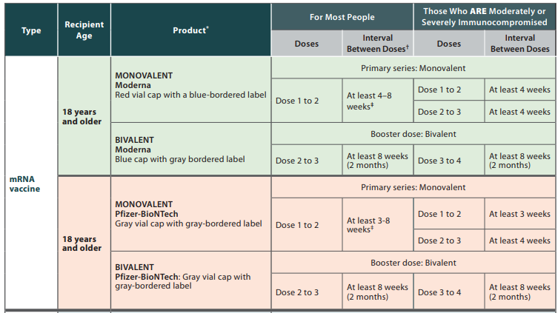
COVID-19 Vaccination (18 and older)

Slide 40
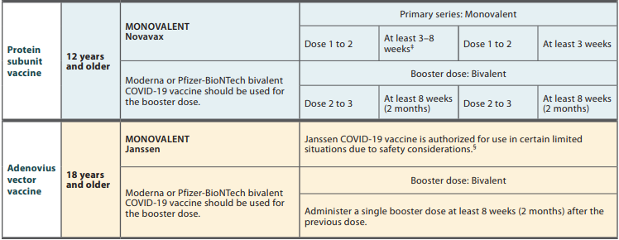
COVID-19 Vaccination (18 and older)

Slide 41
COVID-19 Vaccination (minors)
COVID-19 Vaccine Interim COVID-19 Immunization Schedule for 6 Months of Age and Older (cdc.gov)

Slide 42
“…When it’s over, I want to say all my life I was a bride married to amazement. I was the bridegroom, taking the world into my arms…” excerpt from Mary Oliver, When Death Comes

Slide 43
At the end of this webinar, you will be able to:
Describe
Describe current COVID-19 trends
Implement
Implement mitigation measures to reduce risk of COVID-19 on center
Develop
Develop plans for COVID-19 vaccination in fall

