Slide 1
COVID-19: where are we now? March 2022
Sara Mackenzie, MD, MPH
Regional Medical Specialist, Humanitas

Slide 2
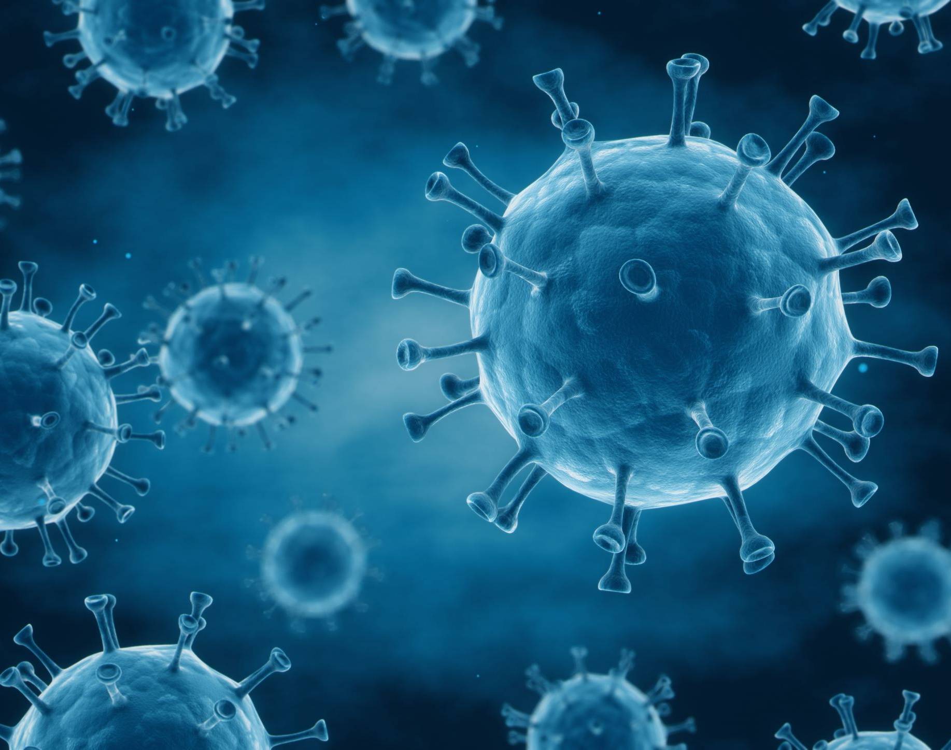
Year 2:
Where did it come from?
Why does the virus change?
What does it mean to move from pandemic to endemic disease?
Where do we go from here?

Slide 3
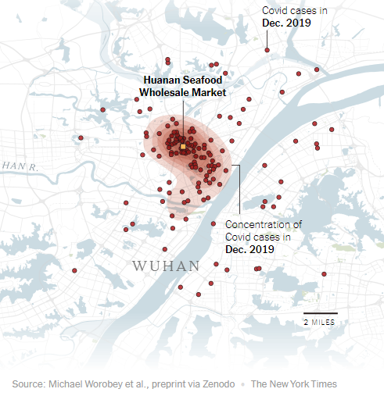
Where did it come from and why does it change?
Two new studies appear to confirm from the Huanan Seafood market (Wuhan)
Lineage – genetically closely related group of variants
Variant – may contain one or more mutations
Lineage A and Lineage B both appear to have jumped from animals to humans, in November 2019

Slide 4
Coronaviruses
mRNA
Viruses constantly change through mutations
Human common cold strains
229E (alpha coronavirus)
NL63 (alpha coronavirus)
OC43 (beta coronavirus)
HKU1 (beta coronavirus)

Slide 5
Novel Coronaviruses
Severe Acute Respiratory Syndrome (SARS-CoV) 2003
Middle East Respiratory Syndrome (MERS-CoV) 2012
SARS-CoV-2
Alpha (B.1.1.7 and Q lineages)
Beta (B.1.351)
Delta (B.1.617.2 and AY lineages)
Omicron (B.1.1.529 and BA lineages)
…
Notes:
Asia 2003 – spread to north America, south America Europe asia until contained; none since 2004

Slide 6
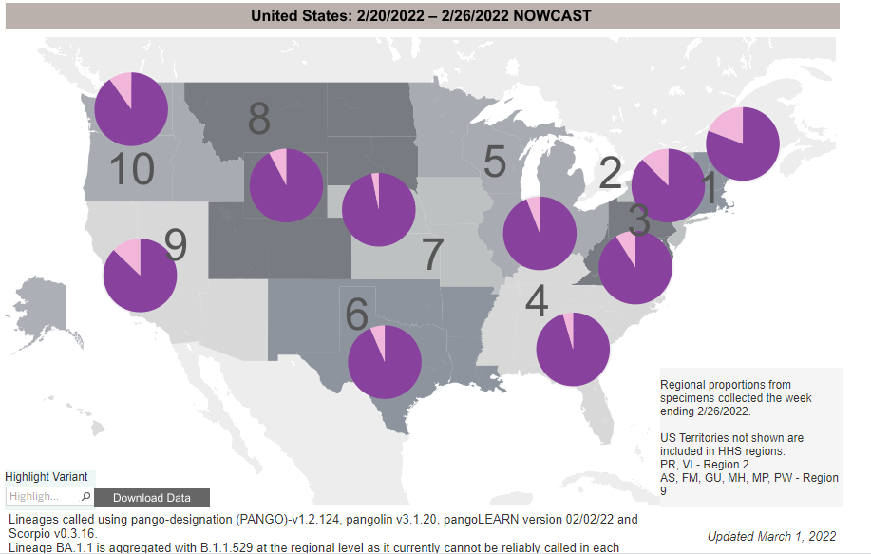
Ongoing surveillance and monitoring
Essential to detect new variants of concern
Changing patterns of transmission
Changing patterns of illness severity

Slide 7
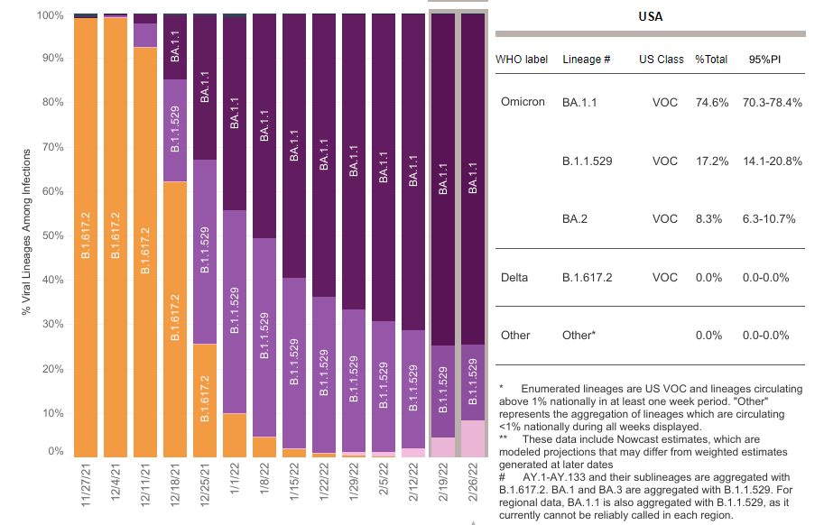
CDC Genomic Surveillance: monitoring variants

Slide 8
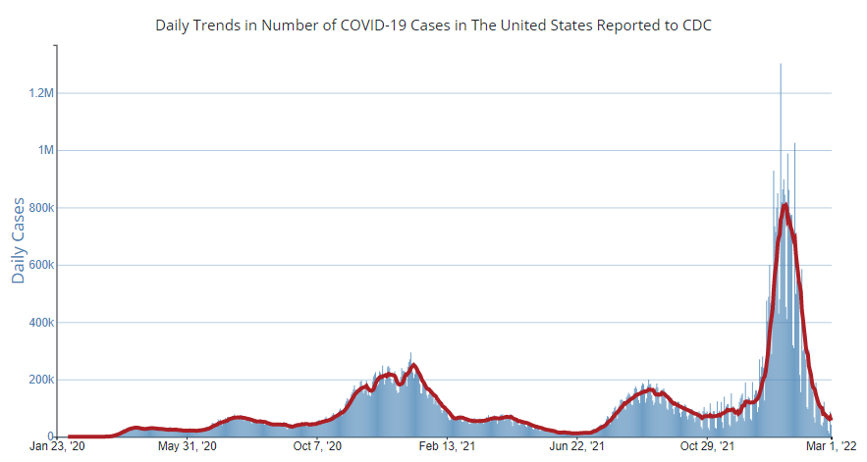
Omicron
Delta
Alpha

Slide 9
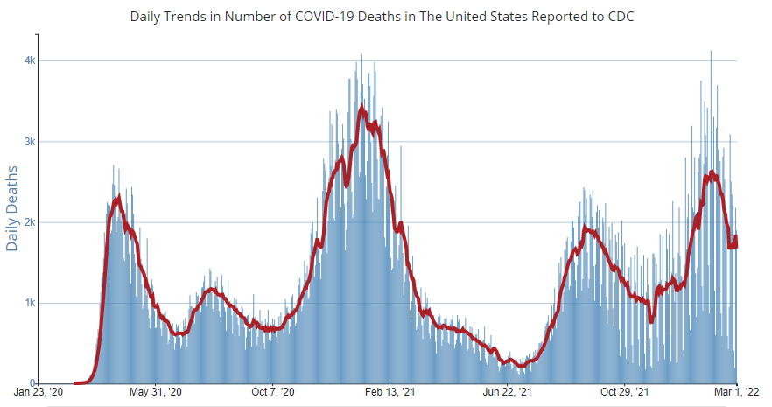

Slide 10
Chain of Infection
SARS-CoV-2
Novel
RNA virus
Variants
Exits the body
Respiratory droplets
Transmission
Primarily droplets
(cough, sneeze, talking)
Less common:
Aerosol
Surfaces
Enters the body
Contact with mouth or nose mucosa
Person factors
Age
Underlying health conditions
Vaccination status

Slide 11
Breaking links – slows or stops the spread!
SARS-CoV-2
Exits the body
Transmission
Enters the body
Person factors

Slide 12
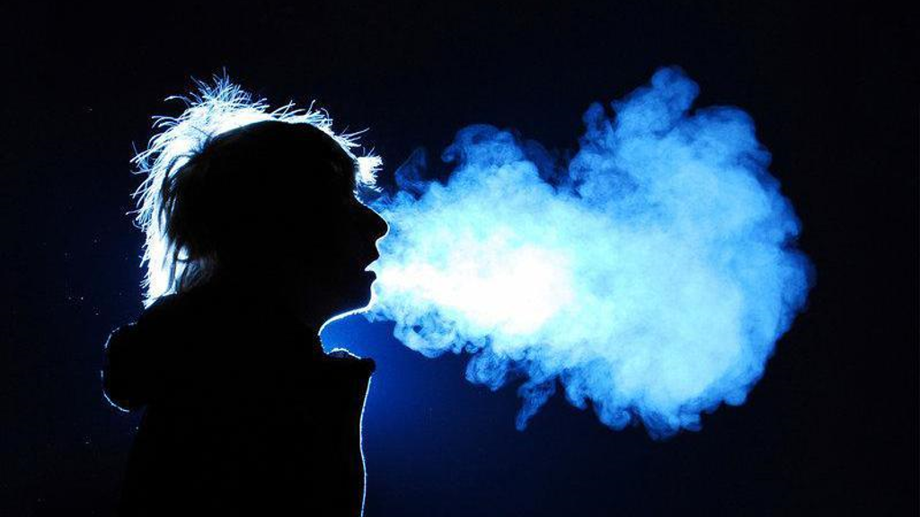
Why are masks (and distancing) required on center?
Exit Transmission Entry

Slide 13
SARS-CoV-2:
Symptoms
Incubation:
2-14 days
median 5 days- delta
median 3 days- omicron
Viral shedding:
for up to 10 days after symptom onset (for most)
Some will have mild to no symptoms
May shed 48 hours PRIOR to onset of symptoms
Exposure:
“Close contact” – within 6 feet for >15 minutes/24 hours
Notes:
CDC shortened quarantine with Omicron as shorter incubation;

Slide 14
Guidelines adapt as learn more:
CDC shortened Isolation to 5 days with optional testing day 5 (Job Corps still 10 days)
New study evaluating January 1-February 9, 2022
3,502 people with SARS-CoV-2
54% of people tested positive by antigen test 5-9 days after symptom onset or after initial positive test;
64% if symptomatic infection
21% if asymptomatic infection
Lefferts B, Blake I, Bruden D, et al. Antigen Test Positivity After COVID-19 Isolation — Yukon-Kuskokwim Delta Region, Alaska, January–February 2022. MMWR Morb Mortal Wkly Rep 2022;71:293–298. DOI: http://dx.doi.org/10.15585/mmwr.mm7108a3external icon.

Slide 15
What’s the risk of getting COVID-19?
Risk of meeting an infected person
Number of cases in community
Number of people you meet
Risk of an infected person transmitting it to you
Multiple factors

Slide 16
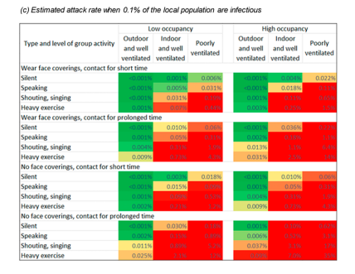
When are you most at risk?
Peng, Z et al. Practical Indicators for Risk of Airborne Transmission in Shared Indoor Environments and Their Application to COVID-19 Outbreaks. Environmental Science and Technology. Available at: https://pubs.acs.org/doi/pdf/10.1021/acs.est.1c06531

Slide 17
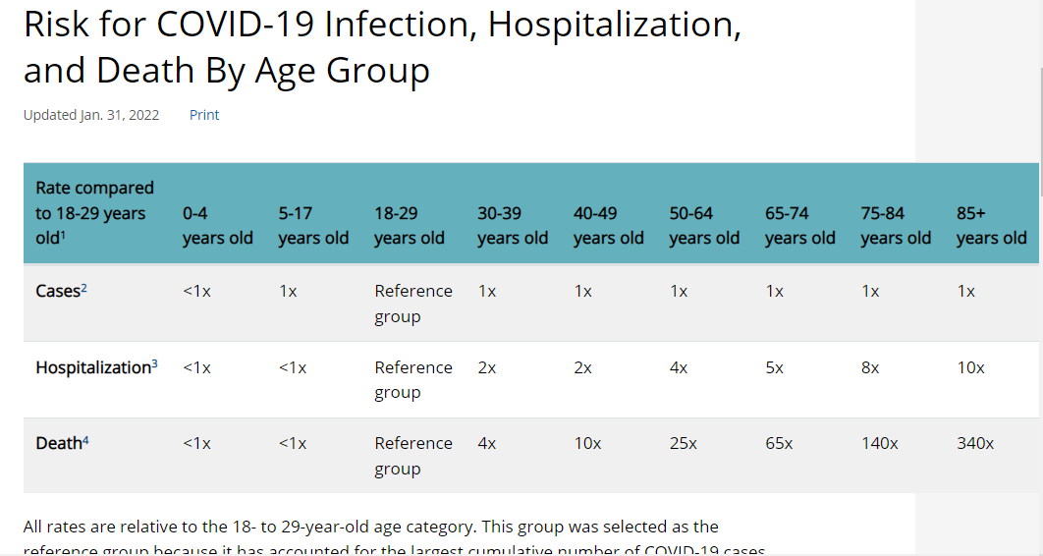
What is the risk of problems if you get COVID-19 – it depends!:
https://www.cdc.gov/coronavirus/2019-ncov/covid-data/investigations-discovery/hospitalization-death-by-age.html

Slide 18
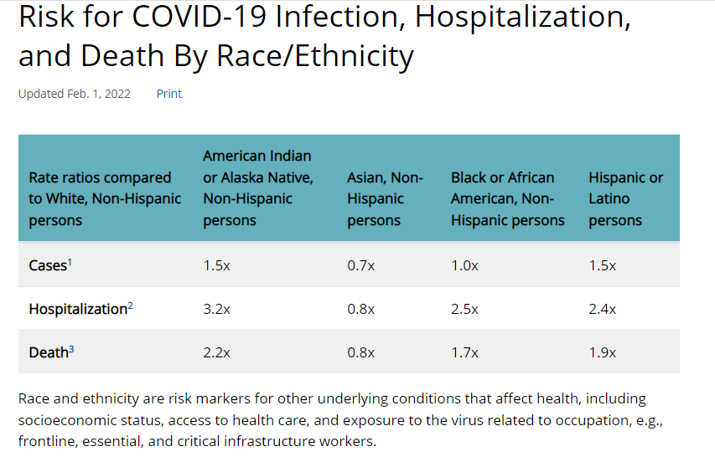
What is the risk of problems if you get COVID-19 – it depends!:
https://www.cdc.gov/coronavirus/2019-ncov/covid-data/investigations-discovery/hospitalization-death-by-age.html

Slide 19
What does it mean to move from pandemic to endemic?
In the chat box, type what you see as the biggest challenges or problems related to COVID-19 at this time.

Slide 20
At present, Job Corps policy remains the same
CDC Institution of Higher Education Guidance has not updated yet
DOL mask guidance page has not updated yet
National Office is reviewing implications and impact for Job Corps centers

Slide 21
Lifting widespread mandates occurs when the risk of those mandates exceeds the risk of pandemic impacts

Slide 22
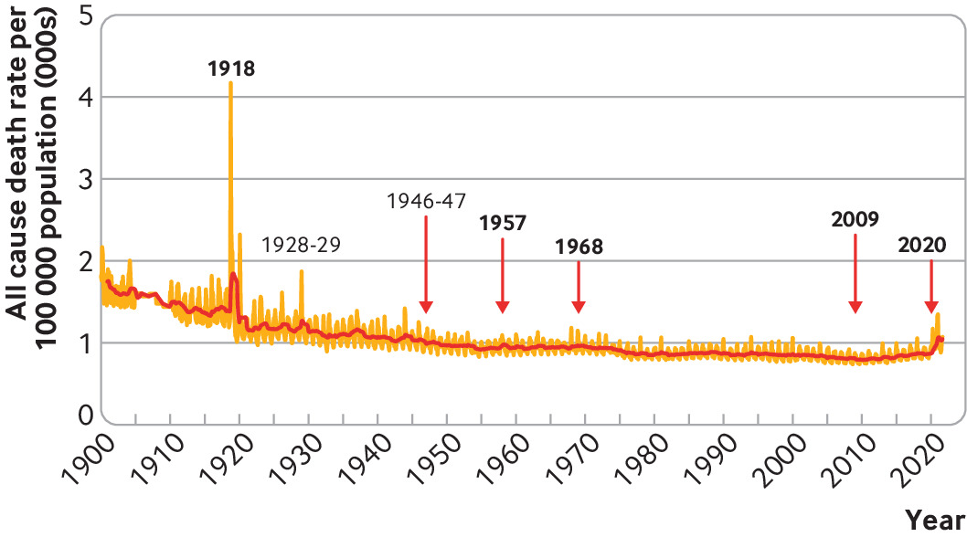
Pandemic impacts on all cause death U.S.
Robertson, D and Doshi, P. (2021) The end of the pandemic will not be televisued. BMJ 2021; 375 doi: https://doi.org/10.1136/bmj-2021-068094 (Published 14 December 2021)Cite this as: BMJ 2021;375:e068094
Notes:
COVID-19 3rd leading cause of U.S. death

Slide 23
What is the risk if you get covid-19?

Slide 24
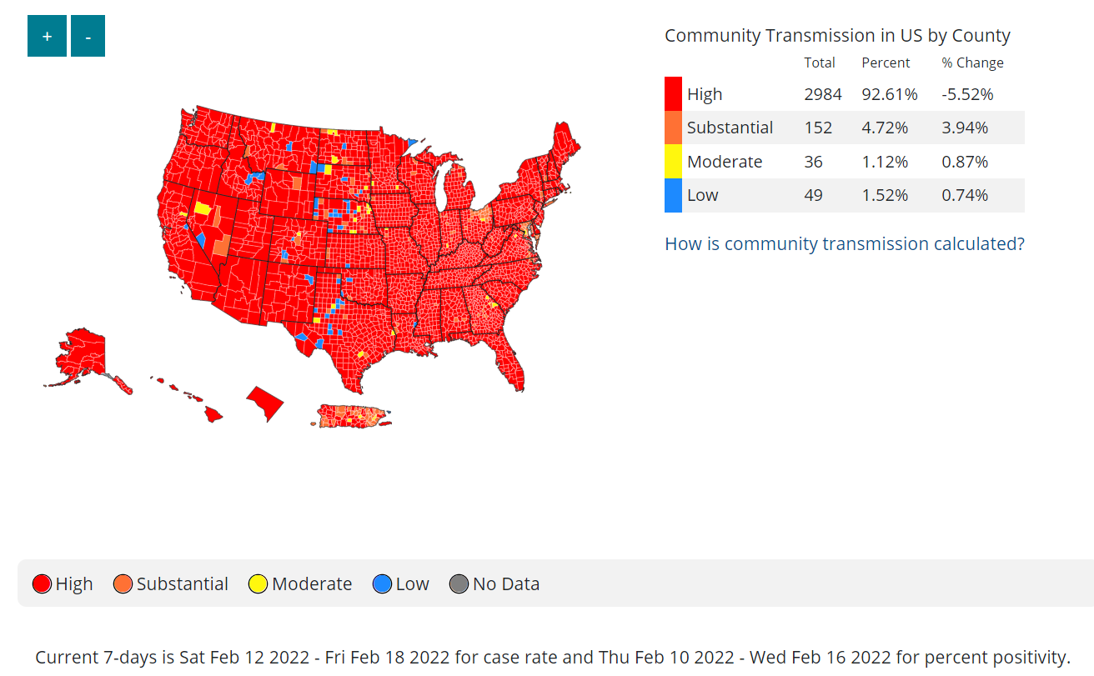
CDC County transmission rates (February 22, 2022):
New cases per 100,000 persons in past 7 days (high >100)
Percent positive NAATs tests during past 7 days (high >10%)

Slide 25
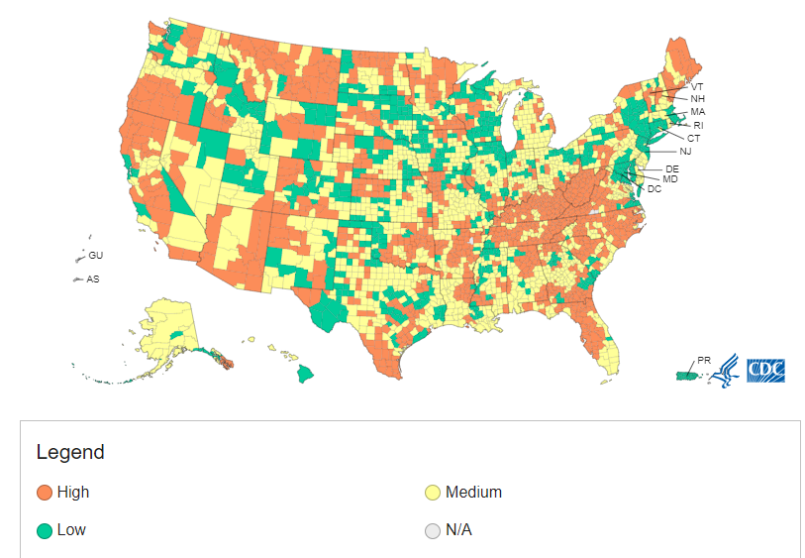
CDC COVID-19 Community Levels (February 24, 2022):

Slide 26
What changed?
February 22, 2022 – COVID-19 Community Transmission
February 24, 2022 – COVID-19 Community levels
Notes:
How we measure and use data
Value placed on different indicators

Slide 27
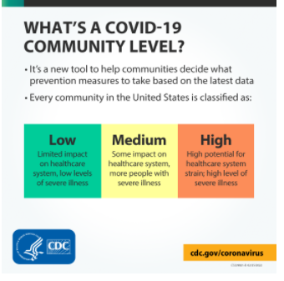
CDC guidance change 2/25/2022

Slide 28
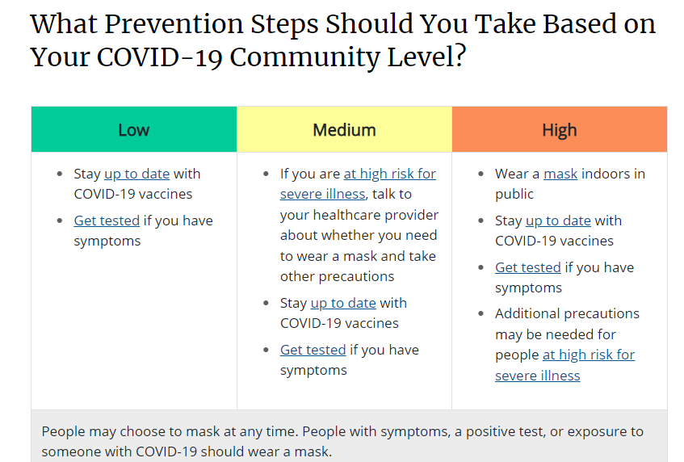
CDC guidance change 2/25/2022

Slide 29
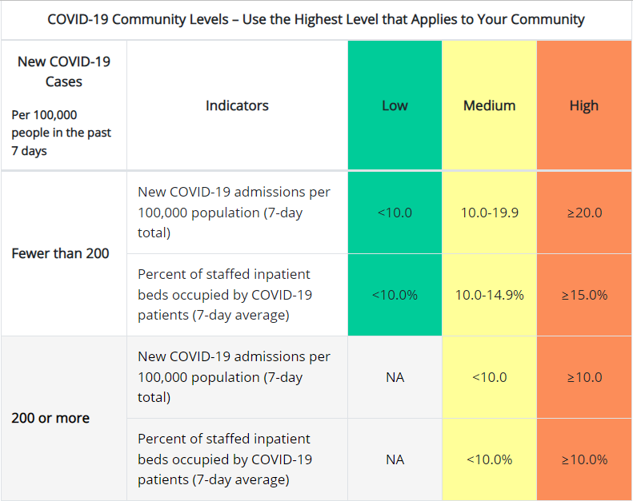

Slide 31
CDC guidance:
New calculations COVID-19 community levels
State/local: consider use of community levels, wastewater surveillance, workforce capacity, ER visits, to inform policy
COVID-19 Community level:
LOW: vaccination, improve ventilation indoors, access to testing, follow Isolation and Quarantine
MEDIUM: plus - protect people at high risk (may choose to wear mask), consider screening testing or other strategies for work/school/settings, implement enhanced in high-risk settings,
HIGH: plus- well fitting mask indoors regardless vaccination, consider setting specific strategies (screening testing, enhance prevention measures)

Slide 32
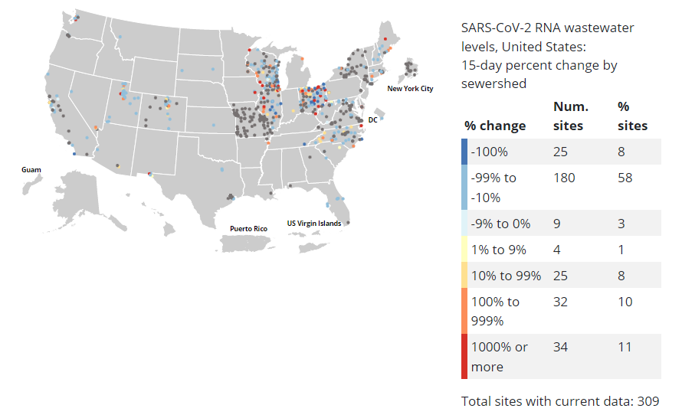
CDC Wastewater surveillance

Slide 33
Who are most vulnerable?
Unvaccinated
Age- >65
Chronic health conditions- heart, lung, kidney, diabetes
Immunosuppression
Obese/overweight
Pregnant
Underlying Medical Conditions Associated with Higher Risk for Severe COVID-19: Information for Healthcare Professionals | CDC

Slide 34
How do you monitor for COVID-19 vulnerable students?
In the chat box, please share your suggestions

Slide 35
Vaccination:
Up to date: a person has received all recommended COVID-19 vaccines, including any booster doses when eligible
Fully vaccinated: a person has received their primary series of COVID-19 vaccines

Slide 36
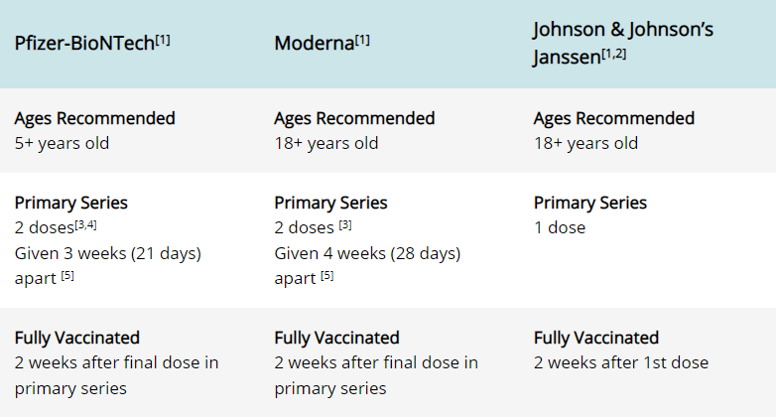

Slide 37
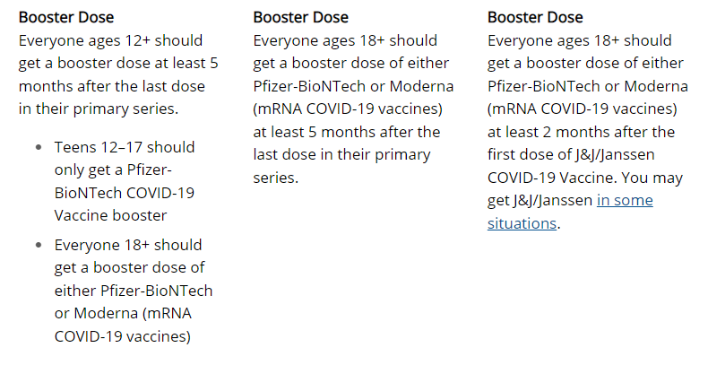

Slide 38
Higher risk for severe COVID-19:
Age is strongest risk factor – 81% of COVID-19 deaths in people 65 and older
Higher risk: cancer, CVA, chronic kidney disease, chronic lung disease, chronic liver disease, cystic fibrosis, diabetes, some people with disabilities, HIV, Immunodeficiencies, Pregnancy, smoking, physical inactivity, obesity
Suggestive higher risk: overweight, sickle cell, substance use disorder, thalassemia
Mixed evidence: asthma, hepatitis B, C, hypertension

Slide 39
Management of Acute COVID-19
Most students will have mild illness and will only require supportive care
Triage to determine whether they require COVID-19 specific therapy
Monitor to determine if progression to more severe disease (symptoms, vitals, O2 monitoring)

Slide 41
Treatments:
Paxlovid (nirmatrelvir and ritonavir) EUA
twice daily for 5 days;
start as soon as possible after symptoms begin
Not authorized for pre-exposure or post-exposure prevention
S.e. impaired taste, diarrhea, high blood pressure, muscle aches
Not recommended if severe kidney or liver disease
Molnupiravir EUA people 18 and older
twice daily for 5 days
start as soon as possible after symptoms begin
Not authorized for pre-exposure or post-exposure prevention
Notes:
Nirmatrelvir- stops virus from replicating
Ritonavir- slows breakdown of nirmatrelvir
Molnupiravir- introduces errors and prevents replication;4 200 mg tablets every 12 hours (40 tablets)

Slide 42
Treatments:
Remdesivir - EUA
Aged 12 and older
IV infusion – must be able to monitor for hypersensitivity
3 day course within 7 days of symptom onset and 5 day course for hospitalized patients
S.e. nausea, increased liver function tests, hypersensitivity
Monoclonal antibodies (sotrovimab)
At present not recommended against omicron variant – reduced susceptibility
https://www.covid19treatmentguidelines.nih.gov/about-the-guidelines/whats-new/
Notes:
Nirmatrelvir- stops virus from replicating
Ritonavir- slows breakdown of nirmatrelvir
Molnupiravir- introduces errors and prevents replication;4 200 mg tablets every 12 hours (40 tablets)

Slide 43
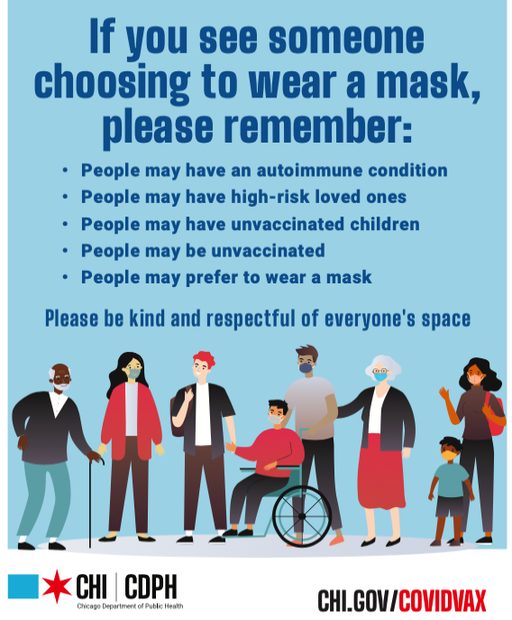
Shift from mandates to focused risk assessment

Slide 44
Risk assessment: we are not good at it!
Three-day eventing
Motorcycle riding

Slide 45
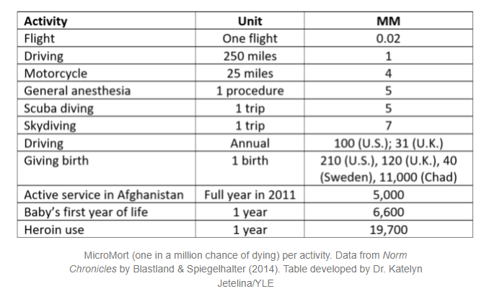
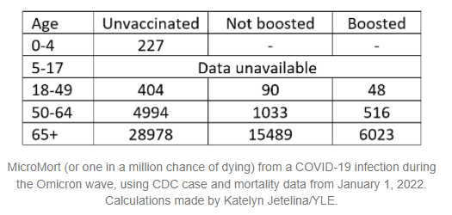
Risk Assessment: all activities have risk
https://yourlocalepidemiologist.substack.com/p/understanding-risk?fbclid=IwAR2AB7G7NNA19qiudpS_YgqWYmCD1xxXU3PD6Cao9nUYGNPObQO6hdc9N44&utm_source=url&s=r

Slide 46
Behavior at the individual level is ALWAYS embedded in context! While as individuals we have choice- our “choices” are determined by the context in which we live our lives!

Slide 47
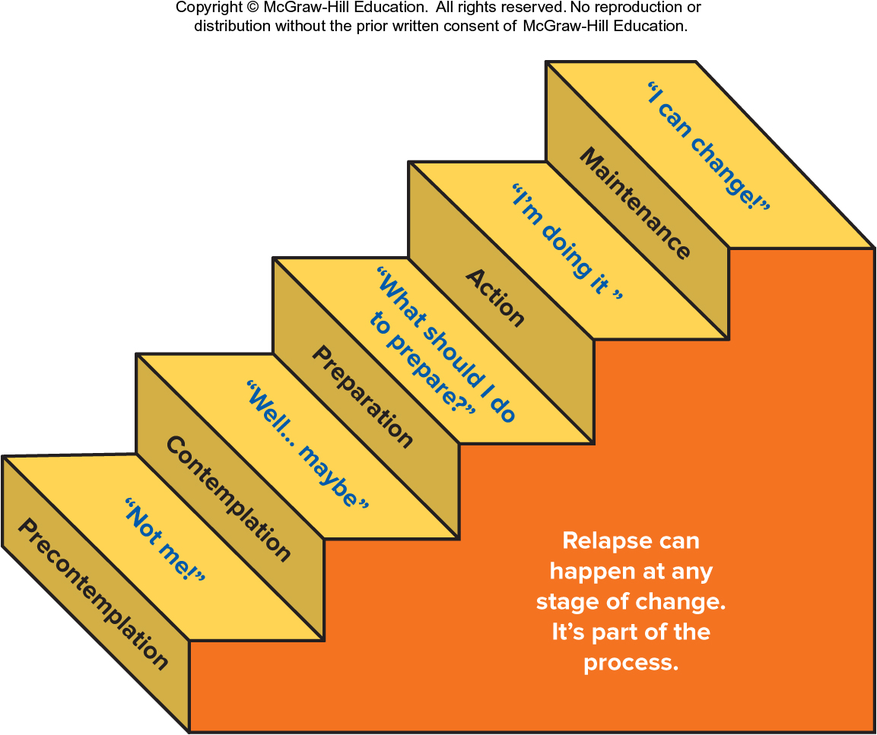
Behavior change theories (CMHCs!)

Slide 48
Where do we go from here?

