Slide 1
Cannabis Information: Updated for 2022
Diane A. Tennies, PhD, LADC LEAD TEAP Regional Health Specialist
09/20 and 09/21/2022

Slide 2
Learning Objectives
Articulate the history of cannabis and how the implications for changing landscape.
01
Describe the different administration routes for cannabis.
02
Explain the commonalities and differences between 9-THC, CBD and Delta-8.
03
Understand the relationship between cannabis and mental health issues.
04

Slide 3
Terms
Cannabis
All products derived from the plant Cannabis sativa
Cannabinoids
Over 540 chemical substances found in the cannabis plant
THC (8 and 9), cannabidiol (CBD), + 100 other cannabinoids
Marijuana
Parts of the Cannabis sativa plant that substantial amounts of tetrahydrocannabinol (THC)
Historically represented oppression and was the language of white aggression/dominance

Slide 4
Terminology Recommendation
Use the plant’s scientific name, more precise terms such as cannabis, 8-THC and 9-THC, instead of “marijuana.”
This Photo by Unknown Author is licensed under CC BY-NC-ND

Slide 5
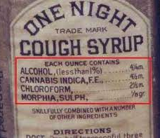
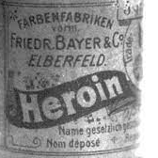
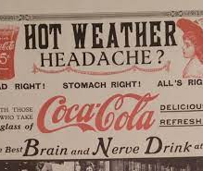
.)
History of Cannabis and Legalization Changes

Slide 6
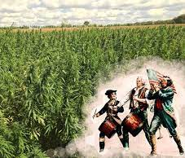
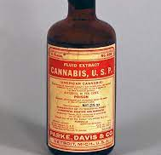
Early Days
Colonial Era
Hemp for rope, sails, and clothing
Post Civil War
Imports replaced hemp
Late 19th Century
Cannabis in many medicinal products

Slide 7
No Federal Regulation
Coca Cola contained cocaine
Heroin available OTC

Slide 8
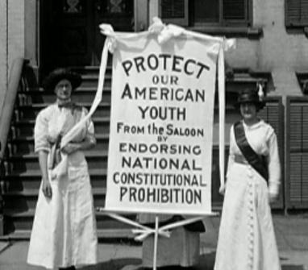
Early 1900s
1900-1920
Temperance/prohibition movements accelerate
Increased immigration and tensions
1920s
Anti-drug campaigners and the "Marijuana Menace"
This Photo by Unknown Author is licensed under CC BY-SA

Slide 9
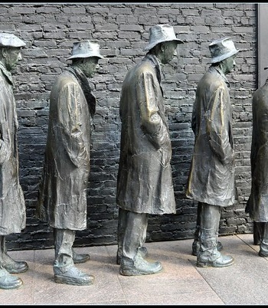
The Great Depression
Unemployment and resentment/fear of immigrants
“Problem of marijuana”
Cannabis misinformation
Language shift from “hemp” and “cannabis” to “marijuana"
By 1931, 29 states had outlawed cannabis
This Photo by Unknown Author is licensed under CC BY

Slide 10
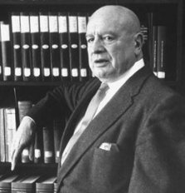
Harry Anslinger
“Marijuana is the most violence-causing drug in the history of mankind. There are 100,000 total marijuana smokers in the US, and most marijuana smokers are Negroes, Hispanics, Filipinos and entertainers. Their satanic music, jazz and swing, results from marijuana usage.” - Harry Anslinger, First Commissioner of the US Treasury Department’s Federal Bureau of Narcotics
This Photo by Unknown Author is licensed under CC BY-SA-NC

Slide 11
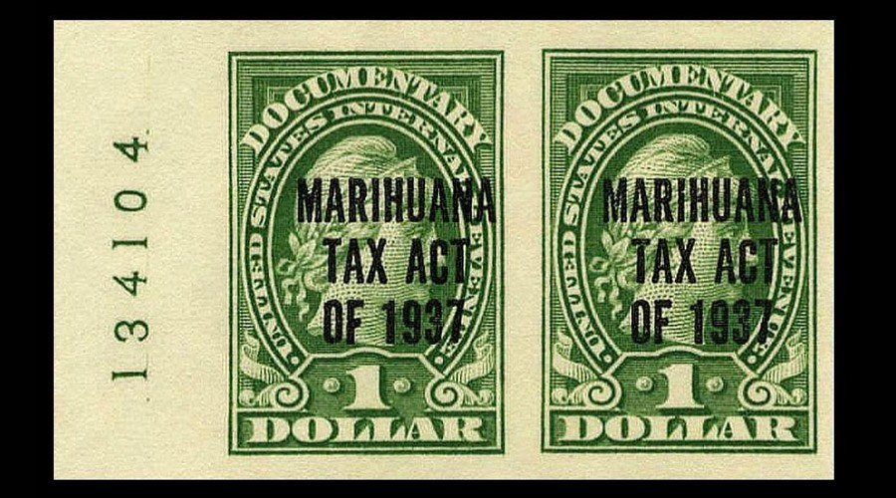
The Marihuana Tax Act (1937)
Tax on cannabis sales
Did not criminalize possession
Violators faced $2,000 fine/five years of prison
Propaganda, prejudice, and power
This Photo by Unknown Author is licensed under CC BY-ND

Slide 12
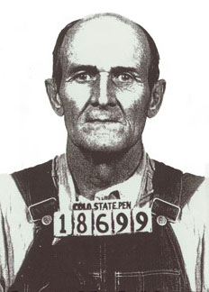
Enforcement
Fifty-eight-year-old farmer Samuel Caldwell was the first person prosecuted under the Act
Arrested for selling marijuana on October 2, 1937, just one day after the Act’s passage
Caldwell was sentenced to four years of hard labor
Incarcerated through 1940
Died in 1941

Slide 13
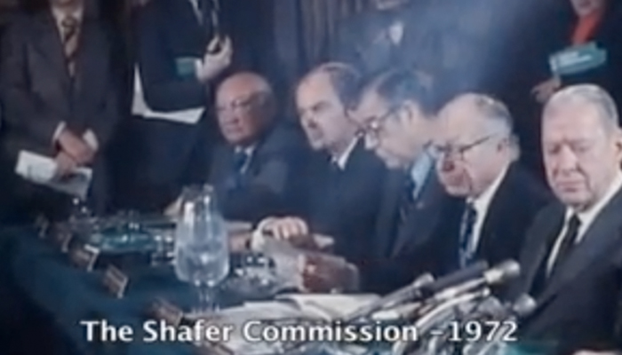
1970s
Cannabis scheduled by the DEA as equivalent to heroin, LSD, and ecstasy
1972: Shafer Commission
“Marijuana: A Signal of Misunderstanding”
Recommended “partial prohibition” and lower penalties for possession
Nixon/government officials ignored the report’s findings
This Photo by Unknown Author is licensed under CC BY-SA-NC

Slide 14
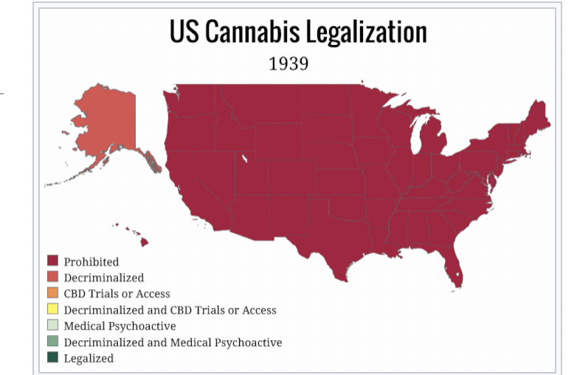

Slide 15
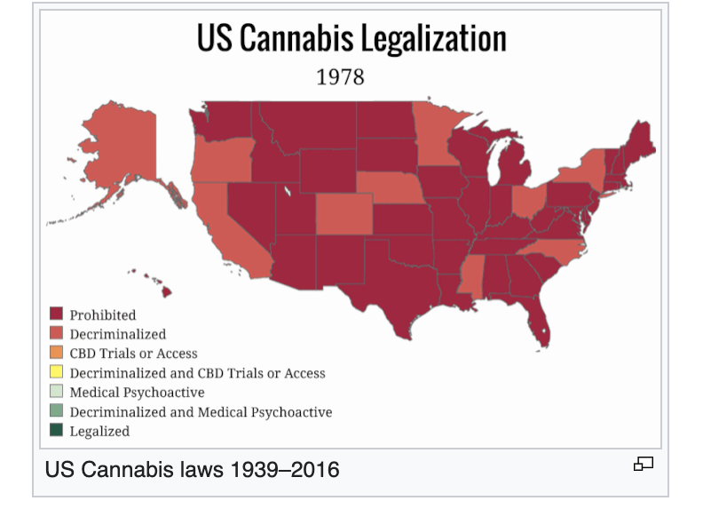
Pre medical legalization
In California in 1996

Slide 16
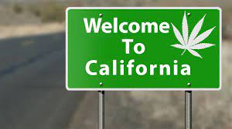
1996- Medical Cannabis Legalized

Slide 17
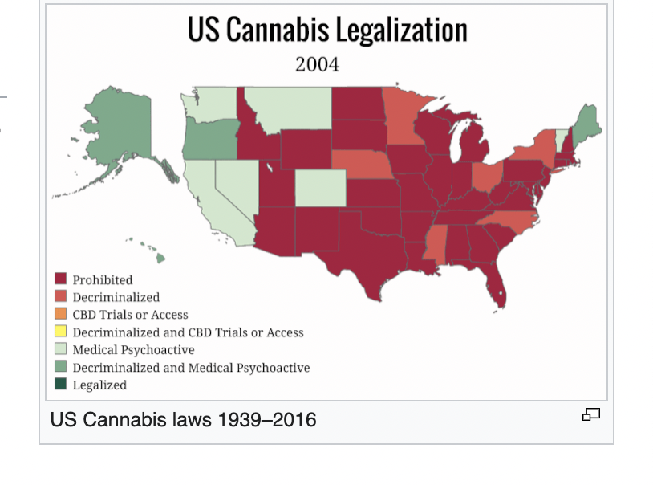

Slide 19
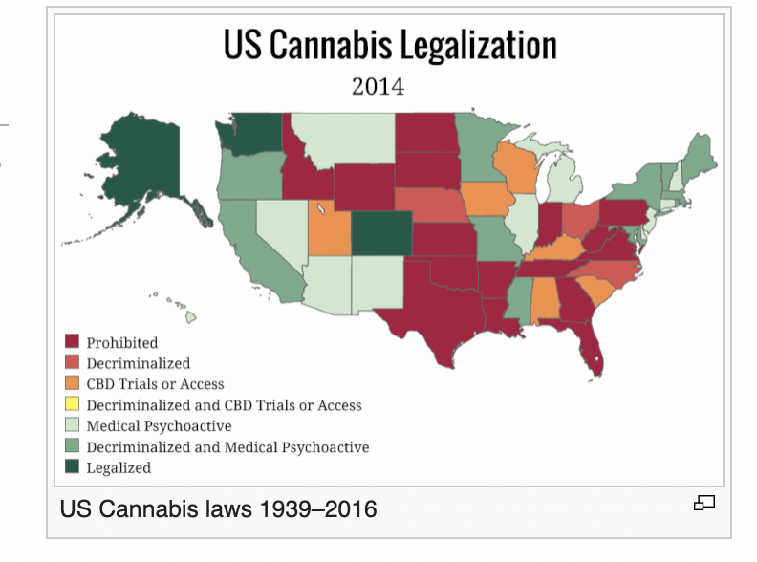

Slide 20
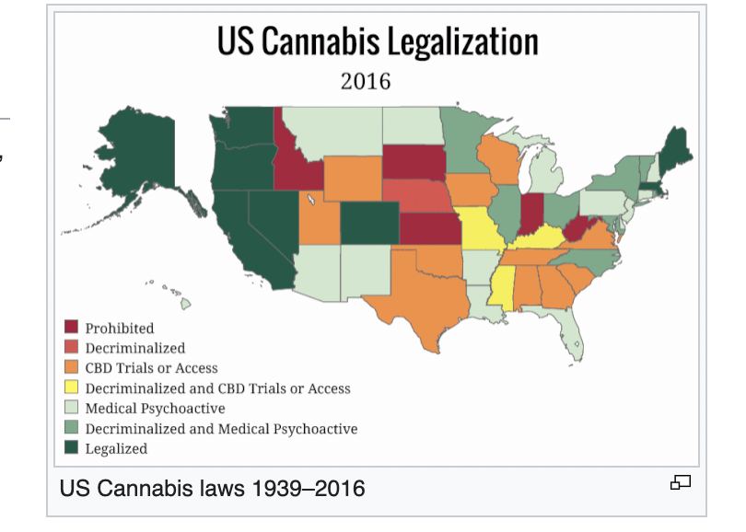

Slide 21
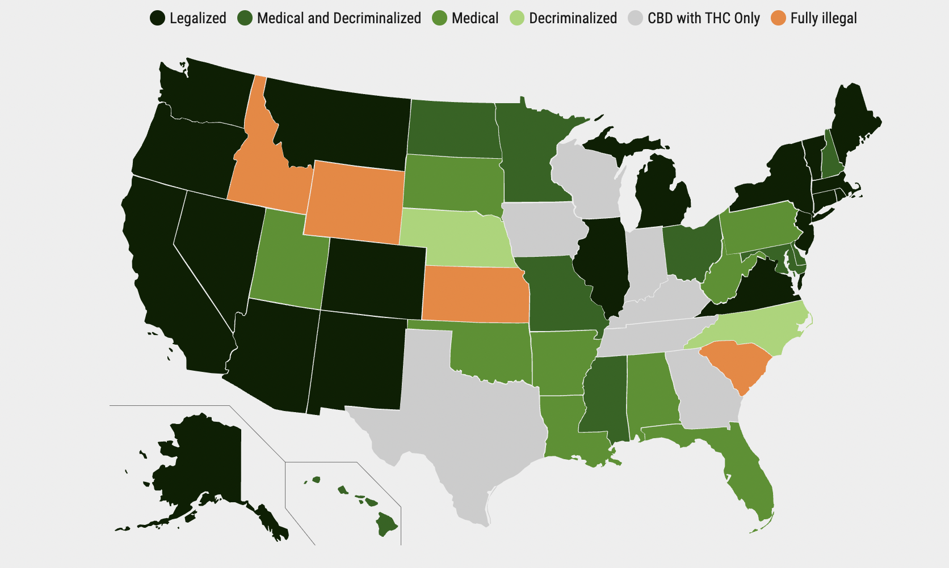

Slide 22
Updated in September 2022
Fully ILLEGAL in only FOUR states: Idaho, Wyoming, Kansas and South Carolina
75% of population now has access to some form of legalization cannabis.

Slide 23
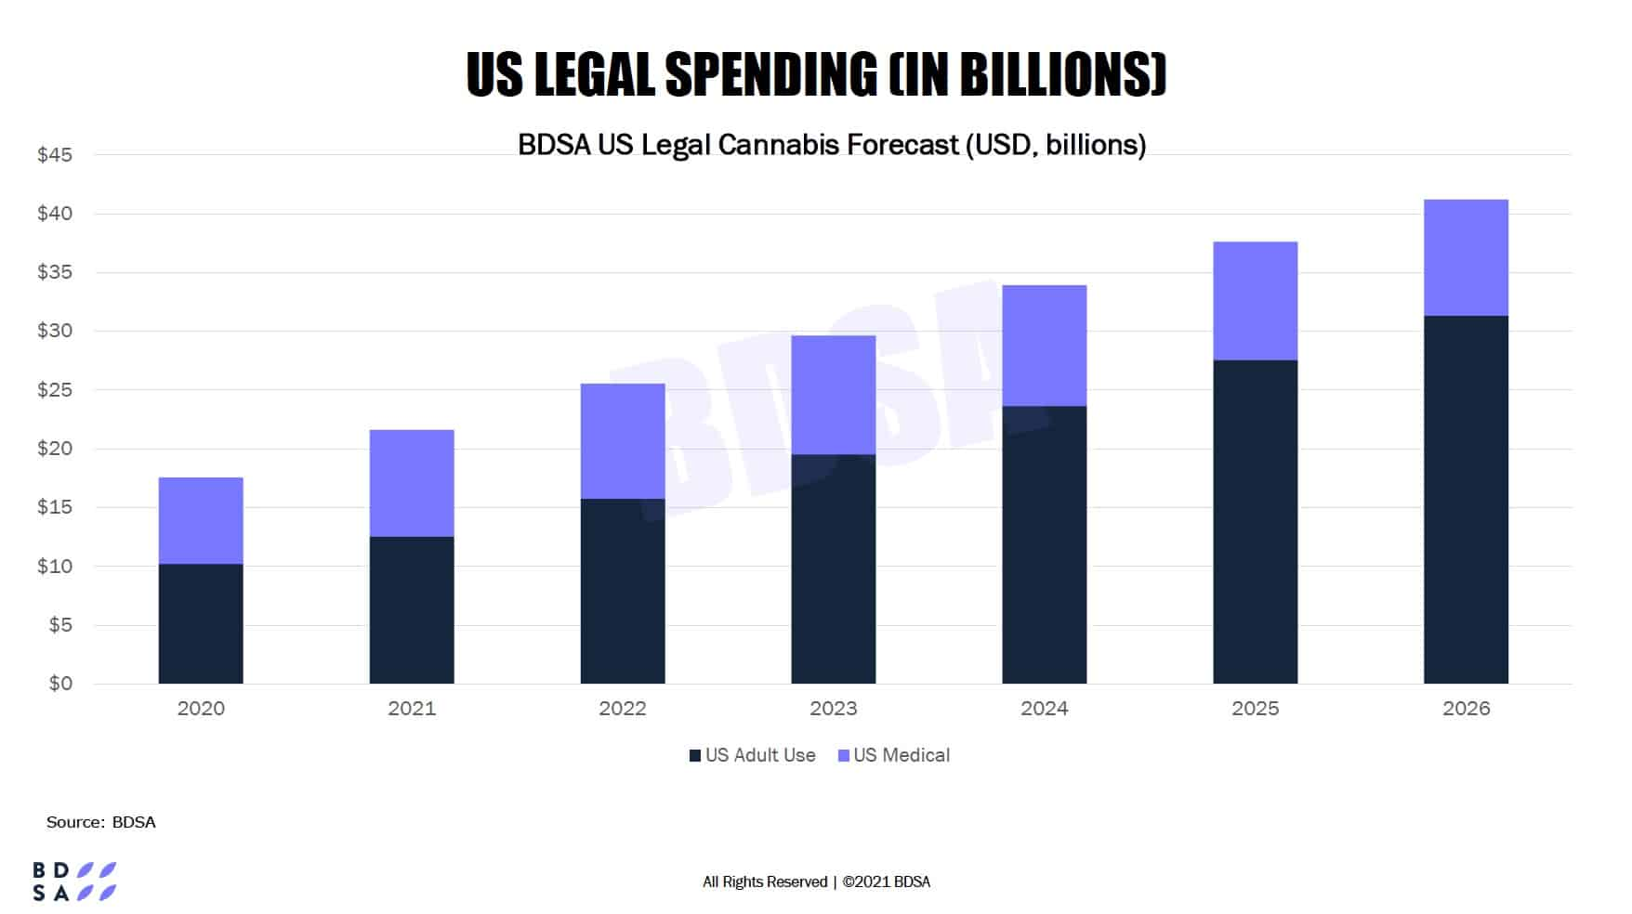

Slide 24
July 2022 - Senate Majority Leader Chuck Schumer’s Cannabis Administration and Opportunity Act proposed to allow states to set their own cannabis laws.

Slide 25
With Legalization
Including how cannabis is used
Came other changes:
Sophistication of manufacturing

Slide 26
Routes of Administration: Diversification
Why Important?
We already know that age, gender, frequency of use and body mass impact metabolism.
But now so does method absorption
In terms of how long THC stays in system.

Slide 27
Two Commonly Known Routes
Onset: 5-10 minutes
Duration: 2-4 hours

Slide 28
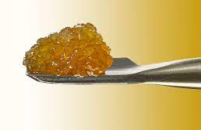
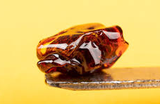
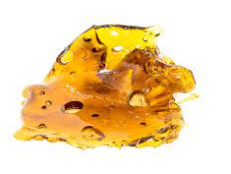
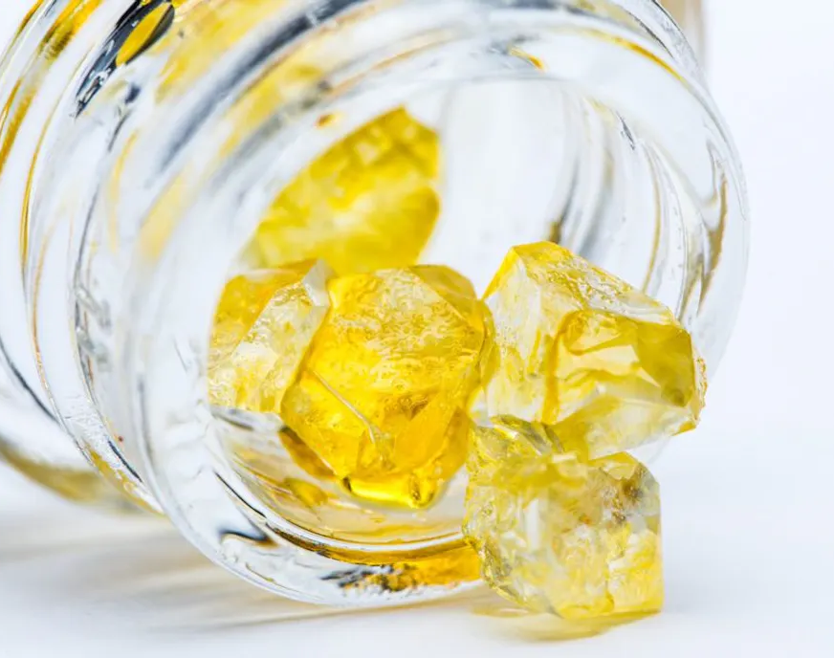
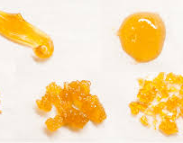

Slide 29
Dabbing
Slang term for consuming high concentrations of THC.
Been around since 1960’s but now growing in popularity, especially among young adult.
Generally, replaces use of terms like ”oil”
Named for the texture, and the texture is indicative of the process used to create them. There are numerous extraction methods to create a myriad of different dabs.
Are sticky and messy in a variety of colors: yellow, amber, brown, and white.
Dabs are heated to an extremely high temperature and then inhaled. A specifically-designed glass bong (oil rig/dab pen/electronic rig).
The change in perception and accessibility of cannabis concentrates is due, in part, to dab pens which were adapted from the e-cigarette/vape pens.
Dab pens are portable, discreet and easy to use.
Concentrates are packed into the chamber and inhaled through the mouthpiece.
This type of ingestion means the effects of dabbing are felt immediately and quicker than traditional smoking.

Slide 30
Another Version: Shatter
Shatter is also a cannabis extract.
Has brittle consistency - literally shatters like glass when broken.
Varies in shade from dark ambers to honey-like tones to lighter shades of yellow.
Other terms: Sugar, crumble, live resin, diamonds, sauce and bubble hash.

Slide 31
Risks of THC Concentrates
Exposed to higher levels of toxins.
Higher levels of THC which means takes longer to metabolize out of system.
Higher tolerance/increased withdrawal symptoms than more traditional cannabis use.
Side effects like a rapid heartbeat, blackouts, crawling sensations on the skin, loss of consciousness, and psychotic symptoms (paranoia and hallucinations).

Slide 32
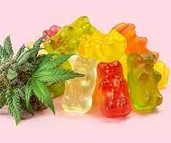
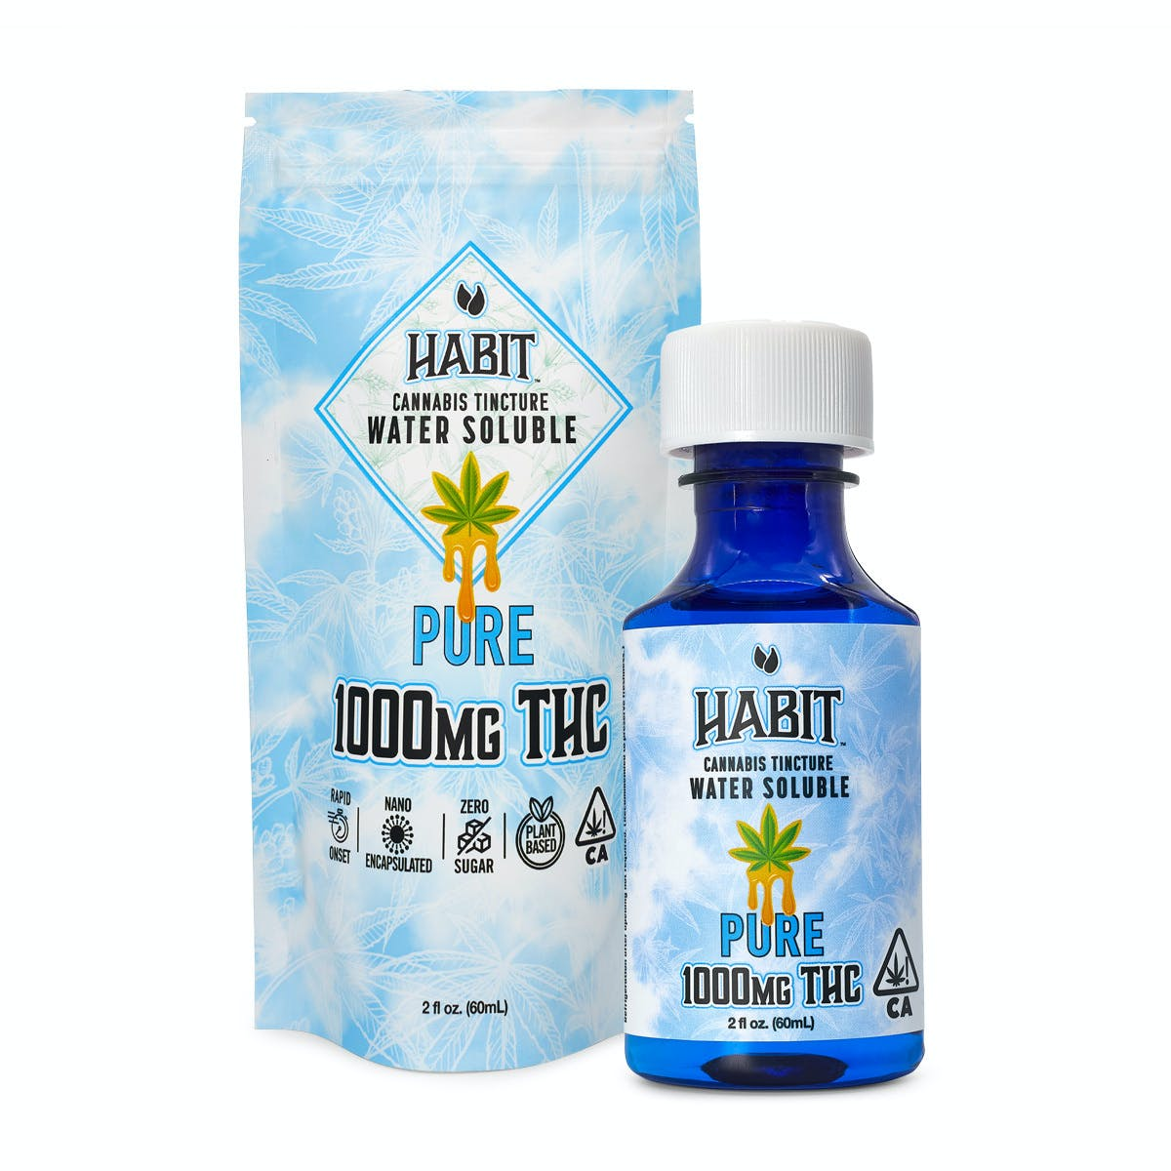
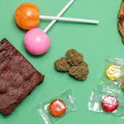
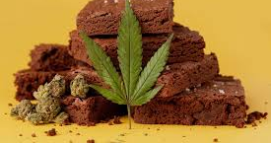
Oral Administration – Edibles
Onset: 60-180 minutes
Duration: 6-8 hours

Slide 33
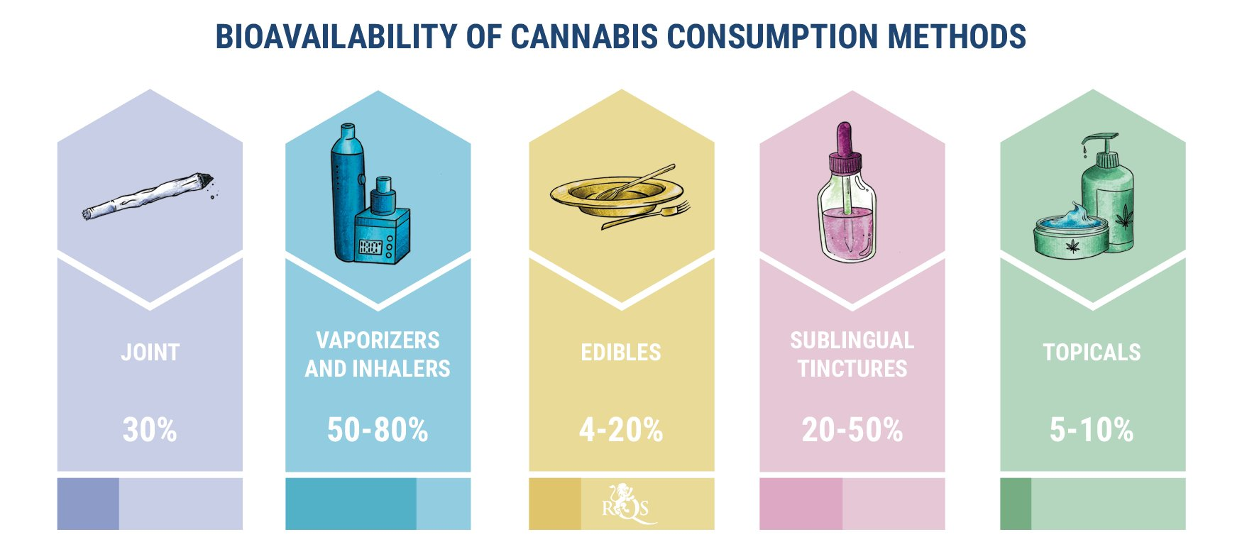

Slide 34
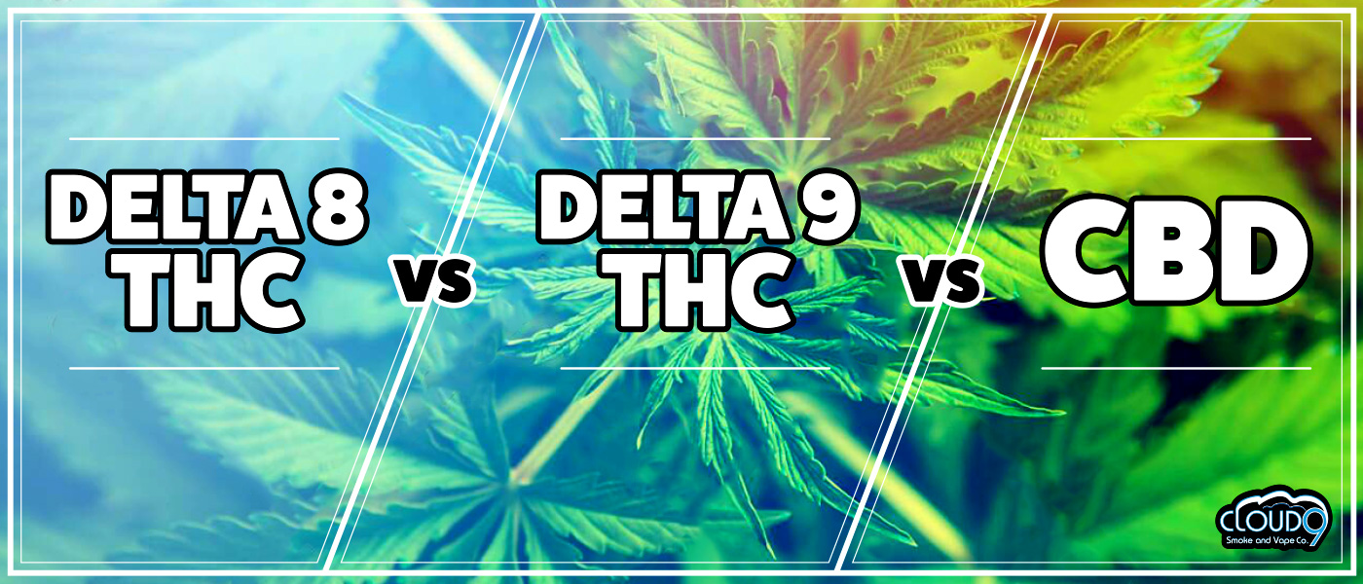

Slide 35
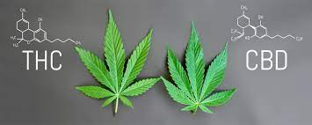
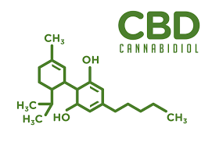
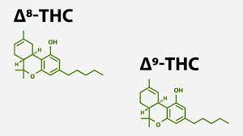
Commonalities and Differences of THC, CBD and Delta-8 (“THC-lite”)

Slide 36
List of Different Cannabinoids
THC (tetrahydrocannabinol)
THCA (tetrahydrocannabinolic acid)
CBD (cannabidiol)
CBDA (cannabidiolic acid)
CBN (cannabinol)
CBG (cannabigerol)
CBC (cannabichromene)
CBL (cannabicyclol)
CBV (cannabivarin)
THCC (tetrahydrocannabiorcol)
THCV (tetrahydrocannabivarin)
THCP (tetrahydrocannabiphorol) CBDV (cannabidivarin)
CBCV (cannabichromevarin)
CBGV (cannabigerovarin)
CBGM (cannabigerol monomethyl ether) CBE (cannabielsoin)
CBT (cannabicitran)

Slide 37
Hemp
Cannabis and hemp – all plants in the Cannabaceae family.
Hemp is Cannabis sativa which has low levels of THC (tetrahydrocannabinol- psychoactive) and high levels of CBD (cannabidiol – non-intoxicating).
Legally defined as <0.3 percent THC.
The Agricultural Act of 2018 defined HEMP as non-intoxicating Cannabis that is harvested for the industrial use of its derived products (CBD, skin care, rope, and clothing, etc.).
Must be “Derived from Hemp”

Slide 38
Delta-9 THC
Cousin of Hemp (taxonomically speaking)
Mainly from the Cannabis Sativa plant
Contains intoxicating and psychoactive effects of THC-Delta 9
Main compound in cannabis causes: euphoria, happiness, sedation, symptom relief, and much more
Large amounts of THC are found in majority of cannabis strains

Slide 39
Delta 8-THC
2018 Farm Bill made it legal to grown hemp.
Defined hemp as: “All derivatives, extracts, cannabinoids, isomers, acids, salts, and salts of isomers, whether growing or not, with a delta-9 tetrahydrocannabinol concentration of not more than 0.3 percent.”
This language made delta-8 legal, because it does not contain any delta-9 THC.
Delta-8 is extracted/derived from Hemp.
Making delta-8 legal in states where delta-9 THC is illegal (sometimes).
Producers/retailers of delta-8 sell only in states that have laws mirroring the farm bill’s language.
08/2020 DEA released Interim Final Rule to update and confirm the differences between hemp and cannabis which said: “All synthetically derived tetrahydrocannabinols remain Schedule I controlled substances,” which would make delta-8 illegal because it is a tetrahydrocannabinol that is extracted, or synthetically derived.
Conflicts with farm bill language making delta-8’s federal legality hazy.

Slide 40
Delta-8-tetrahydrocannabinol versus Delta-9-tetrahydrocannabinol
Delta-8 and delta-9 are both forms of THC
Delta-8 THC іѕ a minor cannabinoid occurring in the plant in very small concentrations
Delta-8-THC sometimes called “THC lite” and produces a weaker psychoactive result
Delta-8 (like delta-9), binds to the body’s endocannabinoid system = intoxicating effects
Both cannabinoids have a chain of carbon atoms, but delta-8 has the double bond (what causes intoxication) on the eighth carbon, whereas delta-9 has it on the ninth
THC can cause negative effects (anxiety or paranoia). Delta-8 may offer a smoother and milder high (theoretically)
Very little research on delta-8 as compared to Delta 9 THC

Slide 41
If Delta 8 is Legal Federally - Why Not at JC?
Exhibit 2.1 Zero Tolerance Infractions
Drugs: Possession or distribution of drugs on center or under center supervision Knowingly possessing, using, or distributing any of the following:
Illegal drugs, as defined by the Controlled Substances Act including seeds and residue, except when the drug is possessed and/or used in accordance with a valid prescription (Note: Under Federal law, no valid prescription can be provided for Schedule I drugs, including marijuana)
Synthetic drugs
Legalized marijuana
Prescription drugs not prescribed for the individual
Substances used for the purpose of intoxication
Over-the-counter medications for the purpose of intoxication
Drug paraphernalia
Drug sale ledger or distribution list

Slide 42
What about Drug Testing?
Will someone using Delta 8 test positive for cannabis?
Short Answer is Yes.
Those using Delta-8 have a high probability of having a positive drug test (unlike CBD where the likelihood is lower of testing positive).

Slide 43
The Impacts of Increased Cannabis Availability and Use
What has changed with increased legalization of cannabis?
Created jobs and tax revenue.
Effects on crime rates/social justice have been somewhat positive.
Some people benefit from more access to cannabis but easily availability increases risk of addiction for those using and has increased impaired driving.
Increase in use of cannabis with alcohol/other substances and cases of drug-impaired driving rose significantly.

Slide 44
Medical Impacts and Uses
Increased risk of overdose injuries, including respiratory distress, among pediatric populations where cannabis is legal.
Evidence that cannabis can reduce:
Chronic pain
Multiple-sclerosis-related muscle spasms
Chemotherapy-related nausea
There are FDA approved medical uses as well:
Epidiolex - contains CBD and approved for the treatment of seizures associated with Lennox-Gastaut syndrome/Dravet syndrome (rare and severe forms of epilepsy).
Marinol and Syndros, contain dronabinol (synthetic THC), and Cesamet, which contains nabilone (a synthetic substance similar to THC). Approved to treat nausea and vomiting caused by cancer chemotherapy.
Dronabinol used to treat loss of appetite and weight loss in people with HIV/AIDS.

Slide 45
Mental Health Impacts
Increased development of schizophrenia or other psychoses, with the highest risk among the most frequent users
Increased symptoms of mania and hypomania in individuals diagnosed with bipolar disorder.
Small increased risk for the development of depressive disorders.
Increased incidence of suicidal ideation and suicide attempts with a higher incidence among heavier users.
Increased incidence of suicide completion.
Increased incidence of social anxiety disorder with regular cannabis use.

Slide 46
Revisiting Learning Objectives and Summarizing
1.) Articulate the history of cannabis and how it has changed since legalization began over 25 years ago.
75% of the population of the US now has access to some form of legalized cannabis. As expected, rates of testing positive on entrance and at the follow-up drug test are increasing. Legalization has created many changes in the industry such as improved manufacturing processes which increase the amount of THC in the product.
2.) Describe the different administration routes for cannabis.
Many different methods from smoking to oral consumption and the bioavailability of each method may mean THC stays in the body longer.
3.) Explain the commonalities and differences between 9-THC, CBD and Delta-8.
These are all forms of cannabinoids with differing degrees of psychoactive properties.
4.) Understand the relationship between cannabis and mental health issues.
Individuals with other mental health vulnerabilities may be at increased risk when using cannabis.

